Slide 1
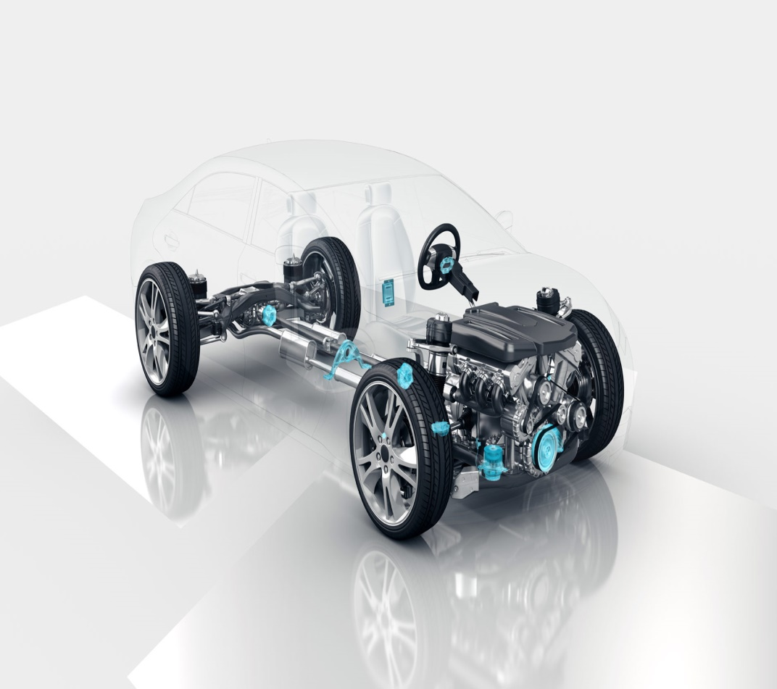
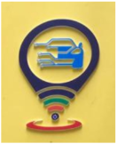

Center for Intelligent Mobility (CIM)
Envisions Smarter and Safer Mobility
Research Experience for Undergraduates(REU) – Review
Title: Zero-Shot Scene Affordance Detection Using Semantic Embeddings for Open-World Perception
Presented By:
Tushar S Pyati – 01FE22BEC177
Guide Details:
Dr. UJWALA PATIL
Prof. PREETI PILLAI

Slide 2
Center for Intelligent Mobility (CIM)
Envisions Smarter and Safer Mobility
Contents
Introduction
Problem statement
Literature Survey
Objectives
CLIP architecture
CLIPSeg
Affordance detection
Methodology
Results
Conclusion
Future Scope

Slide 3
Center for Intelligent Mobility (CIM)
Envisions Smarter and Safer Mobility
Introduction
Advanced Driver Assistance Systems (ADAS) rely on accurate perception for safe driving but are confined to known objects and situations on base models. Driving in the real world, however, demands open-world perception to handle unforeseen situations. Scene affordance detection is interested in actionable understanding (e.g., drivable, crossable, obstructed) rather than mere object labels.
Through the application of zero-shot learning with semantic embeddings, ADAS can reason about affordances of unknown objects without direct training, enabling scalable, flexible, and safer decision-making in dynamic scenarios.

Slide 4
Center for Intelligent Mobility (CIM)
Envisions Smarter and Safer Mobility
Problem Statement
Zero-Shot Scene Affordance Detection Using Semantic Embeddings for Open-World Perception.
Inference from Problem Statement
This problem aims to equip perception systems with zero-shot affordance detection using semantic embeddings, allowing them to generalize to unseen objects and hazards. Such capability supports open-world perception in ADAS by focusing on actionable understanding rather than fixed object categories, leading to safer and more adaptive decision-making.

Slide 5
Center for Intelligent Mobility (CIM)
Envisions Smarter and Safer Mobility
Literature Survey:
Sl.No | Title | Dataset | Methodology | Gaps | Results
1. | On the Potential of Open-Vocabulary Models for Object Detection in Unusual Street Scenes (CVPR 2024) | RoadObstacle21 RoadAnomaly21 LostAndFound | Models tested upon are: 1.Grounding DINO 2.YOLO-World 3.MDETR 4.OmDet-Turbo | 1. Performs weak for outdoor conditions. 2. Models sometimes label normal things as unusual (false positives). | Grounding DINO performed best overall. On RoadObstacle21 AP50..95 =48.3% On LostAndFound AP50..95 = 25.4%
2. | AffordanceLLM: Grounding Affordance from Vision-Language Models (2024) | AGD20K | Use off-the-shelf VLMs to generate dense affordance heatmaps from text prompts | 1. Performance drops on harder/unseen settings like fog, rain etc.
Split | KLD | SIM | NSS
Easy | 0.88-1.10 | 0.52-0.58 | 2.0-2.2
Seen | 1.20-1.40 | 0.45-0.50 | 1.4-1.6
Unseen | 1.60-1.70 | 0.35-0.38 | 1.0-1.1

Slide 6
Center for Intelligent Mobility (CIM)
Envisions Smarter and Safer Mobility
Literature Survey:
Sl.No | Title | Dataset | Methodology | Gap(s) | Results
3. | One-Shot Open Affordance Learning with Foundation Models (2023) | AGD20K UMD | Train with only one annotated image per base object class; at test time, do zero-shot affordance segmentation on novel objects and even novel words | 1.Choice of the one-shot example matters (bad lighting/occlusion hurts). 2.Depends on one sample, poor mask quality | With 1 example/class, matches or beats baselines; close to full supervision with <1% data.
4. | YOLO-World: Real-Time Open-Vocabulary Object Detection (2024) | LVIS COCO | YOLO-speed with a CLIP text encoder and a decoupled classification/localization design, so you can detect any text-described class in real time. | 1.Losing zero-shot after full fine-tune due to which catastrophic overfitting happens. 2. Detects only object names, not affordances | Real-time open-vocab detection AP 34.1 on LVIS; fine-tune boosts closed-set but hurts zero-shot.

Slide 7
Center for Intelligent Mobility (CIM)
Envisions Smarter and Safer Mobility
Objectives
To design affordance-focused textual prompts that guide the vision–language model toward identifying actionable scene categories (such as drivable, crossable, and obstructed regions) relevant for autonomous navigation.
To achieve precise affordance localization by accurately detecting and segmenting the exact spatial regions in a scene that correspond to each actionable affordance.
To evaluate the robustness of the affordance detection model under adverse weather and challenging lighting conditions (e.g., fog, rain, low illumination), analyzing its reliability for open-world perception scenarios.

Slide 8
Center for Intelligent Mobility (CIM)
Envisions Smarter and Safer Mobility
CLIP:
CLIP stands for Contrastive Language–Image Pretraining, which is developed by OPEN-AI.
It is pretrained with 400 million Image-text pairs.
It has two parts — an image encoder (like a vision model) and a text encoder (like a language model).
Both turn their inputs (image and text) into feature vectors (numerical summaries).
CLIP then compares these vectors — if the image and text describe the same thing, their vectors will be close together.

Slide 9
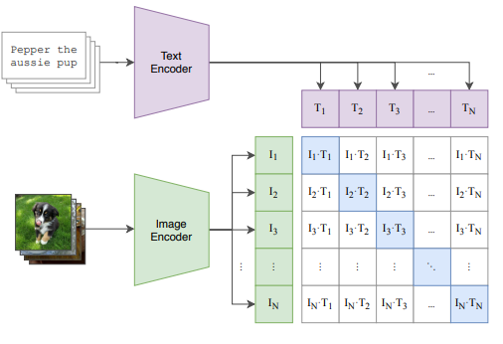
Center for Intelligent Mobility (CIM)
Envisions Smarter and Safer Mobility
CLIP:
Source: Radford, Alec, et al. "Learning transferable visual models from natural language supervision." International conference on machine learning. PmLR, 2021.

Slide 10
Center for Intelligent Mobility (CIM)
Envisions Smarter and Safer Mobility
CLIPSeg:
CLIPSeg builds on top of CLIP — but instead of classifying an image, it performs pixel-wise segmentation (it shows where in the image the text applies).
It uses CLIP’s text and image encoders to get understanding of both.
Then adds a segmentation decoder (a small network) that predicts a heatmap — highlighting which pixels match the text prompt (e.g., “road” or “crosswalk”).
Each pixel gets a “confidence score” of how much it matches the text.
The result is a mask that shows the region related to the prompt.

Slide 11
Center for Intelligent Mobility (CIM)
Envisions Smarter and Safer Mobility
Affordance Detection:
Affordance Detection is the process of identifying where and what kind of actions can be performed in an image or scene.
The goal is to segment regions of an image based on function or usability (e.g., drivable etc).
Traditional methods used labeled datasets, but modern zero-shot models (like CLIP or CLIPSeg) can detect affordances from text prompts without retraining.

Slide 12
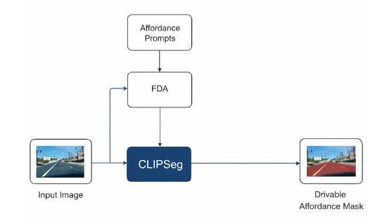
Center for Intelligent Mobility (CIM)
Envisions Smarter and Safer Mobility
Functional Block Diagram:

Slide 13
Center for Intelligent Mobility (CIM)
Envisions Smarter and Safer Mobility
Affordance Detection:
The model detects the drivable affordance in road scenes, which corresponds to regions where a vehicle can safely move, such as open roads and driving lanes. Identifying drivable areas provides an action-centric understanding of the scene by directly highlighting navigable surfaces rather than semantic object categories. This affordance-based representation supports reliable decision-making in autonomous driving and navigation tasks by focusing on regions that enable safe vehicle motion.

Slide 14
Center for Intelligent Mobility (CIM)
Envisions Smarter and Safer Mobility
Prompts for affordance detection:
Drivable:
"a road where vehicles can drive",
"an open road for cars to drive on",
"asphalt road surface",
"a clear street for driving",
"highway or main road for cars",
"drivable path for a vehicle"

Slide 15
Center for Intelligent Mobility (CIM)
Envisions Smarter and Safer Mobility
Results:
Average IoU for each affordance:
Affordances | Mean IoU | Threshold
Drivable | 0.619 | 0.7
IoU (Intersection over Union) measures how much the predicted area overlaps with the ground truth area — it’s the ratio of the common (overlapping) area to the total area covered by both.

Slide 16
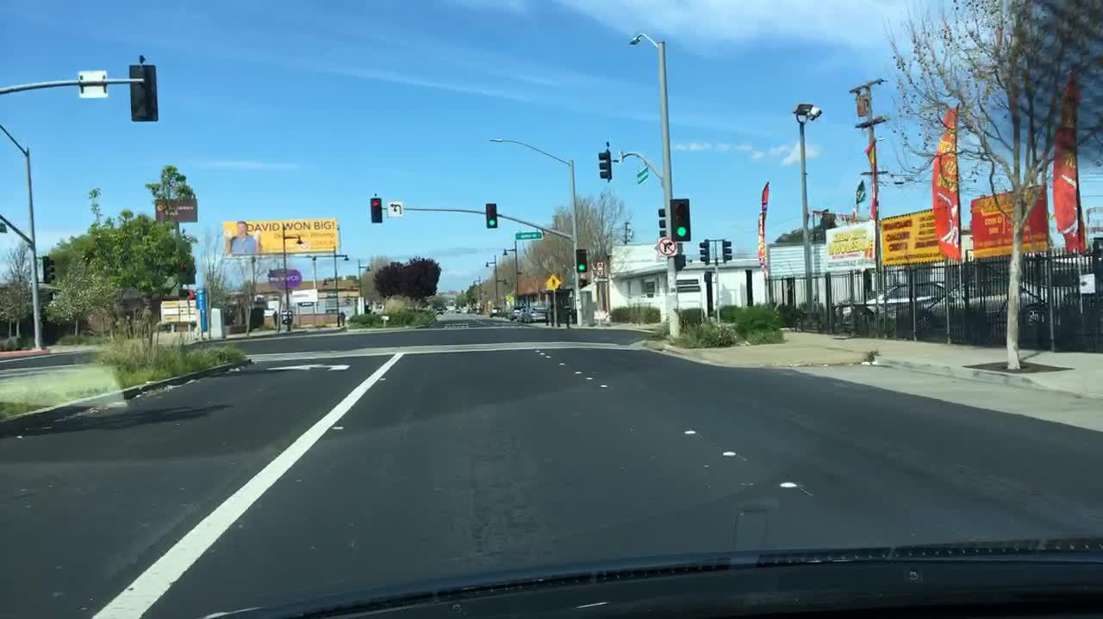
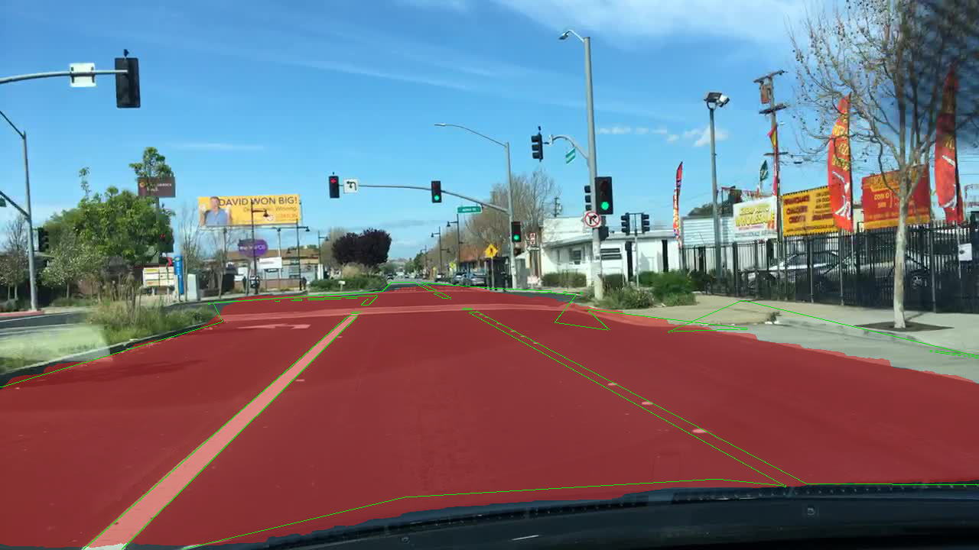
Center for Intelligent Mobility (CIM)
Envisions Smarter and Safer Mobility
Visual Results:
Affordance detection for drivable:
Figure: Original Image
Figure: Affordance detected Image

Slide 17
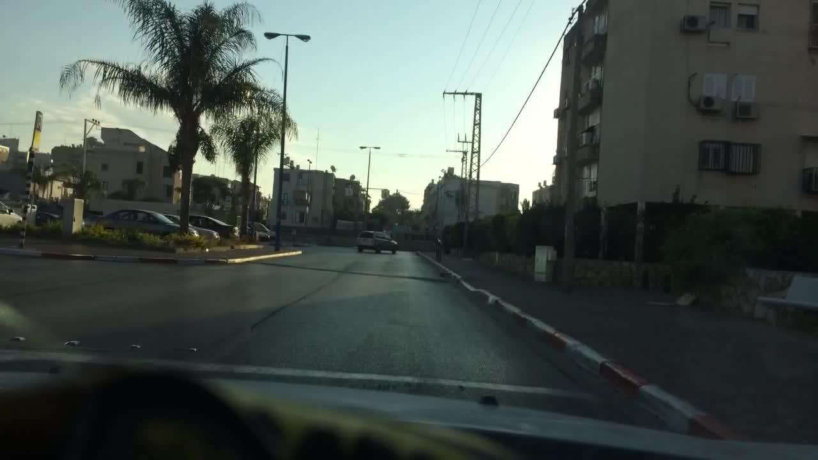
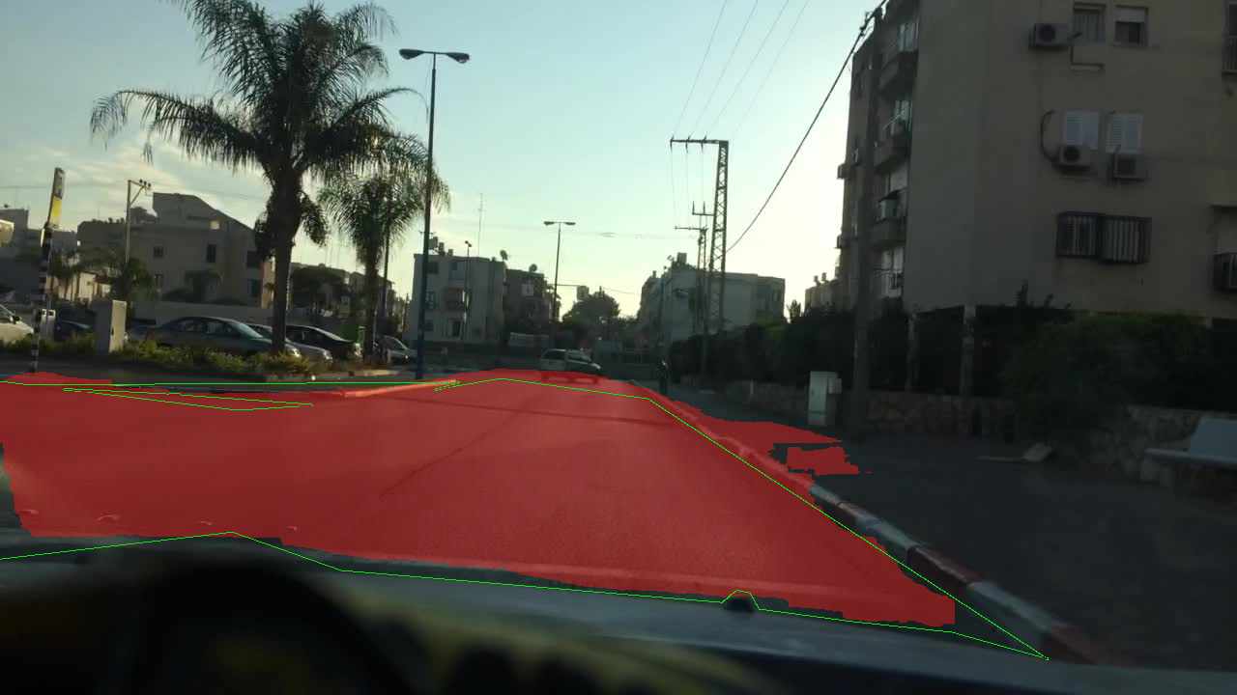
Center for Intelligent Mobility (CIM)
Envisions Smarter and Safer Mobility
Visual Results:
Affordance detection for drivable:
Figure: Original Image
Figure: Affordance detected Image

Slide 18
Center for Intelligent Mobility (CIM)
Envisions Smarter and Safer Mobility
Affordance detection during Adverse Condition:
Adverse weather and lighting conditions are incorporated into the evaluation objective to assess the robustness of the proposed framework in visually degraded environments without altering the zero-shot inference setting.
To support this objective, Fourier Domain Adaptation is implemented as a preprocessing step, enabling robustness analysis without retraining or modifying the pretrained vision–language model.
FDA operates by altering low-frequency appearance components associated with weather effects such as fog, rain, and haze while preserving high-frequency structural information, allowing scalable and open-world robustness evaluation without additional annotation effort.

Slide 19
Center for Intelligent Mobility (CIM)
Envisions Smarter and Safer Mobility
FDA Working:
Start with two images: one from the clear (source) domain and one from the adverse weather (target) domain.
Convert both images from the spatial (pixel) domain into the frequency domain using a Fourier Transform.
Separate the frequency representation into low-frequency and high-frequency components.
Replace the low-frequency part of one image with the low-frequency part of the other image.
Keep the high-frequency components unchanged so that object shapes and scene structure remain the same.
Apply the inverse Fourier Transform to convert the modified frequency image back to the spatial domain.
The final image retains original content but adopts the appearance and style of the target domain, improving robustness under adverse conditions.

Slide 20
Center for Intelligent Mobility (CIM)
Envisions Smarter and Safer Mobility
FDA Results:
The application of Fourier Domain Adaptation (FDA) as a preprocessing step demonstrates its effectiveness in evaluating the robustness of the proposed zero-shot drivable affordance detection framework under adverse weather and lighting conditions.
FDA modifies appearance-level characteristics such as illumination and contrast while preserving the structural content of the scene.
Qualitative results indicate that the model maintains stable localization of drivable regions even after appearance adaptation, with predicted masks remaining well-aligned to the road surface.
This suggests that the vision–language-based segmentation model relies primarily on semantic and structural cues rather than low-level visual appearance.
Overall, the FDA results confirm the robustness of the proposed approach without requiring retraining, supporting its suitability for open-world driving scenarios.

Slide 21
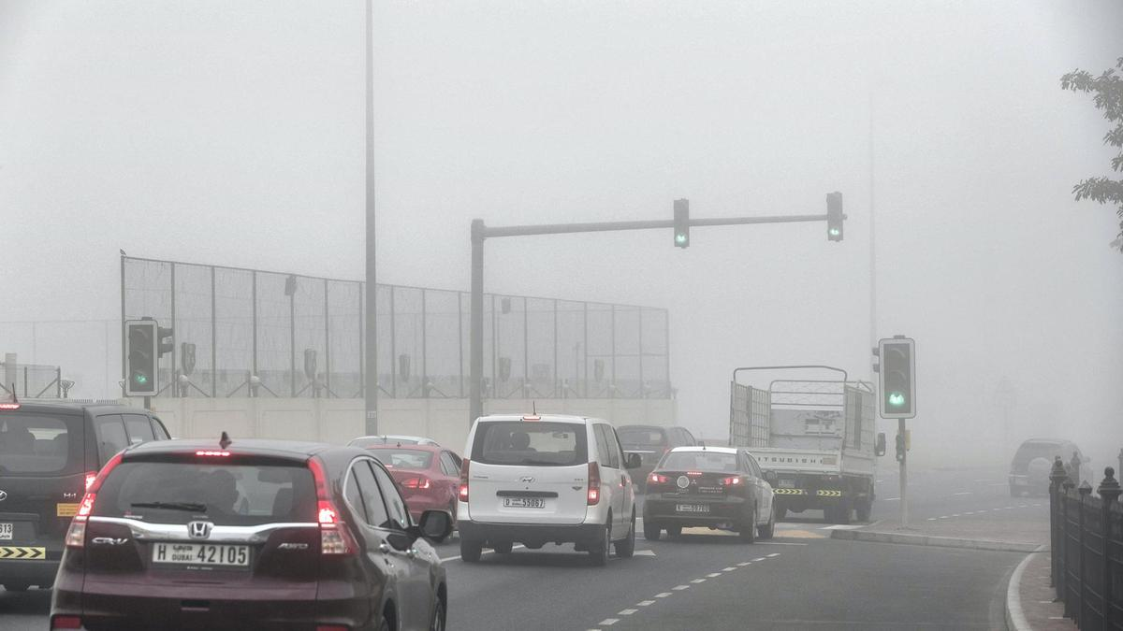
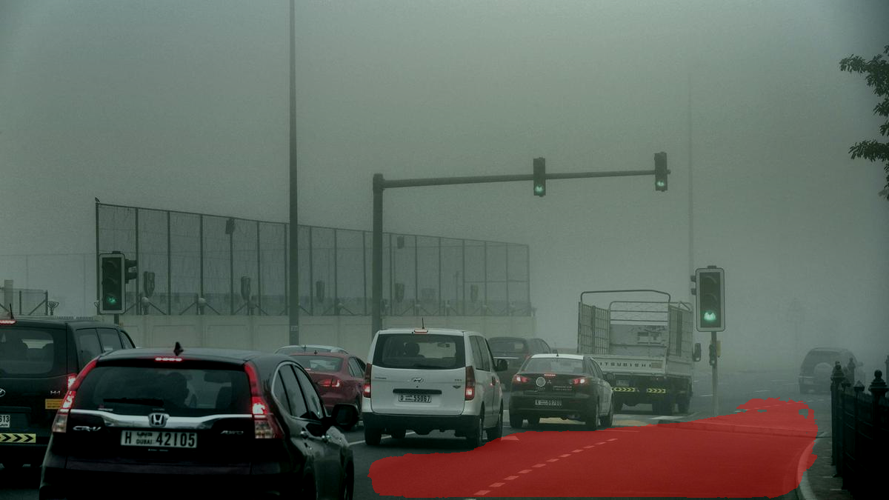
Center for Intelligent Mobility (CIM)
Envisions Smarter and Safer Mobility
Qualitative visual Results for adverse conditions :
Figure: Original Foggy Image
Figure: Drivable affordance detected

Slide 22
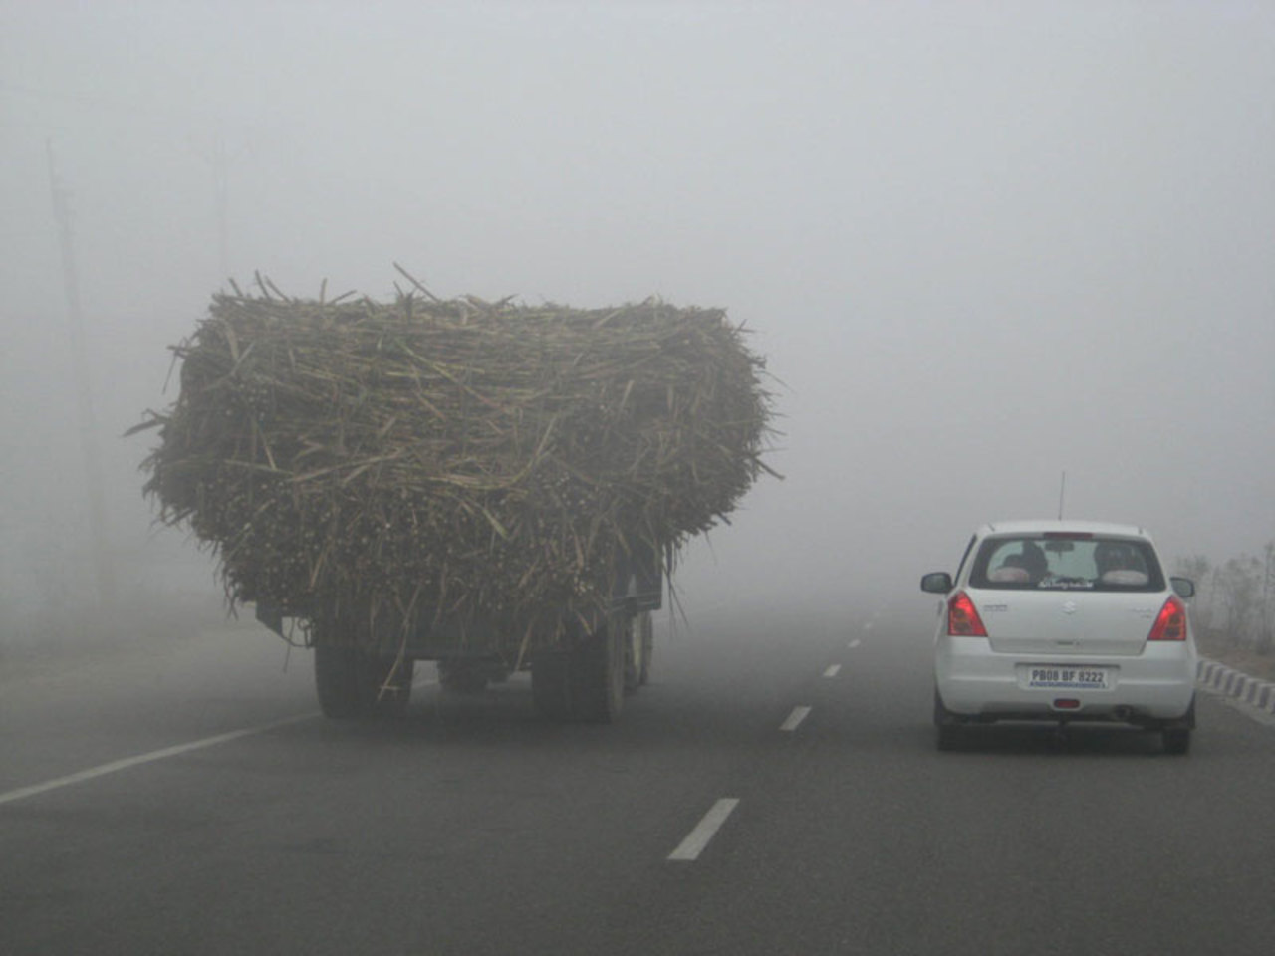
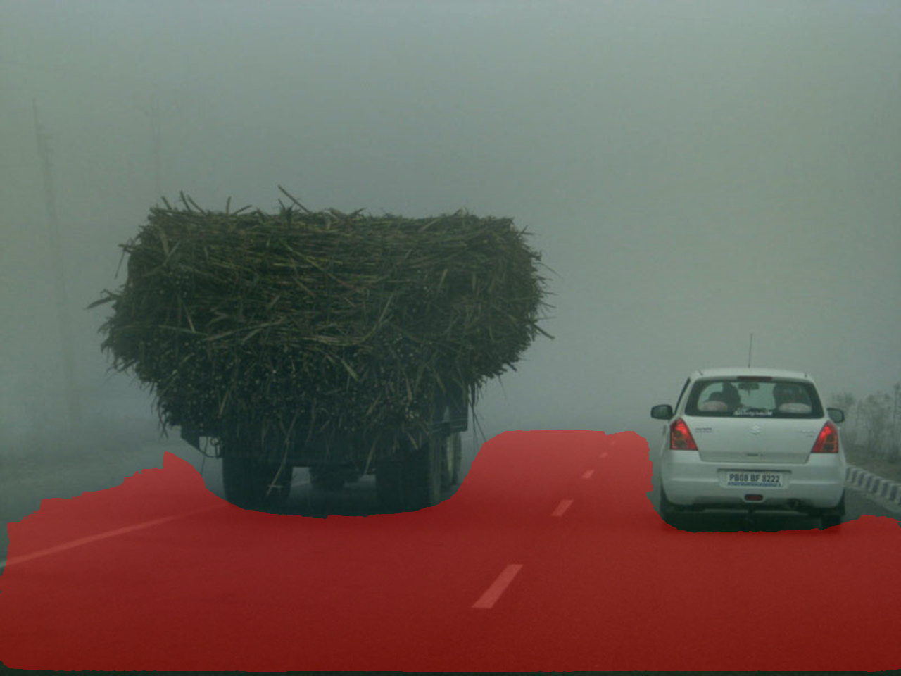
Center for Intelligent Mobility (CIM)
Envisions Smarter and Safer Mobility
Qualitative visual Results for adverse conditions :
Figure: Original Haze Image
Figure: Drivable affordance detected

Slide 23
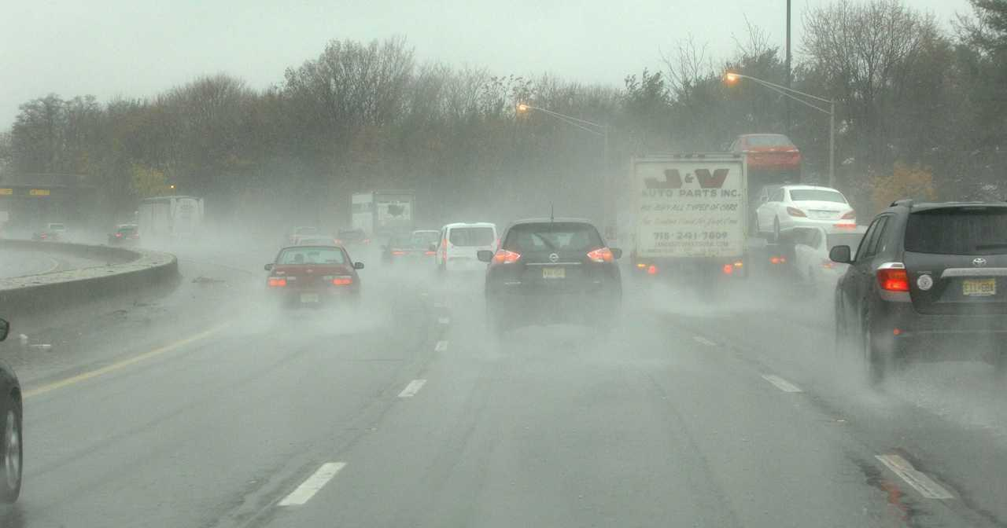
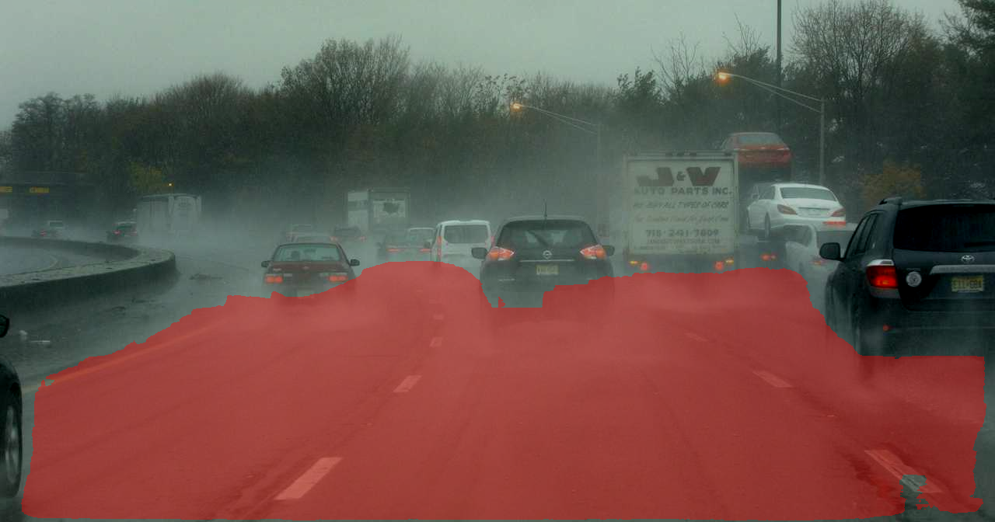
Center for Intelligent Mobility (CIM)
Envisions Smarter and Safer Mobility
Qualitative visual Results for adverse conditions :
Figure: Original Rainy Image
Figure: Drivable affordance detected

Slide 24
Center for Intelligent Mobility (CIM)
Envisions Smarter and Safer Mobility
Conclusion:
This work demonstrates that vision–language models can be effectively leveraged for zero-shot drivable affordance detection, enabling action-centric scene understanding without task-specific training or extensive annotations.
The use of affordance-focused prompt design and aggregation improves spatial consistency and aligns semantic embeddings with navigable road regions across diverse driving scenarios.
Robustness evaluation under adverse weather and lighting conditions shows that the proposed framework maintains stable drivable region localization despite visual degradation, highlighting its reliability in real-world environments.
Overall, the proposed approach offers a scalable and interpretable solution for open-world perception, providing a strong foundation for future extensions toward multi-affordance reasoning and deployment in autonomous driving systems.

Slide 25
Center for Intelligent Mobility (CIM)
Envisions Smarter and Safer Mobility
Future Scope:
Future work may extend this framework in a number of directions. First, the approach can be generalized to incorporate more affordances, such as crossable and obstructed regions, to further increase the accuracy of action-aware perception.
Second, incorporating temporal information from video sequences can improve the stability and continuity of affordance predictions in dynamic driving situations.
Third, further improvement of robustness is possible by combining Fourier-based adaptation with other domain-generalization techniques or by fine-tuning the vision-language model on datasets captured in adverse conditions.
Finally, coupling the affordance perception with downstream planning and control modules will enable end-to-end evaluation of its value for autonomous navigation performance in natural scenes.

Slide 26
Center for Intelligent Mobility (CIM)
Envisions Smarter and Safer Mobility
Thank You

