Slide 1


Slide 2

Summer Internship 2
Name = Tushar Saini
Program = B.tech(CSE)
Section = 4
QID = 23030561

Slide 3
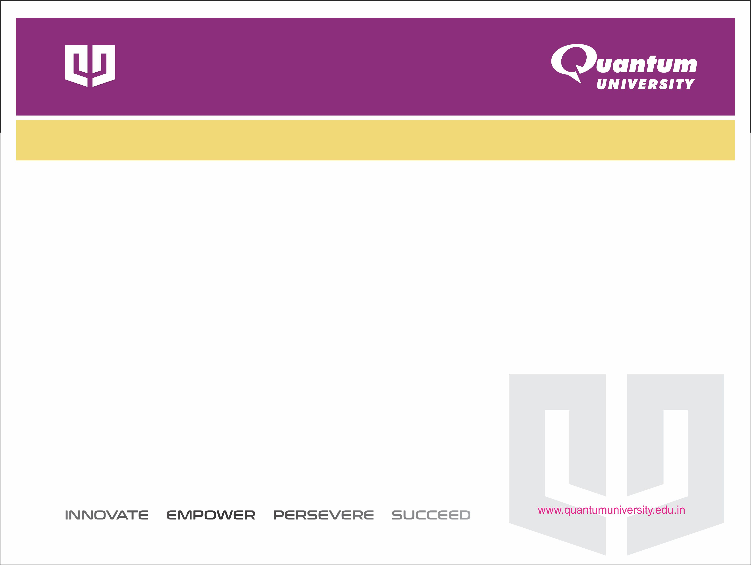
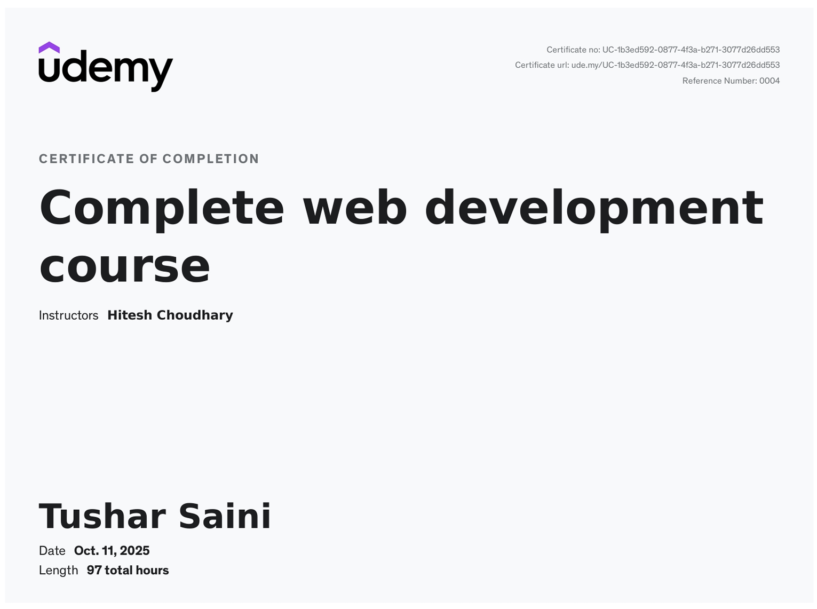

Slide 4
Introduction
My name is Tushar Saini, and I am currently pursuing a B.Tech in Computer Science and Engineering from Quantum University, Roorkee. During my academic journey, I have developed a keen interest in web development, app development, and data analysis.
The Quick Post project was developed as part of the Complete Web Development Course on Udemy. This presentation explains the entire learning journey — from foundational concepts to building a real-world full-stack application.
Throughout the course, I learned to design responsive web pages, create backend APIs, connect databases, and deploy full-stack projects. The final project, Quick Post, is a blogging platform built using modern web technologies like React.js and Appwrite.

Slide 5
Course Overview
The only course you need to become a full-stack web developer.
Covers: HTML, CSS, Tailwind CSS, JavaScript, Node.js, Express, React, MongoDB, Prisma, and Deployment.
97 hours of on-demand video, 35 sections, and 300 lectures.
Includes 45 coding exercises, 5 articles, and 30 downloadable resources.
Lifetime access with regular updates and a certificate of completion.
Designed and taught by Hitesh Choudhary, a developer with 15+ years of experience.

Slide 6
Phase 0 – Introduction to Web Development
The course begins with an overview of web development and its career opportunities.
Introduces the basic structure of websites and how the internet works.
Discusses the different paths available — frontend, backend, and full-stack development.
Guidance on freelancing and building a career in the tech industry.
Setup instructions for a development environment using VS Code and browser developer tools.
Emphasis on consistency, problem-solving, and real-world practice.

Slide 7
Phase 1 – The Foundations
Focuses on building the core skills of web development.
Covers essential technologies: HTML, CSS, Tailwind CSS, and JavaScript.
Learn to structure web pages using semantic HTML.
Style layouts with CSS and responsive design using Flexbox and Grid.
Introduction to Tailwind CSS for faster, utility-based styling.
JavaScript basics: variables, functions, loops, events, and DOM manipulation.
Hands-on mini-projects to apply concepts, such as interactive forms and responsive web pages.

Slide 8
Phase 2 – Modern Backend Development
Introduces server-side programming and backend logic.
Technologies covered: Node.js, Express.js, Mongoose, Prisma, PostgreSQL, and NeonDB.
Learn to build RESTful APIs for data communication.
Implement user authentication and authorization systems.
Understand database design, schema creation, and data relationships.
Learn to handle API requests, responses, and middleware.
Develop CRUD (Create, Read, Update, Delete) operations for real-world applications.
Focus on scalability, modular coding, and security best practices.

Slide 9
Phase 3 – Frontend Mastery with React
Learn to build modern, dynamic, and responsive front-end applications using React.js.
Understand core concepts: components, props, state, and lifecycle methods.
Manage data flow and reactivity with hooks like useState and useEffect.
Integrate APIs to fetch and display dynamic data.
Implement state management using Redux Toolkit and Zustand for scalable applications.
Learn to handle user input efficiently with React Hook Form.
Build reusable UI components and optimize rendering performance.
Apply routing using React Router for multi-page navigation

Slide 10
Phase 4 – Full-Stack Projects & AI Introduction
Combines all previously learned technologies to build complete full-stack applications.
Connects frontend (React) with backend (Node, Prisma, Appwrite) and databases.
Focus on project structuring, authentication, and deployment workflows.
Introduction to AI and Machine Learning in web development.
Learn to use TensorFlow.js and LangChain for AI-powered features.
Explore how AI can enhance user experience through automation and intelligent content handling.
Hands-on full-stack projects that replicate real-world scenarios.
Learn to host and deploy web applications on modern cloud platforms.

Slide 11
Quick Post – Project Overview
Quick Post is a web-based blogging platform designed for creating, editing, and publishing blog posts easily.
Provides a clean and responsive interface where users can manage posts with one-click background operations.
Frontend: React.js, React Hook Form, Redux Toolkit, TinyMCE Editor.
Backend: Appwrite BaaS for authentication, database, and file storage.
Objective: Build an easy-to-use system with speed, usability, and modern web technology integration.
Scope:
  User authentication
  Blog post creation and editing
  Category and tag management
  Responsive UI for all devices

Slide 12
Technologies Used
Frontend: React.js, React Hook Form, Redux Toolkit, TinyMCE Editor, Tailwind CSS, React Toastify
Backend: Appwrite (BaaS), Appwrite Cloud Functions, Node.js
Database: Appwrite Database – stores profiles, posts, comments, categories; real-time CRUD with indexing
Version Control & Deployment: Git/GitHub, Vercel (frontend), Appwrite Cloud (backend)

Slide 13
Key Features of Quick Post
User Authentication: Secure login and registration system.
Blog Post Management: Create, edit, and delete posts easily.
Category & Tag Management: Organize posts effectively.
One-Click Background Operations: Smooth user experience without page reloads.
Responsive Design: Works seamlessly across all devices.
Rich Text Editing: Format content with TinyMCE editor.
Notifications: Instant feedback using React Toastify.

Slide 14
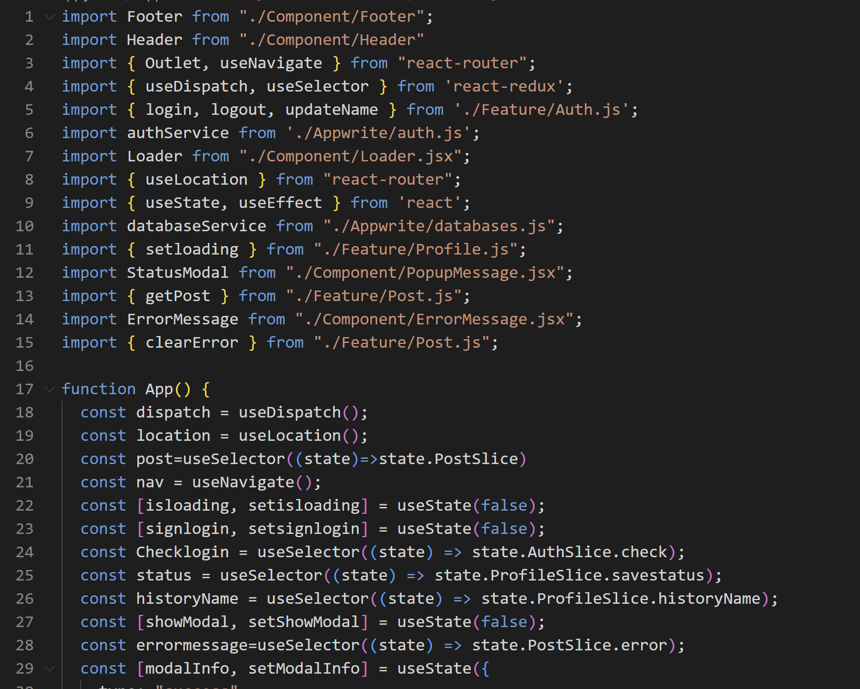
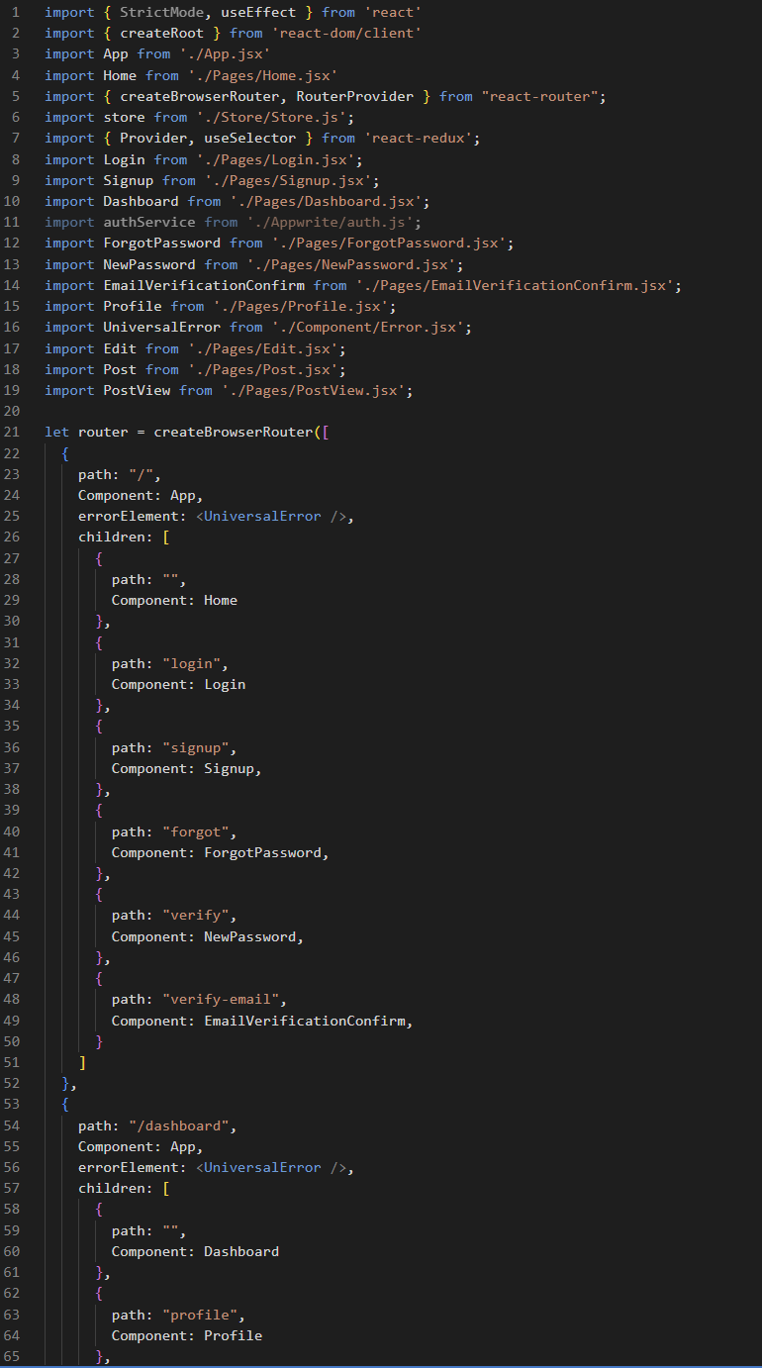
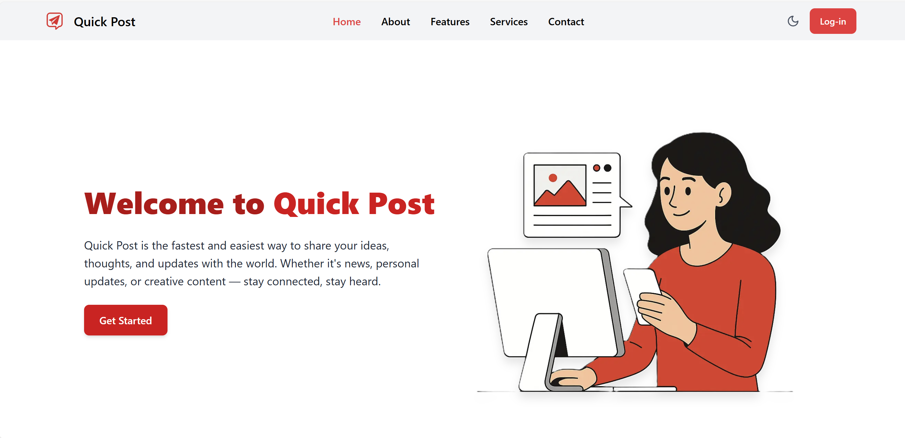
Code

Slide 15
Conclusion
Quick Post demonstrates the complete learning journey from basic web development to full-stack project deployment.
Combines modern technologies for a responsive, interactive, and scalable blogging platform.
Represents a real-world application of skills learned during the course.
Prepares for professional or freelance projects in full-stack web development.

Slide 16
    THANK YOU

