Slide 1


ENGAGE
FLOW
PRESENTATION

Slide 2

OVERVIEW
EngageFlow is a marketing automation platform designed to help organizations like colleges, schools, and companies generate high-quality leads, engage potential customers through automated calls and WhatsApp, and convert them into clients.

Slide 3

THE MARKETING CHALLENGES
Organizations struggle with:
1. Engaging potential customers effectively.
2. Converting leads into clients due to manual processing
EXAMPLE
Colleges spend hours calling students, but only 10% convert

Slide 4

OUR SOLUTION
Generates targeted leads from Google searches.
Engages users via automated Calling or WhatsApp.
Converts leads with personalized communication.

Slide 5

KEY FEATURES
Personalized Content Delivery
Geo-Targeting
Analytics for Organizations
Voice Mode Customization
Gamification for Users

Slide 6

BENEFITES FOR
Organisation like Colleges, Schools, NGOs, Companies etc.
Users for getting organization easily and quickly.

Slide 7

TECH STACK
Frontend: React
Backend: Spring Boot
Database: NoSQL(MongoDB)
API: Google Custom Search for Lead generation, Twilio Voice for calling agents, WhatsApp Business API
Deployment: Digital Ocean
Authentication & Security: JWT + Autho

Slide 8

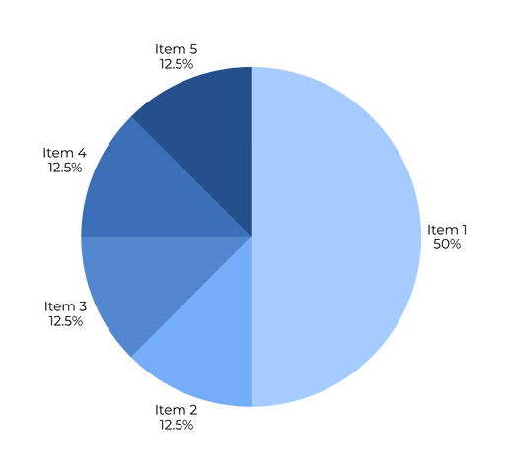
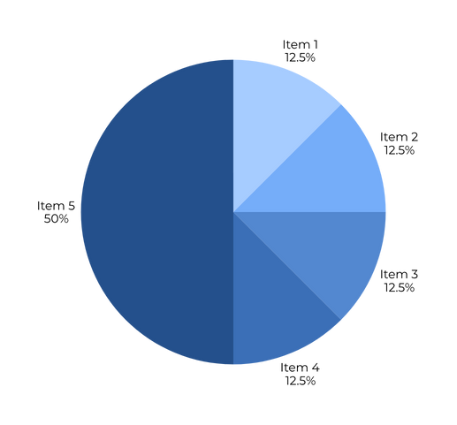
GET STARTED WITH ENGEGEFLOW
Free Trial: Test with limited leads or duration.
Flexible Pricing: Subscription or pay-per-lead plans.
Scalable: Suitable for small to large organizations.

Slide 9

THANK
YOU
Name Roll. No.
Nikita Singh 23-CSE-125
Tushar Samaniya 23-CSE-139
Ritik Pal 23-CSE-132
Rinku 23-CSE-131

