Slide 1

Online Sneaker Shopping
Group Name : G-105
Team Details :
Tushar Shitre -1193
Monica Shewale -1175

Slide 2
Introduction :
In today’s busy world, people don’t have time for their personal needs. And the technology is so fast that anyone can do anything by just sitting in a room. The internet is the way that helps a person in all aspects. If someone wish to buy and view things, he can buy online with the help of internet. Today there are very least organizations which are manual. Everything is going to be computerized and online whether it is shopping, advertising or banking. We are trying to help people to make their life easier by proving online sneakers shopping as well as second hand buying and renting sneaker system.

Slide 3
Motivation :
Online shopping is the process preferred by many these days. This sneaker shopping website is a good collection of sneakers for men and women paired with extremely profitable offers and deals to choose from this website. Customer can also quickly find the nearest sneaker stores by selecting the area in the search tools. Thus, this online sneaker shopping will relieve people by providing access for purchasing, renting sneakers just by sitting at home

Slide 4
Problem Statement :
In order to increase online shopping, customer online shopping behaviour while shopping online should be given priority. The Current shopping System is critical to set up online shops, customers to browse through the shops, and a system administrator to approve and reject requests for new shops and maintain lists of shop categories. The basic idea is that the customer can buy sneakers from anywhere during any time by using their email and password through which they have been logged in. Some sneakers are too expensive for getting a hands-on, so we have provided a feature of buying a secondhand sneaker and also a rental system which is not present in existing systems.

Slide 5
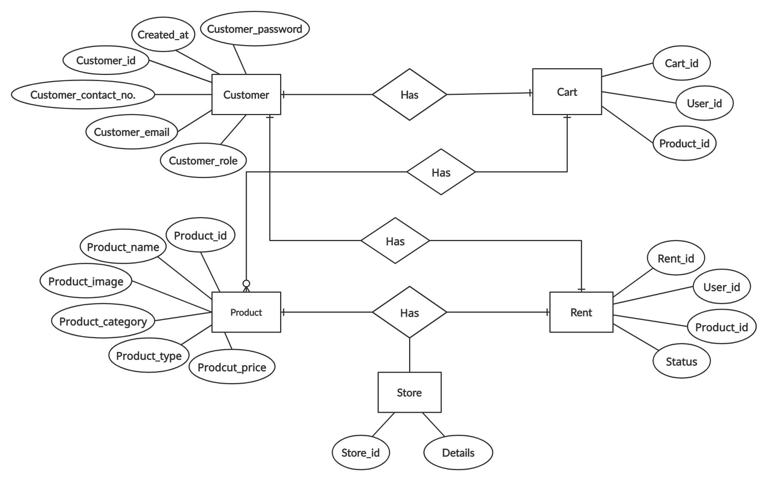
ER Diagram :

Slide 6
Module :
Admin:
• Admin can add suppliers, view suppliers and delete suppliers.
• Admin can register and login his personal account using id and password.
• As soon as the data is filled by the admin, he gets redirect to the add suppliers page.
• Admin will add new suppliers.
• Admin can view the products added by the suppliers and approve or reject them before them before adding the product to the home screen.
Suppliers:
• Suppliers are added by the admin according to the products they supply.
• Supplier has to fill a new form add product for adding a product.
• The product then goes to the admin for approval and then added accordingly.
• The supplier can also delete the product if needed.

Slide 7
Customer
• Customer can register and login using credentials.
• He/she can view the sneakers and can buy the sneakers.
• There is also a delete option so if a customer wants to delete
particular sneaker he can do it by using delete option.

Slide 8
Advantages :
• Customer can register and login using credentials.
• He/she can view the sneakers and can buy the sneakers.
• There is also a delete option so if a customer wants to delete particular sneaker he can do it by using delete option.
Convenience of online shopping.
No pressure shopping.
Online shopping saves time.
Availability of online shop.
Online shopping saves money in form of sales.
Second hand and Rental System for sneakers which costs a lot for a normal budget.

Slide 9
Existing System :
Traditionally if anyone wanted to buy a sneaker, he/ she would have to physically go a store and buy a sneaker which was good for older days when technology was not that improved but as time passed .
Online Systems were developed which consisted of an online application for buying sneakers without physically going to the place. The products were then shipped to the customers address according after buying the products.
But some of the sneakers are too costly for some people to afford so we have proposed a system in which a user can rent a sneaker or buy them second hand at lower price from the actual one.
Also if the customer wants to still buy any product from an offline outlet of ours the details of the same are provided in the system itself which provides a seamless experience for sneaker lover.

Slide 10
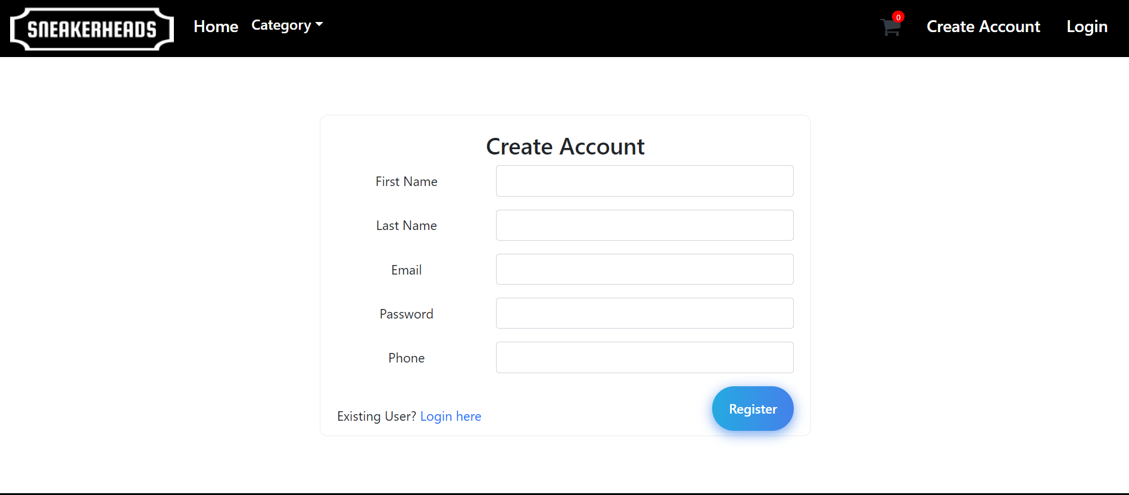
Screenshots :
Sign Up

Slide 11
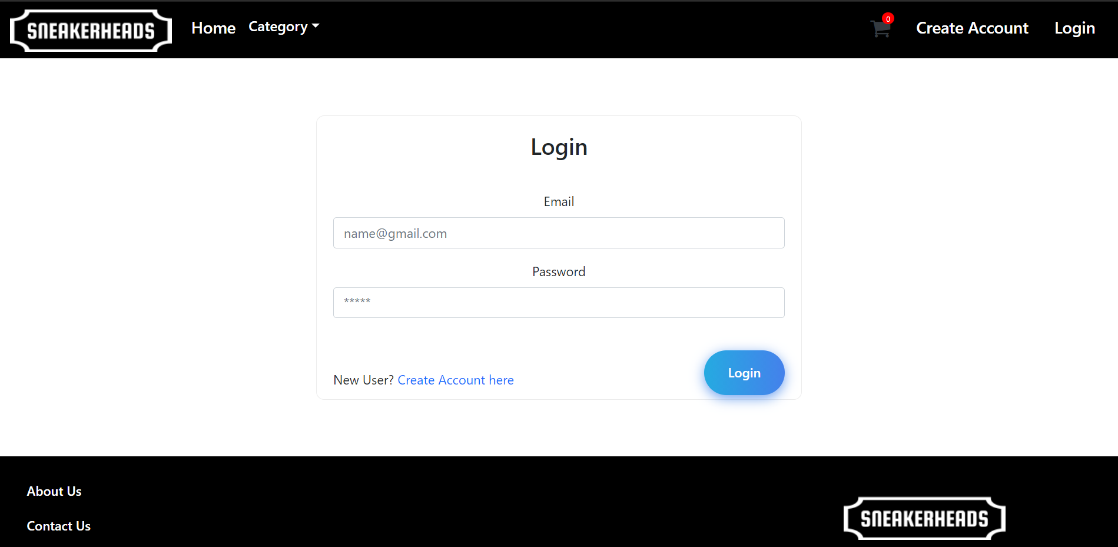
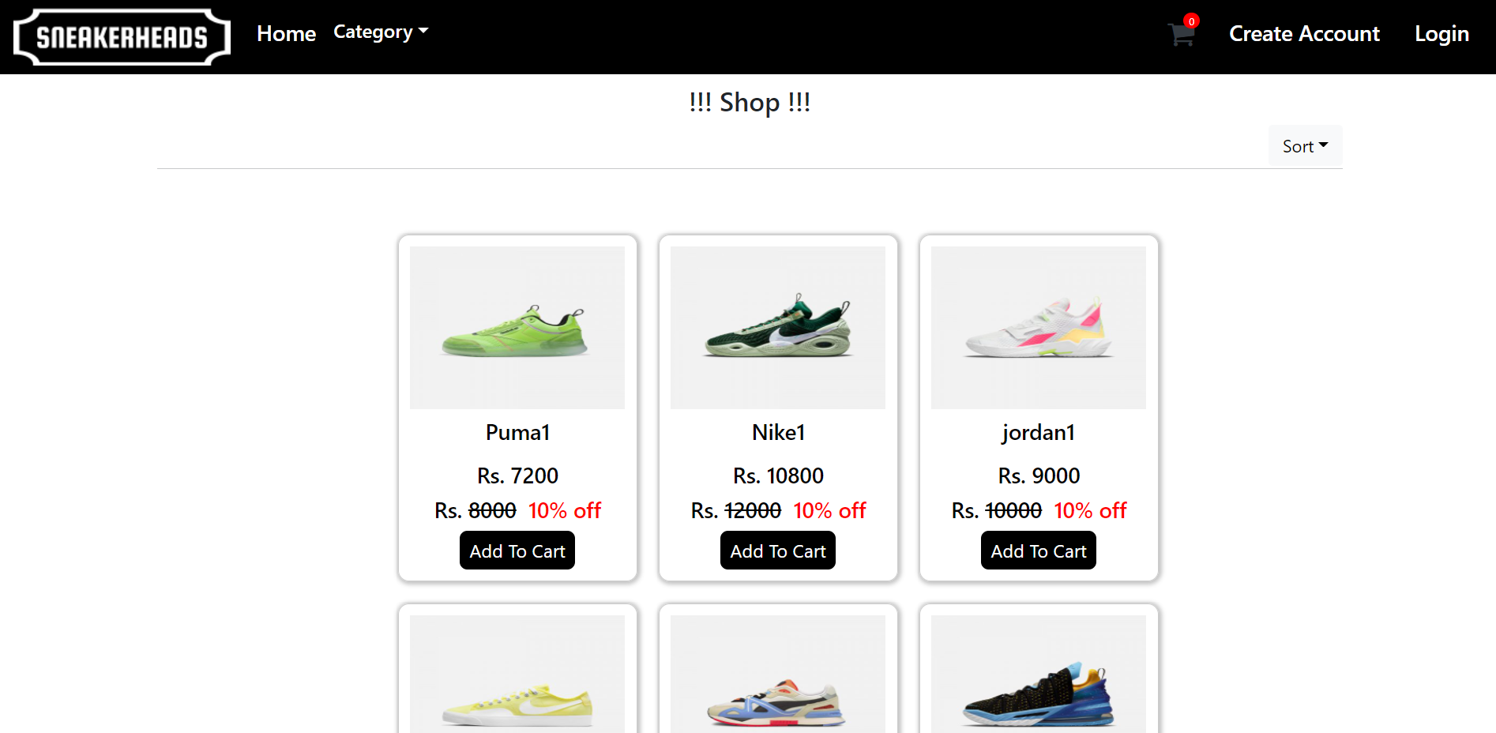
Login
Products Page

Slide 12
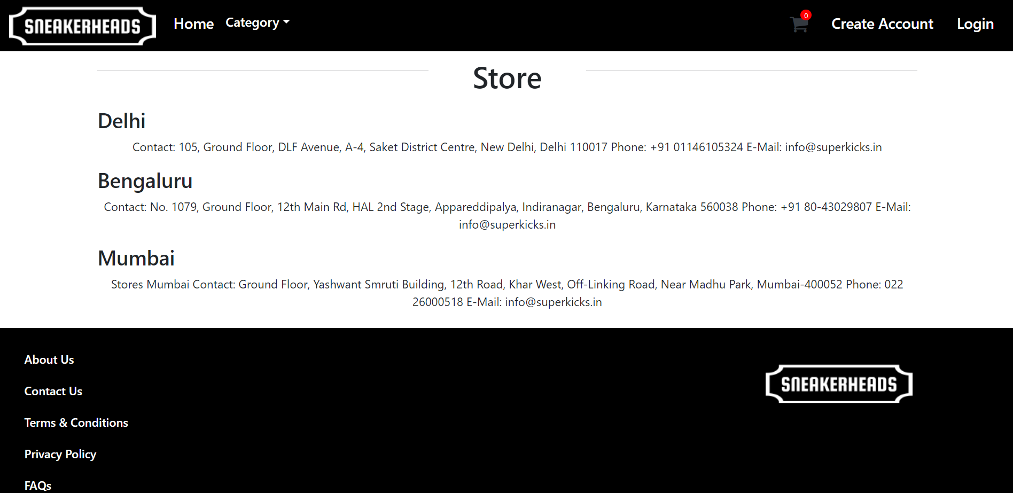
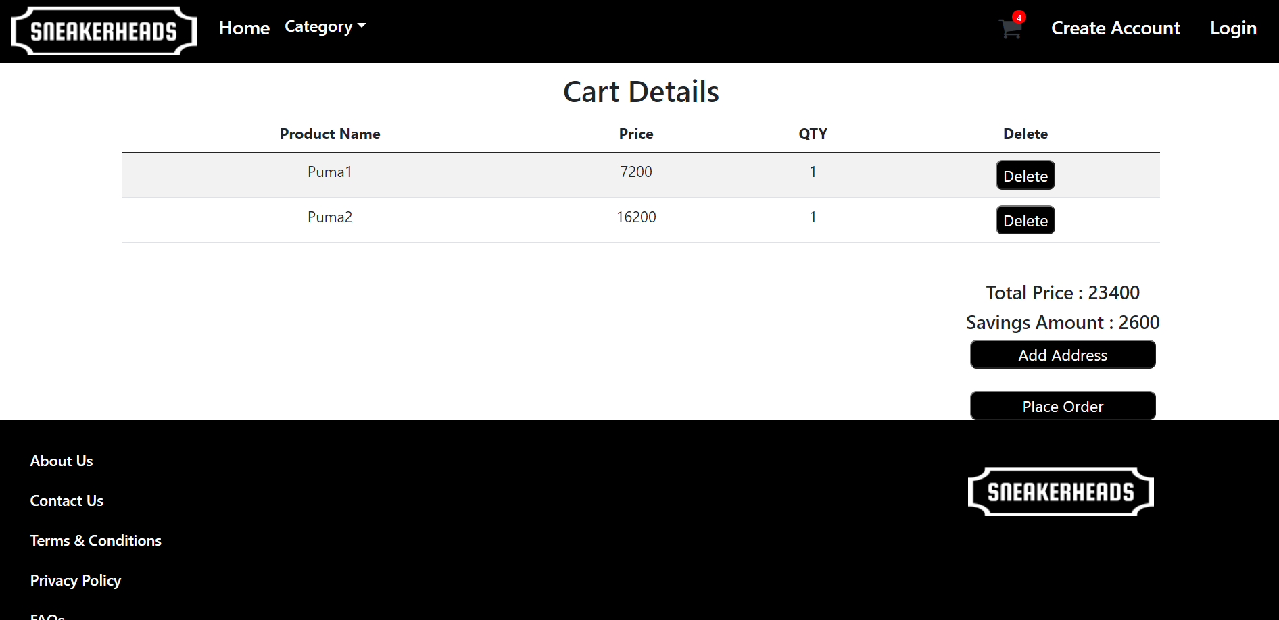
Store
Cart

Slide 13
Scope Of The Project :
TECHNOLOGIES USED:
Spring Boot
React
My SQL
Scope:
This online sneaker shopping application has two actors namely, Admin and Customer. First is Admin login, Admin can add products, view products and delete products.
Admin can register and login his personal account using id and password. As soon as the data is filled by the admin, he gets redirect to add product page. Admin will add new sneakers, second hand sneakers, rental sneakers.
Second module is Customers, customers can register and login using credentials. He/she can view products, can add products to the cart and place order. He/ She can also buy second hand sneakers or rent sneakers for one month.
SC

Slide 14
Conclusion :
E-commerce is continuously progressing and is becoming more and more important to businesses as technology continues to advance and is something that should be taken advantage of and implemented.
From the inception of the Internet and e-commerce, the possibilities have become endless for both businesses and consumers. Creating more opportunities for profit and advancements for businesses, while creating more options for consumers. However, just like anything else, e-commerce has its disadvantages including consumer uncertainties, but nothing that can not be resolved or avoided by good decision-making and business practices.
We have Proposed a system keeping in mind all the factors which would increase or affect the sneaker shopping application

Slide 15
THANK YOU

