Slide 1

Grid Search Hyper-Parameter Tuning and K-Means Clustering to Improve the Decision Tree Accuracy
Synopsis Presentation
Submitted To-
Naveen Kumar Rathore
(Assistant Professor)
Submitted By
Tushar Singh(1901430100226)
Shivam Singh(1901430100201)
Shivam Kumar(1901430100199)
Smita Singh(1901430100211)
Department of Computer Science & Engineering IMS Engineering College, Ghaziabad, India

Slide 2





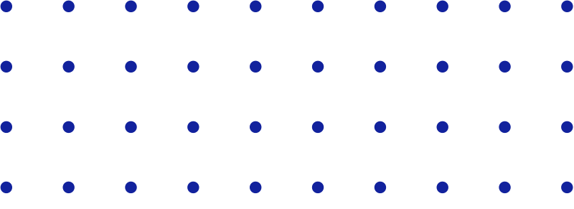
Grid Search Hyper-Parameter Tuning and K-Means Clustering to Improve the Decision Tree Accuracy
MACHINE LEARNING

Slide 3






INTRODUCTION
Representation and quality of the instance data are the foremost factors that affects classification accuracy of the statistical - based method Decision tree algorithm which gives less accuracy for binary classification problem.
Experiments shows that by using clustering and hyper-parameter tuning, the desicion tree accuracy can be achieved above 95% , better than the 75% recognition using decision tree alone.

Slide 4


OBJECTIVE
By Utilizing K-means algorithm, Decision Tree algorithm, and hyperparameter tuning, our aim is to improve the accuracy of decision tree algorithm by making more than 20% to 25%
Classification
Clustering
Hyper-parameter Tuning

Slide 5


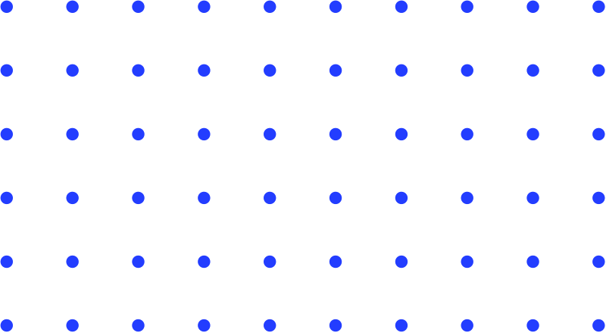


FLOW CHART
CLUSTERING
- 1
DATA FILTRATION
CLASSIFICATION PROCESS
RESULT EVALUATION
START
CLUSTERING
CLUSTERING
- 2
PARAMETER TUNING
END
CLUSTERING - N

Slide 6


Symbolic method
Grouping customers by purchase behavior.
Why K-Means Algorithm for clustering
Robust methods
One of the most robust methods that is far better than other clustering algorithms like density- based, expectation-maximization.
Performance
By using k-means algorithm performance can be increased as decision tree makes the model to train and perform better.

Slide 7






General
Customer Churn
More Reliable
Role in
E-commerce
Field Independent

Slide 8



K-MEANS CLUSTERING FOR PRE-PROCESSING
By making the data more structured with k- means clustering process, our Decision Tree model makes it easier to train and perform better.
Note-*General accuracy of this classifier varies from 80% - 85%, but it is far from the best.

Slide 9

Pre-Processing steps
Data cleaning
Handling missing data Data Integration
Data Transformation
Data Reduction Feature selection

Slide 10
Past Knowledge:
Grid Search for hyper- parameter tuning
Optimization tool
Used for hyper parameter tuning.
Define the grid of parameters we want to search, and we choose the best combination of parameters for our data.
Goal
Our goal of using grid search is to find a specific combination of parameters.
Grid search allows us to find the best parameters for a data set.
Comparison
We compare different models with each other and try to find the model that works best.
After checking all the grid points, we know which parameter combination is best for our prediction.

Slide 11
TECHNICAL REQUIREMENT
Window/Linux Processor: Dual Core 1.6
1GB RAM .

Slide 12




CONCLUSION
A great tool for almost any modern company, offers a number of important advantages, including:
Insightful facts
Automation Accuracy
Strength and weakness of model
Standard error of misclassification rate Prediction of customer churn
Decision trees play an important role in the data mining and machine learning
01
02
03
04
05

Slide 13




Thank You

