Slide 1

Lodestar
GLOBAL ENERGY HACKATHON 2026 · INNOVATIVE & AFFORDABLE SOLUTIONS
HOW THIS PITCH IS SCORED
Impact
25%
Innovation
25%
Sustainability
25%
Bankable demand forecasts that tell mini-grid developers and their lenders how much power a village will use, before anyone builds.
Feasibility
15%
BRIEF
03 · Predict mini-grid demand before building
TRACK
2 · Digital Solutions & AI
TEAM
Tushar Agarwal · product, data and engineering
Scalability
10%
Notes:
Title. I'm Tushar, team Lodestar, Brief 03. Lodestar tells mini-grid developers and their lenders how much power a village will use, as a range they can bank on, before anyone builds.

Slide 2

Every mini-grid is sized on a guess about demand
IMPACT · 25% OF SCORE
5 of 6
years where real metered demand landed inside our forecast range (DR Congo, forecast without the site's meters)
THE PROBLEM
490 million people need the 217,000 mini-grids still to be built (ESMAP). Each is sized before anyone connects. Too big, and tariffs price villagers out. Too small, and evenings go dark.
"Survey-based estimates miss individual customers' demand by 65%." (CrossBoundary Innovation Lab)
+37% → +6%
oversizing at a real site: today's desk estimate vs Lodestar's plan
−48%
cost of power when built for likely demand, not the optimistic case (20 villages)
Bottom line: Tested on real meters: demand landed in our range 5 of 6 times, and right-sizing roughly halves the cost of power.
Notes:
Impact. 490 million people need 217,000 mini-grids, and every one is sized on a guess: surveys miss what a customer uses by 65%. Too big and tariffs price villagers out; too small and evenings go dark. On two real metered mini-grids in DR Congo, forecast without their meters, real demand landed inside our range in 5 of 6 years. A desk estimate oversized one site by 37%; our plan by 6%. Building for likely demand instead of the optimistic case roughly halves the cost of power.

Slide 3

We forecast demand as a range lenders can bank on
INNOVATION · 25% OF SCORE
TODAY
OUR APPROACH
ROOT CAUSE WE ADDRESS
One day-one number from a survey or benchmark: no range, no growth, never checked against meters.
A probabilistic range, month by month: a safe level demand beats 9 times in 10, the likely level, and the upside.
No trusted demand number before building, so sites are mis-sized or never financed.
HOW IT WORKS
1
Click a village: satellite buildings and OpenStreetMap count customers
2
20,000 growth scenarios give a five-year range, in plain words
3
Size the system, stress-test the loan; operators' meters sharpen it
Bottom line: A range instead of a guess, with growth over time and a lender view, tested on real meters.
Notes:
Innovation. Today a developer gets one number. We give a probabilistic range, as solar finance does for sunshine: a safe level demand beats 9 times in 10, the likely level, and the upside, month by month for five years. Click a village; satellite buildings and OpenStreetMap count customers; 20,000 scenarios give the range; then size the system and stress-test the loan. Operators' meters sharpen it.

Slide 4





Villagers pay nothing; developers and funders do
SUSTAINABILITY & AFFORDABILITY · 25% OF SCORE
COST TO THE USER
WHO PAYS
HOW IT PAYS FOR ITSELF
$0
Developers: $300 per site report. Funders (RBF programmes, DFIs): $12k/yr to screen portfolios. Lenders: later, per loan file.
Costs ~$60k/yr (two analysts, one server). Covered by 3 funder subscriptions + ~80 reports, e.g. 3–5 developers.
for households. A developer pays $300 per site report: 0.05% of a ~$585k mini-grid.
MARKET
ENVIRONMENTAL BENEFIT
BREAK-EVEN
AMDA members plan 6,116 sites (≈$1.8M in reports). Nigeria's DARES alone: 1,000+. Needed by 2030: 217,000.
No stranded panels and batteries (desk plan oversized a real site by 61 kWp, ours by 9) and less backup diesel.
6–8 customers
Bottom line: Villagers pay nothing. 6–8 paying customers cover costs, in a pipeline of thousands of planned sites.
Notes:
Sustainability. Villagers never pay. Developers pay $300 per site report, 0.05% of a mini-grid; funders pay $12k a year to screen portfolios; lenders follow later. Running costs are about $60k a year, so 3 funder subscriptions and about 80 reports break even: 6 to 8 customers. The market: 6,116 sites planned by AMDA members, 1,000+ in Nigeria's DARES alone, 217,000 needed by 2030. Right-sizing also avoids stranded panels and diesel.

Slide 5

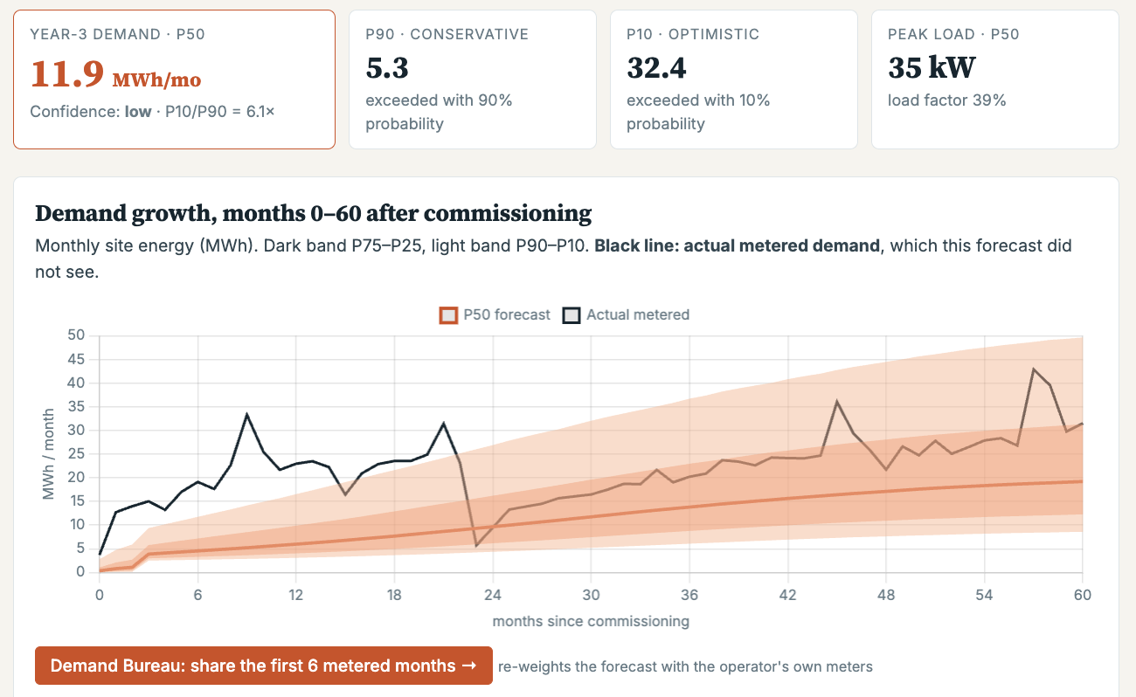


Live and tested; next, a 10-site pilot in Nigeria
FEASIBILITY · 15% + SCALABILITY · 10%
PATH TO SCALE
PILOT
EXPAND
SCALE
Nigeria: 10 sites with DARES developers
Score on meters; one funder; Kenya next
5 countries: ~$30k/yr per country (est.), compute ~free
OUR ASK
EVIDENCE IT WORKS
Real meters: demand in range 5 of 6 years
Exports to HOMER; open data and licences
Risk: few public meters → backtest operators first
2–3 operators' past meter data, and one RBF programme as pilot partner. They get back: tighter forecasts (cheaper debt), peer benchmarks, free reports.
Bottom line: Live at lodestar-utfz.onrender.com. Partners who share meter data get tighter forecasts and cheaper debt in return.
Notes:
Feasibility and scale. Lodestar is live, tested on real meters, and exports to HOMER. The risk is few public meters, so we test on operators' data first. Pilot: 10 sites with DARES developers in Nigeria, then one funder and Kenya, then 5 countries at about $30k a year each. Our ask: 2 to 3 operators' meter data and one RBF programme. In return they get tighter forecasts, which means cheaper debt, peer benchmarks and free reports.

