Slide 1
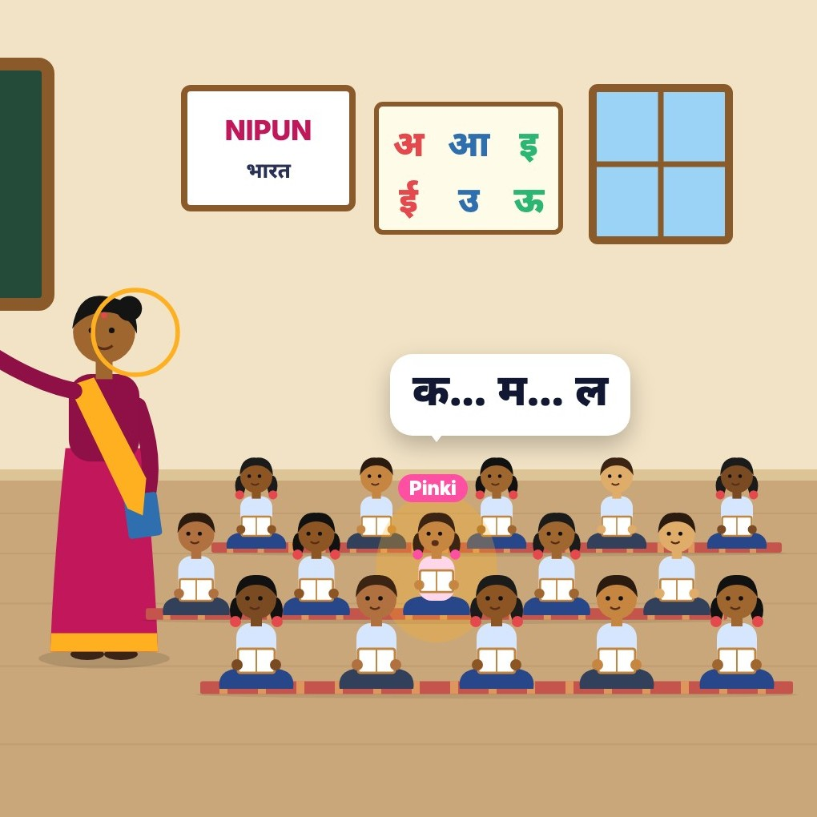
SUNO सुनो
AI FOR FOUNDATIONAL LEARNING HACKATHON · CHALLENGE 2: LEARNING-LEVEL VISIBILITY
SUNO listens to the teacher, not the classroom.
A 60-second voice note after the reading period becomes checked, per-child evidence, and a 2-minute Hindi brief the next morning: who needs support with what, today's activity, and whom to listen to.
Live: suno-8qoh.onrender.com · code SUNO-DEMO · video: youtu.be/GG3v7lQ212M
Team Sunvai · Tushar (product, engineering) · Saikiran (architecture, risk)
Notes:
Title. SUNO is for Grade 1-3 government-school teachers. No test, no child's voice recorded, about a minute of teacher time a day.

Slide 2



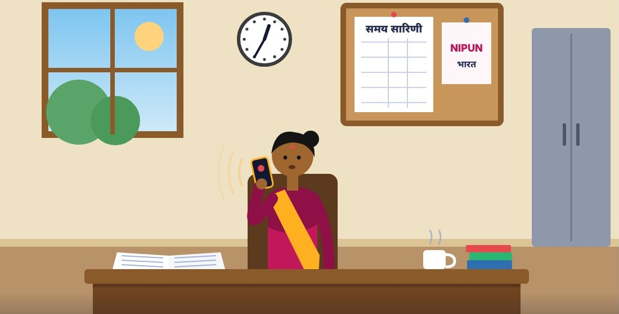
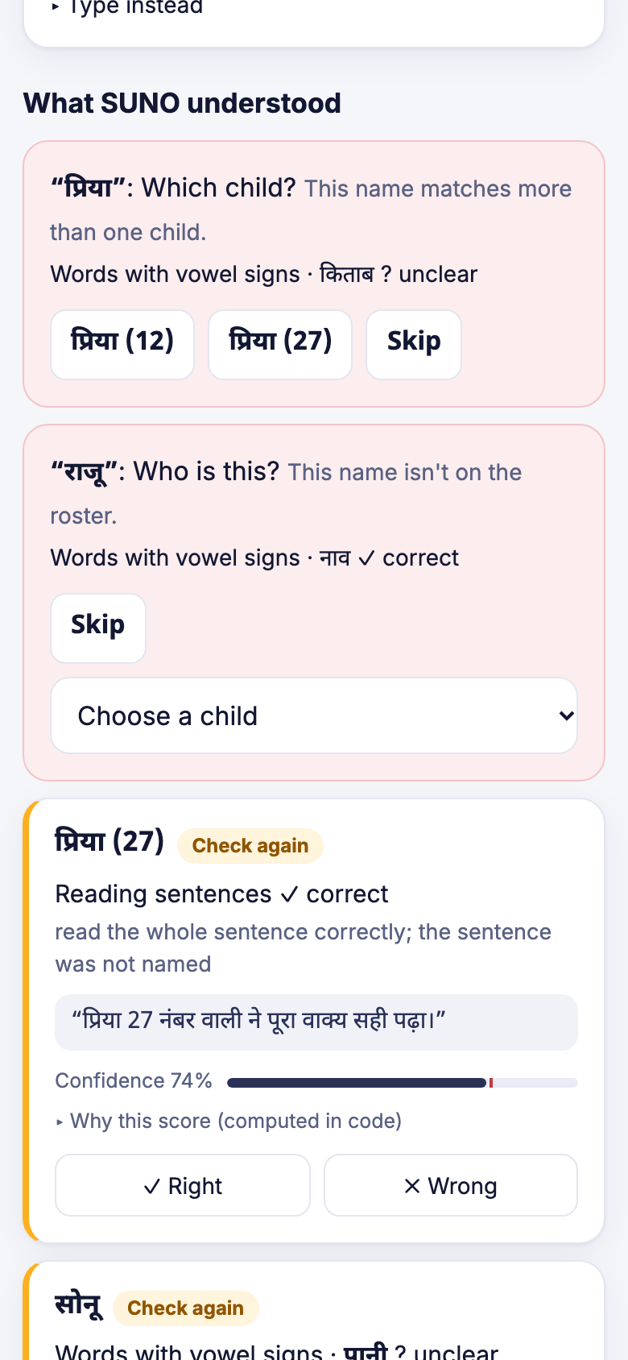
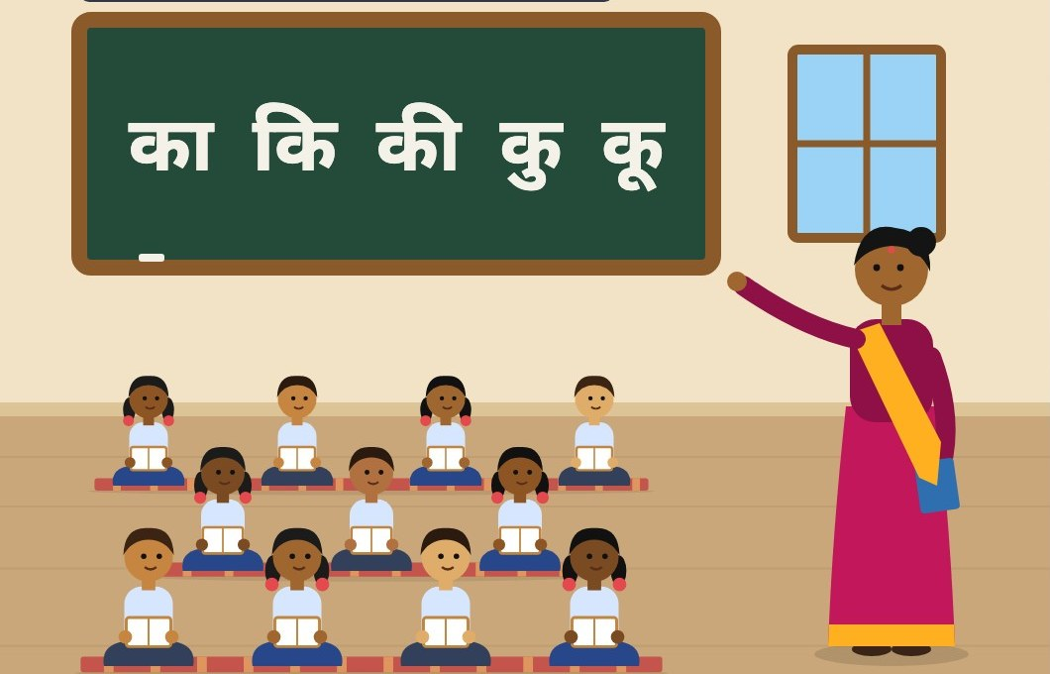
The teacher already hears every child. By tomorrow, it's gone
76.6%
After the reading period
SUNO checks
Next morning
of Class 3 children in government schools can't read a Class 2 text (ASER 2024).
She speaks a 60-second note in her own words: who read what, who got stuck where, who was absent.
Claude turns it into per-child observations. Code checks every claim against her words and the roster, and computes confidence.
A 2-minute Hindi brief: who needs support with what, a 10-minute group activity, and five children to listen to.
35 children, one teacher, two exams a year: help comes too late.
Assessment apps add a test event, one child at a time. SUNO adds no test: it keeps what she already notices.
Notes:
Sources: ASER 2024 (Pratham). The loop: note -> checks -> brief.

Slide 3
Effective AI use and technical strength
Claude where it is strong: messy, code-mixed speech. Code where it must be exact: who, how sure, and what she hears.

Slide 4
AI in layers: from her voice note to the morning brief
Data input
Processing
Guardrails (code)
Evaluation
Output
Teacher's voice note
60 s, Hindi or Hinglish, her own words
Sarvam saaras:v4
speech to text; numbered sentences
Grounding
every claim cites her real sentences
Real speech
15 recordings, 3 settings
Morning brief
2-minute Hindi voice (Sarvam bulbul:v3), checked against code; fails closed
Class roster
first names + roll numbers (register photo)
Claude ① claude-opus-5-5
per-child observations + whole-class remarks; JSON schema; cites sentence IDs
Names resolved by code
roster, roll numbers; one tap if unsure
Pipeline simulation
32 notes, 4 teacher styles
Class picture
levels, groups, progress
This week's lesson
words and sums (textbook photo)
Ladder + planner (code)
Bayesian TaRL levels; picks 5 children to listen to
Labels masked, opinions held
"weak" / कमज़ोर never evidence
Term simulation
200 terms, plus ASER 2024 classes
"How SUNO decided"
raw Claude output, every check, the arithmetic
Optional starting levels
ASER-style check
Claude ②
words the brief from code's decisions
Confidence computed in code
gate 0.75; else "check tomorrow"
Unit + adversarial tests
97 tests, no keys needed
Notes:
Two Claude calls per day per class (note, brief) plus vision only at setup (register, textbook). Prompts in prompts/, schemas in schemas/, one module per stage in server/pipeline/.

Slide 5
Where each AI call happens, and what it actually does
When | Model | Input → output | What code does with it
Each note | Sarvam saaras:v4 | 60 s of audio → Hindi transcript, split into numbered sentences | Audio deleted after transcription; the transcript is the only source of evidence
Each note | Claude ① claude-opus-5-5 adaptive thinking, effort high | Transcript + roster + lesson → JSON (observations.v2): child, skill, item, right/wrong, sentence IDs | Checks grounding, resolves the child, masks labels, computes confidence; below 0.75 → "check tomorrow"
Each morning | Claude ② claude-opus-5-5 effort medium | Code's decisions (levels, groups, list) → warm 2-minute Hindi script (brief.v3 schema) | Rejects any child, skill or plan code didn't decide; fails closed to code's own text
Each morning | Sarvam bulbul:v3 | Hindi script → MP3 voice (32 kbps) | Cached on the phone for offline listening
Setup only | Claude vision | Register photo → first names; textbook page → words by skill | Keeps first names only; the teacher checks the list; the photo is not stored
Claude API features used: structured outputs (JSON schema), adaptive thinking with explicit effort, prompt caching (95% of note input served from cache), server-side fallback, image input. Versioned prompts in prompts/, schemas in schemas/.
Notes:
Cost per teacher-day: Rs 17.61 (eval/results/cost.md). Claude reading the note $0.034, brief $0.121.

Slide 6








Guardrails: wrong AI output never reaches a child's record
Grounded in her words
Code names the child
Every claim must cite the teacher's real sentence IDs, and its words must appear there.
Phonetic match across Devanagari and Latin; roll numbers; two Priyas → one tap, never a guess.
Labels masked
Opinions aren't evidence
"Weak", कमज़ोर and similar words (Hindi and English list) are masked and never repeated.
"Sonu is weak" becomes "listen to Sonu tomorrow", not a record.
Confidence from code
Rule of three
Computed from measured signals; Claude never sets it. Below 0.75 → "check tomorrow".
A child is named "needs support" only after 3 observations on 2 days.
Brief checked, fails closed
The teacher decides
Claude's brief may only say what code decided, or code's own text is used.
Right / wrong taps on every record; "How SUNO decided" shows the raw output and every check.
In the app: "which Priya?" is one tap; a name not on the roster is asked, not guessed.
Notes:
Adversarial tests in tests/ cover the hard cases: shared names, labels, names not on the roster, opinions, erased misreadings (speech-to-text 'correcting' a child's mistake).

Slide 7
It works on a real voice, on an ordinary phone, in classroom noise
0 / 56
0 / 21
evidence records about the wrong child
opinions, labels or vague remarks that became evidence
98%
15 / 15
of clear observations captured (56 of 57)
absences recorded, and unclear names resolved by one tap
Despite 15–22% transcription errors, no evidence landed on the wrong child: code resolves names, and a specific word or sum is required.
Real-speech test: 15 recordings of 5 scripted notes by one team member (an adult man) in three settings; a fictional class, so ground truth is known. Not yet a teacher. Source: eval/results/real_notes.md
Notes:
All numbers from eval/real_notes/score.py output.

Slide 8
Simulated terms: the listening list finds the children a diary misses
93% vs 41%
of the quietest third heard by week 2
36% vs 4%
of quiet children's gaps found by week 8
≈ 99%
of "needs support" flags are right, in every state
SIMULATED children and teachers, SUNO's real tracker and planner, error rates from the pipeline tests (floored at 3/n). Chart: reading levels and attendance from ASER 2024's published state tables (eval/results/sim_aser.md). Stat cards: 200 default terms (eval/results/sim_term.md). The first planner made detection worse; the simulation changed the design.
Notes:
Two assumptions in the ASER run: ASER's word level is split in two; the table covers government and private schools.

Slide 9



Built for low connectivity, low data and low-cost phones
Works offline
Needs a network
Degrades gracefully
Recording a note: saved on the phone, sent automatically when the network returns
The last brief and its audio
The class picture and child pages as last loaded
The app itself (installable PWA, no app store)
Sending a note: about 100–250 KB a minute
Fetching the next brief: a few KB of text plus ~0.5 MB of audio (32 kbps MP3)
Setup photos: shrunk to ~1600 px on the phone before upload
No signal: the note waits in an offline queue, nothing is lost
A skipped day breaks nothing
If Claude's brief fails a check, code's own text is used
Server asleep (free hosting): first visit takes ~1 minute
1
Turn the phone's network off
2
Record a note: it is saved on the phone
3
Turn the network on: it sends itself, and the result appears
Try the offline test
Any Android phone with Chrome (₹8–10k class). About a minute of teacher time a day. ₹17.6 per teacher per school day, ≈ ₹117 per child per year (from logged usage, eval/results/cost.md).
Notes:
Evaluators will test offline: turn off the network, record a note, turn it back on; the queued note sends itself.

Slide 10
User inputs and testing
Two mentor calls, organiser guidance, a feasibility test and a real-speech test each changed what we built.

Slide 11
What we heard, and what we changed
Source | What they said or showed | What we changed
Technical mentor, 20 Oct | "Test whether each answer maps to the right child before building any app." Recording all day heats and drains a ₹8–10k phone. | Built feasibility test F1 on real child voices: voice matching cannot name the child. Dropped classroom recording; SUNO now listens to the teacher.
Real-speech test, 27 Oct | 3 of 21 vague remarks became evidence; 3 of 15 absences lost ("रोल तेरह" heard as "रोल तेरा"). | Evidence now needs a specific word or sum; spoken roll numbers parsed; one-tap question for unclear absences. Re-run: 0 of 21, 15 of 15.
Education mentor, 28 Oct Rebecca Swittens, Madhi Foundation | A note after each of ~6 classes is too much. | One note a day after the reading period, plus a daily reminder in her own calendar.
 | Teachers speak at class level ("most struggled with matras"). | Whole-class remarks become a code-checked "reteach or move on" that opens the brief.
 | Levels need a baseline like the ASER tool; show progress over time. | Optional ASER-style starting levels; each child's level week by week.
 | Teachers skip children; use TaRL-style nudges. Align to the textbook. | After each note, a one-tap nudge for listed children she didn't mention. Textbook page photo → this week's words.
Organisers, mid-Oct | Real users and settings score higher; show mentor input and what it changed. | This change log (docs/decisions.md); teacher sessions requested for the finale.
Full log with dates and where each change shows in the code: docs/decisions.md. Language per class (e.g. Tamil), also from the education mentor, is on the roadmap.

Slide 12
How the design changed, and what we have not proven yet
1
2
3
4
5
6
Ideate
F1 test
Pivot
Simulation
Real speech
Mentor
A phone records the reading lesson
Voice matching can't name the child
Listen to the teacher, not the classroom
First planner made detection worse → ladder + two-item check
Vague remarks slipped in → specific-word rule
One note a day, class-level remarks, baseline, nudges, textbook
Tested
Not proven yet, and our plan
One real speaker, 15 recordings, three settings
32 simulated notes, 4 teacher styles, real speech-to-text: 0 of 101 records on the wrong child, 0 of 42 opinions became evidence
200 simulated terms, and 200 per state in ASER 2024-calibrated classes
97 tests, including adversarial cases
No real teacher has used SUNO in her class yet (sessions requested through the organisers)
Most teachers are women; our real-speech speaker is a man
A level from SUNO is not yet compared with an ASER check on the same children: that is the November pilot

Slide 13
Future roadmap
From a validated pilot to a capability inside the apps teachers already use.

Slide 14
Three phases: validate, reach a block, live inside state systems
Nov 2026
Early 2027
2027–28
Classroom pilot + validation
One block, the channel teachers use
Inside state systems
3–5 Grade 1–3 teachers, Hindi-medium government schools, two weeks
Pre-registered check: SUNO's level vs a blind ASER one-to-one test on the same 20–30 children
If agreement within one level < 80%, raise the naming threshold
Measure seconds per note, notes per week, briefs heard
WhatsApp: send the note as a voice note, get the brief back as one
Block dashboard: counts of children by level per school; no names, no teacher field, no ranking
State-owned speech: Bhashini or AI4Bharat IndicConformer (one module to swap)
Seed levels from NIPUN Lakshya or school ORF results
A SUNO module inside NIPUN Lakshya or DIKSHA, not another app
More languages: Marathi, Tamil, Odia, each with its own ladder and banned-word list
The state teacher guide's activities, retrieved by skill
Coaching only with the teacher's consent
In every phase: no child's voice recorded, no teacher score, first names only, aggregates upward, and the teacher decides.

Slide 15
Integration into existing systems, and who pays
NIPUN Lakshya / DIKSHA
SUNO as a module; open JSON schemas
WhatsApp
voice note in, brief out
≈ ₹117
per child per year today (₹17.6 per teacher-day, from logged usage). A leaner setup (overnight batch, lower-effort brief) is estimated at about half.
ASER / NIPUN assessments
seed starting levels
SUNO
Who pays: the state, from the Samagra Shiksha FLN budget for teacher support and assessment
Who owns the data: the school or state; SUNO is the processor (DPDP Act 2023, Rules 2025)
Never: names upward, teacher scores, teacher rankings
VSK / block dashboards
aggregate counts by level: /api/export/summary.json
Bhashini / IndicConformer
state-owned speech-to-text
Notes:
Complements assessment apps (PadhAI, TARA, Vaachan Samiksha, NIPUN Lakshya): an assessment result seeds the ladder; SUNO's daily evidence guides teaching between assessments.

Slide 16
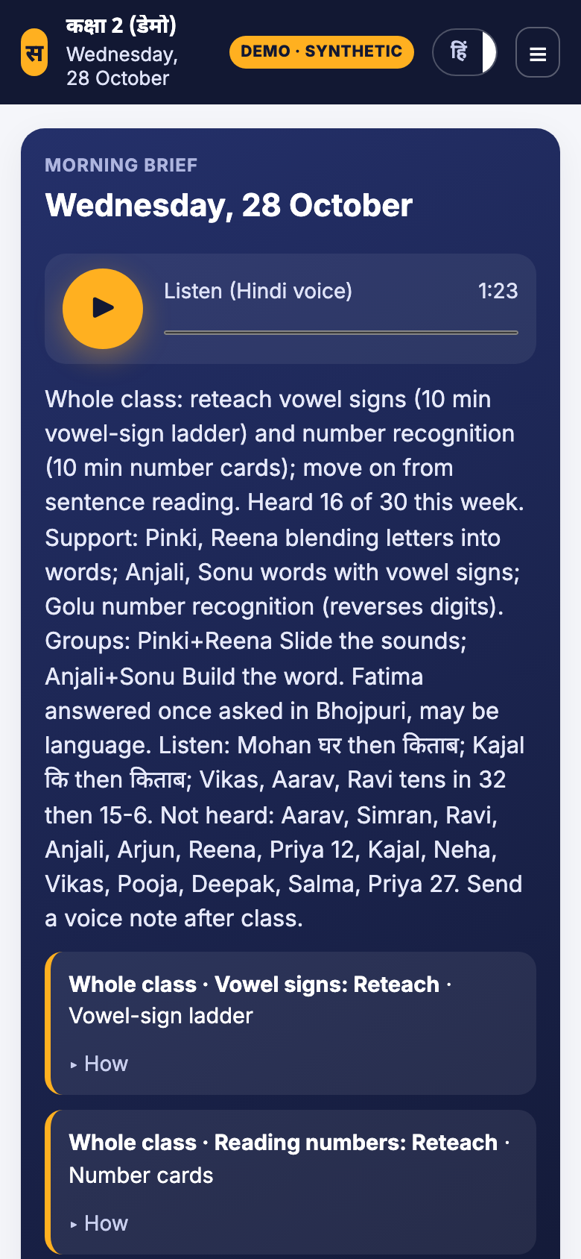
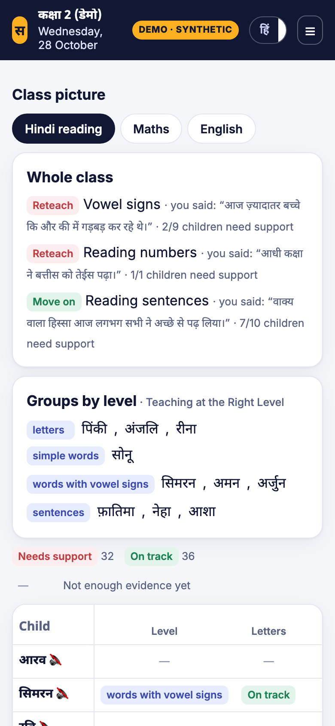
Try SUNO
The teacher already hears every child. SUNO remembers.
Live app suno-8qoh.onrender.com · code SUNO-DEMO (a fresh synthetic class per sign-in), or create your own class
Sample inputs 4 Hindi voice notes (sample notes on the Note tab) + a register photo and a textbook page (☰ menu)
Offline test Turn the network off, record a note, turn it back on: it sends itself
Demo video youtu.be/GG3v7lQ212M (3 minutes)
Source README: setup, local run, .env.example, every AI service and where its key goes

