Slide 1
RETAIL BUSINESS INTELLIGENCE
& Customer Analytics
An end-to-end SQL analytics project on the Olist Brazilian e-commerce dataset — from raw data to a decision-ready Power BI dashboard.
PostgreSQL 18
Power BI
35+ Business Questions
9 Normalized Tables
6 Analytics Views
Tushar Ravindra Vaidya
Mining Engineering, IIT (ISM) Dhanbad | Data Analytics Portfolio Project

Slide 2
Executive summary
Turning 100K+ raw e-commerce records into an analytics-ready decision layer
Objective
Build a full analytics pipeline on Olist's Brazilian e-commerce dataset — from schema design through data-quality validation, SQL-based business analysis, and a Power BI reporting layer — to answer real revenue, customer, and operations questions.
Scope
9 relational tables, 35+ business questions across revenue, sellers, customers and logistics, 6 production-style analytics views, and a 7-page interactive dashboard.
R$16.01M
110K
Total sales analyzed
Total orders
100K
77%
Unique customers
Positive review rate
02

Slide 3
Data pipeline & tech stack
Raw CSVs to a decision-ready dashboard, in five stages
Raw CSV
(Kaggle)
→
PostgreSQL 18
schema design
→
Data quality
validation
→
SQL business
analysis (35Q)
→
Power BI
dashboard
Backend — PostgreSQL 18
Frontend — Power BI
9 normalized tables with primary/foreign keys
CTEs, window functions (RANK, ROW_NUMBER, NTILE, LAG)
6 reusable analytics views for reporting
Systematic null, duplicate and range checks
7-page interactive dashboard
Sales, sellers, customers, payments, reviews
Year slicers and drill-through order details
Custom visuals: tornado, radar, timeline charts
03

Slide 4
Data model — 9 normalized tables
Star-like schema linking orders, customers, sellers, products and payments
customers
orders
order_items
Customer id, unique id, city, state, zip prefix
Order status and full purchase-to-delivery timestamps
Line items: product, seller, price, freight value
products
sellers
payments
Category, dimensions, weight, photo count
Seller id, city, state, zip prefix
Payment type, installments, value per order
reviews
geolocation
category_translation
Review score, comments, response timestamps
Lat/lng by zip code prefix
PT to EN product category mapping
04

Slide 5
Data quality & governance
Every table validated before a single business question was asked
Row counts confirmed across all 9 tables before analysis began
Missing-value scan on category, weight, dimension and delivery-date fields
Duplicate primary key checks on customers, orders, products and reviews
Dataset time span confirmed (first order to last order)
Order status distribution profiled to isolate delivered vs. cancelled orders
Customer distribution by state validated for geographic coverage
Why this matters
Skipping data-quality checks is the fastest way to produce confident-looking, wrong numbers. This phase caught null delivery dates, category gaps and duplicate keys before they could distort revenue and delivery-time calculations downstream.
05

Slide 6
Business KPI overview
The headline numbers behind the full analysis
R$16.01M
R$120.76
3,095
R$4,332
Total sales
Average order value
Active sellers
Average sales per seller
Sourced from the executive-summary and seller-overview analytics views (vw_executive_summary, vw_state_performance) built in the SQL layer — not hand-computed, so every number in the dashboard traces back to a query.
06

Slide 7
Revenue insights
Category mix and payment behavior across 110K orders
Top state — Sao Paulo (SP)
R$5.13M in sales, ~40% of all revenue — the single largest concentration in the dataset.
07

Slide 8
Advanced SQL — window functions in action
Four techniques used to move beyond simple aggregation
ROW_NUMBER() — Top products per category
RANK() / DENSE_RANK() — Seller leaderboard
ROW_NUMBER() OVER (
PARTITION BY category
ORDER BY products_sold DESC
) AS ranking
RANK() OVER (
ORDER BY revenue DESC
) AS seller_rank
Ranks every product within its own category so the top 3 sellers per category can be isolated in one pass.
Ranks all 3,095 sellers by revenue, comparing RANK (with gaps) against DENSE_RANK (no gaps) for tied values.
SUM() OVER(ORDER BY) — Running revenue
SUM() OVER() — Revenue contribution %
SUM(revenue) OVER (
ORDER BY month
) AS cumulative_revenue
100 * revenue /
SUM(revenue) OVER ()
AS contribution_pct
Builds a running monthly total without a self-join, powering the cumulative-growth view of the business.
Expresses each category's revenue as a share of total revenue in a single query, no post-processing needed.
08

Slide 9
Customer analytics — RFM & segmentation
Turning transaction history into actionable customer groups
RFM metrics computed per customer
Additional customer-level analysis
Recency
MAX(order_purchase_timestamp)
Repeat vs. one-time customers, using customer_unique_id to correct for re-registered accounts
Top 1% customers isolated with NTILE(100) for a targeted retention list
Customer lifetime value (CLV) per unique customer
Average orders per customer and full order-count distribution
States ranked by share of repeat customers
Frequency
COUNT(order_id)
Monetary
SUM(payment_value)
Customer value segments
Low value
Medium value
High value
Premium
< R$100
R$100 – 500
R$500 – 1,000
> R$1,000
09

Slide 10
Delivery performance & review correlation
Connecting logistics speed to customer satisfaction
1
Fastest / slowest delivery states
2
Delivery time vs. review score
Average delivery days computed per customer state to flag logistics bottlenecks by geography.
Average delivery duration grouped by review score (1–5) to test whether slower delivery drives lower ratings.
3
Revenue by weekday
4
Revenue by hour
Sales and order volume broken down by day of week to spot purchasing rhythm.
Purchase-hour distribution used to identify peak ordering windows across the day.
10

Slide 11
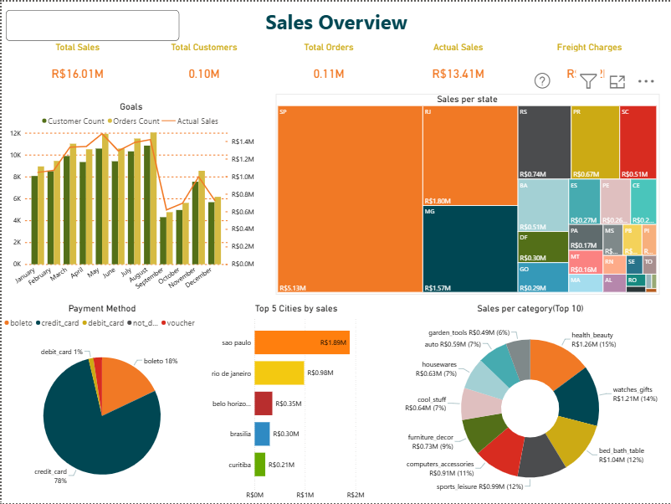
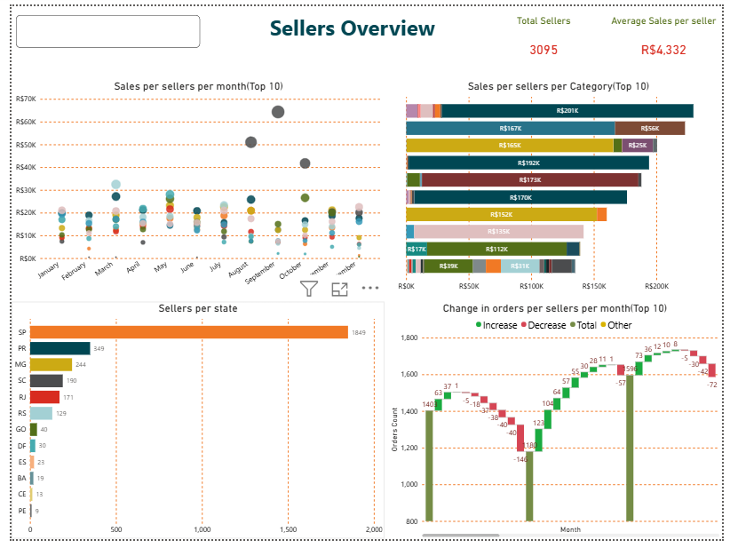
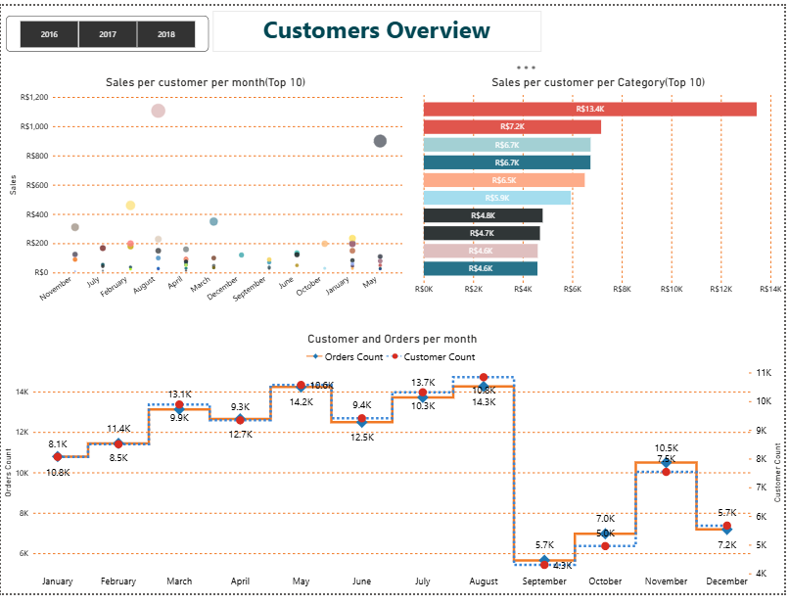
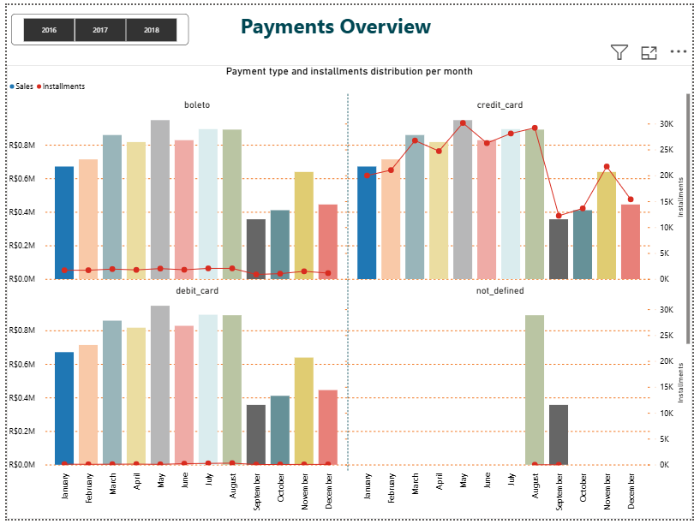
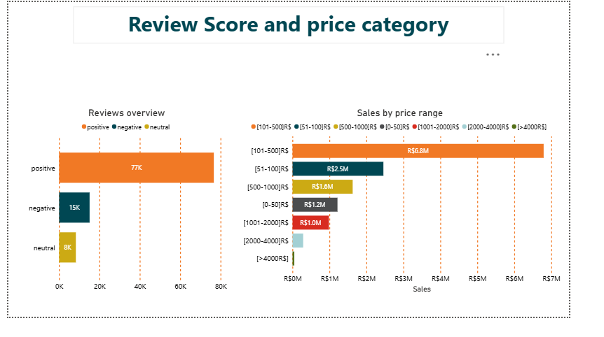
Power BI dashboard walkthrough
SQL views brought to life across five focused pages
Sellers overview
Customers overview
Payments overview
Reviews overview
Sales overview
Full interactive file: Brazil_Ecommerce_Analysis.pbix | Year slicers (2016–2018) and drill-through order detail on every page.
11

Slide 12
Key insights & recommendations
What the data says, and what to do about it
Key findings
Recommendations
SP drives ~40% of total sales, creating regional concentration risk.
Expand seller acquisition outside SP to reduce single-state dependency.
1
Sales drop sharply Sep–Dec — likely a dataset coverage gap, not a real demand decline.
Investigate the Sep–Dec sales cliff before treating it as a seasonal trend.
2
Credit card is 78% of payments; boleto usage stays steady year-round.
Prioritize the top 5 categories for inventory and marketing spend.
3
Top 5 categories drive most revenue; a long tail of 60+ categories underperforms.
Pair review-score analysis with delivery time to target complaint drivers.
4
Data note: Late-2016 records are sparse in the source dataset — treat that period's dips as data-coverage gaps, not real demand trends.
12

Slide 13
Skills demonstrated
SQL
Analytics
BI & delivery
CTEs & subqueries
Window functions (RANK, ROW_NUMBER, NTILE, LAG)
Views for reusable reporting
Data-quality auditing
RFM & customer segmentation
Cohort-style repeat-purchase analysis
Revenue attribution & contribution %
Delivery-to-review correlation
Power BI dashboard design
DAX measures & slicers
Insight-driven storytelling
Version-controlled SQL scripts
Thank you — happy to walk through any query or dashboard page in detail.
Source: Olist Brazilian E-Commerce Public Dataset (Kaggle) | PostgreSQL 18 + Power BI | Tushar Ravindra Vaidya

