Slide 1

Industrial Training Seminar
on
Web Development
Presented By:
Dev Kataria
22EJCIT301
Information Technology/4th year/C
Submitted To:
Mr. Piyush Gautam
Industrial Training Coordinator, IT

Slide 2
Contents
1. Introduction/Abstract 2. Company Profile 3. Certificate 4. Technology Name-Detailed Description
5. Tools Used 6. Project Description 7. Screenshots of Project 8. Conclusion 9. Future Scope

Slide 3
Abstract
The Industrial Training at Learn and Build Pvt. Ltd provided a comprehensive exposure to web development and full-stack project implementation. During this training, I developed Quickblog, an interactive blogging platform, which enhanced my skills in both frontend and backend development. The project involved creating a responsive user interface, implementing secure login mechanisms for admin users, and integrating functionalities such as blog categorization, comment moderation, and AI-assisted content generation.
This training not only strengthened my coding abilities but also provided practical insights into project planning, user experience design, and content management. It prepared me to develop scalable, feature-rich web applications while understanding real-world challenges like data validation, administrative controls, and user interaction flows.

Slide 4
Company Details
Learn and Build Pvt. Ltd. is a technology-driven organization dedicated to providing practical training and project-based learning for students and professionals. The company focuses on hands-on mentoring, enabling interns to work on real-world projects that enhance their technical and problem-solving skills.
Key Features of the Company:
- Offers training in multiple domains such as Web Development, Data Science, Artificial Intelligence, Machine Learning, Mobile App Development, and Cloud Computing.
- Provides project-oriented learning to bridge the gap between academic knowledge and industry requirements.
- Encourages innovative thinking and practical implementation, allowing interns to design, develop, and deploy applications in real-world scenarios.
- Supports skill development in full-stack development, UI/UX design, database management, and software testing.

Slide 5
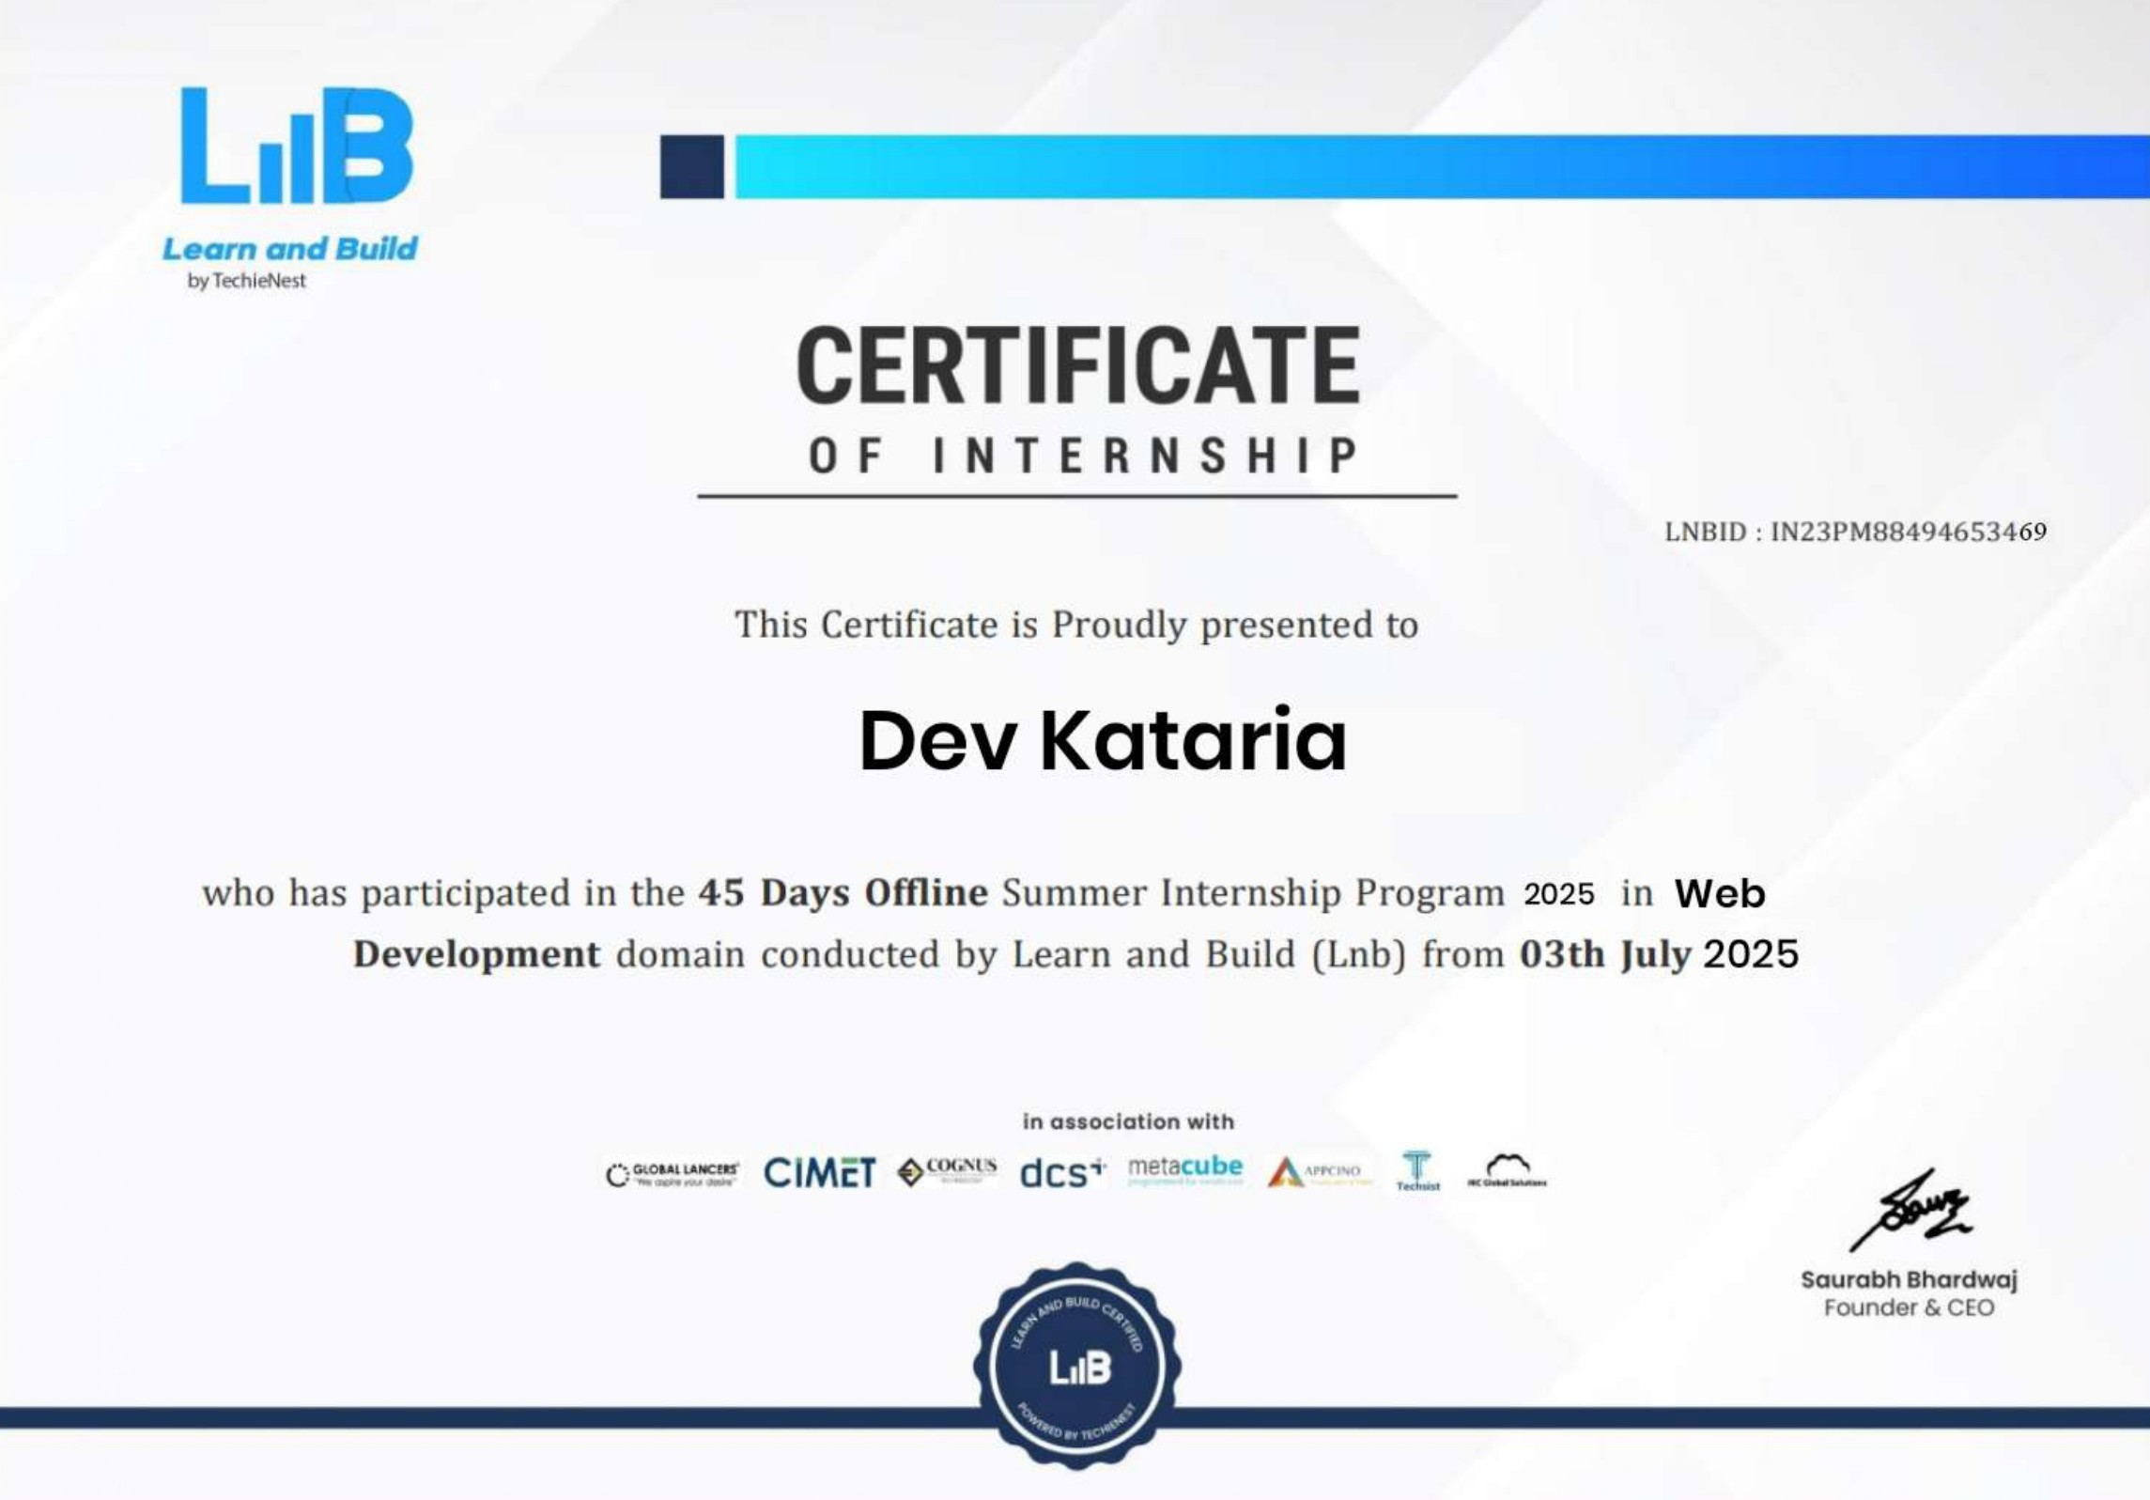
Certificate

Slide 6
Technologies Used
1. React.js: - Description: React is a JavaScript library for building user interfaces. It uses a component-based architecture, allowing developers to create reusable UI elements. - Why Used: Ensures dynamic rendering of content, seamless state management, and efficient updates to the DOM, making the application fast and interactive. 2. Node.js: - Description: Node.js is a JavaScript runtime built on Chrome's V8 engine. It allows server-side scripting using JavaScript, enabling developers to build scalable and lightweight applications. - Why Used: Provides a non-blocking, event-driven architecture ideal for building RESTful APIs and handling multiple simultaneous requests efficiently. 3. Express.js: - Description: Express.js is a minimal and flexible Node.js web application framework. It provides tools for building robust APIs and web applications. - Why Used: Simplifies server-side routing, middleware handling, and API development, reducing development complexity.

Slide 7
Technologies Used
4. MongoDB: - Description: MongoDB is a NoSQL database designed for storing data in a flexible, JSON-like format. It supports scalable and distributed data management. - Why Used: Enables efficient storage and retrieval of structured and unstructured data, making it ideal for assignments, user roles, and submission records. 5. JWT (JSON Web Tokens): - Description: JWT is an open standard for securely transmitting information between parties as a JSON object, digitally signed using a secret or public/private key pair. - Why Used: Implements secure authentication and authorization for role-based access control. 6. bcrypt: - Description: bcrypt is a password-hashing library that uses a salt to protect against brute force attacks. - Why Used: Ensures secure storage of user passwords, adding a layer of security to the application.

Slide 8
Technologies Used
7. ImageKit.io:
- Description: ImageKit.io is a real-time image optimization and media management platform that provides automatic resizing, compression, and CDN delivery.
- Why Used: Enables seamless image uploads for blog thumbnails, ensuring optimized performance and faster image delivery.
8. Gemini API (Google AI):
- Description: Gemini API is Google’s advanced AI model that enables natural language understanding and text generation.
- Why Used: Integrated to automatically generate engaging blog descriptions based on titles, improving content creation efficiency for the admin.
9. Tailwind CSS:
- Description: Tailwind CSS is a utility-first CSS framework that allows developers to design modern, responsive layouts using predefined utility classes.
- Why Used: Enables rapid UI development, consistent styling, and responsiveness across devices without writing extensive custom CSS.

Slide 9
Tools Used
Visual Studio Code (VS Code)
- Description: A lightweight and powerful code editor by Microsoft that supports multiple programming languages and extensions.
- Why Used: Served as the main development environment for coding, debugging, and running both frontend and backend efficiently.
Postman
- Description: An API development and testing tool used to send, monitor, and document HTTP requests.
- Why Used: Helped test backend routes, verify API responses, and ensure smooth communication between client and server.
GitHub
- Description: A cloud-based version control platform built on Git for managing and collaborating on code projects.
- Why Used: Used for maintaining code versions, tracking changes, and enabling collaboration through commits and branches.

Slide 10
Tools Used
MongoDB Atlas:
- Description: A fully managed cloud database service offering scalability, performance, and security for MongoDB.
- Why Used: Hosted and managed the project’s database, providing real-time access and automatic backups with minimal maintenance.
Vercel:
- Description: A cloud platform for deploying and hosting web applications with integrated CI/CD and global CDN.
- Why Used: Used to deploy Quickblog, ensuring fast, reliable, and secure hosting with smooth performance across devices.

Slide 11
Project Description
Quickblog:
A full-stack blogging platform built using the MERN stack (MongoDB, Express.js, React.js, Node.js) designed to simplify and enhance the blogging experience for both authors and readers. The system allows users to browse, read, and interact with blogs across multiple categories such as technology, lifestyle, and more. It also provides a dedicated admin dashboard for content management, comment moderation, and AI-assisted blog creation.
Key Features
Dynamic Blog Management: Admins can create, publish, unpublish, or delete blogs through an intuitive dashboard interface.
AI-Powered Blog Generation: Integrated with Gemini API to automatically generate blog descriptions based on the provided title, saving time and effort.

Slide 12
Project Description
Category-Based Filtering: Users can explore blogs filtered by topics or interests for personalized reading experiences.
Comment Moderation System: Comments added by users are first sent for admin approval before being displayed publicly, ensuring content quality and authenticity
Secure Authentication: Uses JWT for login and bcrypt for password encryption to ensure data security and role-based access.
Responsive UI: Developed with Tailwind CSS, providing a clean, adaptive design across all devices.
Image Uploads with ImageKit.io: Enables real-time image optimization, compression, and CDN delivery for blog thumbnails.
Real-Time Data Handling: API communication managed via Axios for seamless frontend-backend integration.

Slide 13
Project Description
Impact
Provides a centralized platform for creating and managing engaging blog content.
Simplifies content publishing and moderation for admins through automation and AI assistance.
Enhances user interaction and engagement via categorized browsing and commenting features.
Ensures secure, scalable, and high-performance deployment using Vercel and MongoDB Atlas (database).
Bridges creativity and technology by combining human content creation with AI-powered efficiency.

Slide 14
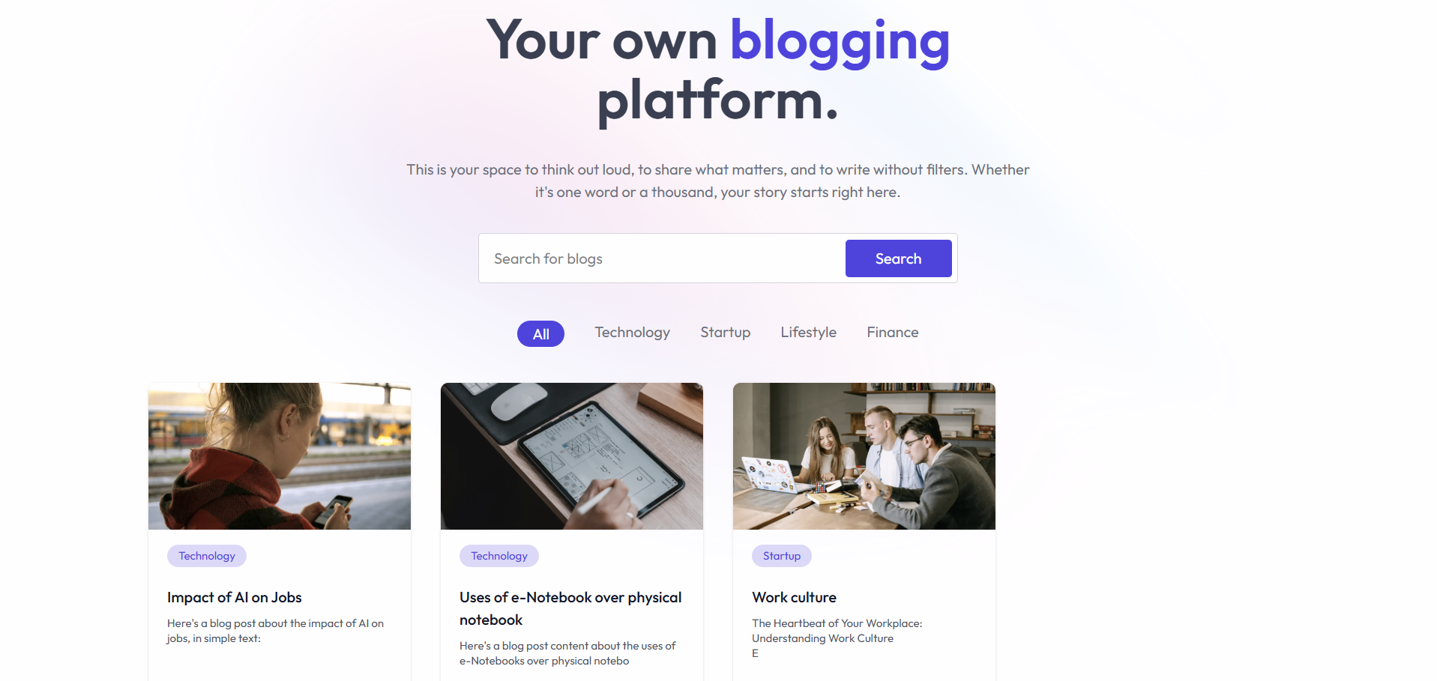
OUTPUT:

Slide 15
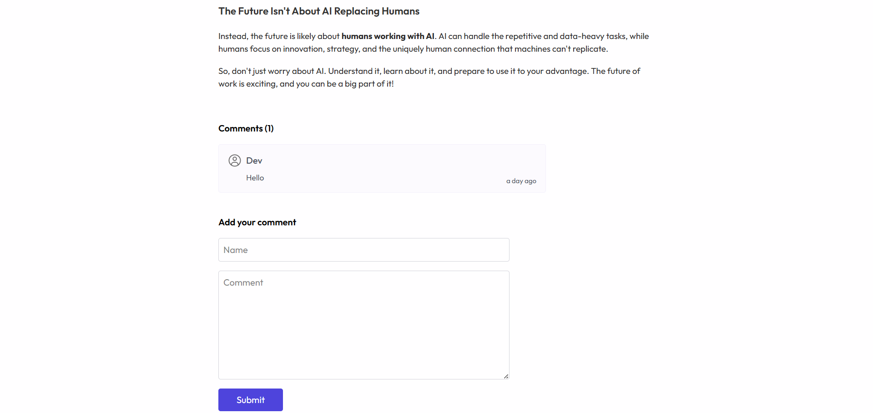
OUTPUT:

Slide 16
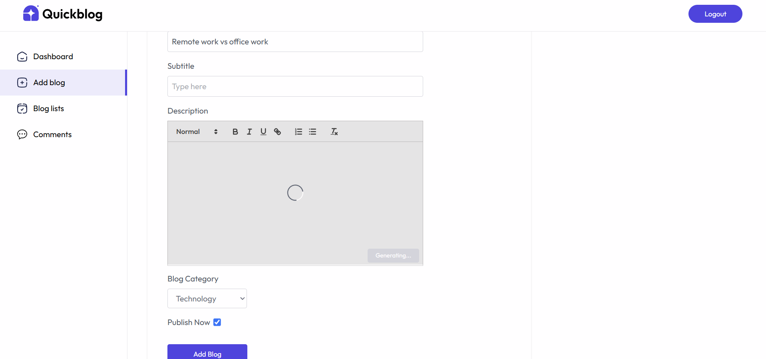
OUTPUT:

Slide 17
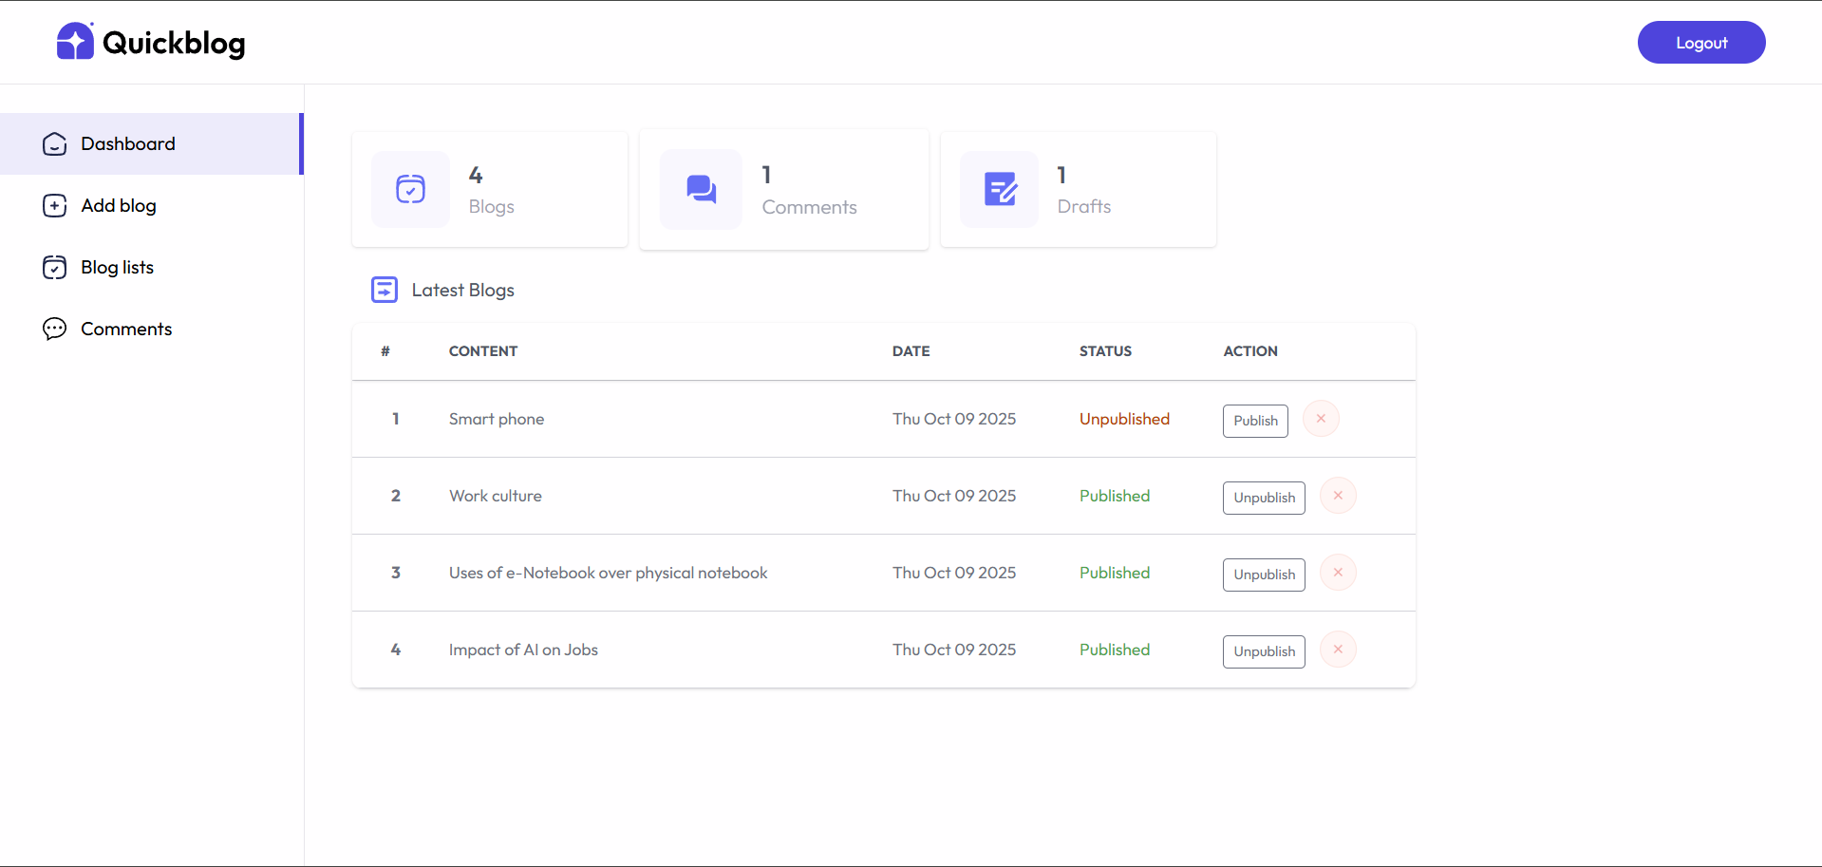
OUTPUT:

Slide 18
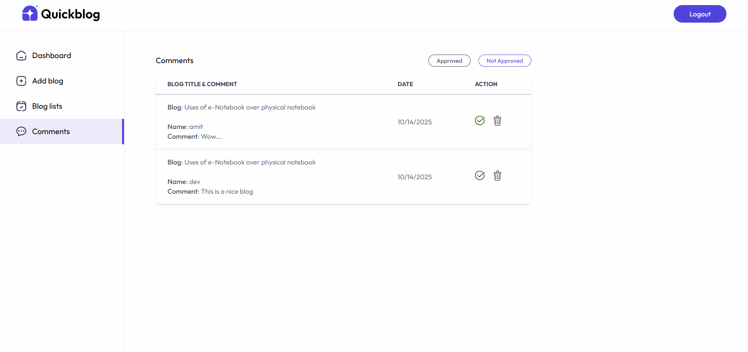
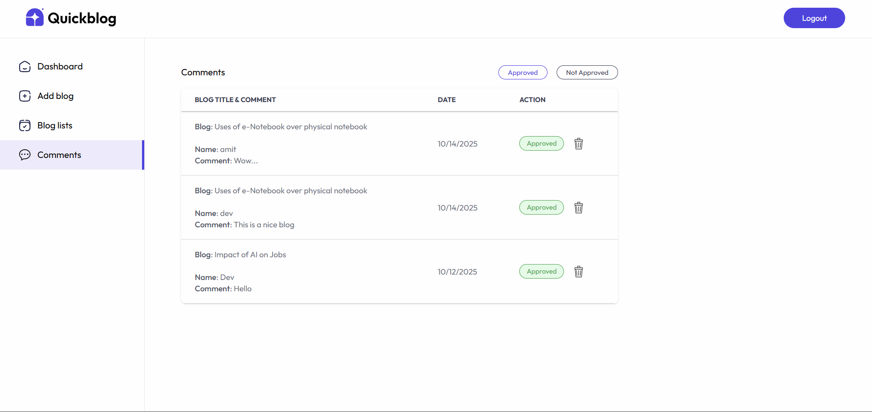
OUTPUT:

Slide 19
Conclusion
The Quickblog system offers a modern, efficient, and scalable solution for managing and publishing blogs. By integrating AI-powered content generation, secure authentication, and optimized image handling, it simplifies content creation while ensuring performance and reliability. Built using the MERN stack and deployed on Vercel with MongoDB Atlas, the platform provides seamless access and smooth user interaction.
This project enhances productivity, reduces manual effort, and leverages automation to improve content quality. With its cloud-based, data-driven design, Quickblog lays a strong foundation for future enhancements in personalization, analytics, and intelligent content management.

Slide 20
Future Scope
Future Improvements for Inventory Management System
AI-Powered Content: Enhance blog generation with smarter AI to create posts, summaries, and personalized recommendations.
Mobile App Development: Build dedicated mobile applications for easy access, reading, and content management on the go.
Analytics & Insights: Add dashboards for tracking blog performance, user engagement, and comment trends to support data-driven decisions.
Category & Tag Expansion: Introduce dynamic categories, tags, and trending topics for better organization and content discovery..
Enhanced Security & Moderation: Implement stronger authentication, spam detection, and AI-assisted comment moderation.
Social Media Integration: Enable seamless sharing and cross-posting to social platforms to boost reach and engagement.

Slide 21
THANK YOU

