Slide 1

Industrial Training Seminar
on
Inventory Management System
Presented By:
UTKARSH SINGH
22EJCIT177
Information Technology/4th year/C
Submitted To:
Mr. Piyush Gautam
Industrial Training Coordinator, IT

Slide 2
Contents
1. Introduction/Abstract 2. Company/Organization details 3. Certificate 4. Technology Name-Detailed Description 5. Project Description 6. Screenshots of Project 7. Conclusion 8. Future Scope
9. References

Slide 3
Abstract
The Industrial Internship at VeroLie Pvt. Ltd. provided an enriching experience in web development through the design and implementation of a robust Inventory Management System. During this internship, I enhanced my technical expertise by developing intuitive user interfaces, implementing secure authentication mechanisms, and integrating backend services with efficient database management tailored to apparel manufacturing operations. The application enabled real-time tracking of inventory, streamlined user roles, and optimized stock management, contributing to improved operational efficiency. This hands-on project not only advanced my coding skills but also provided deep insights into the challenges of supply chain management, data integrity, and performance optimization—preparing me to build scalable and technology-driven solutions in the fast-paced apparel industry.

Slide 4
Company Details
VeroLie Pvt. Ltd. is a Jaipur-based clothing manufacturing company specializing in sportswear and fashion apparel. With a focus on design, quality, and sustainability, the company offers end-to-end solutions—from fabric sourcing and production to packaging and global distribution.
Website | https://www.verolie.com/
Industry | Apparel Manufacturing
Company size | Micro & Small Enterprise(MSE)
Headquarters | Sitapura, Jaipur, Rajasthan – 302022
Type | Privately Held
Founded | September 14, 2016
Founder | Govind Sahay Sharma
Specialties | Sportswear, Casual Wear, Uniforms, Customized Apparel, Sustainable Production, Inventory & Order Management Systems

Slide 5
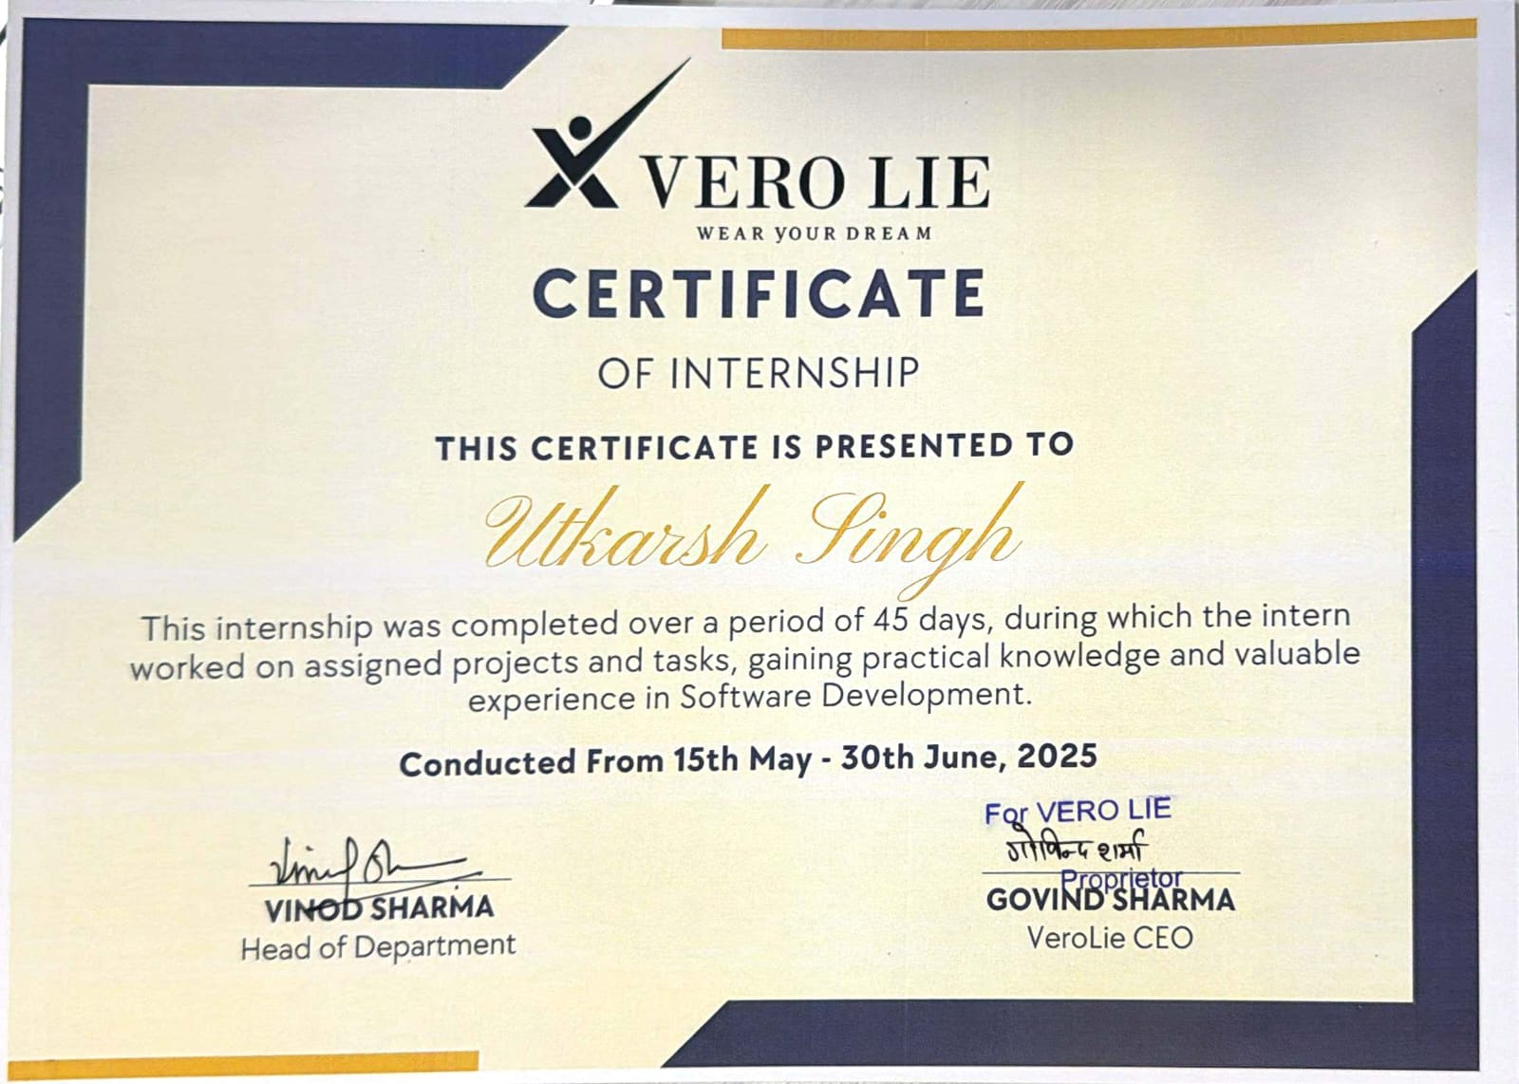
Certificate

Slide 6
Technologies Used
1. React.js: - Description: React is a JavaScript library for building user interfaces. It uses a component-based architecture, allowing developers to create reusable UI elements. - Why Used: Ensures dynamic rendering of content, seamless state management, and efficient updates to the DOM, making the application fast and interactive. 2. Node.js: - Description: Node.js is a JavaScript runtime built on Chrome's V8 engine. It allows server-side scripting using JavaScript, enabling developers to build scalable and lightweight applications. - Why Used: Provides a non-blocking, event-driven architecture ideal for building RESTful APIs and handling multiple simultaneous requests efficiently. 3. Express.js: - Description: Express.js is a minimal and flexible Node.js web application framework. It provides tools for building robust APIs and web applications. - Why Used: Simplifies server-side routing, middleware handling, and API development, reducing development complexity.

Slide 7
Technology Name
4. MongoDB: - Description: MongoDB is a NoSQL database designed for storing data in a flexible, JSON-like format. It supports scalable and distributed data management. - Why Used: Enables efficient storage and retrieval of structured and unstructured data, making it ideal for assignments, user roles, and submission records. 5. JWT (JSON Web Tokens): - Description: JWT is an open standard for securely transmitting information between parties as a JSON object, digitally signed using a secret or public/private key pair. - Why Used: Implements secure authentication and authorization for role-based access control. 6. bcrypt: - Description: bcrypt is a password-hashing library that uses a salt to protect against brute force attacks. - Why Used: Ensures secure storage of user passwords, adding a layer of security to the application.

Slide 8
Technology Name
7. Axios: - Description: Axios is a promise-based HTTP client for the browser and Node.js, used for making API requests. - Why Used: Simplifies communication between the frontend and backend, handling HTTP methods and responses efficiently. 8. CSS: - Description: Cascading Style Sheets (CSS) is used for styling HTML elements. - Why Used: Provides a visually appealing and responsive interface for all user roles (admin, teacher, student).

Slide 9
Project Description
Inventory Management System
A full-stack web application built using the MERN stack (MongoDB, Express.js, React.js, Node.js) to streamline inventory and warehouse management.
Addresses inefficiencies caused by manual record-keeping and outdated systems by offering:
Real-time stock tracking
Secure, role-based access control
Automated reporting and audit logs
Enables managers to make data-driven decisions, maintain accountability, and scale operations efficiently.
Cloud-hosted solution deployed on Vercel (frontend) and Render (backend) with MongoDB Atlas for scalable, reliable access anywhere.

Slide 10
Project Description
Key Features
Modular interface with inbound/outbound tracking, dashboards, and reports
Excel file import for seamless migration using Multer and XLSX libraries
JWT-based authentication and role-based permissions for security
Real-time updates, responsive design, and error handling for smooth operation
Audit logs for full transaction history and accountability
Impact
Reduces manual errors and onboarding time
Enhances replenishment planning and decision-making
Bridges legacy workflows with modern technology
Prepares organizations for future automation and growth

Slide 11
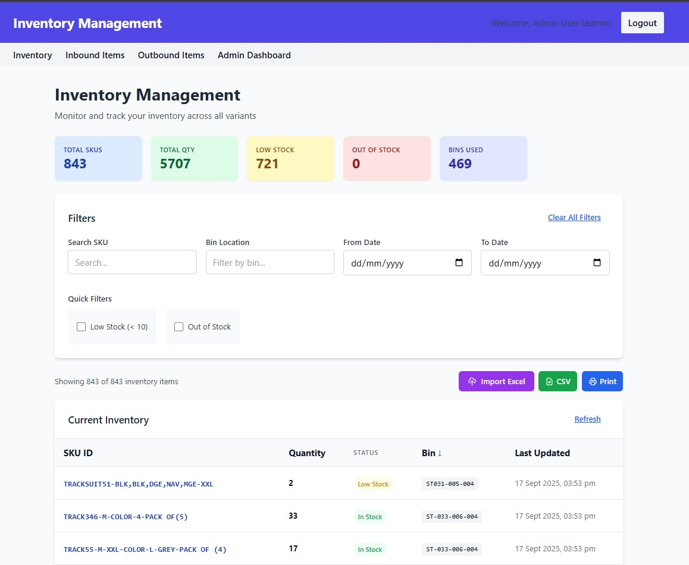
OUTPUT:

Slide 12
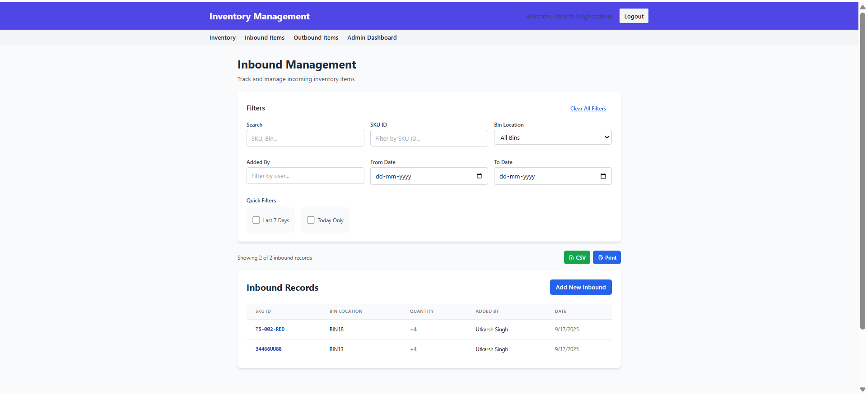
OUTPUT:

Slide 13
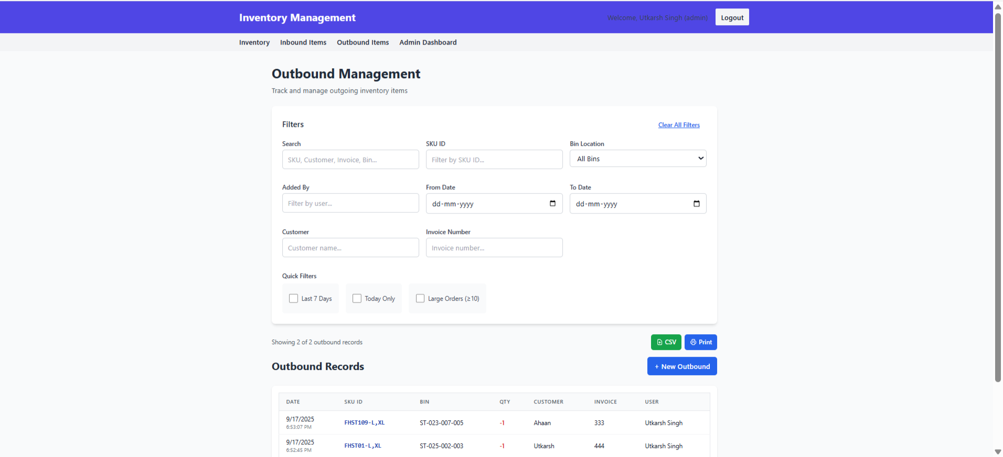
OUTPUT:

Slide 14
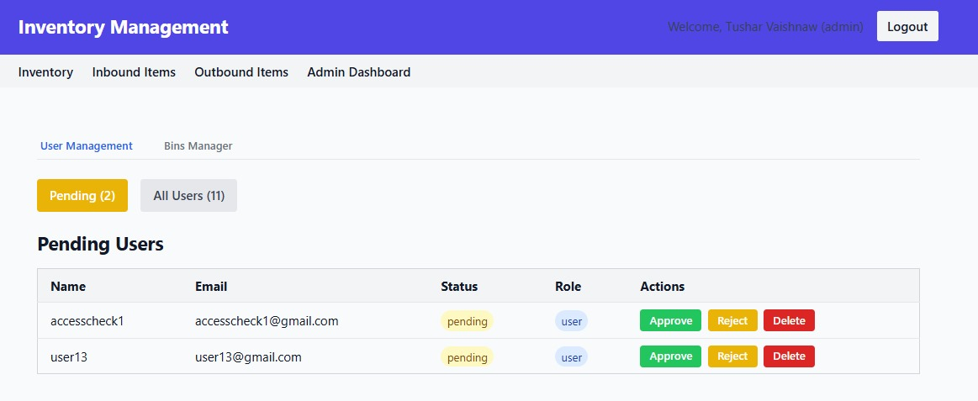
OUTPUT:

Slide 15
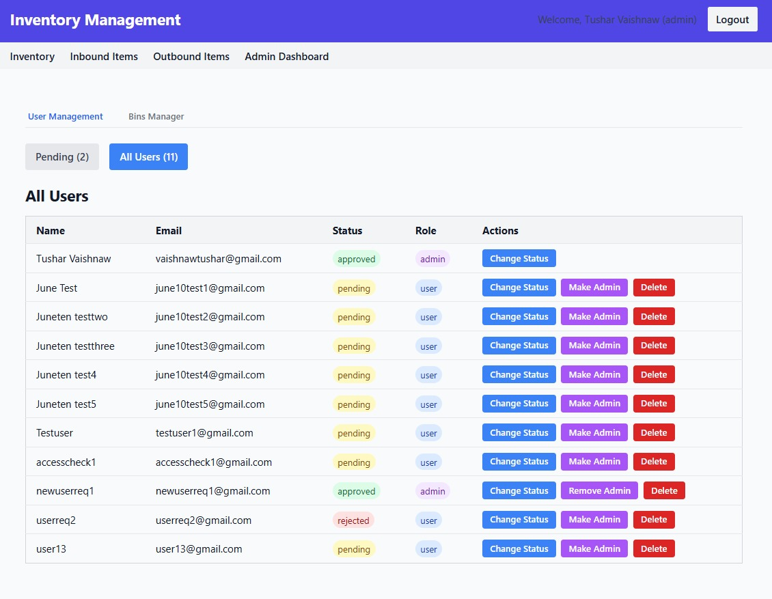
OUTPUT:

Slide 16
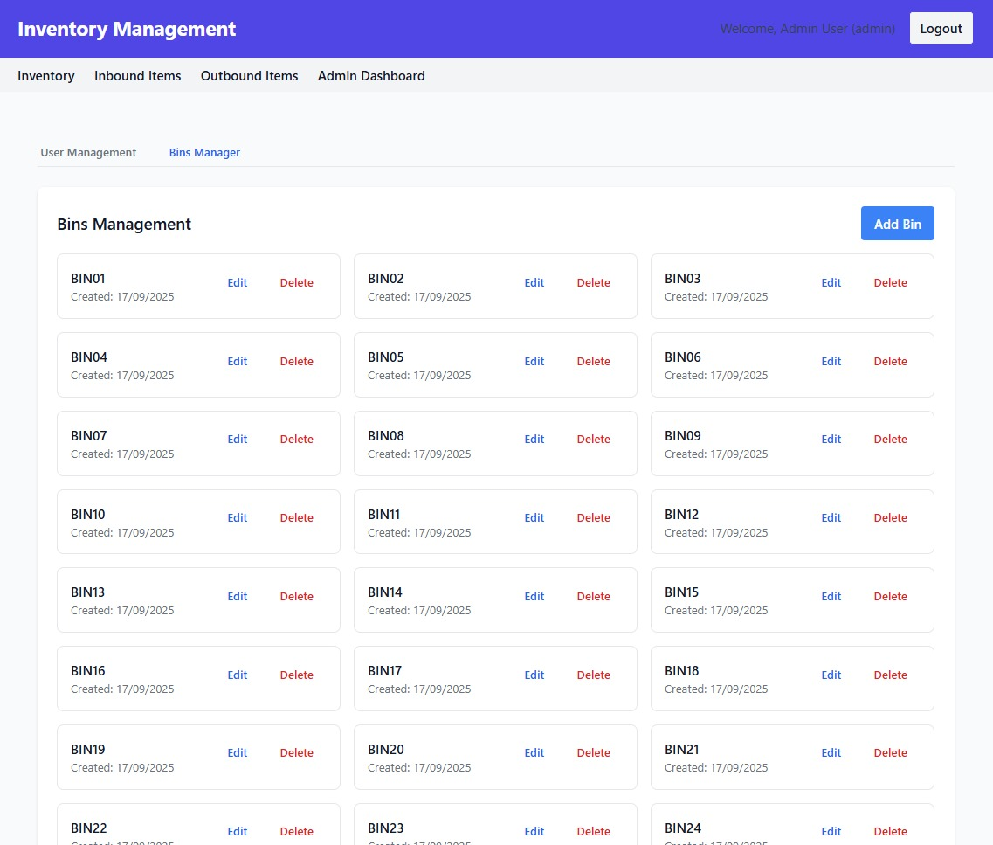
OUTPUT:

Slide 17
Conclusion
The Inventory Management System provides a modern, efficient, and scalable solution for managing warehouse and inventory operations. By integrating real-time tracking, secure access controls, and automated reporting, it addresses common challenges in traditional inventory practices. The system’s cloud-based architecture ensures accessibility and reliability, while features like Excel import and audit logs simplify adoption and enhance accountability. This project not only improves operational efficiency but also lays the foundation for future advancements such as automation and data-driven decision-making, making it a robust tool for organizations aiming to modernize their supply chain management.

Slide 18
Future Scope
Future Improvements for Inventory Management System
Integration with IoT Devices: Automate stock monitoring using sensors for real-time data without manual input.
AI-driven Demand Forecasting: Use historical data to predict stock requirements and optimize inventory levels.
Mobile Application Development: Extend accessibility by building dedicated apps for field staff and managers.
Multi-Warehouse Support: Scale the system to manage inventory across multiple locations with centralized control.
Advanced Analytics & Reporting: Incorporate dashboards with trends, alerts, and insights for strategic planning.
ERP and Supply Chain Integration: Connect with enterprise systems to streamline procurement, logistics, and finance processes.
Enhanced Security & Compliance: Implement advanced encryption, multi-factor authentication, and regulatory compliance features.

Slide 19
References
1. MongoDB Documentation – https://www.mongodb.com/docs/
2. Express.js Guide – https://expressjs.com/en/guide.html
3. React.js Official Tutorial – https://react.dev/learn
4. Node.js Documentation – https://nodejs.org/en/docs/
5. JWT Authentication – https://jwt.io/introduction/
6. Vercel Deployment Docs – https://vercel.com/docs
7. Render Deployment Docs – https://render.com/docs
8. Multer File Upload Middleware – https://www.npmjs.com/package/multer
9. XLSX Library for Excel Handling –https://www.npmjs.com/package/xlsx
10. MongoDB Atlas – https://www.mongodb.com/cloud/atlas

Slide 20
THANK YOU

