Slide 1

NATIONAL INSTITUTE OF TECHNOLOGY AGARTALA
DEPARTMENT OF MECHANICAL ENGINEERING
INCA WHISTLE
Under the guidance of DR. ANKURAN SAHA.
Presented by Satish Kumar 21UME004 Tushar Deb 21UME003

Slide 2
Table of Contents
Page
I
Abstract
3
II Introduction
4
III
Parameters
5-6
IV Objectives
7
V
Classification of Whistles
8-9
VI
Materials Required
10
VII Sound Generation
11-12
VIII Mechanism
13
IX Technology
14
X Uses & Advantages
15-16
XI Conclusion
17

Slide 3
Abstract
Clay, along with humanity’s existence has been used as the most primitive material in making all kinds of goods to meet daily needs. One of these daily use objects is the toy that carries great importance as tool of entertainment, communications and development. The human instinct to explore and play has been shaped in various ways with the clay in different civilizations. Terracotta has become the basic material of the different toys as the main tool of act of playing. Ceramic whistles, widely seen from Prehistoric times to the present day from Europe to Asia, America, pre-Columbian cultures, also appeared in various civilizations as a type of whistling instrument as the ritual objects used in ceremonies. In this sense, ceramic whistles began to lose attention, especially in Turkey started to disappear with missing values due to diversity, changes and the development of toys within the industrial revolution. They are being produced as nostalgic toys, souvenir objects with limited edition. In this study, reference to the history of ceramic whistles, the arrival of the present day is being explained, as handicraft production, particularly by means of traditional aspect.

Slide 4
Introduction
The Inca whistle, also known as a "huayra-puhura" or "whistling vessel," is a unique musical instrument and artifact from the ancient Inca civilization that thrived in South America, particularly in the Andes region, before the Spanish conquest in the 16th century. These whistles are often made of clay or ceramic and are shaped like animals, humans, or various other figures. What sets them apart is their ability to produce melodious sounds when blown into, resembling the chirping of birds or other natural sounds. Inca whistles served not only as musical instruments but also had cultural and ceremonial significance, playing a role in Inca rituals and daily life. This intriguing combination of art, music, and culture makes the Inca whistle a fascinating subject of study and appreciation.

Slide 5
Parameters
Here are some of the key parameters needed in Inca whistle:
Shape and Design: The shape and design of the vessel are crucial for producing the desired sound. Inca whistling vessels often have intricate and unique shapes with one or more openings or spouts. The specific design and the placement of the openings influence the pitch and tone of the whistle.
Airflow Control: The vessel's design and the size of its openings or spouts are designed to control the airflow when you blow into the vessel. This airflow control is essential for creating the whistle sound.
Material and Craftsmanship: The type of clay or material used to make the vessel, as well as the craftsmanship involved in creating it, can affect the quality and resonance of the sound. High-quality craftsmanship ensures that the vessel can produce clear and consistent whistling sounds.
Air Pressure: Blowing air into the vessel at the correct pressure is crucial for producing the desired sound. Too little or too much pressure can result in a change in pitch or the inability to produce a whistle.

Slide 6
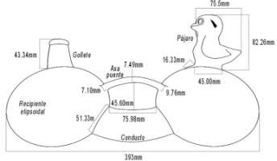
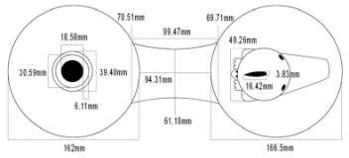
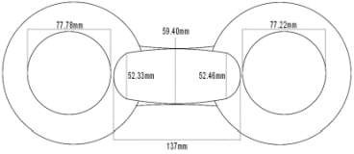
Continue….
v) Mouthpiece: The shape and size of the mouthpiece can affect how you interact with the vessel and the sound it produces.
vi) Size and Volume: The size of the vessel and its internal volume can impact the resonance and sound quality. Smaller vessels typically produce higher-pitched sounds, while larger ones produce deeper tones.
Figure: Side View
Figure: Top View
Figure: Bottom View

Slide 7
OI
bjectives
The Inca whistle, had the several objectives for the Inca civilization:
Communication: Inca whistles were used to convey messages over long distances, alerting people to various events, such as the arrival of important figures or the approach of enemies.
Signaling: They were valuable for signaling purposes in agricultural settings, helping coordinate activities like planting, harvesting, or communal work projects.
Rituals: Inca whistles played a role in religious and ceremonial activities. Their distinctive sounds were integral to various Inca rituals and festivals.
Cultural Symbolism: These whistles held cultural significance, representing the artistic and technical achievements of the Inca civilization. They were often crafted with intricate designs and symbols.
Musical Expression: Some Inca whistles were used for music and entertainment, as they could produce various tones and melodies, adding to the cultural richness of the society.
Artifacts: Inca whistles also serve as archaeological artifacts, shedding light on the culture, craftsmanship, and technology of the Inca civilization. These whistles were versatile instruments that held practical, cultural, and symbolic importance in Inca society 7

Slide 8
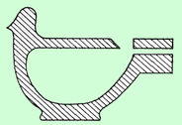
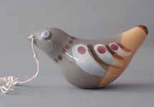


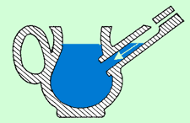
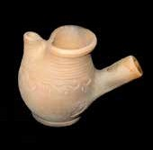
Classification of Whistles
1) Globular Whistles : It is enclosed as form and their bodies have a globular inner cavity. The sound is created by the mouthpiece located on the edge. Their sound intensity is weak.
2) Tubular Whistles : Its tonality depends on the length of the pipe in this whistle type, where blowing form is connected to the base or body from outside. While tubular whistles have high-pitched sound whereas the globular whistles have deeper and softer sound. If it has a pedestal and a base, it may be tubular.
3) Water Whistles : These are called nightingale, botijito pitchers in various languages. It is a combination of globular whistles and tubular whistles. The difference is that the air blown through the pipe hits the water rather than the wall by filling water into the cavity, and the water level raises and creates sound.
Figure 1: Globular Whistle Section
Figure2: Globular Whistle Sample
Figure 3: Tubular Whistle Section
Figure 4: Tubular Whistle Sample
Figure 5 : Water Whistle Section
Figure 6: Water Whistle Sample / Ezgi Martinez Collection

Slide 9
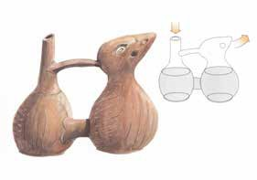
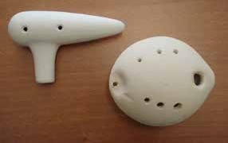
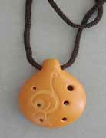
4) Multi-chambered Water Whistles : The types of these special forms commonly encountered in a geography extending from Mexico to Peru since one, two thousand years ago until now, go up to 6 chambers. The types with double chamber are the most common ones. These are jointed from the bottom and connected with a handle from the top. The sound is created by the air coming out of upper chamber of a small hole.
5) Ocarina : It is known that ocarina, derived from the word oca meaning “Little Goose”, invented by Ita- lian Guiseppe Luigi DONATI in 1860. It was encountered in ancient Egypt, Mexico civilizations but was not referred with this name until the said date. This type of instruments is also found among the porcelain product of German Meissen Company (Kura, 2004, 334). It is known that as well as being shaped as handmade or with moulds, they are also produced in different sizes.
Figure 13: Multi-chambered Water Whistle (Abrashev, 2000,p. 41)
Figure 8: Ocarinas by Alp Çam
Figure 9: Ocarina by Sergio Garcia,Chili Collection of Prof.Sevim Çizer

Slide 10
Materials required…
Clay or Ceramic: Clay is the primary material used for making Peruvian whistles. High-quality clay is essential for producing a resonant and durable instrument.
Pottery Tools: Various pottery tools such as clay cutters, shaping tools, and carving tools are necessary for shaping and detailing the whistle.
Kiln: A kiln is used to fire the clay at high temperatures, making it hard and durable. It's an essential part of the firing process.
Water: Water is used to moisten the clay and aid in the shaping process.
Paints (optional): If you wish to decorate the whistle, you'll need paints or pigments suitable for ceramics.

Slide 11
How Sound Generate in Inca Whistle?
If the whistling vessels are moved when filled with water, the air compression is regulated by the air duct and the diameter of the connection tube.
A large air duct in combination with a wide connection tube is able to produce a single short tone only.
A large cross section of the connection tube in combination with a narrow air duct is responsible for the trilling of the whistling vessels.
The trilling is produced because the air accumulates in the whistling chamber and then, in period-ic turns, recedes backwards into the intake chamber.
The air escapes in bubbles and this process is audible as a trilling, since the continuous compression is interrupted.
A whistling vessel may also be brought to sound, if it is blown at the intake chamber by mouth.
The duration of breath decides the length of the tone.
If the intake chambers are half-ﬁlled with water, all whistling vessels trill, no matter in which manner they are constructed.

Slide 12
Continue….
Whistling vessels with a single chamber do not show the effect, as the steam escapes through the inﬁll tube.
Using this technique, the air pressure produced by blowing at the whistling vessel can be maintained for a fairly long period of time, so that the whistling vessels are whistling or trilling for minutes without interruption Another possibility to generate sound is to boil the water inside of a whistling vessel.
Then, the steam escapes through the air duct and generates a sound such as in a tea kettle. The technique can be applied to whistling vessels with two or more chambers and type A (objects with an enclosed whistle) and type B (objects with an exposed whistle) whistles.

Slide 13
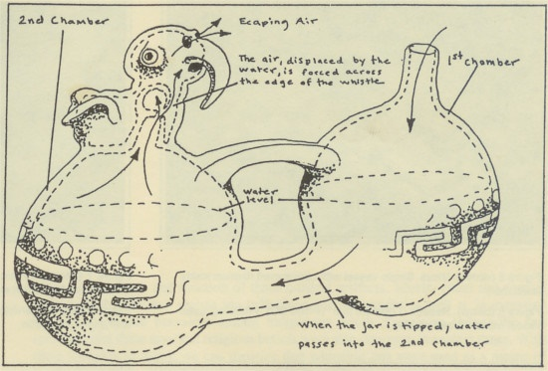
Mechanism
The mechanism that creates the sound is a hollow ball with a circular hole that was a sharp edge. The sharp edge with the air i.e., blown into the mechanism which vibrates the air & produces the sound frequency. This air can be blown to the lungs or depending on the vessel and culture, with water being moved from one container if the vessel to another. These vessels can have a single sound mechanism on many of those two.
13

Slide 14
Technology
When closely tuned vessel are played together they can create binaural frequencies. These frequencies can be used to induce trance states, which can lead to numerous positive responses. This technology alone is amazing, then when you start to realize the complexity of these vessel the advancements of this technology is obvious. Many of these vessel that have been found produce unique notes which can create binaural frequencies when played together. This synchronization of pure tones can increase relaxation, reduce anxiety and stress, by creating an auditory illusion of the two tones creating a third one.
14

Slide 15
Uses of Inca Whistle in Inca Civilization
They used these vessel for journey to other realms as well as helping to improve health a well being.
These vessel are usually made in the shape of animals, peoples or mythical figure.
These whistling bottle was likely used for rituals, religious and secular as a form of entertainment.
The production of binomial frequencies have also been known to induce meditation, help with pain management, improve sleep and reduce stress.

Slide 16
Advantages of Inca Whistle
There are several advantages:
Portability: Ocarinas are small and lightweight, making them easy to carry and play anywhere.
Versatility: They can produce a wide range of tones and melodies, suitable for various musical genres.
Unique sound: They have a distinct, hauntingly beautiful sound that sets them apart from other instruments.
Affordable: Ocarinas are often affordable, making them an attractive option for those on a budget.
16

Slide 17
Conclusion
The Inca whistle, often referred to as the ocarina, is a unique and culturally significant musical instrument with several notable characteristics. Its advantages include portability, ease of learning, versatility, a distinctive sound, cultural significance in Peruvian and Andean music, affordability, and often intricate handmade craftsmanship. Creating a Inca whistle involves working with clay, utilizing pottery tools, and firing the clay in a kiln. The optional use of glazes and paints can add decorative elements to the instrument. Crafting a Inca whistle requires patience, skill, and attention to detail, making it a cherished part of Peruvian and Andean musical traditions and a fascinating instrument for music enthusiasts and collectors.
17

Slide 18
References
i)Acosta, L. 1974 José Martì, la América precolombina y la conquista española, Casa de las Américas.
ii) Bermúdez, E. 1985 Los instrumentos musicales en Colombia (Vol. 7), Universidad Nacional de Colombia.
iii) Crespo Toral, H. 1966 'Nacimiento y evolución de la botella silbato', Humanitas VI(1), 66–87.
iv)Cummins, T. 2003 'Nature as culture's representation: a change of focus in Late Formative iconography' in Raymond, J.S. and Burger, R.L. (eds) Archaeology of Formative Ecuador. 423–64.
v)de Arce, J. and Gili, F. 2013 'Clasificación Sachs-Hornbostel de instrumentos musicales: una revisión y aplicación desde la perspectiva americana', Revista Musical Chilena, 67(219), 42–80. https://doi.org/10.4067/S0716-27902013000100003
vi) de Arce, J.P. 2015 'Flautas arqueológicas del Ecuador', Resonancias 19(37), 47-
88. http://resonancias.uc.cl/es/N%C2%BA-37/flautas-arqueologicas-del-ecuador.html
x) Gérard, A. 2011 'El Sonagrama. Una representación práctica de los sonidos', Revista Boliviana de Física 18, 37-49.

Slide 19
THANK YOU
19

