Slide 1

SWASTH
Way to healthy life..!!
Arpit Porwal
Amit Kumar Agrawal
Tushar Gupta

Slide 2

Problem Statement :
Lack of awareness in the field of health.
Ignorance of disease due to lack of doctors nearby.
Negligence of First-aid in case of any Disease or disorder .
More focus on cure rather than prevention

Slide 3


Literature Survey :
According to a latest survey of United Nations, we are behind Pakistan in terms of Doctors available in the country per 1000 people.
According to the Global Burden of Disease Study (GBD) published in the medical journal The Lancet, India was ranked 154th among 195 countries on the healthcare index i.e. below Sri Lanka and Bangladesh.
India ranks 145th among 195 countries in terms of quality and accessibility of healthcare, behind its neighbours like China, Bangladesh, Sri Lanka and Bhutan, according to a Lancet study.

Slide 4


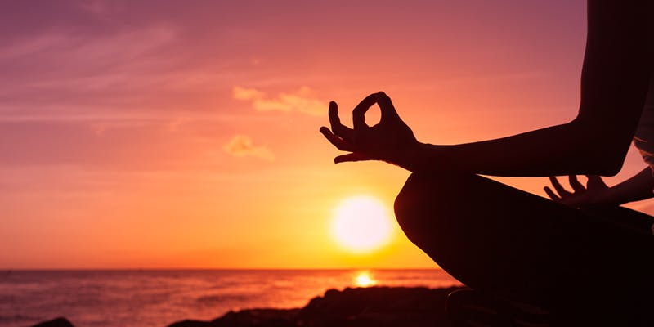
Solution : (i) What’s new
• Tips for Healthy life
• Nearby doctors available with their contact information
• Detection of disease of the basis of symptoms

Slide 5
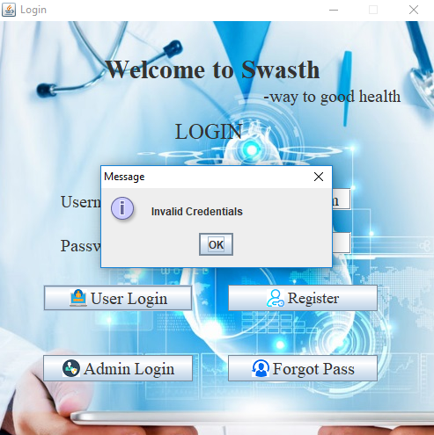
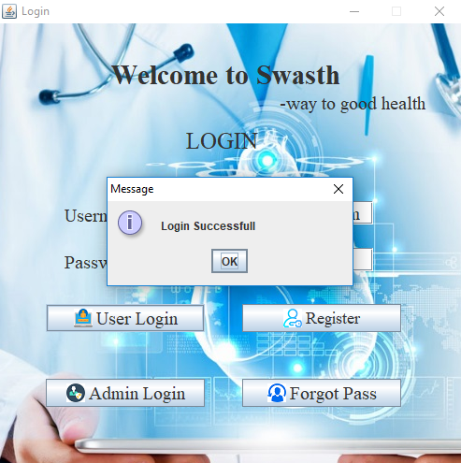
Solution : (ii) Process with Screenshots

Slide 6
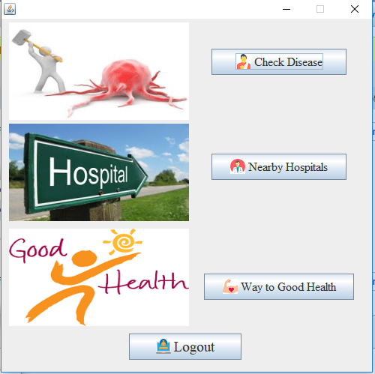
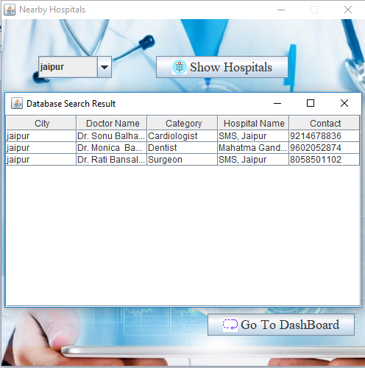
Solution : (ii) Process with Screenshots

Slide 7
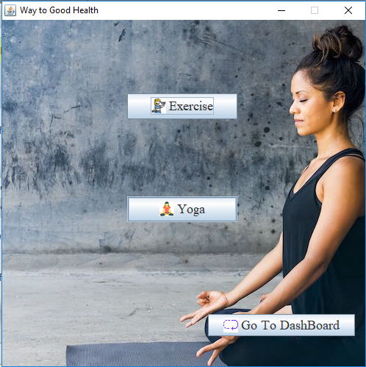
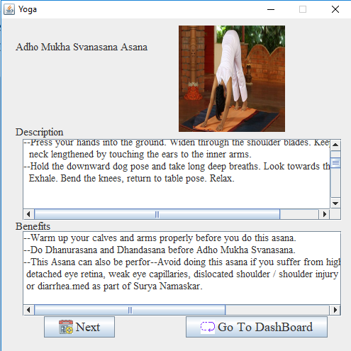
Solution : (ii) Process with Screenshots

Slide 8
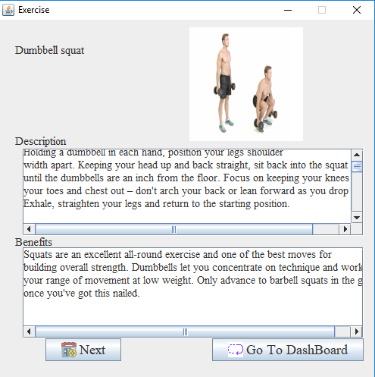
Solution : (ii) Process with Screenshots

Slide 9
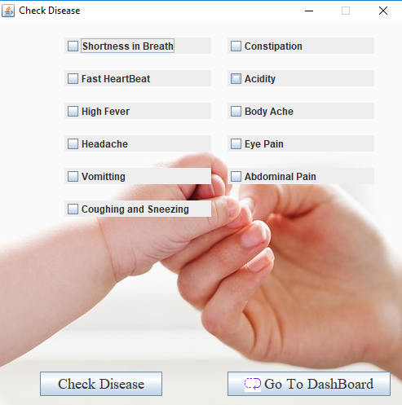
Solution : (ii) Process with Screenshots

Slide 10
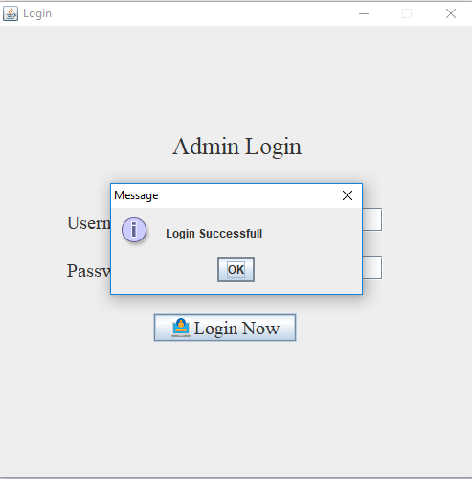
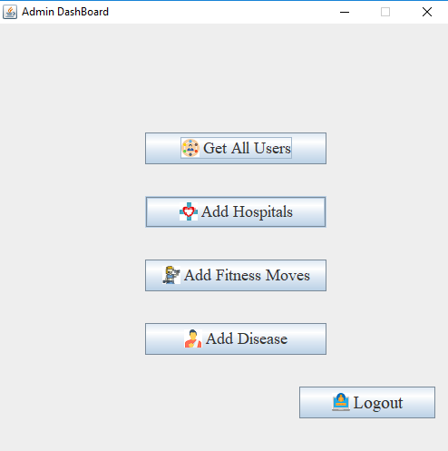
Solution : (ii) Process with Screenshots

Slide 11
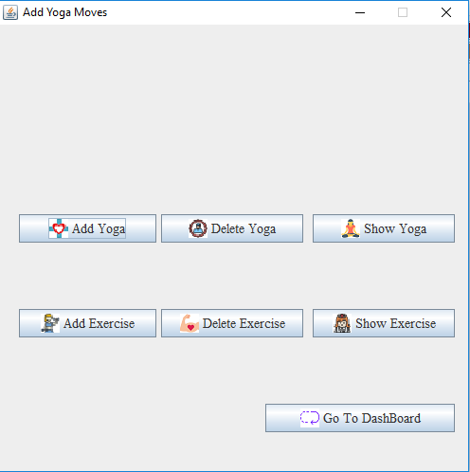
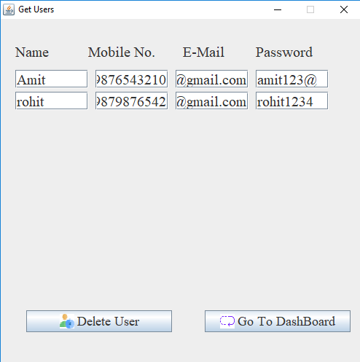
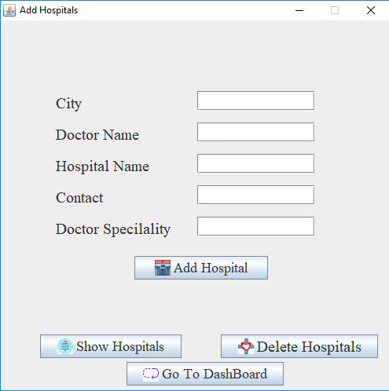
Solution : (ii) Process with Screenshots

Slide 12
Block Diagram : User Panel
Start
Login
Not Registered
Register
Successful
Check Disease
Nearby Hospitals
Display list of Doctors
Get Symptoms
Enter City
Show Disease + prevention+ cause
Display list of Doctors
Exercise
Yoga

Slide 13
Block Diagram : Admin Panel
Start
Login
Manage Hospitals
Add moves
Get all users
Delete user
Exercise
Yoga
Add Hospital
List of H.
Delete H.
Add
Delete
Show

Slide 14
Solution : (iii) Target User
People living in town where there is lack of medical facilities
People living in cities who are stressed due to their congested life and want some change in their lifestyle
People in need of doctors nearby.
Can be used by any person in the world due to our section way to healthy life

Slide 15

Future Scope :
Addition of GPS Facility to get the live location of doctors
Inclusion of lethal diseases like cancer, zika and nipah infection
Addition of video tutorials of yoga poses and gym exercises.
Inclusion of appointment of doctors with the help of application.
Online ordering of medicines prescribed by the doctor.

Slide 16
Conclusion
Swasth is to provide a platform to the user to get a one stop solution to all medical things.
In this project, we have coded a stand-alone application in which we have added some features like get nearby doctors, diagnose your disease on the basis of your symptoms and a section of way to healthy life which include yoga and gym tips.
It is basically a mini doctor and a personal guide to each and every stakeholder of this application.

Slide 17
REFERENCES :
• https://yellowpages.webindia123.com/o-d/Rajasthan/Jaipur/2/1/
• http://www.un.org/en/sections/issues-depth/health/index.html
• https://www.javatpoint.com/
• https://www.wikihow.com/Get-Fit-in-the-Gym
• https://www.wikihow.com/Enjoy-Yourself-at-the-Gym
https://www.cdc.gov/DiseasesCondition/az/f.html

