Slide 1



Data-Driven Inventory Optimization and Profitability Analysis for a Residential Supermarket
BDM CAPSTONE PROJECT
PRESENTATION BY
Tushar Jalan
ROLL NO. 23F2003751

Slide 2
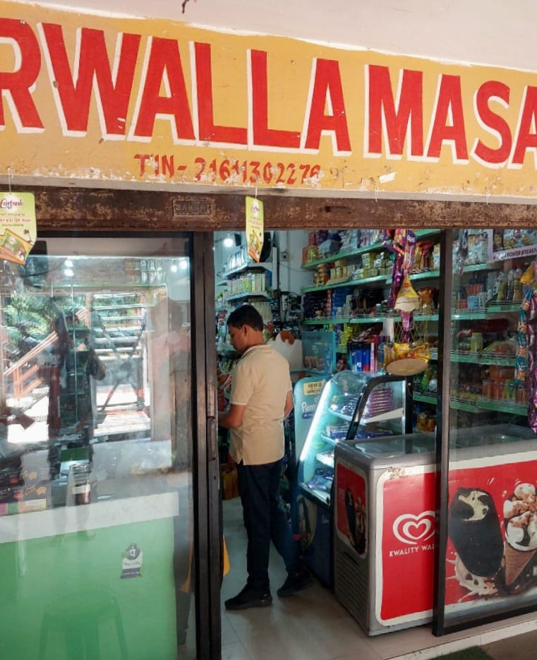



ABOUT THE PROJECT
Agarwalla Masala is a family-run B2C residential supermarket with a 30+ year history in Nalco,Angul, Odisha.
Serves a loyal local community with a broad mix of groceries, household essentials, and festival-specific items.
This project analyzed the store's complete 2024 transaction history, covering a diverse product mix of 222 unique SKUs.
Objective of the project was to identify the business problems and find a way out to solve those problems to help the shop owner run the business in a better way.

Slide 3


PROBLEM STATEMENTS
01
02
03
Seasonal Demand Forecasting & Stockout Mitigation
To create an accurate forecasting model for seasonal variations to minimize stock outs of high-demand items, addressing the challenges posed by long supplier lead times
Product Performance & Profitability Analysis
To identify high-performing and underperforming products by analyzing SKU-level sales data, enabling the optimization of the product mix to maximize overall profitability.
Inventory Optimization within Space Constraints
To develop a data-driven strategy to maximize the efficiency of the store's limited physical storage (~15-day inventory limit) by identifying and prioritizing key products.

Slide 4
DATA COLLECTION
Data Collection & Preprocessing
Data Source: Primary data from the store's Stock_Ledger_Summary.csv.
Time Period: One full year of transactional data (January 2024 to December 2024).
Scope: The dataset encompasses all transactions for 222 unique SKUs.
Preprocessing Steps:
Standardization: All product categories and brand names were cleaned and standardized to ensure consistency across the dataset.
Consolidation (Handling the "62 Brands" Problem): A rule-based approach was used to classify and consolidate 62 ambiguous "brand" entries, reducing the initial count of over 280 raw entries to the final 222 analyzable SKUs.
Validation: Data types were converted to ensure calculation accuracy, and logical checks were performed to flag inconsistencies like negative stock.

Slide 5

ANALYSIS PROCESS
Ledger-Only Approach:
A single source of truth was established to ensure 100% analytical consistency, overcoming significant data integrity issues discovered in initial multi-file reconciliation attempts.
Master View Construction:
An automated Python script was developed to build a comprehensive view of all 222 SKUs, calculating key metrics like Current_Stock_Qty, Annual_Revenue, and Days_of_Inventory.
Advanced Segmentation:
Utilized ABC (Value), XYZ (Volume), and Weighted ABC classification to strategically segment the product portfolio.
Dynamic Forecasting:
A forward-looking model was built using historical Uplift_Factors to create an actionable inventory and purchasing plan that respects the store's operational constraints.

Slide 6
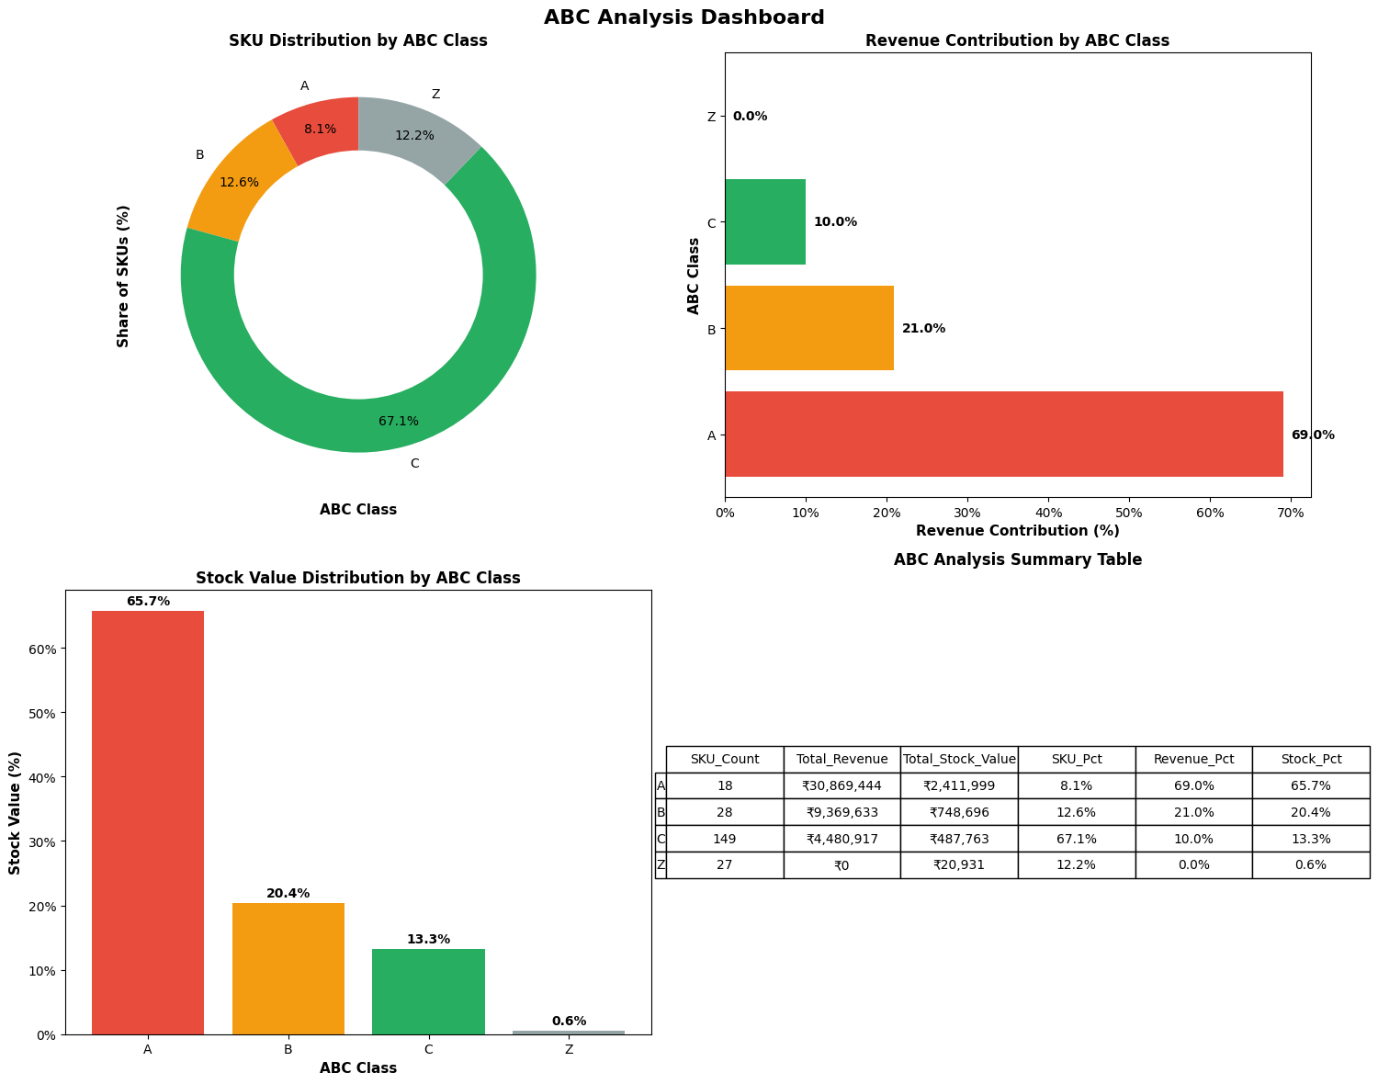
Key Finding 1 - The Pareto Principle
Finding: The business is overwhelmingly driven by a small core of high-performing products.

Slide 7
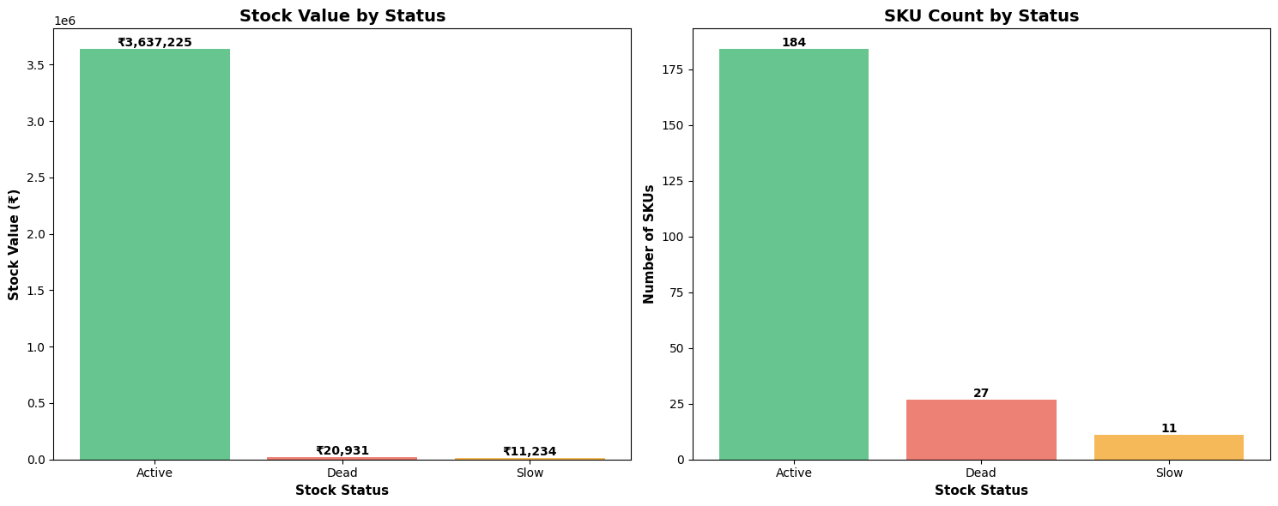
Key Finding 2 - Inventory Health & Inefficiency
While 82.8% of the inventory value is in healthy, "Active" products, the analysis identified 27 SKUs as "Dead Stock."
These non-selling products occupy valuable physical space, creating an artificial constraint on high-performing items and representing a ₹27,485 capital recovery opportunity.

Slide 8
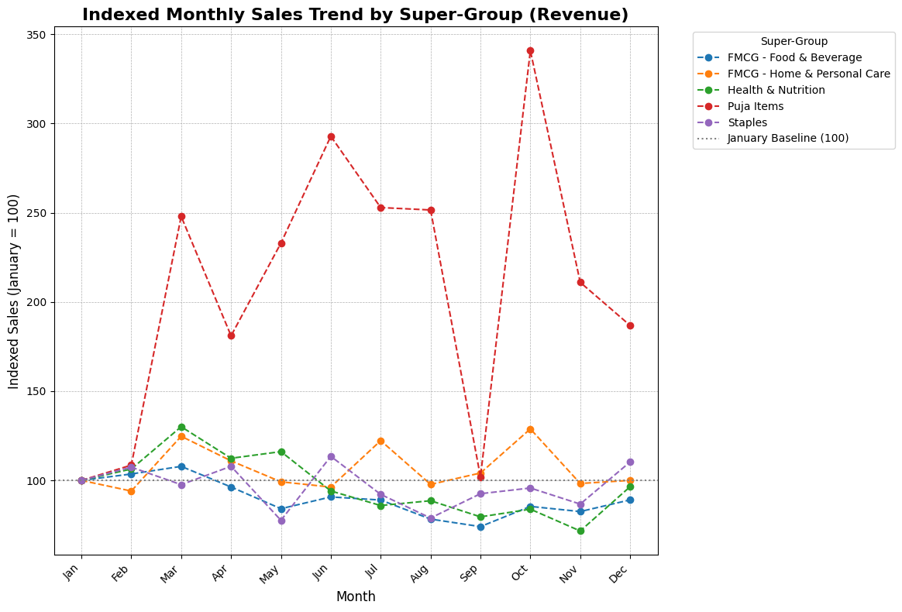
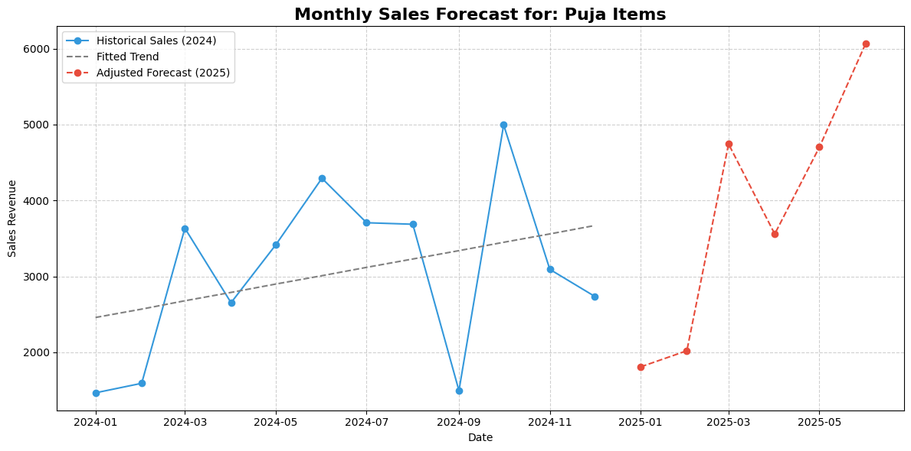
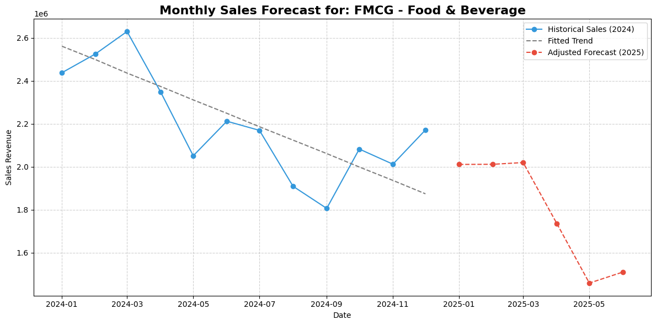
Key Finding 3 - Seasonality & Forecasting
The model successfully identifies predictable sales peaks in March and October, aligning with major festivals.
Niche categories like "Puja Items" exhibit extreme volatility, with sales spiking to over 3 times their January level.
Insight: The forecasting model quantifies these seasonal uplifts to generate a precise, data-driven purchasing plan, preventing stockouts.

Slide 9



RECOMMENDATIONS
INVENTORY OPTIMIZATION
Differentiated Inventory Policy
Implement ABC-XYZ classification: 98% service level for Class A (18 SKUs), standard 15-day cover for Class B (28 SKUs), lean policy for Class C (149 SKUs)
Capital Recovery Program
50% discount clearance for 27 dead stock SKUs, bundle slow-movers with popular items
SEASONAL DEMAND FORECASTING
Data-Driven Purchasing Model
Use Forward Inventory Plan with seasonal uplift factors (up to 57% demand spikes) for proactive ordering
15-Day Stock Cover Maintenance
Align purchases with storage constraints and supplier lead times using quantified seasonal patterns
PROFITABILITY ENHANCEMENT
Strategic Focus Enhancement
Prioritize top 5 high-ROI products (EVEREADY, MANGALAM) with prime visibility and guaranteed stock
Data Quality Management
Implement daily staff checklist, resolve 11 SKUs with data quality flags
STRATEGY N°1
STRATEGY N°2
STRATEGY N°3

Slide 10

THANK YOU

