Slide 1
UTILITY OPTIMO
WIDispatch
The complete operating cycle
Client demonstration for operational users and approvers
Sample-data demonstration / September 2026
Notes:
Operational-user and approver demonstration. Use a 45–50 minute core path and optional detailed canvas sections for a longer workshop. Screenshots contain sample records from multiple dates. The worked shortage case uses the saved Tank Demo run.
Demonstration guidance: Screenshots are sample application states. Use approved trial data for live input and publication.

Slide 2
WIDispatch: purpose and objectives
Purpose
What it does
Objective
Support coordinated water dispatch planning across production, transmission, storage and demand.
Combine operational inputs and approved costs with a network model to simulate supply, identify constraints, review decisions and publish allocations.
Meet demand as far as available capacity allows, manage shortages and assess variable operating cost while preserving decision accountability.
WIDispatch / Client demonstration
02
Notes:
Introduce WIDispatch as the complete operating cycle shared by the Desktop planning application and four domain portals. Approved inputs establish the planning basis. Simulation produces a draft for review, and publication hands the agreed decisions to operations. The dispatch cost objective uses variable operating cost, not total lifecycle cost. Transition: the next slide outlines how we will follow that cycle in the demonstration. Sources: WIDispatch Product Profile and Operating Overview, pp. 1–3; existing demonstrated operating workflow.

Slide 3
Today’s demonstration
01
Assets, portal dashboards, inputs and approvals
15 minutes
02
Network and transmission system walkthrough
12 minutes
03
Emergency assumptions and simulation results
10 minutes
04
Decisions, publication and portal reconciliation
10 minutes
05
Optional canvas tools and geographic detail
20–30 min
WIDispatch / Client demonstration
03
Notes:
Core client walkthrough: approximately 45–50 minutes using selected canvas slides. The extended canvas and outage material supports a longer workshop or follow-up questions. Do not read every reference slide in the core session.
Demonstration guidance: Screenshots are sample application states. Use approved trial data for live input and publication.

Slide 4
One operating cycle, distinct responsibilities
Domain teams
Approvers
Dispatch planners
Maintain asset-specific operating records. Submit information for the applicable approval workflow.
Check quantities, dates, assumptions and supporting reasons within their permitted scope.
Build the network, assess feasible supply, review draft decisions and publish the agreed plan.
Operations teams then record actual outcomes and use the differences to prepare the next cycle.
WIDispatch / Client demonstration
04
Notes:
Domain approval and planner approval serve different purposes. A portal approver validates the input. The dispatch planner decides how the combined network should operate. Publication is the explicit handoff to the operating records. The demonstration account is a management account, so individual operator screens may expose fewer controls. Source: BRD pp. 1–3; PRD pp. 1–4; Product Profile pp. 1–3.
Demonstration guidance: Screenshots are sample application states. Use approved trial data for live input and publication.

Slide 5
WIDispatch Desktop: planning and dispatch
Purpose
What it does
Objective
Provide the planner’s workspace for network modelling and dispatch decisions.
Maintain the shared asset registry, build networks and transmission systems, apply scenario assumptions, run simulations, explain results and publish reviewed decisions.
Produce a feasible, explainable operating plan that operational teams can act on.
WIDispatch / Client demonstration
05
Notes:
Desktop combines the network and the operational planning basis. It supports asset identity, network topology, reusable systems, emergency scenarios, results review and the final publication step. Portal input approval remains distinct from the planner’s decision review. The asset registry appears first because stable identities connect later inputs, network elements and outputs. Transition: begin with the shared registry, then return to network building and simulation after reviewing the portal workflows. Sources: demonstrated Asset Registry, Network Builder, Simulation Config and Decisions views.

Slide 6
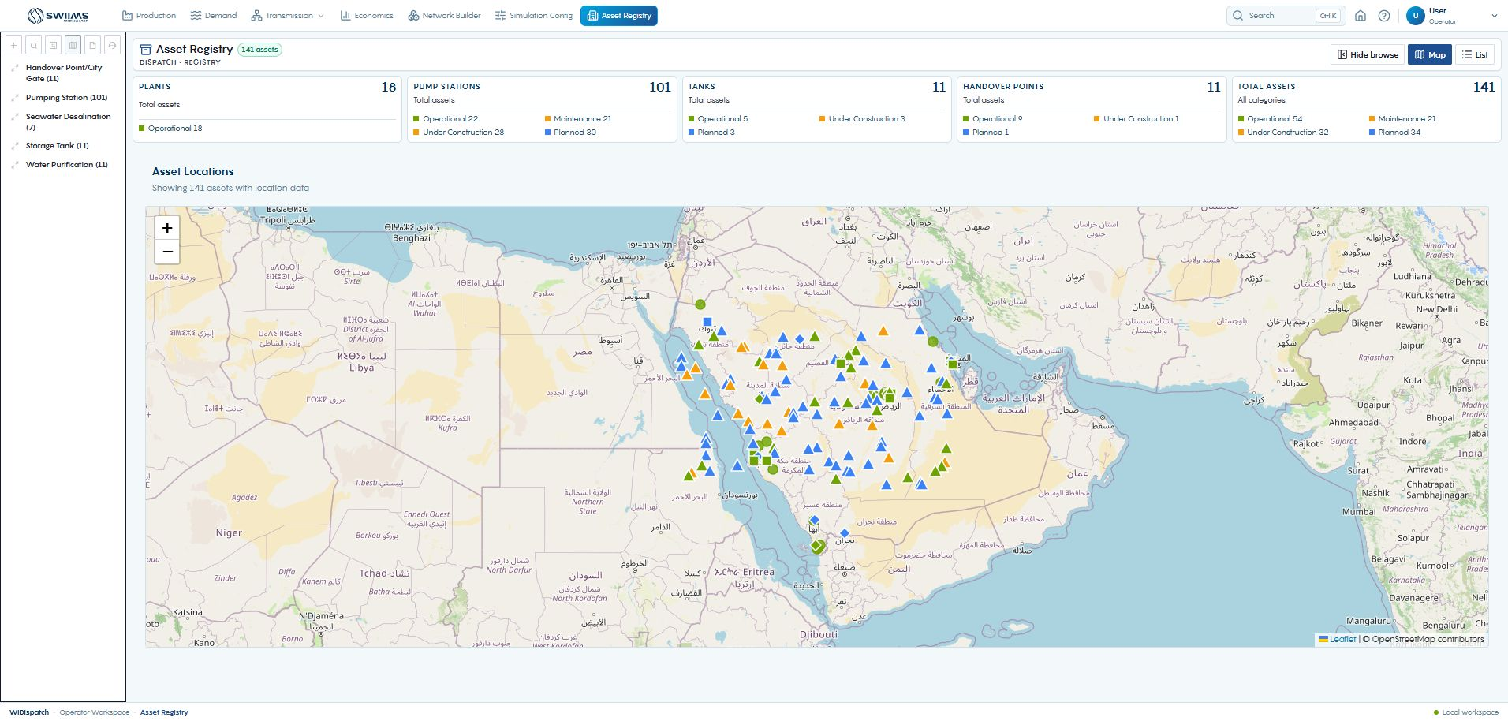
The shared asset registry
01
Open Asset Registry in Desktop.
02
Locate the asset by category or map.
03
Confirm the operating status and location.
The same asset identity connects portal records, network elements and dispatch outputs.
WIDispatch / Client demonstration
06
Notes:
Show plants, pump stations, tanks and handover points. The live registry shows 141 assets in this snapshot. Counts are sample inventory, not licensed capacity. Use the map for location and the list for exact identity. Source: Desktop Asset Registry, captured 27 September 2026; PRD PR-007.
Demonstration guidance: Screenshots are sample application states. Use approved trial data for live input and publication.

Slide 7
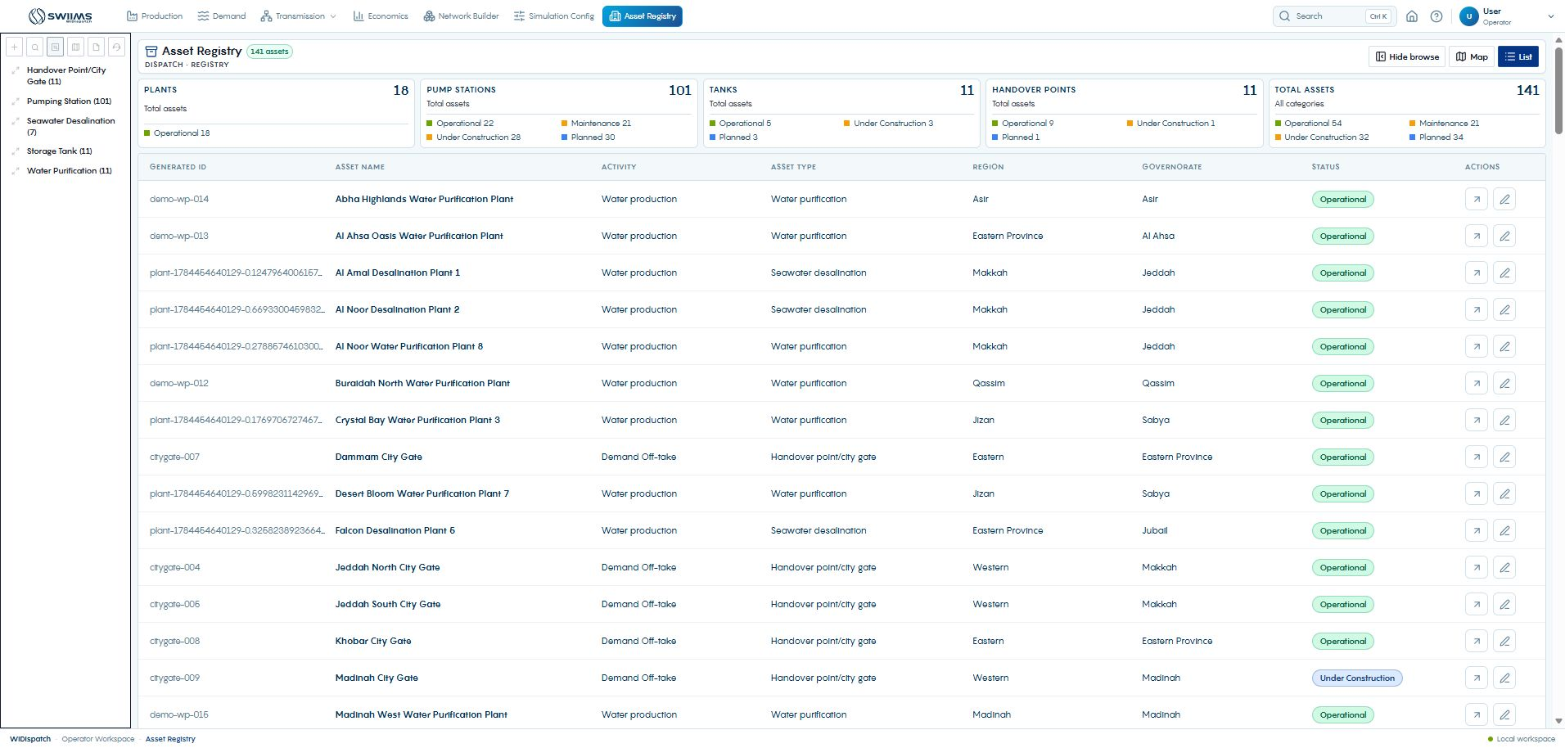
Asset identity and operating specifications
01
Switch to List and locate the exact asset.
02
Open View Details to inspect specifications.
03
Use Edit only for an authorized master-data change.
Check identity before using similarly named assets in a network.
WIDispatch / Client demonstration
07
Notes:
Explain the difference between a display name and a stable asset reference. Review category, region, operating status and relevant capacity units. A registry correction can affect more than one network. The presentation demonstrates the controls without changing existing master data. Source: Desktop AssetListView and Asset Registry screen.
Demonstration guidance: Screenshots are sample application states. Use approved trial data for live input and publication.

Slide 8
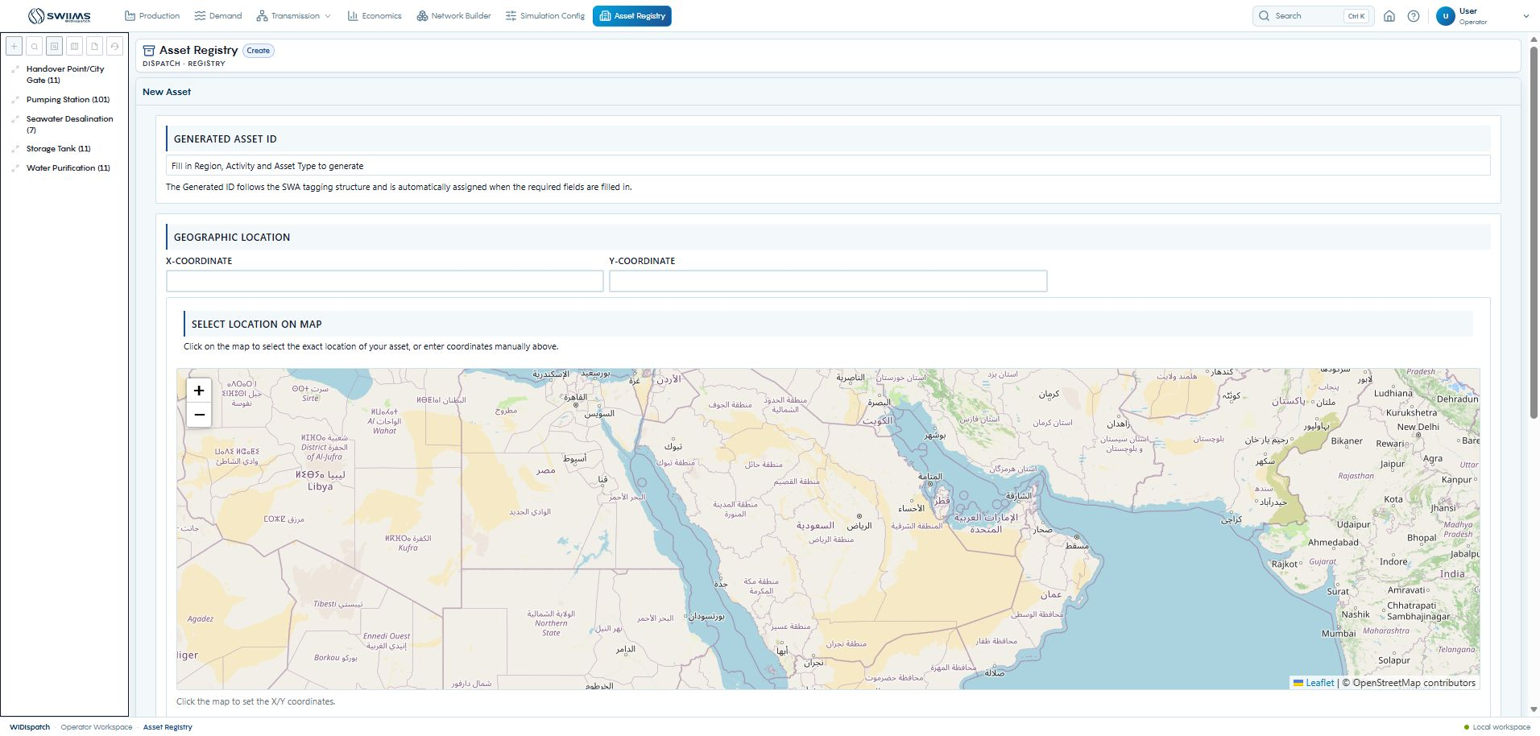
Creating an asset
01
Choose the category, activity and asset type.
02
Enter the name, region, status and lifecycle dates.
03
Set coordinates, then complete the relevant specifications.
Create asset adds the master record that planners can select in the library.
WIDispatch / Client demonstration
08
Notes:
Demonstrate the visible New Asset form. Required region, activity and asset type contribute to the generated tagging identifier. Explain plant capacity, pump configuration, tank storage and city-gate intake specifications as category-dependent fields. Do not imply that every required specification appears before the category is selected. Source: Desktop New Asset form; frontend/src/components/AssetForm.jsx.
Demonstration guidance: Screenshots are sample application states. Use approved trial data for live input and publication.

Slide 9
Production Portal: supply availability and reporting
Purpose
What it does
Objective
Capture the production information needed for dispatch planning and operational follow-up.
Record production, quality, maintenance and outages, with applicable submission and approval workflows. Display published production requests alongside operating records.
Give planners a dependable view of available supply and help operators reconcile actual production with requested output.
WIDispatch / Client demonstration
09
Notes:
Explain Production as the operational source of the supply picture. Maintenance and outage timing can reduce availability, while actual production supports reconciliation after operation. The published requested allocation is different from actual output. Quality and outage records do not necessarily follow the same approval path as production submissions and planned maintenance. Transition: start at the Production dashboard, then open a plant and follow its inputs and approval workflow. Sources: demonstrated Production dashboard, plant records and published allocation view; PRD PR-003.

Slide 10
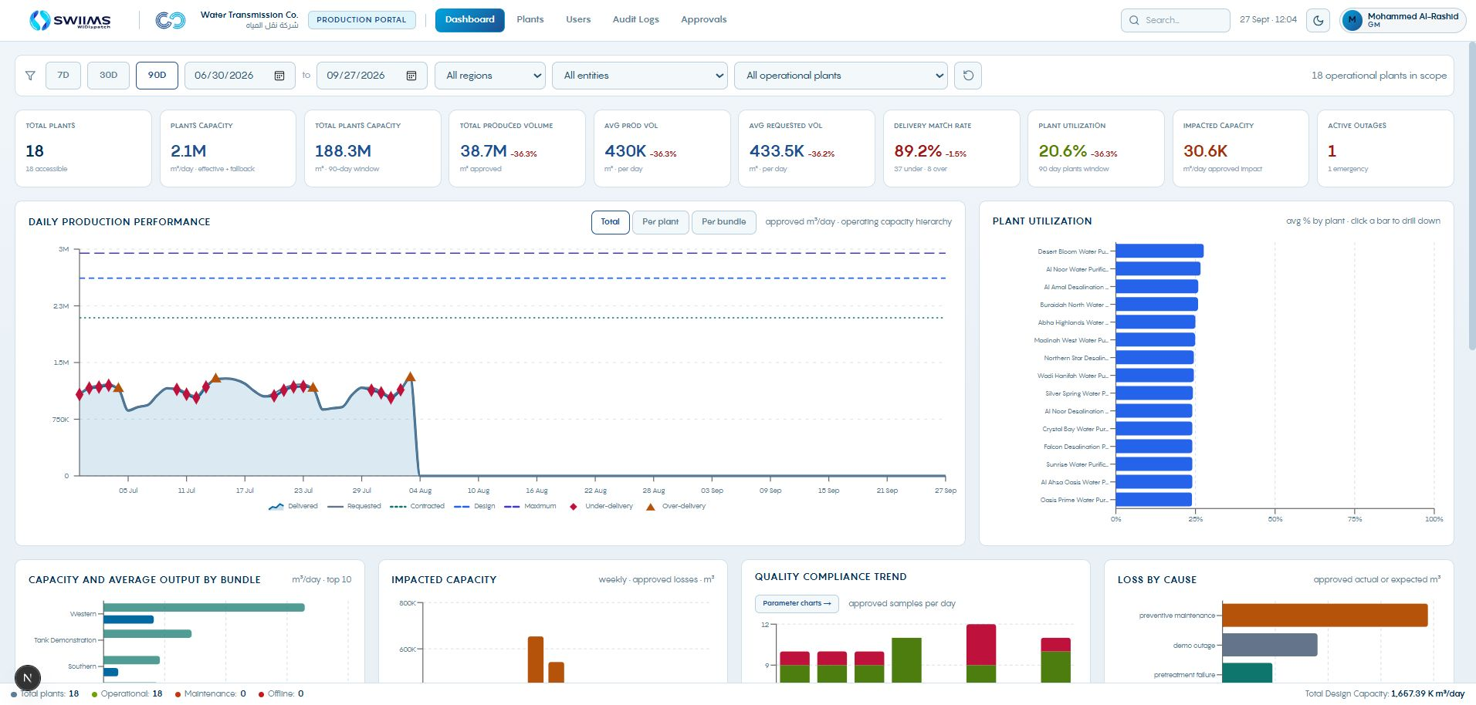
Production dashboard
01
Confirm the role and asset scope.
02
Read availability and loss indicators.
03
Open the affected plant for the underlying records.
The dashboard starts the daily review. Plant records explain the exceptions.
WIDispatch / Client demonstration
10
Notes:
Source: Production dashboard. Use period filters consistently. Dashboard figures are sample data. This view is shown early so users understand how to enter the input workflow.
Demonstration guidance: Screenshots are sample application states. Use approved trial data for live input and publication.

Slide 11
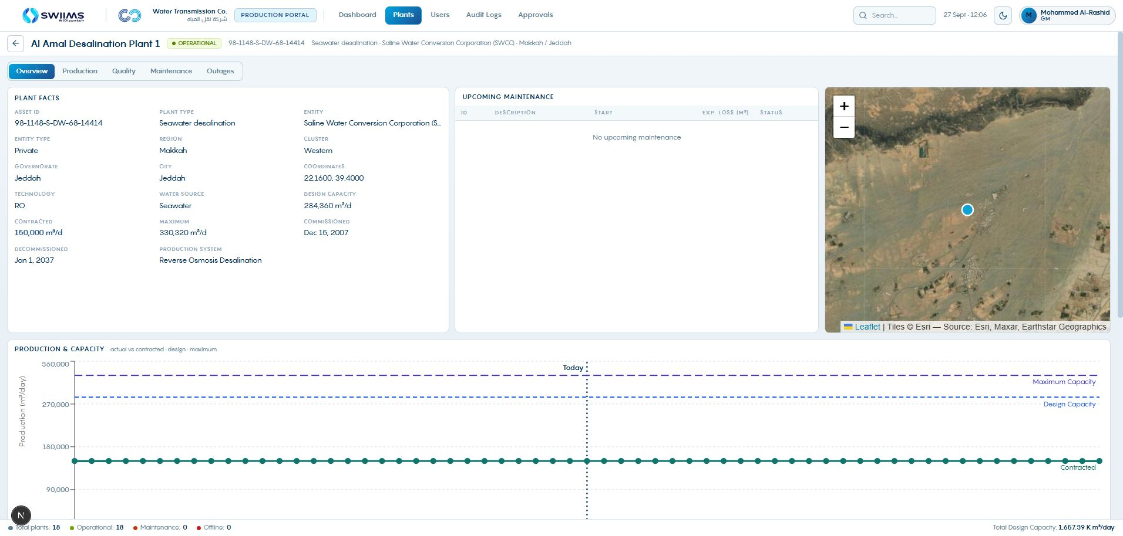
Production starts with the plant
01
Open Production Portal, then Plants.
02
Select the plant and confirm its capacity basis.
03
Review Production, Quality, Maintenance and Outages.
Contracted capacity, dates and operating events determine the planning context.
WIDispatch / Client demonstration
11
Notes:
Al Amal is the input-workflow example. The later dispatch example uses the Tank Demo assets. State this transition clearly. The overview displays contracted, design and maximum capacity, lifecycle dates and location. Do not treat these three capacity measures as interchangeable. Source: Production Portal plant overview.
Demonstration guidance: Screenshots are sample application states. Use approved trial data for live input and publication.

Slide 12
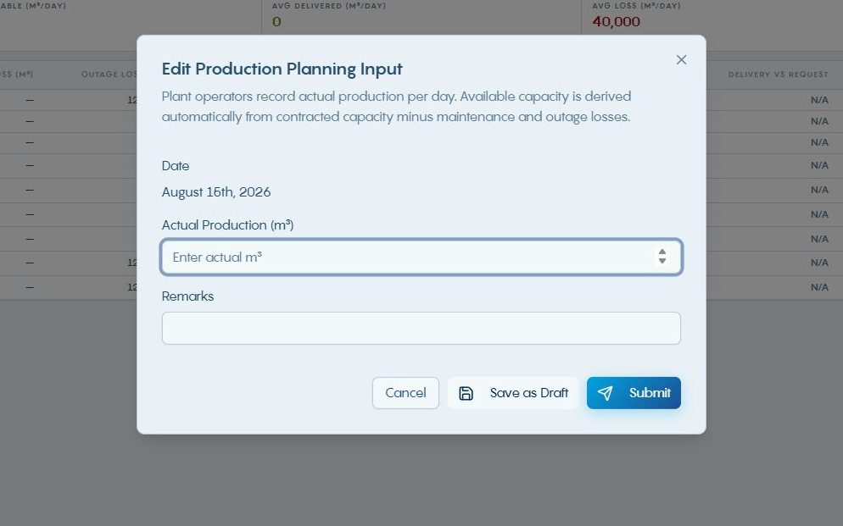
Recording production
01
Open Record Production or edit an existing day.
02
Enter actual production and useful remarks.
03
Save as Draft or Submit for review.
Available capacity is derived from contracted capacity and recorded losses.
WIDispatch / Client demonstration
12
Notes:
The current Production Planning Input screen records actual production by date. This screenshot shows the edit form for 15 August at Tank Demo Plant A; new entry uses the same actual-production and remarks concepts with a date-range selector. Actual and allocated quantities must remain within effective capacity. The modal shown is an input screen, not evidence of a submitted record. Verify dates before entry. Do not overwrite the published requested quantity to make it match actual output. Source: Production Portal Production Planning Input; PRD PR-003.
Demonstration guidance: Screenshots are sample application states. Use approved trial data for live input and publication.

Slide 13
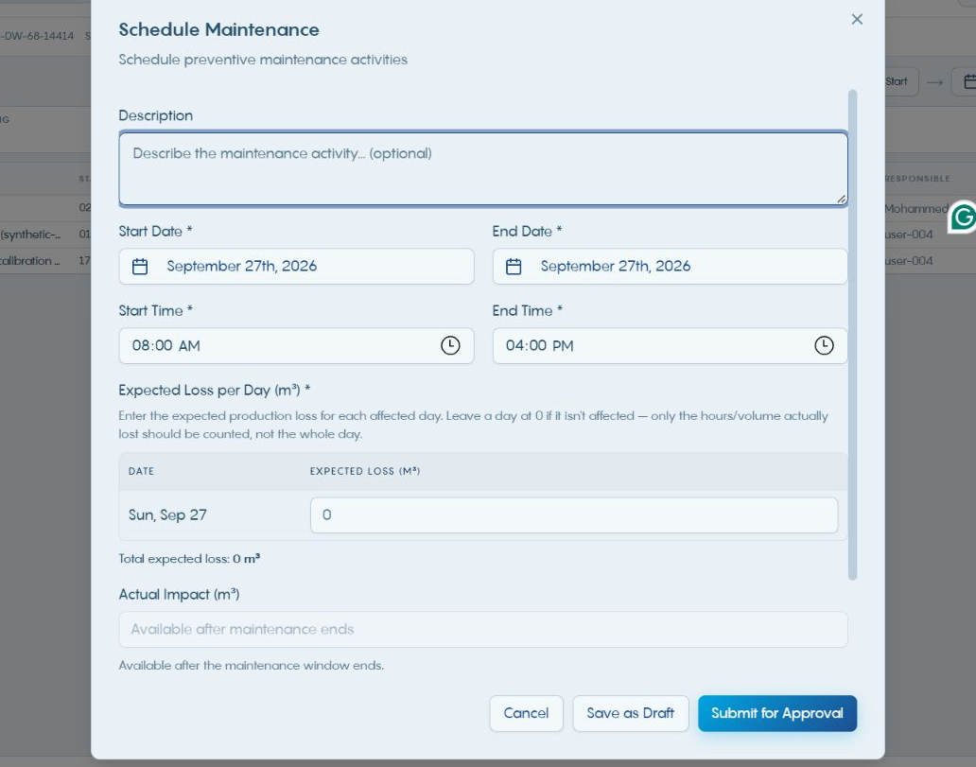
Maintenance changes available production
01
Describe the work and its start/end window.
02
Enter the expected loss for each affected day.
03
Submit for Approval after checking the total impact.
Daily loss should reflect the affected volume rather than assuming a full-day shutdown.
WIDispatch / Client demonstration
13
Notes:
The maintenance form separates expected daily loss from actual impact. Actual impact becomes available after the maintenance window ends. Explain partial-day work with a concrete example: an eight-hour activity should carry the expected lost volume for that window. Source: Production Schedule Maintenance form; backend/src/simulation/capacity.js.
Demonstration guidance: Screenshots are sample application states. Use approved trial data for live input and publication.

Slide 14
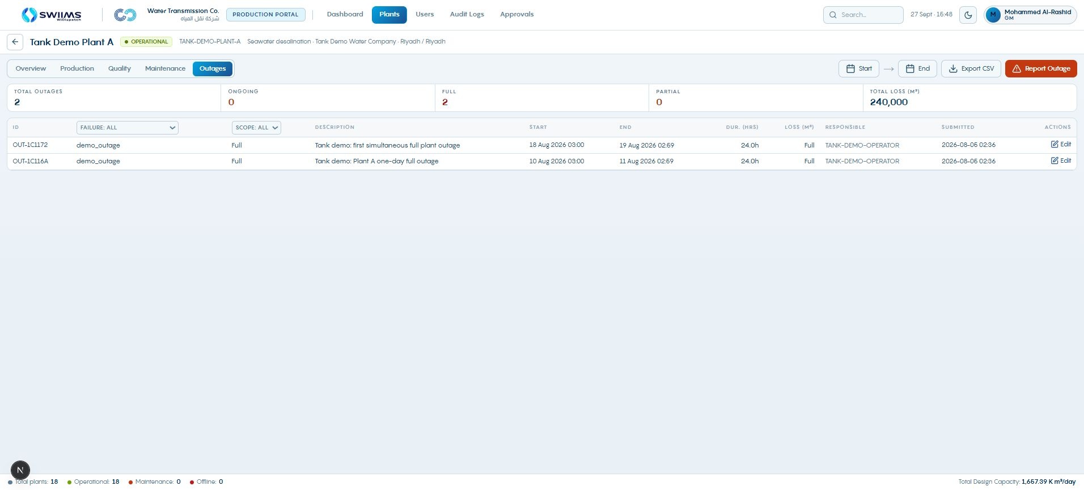
Outage records and operating impact
01
Open the asset’s Outages tab.
02
Check full or partial scope and the event window.
03
Review loss and whether the outage is ongoing.
Outage timing can change availability on more than one planning day.
WIDispatch / Client demonstration
14
Notes:
Source: Production Outages screen. Existing Tank Demo Plant A events are used. Confirm local time and day boundaries. This is distinct from planned maintenance.
Demonstration guidance: Screenshots are sample application states. Use approved trial data for live input and publication.

Slide 15
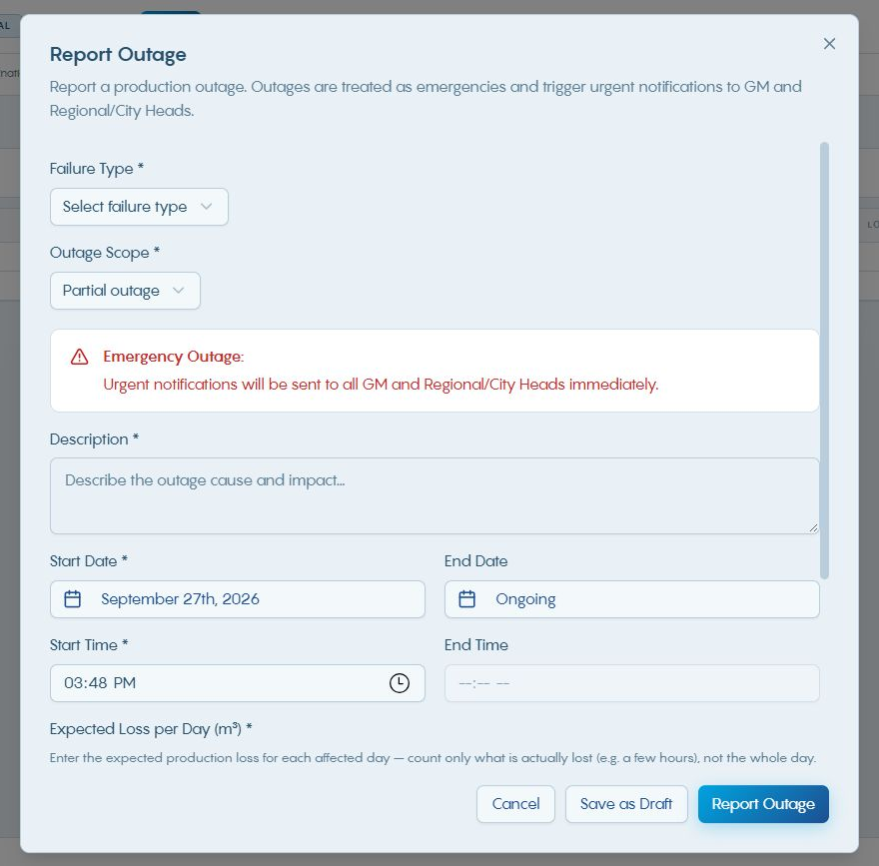
Reporting an outage
01
Choose the failure type and outage scope.
02
Enter timing, cause and expected daily loss.
03
Report the event and update actual loss after it ends.
An ongoing outage has no confirmed end time. Update it when recovery is known.
WIDispatch / Client demonstration
15
Notes:
Source: Production Report Outage dialog. The partial-outage form accepts expected losses by day. Actual loss remains disabled until the event end is in the past. The screenshot is an unsubmitted form. No alert was sent for this presentation.
Demonstration guidance: Screenshots are sample application states. Use approved trial data for live input and publication.

Slide 16
Outage notification and planner response
Desktop alert
Operating review
Planning response
A new-event toast identifies the asset and full or partial outage. Selecting it opens the affected asset’s outage view.
Inspect the event record, effective capacity and impacted days. Confirm whether the event is still ongoing.
Update the scenario assumptions, rerun dispatch and review the new shortage before publishing revised decisions.
The alert starts the response. The updated run provides the decision evidence.
WIDispatch / Client demonstration
16
Notes:
Source: frontend/src/components/production/OutageNotificationToast.jsx. Desktop polls every 10 seconds, suppresses already-seen IDs and surfaces recent first-load events from the last five minutes. It routes plant, pump and city-gate events to their respective views. No fresh notification was triggered during capture. The portal form promises urgent management notifications, but email recipient coverage and delivery require deployment-specific verification. Do not promise confirmed email delivery in this demonstration.
Demonstration guidance: Screenshots are sample application states. Use approved trial data for live input and publication.

Slide 17
Quality and outages complete the operating picture
Quality records
Outage records
Capacity impact
Record the sample date and parameter readings. Review compliance flags and any supporting remarks.
Identify the affected asset, outage scope and timing. Record the actual loss or full outage as applicable.
Check the effective capacity for the same planning day before accepting a dispatch result.
Quality and outage entry follow different rules from production and preventive-maintenance approval.
WIDispatch / Client demonstration
17
Notes:
In the current Production role rules, quality and outage records save directly or auto-approve, while production inputs and preventive maintenance require approval. Do not tell users that every record passes through the same queue. Water-quality visibility does not by itself establish a quality-constrained dispatch model. Source: WIDispatch-Production/lib/rbac.ts requiresApproval; PRD PR-003; Desktop capacity.js.
Demonstration guidance: Screenshots are sample application states. Use approved trial data for live input and publication.

Slide 18
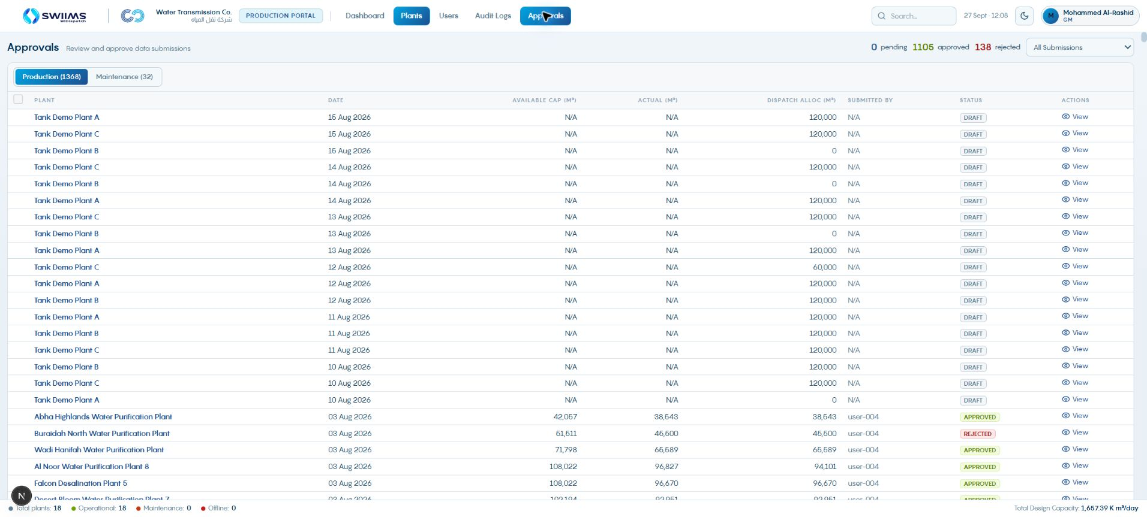
Production submission approval
01
Open Approvals and choose the record type.
02
Review the asset, day, quantity and submitter.
03
Approve a valid submission or reject it with a reason.
The portal’s submission status remains separate from Desktop dispatch allocation.
WIDispatch / Client demonstration
18
Notes:
The screenshot shows All Submissions, including existing draft allocation records and historical submissions. For a live approval walkthrough use Pending Review and an eligible submission. Current Production supports selection and bulk action, with individual reasons required for bulk rejection. View opens the plant page. Source: Production Approvals screen and components/approvals/approvals-view.tsx.
Demonstration guidance: Screenshots are sample application states. Use approved trial data for live input and publication.

Slide 19
Demand Portal: requirements and reconciliation
Purpose
What it does
Objective
Capture water requirements at city gates and support delivery reconciliation.
Record demand for approval and maintain receiving-point operating information and actual receipts.
Establish an approved demand basis and reveal differences between requirements and operational outcomes.
WIDispatch / Client demonstration
19
Notes:
The Demand Portal expresses what receiving points need for a defined date range. Keep requested demand, the planner’s allocation and actual received water distinct. The current portal table does not expose every published Desktop decision field, so use Desktop Decisions when reviewing the planner’s approved quantity and comment. Transition: use the Demand dashboard to identify a delivery gap, then open the relevant city gate and its demand entry. Sources: demonstrated Demand dashboard, demand approval and reconciliation views; PRD PR-004 and PR-015.

Slide 20
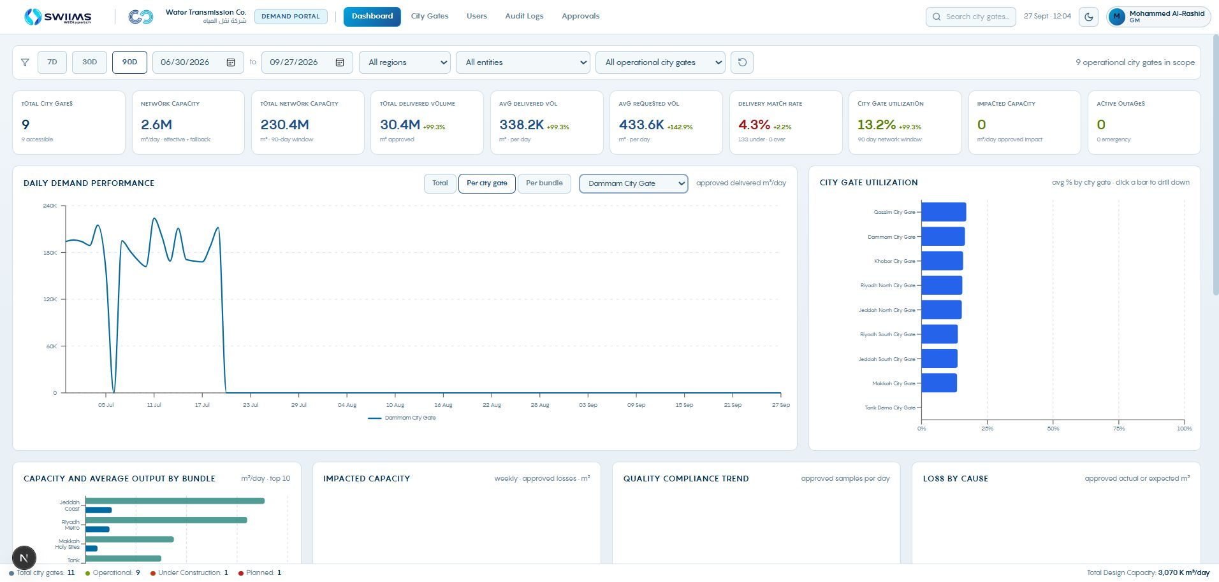
Demand starts at the city gate
01
Use the dashboard to identify delivery gaps.
02
Open City Gates and select the delivery point.
03
Check the requested period and capacity context.
Requested demand, approved allocation and actual delivery answer different questions.
WIDispatch / Client demonstration
20
Notes:
The demand dashboard contains historical sample data. Show the selected date window before interpreting any KPI. Requested volume is the need. The planner’s published quantity is the operating decision. Actual delivered and received quantities support reconciliation after operation. Source: Demand dashboard; PRD PR-004 and PR-015.
Demonstration guidance: Screenshots are sample application states. Use approved trial data for live input and publication.

Slide 21
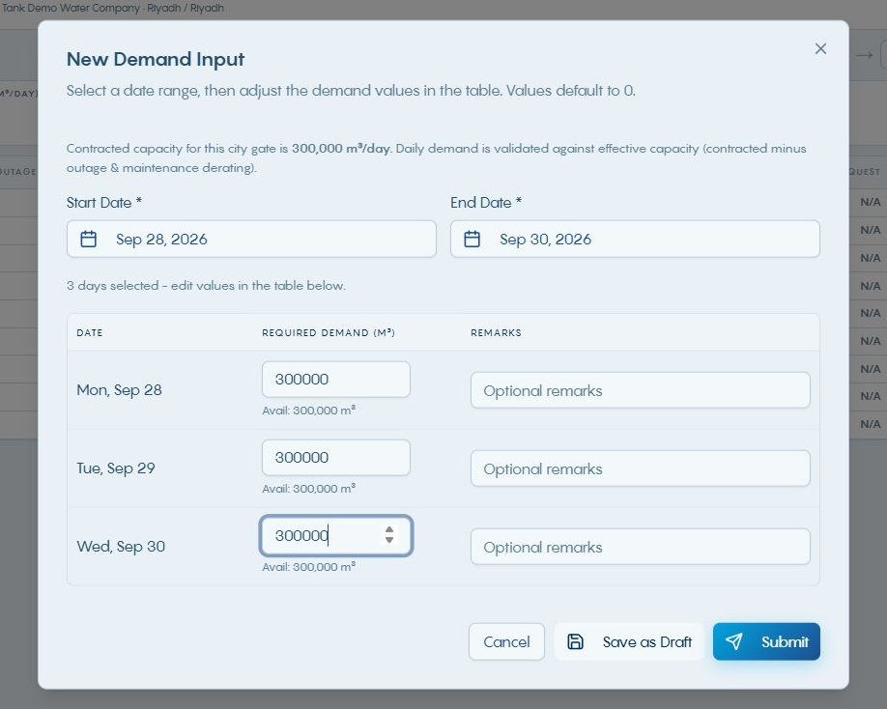
Entering city-gate demand
01
Choose a start date and end date.
02
Enter the daily quantities in the generated table.
03
Save the draft or submit the completed request.
Daily demand is checked against effective city-gate capacity.
WIDispatch / Client demonstration
21
Notes:
The screenshot shows an unsaved example for 28–30 September with 300,000 m³ per day. Selecting a valid range reveals the daily demand grid, initially zero. The form was cancelled after capture, and no request was submitted. Review every day and do not leave unintended zeros. The current form validates against contracted capacity minus maintenance and outage derating. Source: Demand New Demand Input form and demand-input-form implementation.
Demonstration guidance: Screenshots are sample application states. Use approved trial data for live input and publication.

Slide 22
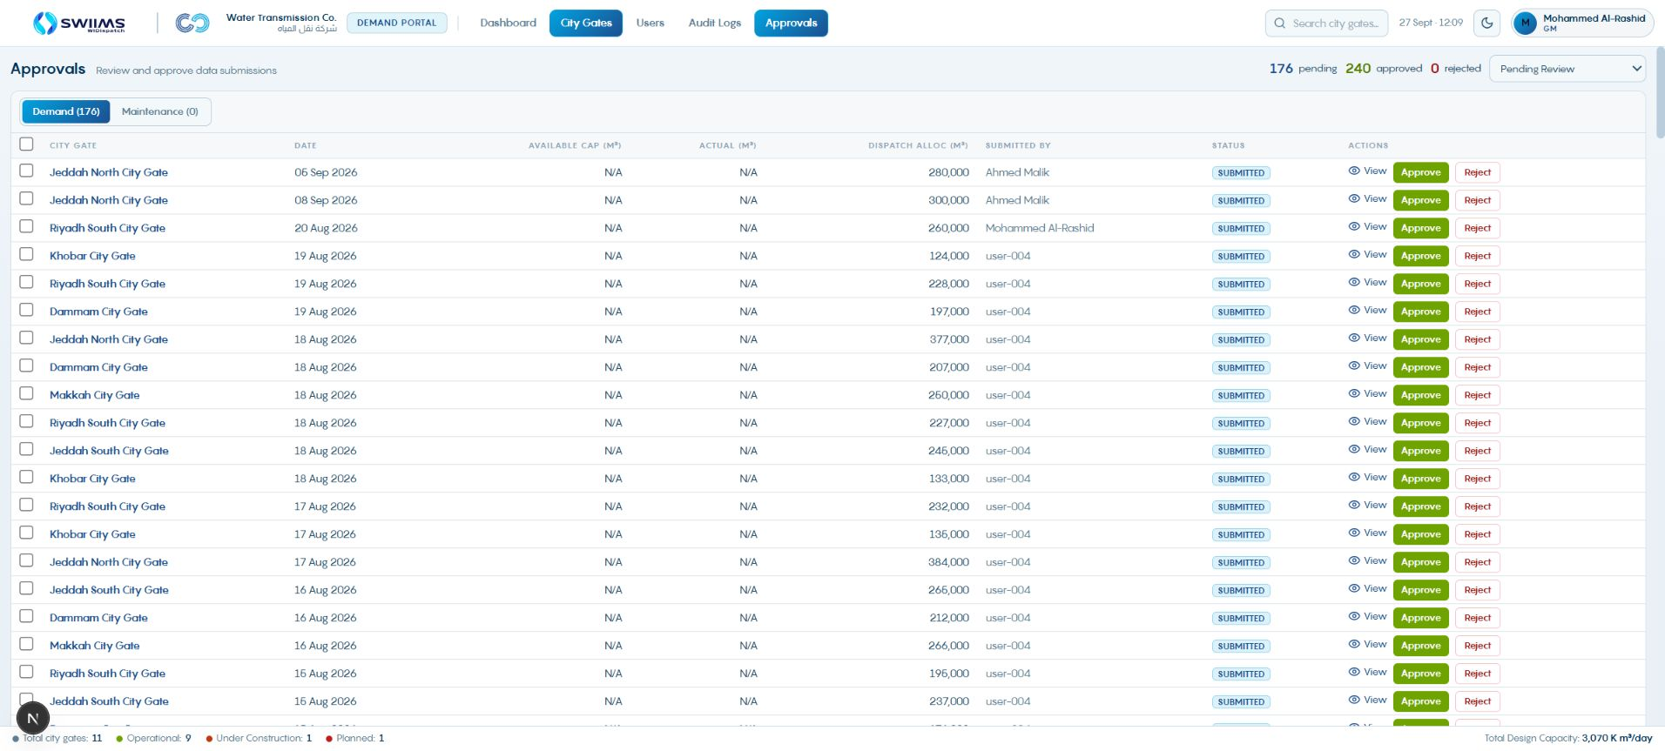
Demand approval and correction
01
Filter Approvals to Pending Review.
02
Open the city-gate record and check daily demand.
03
Approve, or reject with a specific correction reason.
The operator revises the input and resubmits before the planner uses the approved demand.
WIDispatch / Client demonstration
22
Notes:
This screenshot contains pending submissions with View, Approve and Reject controls. No approval is performed by the presentation. For a rejection, describe what should change, for example the date or volume and its supporting basis. Keep the requested demand intact when discussing a later dispatch reduction. Source: Demand Approvals screen; PRD PR-002 and PR-004.
Demonstration guidance: Screenshots are sample application states. Use approved trial data for live input and publication.

Slide 23
Transmission Portal: network availability and water movement
Purpose
What it does
Objective
Provide operational visibility into the infrastructure carrying water between supply and receiving points.
Display Desktop-authored systems and lines, pump availability, maintenance and outages, and receipt/delivery records.
Represent transmission constraints accurately and support reconciliation of water movement.
WIDispatch / Client demonstration
23
Notes:
The portal connects the saved system structure with the operating condition of transmission assets and records of water movement. Desktop authors the systems and lines. Explain pump throughput, line capacity and receipt/delivery records as distinct information. Do not add pump and line capacities together to describe system size. Transition: start with the Transmission dashboard, then inspect its systems page before reviewing individual pump stations. Sources: demonstrated Transmission dashboard, systems list/detail, pump availability and reconciliation views.

Slide 24
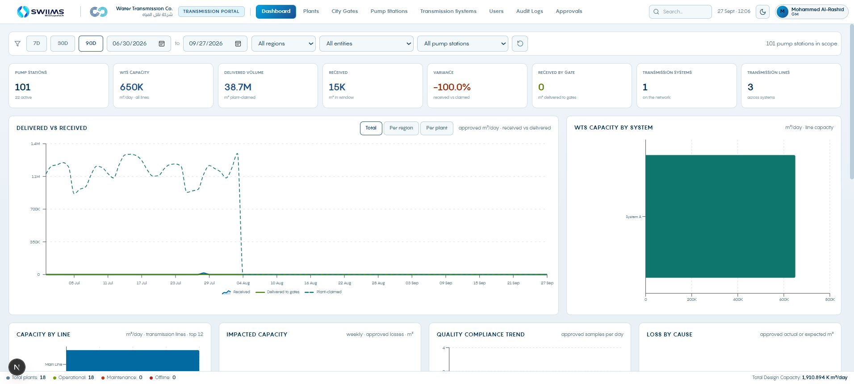
Transmission dashboard
01
Review capacity and operating exceptions.
02
Check the date range and system context.
03
Continue into systems or individual pump stations.
System capacity and pump availability describe different constraints.
WIDispatch / Client demonstration
24
Notes:
Source: Transmission dashboard. Do not add pump capacity to logical line capacity when explaining WTS size.
Demonstration guidance: Screenshots are sample application states. Use approved trial data for live input and publication.

Slide 25
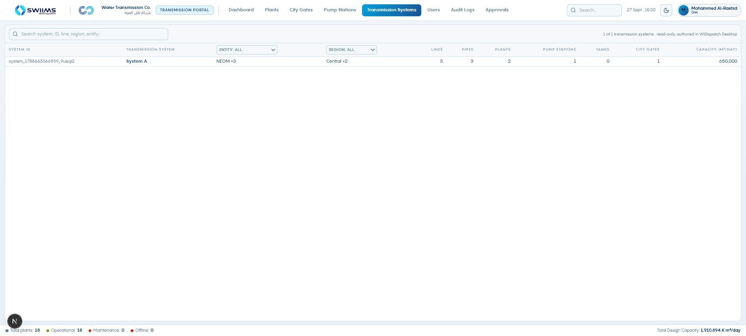
Transmission systems in the portal
01
Open Transmission Systems.
02
Find the Desktop-authored system.
03
Select it to review lines and connected assets.
The portal provides the operating view of the saved network structure.
WIDispatch / Client demonstration
25
Notes:
Source: Transmission systems list. System A is the saved example. Systems and lines originate in Desktop.
Demonstration guidance: Screenshots are sample application states. Use approved trial data for live input and publication.

Slide 26
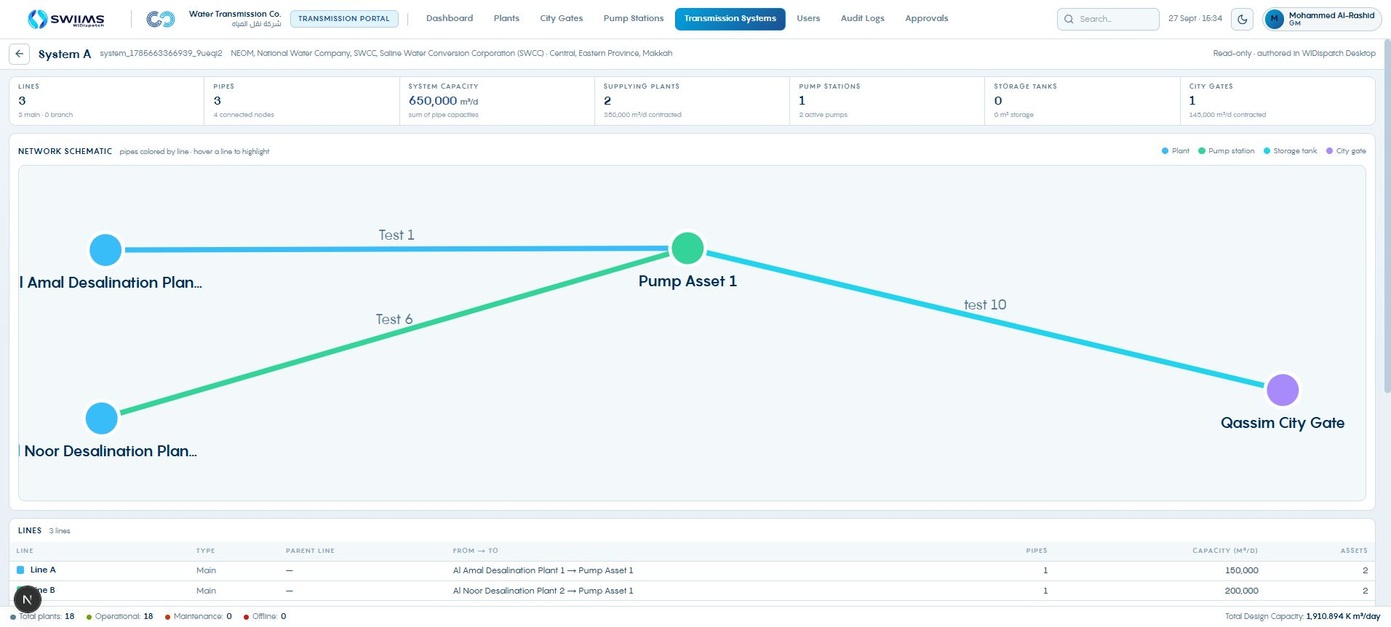
The system schematic and line details
A system view connects its schematic to registered lines and supplying assets.
WIDispatch / Client demonstration
26
Notes:
Source: Transmission System A detail. Three registered main lines, four saved nodes and three saved pipes. The displayed system aggregate is not proof of end-to-end deliverable flow. Explain source, pump and receiving-gate constraints separately.
Demonstration guidance: Screenshots are sample application states. Use approved trial data for live input and publication.

Slide 27
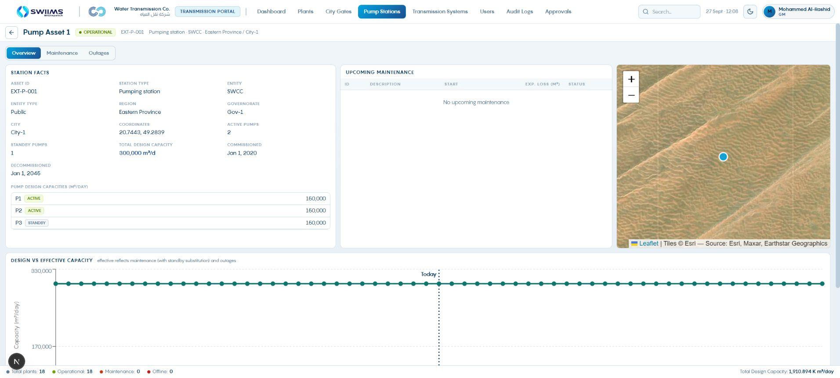
Transmission availability at pump level
01
Open Pump Stations and select the station.
02
Review functional and standby pumps.
03
Confirm effective capacity across the planning window.
A standby pump contributes through a valid substitution, not merely because it exists.
WIDispatch / Client demonstration
27
Notes:
Pump Asset 1 shows two functional pumps and one standby, each 150,000 m³/day. Explain why normal functional capacity is 300,000 m³/day. The overview plots effective capacity after maintenance and outages. Source: Transmission station overview; Desktop capacity.js stationPumps and activeFunctionalPumps.
Demonstration guidance: Screenshots are sample application states. Use approved trial data for live input and publication.

Slide 28
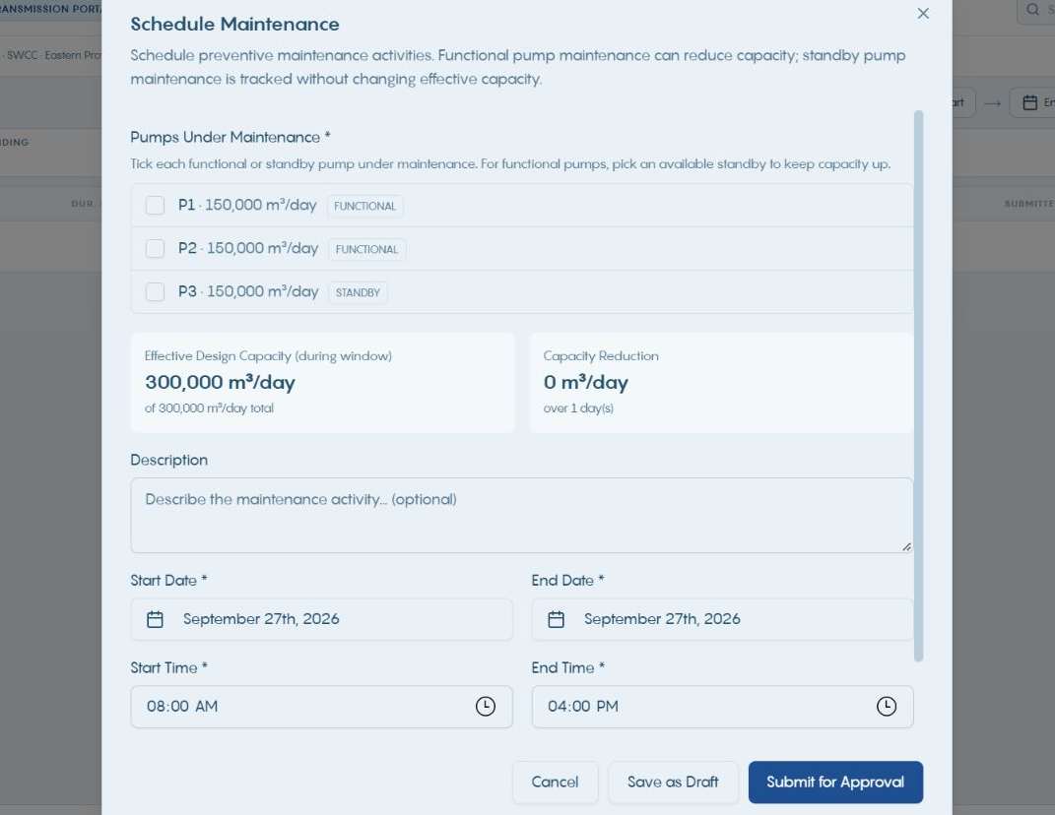
Pump maintenance and standby substitution
01
Select the pumps that will be unavailable.
02
Assign an available standby where appropriate.
03
Check capacity reduction and submit the maintenance.
The form shows the effect on station capacity before submission.
WIDispatch / Client demonstration
28
Notes:
Functional pump maintenance can reduce throughput. Standby maintenance is tracked without directly removing active capacity. A standby substitution can cover lost functional capacity subject to the recorded configuration. This is a separate Transmission form, not the plant daily-loss form. Source: Transmission Schedule Maintenance dialog; PRD PR-005.
Demonstration guidance: Screenshots are sample application states. Use approved trial data for live input and publication.

Slide 29
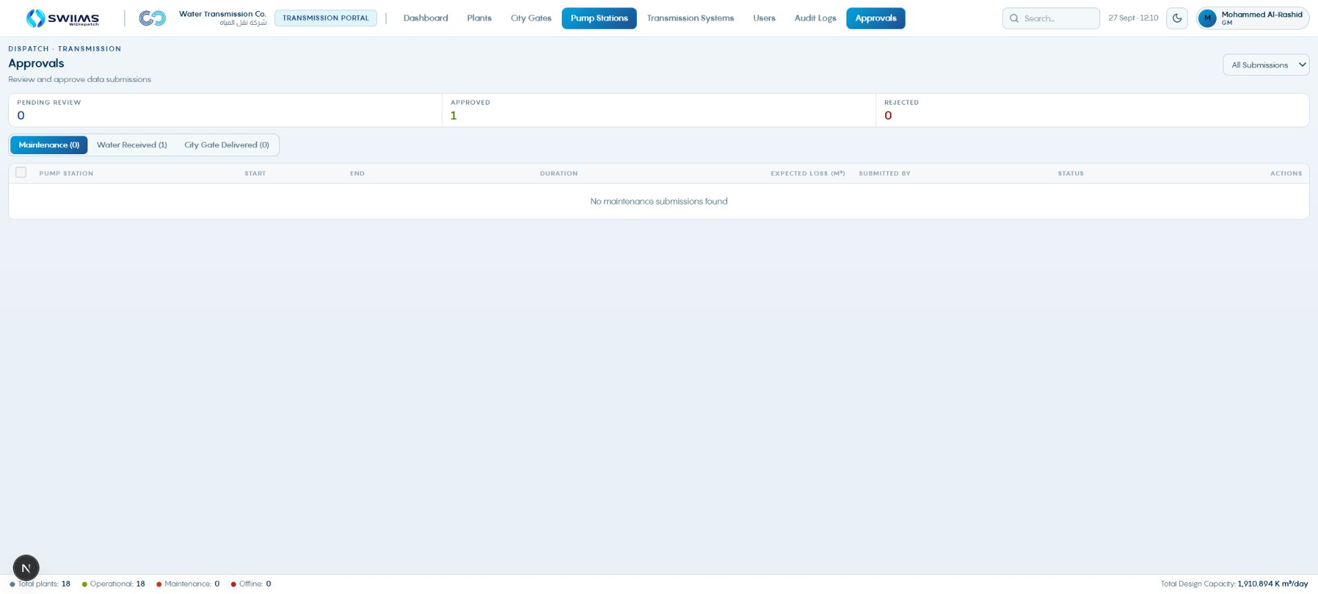
Transmission approvals
01
Review Maintenance, Water Received or City Gate Delivered.
02
Check the correct asset and reporting date.
03
Approve or return an invalid submission with a clear reason.
Receipts and deliveries are operational evidence for reconciliation.
WIDispatch / Client demonstration
29
Notes:
The current approval screen exposes three record-type queues. The captured queue is an existing state and may be empty under the selected filter. Receipt and delivered forms accept past dates, yesterday or earlier, and include quantity and quality readings. These actual records belong after execution in the cycle. Source: Transmission Approvals; received-record-form.tsx and delivered-record-form.tsx.
Demonstration guidance: Screenshots are sample application states. Use approved trial data for live input and publication.

Slide 30
Economics Portal: approved cost assumptions
Purpose
What it does
Objective
Maintain the approved, effective-dated cost information used in planning and financial review.
Support cost proposals and approvals, including variable O&M, fixed costs and capital information.
Give dispatch a traceable variable operating-cost basis and support review of operating outcomes.
WIDispatch / Client demonstration
30
Notes:
Emphasize the effective date and approved status of a cost snapshot. The financial records contain several cost categories, while the dispatch calculation uses variable O&M. Publication of a dispatch decision does not rewrite the approved economic snapshot. Transition: open the Economics dashboard, then inspect the financial record and follow a cost proposal through approval. Sources: demonstrated Economics dashboard, Financials, proposals and approvals; PRD PR-006; Product Profile p. 3.

Slide 31
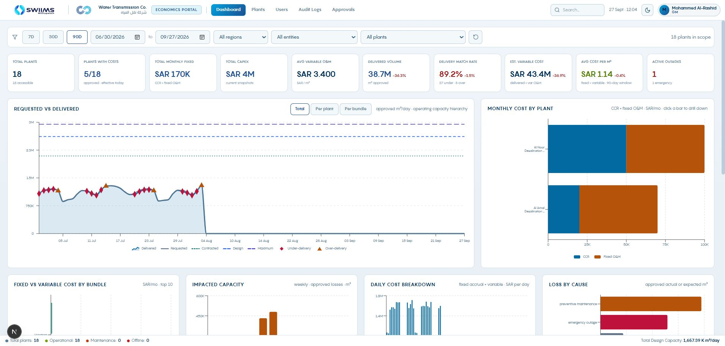
Economics dashboard
01
Check the operating period and accessible plants.
02
Review the cost and production context.
03
Open Financials for the effective cost records.
The cost basis must match the dispatch period.
WIDispatch / Client demonstration
31
Notes:
Source: Economics dashboard. Approved production availability depends on account scope and period. Do not infer missing source data solely from an empty dashboard panel.
Demonstration guidance: Screenshots are sample application states. Use approved trial data for live input and publication.

Slide 32
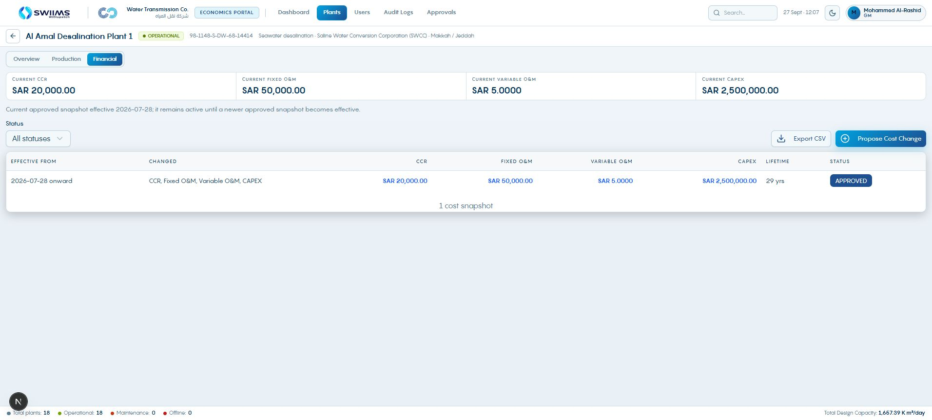
Economics uses effective cost snapshots
01
Open the plant’s Financial tab.
02
Check the current approved snapshot and effective date.
03
Review variable O&M separately from fixed cost and CAPEX.
The approved snapshot remains active until a newer approved snapshot becomes effective.
WIDispatch / Client demonstration
32
Notes:
Explain SAR/month for CCR and fixed O&M, SAR/m³ for variable O&M, and SAR for CAPEX. This example shows Al Amal. The later outage scenario uses the separate Tank Demo costs. The dispatch objective uses variable O&M, not a total lifecycle-cost optimization. Source: Economics Financial tab; Product Profile p. 3; PRD PR-006.
Demonstration guidance: Screenshots are sample application states. Use approved trial data for live input and publication.

Slide 33
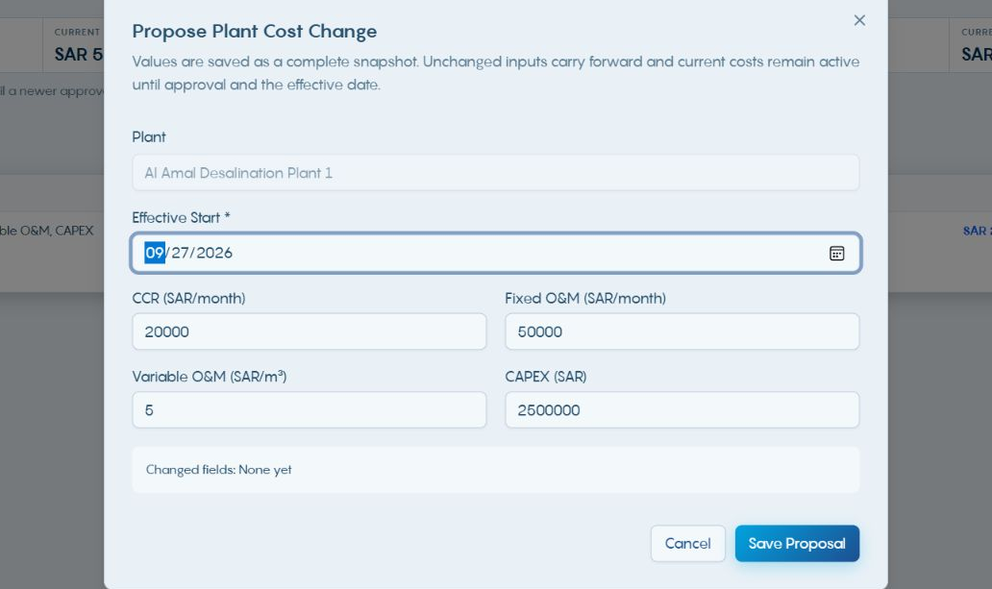
Proposing a cost change
01
Choose Propose Cost Change.
02
Set the effective start and revise the relevant values.
03
Check the changed fields, then Save Proposal.
Unchanged values carry forward in the complete proposed snapshot.
WIDispatch / Client demonstration
33
Notes:
A saved proposal does not immediately replace current approved economics. The approval and effective date determine when it applies. Demonstrate a future effective date conceptually, without saving a commercial change. Source: Economics Propose Plant Cost Change dialog.
Demonstration guidance: Screenshots are sample application states. Use approved trial data for live input and publication.

Slide 34
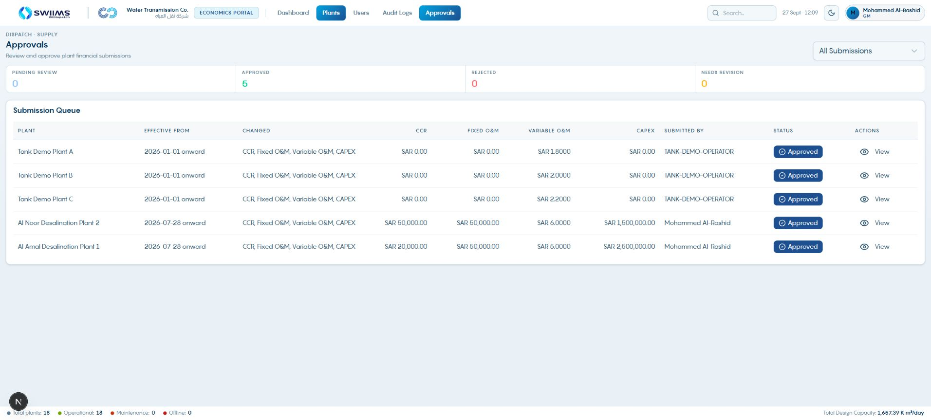
Economic approval activates the cost basis
01
Review the plant, effective date and changed fields.
02
Approve, Reject or request Revision as appropriate.
03
Check the active financial snapshot after approval.
A rejection or revision request requires a useful reason.
WIDispatch / Client demonstration
34
Notes:
The screen shows approved snapshots including 1.80, 2.00 and 2.20 SAR/m³ for Tank Demo Plants A, B and C. These are the costs in the worked scenario. Pending records expose action buttons. Rejection and Revision require comments in the current implementation. Source: Economics Approvals screen and approvals-view.tsx.
Demonstration guidance: Screenshots are sample application states. Use approved trial data for live input and publication.

Slide 35
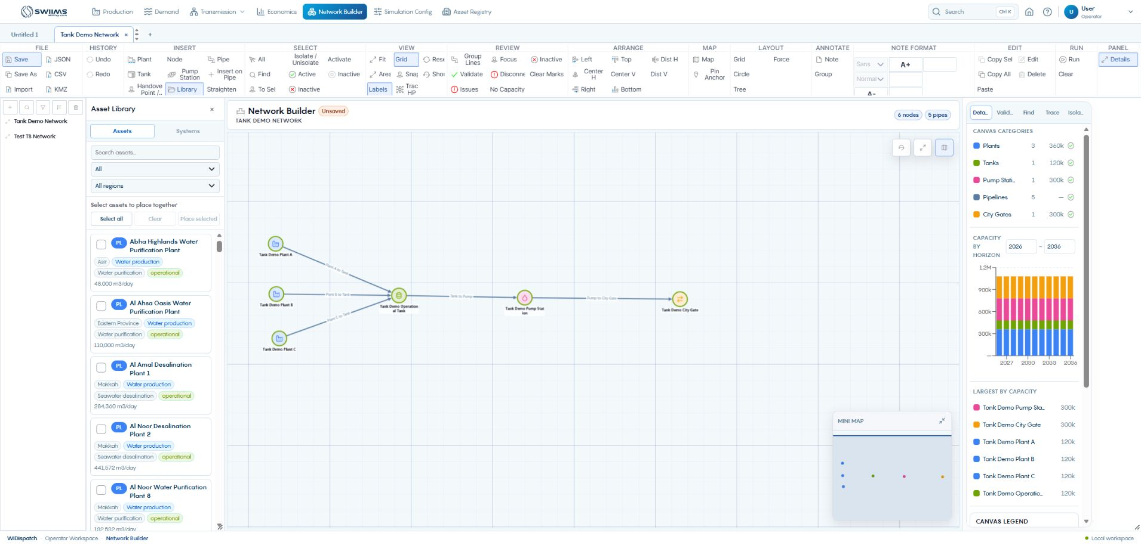
Building a network from registered assets
01
Open Network Builder and create a new network.
02
Filter the Asset Library and select the required assets.
03
Place the selected assets on the canvas.
Registered assets preserve the link to operational inputs.
WIDispatch / Client demonstration
35
Notes:
The screenshot shows an existing demonstration network and the library controls used to build it. Explain Plant, Tank, Pump Station and Handover Point tools. Existing library assets are preferred when demonstrating operational linkage. The six-node example contains three plants, one tank, one station and one city gate. Source: Desktop Network Builder.
Demonstration guidance: Screenshots are sample application states. Use approved trial data for live input and publication.

Slide 36
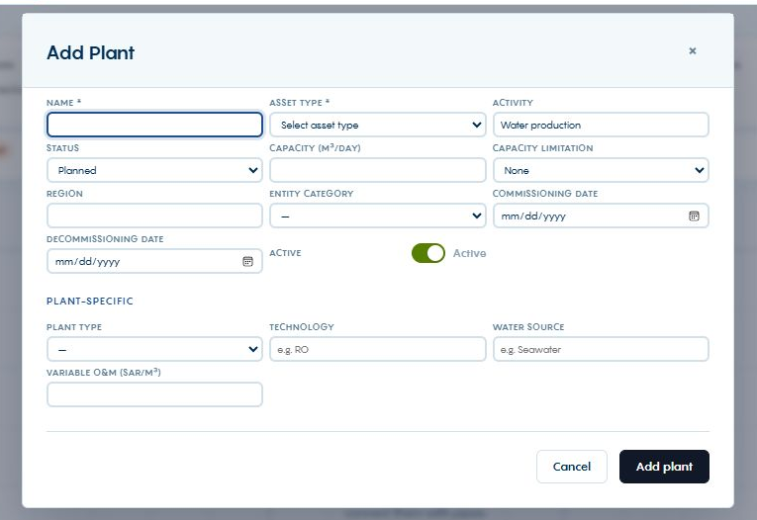
New assets from the canvas toolbar
01
Choose Plant, Tank, Pump Station or Handover Point.
02
Click the intended position on the canvas.
03
Complete the asset form and add the asset.
The quick-add form creates a registry asset as well as placing it on the network.
WIDispatch / Client demonstration
36
Notes:
Source: NetworkEntityCreateModal.jsx and observed Add Plant dialog. Required fields vary by type. The form was opened and cancelled during capture. Use Node for a junction. Creating operational master data requires a valid name, type and specifications.
Demonstration guidance: Screenshots are sample application states. Use approved trial data for live input and publication.

Slide 37
Library placement and drag-and-drop
Find an asset
Place a group
Place one asset
Search by name and filter category or region. Check the registry identity and capacity before placement.
Select the asset checkboxes and choose Place selected. Click the canvas where the group should appear.
Drag the library asset onto the canvas, or select it and place it. Existing canvas assets show an on-canvas state.
Library assets preserve the identity needed to read portal inputs.
WIDispatch / Client demonstration
37
Notes:
Source: NetworkPalette and NetworkBuilderPage. The earlier library screenshot shows selection and placement controls. Avoid duplicate registry identities. Positioning changes the drawing, while source records remain in the portals.
Demonstration guidance: Screenshots are sample application states. Use approved trial data for live input and publication.

Slide 38
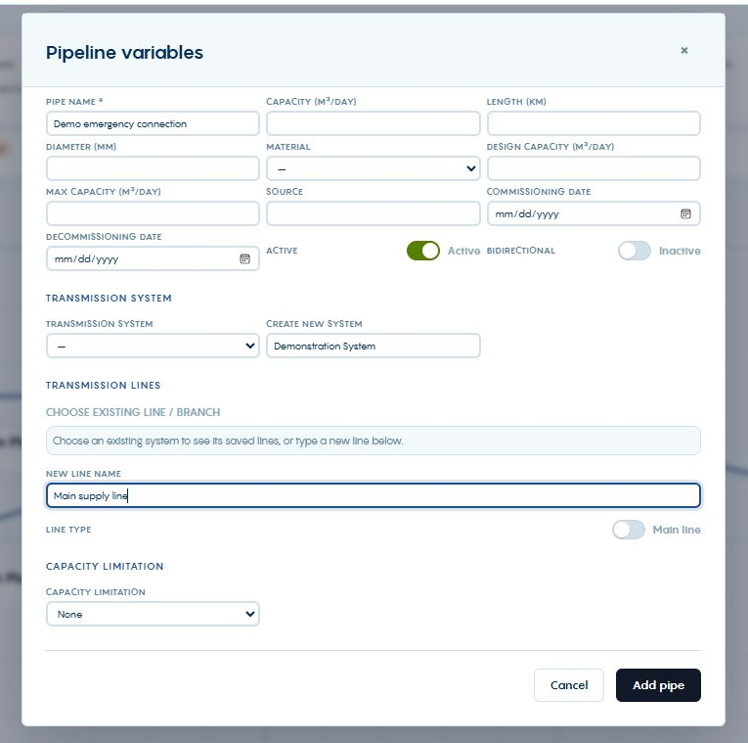
Pipe variables and system creation
01
Choose Pipe, then click source and destination.
02
Enter capacity, direction and lifecycle dates.
03
Select a system or name a new system and line.
A pipe segment can belong to a named transmission line within a system.
WIDispatch / Client demonstration
38
Notes:
Source: observed Pipeline variables dialog and PipeVariablesModal.jsx. Demonstration System and Main supply line are unsaved form examples. Add pipe creates the new system/line references and adds the connection. Save the network to preserve the reusable geometry. The saved System A shown next illustrates the resulting structure.
Demonstration guidance: Screenshots are sample application states. Use approved trial data for live input and publication.

Slide 39
Main lines and branches
System
Line
Branch
The named collection used for inspection, reporting and library reuse.
A logical line can contain multiple pipe segments. Assign it in the pipe form or element details.
Choose a parent line when creating a branch. Give the branch a meaningful operational name.
System, logical line and pipe segment are separate levels of the network.
WIDispatch / Client demonstration
39
Notes:
Source: TransmissionLinePicker.jsx and transmissionLines.js. The Group Lines toolbar command is currently a placeholder. Use the implemented system and line fields in pipe forms instead.
Demonstration guidance: Screenshots are sample application states. Use approved trial data for live input and publication.

Slide 40
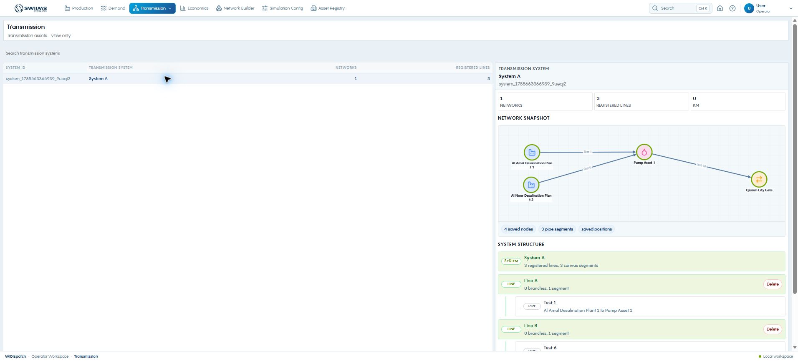
The saved system in Desktop
01
Open Transmission, then Transmission Systems.
02
Select the saved system.
03
Inspect its network snapshot and line structure.
The saved structure supplies the reusable system in the canvas library.
WIDispatch / Client demonstration
40
Notes:
Source: observed Desktop System A. It contains one saved network, three registered lines and three canvas segments. A system name without a saved network bundle does not provide reusable geometry.
Demonstration guidance: Screenshots are sample application states. Use approved trial data for live input and publication.

Slide 41
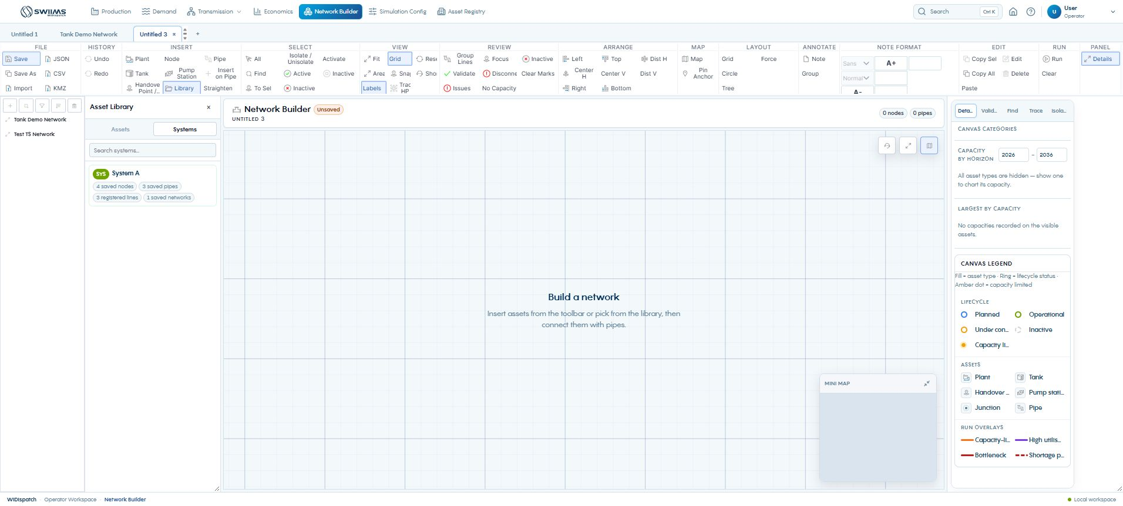
The Systems library
01
Open Library and select Systems.
02
Search for the required system.
03
Check saved nodes and saved pipes before placement.
Reusable systems bring their saved nodes and connections together.
WIDispatch / Client demonstration
41
Notes:
Source: Desktop Systems library. System A has four saved nodes and three saved pipes. The screenshot shows the library before placement.
Demonstration guidance: Screenshots are sample application states. Use approved trial data for live input and publication.

Slide 42
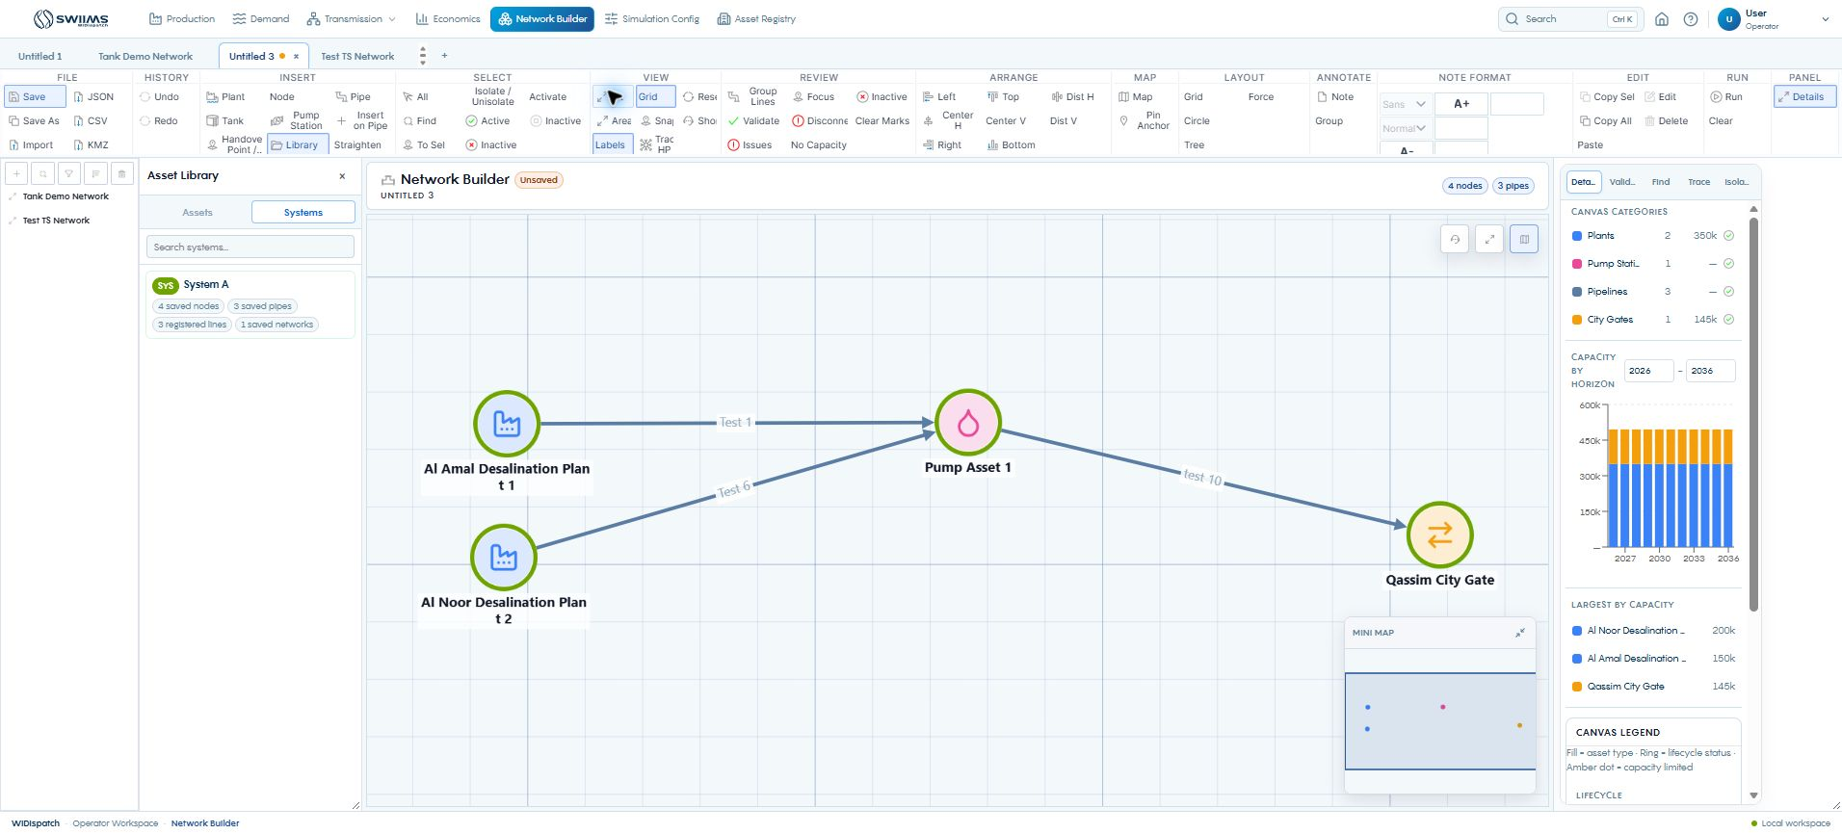
A complete system placed on the canvas
Select the system, then click the canvas to place its saved network structure.
WIDispatch / Client demonstration
42
Notes:
Source: live placement of System A into a separate unsaved demonstration network. The action reported four nodes and three pipes and the network rendered after refresh. Review the connections and save under the intended network name. Asset identities remain linked to registered assets.
Demonstration guidance: Screenshots are sample application states. Use approved trial data for live input and publication.

Slide 43
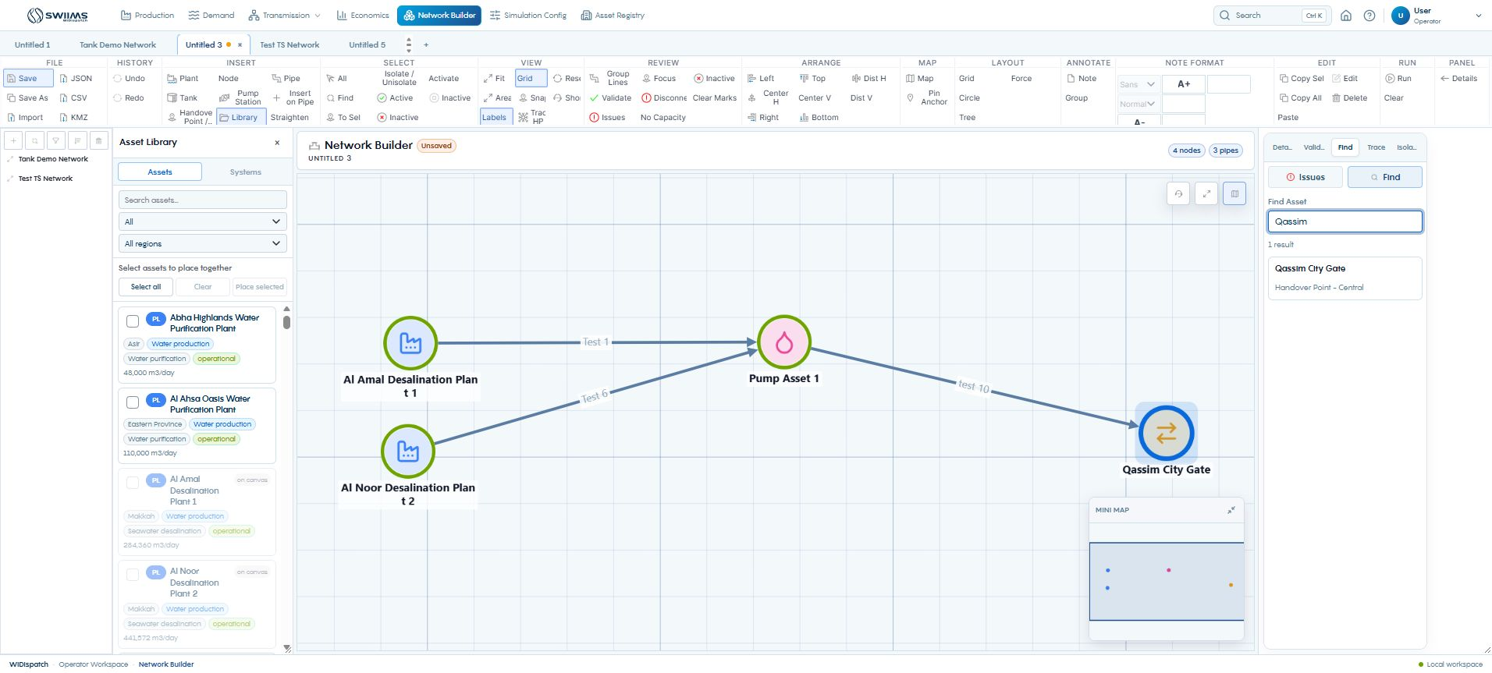
Finding an asset on the canvas
01
Open Find.
02
Search by name, ID, type or region.
03
Select a result to focus the matching element.
Find searches the current drawing. The library searches available source assets.
WIDispatch / Client demonstration
43
Notes:
Source: observed Qassim City Gate search. To Sel zooms to selected elements. Use Fit to restore the whole-network view.
Demonstration guidance: Screenshots are sample application states. Use approved trial data for live input and publication.

Slide 44
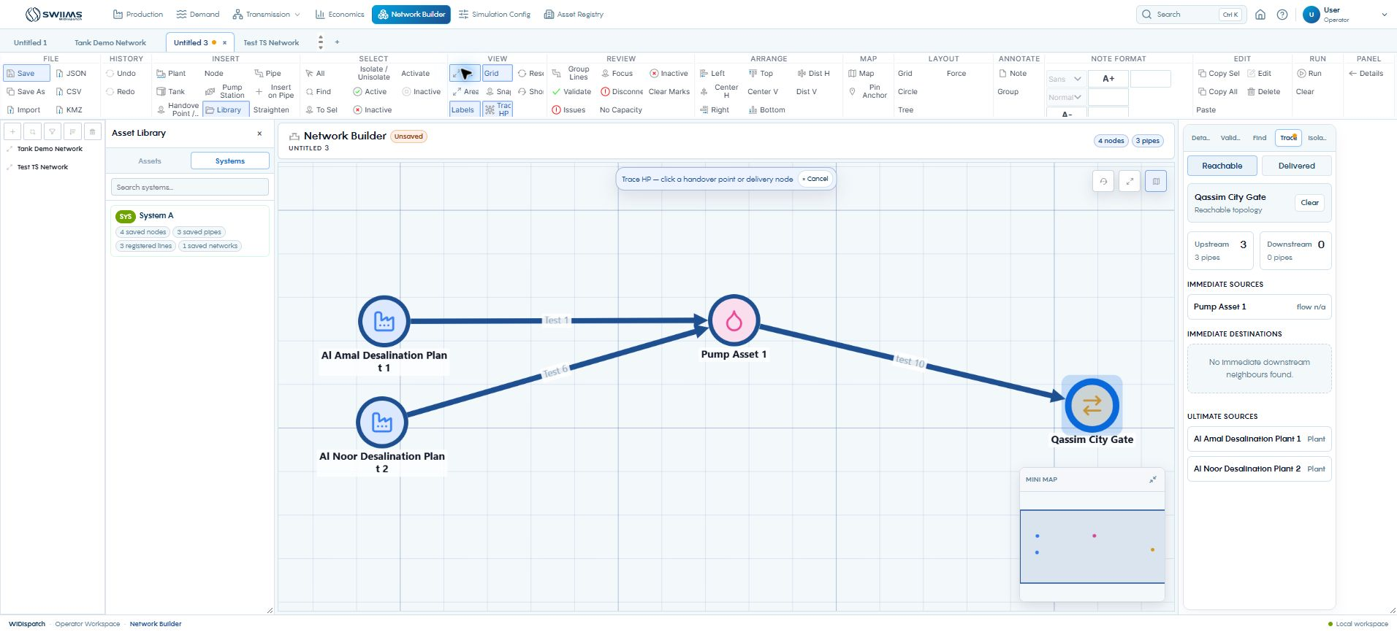
Tracing the upstream supply path
01
Turn on Trace HP.
02
Click a city gate or delivery node.
03
Inspect immediate and ultimate sources.
Reachable mode explains topology. Delivered mode needs simulation flow results.
WIDispatch / Client demonstration
44
Notes:
Source: observed Qassim City Gate trace. The example finds Pump Asset 1 as the immediate source and two plants as ultimate sources. A reachable path does not guarantee adequate capacity.
Demonstration guidance: Screenshots are sample application states. Use approved trial data for live input and publication.

Slide 45
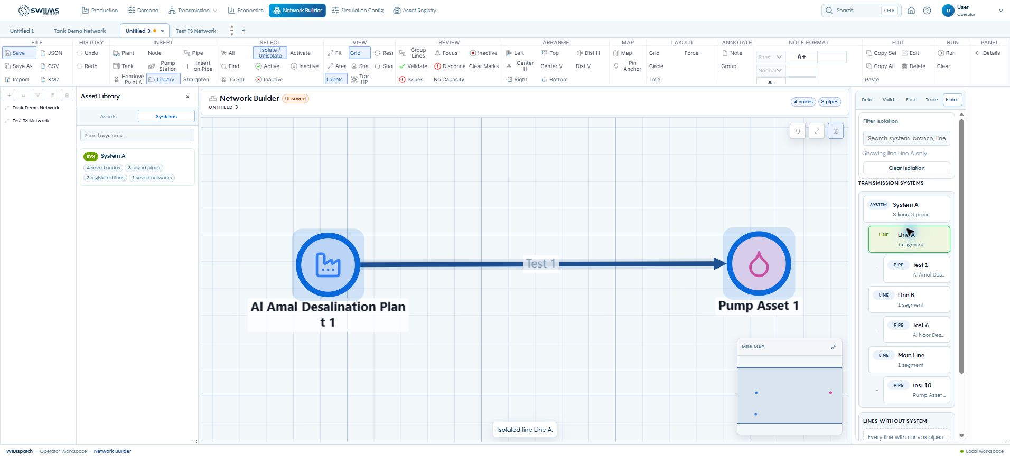
Isolating systems, lines and assets
01
Open Isolation and find the system or line.
02
Select a system, line, branch or pipe.
03
Clear Marks to restore the complete view.
Isolation changes what you inspect. It does not shut down the hidden assets.
WIDispatch / Client demonstration
45
Notes:
Source: observed Line A isolation in System A. Isolate / Unisolate also works with a canvas selection. Distinguish visibility filtering from active-state and simulation overrides.
Demonstration guidance: Screenshots are sample application states. Use approved trial data for live input and publication.

Slide 46
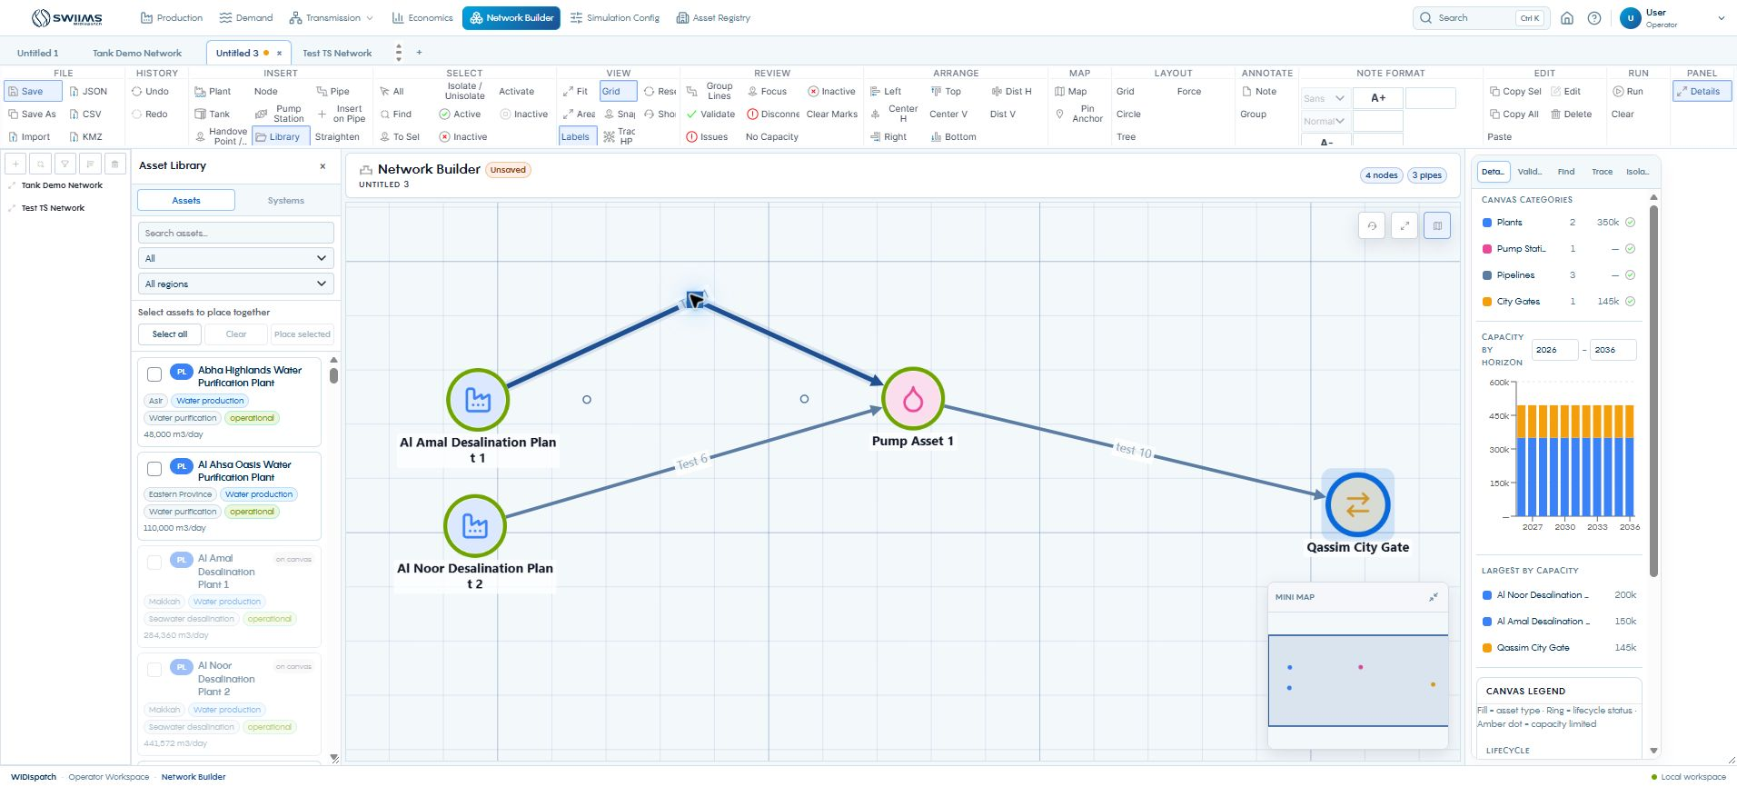
Pipe bends and route clarity
01
Select a pipe to reveal its handles.
02
Drag a midpoint to create or move a bend.
03
Remove a bend or use Straighten for all bends.
Bends improve schematic readability without changing the pipe’s capacity.
WIDispatch / Client demonstration
46
Notes:
Source: observed midpoint drag and Straighten control, cytoscape/bendEditing.js and NetworkBuilderPage. Double-click an existing bend to remove it. Context actions also add a bend, remove the nearest bend and remove all bends. Recheck direction after editing geometry.
Demonstration guidance: Screenshots are sample application states. Use approved trial data for live input and publication.

Slide 47
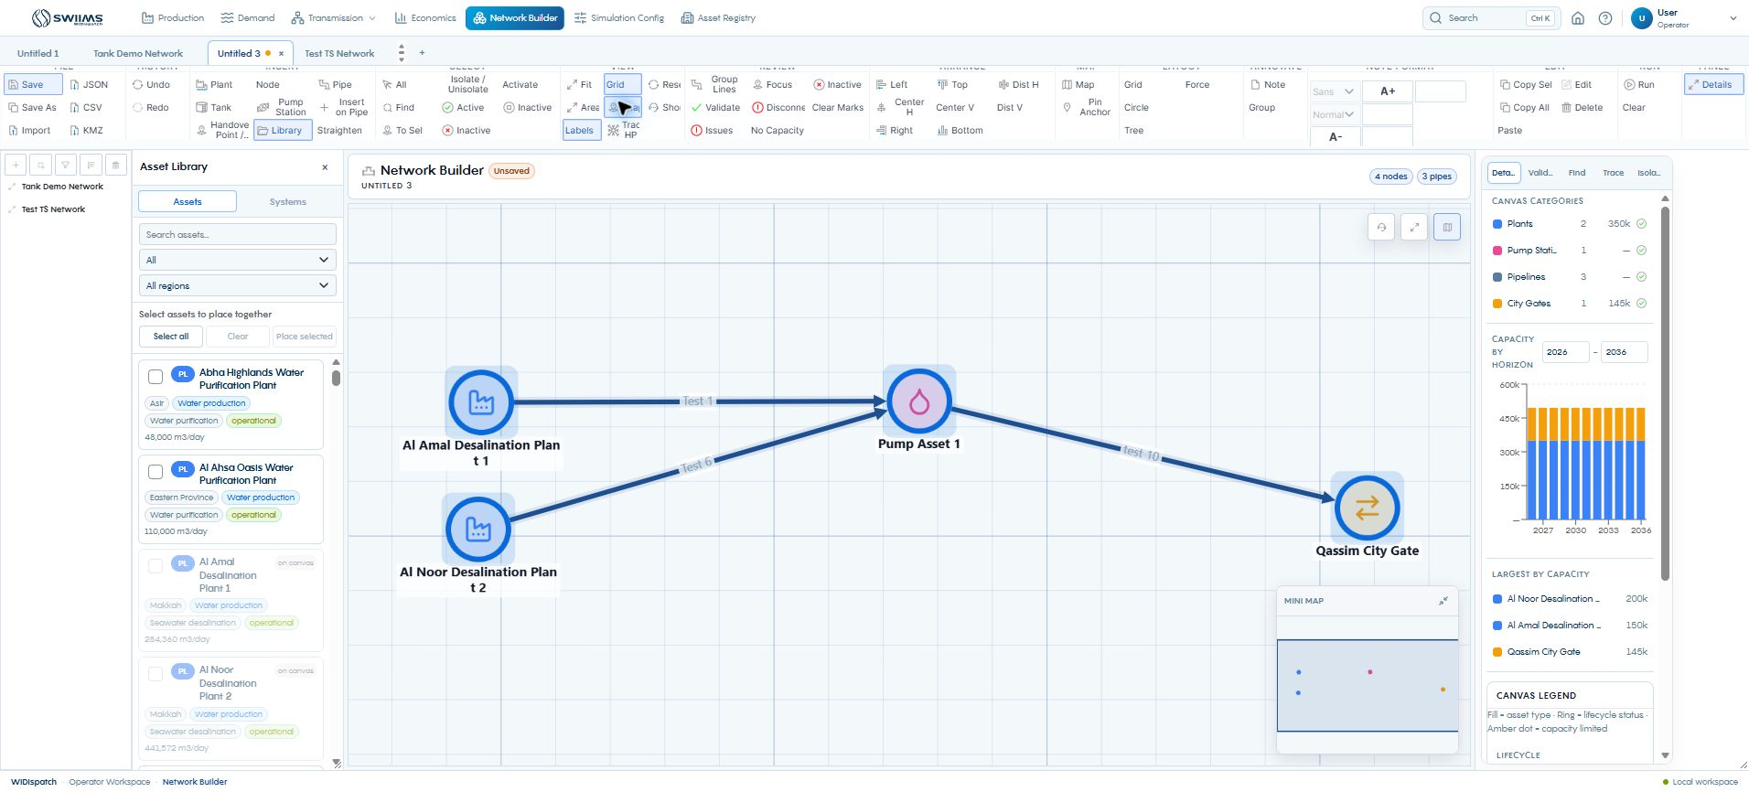
Alignment, grid and snapping
01
Select the assets to arrange.
02
Use alignment or equal-distribution controls.
03
Enable Grid and Snap for consistent placement.
Arrange affects the drawing. Hydraulic capacity and approved records stay separate.
WIDispatch / Client demonstration
47
Notes:
Source: observed toolbar and selected network. Left, Center H, Right, Top, Center V, Bottom, Dist H and Dist V arrange selections. Hold Alt to bypass snapping while moving. Grid, Circle, Tree and Force are alternate layouts. Use Undo if a layout obscures an important route.
Demonstration guidance: Screenshots are sample application states. Use approved trial data for live input and publication.

Slide 48
Active assets and disconnected paths
Availability
Diagnosis
Restoration
Use element details for asset active state and lifecycle. Activate/Inactive toolbar actions target selected pipes.
Use Disconnected, No Capacity and Inactive review filters. Validate lists errors and warnings with focus controls.
Fix the missing connection or specification, then validate again. Clear Marks resets selection and review highlights.
Visibility, active state and scenario inclusion have different effects.
WIDispatch / Client demonstration
48
Notes:
Source: NetworkBuilderPage and NetworkNodeDetails. Active/Inactive selection tools select matching elements, whereas activation controls change selected pipes. Disconnected finds isolated components. A capacity-free pipe may be treated as unconstrained by dispatch, so inspect its table value before running.
Demonstration guidance: Screenshots are sample application states. Use approved trial data for live input and publication.

Slide 49
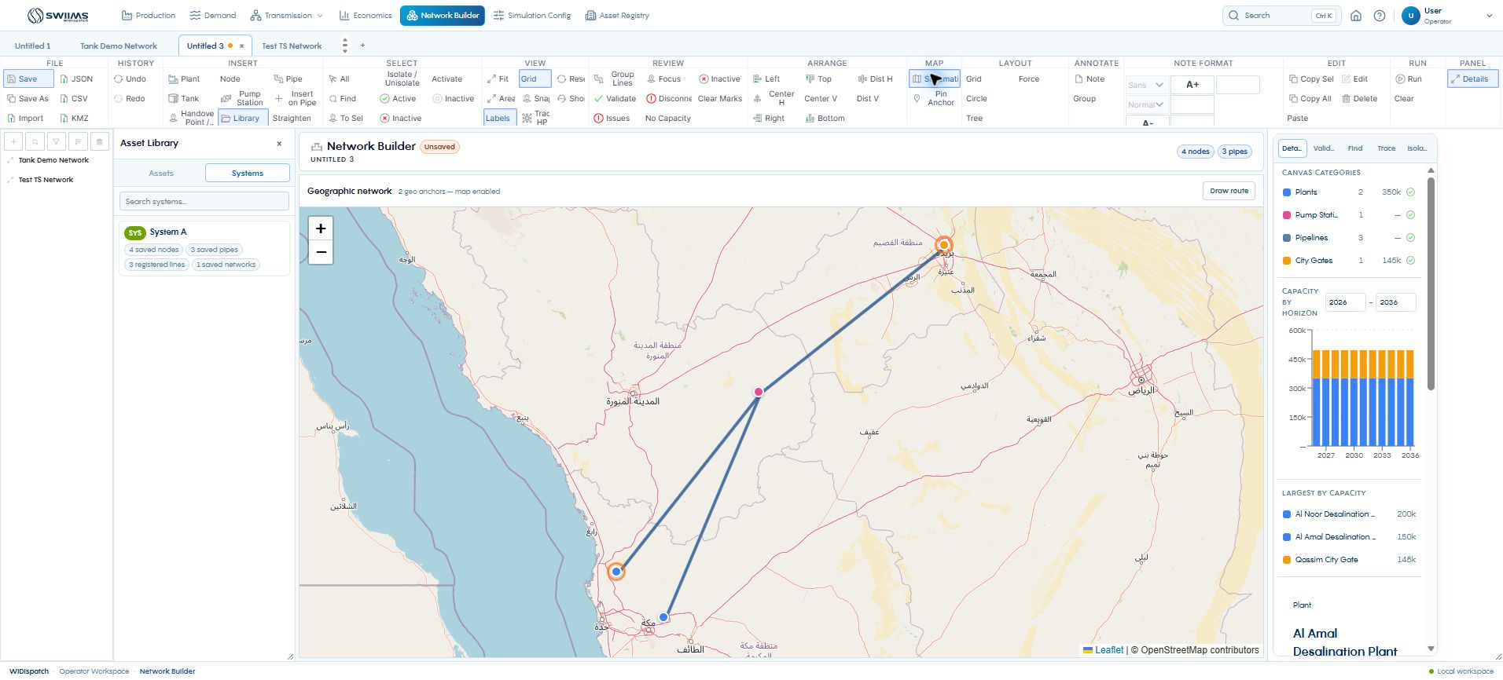
A schematic reflected on the map
01
Select an asset with known coordinates.
02
Pin at least two geographic anchors.
03
Open Map and inspect the projected network.
Anchor accuracy determines the geographic interpretation of the drawing.
WIDispatch / Client demonstration
49
Notes:
Source: observed Map view after pinning Al Amal and Qassim as anchors. Existing registered coordinates avoided manual location entry. Additional unanchored points follow the drawing-to-map transform and are not surveyed positions. Draw route is available in the map view. Return through Schematic.
Demonstration guidance: Screenshots are sample application states. Use approved trial data for live input and publication.

Slide 50
KMZ import and geographic review
Import
Review geometry
Complete the model
Choose Import and select a KMZ or KML file in a separate network workspace. JSON uses the same import control.
Points become classified nodes. Lines become pipes between resolved endpoints, with junctions where needed.
Check types and connectivity. Add capacities and source-asset links before using imported geometry for dispatch.
A geographic import supplies geometry. It still needs operating specifications.
WIDispatch / Client demonstration
50
Notes:
Source: NetworkBuilderPage buildGeoImportDoc and networkKmz. Imported points become geographic anchors. The browser connection rejected file selection during this capture, so the file-import execution was not verified live. This is a procedure walkthrough, not a successful-import screenshot. Imported geometry does not automatically recreate approved portal identity or every source specification.
Demonstration guidance: Screenshots are sample application states. Use approved trial data for live input and publication.

Slide 51
Saving and exporting the network
Save and Save As
JSON and CSV
KMZ
Save the operational network with a clear name. Save As creates a separate copy for a new scenario.
JSON exports the canvas document. CSV provides node and edge tables for inspection.
Set at least two valid geographic anchors, then export KMZ for geographic exchange.
Keep the saved network and the exported exchange file identifiable by scenario and date.
WIDispatch / Client demonstration
51
Notes:
Source: NetworkBuilderPage handleSave, handleExportJSON, handleExportCSV, handleExportKMZ. KMZ requires a valid georeference. JSON and KMZ imports replace the current canvas document, so use a new workspace for demonstration. Exports were not opened in external GIS software during this walkthrough.
Demonstration guidance: Screenshots are sample application states. Use approved trial data for live input and publication.

Slide 52
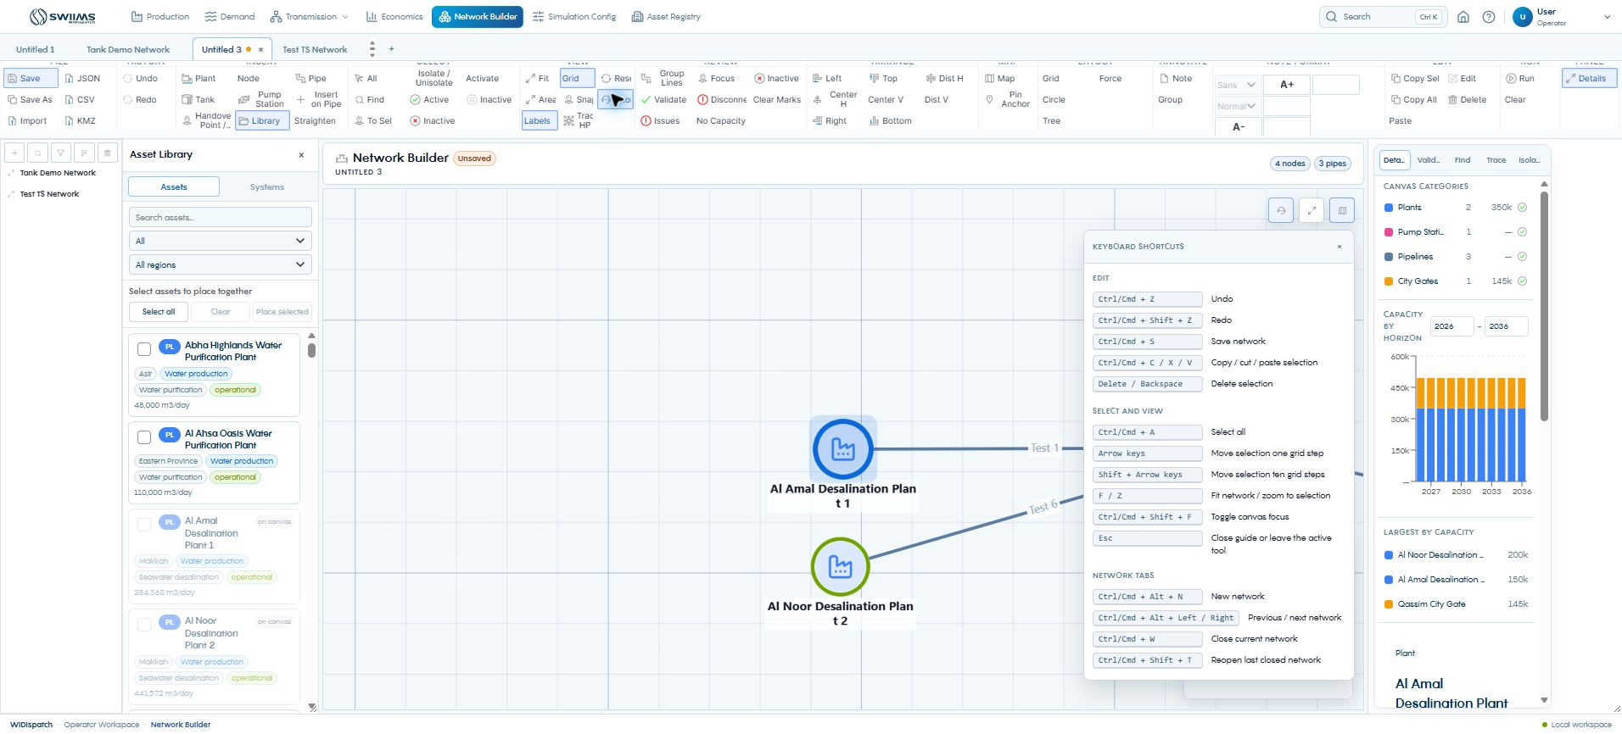
Canvas shortcuts and supporting tools
01
Use Fit, Area or To Sel to navigate.
02
Use Undo/Redo and Copy/Paste while editing.
03
Use network tabs to separate working alternatives.
Notes and groups can explain the drawing without becoming supply assets.
WIDispatch / Client demonstration
52
Notes:
Source: observed shortcut guide and toolbar. Additional tools: Labels, minimap, canvas focus mode, category filters, capacity horizon, largest-asset list, Note with font controls, Group, Copy Sel/All, Paste, Edit and Delete. Insert on Pipe places an asset within a connection and splits it. Run/Clear controls show or clear the builder run overlay. The full simulation workflow is in Simulation Config. Group Lines remains a placeholder.
Demonstration guidance: Screenshots are sample application states. Use approved trial data for live input and publication.

Slide 53
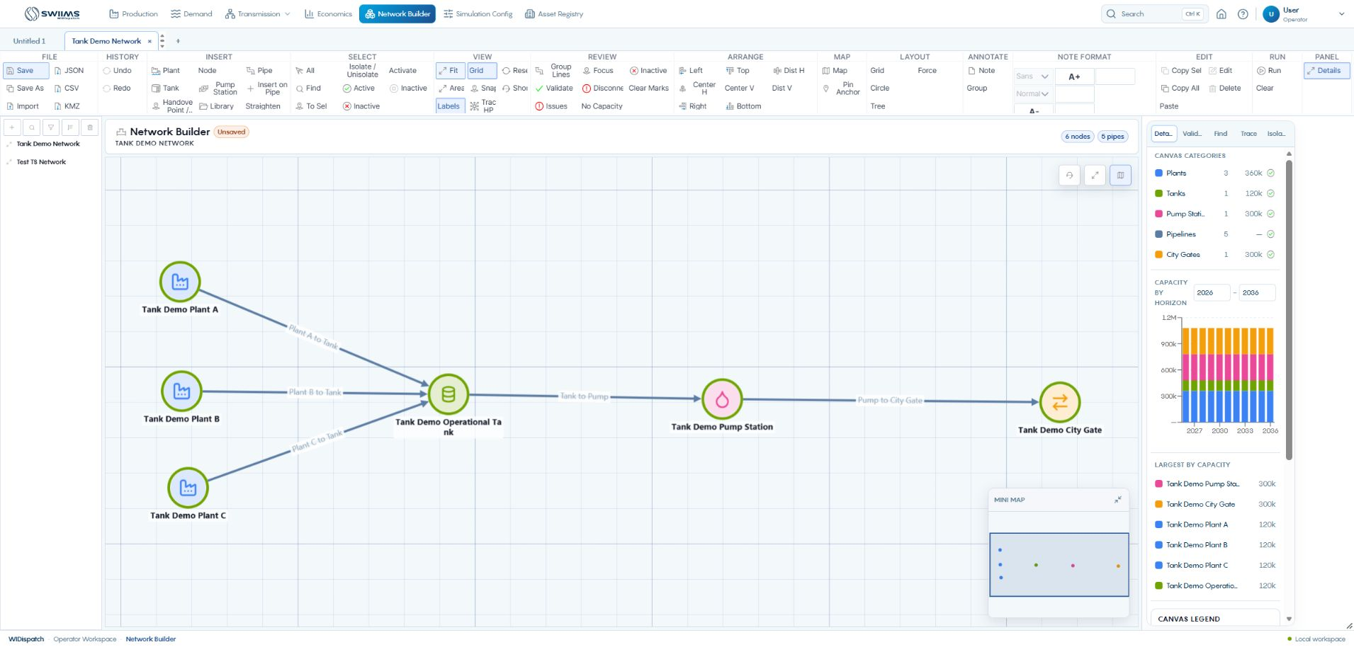
Connections, direction and capacity
Connect plants to storage, storage to the pump station, and the pump station to the city gate.
WIDispatch / Client demonstration
53
Notes:
Show the Pipe tool and connect the source node to the destination node. Inspect each pipe’s direction, capacity and active state. The saved example has three 120,000 m³/day plant connections and two 300,000 m³/day downstream connections. Arrange the drawing for readability. Saving a canvas is separate from running a simulation. Source: observed Tank Demo Network and Simulation Configuration pipeline table.
Demonstration guidance: Screenshots are sample application states. Use approved trial data for live input and publication.

Slide 54
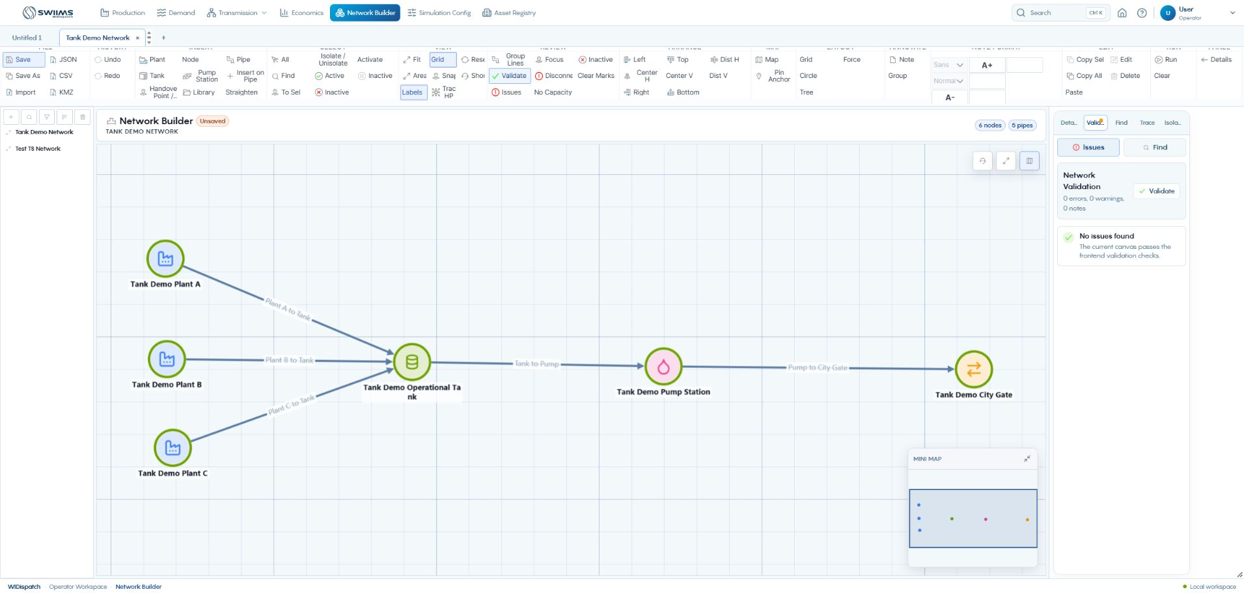
Network validation and saving
01
Run Validate and inspect the issue list.
02
Resolve missing capacity or disconnected assets.
03
Save the network with a clear scenario name.
A clean topology check is one checkpoint before simulation.
WIDispatch / Client demonstration
54
Notes:
The current canvas reports zero errors, warnings and notes in frontend validation. This is not evidence that the selected operating period has enough water. Some pipes with no capacity are treated as unconstrained by dispatch, so review the configuration table even when drawing validation passes. Confirm the saved network is the one selected by the scenario. Source: Network Validation screen and SimulationTables.
Demonstration guidance: Screenshots are sample application states. Use approved trial data for live input and publication.

Slide 55
The worked outage scenario
Network
Planning period
Operating constraints
Three plants, each 120,000 m³/day. A 120,000 m³ operational tank. A 300,000 m³/day pump station and city gate.
10–18 August 2026. City-gate demand is 300,000 m³ each day, or 2.70 million m³ over nine days.
Plant B has a maintenance window. Plants A and C have outage days. The tank starts full and carries inventory between days.
All figures in this case are demonstration data.
WIDispatch / Client demonstration
55
Notes:
Introduce the saved Tank Demo – Two Plant Outages configuration. Costs are 1.80, 2.00 and 2.20 SAR/m³ for A, B and C. The operational tank uses Ignore reserve with 0% minimum even though a 70% strategic storage setting appears in Setup. Do not imply that 70% applies to this operational tank. Source: observed Simulation Configuration and Results.
Demonstration guidance: Screenshots are sample application states. Use approved trial data for live input and publication.

Slide 56
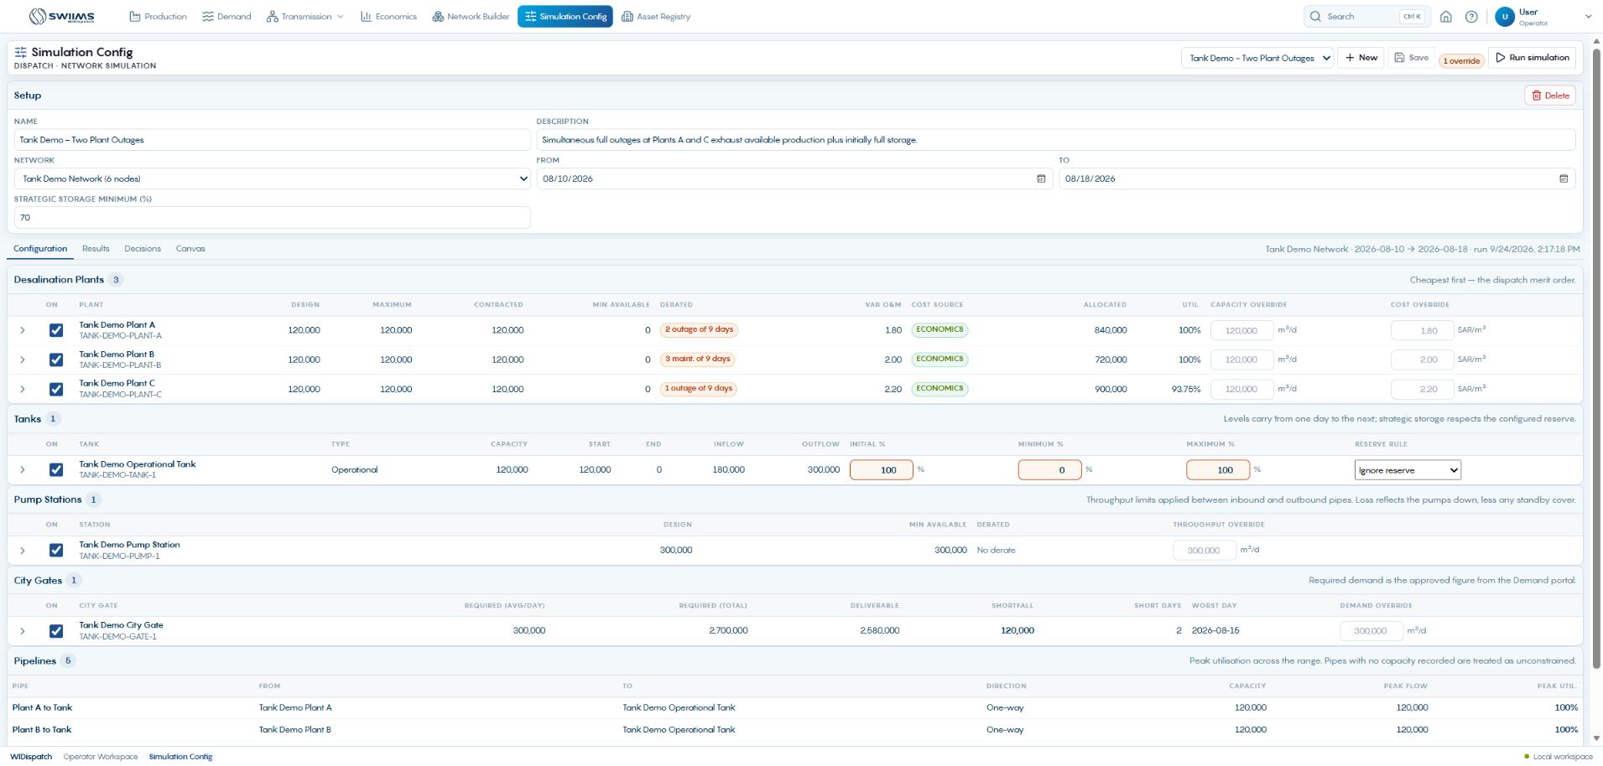
Simulation setup and the planning horizon
01
Select or create the simulation configuration.
02
Choose the saved network and inclusive dates.
03
Review storage rules and any visible overrides.
Save stores reusable settings. Run simulation creates a draft plan.
WIDispatch / Client demonstration
56
Notes:
Explain name, description, network, From and To. The example has one override. Configuration fields support capacity, cost, demand and tank-level what-if assumptions. Review cost source alongside the value. An override should be an explicit scenario assumption, not a hidden correction to approved source records. Source: SimulationConfigPage.jsx; PRD PR-009.
Demonstration guidance: Screenshots are sample application states. Use approved trial data for live input and publication.

Slide 57
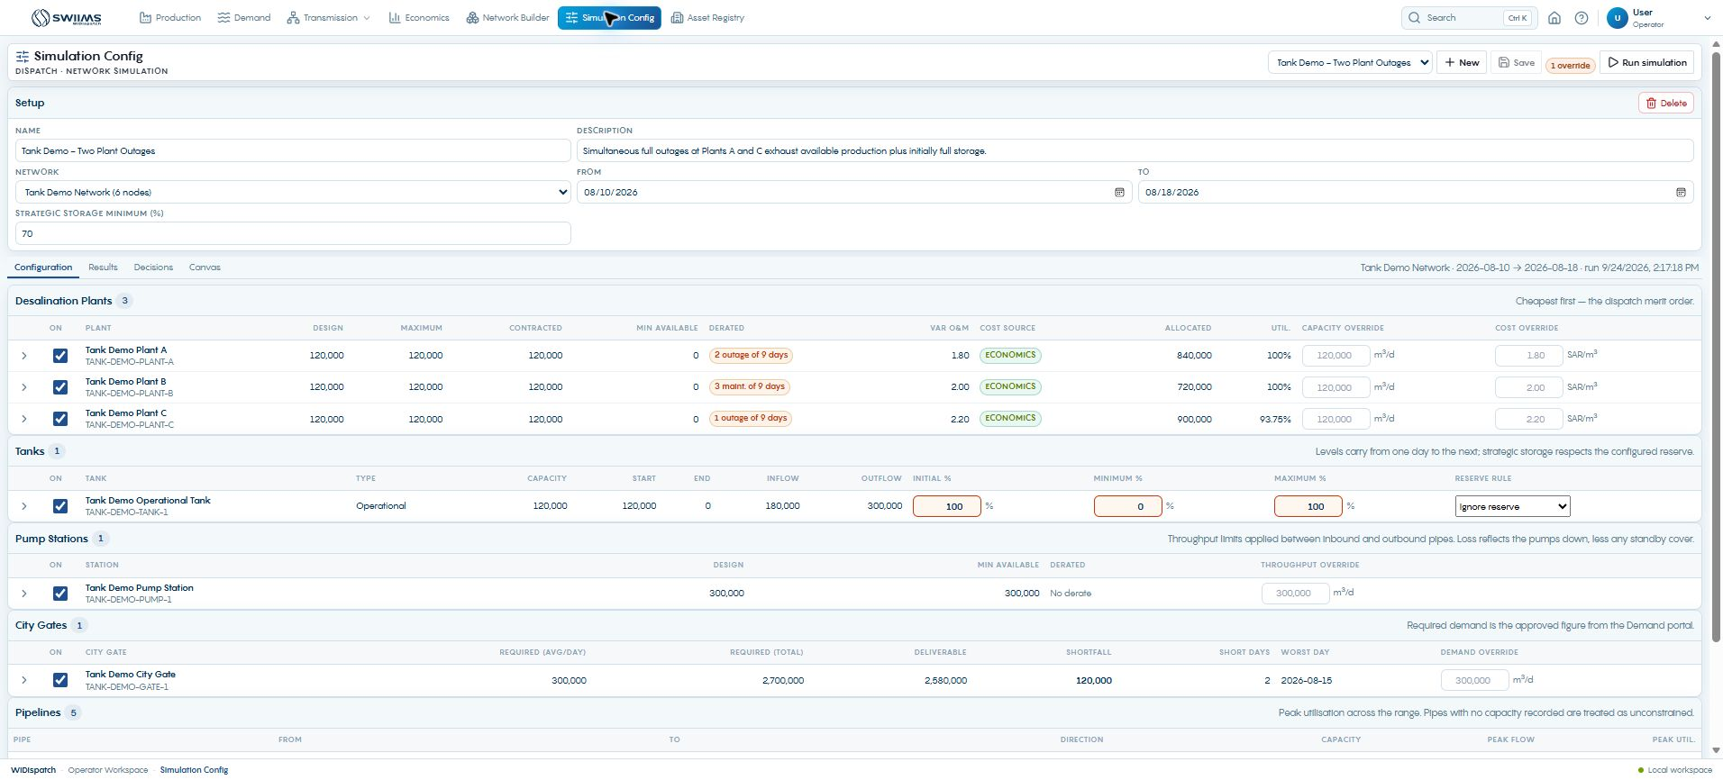
Configuration tables and asset inclusion
Each On checkbox controls whether that asset participates in the scenario.
WIDispatch / Client demonstration
57
Notes:
Source: observed Configuration tables. Plant, tank, pump and gate rows offer Include in the dispatch. These are per-scenario assumptions. Pipelines have a separate capacity/direction table. Expand an asset’s daily breakdown to inspect outages and maintenance rather than relying only on the minimum available value.
Demonstration guidance: Screenshots are sample application states. Use approved trial data for live input and publication.

Slide 58
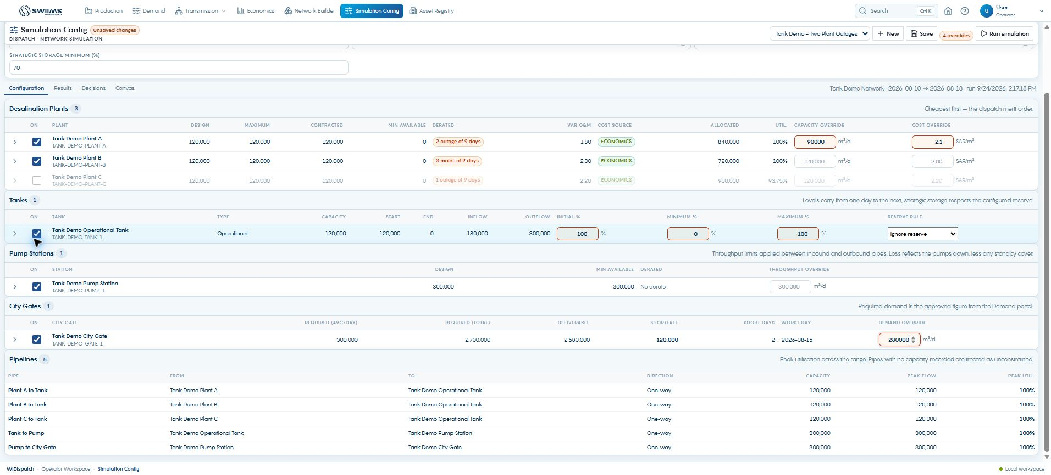
Emergency capacity and demand assumptions
01
Exclude an unavailable asset with its On checkbox.
02
Enter capacity, cost or demand overrides.
03
Run again to calculate the changed outcome.
This screenshot shows unsaved assumptions. The displayed results still belong to the prior run.
WIDispatch / Client demonstration
58
Notes:
Source: observed unsaved example: Plant A capacity 90,000 m³/day and cost 2.10 SAR/m³, Plant C unchecked, gate demand 280,000 m³/day. All edits were discarded by reloading. No new result is claimed for these settings. Enter a scenario description explaining the emergency and compare a fresh result before publication.
Demonstration guidance: Screenshots are sample application states. Use approved trial data for live input and publication.

Slide 59
Storage and throughput during an emergency
Tank policy
Pump throughput
Demand assumption
Set initial, minimum and maximum percentages. Choose the reserve rule appropriate to the tank’s role.
Use the pump capacity override to test a temporary limit. Inspect daily derating and standby coverage.
Test a clearly documented gate demand assumption. Compare delivered volume and shortage after the new run.
A capacity or demand override needs a reason, a planning period and a new simulation.
WIDispatch / Client demonstration
59
Notes:
Source: SimulationTables. Tank initial/minimum/maximum overrides and reserve policy differ from the global strategic reserve setting. In the worked scenario the operational tank uses Ignore reserve. A changed cost can alter dispatch order. Configuration edits do not update portal source records.
Demonstration guidance: Screenshots are sample application states. Use approved trial data for live input and publication.

Slide 60
What to check before Run simulation
Availability
Demand and cost
Storage
Check per-day derating, active elements, pump throughput and pipe direction/capacity.
Confirm approved demand, the correct cost dates and whether the cost source is Economics or a fallback.
Confirm starting inventory, minimum and maximum levels, and the reserve rule for each tank.
Run simulation stores a draft. Portal allocations change only through Publish decisions.
WIDispatch / Client demonstration
60
Notes:
The configuration tables provide the detailed pre-run review. Expand daily breakdowns when a minimum available capacity is zero to see which day causes it. The solver maximizes feasible delivery before reducing variable operating cost within the configured policy. Existing results in this deck are a saved run. Source: SimulationTables, simulationConfigs.js and Product Profile p. 3.
Demonstration guidance: Screenshots are sample application states. Use approved trial data for live input and publication.

Slide 61
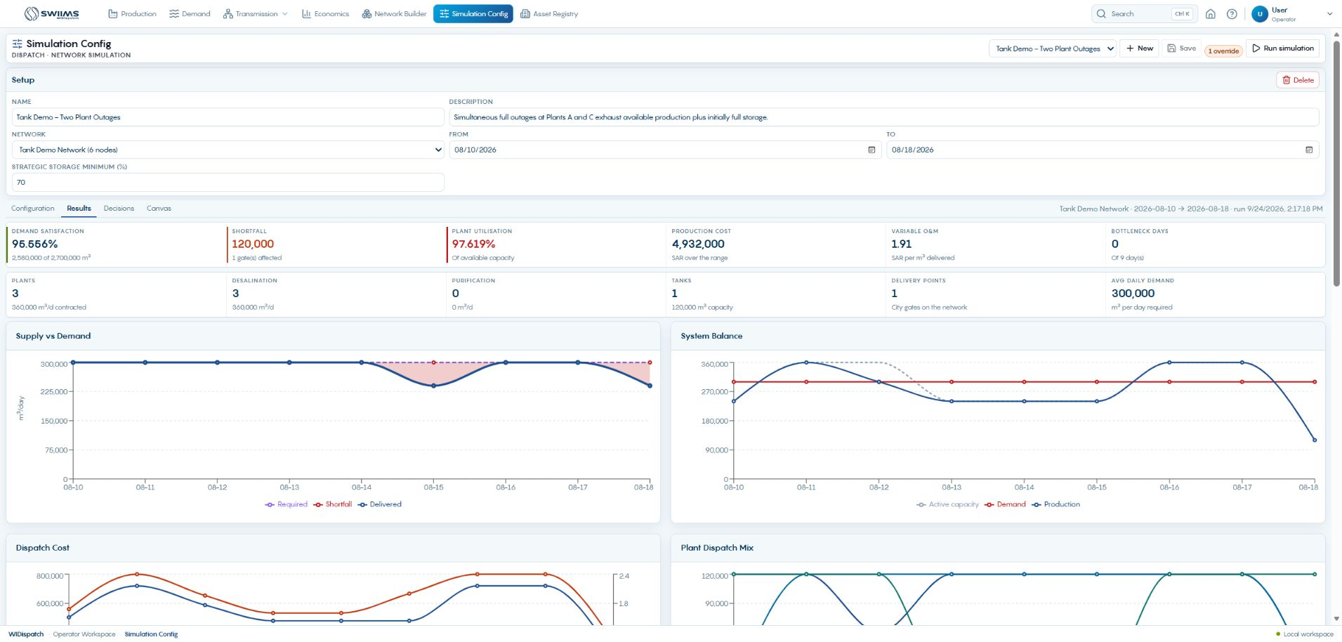
Results for the selected run
01
Confirm the run name and date range.
02
Read delivered demand and shortfall together.
03
Review utilization and variable operating cost.
The saved example delivers 2.58 million m³ against 2.70 million m³ requested.
WIDispatch / Client demonstration
61
Notes:
Observed KPIs: demand satisfaction 95.556%, shortfall 120,000 m³, plant utilization 97.619%, production variable O&M cost SAR 4,932,000, average SAR 1.91 per delivered m³. These are sample results and do not establish client savings. The zero bottleneck-days KPI does not mean zero shortage: daily shortfalls here are attributed to production capacity. Source: saved Results screen.
Demonstration guidance: Screenshots are sample application states. Use approved trial data for live input and publication.

Slide 62
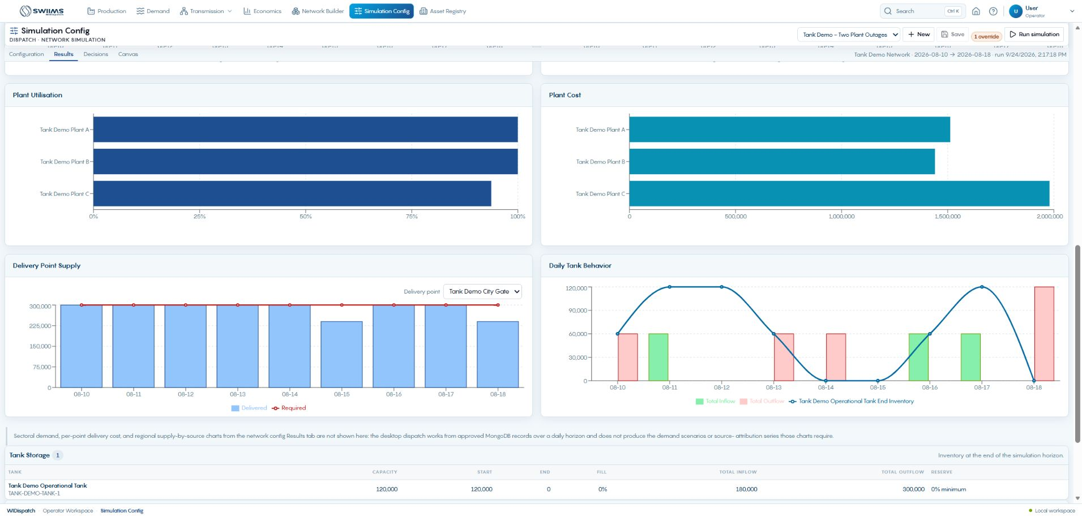
Daily supply and dispatch behavior
Daily charts reveal timing that a period total can hide.
WIDispatch / Client demonstration
62
Notes:
Show Plant Utilization, Plant Cost, Delivery Point Supply and Daily Tank Behavior. Explain how the selected gate falls below its request on two days, and how tank inventory moves between days. Use the previous Results screen for Supply vs Demand and System Balance. Keep comparisons on the same planning horizon. Source: saved Results charts.
Demonstration guidance: Screenshots are sample application states. Use approved trial data for live input and publication.

Slide 63
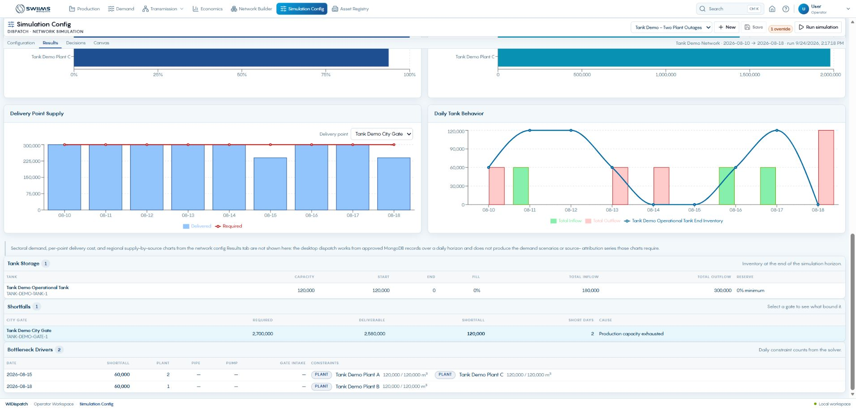
Storage and shortage investigation
01
Inspect tank inflow, outflow and ending inventory.
02
Find the city gate and days with shortfalls.
03
Read the limiting condition before changing a decision.
In this example, production capacity exhaustion leaves 60,000 m³ unmet on each of two days.
WIDispatch / Client demonstration
63
Notes:
Short days are 15 and 18 August. Total shortage is 120,000 m³. Tank starting inventory is 120,000 m³, final inventory zero, total inflow 180,000 m³ and total outflow 300,000 m³. Verify where these appear on the visible charts/tables. A planner should assess reserve policy as well as demand satisfaction. Source: saved Results storage, shortfall and daily-driver tables.
Demonstration guidance: Screenshots are sample application states. Use approved trial data for live input and publication.

Slide 64
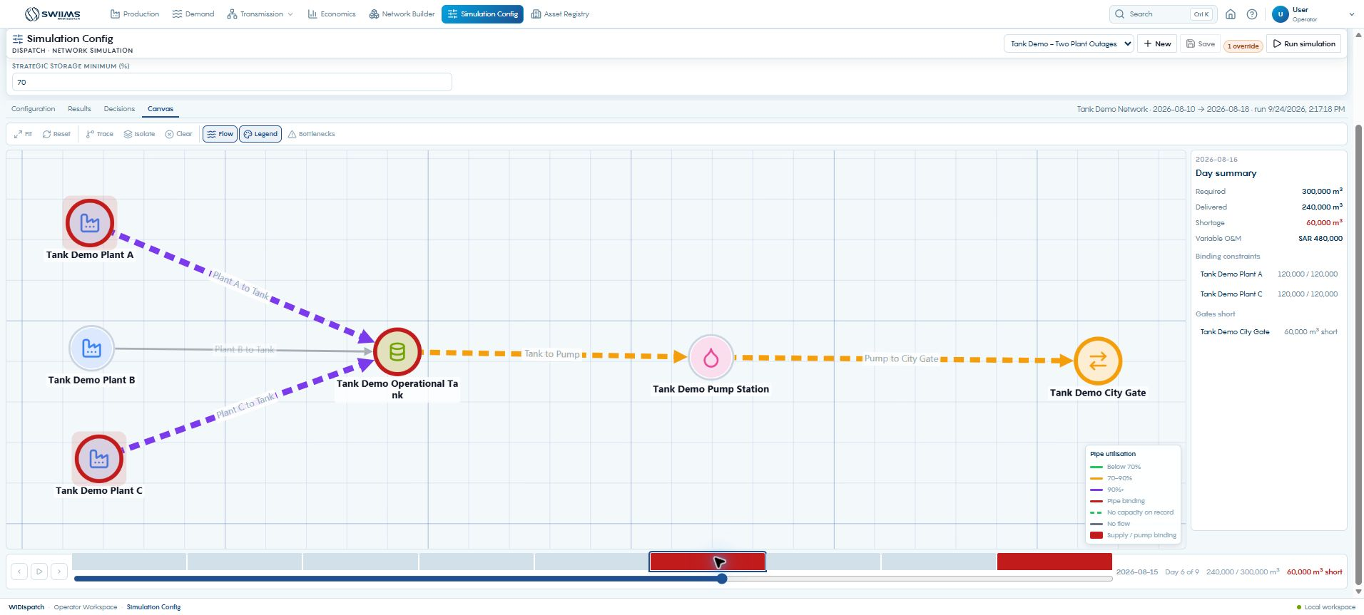
The shortage day on the canvas
Select a day to inspect its flows, binding constraints and city-gate shortage.
WIDispatch / Client demonstration
64
Notes:
The day selector is set to 15 August 2026. Required volume is 300,000 m³, delivered volume is 240,000 m³ and shortage is 60,000 m³. Use the day controls, Flow and Bottlenecks to connect table results to network elements. Source: Desktop Simulation Canvas.
Demonstration guidance: Screenshots are sample application states. Use approved trial data for live input and publication.

Slide 65
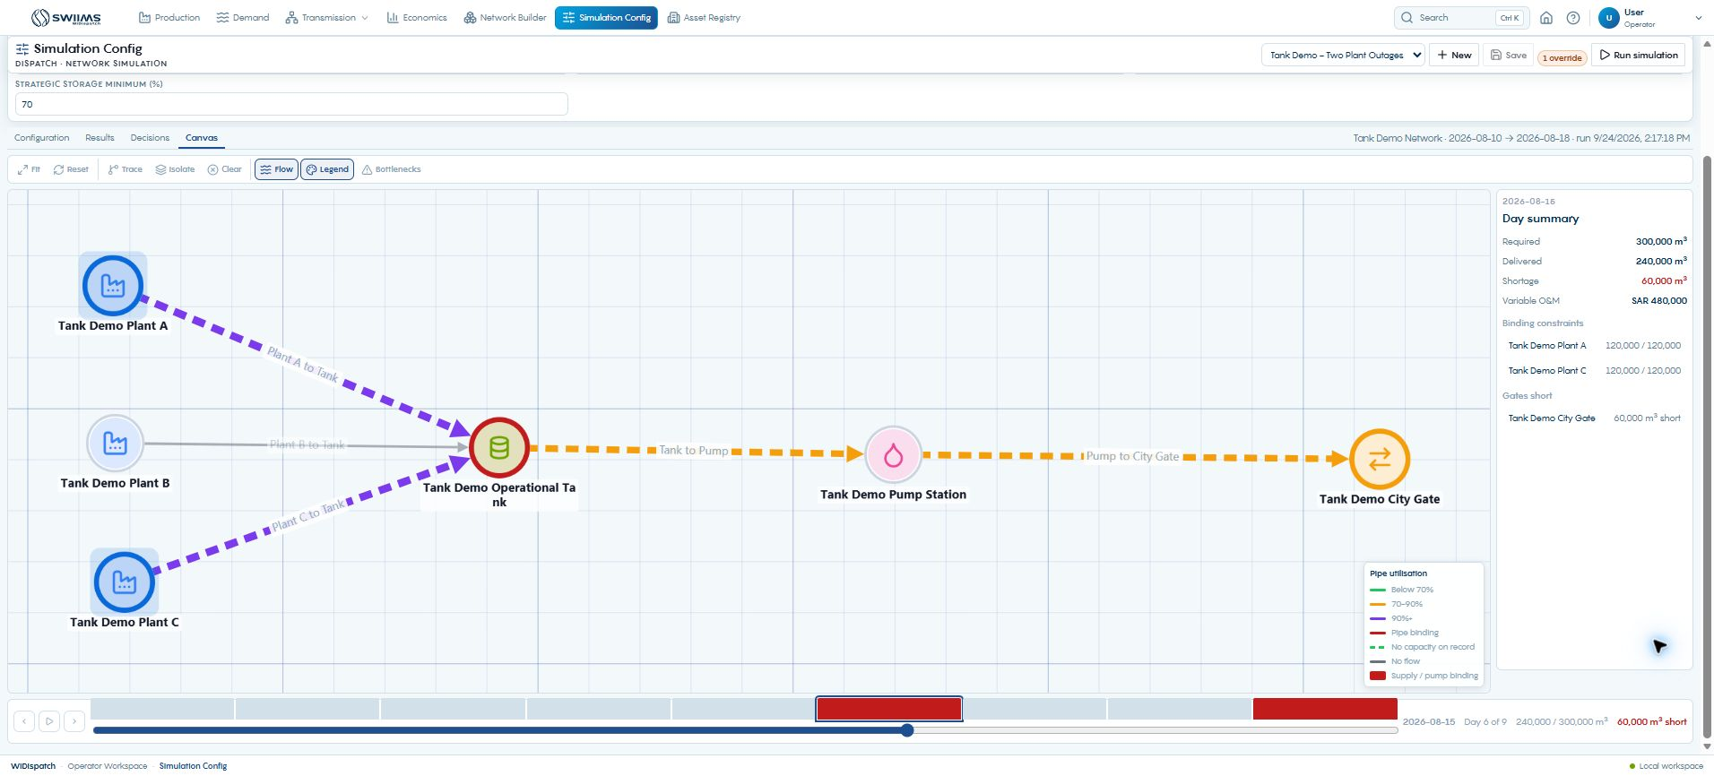
Binding constraints on the simulation canvas
The shortage day shows which supplies bind and which gate receives less than requested.
WIDispatch / Client demonstration
65
Notes:
Source: live Simulation Config Canvas on 15 August 2026. Required 300,000 m³, delivered 240,000 m³, shortage 60,000 m³. Plants A and C each bind at 120,000 m³. High utilization and a binding constraint are different signals. Use the legend rather than interpreting every colored pipe as a bottleneck.
Demonstration guidance: Screenshots are sample application states. Use approved trial data for live input and publication.

Slide 66
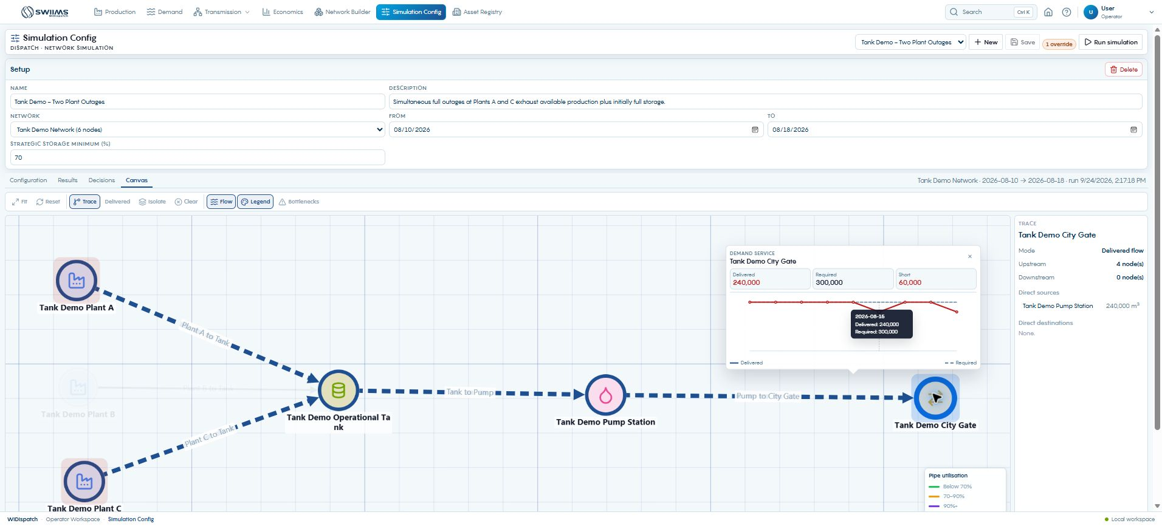
Tracing delivered water after the run
Delivered trace follows the selected day’s contributing flows to the receiving gate.
WIDispatch / Client demonstration
66
Notes:
Source: live selected Tank Demo City Gate trace. Immediate source is Tank Demo Pump Station with 240,000 m³. Four upstream nodes contribute. The side panel and element history help connect a local shortfall to daily operation.
Demonstration guidance: Screenshots are sample application states. Use approved trial data for live input and publication.

Slide 67
Simulation canvas review tools
Time controls
Network overlays
Focused review
Select an individual day, use Previous/Next, or play the horizon. Compare shortage days with fully served days.
Toggle Flow, Legend and Bottlenecks. Select an element to inspect its daily operating history.
Use Trace and Isolate to inspect a path. Fit, Reset and Clear restore a broader view.
The simulation canvas explains the saved run. Edit the model or assumptions before rerunning.
WIDispatch / Client demonstration
67
Notes:
Source: observed Simulation Canvas and CanvasToolbar. The canvas is a result-inspection surface. Use Configuration for scenario overrides and Network Builder for topology changes. Keep the selected run and day visible when discussing decisions.
Demonstration guidance: Screenshots are sample application states. Use approved trial data for live input and publication.

Slide 68
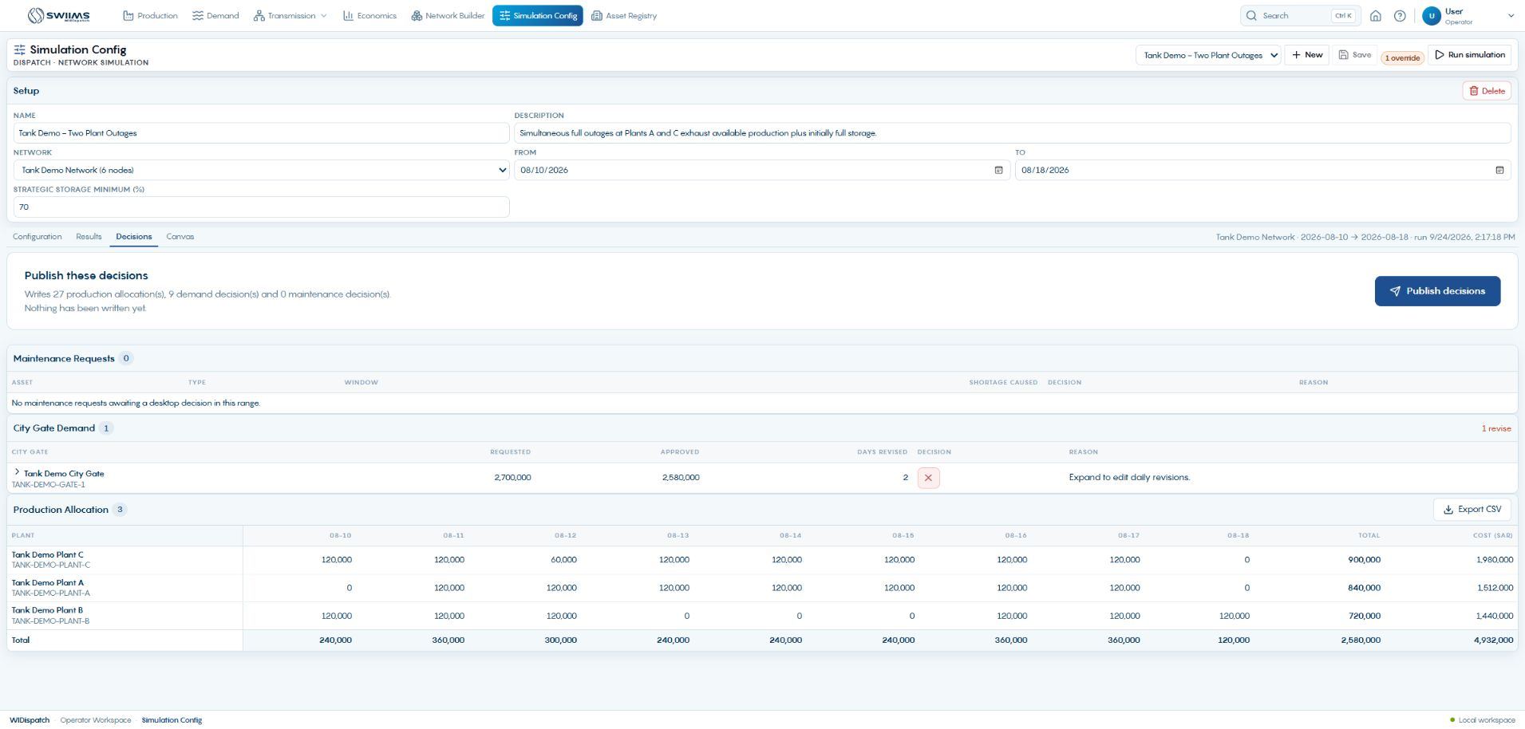
Draft decisions and proposed publication
01
Open Decisions after reviewing Results.
02
Review maintenance verdicts and city-gate demand.
03
Check the production allocation grid and publication scope.
This draft proposes 27 production allocations and 9 demand decisions.
WIDispatch / Client demonstration
68
Notes:
The selected draft has zero maintenance decisions awaiting publication. Do not interpret that as zero maintenance impact: Plant B maintenance still derates capacity. Decision eligibility and capacity impact are different concepts. Explain the existing wording Nothing has been written yet as referring to this draft. Source: Decisions screen; writeback.js.
Demonstration guidance: Screenshots are sample application states. Use approved trial data for live input and publication.

Slide 69
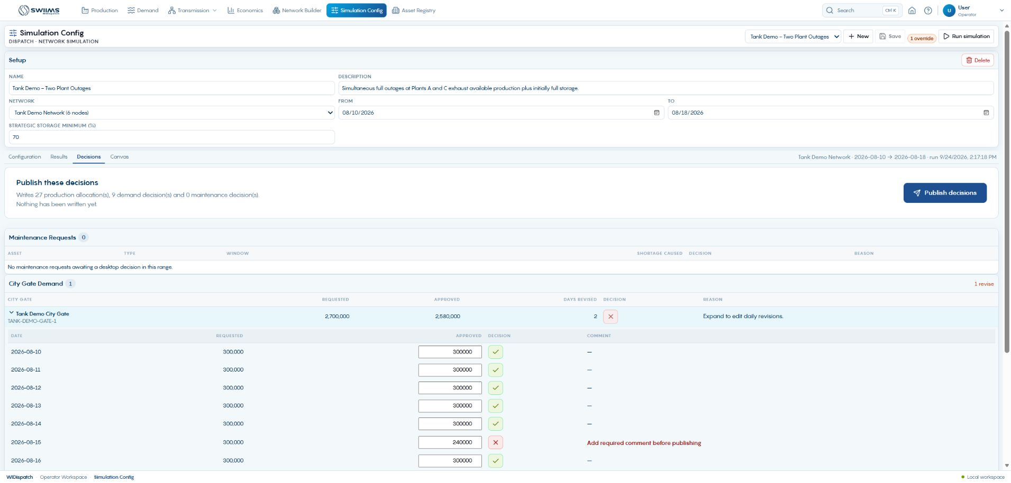
Editing the daily demand decision
01
Expand the city-gate row.
02
Edit the Approved volume for the required day.
03
Add the required comment when approving less than requested.
The gate summary is read-only. Daily controls hold the editable decisions.
WIDispatch / Client demonstration
69
Notes:
A quantity edit commits on leaving the field. The browser prompt asks for a comment on a reduction. Approved volume must be finite and between zero and requested demand. The tick/cross control toggles full approval versus zero; use the quantity field for partial approval. Changes affect the draft decision, not the saved flow results. Source: DecisionsPanel.jsx DemandVolumeEditor and changeDemand; simulationConfigs.js validation.
Demonstration guidance: Screenshots are sample application states. Use approved trial data for live input and publication.

Slide 70
A useful decision comment
Approve 240,000 m³ for 15 August. Available production and storage cannot cover the 300,000 m³ request. The shortfall is 60,000 m³. Coordinate the operating response and review the next daily plan.
Example wording for the demonstrated demand reduction
State the asset/date, final quantity, constraint and required follow-up. Use the actual responsible team and agreed action when recording a real decision.
WIDispatch / Client demonstration
70
Notes:
This is suggested wording, not a comment entered or published to the system. The current comment control opens a browser prompt. Click Add required comment before publishing for an existing reduction, or edit the daily amount and leave the field. Confirm the comment and wait for the draft save to complete. Cancel leaves the decision uncommitted. Source: DecisionsPanel.jsx.
Demonstration guidance: Screenshots are sample application states. Use approved trial data for live input and publication.

Slide 71
Maintenance decisions and schedule changes
Review the recommendation
Record the decision
Coordinate any new window
Inspect the affected asset, proposed window, shortage caused and any affected city gates.
Keep or change the tick/cross decision. A maintenance rejection needs an operator comment.
Treat an alternative window as a recommendation. The domain team must revise its schedule through the applicable workflow.
A planner decision does not silently rewrite the submitted maintenance dates.
WIDispatch / Client demonstration
71
Notes:
Use a scenario containing pending maintenance requests for this part of a live demonstration. The current outage screenshot has no awaiting requests, so this slide explains the supported workflow without inventing a populated table. Expanded maintenance details can expose affected gates and an alternative window. A schedule change requires a revised operating record and rerun. Source: DecisionsPanel.jsx; PRD PR-013; SRD SR-014 and SR-015.
Demonstration guidance: Screenshots are sample application states. Use approved trial data for live input and publication.

Slide 72
When a decision needs a new simulation
Decision annotation
Changed operating assumption
Fresh assessment
Explain a reviewed allocation or maintenance decision using the supported draft controls.
Update capacity, demand, cost, storage or maintenance input when the intended operating plan changes.
Rerun and inspect the resulting flows, costs and shortages before publishing the replacement plan.
A manually edited approved volume does not recalculate physical dispatch or the Results charts.
WIDispatch / Client demonstration
72
Notes:
This is operational guidance grounded in the separation of immutable run results and editable verdicts. Current decision validation checks volume bounds and comments, not a complete re-optimization of the edited plan. Do not promise an automatic feasibility rerun when the user changes a decision. Source: simulationConfigs.js applyDecisionPatches; DecisionsPanel.jsx; PRD PR-013.
Demonstration guidance: Screenshots are sample application states. Use approved trial data for live input and publication.

Slide 73
Publication is the operational handoff
Before publishing
Publish decisions
After publishing
Check the selected run, dates, final quantities and all required comments. Confirm that source inputs still represent the intended plan.
Use the explicit Publish decisions action. Wait for success or a reported error before proceeding.
Confirm the published state and inspect the affected portal records for the same assets and dates.
Published plans disable decision editing. A revised plan requires a new reviewed run.
WIDispatch / Client demonstration
73
Notes:
The current UI changes to Published to the portals and disables the publish button and decision editors when a plan is published. Publishing returns counts for production, demand and maintenance updates. A partial failure should be investigated rather than assumed to mean nothing changed. Do not claim transaction or stale-input protections that the requirements describe as targets. Source: DecisionsPanel.jsx; simulationConfigs.js; writeback.js; PRD PR-014.
Demonstration guidance: Screenshots are sample application states. Use approved trial data for live input and publication.

Slide 74
What publication changes
Destination | Published information | Information retained separately
Production | Requested production allocation by plant/day | Actual production and submission approval
Demand | Approved volume, decision and planner comment | Original requested demand and portal approval
Maintenance | Desktop decision, reason and plan reference | Submitted maintenance dates and domain workflow
Transmission / Economics | Relevant shared operating records for follow-up | Receipt/delivery actuals and financial proposals
The published records carry a dispatch-plan reference for traceability.
WIDispatch / Client demonstration
74
Notes:
Publication writes productionInputs, demandInputs and maintenanceRecords and marks the dispatch plan published. There is no separate financialEntries or receivedRecords/deliveredRecords write in this publication function. Transmission and Economics views display relevant shared records or maintain their own follow-up actuals. Source: backend/src/simulation/writeback.js; PRD PR-015 and SRD SR-017.
Demonstration guidance: Screenshots are sample application states. Use approved trial data for live input and publication.

Slide 75
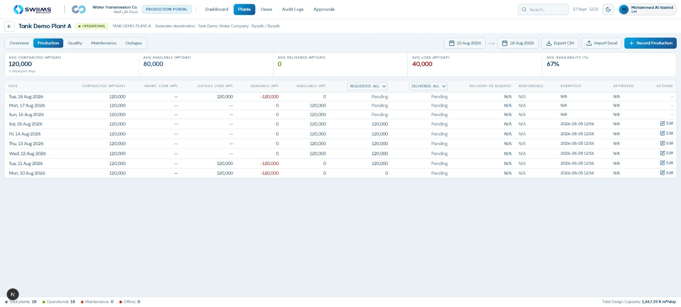
Production sees the requested allocation
01
Open the same plant and Production date range.
02
Locate the published requested quantity.
03
Record actual production separately after operation.
A difference between requested and actual production is a reconciliation item.
WIDispatch / Client demonstration
75
Notes:
Use the existing historical allocation visible in Production for this demonstration. Do not present it as publication of the draft outage scenario shown earlier. Publication sets required_m3 and marks its source as Desktop simulation while retaining actual_m3 and existing submission metadata. Source: writeback.js and Production record view.
Demonstration guidance: Screenshots are sample application states. Use approved trial data for live input and publication.

Slide 76

Demand reconciliation after publication
01
Open the city gate and matching planning dates.
02
Review requested demand, delivery and receipt.
03
Use Desktop Decisions for the approved quantity and comment.
The current Demand table shows requested and actual volumes; the planner verdict is reviewed in Desktop.
WIDispatch / Client demonstration
76
Notes:
Publication persists desktop_approved_m3, decision status and comment on demandInputs. The current Demand production-input-table reads required_m3, actual_m3 and received_m3, and does not expose the approved volume or planner comment. This screen is therefore a reconciliation view, not visual proof of the planner verdict. Demonstrate the final decision in Desktop and explain this current display limitation. Source: writeback.js; Demand components/production/production-input-table.tsx lines 187–189; captured Demand portal.
Demonstration guidance: Screenshots are sample application states. Use approved trial data for live input and publication.

Slide 77

Transmission records actual receipts
01
Open the relevant plant’s Received records.
02
Enter the past reporting date and received quantity.
03
Record quality readings and submit for approval.
Actual receipt is recorded after operation and does not replace the plan.
WIDispatch / Client demonstration
77
Notes:
The received-entry form permits strictly past days, yesterday or earlier. It captures received_m3 and quality readings, then submits for approval. Production quantities in this portal are read-only. Source: Transmission received-record-form.tsx; production-input-form.tsx.
Demonstration guidance: Screenshots are sample application states. Use approved trial data for live input and publication.

Slide 78

Transmission records actual city-gate delivery
01
Open the city-gate Delivered records.
02
Enter the actual delivered quantity for the past day.
03
Submit and reconcile against the requested operating quantity.
Use matching asset identities, dates and units when comparing receipt and delivery.
WIDispatch / Client demonstration
78
Notes:
The Delivered form accepts a past reporting date and delivered volume with quality readings. Differences may reflect timing, storage movement, measurement or operating events and need investigation. Do not automatically label every difference a network loss. Source: Transmission delivered-record-form.tsx; PRD PR-005 and PR-015.
Demonstration guidance: Screenshots are sample application states. Use approved trial data for live input and publication.

Slide 79

Approval history and audit trail
01
Open Audit Logs within the permitted scope.
02
Filter to the relevant asset, action or period.
03
Follow the submission and review history.
Keep domain approval history distinct from the planner’s dispatch decision.
WIDispatch / Client demonstration
79
Notes:
Show available actor, timestamp, action and change details. Published operating records carry dispatch_plan_id, while complete actor auditing across the entire deployment remains an acceptance requirement. Do not claim an immutable complete cross-application audit from the presence of one audit screen. Source: portal Audit Logs; PRD PR-016 and SRD SR-018.
Demonstration guidance: Screenshots are sample application states. Use approved trial data for live input and publication.

Slide 80
The next operating cycle
Published plan
Actual outcome
Next review
Operators receive the approved allocation and applicable decisions.
Teams enter actual production, receipts and delivery against the same date and asset.
Use variance, outages and approval history to prepare the next scenario.
Publication completes a planning cycle. Reconciliation begins the next one.
WIDispatch / Client demonstration
80
Notes:
Return to the Production dashboard as the operational feedback example. Confirm reporting dates and scope. Discuss one under-delivery case and which team owns its correction. This completes the journey from registered asset through approved data and planner publication back to operating evidence. Source: Product Profile p. 3; PRD PR-015.
Demonstration guidance: Screenshots are sample application states. Use approved trial data for live input and publication.

Slide 81
Client discussion and rehearsal checkpoints
Ownership
Operating rules
Acceptance example
Who enters each record, who approves it, and who can publish the dispatch plan?
Which dates, capacity definitions, reserve rules and escalation thresholds should the trial use?
Can the client trace one asset and day from input through approval, decision and actual outcome?
Agree one representative trial scenario and its expected operating handoffs.
WIDispatch / Client demonstration
81
Notes:
Close with client-specific questions. Ask the users to narrate the workflow rather than just confirm that the screens look familiar. Agree how to handle missing inputs, shortage comments and changed maintenance dates. Commercial and deployment terms remain separate from this operational demonstration.
Demonstration guidance: Screenshots are sample application states. Use approved trial data for live input and publication.

Slide 82
Reference: the four portal workflows
Portal | Input action | Review action | After publication
Production | Record Production / New Maintenance | Approvals: Production or Maintenance | Requested allocation vs actual output
Demand | Record Demand | Approvals: Demand | Requested vs actual; verdict in Desktop
Transmission | Pump maintenance / Received / Delivered | Three applicable approval queues | Receipts and deliveries for reconciliation
Economics | Propose Cost Change | Approve / Reject / Revision | Cost and operating-performance review
Record-type rules differ. Quality and outage entry may save directly.
WIDispatch / Client demonstration
82
Notes:
Use this appendix for role training or questions. Portal labels are from the captured implementation. Production and Demand approval screens primarily show Approve and Reject, while Economics exposes Revision separately. Source: observed portals and current approval components.
Demonstration guidance: Screenshots are sample application states. Use approved trial data for live input and publication.

Slide 83
Reference: sample scenario results
Measure | Saved scenario value | Interpretation
Planning horizon | 10–18 August 2026 | 9 inclusive days
Requested / delivered | 2,700,000 / 2,580,000 m³ | 95.556% demand satisfaction
Shortfall | 120,000 m³ | 60,000 m³ on 15 and 18 August
Variable O&M cost | SAR 4,932,000 | SAR 1.91 per delivered m³
Tank start / end | 120,000 / 0 m³ | Inventory declines across the horizon
Demonstration data illustrates the workflow and does not represent client performance.
WIDispatch / Client demonstration
83
Notes:
These values are transcribed from the saved Tank Demo – Two Plant Outages run dated 24 September 2026. The calculations reconcile: 2,580,000 / 2,700,000 = 95.5556%; 4,932,000 / 2,580,000 = 1.9116 SAR/m³. Source: captured Results, Configuration and Decisions screens.
Demonstration guidance: Screenshots are sample application states. Use approved trial data for live input and publication.

Slide 84
Reference material
Business and product
Technical behavior
Product overview
WIDispatch BRD and PRD, version 1.0, 10 September 2026. Operating roles, workflows and acceptance requirements.
WIDispatch SRD, version 1.0, 10 September 2026. Dispatch rules, supported decision edits and publication ownership.
Product Profile and Operating Overview, version 1.0. Scope, operating cycle and demonstration boundaries.
Screens show the September 2026 demonstration environment. Figures are sample data.
WIDispatch / Client demonstration
84
Notes:
Full sources: C:/Users/mabdu/OneDrive/Desktop/Utility Optimo/WIDispatch/Documentation/WIDispatch_BRD.pdf; WIDispatch_PRD.pdf; WIDispatch_SRD.pdf; WIDispatch_Product_Profile_and_Operating_Overview.pdf. Current behavior also checked against the Desktop, Production, Demand, Transmission and Economics repositories and browser screens. Requirements labeled Target or Proposed are not represented as delivered functionality.
Demonstration guidance: Screenshots are sample application states. Use approved trial data for live input and publication.

