Slide 1
Challenges and Solution
1. Document Quality Issues
Solution: Implement image preprocessing techniques like grayscale conversion and thresholding.
2. Data Accuracy and Misclassification
Solution: Use deep learning-based OCR models and apply post-processing corrections.
3. Handling Multiple File Formats
Solution: Convert inputs to high-resolution, lossless formats like PNG or TIFF.
4.Multilingual Text Recognition Solution: Use OCR models with multilingual support, such as Tesseract with language packs or Google Vision OCR, and implement language detection algorithms before processing.

Slide 2
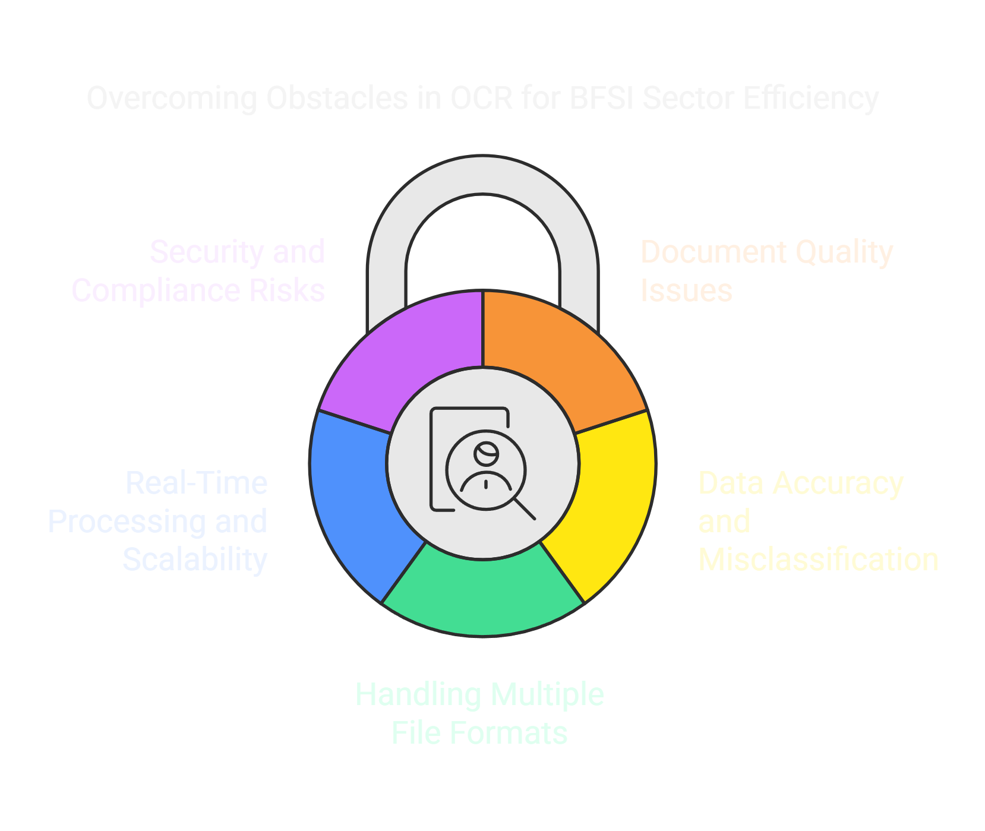

Slide 3
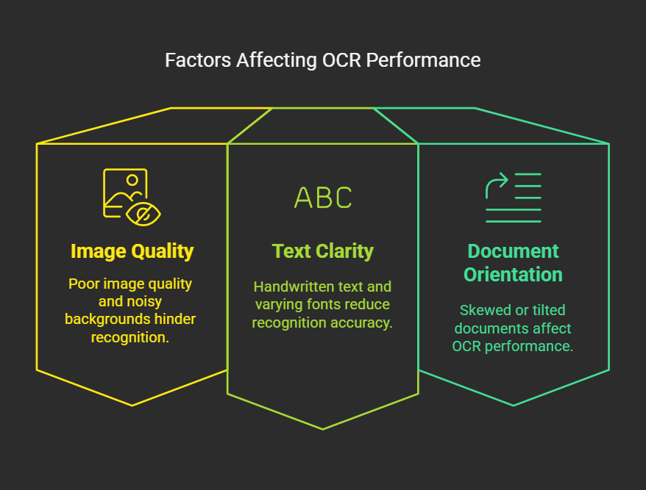
Challenges and Solutions in the BFSI_OCR Project

Slide 4
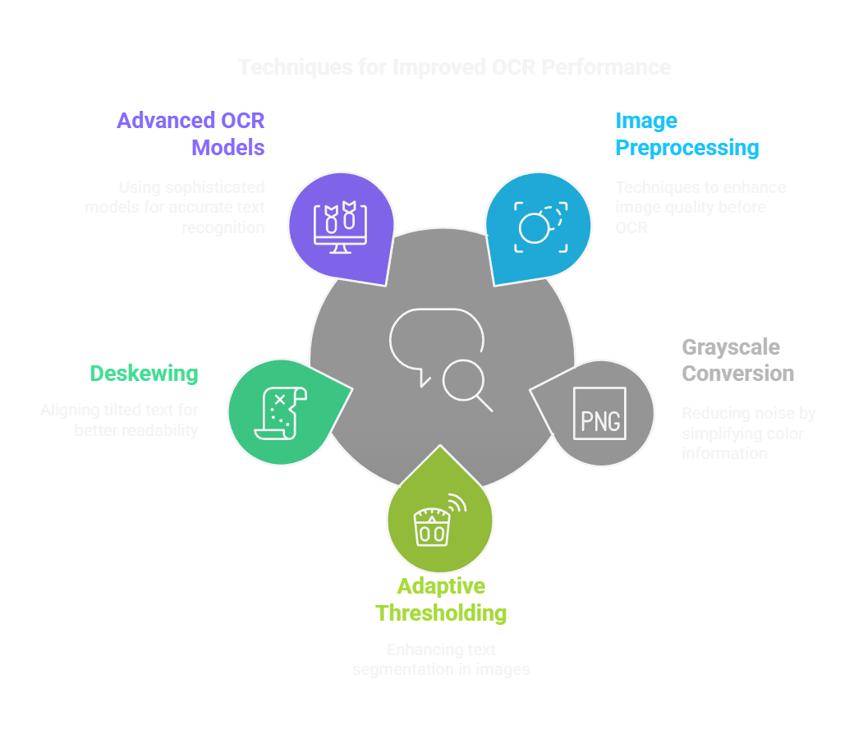

Slide 5
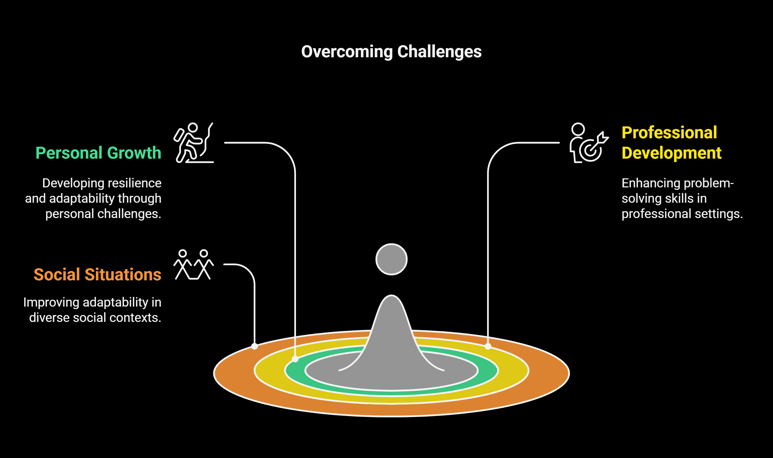
Data Accuracy and Misclassification

Slide 6
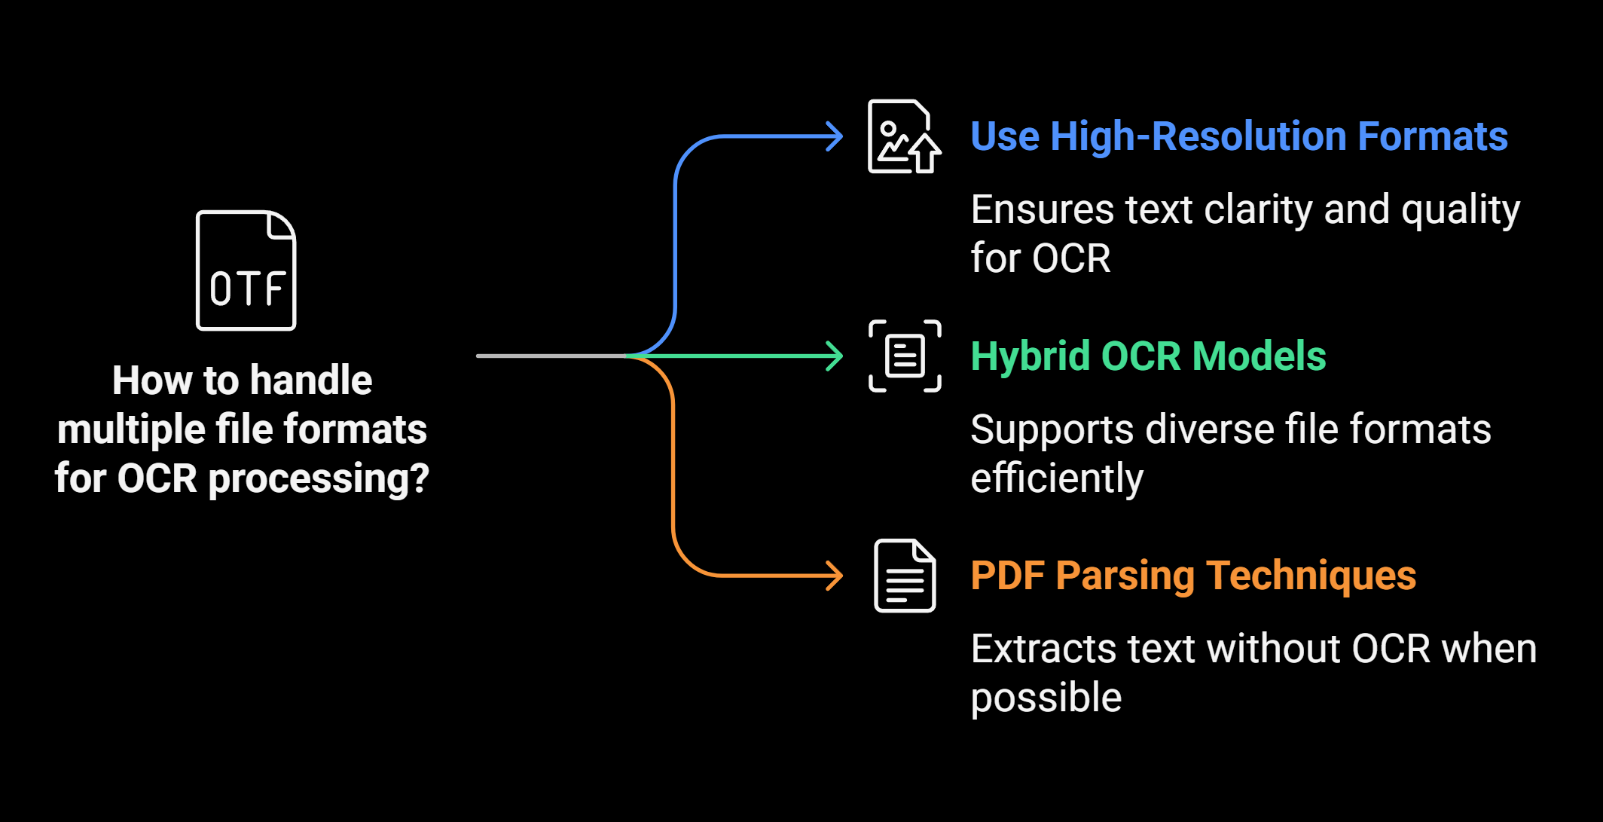
Handling Multiple File Formats

Slide 7
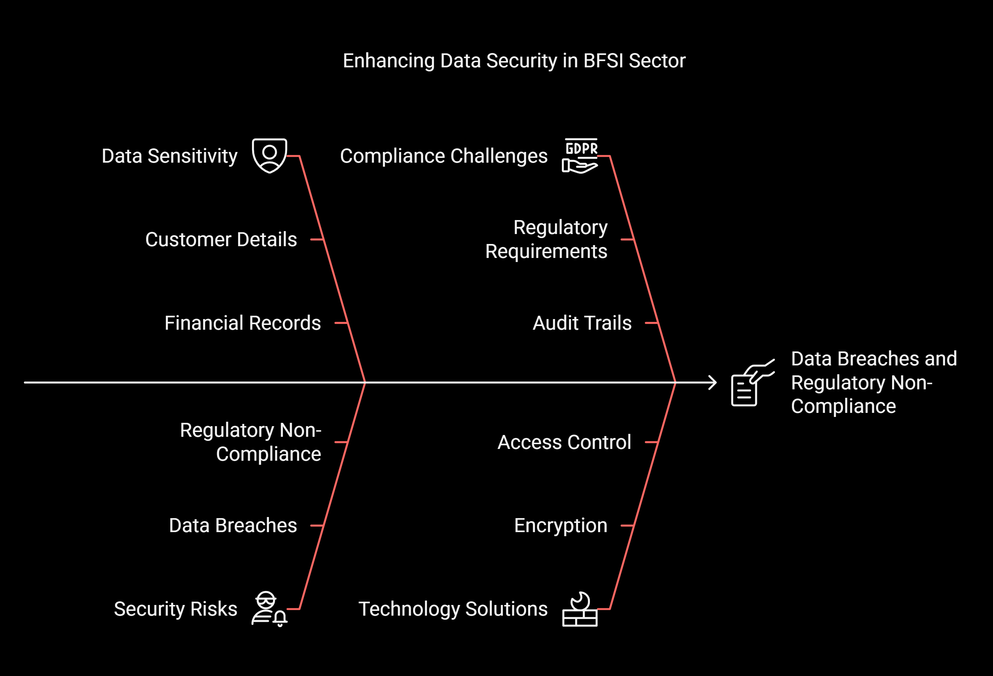
Security and Compliance Risks

Slide 8
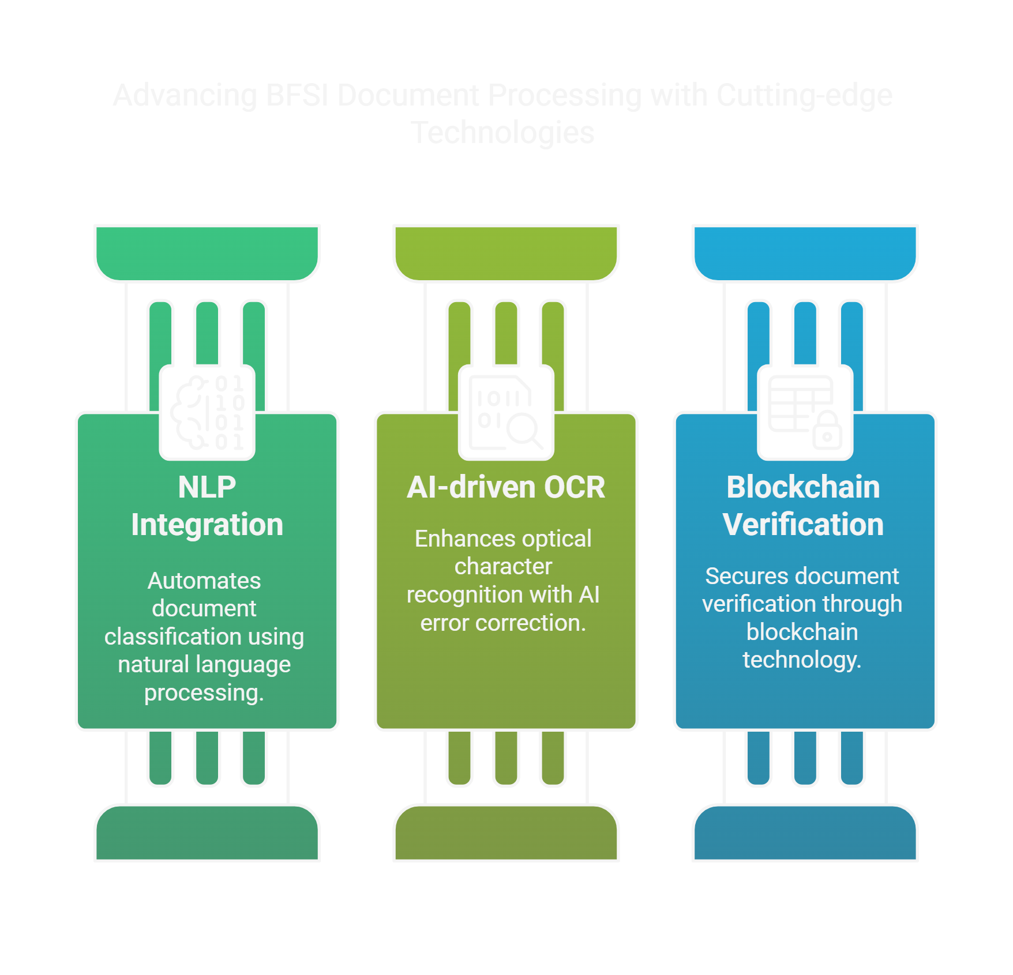
Future Enhancements

