Slide 1
Dynamic Form Builder
Technical Progress Report
1 / 20

Slide 2
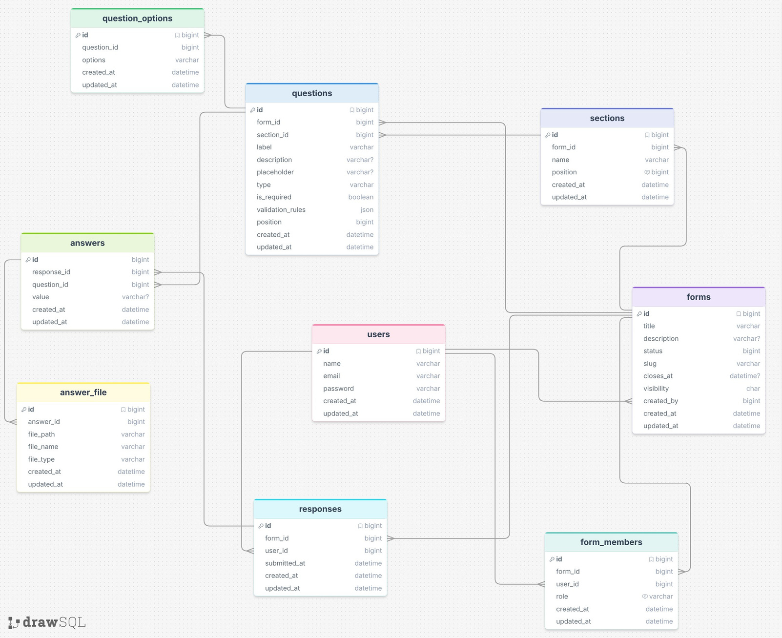
Old Database Schema
Before
Initial design — 8 tables
What the old schema had:
▸ forms, sections, questions, question_options
▸ answers, answer_file, responses
▸ form_members (users → forms)
▸ validation_rules stored as JSON blob in questions
▸ No deleted_at column — hard deletes only
▸ No audit log table
▸ No invitations table
▸ No tags tables
▸ No response_sessions table
2 / 20

Slide 3
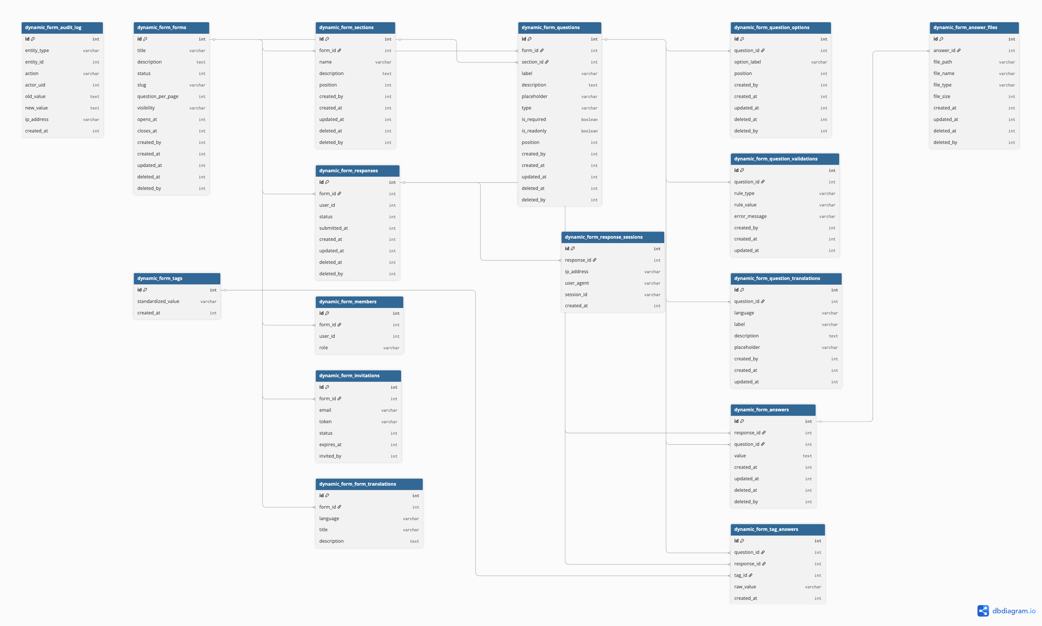
New Database Schema
After
16 tables — with soft delete; added via hook_schema() + update hooks
What changed:
+ deleted_at / deleted_by
Added to ALL 5 entity tables — enables soft d. elete
+ dynamic_form_audit_log
Append-only log; old_value + new_value as JSON
+ dynamic_form_invitations
Token-based email invites; 7-day expiry
+ dynamic_form_tags
Canonical tag dictionary — normalised values
+ dynamic_form_tag_answers
response × question × tag
+ response_sessions
IP, user_agent
+ question_validations
Normalised rules (was JSON blob)
~ forms.slug
Auto-generated, unique, collision-safe
~ forms.visibility
p / r / m (public, restricted, members)
Schema evolved in 3 update hooks: 7001 (tags), 7002 (width column), 7003 (invitations)
3 / 20

Slide 4
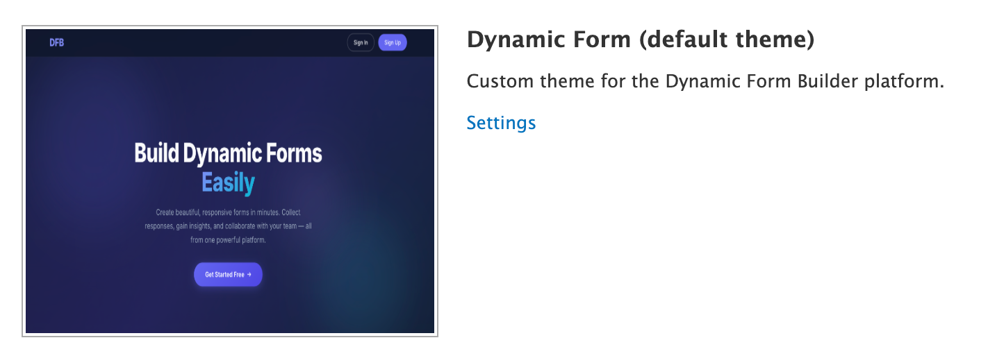
Custom Theme: dynamic_form
Activated programmatically on module enable — overrides Drupal's default Bartik theme
How theme activation works:
// In dynamic_form.install — hook_enable():
theme_enable(array('dynamic_form'));
variable_set('theme_default', 'dynamic_form');
drupal_theme_rebuild();
// hook_disable() — reverts cleanly:
variable_set('theme_default', 'bartik');
theme_disable(array('dynamic_form'));
Key overriding points:
hook_theme()
Registers 'dynamic_form_dashboard' template with sidebar + content vars
template.php
Preprocesses variables before tpl.php renders (adds user context, nav)
page.tpl.php
Replaces Drupal's default page HTML — controls nav, header, footer
dashboard.tpl.php
Custom layout: sidebar nav + main content region
4 / 20

Slide 5
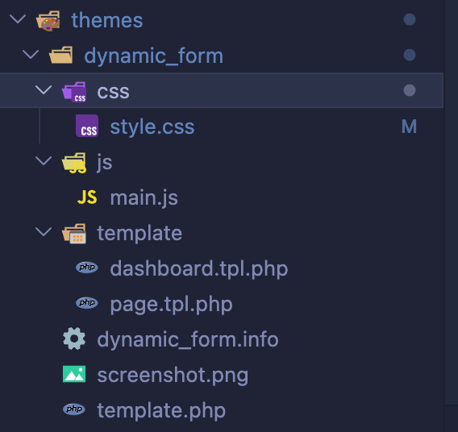
Theme File Structure & Template Files
themes/dynamic_form/ — css, js, template, info, template.php
Template file roles:
dynamic_form.info
Declares theme name, core=7.x, regions; no dependencies needed
template.php
Implements template_preprocess_*() hooks — injects PHP vars into tpl
template/page.tpl.php
Full HTML shell: <head>, navigation bar, <main>, footer rendered here
template/dashboard.tpl.php
Renders $sidebar and $content — used by hook_theme() registration
css/style.css
All theme CSS — dashboard layout, form cards, builder UI
js/main.js
Theme-level JS — nav toggle, responsive behaviour
Drupal 7 looks for page.tpl.php in the active theme. Because dynamic_form is set as theme_default, Drupal uses our page.tpl.php instead of Bartik's — giving us full control over every HTML element on every page. dashboard.tpl.php is only invoked for routes that call theme('dynamic_form_dashboard', …) registered in hook_theme().
5 / 20

Slide 6
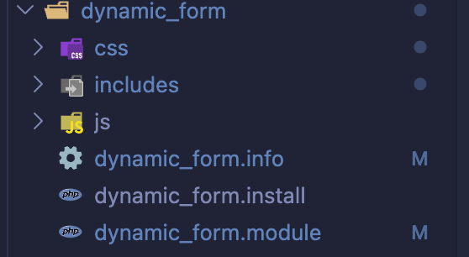
Dynamic Form Module — Structure & Hooks
sites/all/modules/dynamic_form/ — split across .info, .install, .module, includes/, js/, css/
Module file responsibilities:
dynamic_form.info
Module metadata — name, description, core=7.x, dependencies
dynamic_form.install
hook_schema(): all 14 table definitions; hook_enable/disable/uninstall; update hooks 7001-7003
dynamic_form.module
All hooks: hook_init, hook_permission, hook_menu, hook_theme, hook_cron, hook_mail, hook_form_alter
includes/*.inc
Domain logic loaded on demand via 'file' key in hook_menu() — not always in memory
js/*.js
builder.js, members.js, invitations.js, dashboard-search.js, dashboard-delete.js, toast.js
css/*.css
builder.css, preview.css, toast.css, members.css
The 'file' key in hook_menu() means includes/*.inc files are loaded only when their route is visited — keeping memory footprint low. The module file itself always loads; it only contains hooks and helpers.
6 / 20

Slide 7
Custom Hooks — Part 1
hook_init · hook_permission · hook_theme · hook_form_alter
hook_init()
hook_theme()
{
drupal_add_css($module_path . '/css/toast.css');
drupal_add_js($module_path . '/js/toast.js');
}
return array(
'dynamic_form_dashboard' => array(
'variables' => array('sidebar' => '', 'content' => ''),
'template' => 'dashboard',
// Points to themes/dynamic_form/template/dashboard.tpl.php
'path' => drupal_get_path('theme', 'dynamic_form') . '/template',
),
);
hook_permission()
hook_form_alter()
▸ access dashboard
// Overrides Drupal's generic "Sorry, unrecognized username or password"
// error message on login forms with a more user-friendly message.
if ($form_id == 'user_login' || $form_id == 'user_login_block') {
$form['#validate'][] = 'dynamic_form_custom_login_error_override';
}
▸ view forms / create new form
▸ edit own form / edit any form
▸ delete own form / delete any form
▸ view soft delete / restore deleted
▸ view activity log
7 / 20

Slide 8
Custom Hooks — Part 2
hook_menu · hook_cron · hook_mail
hook_menu() — 30+ routes across 5 groups
hook_cron() — email queue processing + invitation expiry
/login, /register
access callback: user_is_anonymous
function dynamic_form_cron() {
// Process invitation emails (batch of 20)
_dynamic_form_process_queue_batch(
'dynamic_form_invite_notify',
'_dynamic_form_send_invite_notification', 20
);
// Process member-added emails (batch of 20)
_dynamic_form_process_queue_batch(
'dynamic_form_member_notify',
'_dynamic_form_send_member_notification', 20
);
// Expire stale pending invitations
db_update('dynamic_form_invitations')
->fields(array('status' => 'expired'))
->condition('status', 'pending')
->condition('expires_at', REQUEST_TIME, '<')
->execute();
}
/form/create, /form/%/edit
custom access callback—ownership + member role check
/dashboard/**
access callback: user_is_logged_in
/dashboard/forms/%/builder
_dynamic_form_edit_access() — 3-layer check
/dynamic-form/ajax/**
AJAX endpoints — return JSON commands, no HTML
/dynamic-form/invite/accept/%
access callback: TRUE — token is the secret
hook_mail() — two email templates
'file' key on each route means the .inc is only loaded when that path is visited.
'member_added'
Notifies registered user they were added to a form with their role + URL
'invitation_sent'
Sends token accept link to unregistered invitees; includes 7-day expiry notice
8 / 20

Slide 9
DFBToast — Custom Notification System
Why custom-built?
PHP side — AJAX command:
▸ No third-party library — zero extra HTTP requests
// Defined in dynamic_form.module:
function ajax_command_dfb_toast($type, $message) {
return array(
'command' => 'dfbToast',
'toast_type' => $type, // success|error|warning|info
'message' => $message,
);
}
// Usage in any AJAX callback:
$commands[] = ajax_command_dfb_toast('success', t('Saved.'));
$commands[] = ajax_command_replace('#wrapper', $html);
return array('#type' => 'ajax', '#commands' => $commands);
▸ jQuery .bind() / .animate() / .slideDown() used throughout
▸ (.on() would work with jQuery 1.12.4 — kept .bind() for safety)
▸ Converts Drupal's div.messages into toasts on attach
▸ PHP callbacks fire toasts via custom AJAX command
JS registration (toast.js, runs on DOM ready):
// Extends Drupal's AJAX command protocol:
Drupal.ajax.prototype.commands.dfbToast =
function (ajax, response) {
DFBToast[response.toast_type](response.message);
};
// Also intercepts Drupal div.messages on attach:
Drupal.behaviors.dfbToast = {
attach: function (context) {
$('div.messages', context).once('dfb-toast-convert',
function () { /* map .status/.error/.warning → toast */ });
}
};
Public JS API (window.DFBToast):
DFBToast.success(msg [, durationMs]) // 4500 ms default
DFBToast.error(msg [, durationMs]) // 7000 ms default
DFBToast.warning(msg [, durationMs]) // 5000 ms default
DFBToast.info(msg [, durationMs]) // 4500 ms default
9 / 20

Slide 10
Soft Delete Workflow
Delete flow:
Restore flow:
User clicks Delete
→ JS opens #dfb-delete-confirm-modal (dashboard-delete.js)
→ User confirms
→ $.ajax POST to /dynamic-form/ajax/delete/{type}/{id}
PHP callback (dynamic_form_ajax_entity_delete):
→ db_update(table)
->fields(array(
'deleted_at' => REQUEST_TIME,
'deleted_by' => $user->uid,
))
->condition('id', $id)
->execute()
→ _dynamic_form_audit_log(type, id, 'deleted', $old, NULL)
→ ajax_command_remove('#card-{id}')// removes card from DOM
→ ajax_command_dfb_toast('success', 'Moved to Trash')
User visits /dashboard/trash
→ Sees all rows where deleted_at IS NOT NULL
→ Clicks Restore
→ JS opens restore confirmation modal
→ User confirms
PHP callback (dynamic_form_ajax_entity_restore):
→ db_update(table)
->fields(array(
'deleted_at' => NULL,
'deleted_by' => NULL,
))
->condition('id', $id)
->execute()
→ _dynamic_form_audit_log(type, id, 'restored', $old, $new)
→ ajax_command_remove('#trash-row-{id}')
→ ajax_command_dfb_toast('success', 'Restored')
Permanent delete:
→ db_delete(table)->condition('id', $id)->execute()
→ Requires 'restore deleted' permission
All read queries filter:
->condition('deleted_at', NULL, 'IS NULL')
Permissions: 'view soft delete' to see Trash page; 'restore deleted' to restore or permanently delete.
10 / 20

Slide 11
Audit Log
Append-only table — full before/after JSON snapshots of every change
_dynamic_form_audit_log() — called on every write:
_dynamic_form_audit_log($entity_type, $entity_id, $action, $old_value = NULL, $new_value = NULL)
// Examples:
_dynamic_form_audit_log('form', $id, 'created', NULL, $fields);
_dynamic_form_audit_log('form', $id, 'updated', $before, $fields);
_dynamic_form_audit_log('section', $id, 'deleted', $before, NULL);
_dynamic_form_audit_log('question', $id, 'restored',$before, $after);
// Inside the function:
db_insert('dynamic_form_audit_log')->fields(array(
'entity_type' => $entity_type, 'entity_id' => $entity_id,
'action' => $action, 'actor_uid' => $user->uid,
'old_value' => json_encode($old_value), // NULL on 'created'
'new_value' => json_encode($new_value), // NULL on 'deleted'
'ip_address' => ip_address(),
'created_at' => REQUEST_TIME,
))->execute();
Table design:
Dashboard page:
Append-only
Schema comment: 'Rows must never be updated or deleted'
/dashboard/activity-log — requires 'view activity log' permission. Displays entity type, entity id, action, actor name, timestamp, and old/new JSON diff for every recorded change in reverse chronological order.
Entities covered
form, section, question, option, validation, response, answer, member
Actions tracked
created, updated, deleted, restored, published, unpublished, submitted
Indexes
entity (type+id), actor_uid, action, created_at, entity_time
11 / 20

Slide 12
includes/dynamic_form.forms.inc
Form CRUD — create, edit, list, delete + members picker + access callbacks
Key functions:
jQuery in forms.inc context (members.js):
dynamic_form_create_form()
Drupal Form API: title, description, visibility, closes_at, members
// Live user search — debounced 300 ms
$search.bind('keyup', function () {
clearTimeout(searchTimer);
searchTimer = setTimeout(function () { _doSearch(q); }, 300);
});
// $.ajax GET to /dynamic-form/ajax/members/search?q=...
// Returns JSON array of {uid, name, mail}
// Results rendered as dropdown; click adds to in-memory members[]
// On form submit — members[] serialized to hidden input:
function _sync() {
$hidden.val(JSON.stringify(members));
}
// All event binding uses .bind() — compatible with all jQuery versions
dynamic_form_edit_form()
Pre-populates same fields; loads existing members via AJAX picker
dynamic_form_create_form_submit()
Generates slug, inserts to DB, saves members, logs audit, sends queue notifications
dynamic_form_list_page()
Lists forms the current user owns or is a member of
dynamic_form_delete_confirm()
Drupal confirm form — soft deletes on submit
_dynamic_form_members_picker_html()
Renders the AJAX member search + invite HTML block
members.js runs entirely in JS memory — the member list is only persisted to the DB when the form is saved. The PHP side reads the hidden JSON input and batch-inserts into dynamic_form_members, then queues notification emails.
Slug generation: _dynamic_form_generate_slug() — lowercase + hyphens + collision counter (my-form → my-form-1 → my-form-2) using a while loop against the DB.
12 / 20

Slide 13
includes/dynamic_form.builder.inc
Form Builder page — SortableJS drag-drop, Drupal AJAX Forms, modal question editor
SortableJS — loaded from CDN:
Drupal AJAX Form — sections form:
drupal_add_js(
'https://cdn.jsdelivr.net/npm/sortablejs@latest/Sortable.min.js',
'external'
);
// builder.js — _dfbInitSortable():
function _dfbInitSortable(container, handleSel, itemType, endpoint, groupName) {
new Sortable(container, {
handle: handleSel,
group: groupName, // allows dragging between sections
onEnd: function (evt) {
// Collect new order from DOM
$(evt.to).children('.dfb-question-card')
.each(function (index) { /* read data-id */ });
// POST to /dynamic-form/ajax/builder/reorder
$.ajax({ url: endpoint, type: 'POST', data: payload, ... });
}
});}
// Add Section button has #ajax key:
$form['add_section_btn']['#ajax'] = array(
'callback' => 'dynamic_form_builder_sections_ajax_callback',
'wrapper' => 'dfb-sections-wrapper',
);
// Callback returns commands array:
$commands[] = ajax_command_replace('#dfb-sections-wrapper',
render($form['sections_wrapper']));
$commands[] = ajax_command_invoke('input[name="section_name"]',
'val', array('')); // clear input
return array('#type' => 'ajax', '#commands' => $commands);
Question edit modal — loaded on demand:
// Click on question card → $.ajax GET:
// /dynamic-form/ajax/builder/question/{id}/edit-form
// PHP returns ajax_command_html() injecting form HTML into modal
// Modal contains full Drupal AJAX form (add/remove options, validations)
// Save button calls _dfb_question_form_save_ajax_callback():
$commands[] = ajax_command_replace('#question-{id}', $rendered);
$commands[] = ajax_command_invoke('#dfb-edit-question-modal', 'fadeOut', ...);
$commands[] = ajax_command_dfb_toast('success', t('Saved.'));
Drag-drop between sections works via SortableJS group option — questions can be moved across sections.
13 / 20

Slide 14
includes/dynamic_form.questions.inc
Question CRUD — 12 question types, #states API, add-more options/validations via AJAX
12 question types:
Drupal #states API — conditional visibility:
Short Text
Long Text
Text Editor
Single Choice
Multi Choice
Dropdown
Tags
File Upload
Date
Time
Rating
Scale
// Options wrapper only shows for select/radio/checkbox types:
$form['options_wrapper']['#states'] = array(
'visible' => array(
':input[name="type"]' => array(
array('value' => 'select'),
array('value' => 'radio'),
array('value' => 'checkbox'),
),
),
);
Add-more options — AJAX within Drupal Form API:
// 'Add Option' button triggers AJAX rebuild:
$form['add_option_btn']['#ajax'] = array(
'callback' => '_dfb_question_options_ajax_callback',
'wrapper' => 'dfb-q-options-wrapper',
);
// submit handler increments count in $form_state
// callback re-renders only the options wrapper (not full page)
// Same pattern for 'Add Validation Rule' button
// Validation rules: min_length, max_length, regex, email, url, numeric
14 / 20

Slide 15
includes/dynamic_form.invitations.inc
Token-based email invites — two code paths; session-based post-registration accept
Send flow — two code paths:
Invitation lifecycle:
dynamic_form_ajax_invitation_send() [POST from invitations.js]
│
├── user_load_by_mail($email) found?
│ YES → _dynamic_form_invite_existing_user()
│ INSERT dynamic_form_members directly
│ _dynamic_form_queue_member_notifications()
│
└── NO → _dynamic_form_invite_new_email()
$token = _dynamic_form_generate_invite_token()
= bin2hex(drupal_random_bytes(24)) // 48 hex chars
INSERT dynamic_form_invitations (status=pending, expires=+7d)
_dynamic_form_queue_invite_notification()
→ DrupalQueue::get('dynamic_form_invite_notify')
->createItem(array('invite_id' => ..., ...))
pending
Token issued, awaiting acceptance
accepted
accepted_at timestamp set; user_id FK populated
expired
Set by hook_cron() when expires_at < REQUEST_TIME
revoked
revoked_at + revoked_by set by ajax/invitations/%/revoke
Resend endpoint:
dynamic_form_ajax_invitation_resend($id):
→ UPDATE invitations SET
expires_at = REQUEST_TIME + 7*24*3600,
resend_count = resend_count + 1,
last_resent_at = REQUEST_TIME
→ _dynamic_form_queue_invite_notification() — new email queued
15 / 20

Slide 16
includes/dynamic_form.preview.inc
Form preview renderer — Select2, TinyMCE
Select2 — conditional loading:
TinyMCE — conditional loading:
// Only loaded if the form has 'select' or 'tags' questions:
function _dynamic_form_preview_maybe_load_select2($form_id) {
$has_select2 = db_select('dynamic_form_questions', 'q')
->condition('form_id', $form_id)
->condition('type', array('select','tags'), 'IN')
->condition('deleted_at', NULL, 'IS NULL')
->countQuery()->execute()->fetchField();
if (!$has_select2) { return; } // skip assets if not needed
drupal_add_css('sites/all/libraries/select2/select2.css');
drupal_add_js('sites/all/libraries/select2/select2.min.js', array('weight' => 10));
}
// Select2 init (Drupal behavior):
$('.dfp-select2').select2({ width: '100%', allowClear: TRUE });
// Tags — free-form input using Select2 createSearchChoice:
$('.dfp-tags-select2').select2({
tags: [],
ajax: { url: '/dynamic-form/ajax/tags/autocomplete',
results: function(data) { return { results: data }; } },
createSearchChoice: function(term, data) {
return { id: term, text: term }; // allows new tags
}
});
function _dynamic_form_preview_maybe_load_tinymce($form_id) {
// Only loads if form has 'richtext' question
$tinymce_js = 'sites/all/libraries/tinymce/.../tinymce.min.js';
drupal_add_js($tinymce_js, array('type' => 'file', 'weight' => 10));
// Init as inline JS (footer, weight 20):
tinymce.init({ selector: '.dfp-text-editor-area',
toolbar: 'bold italic | link | bullist' });
}
⚠ Select2 works because jQuery 1.12.4 is active (jQuery Update module). Select2 v4 requires .prop() which is only available from jQuery 1.6+.
16 / 20

Slide 17
jQuery, Select2 & SortableJS — Technical Summary
How and where each library is used across the module
jQuery 1.12.4 (via jQuery Update module)
Why upgraded
Drupal 7 ships jQuery 1.4.4 — Select2 v3 requires .prop() (jQuery 1.6+)
Event binding
.bind() used throughout for compatibility safety; .delegate() for dynamic elements
AJAX
$.ajax() for all custom AJAX calls (member search, invite actions, reorder, section rename)
Drupal behaviors
All JS wrapped in Drupal.behaviors.attach() — safe for AJAX-injected content
.once()
Prevents double-binding when Drupal re-attaches behaviors after AJAX
Select2 (sites/all/libraries/select2/)
Used for
select questions (multi-select with search) + tags questions (free-form tagging)
Loading strategy
Conditionally loaded: only added to page if form contains select or tags questions
Tags mode
createSearchChoice callback allows new values; ajax option hits /dynamic-form/ajax/tags/autocomplete
Normalization
Tag raw input stored in dynamic_form_tag_answers.raw_value; canonical in dynamic_form_tags
SortableJS (CDN — jsdelivr)
Used for
Drag-and-drop reordering of sections and questions in the builder
Two instances
#dfb-sections-wrapper (sections) + each .dfb-questions-wrapper (questions per section)
Cross-section
SortableJS group option allows dragging questions between sections
Persistence
onEnd callback POSTs new order to /dynamic-form/ajax/builder/reorder — PHP updates position column
19 / 20

