Slide 1
Customer Segmentation
& Predictive Modelling
RFM Analysis · Clustering · Risk Modeling · Predictive Classifier

Slide 2

Introduction & Objectives
Main Objective
Segment customers for targeted marketing & retention
RFM Analysis -> Clustering ->
Risk Scoring -> Predictions
Approach Pipeline
→ Identify high-value VIP customers for upselling
→ Flag at-risk customers before churn occurs
→ Discover growth opportunities in Potential segment
→ Enable personalized campaign targeting at scale
Business Impact
5-15%
Customer Retention
Opportunity
20%
Churn Reduction
Potential

Slide 3
Dataset Features
EDA Highlights
InvoiceNo
UNIQUE CUSTOMERS
Transaction ID
4372
StockCode
TOTAL TRANSACTIONS
541909
Product code
COUNTRIES
InvoiceDate
37
Timestamp
AVG ORDER VALUE
£441.8
CustomerID
Unique ID
Data Quality Issues
Quantity
Units ordered
Missing CustomerID
Missing Description
Promotions
(Free items)
Negative Quantity
24.9%
0.3%
0.2%
1.8%
UnitPrice
£ per unit

Slide 4
Feature Engineering & Preprocessing
Transforming raw transactions into ML-ready features via RFM computation and robust normalization.
Recency
Preprocessing Pipeline
Days since last purchase (snapshot: 2011-12-31)
1
Outlier Capping — clip at 1st–99th percentile to remove extreme values
Frequency
Total number of unique invoices per customer
2
Yeo-Johnson Transform — normalize skewed distributions (handles zeros & negatives)
Monetary
3
Robust Scaling — scale using median & IQR, immune to residual outliers
Total spend (Quantity × UnitPrice) per customer
AvgOrderValue
rfm["Monetary"].clip(upper=rfm["Monetary"].quantile(0.99))
rfm["Frequency"].clip(upper=rfm["Frequency"].quantile(0.99))
rfm["AvgOrderValue"].clip(upper=rfm["AvgOrderValue"].quantile(0.99))
pt = PowerTransformer(method='yeo-johnson')
pt.fit_transform(rfm[features])
RobustScaler().fit_transform(rfm[features])
Monetary ÷ Frequency (basket size metric)

Slide 5
Customer Segmentation Methodology
Dual-algorithm approach: KMeans for crisp boundaries, GMM for probabilistic membership & risk scoring.
K-Means Clustering
GMM Clusters
Labelling
→ Minimizes intra-cluster variance
→ Euclidean distance metric
→ Elbow method: k=4 optimal
→ Silhouette Score: 0.49
→ Gaussian mixture distributions
→ Log-likelihood risk scoring
→ BIC: n=4 components
→ Covariance: full matrix
VIP → ↓ R, ↑ (F + M)
At Risk → ↑ R, ↓ F
Potential → — R, ↗ F
Churned → ↑ ↑ R
Hard Assignment
Soft Probabilistic
RFM-Based Rules
Cluster Distribution
VIP
At Risk
Potential
Churned
100
2572
625
1026

Slide 6
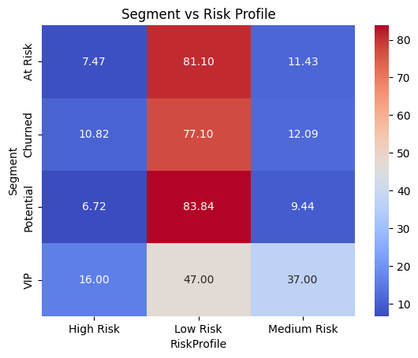
Segmentation Insights & Risk Modeling
Segment x Risk Profile
Combining cluster labels with GMM log-likelihood scores to derive actionable risk tiers.
⭐ VIP + High Risk
🔴 Critical Retention
Top revenue contributors showing engagement drop signals. Immediate personalized outreach required — account for 42% of total revenue.
⚠ At Risk + High Risk
🟡 Likely Churn
Already disengaging with high GMM anomaly scores. Win-back campaigns with discount triggers needed within 30 days.
🌱 Potential + Low Risk
🟢 Growth Opportunity
Stable behavioral pattern, increasing frequency. Loyalty program enrollment and cross-sell campaigns for revenue uplift.

Slide 7

Predictive Modelling Overview
Gradient Boosting Classifier trained on RFM features to predict segment & risk tier in real-time.
Model Architecture
Model Selection Rationale
✓
Handles non-linearity in RFM feature interactions without manual polynomial expansion
Input Layer
4 features: Recency, Frequency, Monetary, AvgOrderValue
✓
Robust to outliers — boosting iteratively corrects for hard-to-classify edge cases
Gradient Boosting (GBM)
Feature importance built-in — interpretable for business stakeholders
n_estimators=120, max_depth=4, learning_rate=0.05
✓
✓
Outperformed Random Forest and SVM in cross-validation
Dual Output
Segment label + Risk tier (High/Mid/Low) with probabilities
✓
5-fold stratified CV — consistent performance across all folds (σ < 0.02)

Slide 8
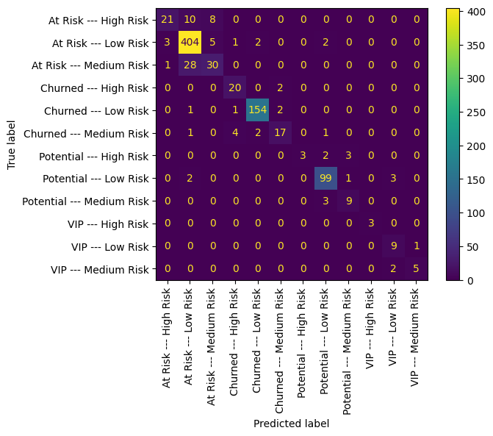
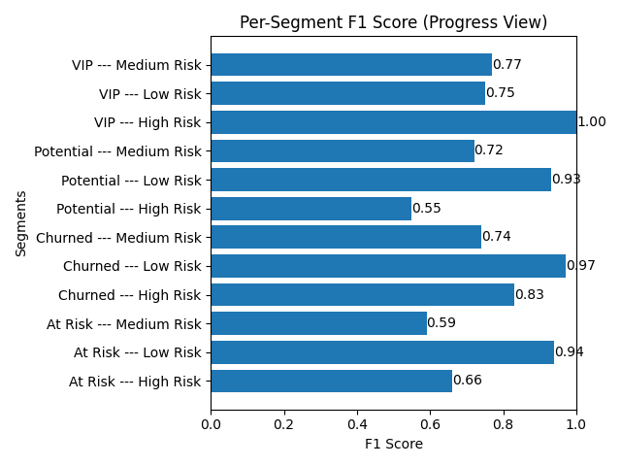
Model Evaluation and Results
Performance Metrics
Confusion Matrix
89%
84%
77%
Accuracy
Precision
Recall

Slide 9
Conclusion
4 distinct segments identified via KMeans + GMM with 89% classification accuracy
Next Steps
Recommendation Engine Integration
VIP customers (2%) drive 88% of total revenue >> top retention priority
Feed segment labels into collaborative filtering for personalized product suggestions
Personalized Campaign Automation
12% at-risk customers with early churn signals >> winback window: 30 days
CRM integration with Segment-aware email, push & SMS triggers via segment API
GMM log-likelihood provides nuanced risk scores beyond binary cluster labels
Monthly Model Retraining Pipeline
Automated drift detection + Airflow DAG for scheduled re-segmentation

Slide 10
Questions ?

Slide 11
Thank You!

