Slide 1


Business Intelligence and Business Analytics
Presented by:
Prathamesh Gaikar (x19216301) Tushar Patil (x19199988)
Ritika Chendvenkar (x19199473) Jignesh Waghela (x19202024)

Slide 2


About
Amica is a mutual insurance company from Lincoln, RI, USA. It is one of the oldest automobile insurance providers in the USA which was founded in 1907 by A.T.Vigneron. The company started with automobile, fire, and theft insurance products and now it offers various products and services like house, auto marine, and life insurance as well. It is a well recognized insurer in the insurance industry in the USA. “To create peace of mind and build enduring relationships” is the mission statement of Amica and the firm has reflected that from its increasing market share over the century. Currently, Amica offers all their products through online platforms and has office premises at 44 locations throughout the states.

Slide 3

Objective
To propose a simple, cost-efficient, and scalable system solution using the Business analytics for Amica Mutual Insurance Company. As a part of the Business Intelligence team, we would be studying the structure of the firm, its marketplace, and the previous data to get meaningful insights and propose the system solution.

Slide 4

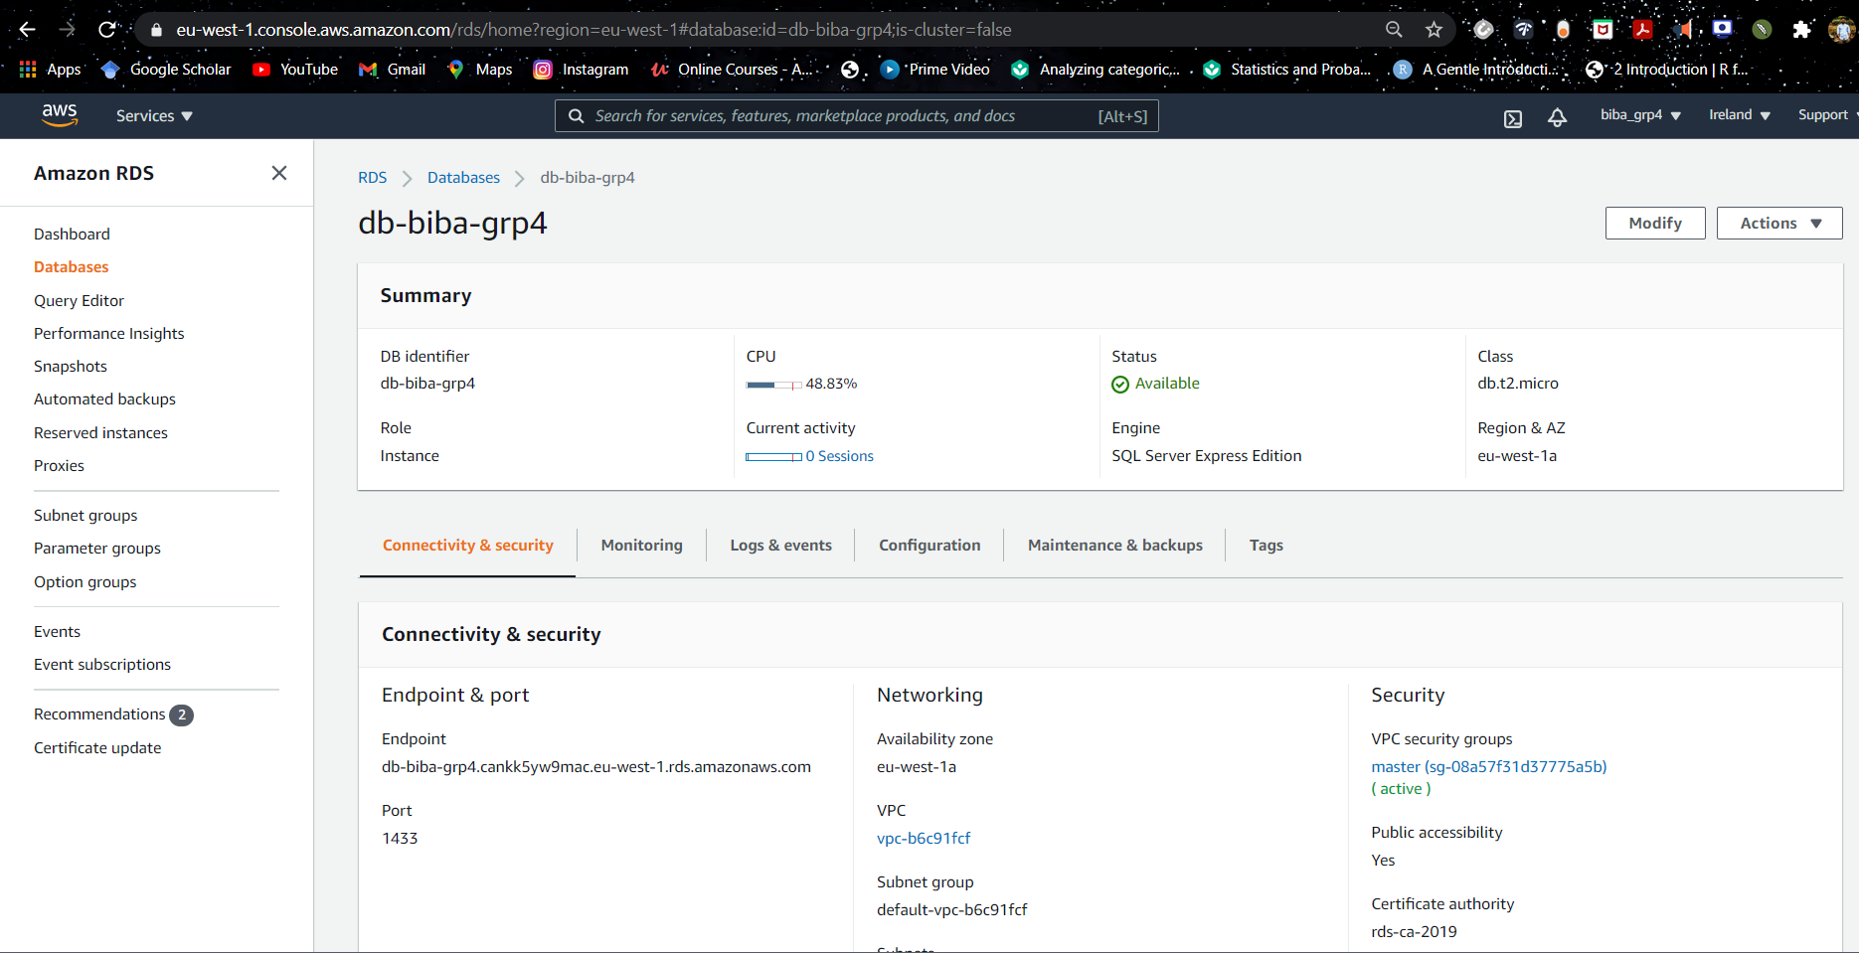
Data Management
DB instance creation on AWS for SQL server and connection it to Power BI
Database management and security.

Slide 5

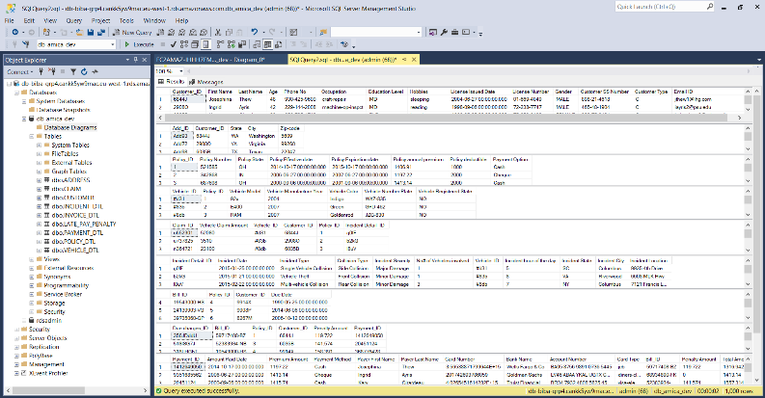
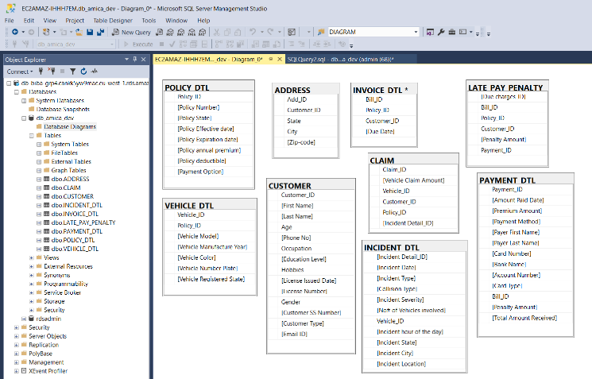

Data Management
Pushing the sample data into DB.
Data transactions using SQL Server Management studio(SSMS)

Slide 6


CRM and Power BI
CRM
Collect Information​
Analyzing the raised ticket​
Handle Customer Complaints​
Insurance Claim Flow
Power BI
Reports and Dashboard​
Overall Customer Dashboard​
Incident Dashboard​
State-wise Dashboard

Slide 7
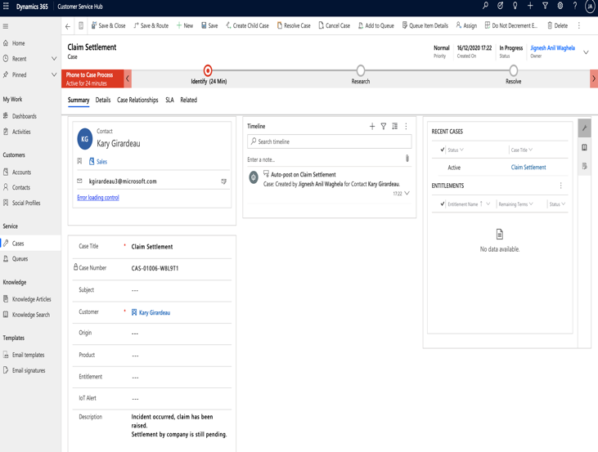
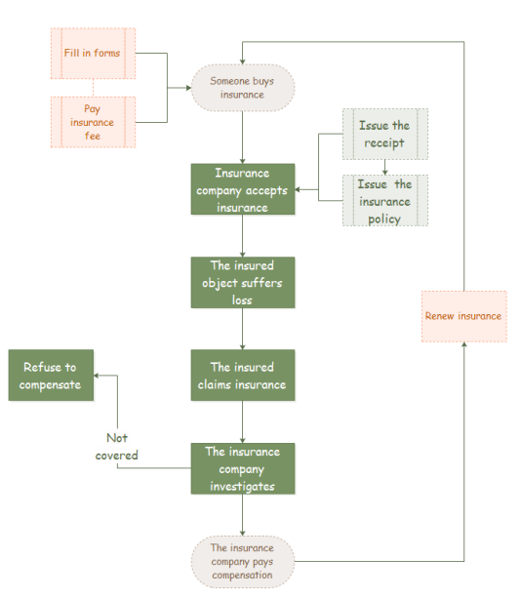
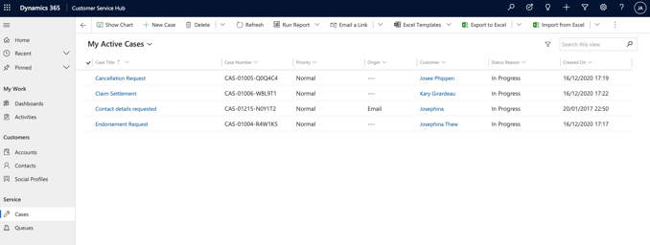
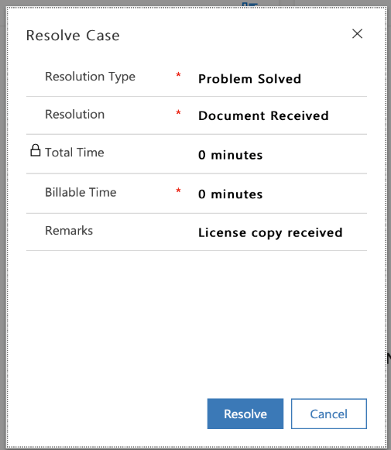
CRM

Slide 8
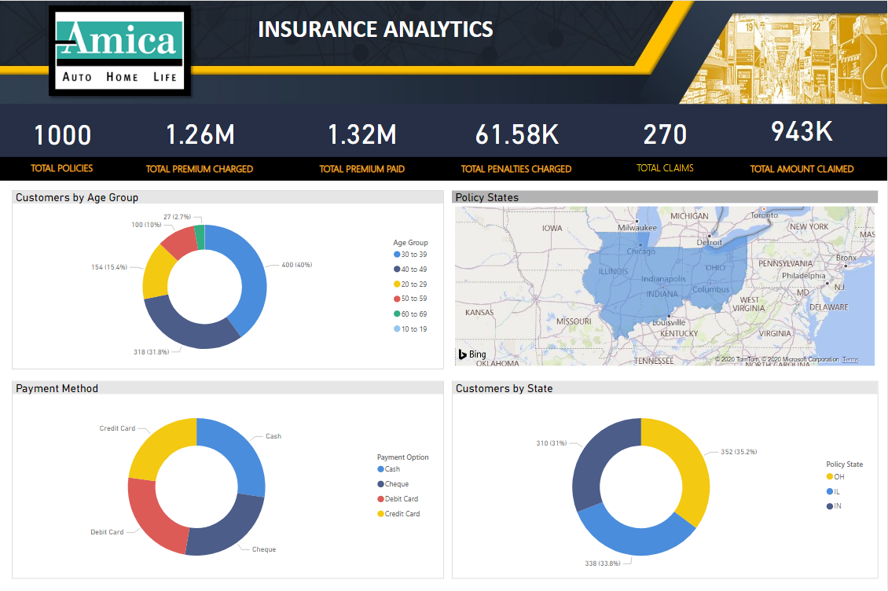
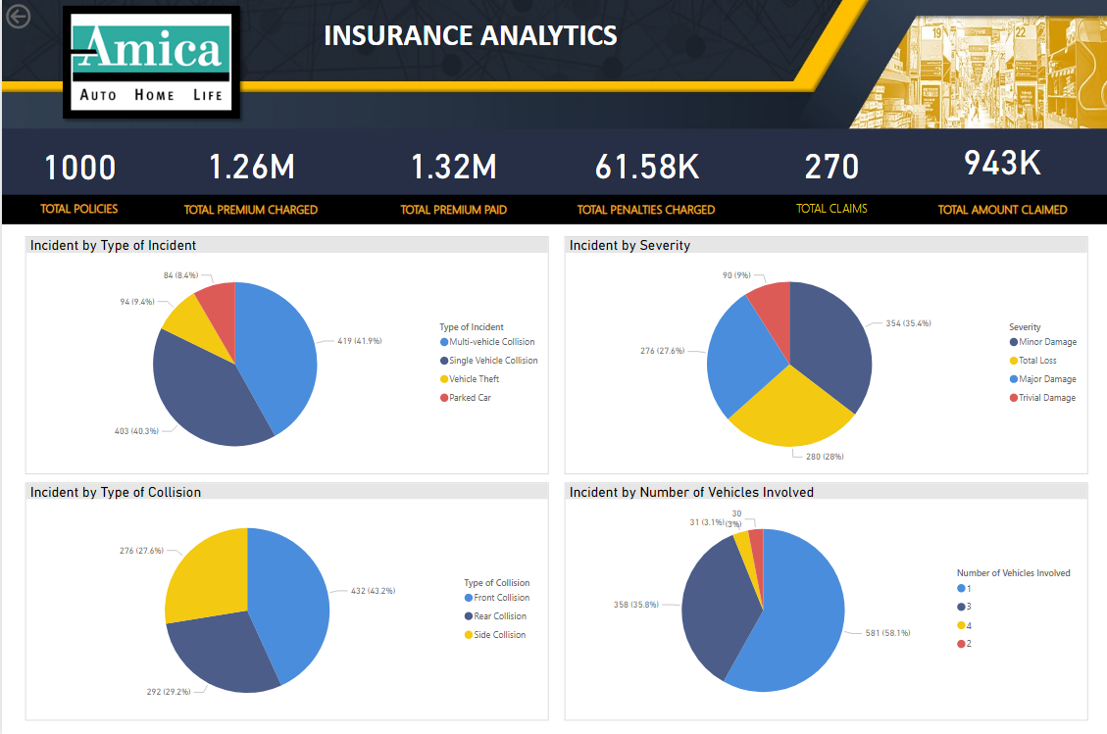
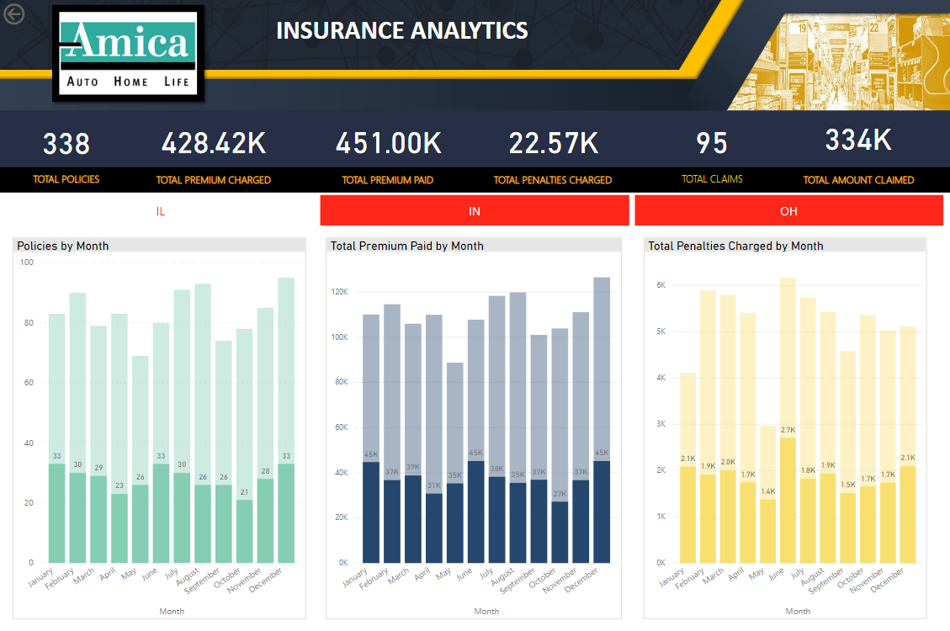
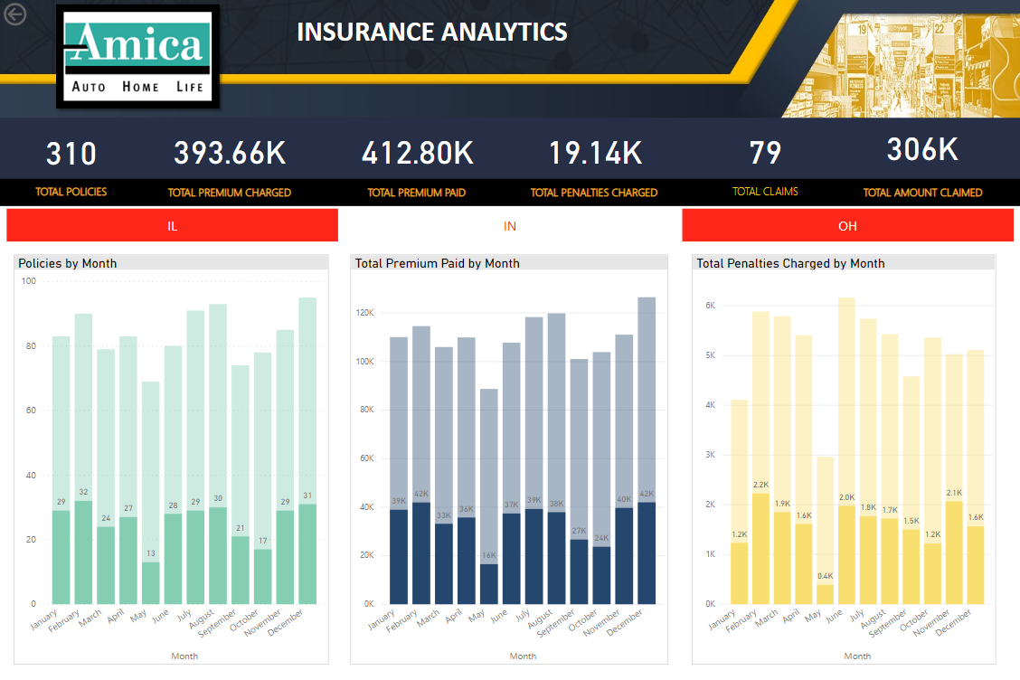
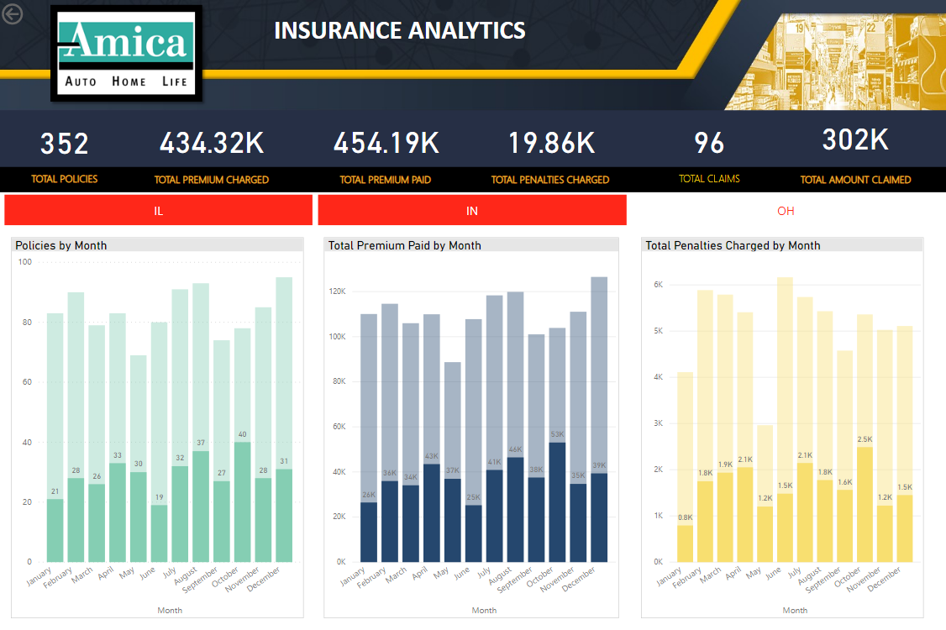
Power BI

Slide 9
?
ANY QUESTIONS?

Slide 10

Presentation link (MS Stream)
https://web.microsoftstream.com/video/d03d375c-7064-4dc3-b467-b21ec188da57

Slide 11
THANK YOU

