Slide 1
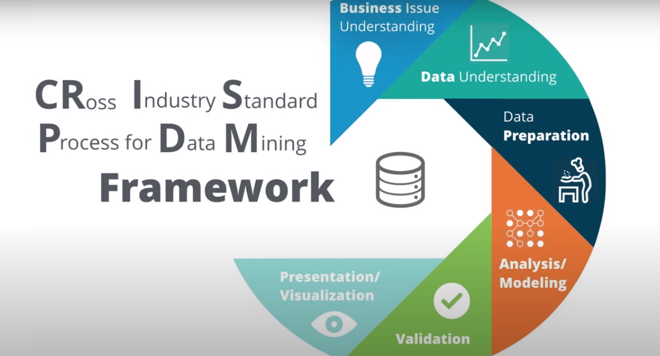
Domain Application of Predictive Analytics Project for Loan Default Prediction
Tushar patil-19199988
Objectives:
Prediction of default loan accounts.
Detecting underlying features apart from financial features which results in the loan default.
Use of informative visualization to uncover patterns present in data.

Slide 2
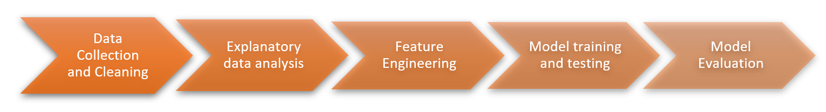
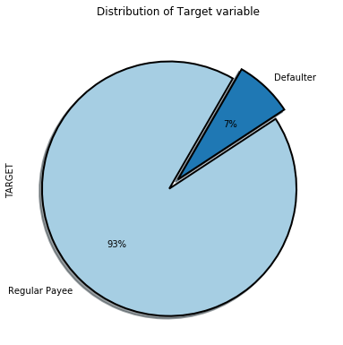
Methodology
Data Pre-processing – collection and cleaning
EDA
Feature Engineering- PCA
Approach 1- Without Resampling
Approach 2- With Resampling
Model Evaluation
Results

Slide 3
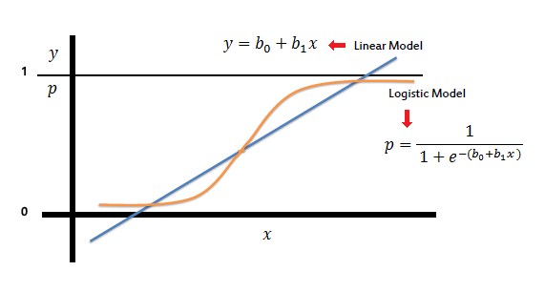
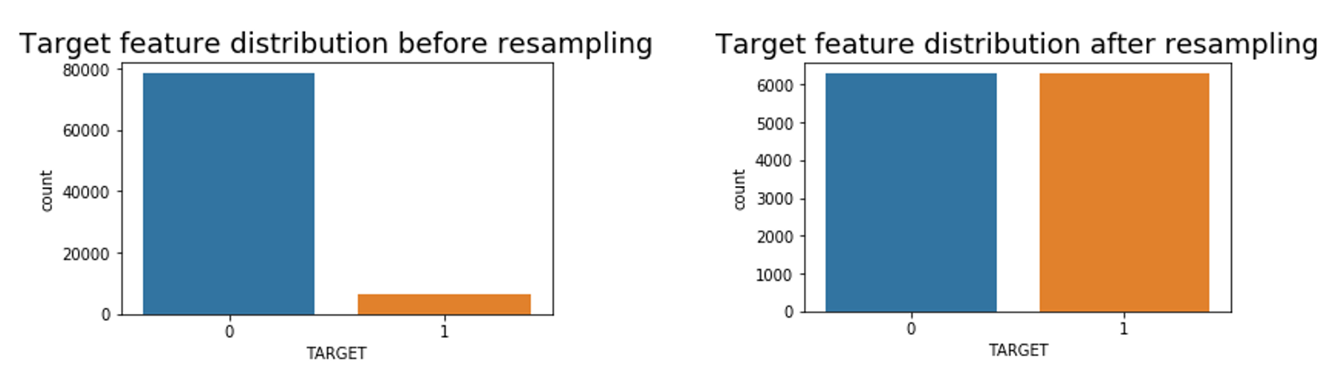
Implementation
Data Cleaning
EDA
Logistic regression- Sigmoid Function, low cost, flexible, fast
Class Imbalance – Affects Model Performance
Random Undersampling Method- Balances Data
Model Training and Testing- 80:20 ratio

Slide 4
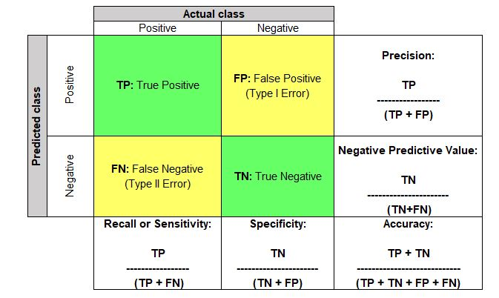
Evaluation
Performance Matrix
Confusion Matrix
Type-II errors- Default accounts labelled as normal accounts, High cost
Accuracy- Dominated by majority class ,Not sufficient
F1-Score- Overall performance

Slide 5
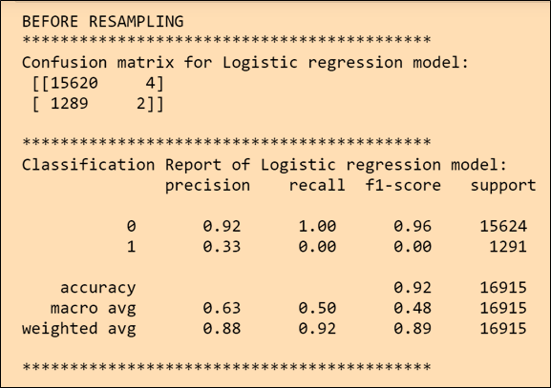
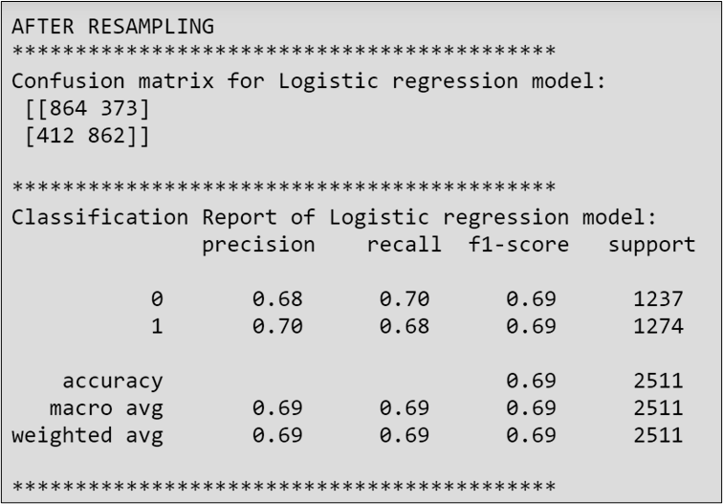
Results and Conclusion
Class Imbalance Affects the Performance of Model.
Cost of Type-II errors(False Negative) is higher in default prediction task.
Random sampling elevates the model performance.
Higher F1-score indicates better performance.
Demographic features plays important role in default prediction.

Slide 6
Presentation Link(MS Stream)
https://web.microsoftstream.com/video/d948b4fc-6069-4588-8886-069b307b0a90

Slide 7
Thank You

