Slide 1
Snowflake - Session
Day-4

Slide 2
Stages
Internal stage : used for loading data from local folder to snowflake
Three types of internal stages:
User stage -User stages are tied to a specific user. Every user has a default stage created. We will not be able to either modify or remove these stages. We need to refer to the user stages using ‘@~’
Table Stage - Table stages are tied to a specific user. Whenever a table is created, then automatically table stage is created. Like the user stage will not be able to either modify or remove the table stage. So, if you need to load one table then you can choose the table stage. We need to refer to the table stages using ‘@%’
Internal Named Stage - These stages offer more flexibility compared to user or table stages. We need to create these stages manually and we can also specify the file format options while creating the stage itself which is unlike the table or user stage. We need to refer to the internal named stages using ‘@’.
External stage : used for loading data from other cloud services like AWS, AZURE, GCP.

Slide 3
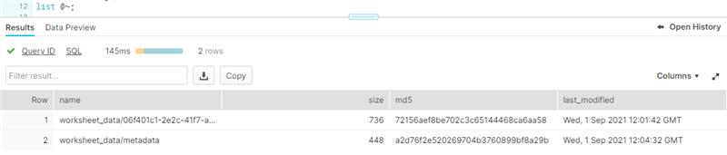
Stages
Internal stages:
Table stage:
SYNTAX: list @%<table_name>;
EXAMPLE: create table table(t int);
list @%table;
User stage:
SYNTAX: list @~
EXAMPLE:
​
Named stage:
SYNTAX: create stage <stage_name>;
list @<stage_name>
EXAMPLE: create stage internal_stage;
list @internal_stage;

Slide 4
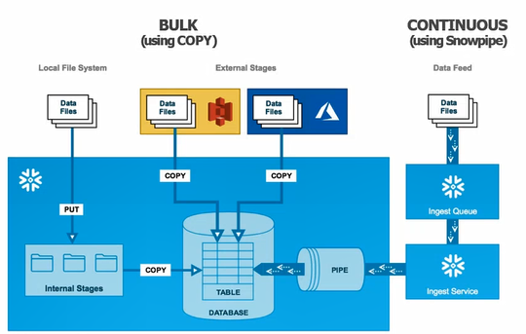
Data Loading

Slide 5
Internal Loading
Internal Loading Syntax:
create stage <stage_name>;
put file:///<location_of_the_file> @<stage_name>;
copy into <table_name> from @<location_in_stage> file_format = (format_name = CSV_Format)
STEP 1: Create an internal stage and file format
CREATE FILE FORMAT "DEMO_DB"."SCHEMA_FILE_FORMAT".CSV_FORMAT
COMPRESSION = 'AUTO'FIELD_DELIMITER='|’
RECORD_DELIMITER='\n'SKIP_HEADER=0;
CREATE STAGE "DEMO_DB"."SCHEMA_STAGES".internal_stage_demo;

Slide 6
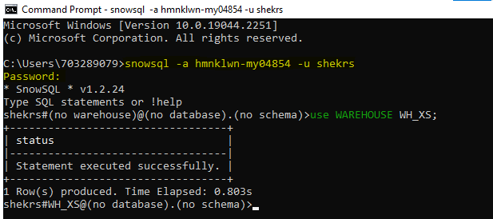
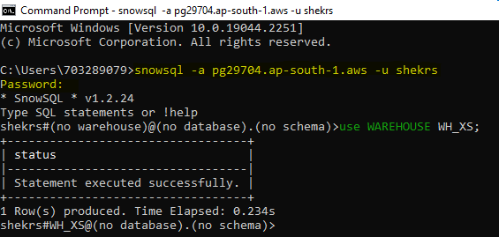
SnowSQL Installation & login
SnowSQL installation link: https://developers.snowflake.com/snowsql/
Using Snowsql:
Open cmd prompt
Run snowflake login cmd: snowsql -a <account_identifier> -u <username>
username> - that is used while login
https:// <account_identifier>.snowflakecomputing.com
<account_locator>.<cloud_region_id>.<cloud> or <organization_name>-<account_name>
e.g.,
https://pg29704.ap-south-1.aws.snowflakecomputing.com
https://app.snowflake.com/ap-south-1.aws/pg29704/dashboards
https://hmnklwn-my04854.snowflakecomputing.com

Slide 7
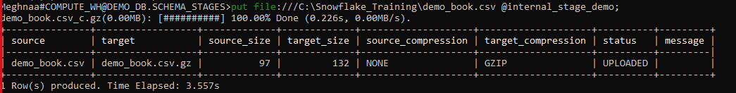
Internal Loading
STEP 2: Load data from local folder into the internal stage using SnowSQL
put file:///C:\Snowflake_Training\demo_book.csv @internal_stage_demo
Step 3: Copy the file from internal stage to the table (first create a table with the same parameters before copying)
copy into demo_book_table from @internal_stage_demo/demo_book.csv.gz file_format =
(format_name = CSV_Format);
Important Commands:
SHOW FILE FORMATS
SHOW STAGES
DESC FILE FORMAT “TRAINING”.”SNOWFLAKE_TUTORIAL”.”CSV_FORMAT”
Remove @STAGE_TRAINING/
List @STAGE_TRAINING

Slide 8
Data Unloading
Internal Unloading Syntax:
copy into @<stage_name> from <table_name> ;
get @<location_in_stage> file://<location_in_local_disk>;
Example:
copy into @internal_unload_stage from demo_book;
Write the following code in SnowSQL to unload in your local folder:
get @internal_unload_stage/y1_0_0_0.csv.gz file://C:\Users\703289284\Desktop\Snowflake\Data_files\;
External Unloading Syntax:
copy into @<stage_name> from <table_name> ;
Example:
copy into @external_unload_stage from book_demo;
**first create an internal and external unload stage**

Slide 9
Semi-Structured Data
Semi-structured data is the data which does not conforms to a data model but has some structure.
It lacks a fixed or rigid schema.
For e.g., JSON, etc.
The VARIANT data type imposes a 16 MB (compressed) size limit on individual rows.
It is recommended to enable the STRIP_OUTER_ARRAY file format option for the COPY INTO <table> command to remove the outer array structure and load the records into separate table rows:
Ex., copy into <table>
from @~/<file>.json
file_format = (type = ‘JSON’ strip_outer_array = true);
Following are the steps for loading semi-structured data:
Create a file format for the semi-structured file you want to load, e.g., XML, JSON.
Example:
Create FILE FORMAT JSON_FORMAT
COMPRESSION = 'AUTO' TYPE='JSON’;
2. Now follow the same steps as we did for data loading and unloading for structured data.

