Slide 1

AIR QUALITY MONITORING
BY - Tushar Mehra
2310994820

Slide 2
INTRODUCTION OF THE PROJECT
Air quality monitoring is becoming increasingly important due to the rise in environmental pollution and its adverse effects on human health. With advancements in technology, affordable solutions for real-time air quality monitoring have become more accessible, helping to track and control pollution levels in various environments, including cities, industrial areas, and homes.
This project focuses on creating an Air Quality Monitoring System using Arduino Nano 33 IoT to measure various air quality parameters (e.g., levels of pollutants like CO2, CO, PM2.5) and Raspberry Pi 4 Model B to log, visualize the data, and send alerts when pollutant levels exceed a certain threshold. The system can be used indoors to monitor air quality in homes, offices, or schools, or deployed outdoors to measure pollution levels in urban areas.

Slide 3
TABLE OF CONTENTS
01
KEY COMPONENTS
02
PROBLEM STATEMENT
03
STEPS TO BUILD
04
CONCLUSION
Components Involved
Problem Statement to be Resolved
Detailed description of the steps involved
Concluding the project

Slide 4
KEY COMPONENTS
Arduino Nano
Raspberry Pi
Acts as the sensor hub to collect real-time air quality data.
Interfaces with various air quality sensors to measure pollutants.
Communicates the sensor data to Raspberry Pi for further processing.
Receives data from the Arduino.Logs the air quality data in a database. Visualizes the data through a web interface or desktop display Sends alerts.
Air Quality Sensors (connected to Arduino)
Communication Protocols
UART (Serial) or I2C for wired communication.
Wi-Fi (through the Nano 33 IoT’s onboard module) for wireless communication
MQ-135 - for detecting gases like CO2, NH3, Benzene, Alcohol, and Smoke
DHT22 - for temperature and humidity, which affect air quality
PM2.5 Sensor - particulate matter in the air).
MQ-7 (for detecting Carbon Monoxide).

Slide 5
DETAILED STEPS TO BUILD THE PROJECT

Slide 6
1. Setting Up Arduino Nano 33 IoT with Sensors
- Connect air quality sensors (MQ-135, PM2.5) to Arduino.
- Read sensor data and process it into meaningful values (e.g., pollutant concentration).
- Send processed data to Raspberry Pi via UART, I2C, or Wi-Fi.
2. Configuring Raspberry Pi to Receive Data
- Set up Raspberry Pi for communication using pySerial (UART), smbus (I2C), or Wi-Fi (HTTP/MQTT).
- Create a Python script to receive and store data in a database (SQLite/MySQL/InfluxDB).
3. Data Logging and Visualization
- Log air quality data with timestamps.
- Set up a web server (Flask/Node.js) or Grafana to visualize data with real-time graphs.
4. Setting Up Alerts for Dangerous Air Quality Levels
- Define thresholds (e.g., PM2.5 > 35 µg/m³, CO2 > 1000 ppm).
- Send email or SMS alerts using Python (smtplib or Twilio) when thresholds are exceeded.
5. Powering and Deploying the System
- Ensure stable power supply with battery backup for deployment in unstable environments

Slide 7
HARDWARE REQUIREMENTS
Raspberry Pi 4 Model B with microSD card (Raspbian OS installed).
Arduino Nano 33 IoT.
MQ-135 Gas Sensor for detecting multiple gases (CO2, NH3, etc.).
PM2.5 Sensor for particulate matter (dust).
DHT22 Temperature and Humidity Sensor.
Power Supply (for both Raspberry Pi and Arduino).
Jumper wires and breadboard for wiring.
USB-to-serial cable (if using UART communication).
Software Requirements
Arduino IDE (to program Arduino Nano 33 IoT).
Raspbian OS (for Raspberry Pi).
pySerial (for UART communication between Pi and Arduino).
smbus (for I2C communication).
Flask or Node.js (for web dashboard on Raspberry Pi).
Grafana (for advanced data visualization).
Twilio or SMTP libraries for sending alerts (optional).

Slide 8
PROJECT WORKFLOW
Arduino Nano 33 IoT continuously reads sensor data (air pollutants like CO2, PM2.5).
Arduino sends this data to Raspberry Pi via UART or I2C.
Raspberry Pi logs the data in a local or cloud database.
The Raspberry Pi also hosts a web dashboard for real-time air quality visualization.
If air quality exceeds predefined thresholds, the Pi sends email/SMS alerts to notify the user.
Optionally, the data can be accessed remotely via a cloud-based interface.
To accurately represent air quality, the sensor data collected from the Arduino is processed on the Raspberry Pi. The system uses established formulas to convert raw sensor readings, such as particulate matter levels and gas concentrations, into an Air Quality Index (AQI) value. The AQI formula takes into account various pollutants and their concentration ranges, assigning an index value that reflects the air quality level. The Raspberry Pi processes this data continuously, allowing real-time tracking of air quality. The resulting AQI values can be visualized on a local display, sent to a web interface, or uploaded to a cloud platform for further analysis.

Slide 9
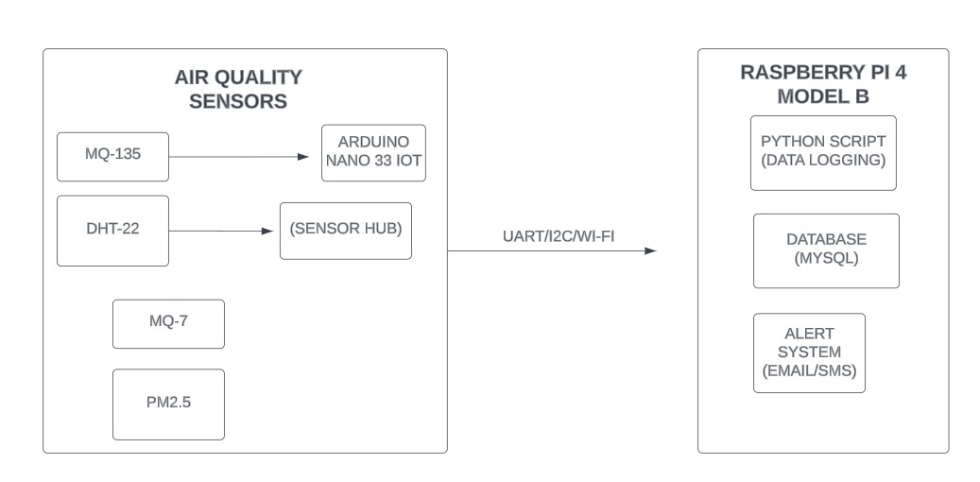
Block Diagram

Slide 10
CONCLUSION

Slide 11

The Air Quality Monitoring System provides a scalable solution for tracking indoor or outdoor air pollution levels in real-time. With the use of Raspberry Pi and Arduino, the system combines real-time data collection, logging, and remote access capabilities. It's particularly useful for smart homes, environmental monitoring in schools or offices, or even outdoor pollution tracking in urban areas. The flexibility of adding more sensors and alert mechanisms makes this a robust project for air quality awareness.

Slide 12
THANK YOU

