Slide 1

GLA University, Mathura
Department of Computer Engineering and Applications Institute of Engineering and Technology
Predicting Type 2 Diabetes Using Electronic Medical Records
By:-
Tushar Saxena
Vipul
Umesh Pratap Singh
Sakshi Bhardwaj
Submitted To-
Dr. Pooja Pathak

Slide 2
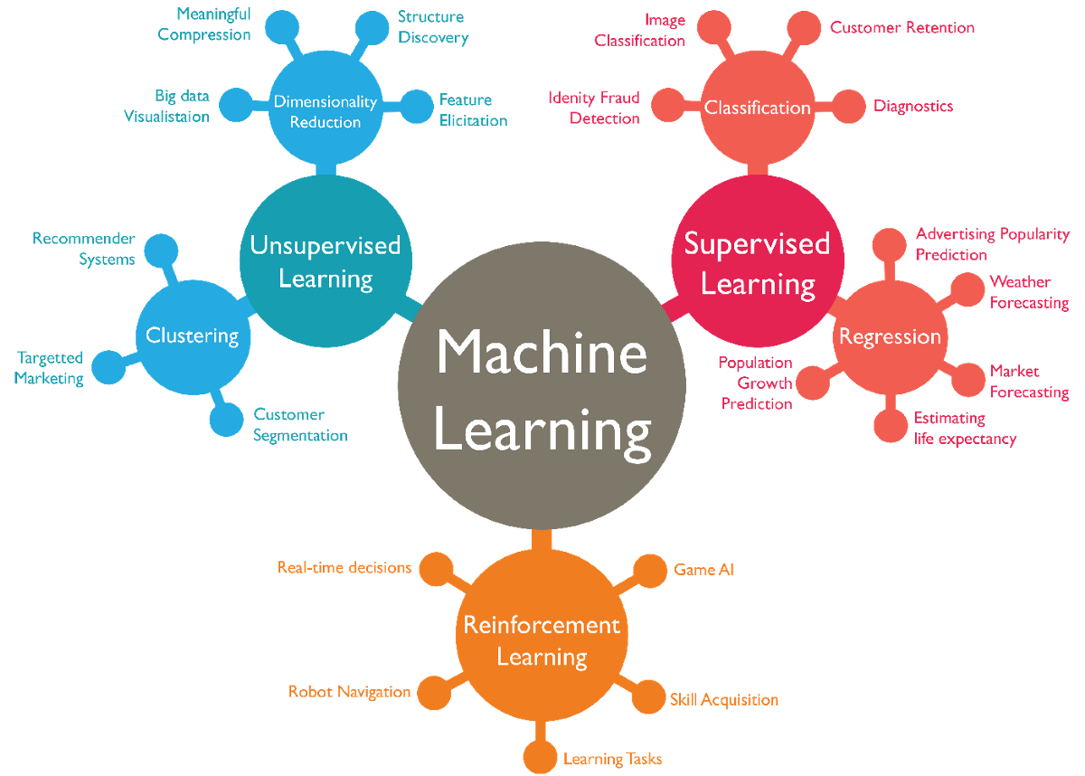
Predicting Type 2 Diabetes Using Electronic Medical Records

Slide 3
Introduction
Machine learning methods are widely used in predicting diabetes, and they get preferable results. Decision tree is one of popular machine learning methods in medical field, which has grateful classification power. Random forest generates many decision trees.

Slide 4
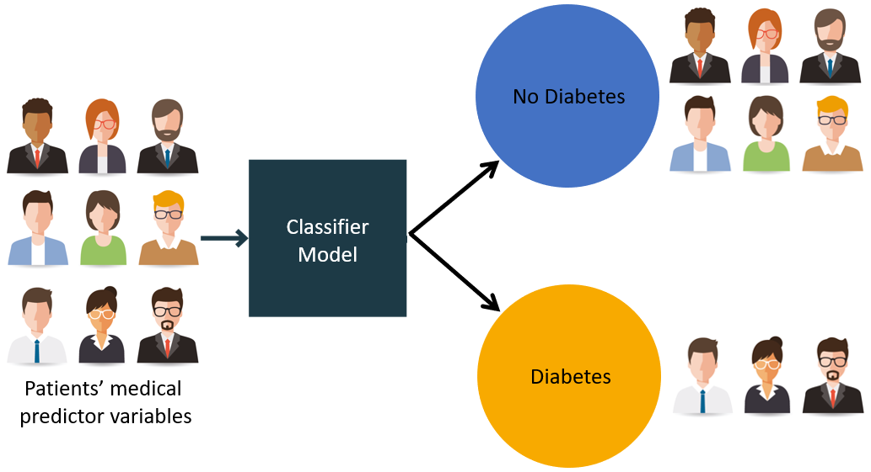
OBJECTIVE
The objective of this project is to build a predictive Machine learning model to predict based on medical records whether patient has diabetes or not. this is a binary(2-class) classification project with supervised learning.

Slide 5

MOTIVATION
Diabetes is a common chronic disease. Prediction of diabetes at an early stage can lead improved treatment. Data mining techniques are widely used for prediction of diabetes at an early stage.
A small study has been conducted to analyse their medical records to assess if it is possible to predict the onset of diabetes based on diagnostic measures.

Slide 6
DATASET
The dataset used in this study, is originally taken from the National Institute of Diabetes and Digestive and Kidney Diseases (publicly available at: UCI ML Repository ). 768 records describing female patients (of which there were 500 negative instances (65.1%) and 268 positive instances (34.9%)).
We can have another alternative for dataset. The dataset is downloaded from Kaggle, where all patients included are females at least 21 years old of Pima Indian heritage.

Slide 7
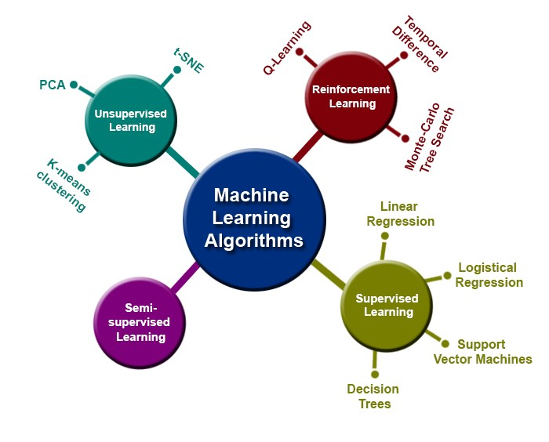
EXPECTED ALGORITHMS USED
Logistic Regression
Decision Tree Classifier
Naïve Bayes Classifier

Slide 8
Logistic Regression
Logistic regression is a statistical model that in its basic form uses a logistic function to model a binary dependent variable, although many more complex extensions exist. In regression analysis, logistic regression (or logit regression) is estimating the parameters of a logistic model (a form of binary regression).
Logistic Regression is one of the basic and popular algorithm to solve a classification problem. It is named as 'Logistic Regression', because it's underlying technique is quite the same as Linear Regression.

Slide 9
Naïve Bayes Classifier
The Naïve Bayes Classifier. It is a classification technique based on Bayes' theorem with an assumption of independence between predictors. In simple terms, a Naive Bayes classifier assumes that the presence of a particular feature in a class is unrelated to the presence of any other feature.

Slide 10
Decision Tree Classifier
Decision Tree is a supervised machine learning algorithm used to solve classification problems. The main objective of using Decision Tree in this research work is the prediction of target class using decision rule taken from prior data. It uses nodes and internodes for the prediction and classification.

Slide 11
Accuracy Measures
Naive Bayes, Logistic Regression and Decision Tree algorithms are used in this research work.
Experiments are performed using internal cross-validation 10- folds. Accuracy, F-Measure, Recall, Precision and ROC (Receiver Operating Curve) measures are used for the classification of this work.
In our results we observe that Naïve Bayes Classifier outperforms other algorithms and give better results with highest accuracy of 74.89%.

Slide 12
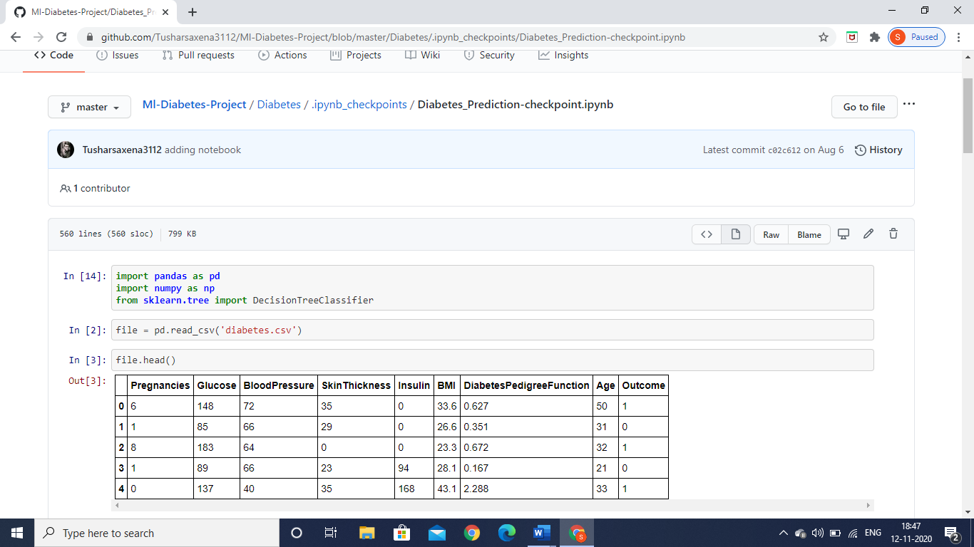
Snapshots of project work

Slide 13
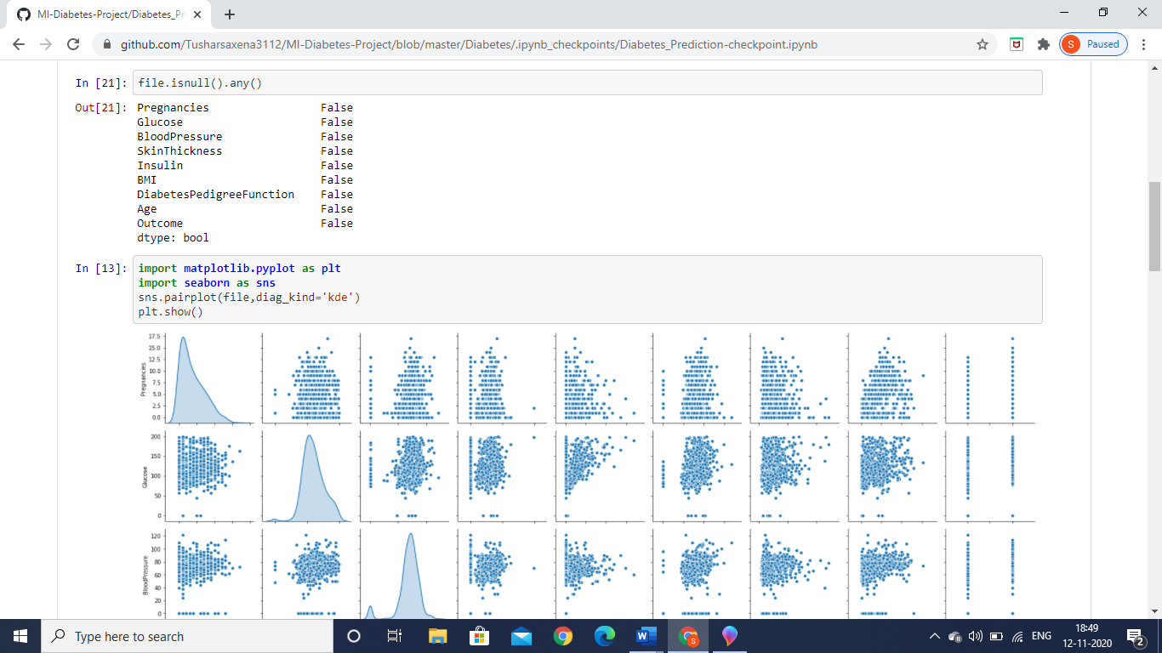
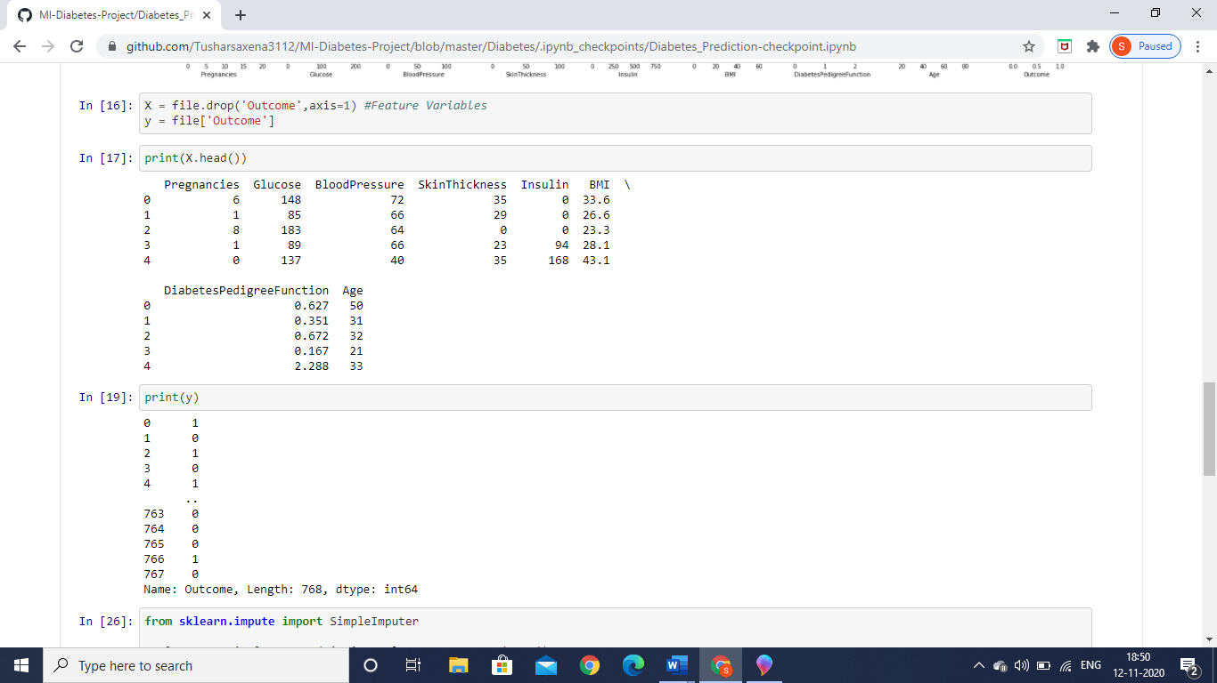

Slide 14
APPLICATIONS
1.ML algorithms have been mainly used to classify diabetic prone cases for pre-diabetes, diabetes, and advanced diabetes based on the patients' HbA1c level.
2. The results demonstrate that AI methods are not only suitable for use in clinical practice but also self-management of diabetes. Also, these methods have the potential for improving patients' quality of life.

Slide 15
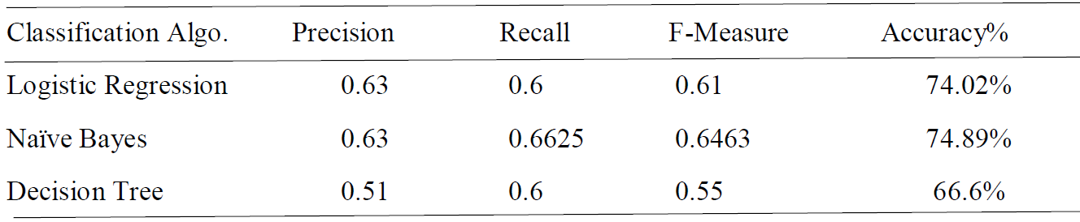
Result

Slide 16


