Slide 1
SUPPORT VECTOR MACHINE

Slide 2
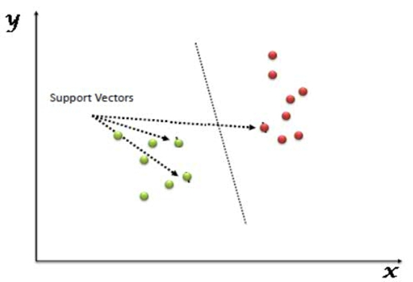
What is SVM ?
Support Vector Machine” (SVM) is a supervised machine learning algorithm which can be used for both classification or regression challenges. However, it is mostly used in classification problems. In the SVM algorithm, we plot each data item as a point in n-dimensional space (where n is number of features you have) with the value of each feature being the value of a particular coordinate. Then, we perform classification by finding the hyper-plane that differentiates the two classes very well (look at the snapshot).

Slide 3
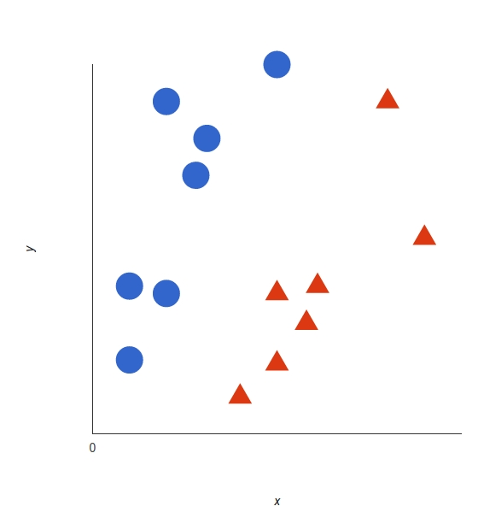
What could be drawn to classify the blue circle from red triangle ?

Slide 4
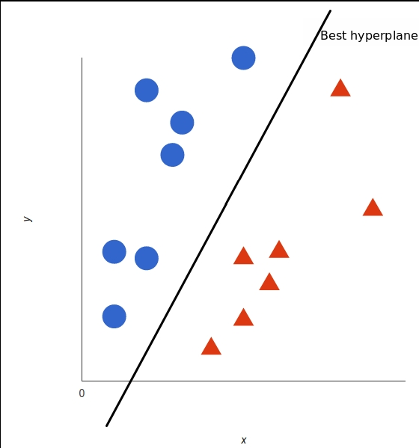
A line drawn between thes data classfiy red triangle and blue circle

Slide 5
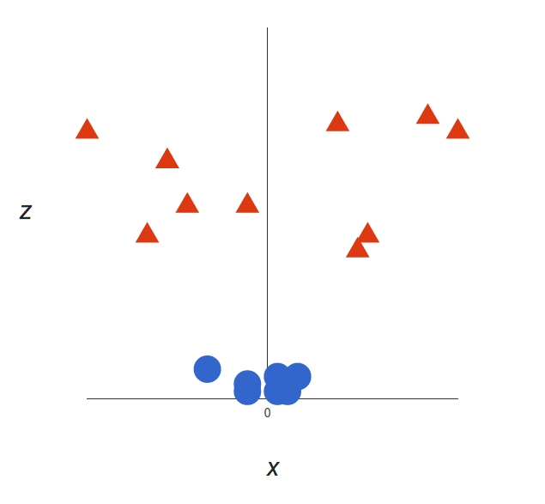
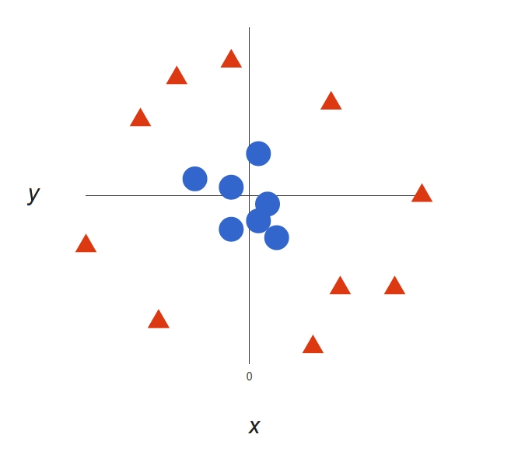
Linear and Nonlinear Separable Data
Linear Separable Data
Nonlinear Separable Data

Slide 6
Tuning Parameters
Kernel Gamma
Regularization
Margin

Slide 7
Margin
Given a particular hyperplane, we can compute the distance between the hyperplane and the closest data point. Once we have this value, if we double it we will get what is called the margin.
Basically the margin is a no man's land. There will never be any data point inside the margin.

Slide 8
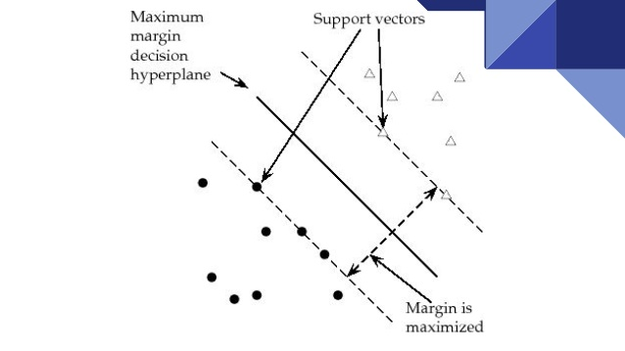

Slide 9
Regularization
SVM algorithms categorize multidimensional data, with the goal of fitting the training set data well, but also avoiding overfitting, so that the solution generalizes to new data points. Regularization algorithms also aim to fit training set data and avoid overfitting.

Slide 10
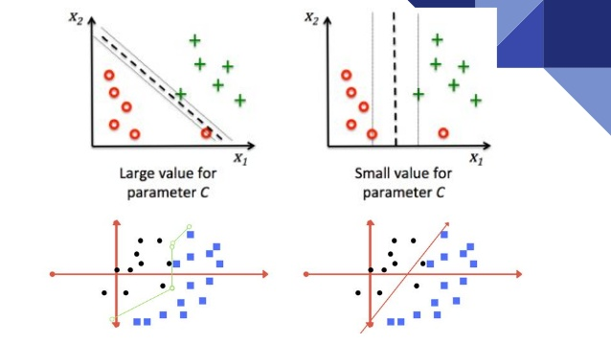

Slide 11
Gamma
The Gamma parameter defines how far the influence of a single training example reaches, with low values meaning ‘far’ and high values meaning ‘close’. The Gamma parameters can be seen as the inverse of the radius of influence of samples selected by the model as support vectors.

Slide 12
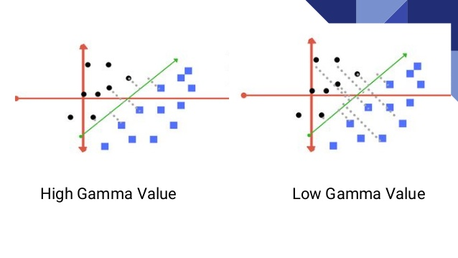

Slide 13
Kernels
SVM algorithms use a set of mathematical functions that are defined as the kernel. The function of kernel is to take data as input and transform it into the required form. Different SVM algorithms use different types of kernel functions.

Slide 14
Various Kernels Available
Linear kernal
Non Linear Kernel
Sigmoid
Polynomial
Exponential
Radial Basis Function (RBF)

Slide 15
Mathematical Representation
X=(X1,X2,X3); Y=(y1,y2,y3)
f(X)=(x1x1,x1x2,x1x3,x2x1,x2x2,X2,X3,x3x1,x3x2,x3x3)
f(Y)=(y1y1,y1y2,y1y3,y2y1,y2y2,y2y3,y3y1,y3y2,y3y3)
K(X,Y)=(<X,Y>)^2

Slide 16
Advantages
It’s very effective in high-dimensional spaces as compared to algorithms such as k-nearest neighbors.
It’s still effective in cases where the number of dimensions is greater than the number of samples.
SVM is versatile: different kernel functions can be specified for the decision function. Common kernels are provided, but it’s also possible to specify custom kernels.
It works really well with a clear margin of separation.

Slide 17
Disadvantages
The main disadvantage of SVM is that it has several key parameters like C, kernel function, and Gamma that all need to be set correctly to achieve the best classification results for any given problem. The same set of parameters will not work optimally for all use cases.
SVMs do not directly provide probability estimates—these are calculated using an expensive five-fold cross-validation process .
It doesn’t perform very well when the dataset has more noise, i.e. target classes are overlapping.

Slide 18
Applications
Face detection
Text and hypertext recognition
Classification of images
Bioinformatics
Handwriting recognition
Generalized predictive control (GPC)
Protein fold and remote homology detection

Slide 19
Thank you
Vipul(62)
Tushar saxena(57)
Umesh Pratap Singh(58)
Sakshi bharadwaj (48)

