Slide 1

Unveiling Trends and Patterns in Automotive Fuel Efficiency
Tushar Vishwanath
Graduate Student and Assistant in Mechanical Engineering,
School for Engineering of Matter, Transport and Energy
Arizona State University
e-mail: tvishwan@asu.edu

Slide 2

United States Environmental Protection Agency
The EPA upholds national environmental standards through assessments, research, and collaborations, fostering comprehensive protection and sustainable practices throughout the United States.
EPA does its emission regulation using data collected that they store in their fuel economy database (www.fueleconomy.gov).
Fuel economy is one of the major targets that must be accounted for controlling emission as well as usage of fuel. According to a census conducted by NADA(National Automobile Dealers Association) there are 280 million cars being used in the US out of which round 256 million are gasoline based.

Slide 3

The average fuel economy for cars in the US is around 24-25 miles per gallon. Increasing the economy by even 1 mile/gallon on an average and considering an average car travels around 29 miles a day [federal highway administration (FHWA) ] we can save 3.65 million gallons of fuel every day.
References :
www.highways.dot.gov
www.fueleconomy.gov
www.epa.gov
www.nada.org
www.eia.gov

Slide 4

Research Question
1) Which Parameter has the most significant impact on fuel economy
2) How does the change in the most significant parameter affect the fuel economy

Slide 5
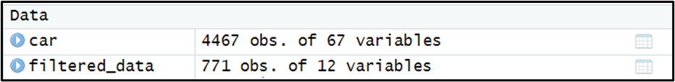
Data Table

Slide 6
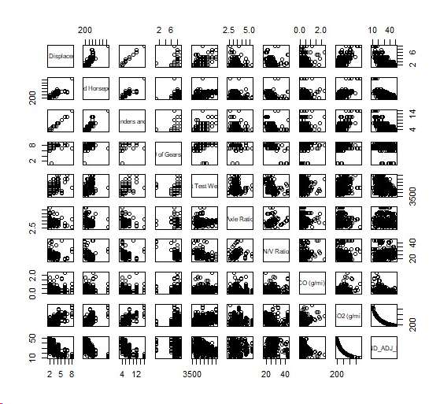
Pairs(mydata)
The scatterplots matrices of the 10 variables we have considered

Slide 7
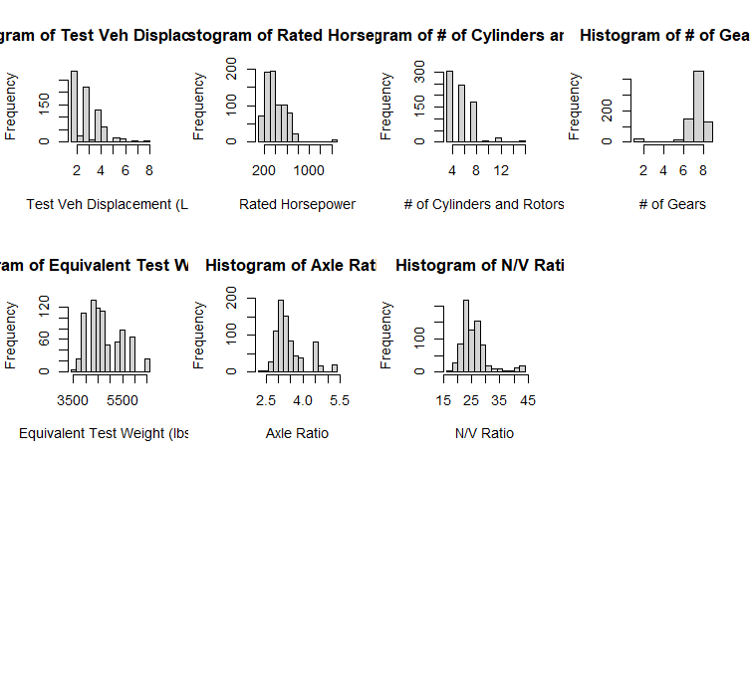
Histograms
Histograms of considered factors that affect the vehicle mileage

Slide 8
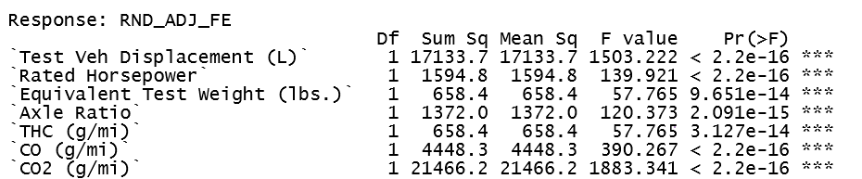
Model 1 (Full Model)
After analysis of the linear model, we eliminated terms with higher P values. Our linear model contains 7 factors now:
The rejected factors include :
No of gears
N/V ratio
No of cylinders and rotors For simplification of the model, we are also rejecting the factors with a relatively high P value, they include :
Equivalent Test weight
Axle ratio
THC
The linear model after rejecting the factors with high P values.

Slide 9
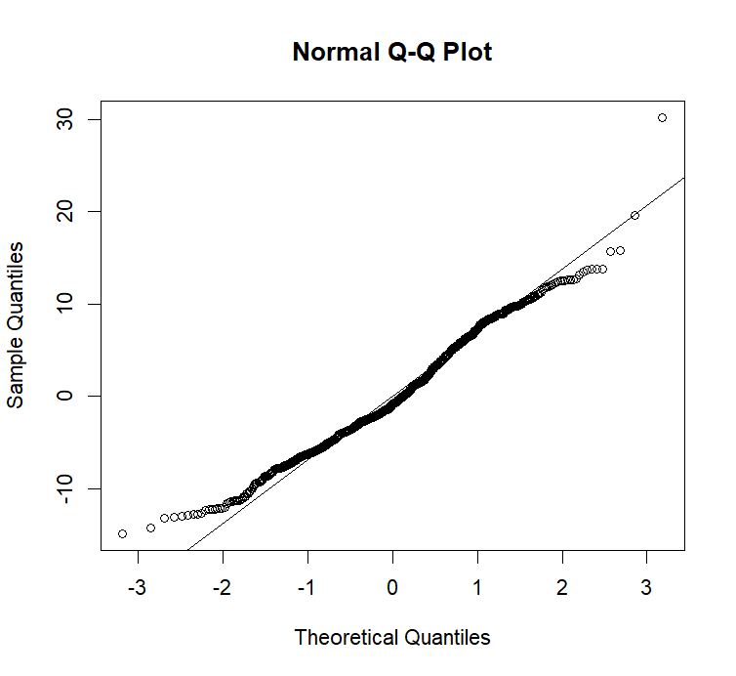
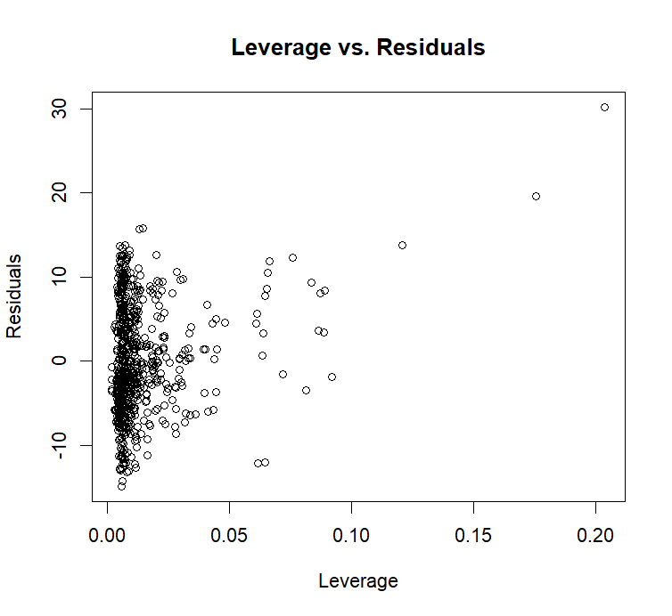
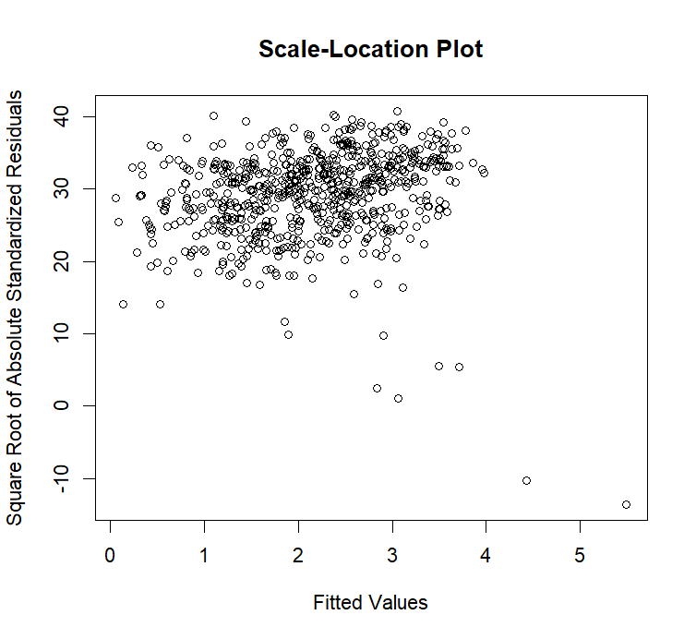
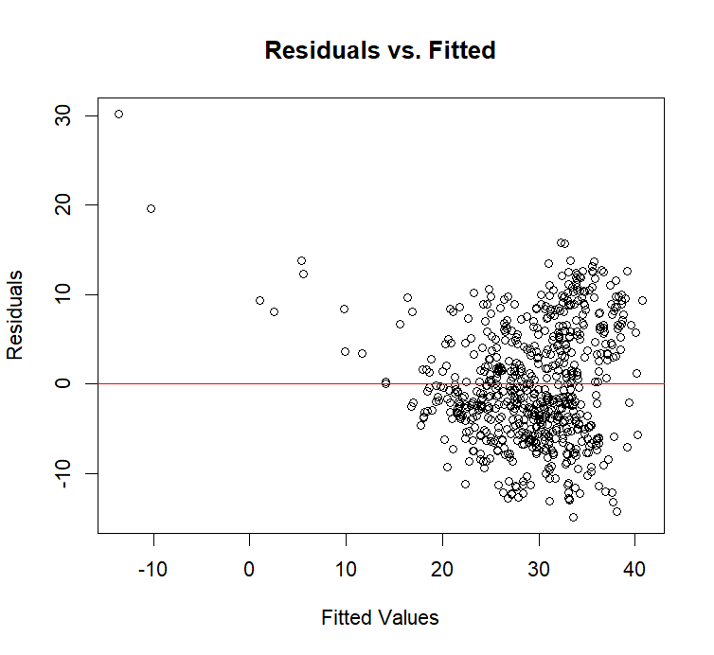
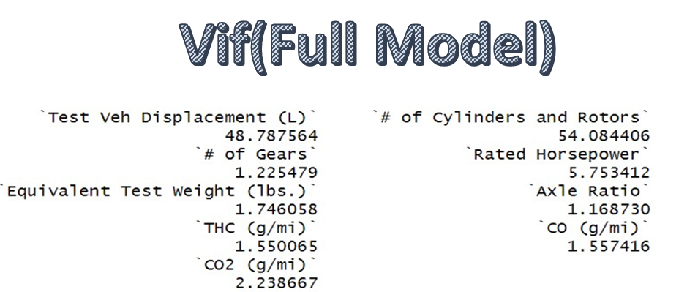

Slide 10
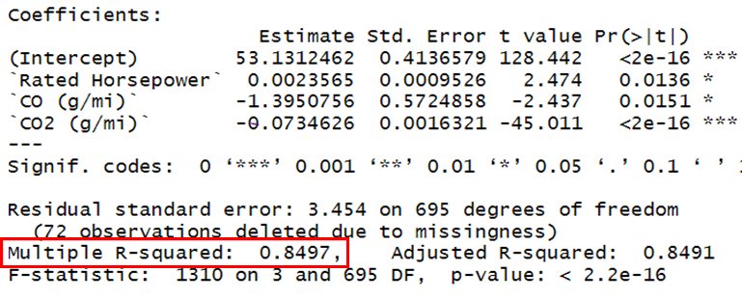
Model 2(Reduced Model 1)
For our reduced model 1 we consider an interaction of all factors except Test Vehicle Displacement

Slide 11
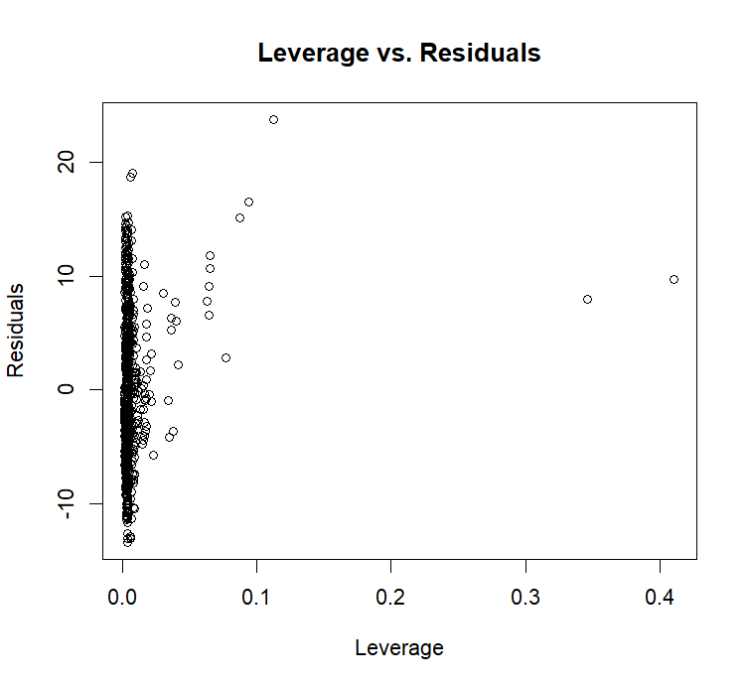
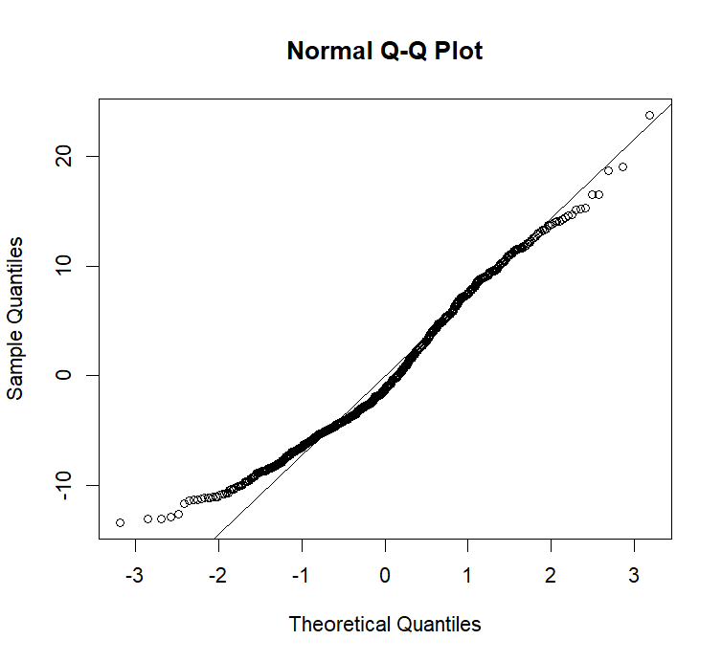
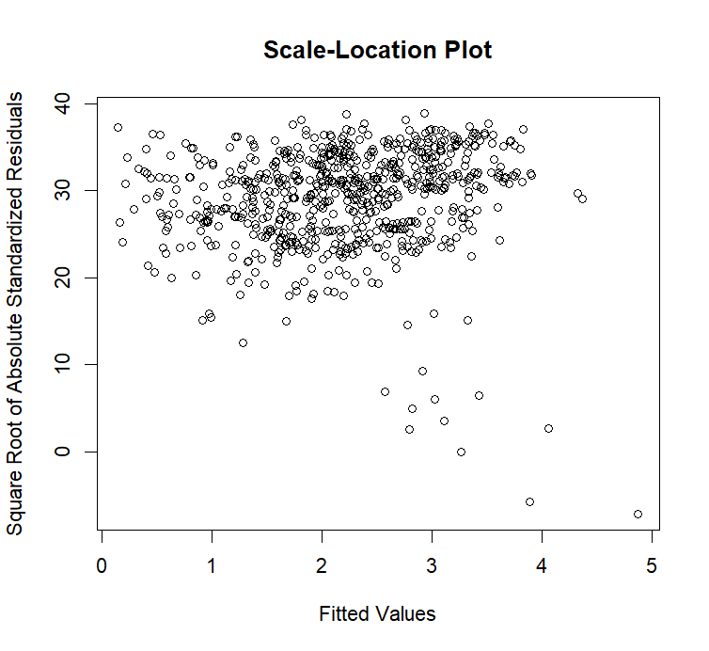
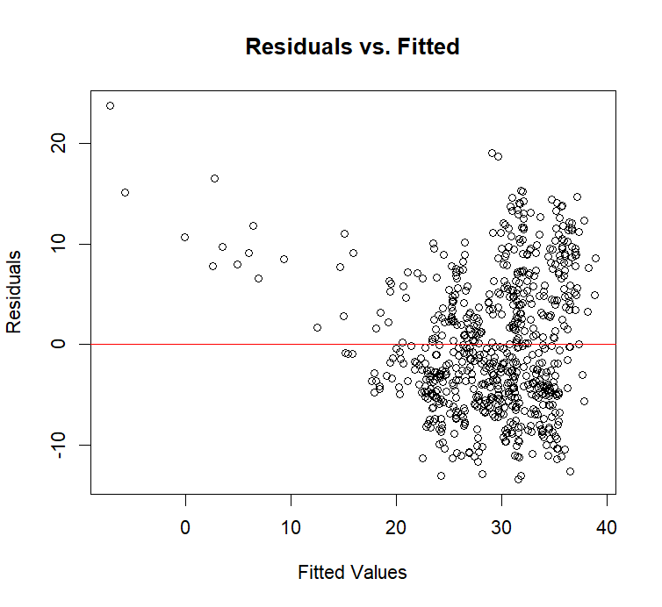
The graphs for Reduced Model 1 show that most of the points in the residuals are concentrated in the same area, with some scattered outliers.
The Q-Q plot closely aligns with a straight line, suggesting that the residuals follow a normal distribution.

Slide 12
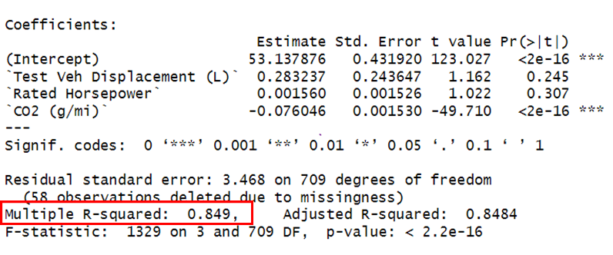
Model 3(Reduced Model 2)
For our reduced model 2 we consider an interaction of all factors except Carbon Monoxide Emissions.

Slide 13
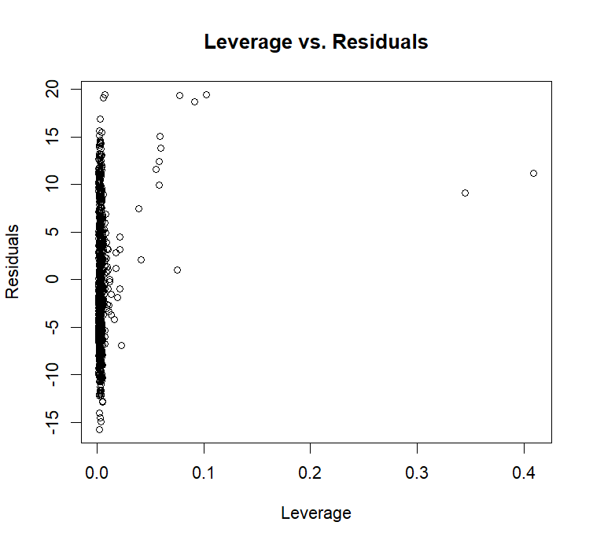
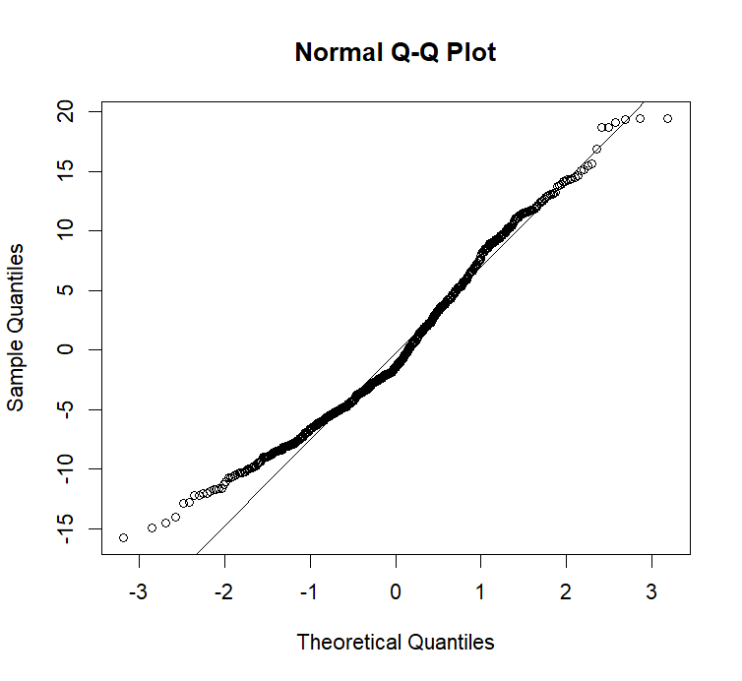
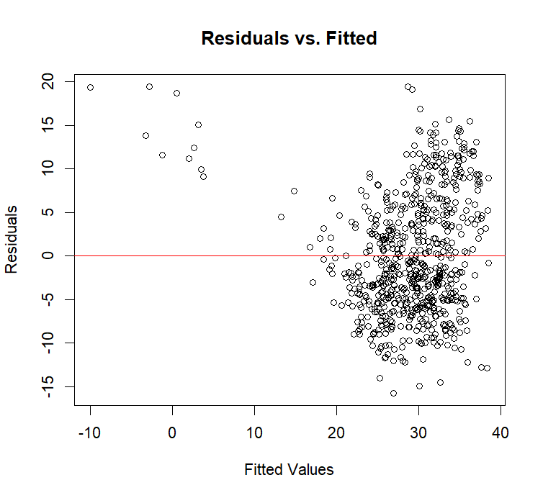
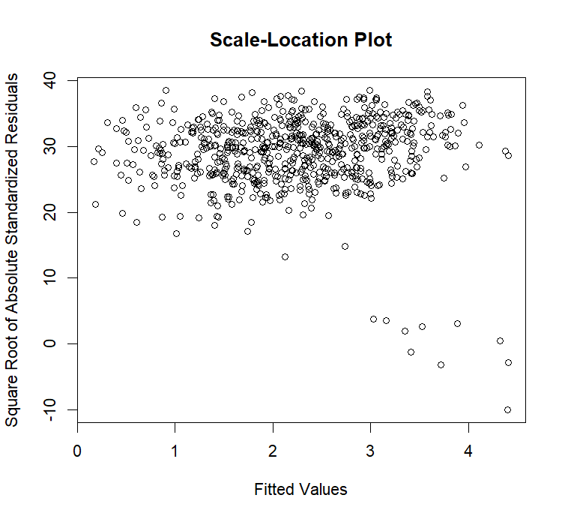
The graphs of Reduced Model 2 show that the points in the residuals are more confined to a line, with very few scattered points throughout the plot.
The Q-Q plot aligns with the straight line, but there is a slight deviation at the lower end.

Slide 14
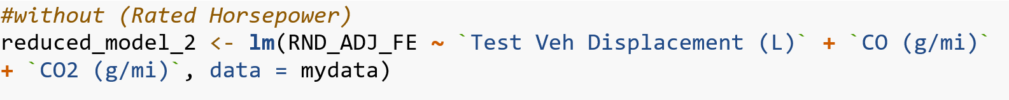
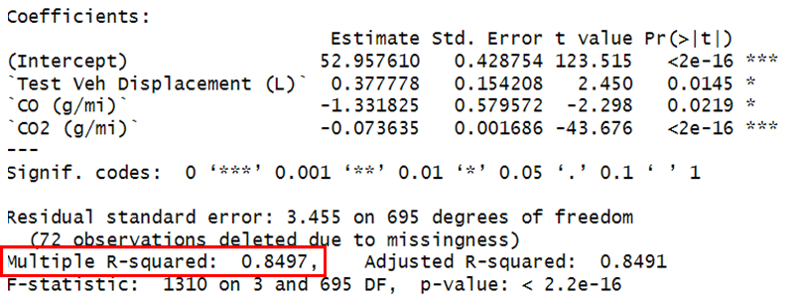
Model 4(Reduced Model 3)
For our reduced model 3 we consider an interaction of all factors except Rated Horsepower Emissions.

Slide 15
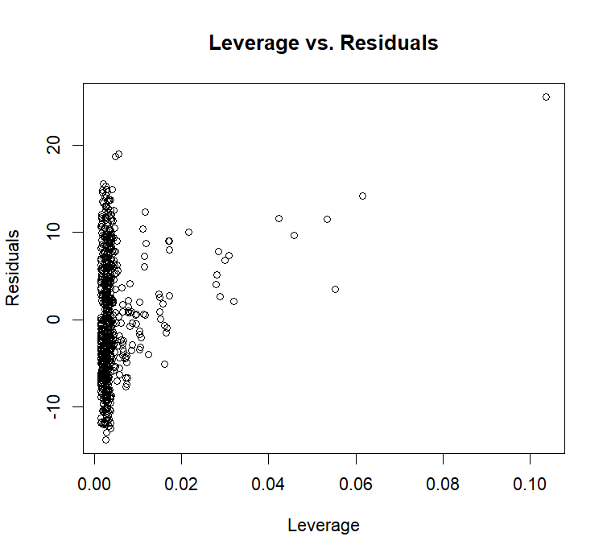

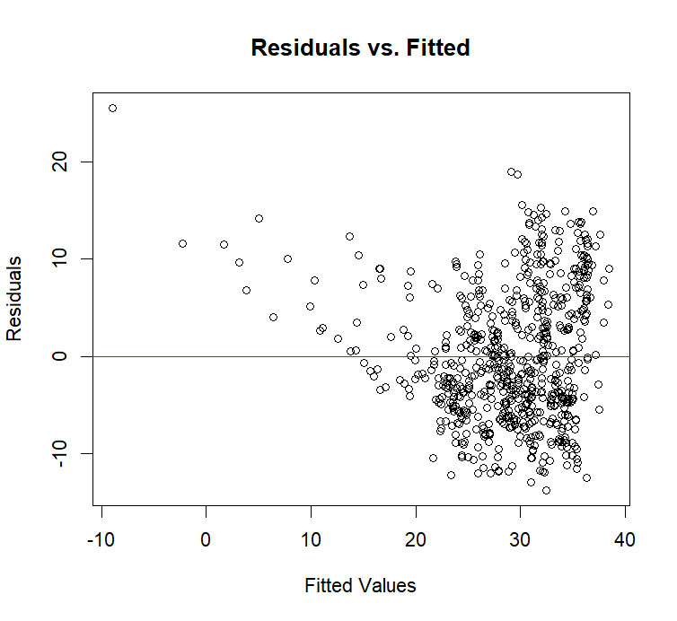
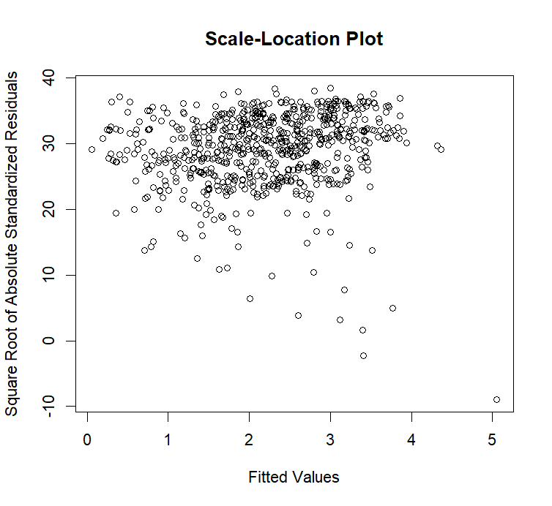
The plots of Reduced Model 3 show that the points in the residuals are slightly scattered, with some possible outliers.
The Q-Q plot mostly aligns with the straight line, but there is a slight deviation at the upper and lower ends.

Slide 16
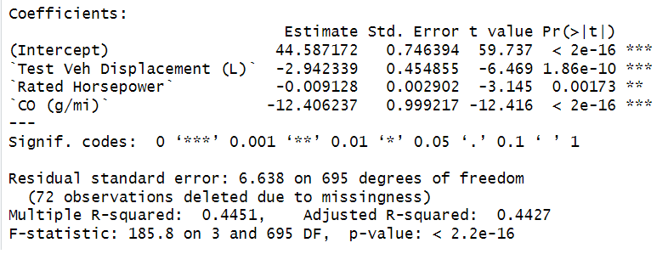
Model 5(Reduced Model 4)
For our reduced model 4 we consider an interaction of all factors except Carbon Dioxide emissions.

Slide 17
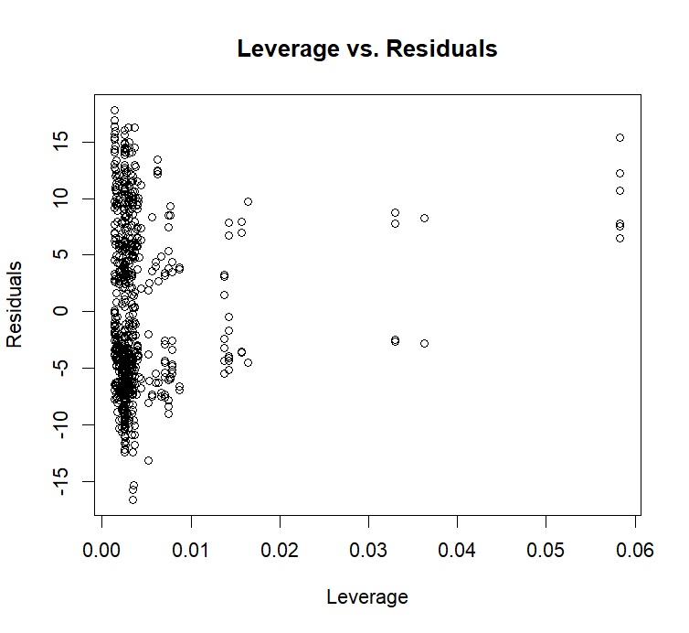
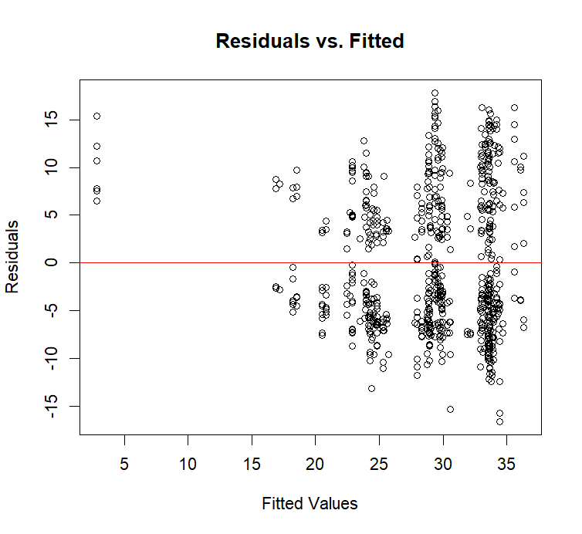
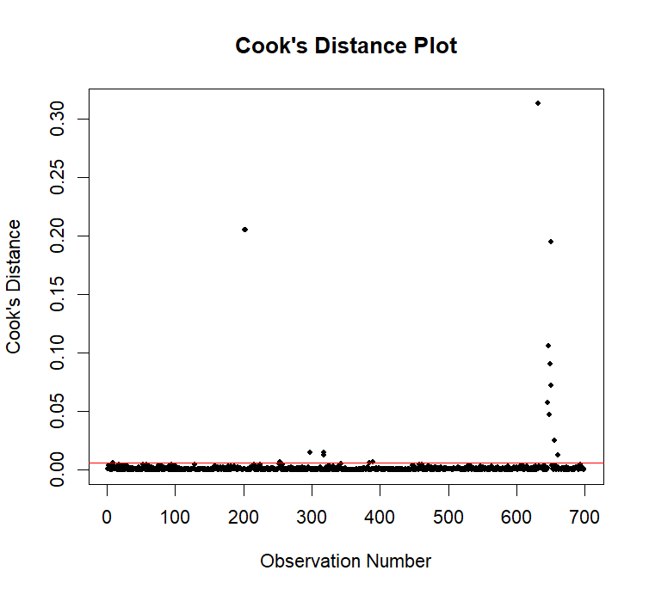
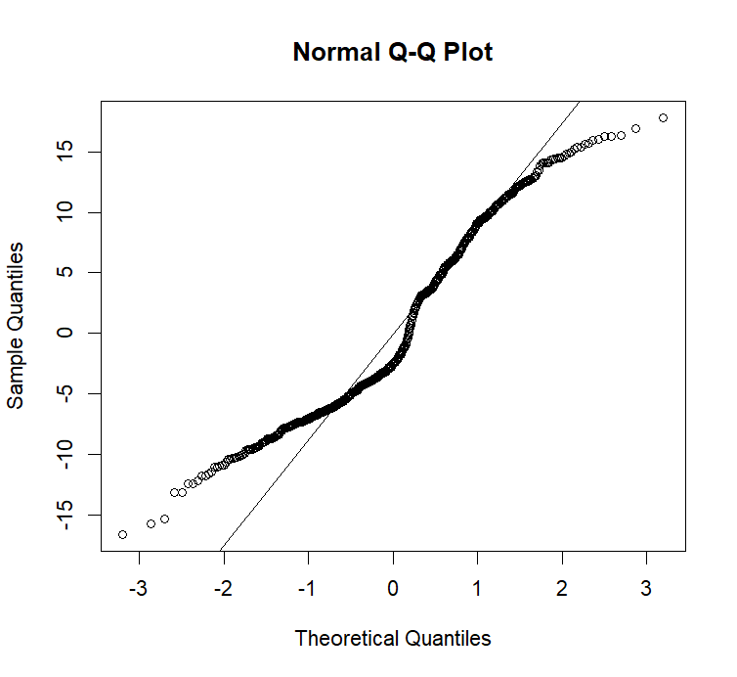
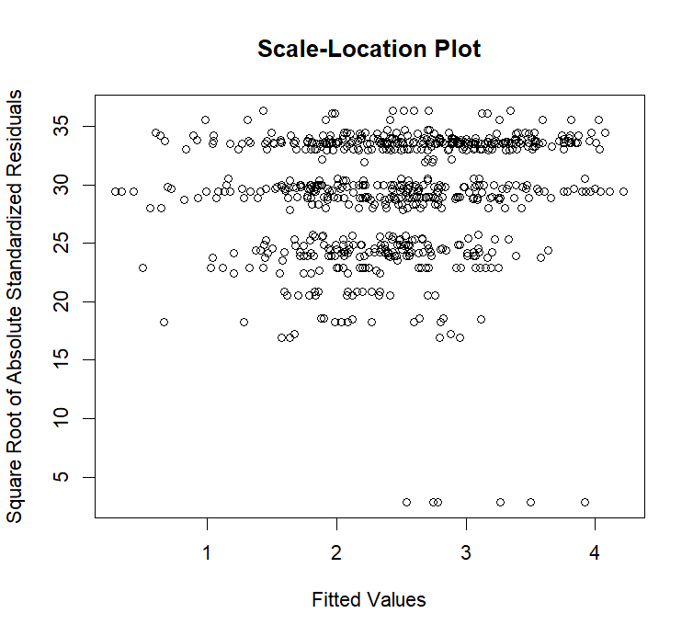
In this model, the Q-Q plot deviates the most from the straight line.
The least R-squared value signifies that the model explains only a small proportion of the variability in the data.
This shows that the C02 is the most significant factor

Slide 18
Discussion/Challenges faced
Though our model looks pretty straightforward we considered and performed many iterations to filter out data and to select the factors that affect our model. We still feel that we could have run different conditions to obtain a better model. Even though our conclusion may be solid, thinking through the automotive aspect creates a question on why important factors such as number of cylinders have lesser impact on the fuel economy.
Though the data is vast, there are certain parameters that are not included which may affect the relationship between CO2 emissions and fuel efficiency :
Vehicle Weight and Aerodynamics: Enhancing aerodynamics can enhance mileage efficiency without proportionately impacting CO2 emissions due to their non-linear relationship.
Emission Control Systems: Engine technologies designed for emission reduction may not always correlate with improved mileage. These systems can impact engine performance differently, affecting CO2 emissions distinct from mileage.
Engine Tuning and Performance Modifications: Modifications aimed at enhancing mileage might not necessarily optimize CO2 emissions, and vice versa. Tuning or performance modifications in vehicles like tuner cars for high performance (e.g., Lamborghini Huracan) vs. untuned models like a standard Honda Civic create divergent data loops due to their distinct design objectives.

Slide 19
Results/Conclusion
From the analysis of the full model and reduced model we can conclude that the Model5 (Reduced model 4) is the least optimized model with the R squared value of 44.5% and with its QQ plot being the one that deviates from the linear the most.
Since model 5 is generated without CO2 this implies that CO2 might be a significant predictor influencing the overall performance of the model.
Other variables might not fully compensate for CO2's absence, indicating its unique contribution to the model. Factors like Test Veh Displacement (L), Rated Horsepower, and CO (g/mi) demonstrate some significance, but their combined influence might not fully replace CO2's impact.
The data shows CO2 is crucial in how the model works but understanding it better might need more study or different ways of looking at things. However, we're focused on different parts of the research, so we're not exploring this further right now.

