Slide 1


Optimization of Diameter for Screw-In Geothermal HeX Insulator
Objective
To evaluate diameter of an insulator positioned between the legs of Geothermal HEX loop.
Group Name: TeX Force
Group Members
Arjun A Seshathri - 1227590561
Anand Anil Kumar - 1226092922
Tushar Vishwanath - 1227565302
Abdulrahman Kurdi - 1228216537
Tasks Completed
Finalized on the study of diameter over pitch of GHEX insulator. Corresponding changes to overall HEX length, diameter and pitch may be assumed to suit ideal results.
Assumption of standard values based on literature review i.e., thermal conductivity of soil and grout, HEX pipe material and diameter, insulator material and thickness, ideal indoor temperatures possible with GHEX, underground temperatures below 30 feet.
Construction of the control volume geometry from the given Cad model. We extracted the Helix tube from the Grout (the control volume) and created interface for the insulator. This is done to get the conformal mesh which will be done through ICEM.
Ira A. Fulton Schools of Engineering
Arizona State University (ASU)
Tempe, Arizona, United States
Pat Phelan
Professor & Assistant Dean
Fluidaptic, LLC
Minneapolis, Minnesota, United States
Thomas BREIDENBACH (Owner)

Slide 2
Assumptions based on literature review
Sr No | Parameter | Value | Source
1 | Thermal Conductivity of Soil (Assuming Sandy Loam Soil) | 0.75 (W/mK) | Moench et. al. "Thermal Conductivity and Diffusivity of Soil Using a Cylindrical Heat Source"
2 | Thermal Conductivity of Grout | 1.96 (W/mK) | Cement-based Grout (Industry Standard for HDPE pipes) Mahmoud et. al. “A review of grout materials in geothermal energy applications”
3 | HEX Pipe Material | SDR 11 HDPE | Industry Standard (As confirmed by Riipen)
4 | HEX Pipe Conductivity | 0.46 (W/mK) | Matweb Material Property Website ”https://www.matweb.com/search/datasheet.aspx?matguid=fce23f90005d4fbe8e12a1bce53ebdc8”
5 | Insulator Material | PU Foam | Ngo et. al. “A new design of ground heat exchanger with insulation plate for effectively geothermal management”
6 | Insulator Thickness | 5 cm | Approx. initial value from Riipen drawing
7 | Ground temperatures below 30 feet | 7-15⁰C | DOE Website ”https://www.energy.gov/energysaver/geothermal-heat-pumps”
8 | HEX Inlet Temp (Consider March, Sept) | 26⁰C | Considering average normal outside temperatures in Arizona
9 | HEX Outlet Temp = Room Temp (Consider March, Sept) | Approx. 20⁰C | Approx. value considering ground inlet temperature to be 15⁰C
10 | Length of HEX Coil (Total Pitch) | 373 ft = 113 m | Result based on Team Tempe Eskimos Project for Q=10 kW

Slide 3
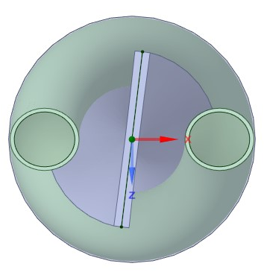
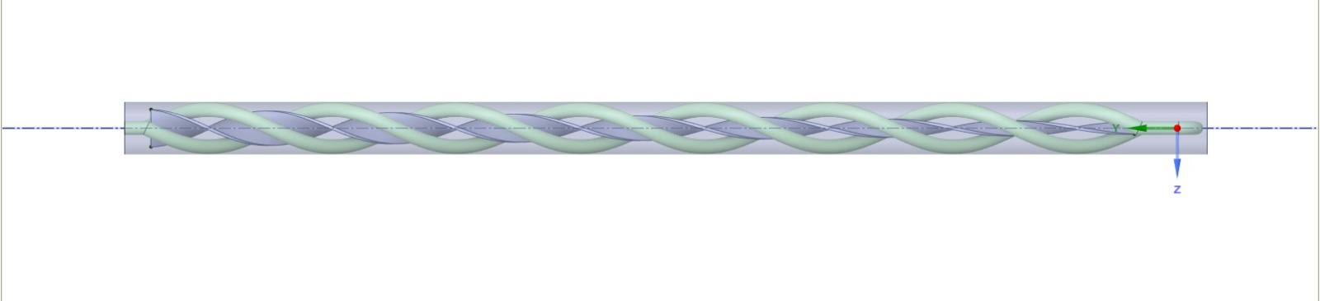
Geometry verification of riipen model
Top view of the control volume
Grout
Insulator
Helix tube
Right side view of the control volume

