Slide 1


Optimization of Pitch/Coil diameter ratio for Screw-In Geothermal Heat exchanger
Objective
To evaluate the optimal Pitch/Coil diameter ratio of a Geothermal Double helical HEX loop.
Group Name: TeX Force
Group Members
Arjun A Seshathri - 1227590561
Anand Anil Kumar - 1226092922
Tushar Vishwanath - 1227565302
Abdulrahman Kurdi - 1228216537
Tasks Completed
Conducted literature review to determine the boundary conditions. Further, an appropriate Nu formula and value were chosen to determine Q where an output temperature was determined based on a simulation software.
Generated a Helix model in SolidWORKS and computed a CFD analysis in ANSYS Fluent at different pitch and diameter values. For a given set of p&D values, we have determined the outlet temperature.
By running the formulae on a python code, we were able to estimate a range of p/D values to maximize Q. A plot has been shown to demonstrate the results.
Ira A. Fulton Schools of Engineering
Arizona State University (ASU)
Tempe, Arizona, United States
Pat Phelan
Professor & Assistant Dean
Fluidaptic, LLC
Minneapolis, Minnesota, United States
Thomas BREIDENBACH (Owner)

Slide 2
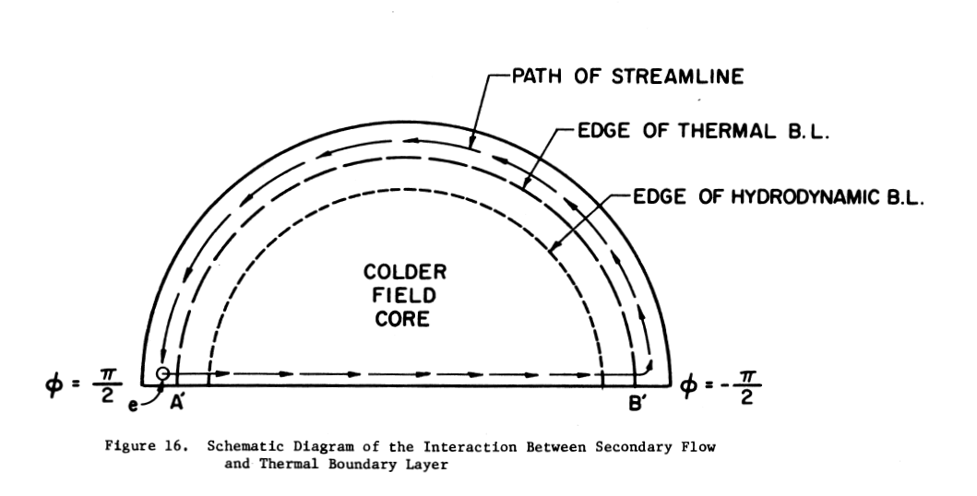
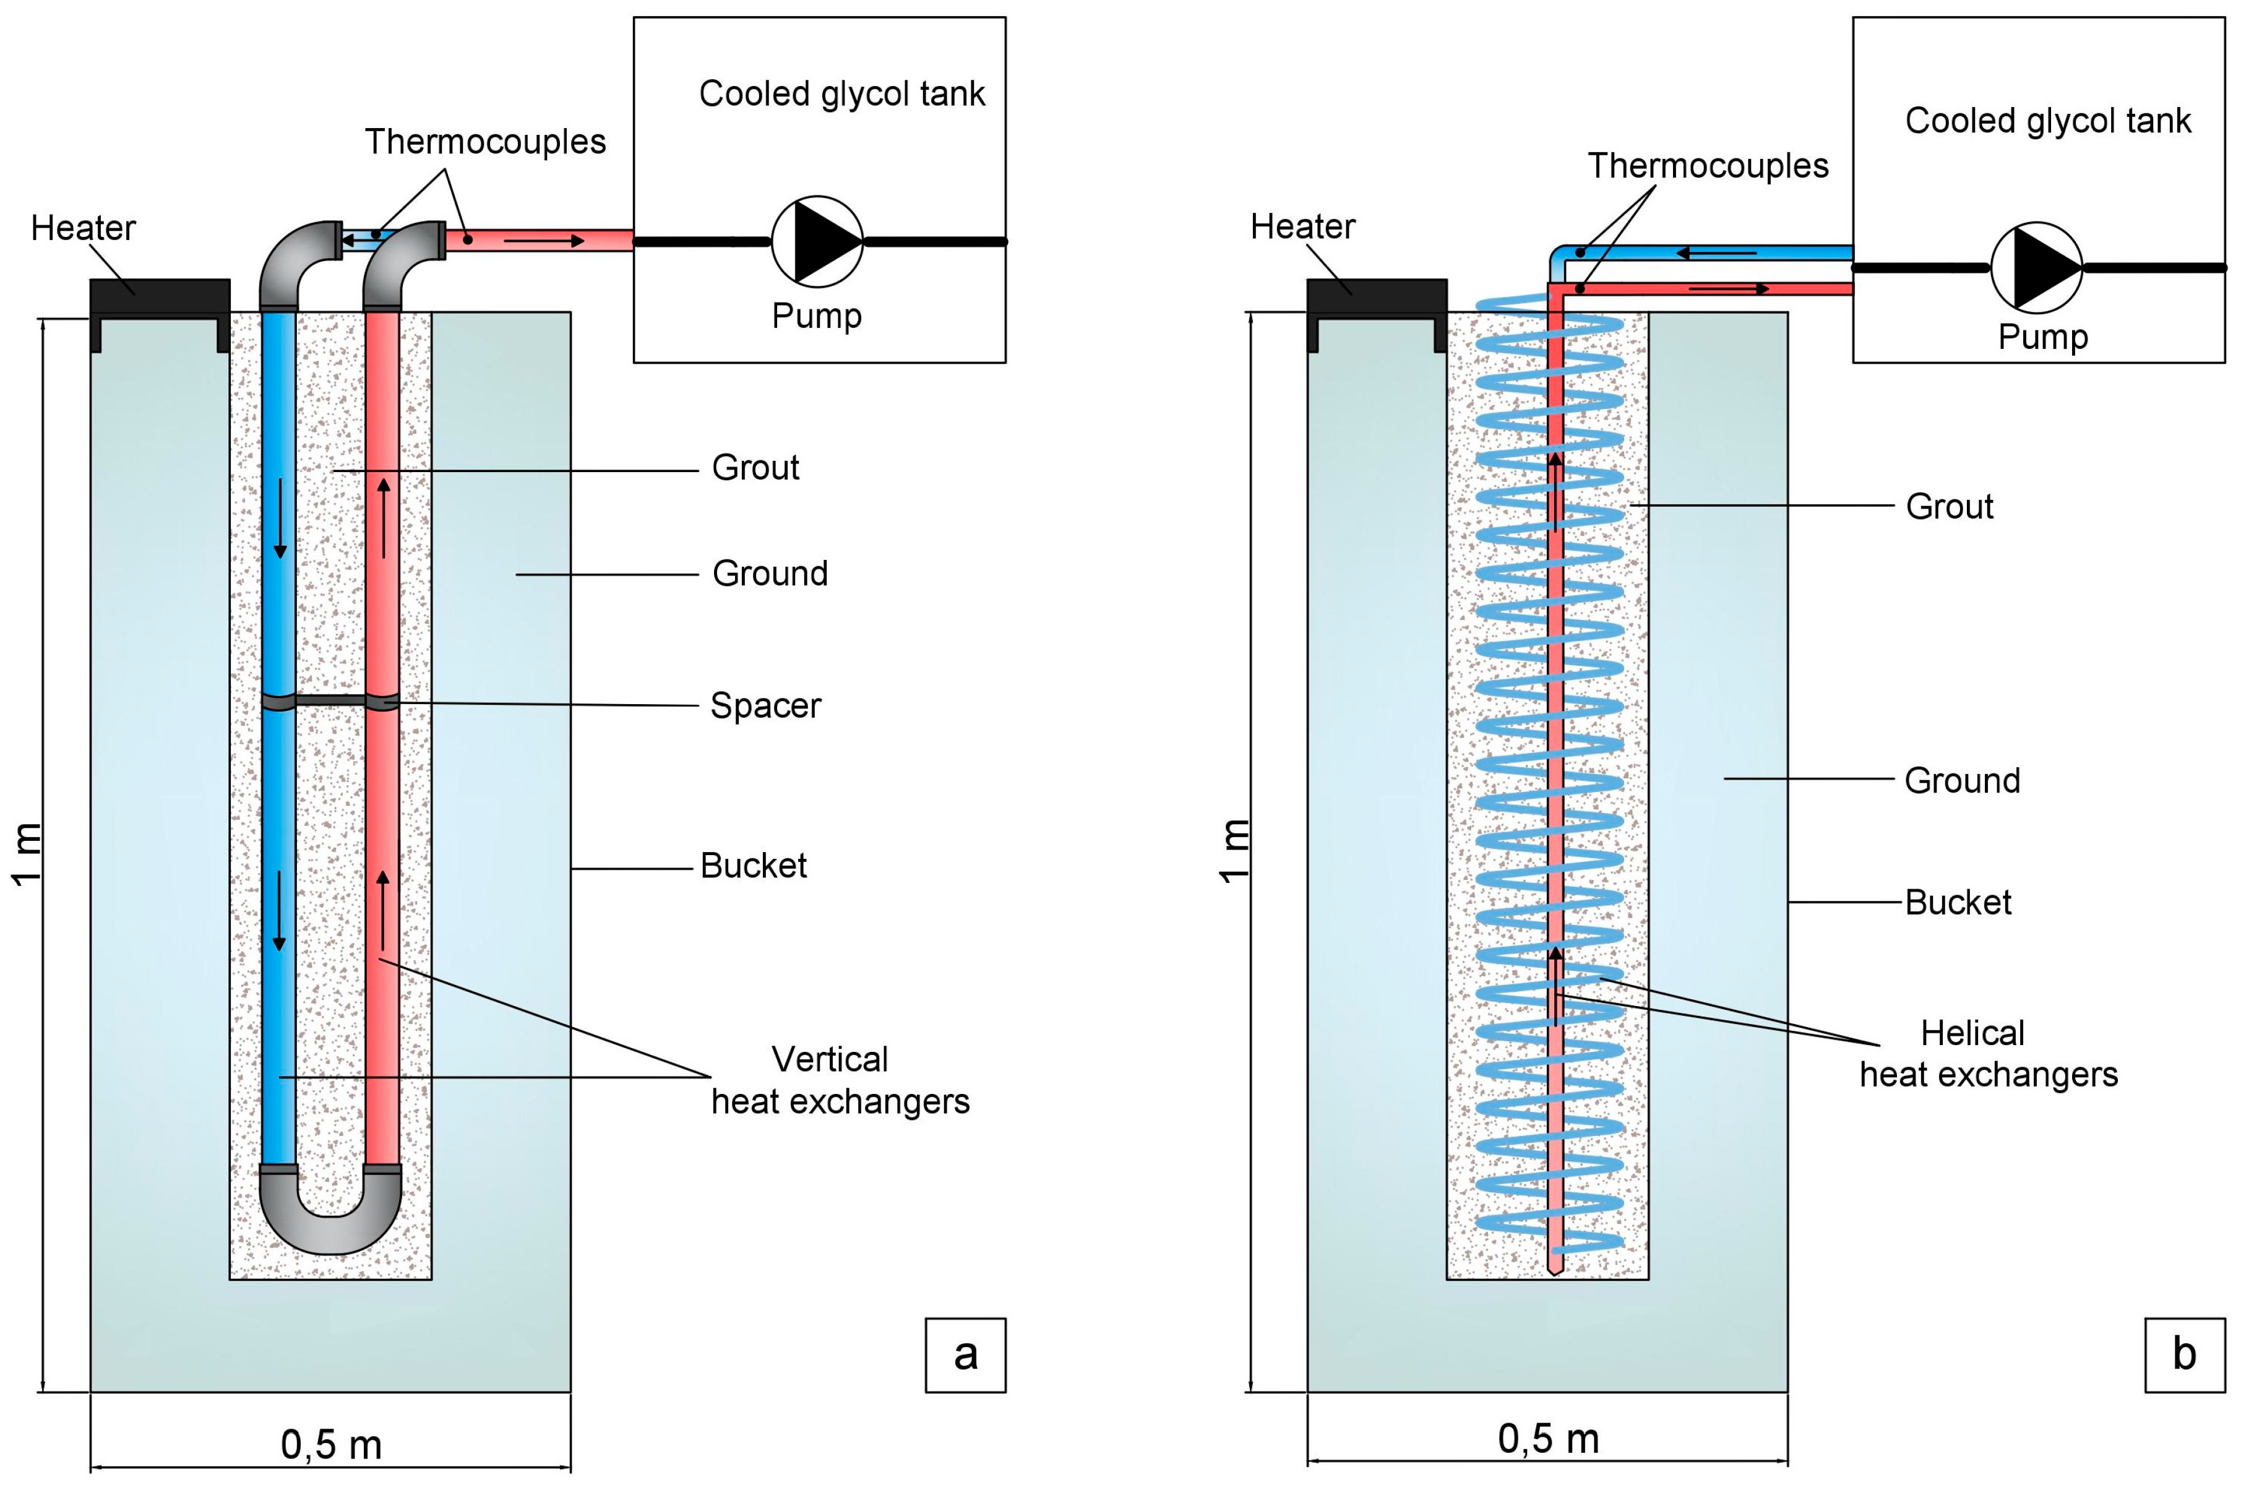
Application and purpose of geothermal heat exchanger
Geothermal HEX is widely used in housing applications as a part of Green HVAC systems in an assisting capacity.
A few hundred meters of geothermal HEX can power up approx. 10 kW.
A double helical coil is preferred over a U coil as demonstrated by team Tempe Eskimos. It has better heat exchanging efficiency over a smaller length.
A helical coil has flow pushed outwards by centrifugal force exerting more h and hence improved heat transfer.

Slide 3
Assumptions for boundary conditions based on literature review
Sr No | Parameter | Value | Source
1 | Thermal Conductivity of Soil (Assuming Sandy Loam Soil typical in Arizona) | 0.75 (W/mK) | Moench et. al. "Thermal Conductivity and Diffusivity of Soil Using a Cylindrical Heat Source"
2 | Thermal Conductivity of Cement-Silica (80-20) Grout | 1.96 (W/mK) | Cement-based Grout (Industry Standard for HDPE pipes) Mahmoud et. al. “A review of grout materials in geothermal energy applications”
3 | HEX Pipe Material | SDR 11 HDPE | Industry Standard (As confirmed by Riipen)
4 | HEX Pipe Conductivity, k (W/mK) | 0.46 (W/mK) | Matweb Material Property Website ”https://www.matweb.com/search/datasheet.aspx?matguid=fce23f90005d4fbe8e12a1bce53ebdc8”
5 | Insulator Material | PU Foam | Ngo et. al. “A new design of ground heat exchanger with insulation plate for effectively geothermal management”
6 | Insulator Thickness, cm | 5 cm | Approx. value from Riipen drawing
7 | Insulator Conductivity, k (W/mK) | 0.05 W/mK | Thermal insulation materials made of rigid polyurethane foam (PUR/PIR) - Specification" by European Committee for Standardization (CEN) (EN 13165:2016)
8 | Ground temperatures below 30 feet | 7-15⁰C | DOE Website ”https://www.energy.gov/energysaver/geothermal-heat-pumps”
9 | HEX Inlet Temp (Consider March, Sept) | 29⁰C | Considering average normal outside temperatures in Arizona
10 | Length of HEX Coil (Total Pitch) | 373 ft = 113 m | Result based on Team Tempe Eskimos Project for Q=10 kW

Slide 4
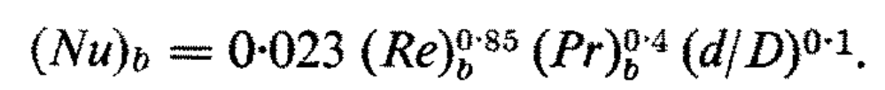
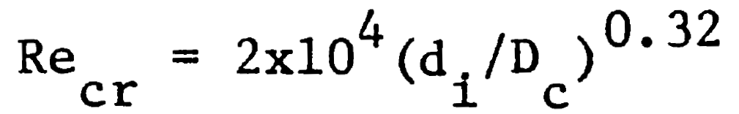
Literature review to determine p&D values
Sr No | Parameter | Value | Source
1. | Nusselt Number | For Re>2000 | Rogers, G. F. C., & Mayhew, Y. R. (1984). Heat transfer and pressure loss in helically coiled tubes with turbulent flow. International Journal of Heat and Mass Transfer, 27(3), 475-486.
2. | Critical Reynolds number |  | Ito, H., "Theoretical and Experimental Investigation Concerning the Flow Through Curved Pipes", Mem. Inst. High Speed Mechanics, Tohoku Univ., Japan, 14, 137 (1959).
3. | Helical Coil Dimensions | H = N * (S + Dw) Lw = (N*(((pi*Dc)^2)+(P^2))^0.5) | Helical Coil Calculator by CalcTool “https://www.calctool.org/electromagnetism/helical-coil”
4. | Heat Capacity Formula | Q = h * (pi * d * Lw) * (Tin – Tout) H = Nu * k / di | Cengel, Y. A., & Ghajar, A. J. (2018). Heat and Mass Transfer: Fundamentals and Applications (5th ed.). McGraw-Hill Education.

Slide 5
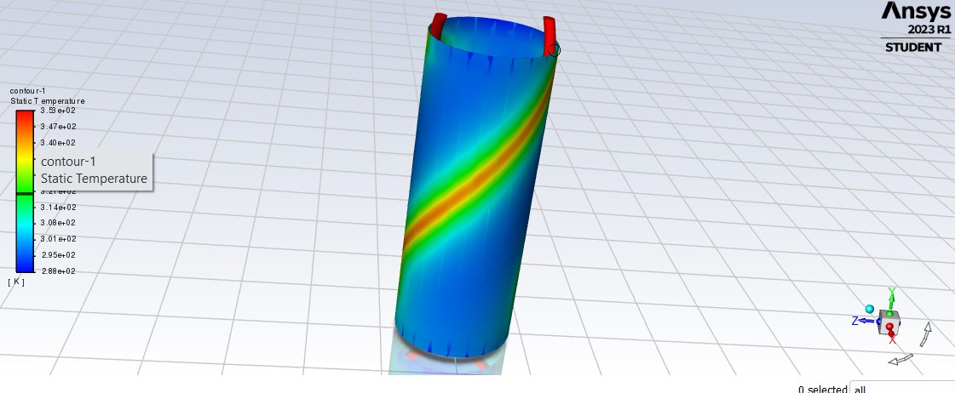
Ansys fluent simulations of various p/d ratios to determine outlet temperature
Parameters | Results
Pitch (mm) | 266.67
Coil Dia (mm) | 300
p/D | 0.8889
Q (W) | 14.15
N | 3.423836751

Slide 6
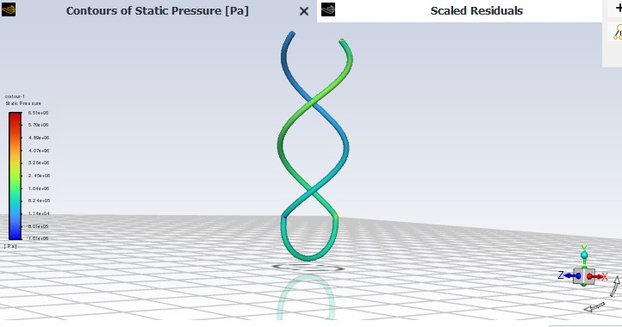
2
Parameters | Results
Pitch (mm) | 848
Coil Dia (mm) | 350
p/D | 2.422857
Q (W) | 2.61
N | 1.144951

Slide 7
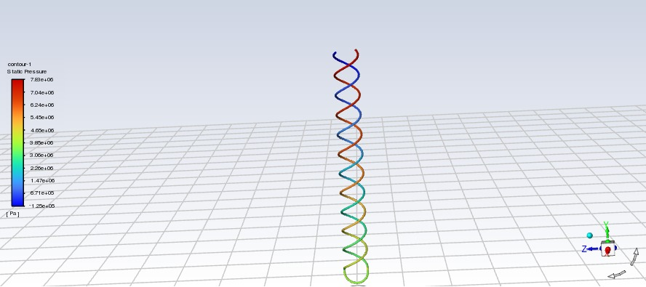
3
Parameters | Results
Pitch (mm) | 500
Coil Dia (mm) | 300
p/D | 1.6666
Q (W) | 6.5
N | 6

Slide 8
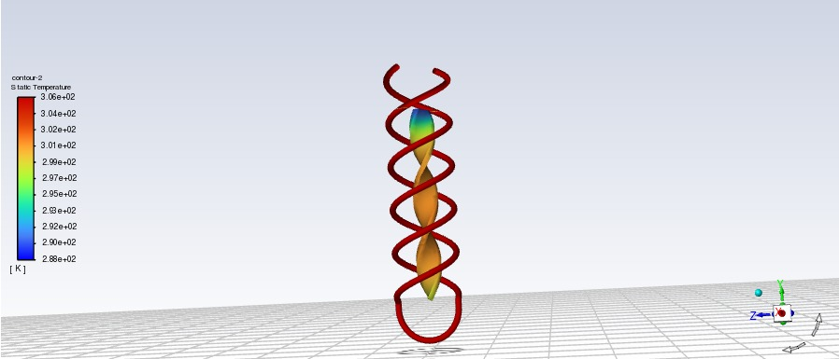
4
Parameters | Results
Pitch (mm) | 350
Coil Dia (mm) | 250
p/D | 1.4
Q (W) | 1.62
N | 2.6638

Slide 9
'p/D' V/s 'Q' Table
Sr No | Pitch (mm) | Coil Diameter (mm) | p/D | Q (W) | T_out (⁰C) | L (mm) | H (mm) | N
1 | 266.67 | 300 | 0.8889 | 14.15 | 79.96495 | 3353.573 | 1000 | 3.423837
2 | 848 | 350 | 2.422857 | 2.61 | 79.98557 | 1589.846 | 1000 | 1.144951
3 | 500 | 300 | 1.666667 | 6.5 | 32.99357 | 6401.368 | 3000 | 6
4 | 350 | 250 | 1.4 | 1.62 | 32.99581 | 2290.481 | 1000 | 2.6638

Slide 10
Simple Excel plot based on values of code and simulation output

Slide 11
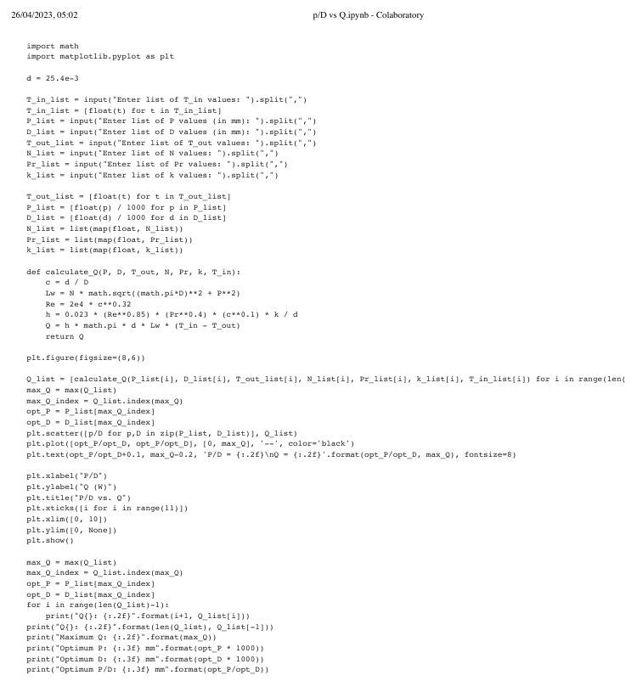
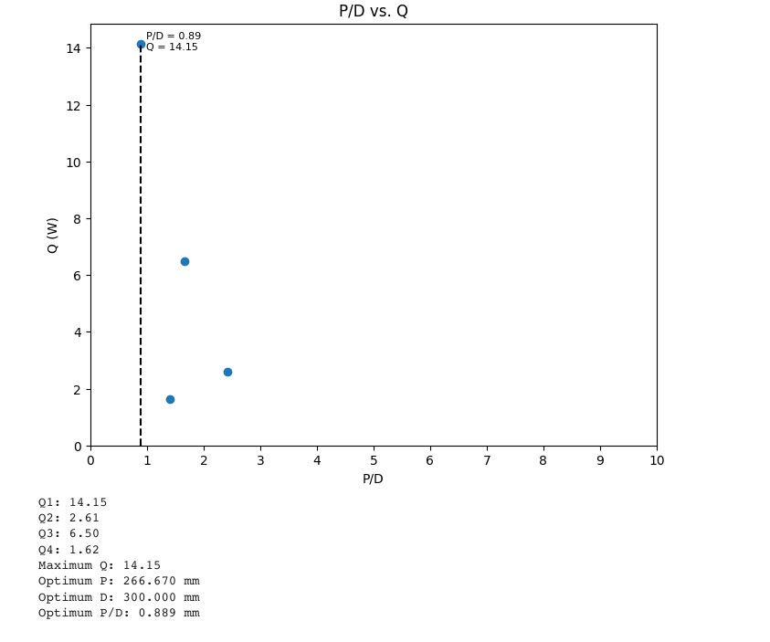
Python code to calculate optimal values of p and d

Slide 12
Conclusion and result
Considering the boundary conditions on a portion of the double coil helical tube heat exchanger considered, an optimal p/D ratio would be approximately 2.5.
More accurate values can be determined by powerful computers with a registered ANSYS software and computing power.
Further studies can be conducted on the secondary flow by the 2nd helical tube and its effect on the overall heat output and the p/D ratio. Also, different flow rates and pipe diameters can be considered as well.

Slide 13
References
Abul-Hamayel, M. A. (1995). Heat transfer in helically coiled tubes with laminar flow. Heat Transfer Engineering, 16(2), 5-12.
Borse, D., & Bute, J. V. (2014). A review on helical coil heat exchanger. International Journal of Advanced Engineering Research and Studies, 2(4), 77-80.
Ito, H., "Theoretical and Experimental Investigation Concerning the Flow Through Curved Pipes", Mem. Inst. High Speed Mechanics, Tohoku Univ., Japan, 14, 137 (1959).
Koenig, A. A. (2013). Thermal resistance of borehole heat exchangers composed of multiple loops and custom shapes. Geothermics, 46, 45-55.
Ngo, V. T., Kim, K. H., & Cho, H. H. (2019). A new design of ground heat exchanger with insulation plate for effectively geothermal management. Energy, 167, 739-746.
Purandare, P. S., Lele, M. M., & Gupta, R. (2014). Parametric analysis of helical coil heat exchanger. Chemical Engineering Research and Design, 92(11), 2397-2406.
Rogers, G. F. C., & Mayhew, Y. R. (1964). Heat transfer and pressure loss in helically coiled tubes with turbulent flow. International Journal of Heat and Mass Transfer, 7(12), 1207-1216.

