Slide 1
ANALYtIcS
Task 1
Data ANALYSIS
DATA
Data Analysis on Furniture Brand EMEA
Submitted By:- Tushar Sonp
Submitted To:- RTB Analytica

Slide 2
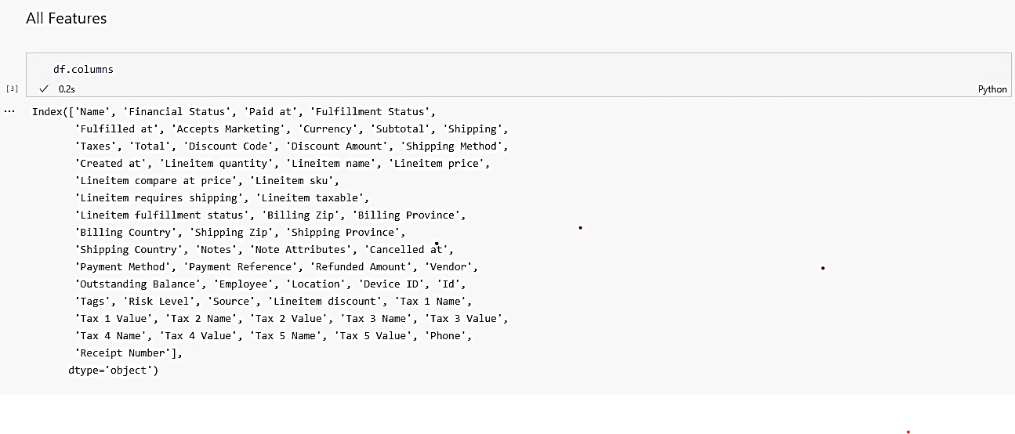
features of dataset
Data ANALYSIS
There are total 57 Features in the dataset. At very first we understand the meaning of each features.
Name:- The order number as it appears in your store admin.
Financial Status:- Whether the order has been paid, authorized, refunded, and so on.
Paid At:- The date when the payment was captured for the order.
Fulfillment Status:- Whether the order has been fulfilled or is still pending.
Accepts Marketing:- Whether the customer has agreed to accept marketing from your store.
Total:- The total cost of the order.
Lineitem name:- The name of the line item.
Billing Country:- The customer's billing country.
And so on.

Slide 3
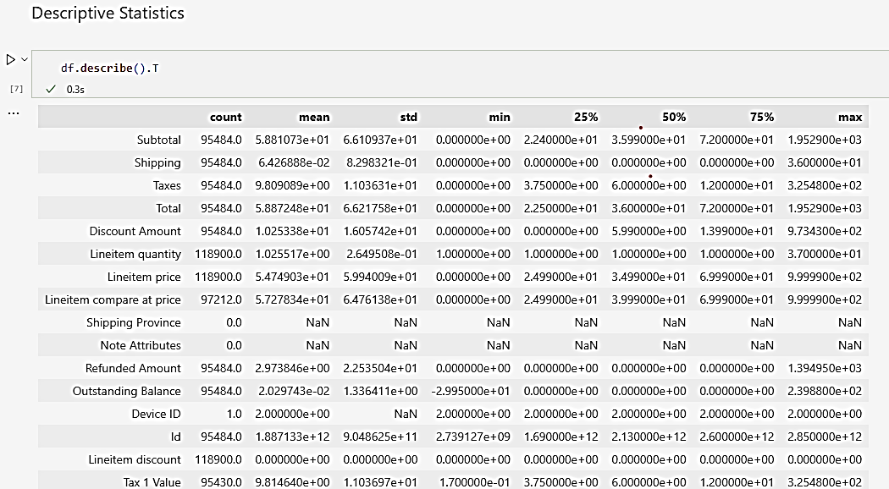
Statistical Analysis of features
Data ANALYSIS

Slide 4
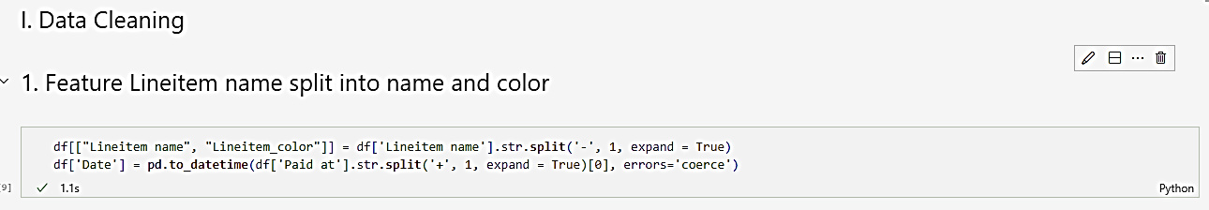
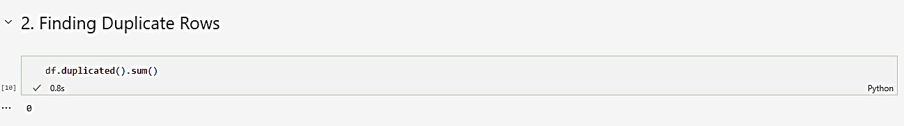
Data Cleaning
Data ANALYSIS
In this stage, we first split the Lineitem name feature into two separate features because this feature contains the name of the item and color. So we separate it into two different features.
After that, we check the duplicate rows in the Dataset and we find that there are no duplicate rows in the dataset.

Slide 5
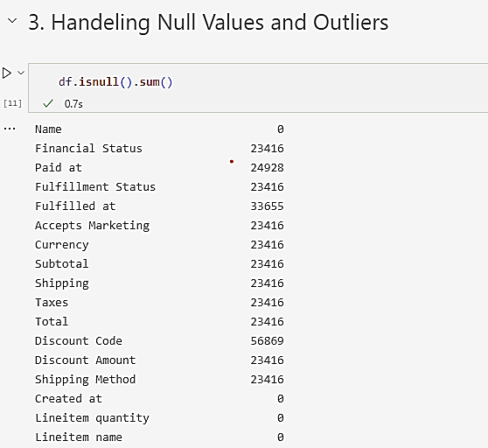
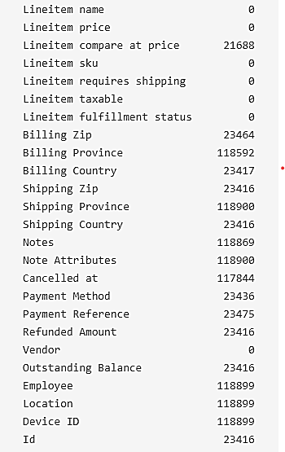
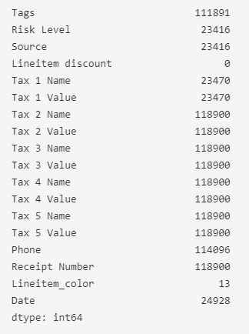
Null Values in Dataset
Data ANALYSIS

Slide 6
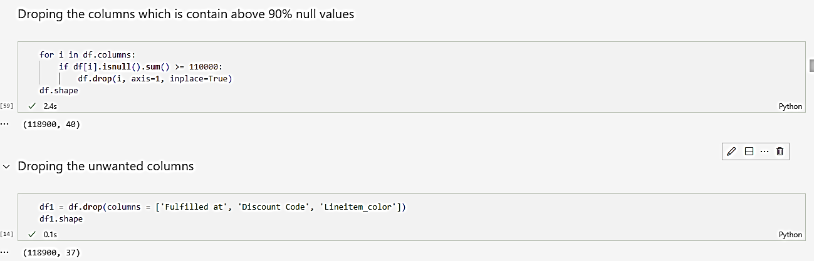
Data Cleaning
Data ANALYSIS
Here we drop all those columns which contain above 90% null values. And after that, we drop fulfilled at, discount code, lineitem_color columns

Slide 7
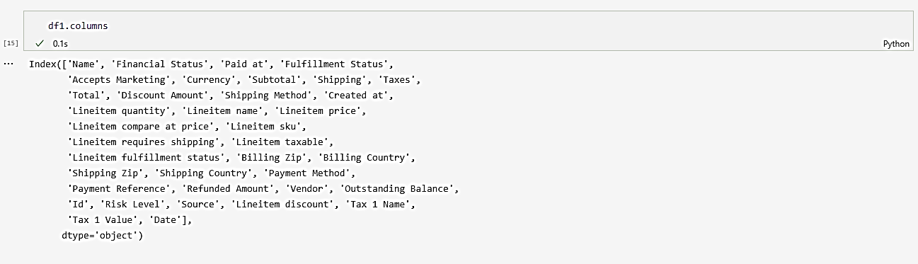
Reamaining Features
Data ANALYSIS

Slide 8
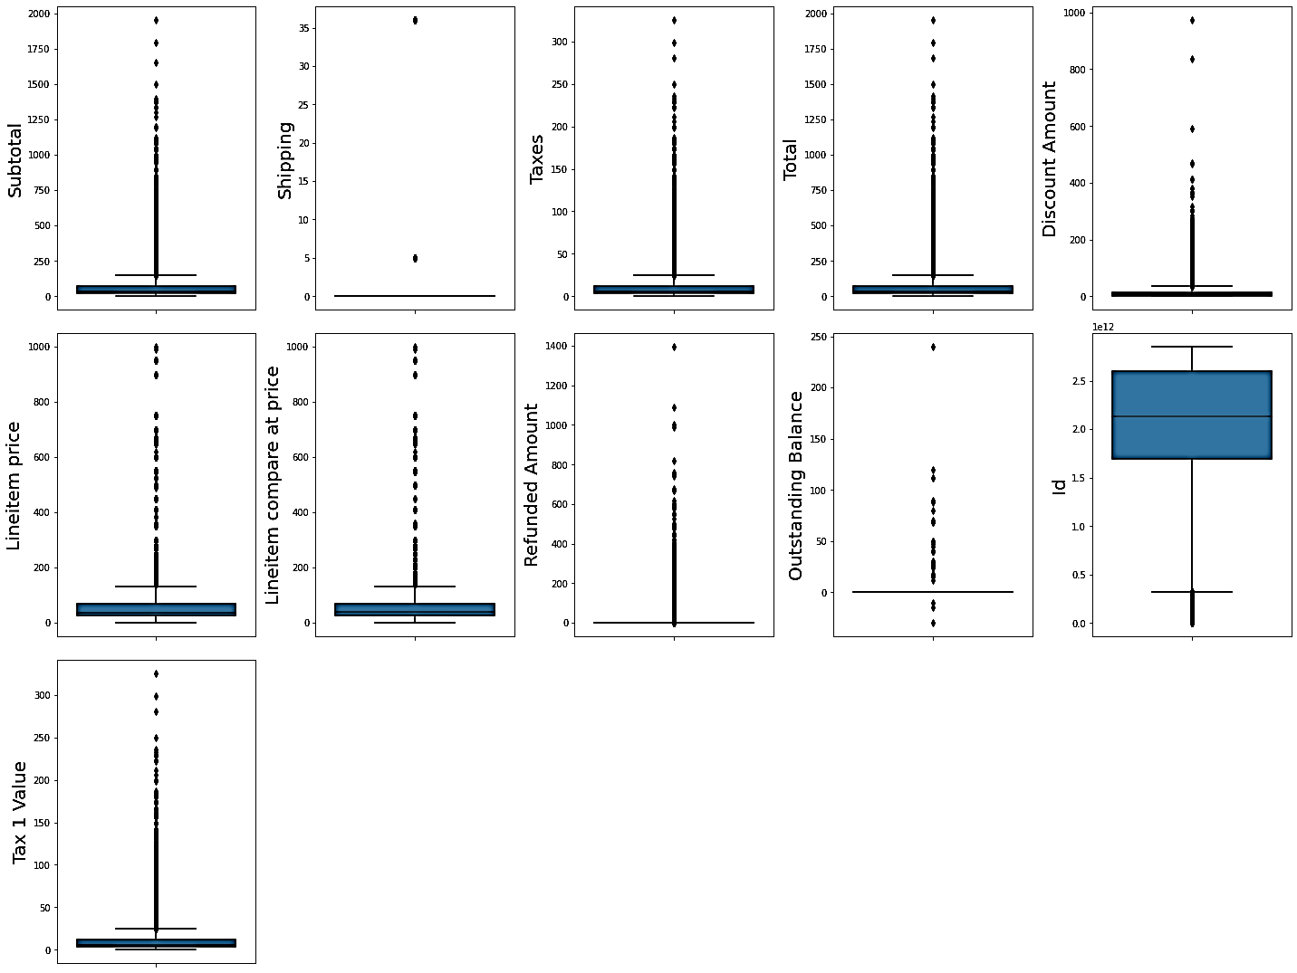
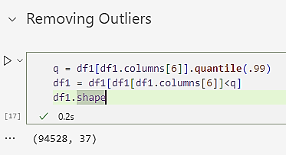
Outliers Handling
Data ANALYSIS
Here we find the outliers of all continuous features and remove the outliers or subtotal by the .99 percentile. After removing the outliers of subtotal we find that most of the other features outliers are also removed with it. Most of the outliers are due to null values, so we remove the outliers of subtotal by .99 percentile, null values and other outliers are also removed with it.

Slide 9
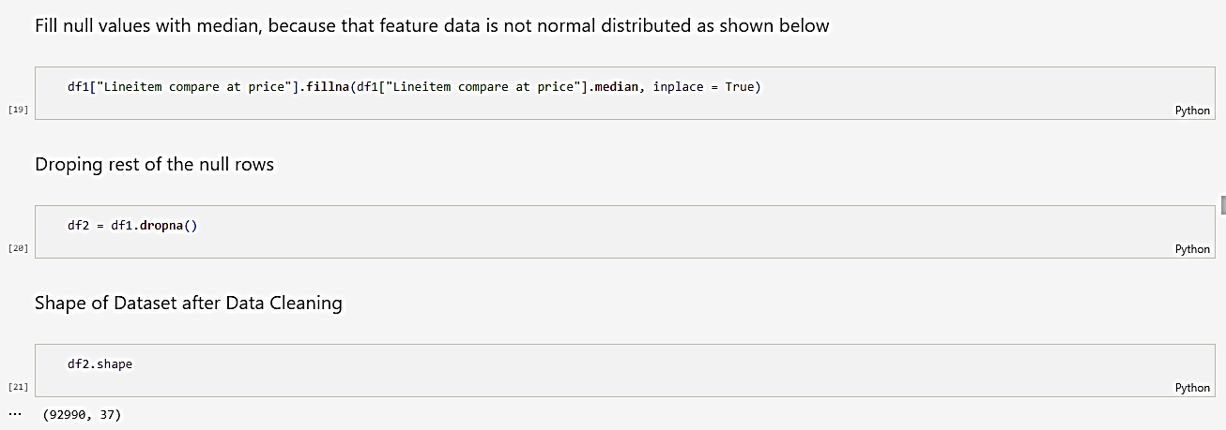
Data Cleaning
Data ANALYSIS
After all, we fill the null values of lineitem compare at price with their median because the feature is not normally distributed.

Slide 10
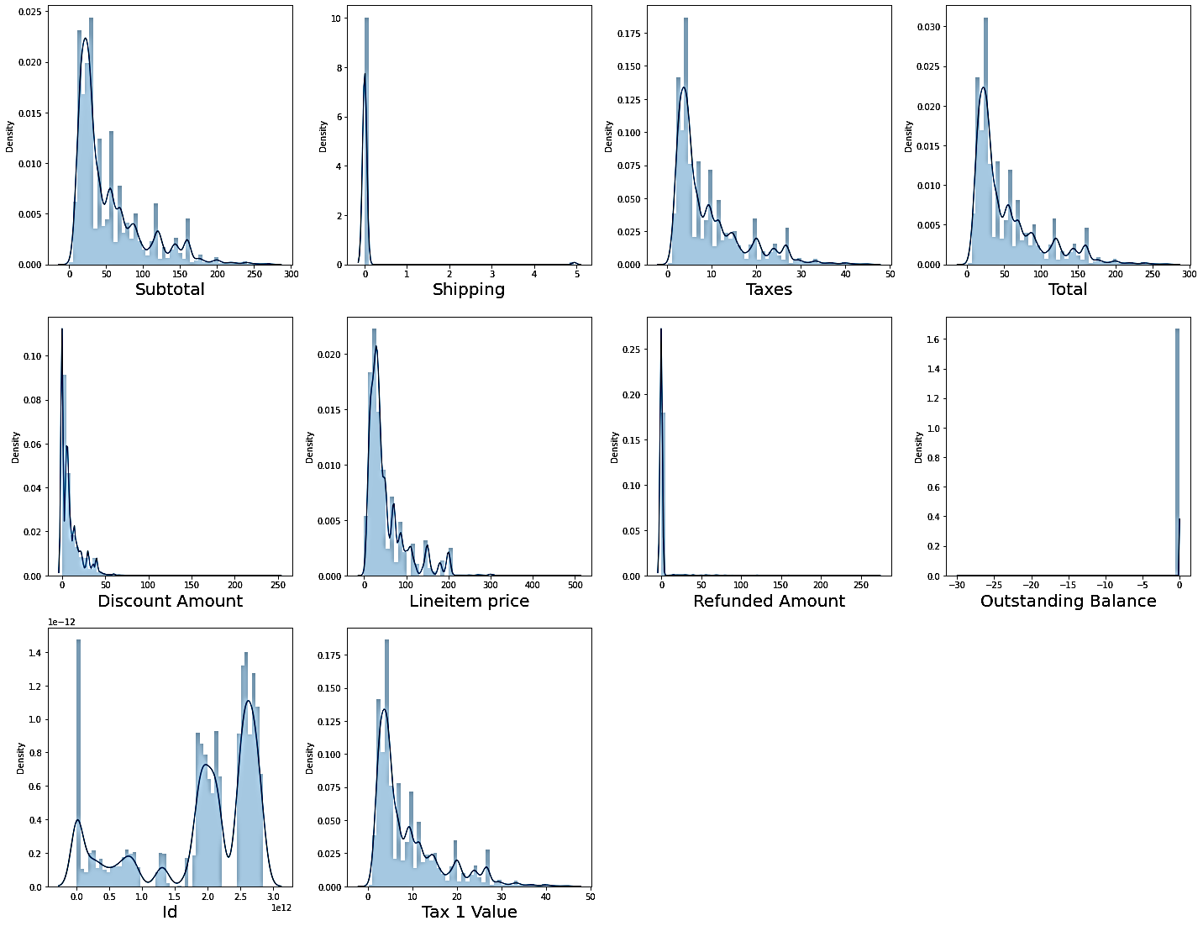
Data Visualization
Data ANALYSIS
This graph shows the distribution of data of all continuous features.

Slide 11
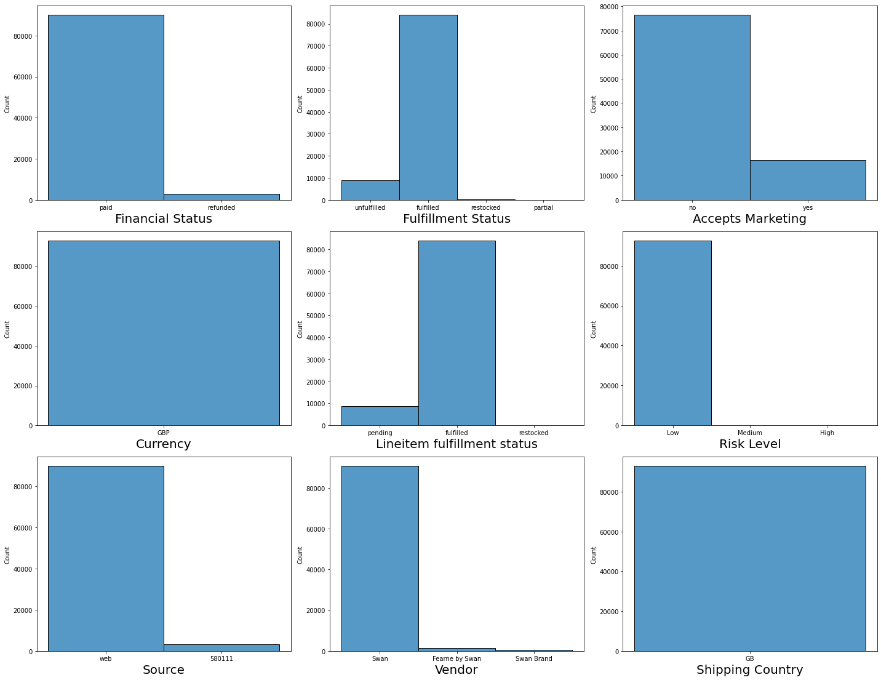
Data Visualization
Data ANALYSIS
Here histogram shows the distribution of categorical features.

Slide 12
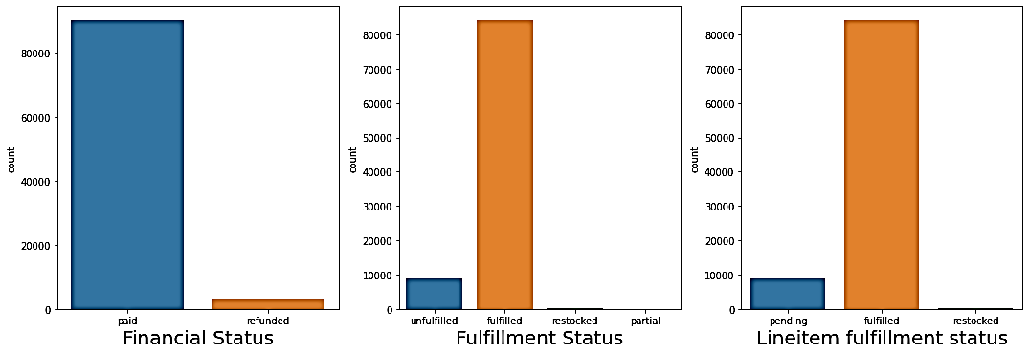
Data Visualization
Data ANALYSIS
Here we clearly see how many products have been paid and fulfilled.

Slide 13
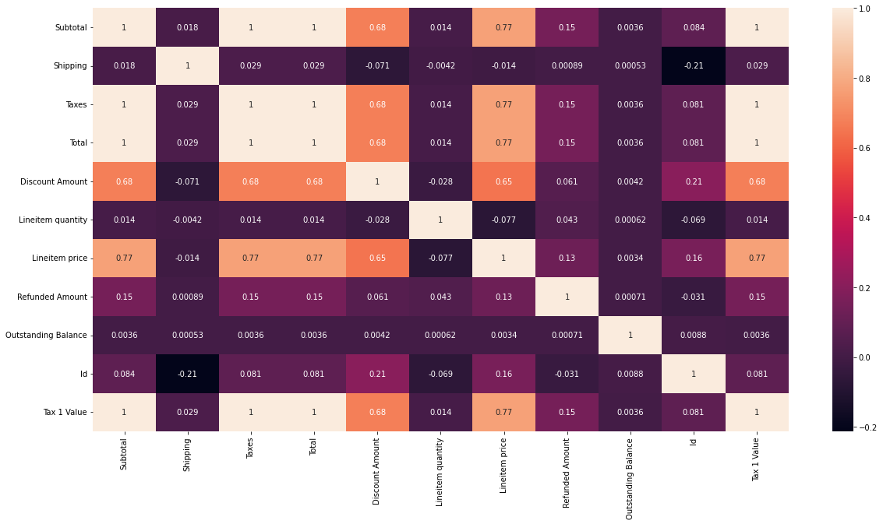
Data Visualization
Data ANALYSIS
Here we plot a correlation plot that tells us which features are highly correlated to each other by coloring. In the correlation plot, light colors show high collinearity and dark colors show low collinearity. In this plot, collinearity is also represented by numbers between 0 to 1 where 0 is the lowest collinearity and 1 is the highest collinearity.

Slide 14
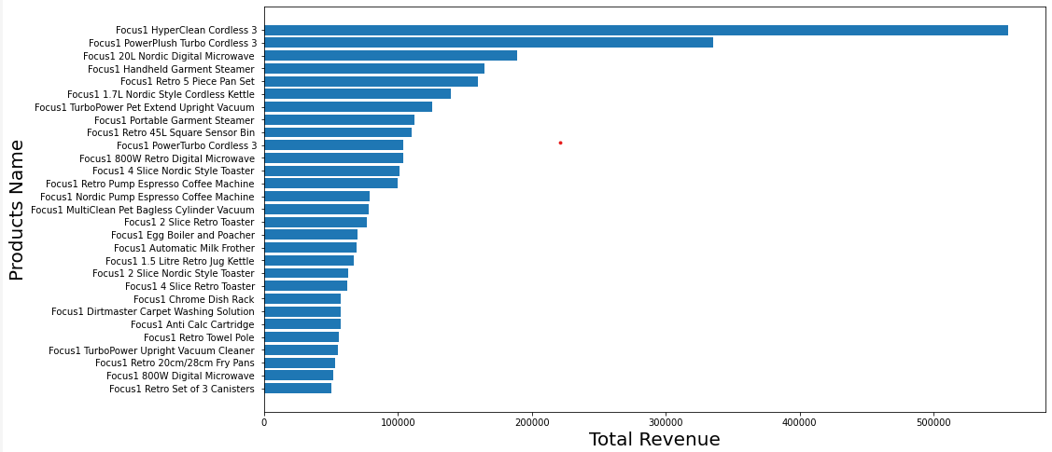
Data Visualization
Data ANALYSIS
Here below graph shows the products which generate the highest revenue

Slide 15
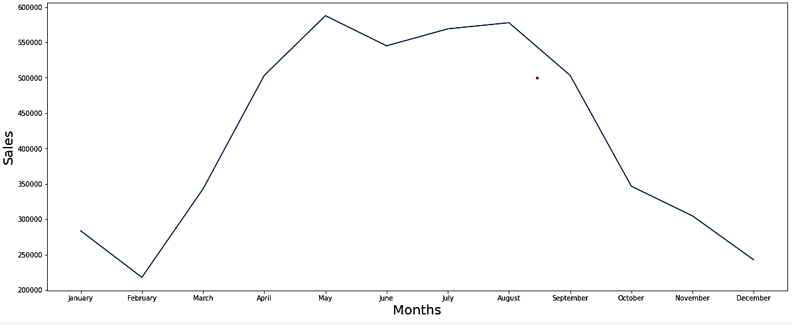
Data Visualization
Data ANALYSIS
The below graph shows the seasonal trend of sales by months.

Slide 16
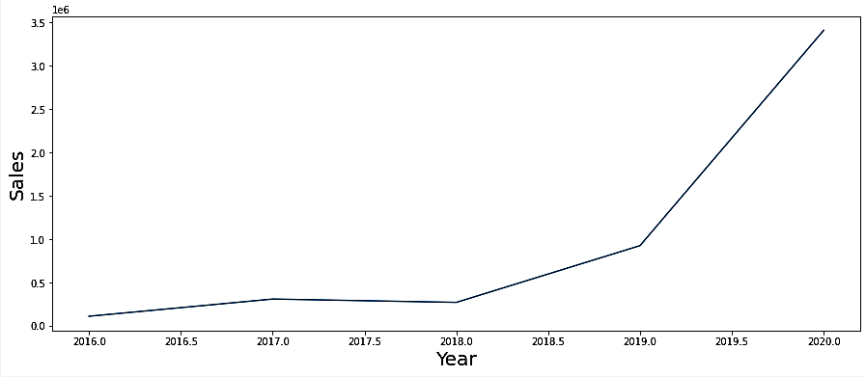
Data Visualization
Data ANALYSIS
The below graph shows the seasonal trend of sales by Year.

Slide 17
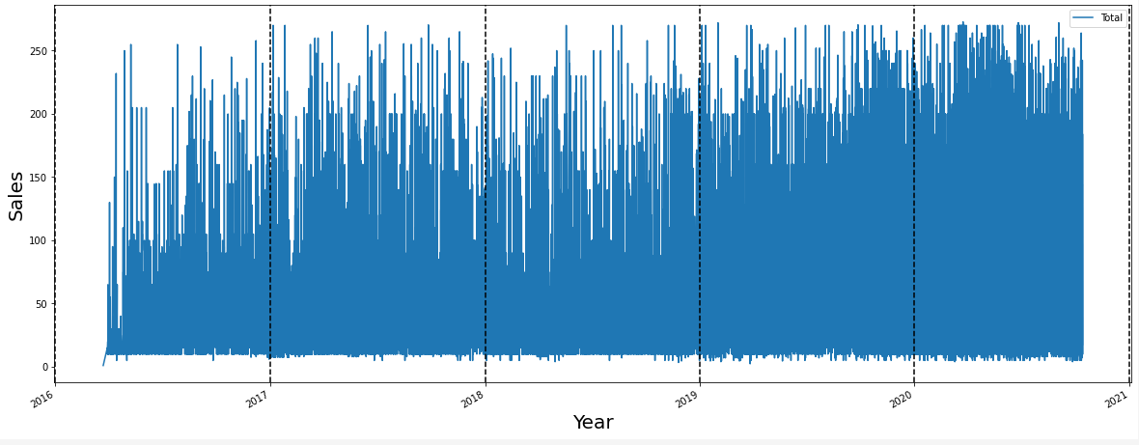
Data Visualization
Data ANALYSIS
The below graph shows the seasonal trend of sales by Year.

Slide 18
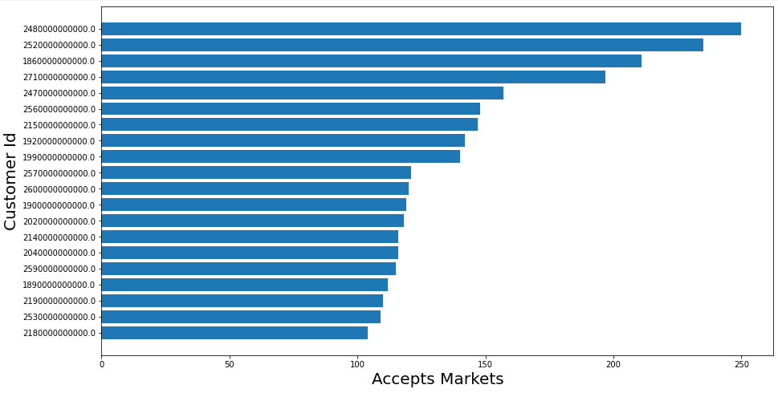
Data Visualization
Data ANALYSIS
The below graph shows the top customers which accepts markets and buy products

Slide 19
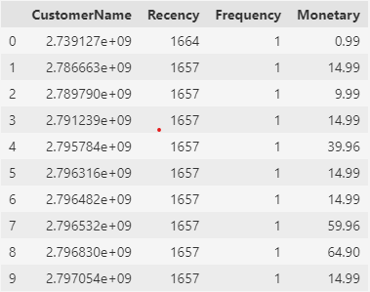
Customer Segmentation
Data ANALYSIS
At this stage, we perform RFM Segmentation of Customers
Recency: How recently has the customer made a transaction with us
Frequency: How frequent is the customer in ordering/buying some product from us
Monetary: How much does the customer spend on purchasing products from us.

Slide 20
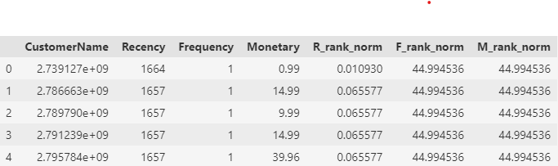
Customer Segmentation
Data ANALYSIS
Here we are ranking Customer based upon their recency, frequency, and monetary score and
normalizing the rank of the customers within a company to analyze the ranking.

Slide 21
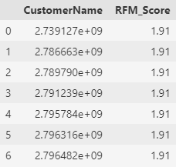
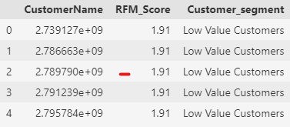
Customer Segmentation
Data ANALYSIS
Calculating RFM score
RFM score is calculated based upon recency, frequency, monetary value normalize ranks. Based upon this score we divide our customers. Here we rate them on a scale of 5. Formula used for calculating rfm score is : 0.15*Recency score + 0.28*Frequency score + 0.57 *Monetary score
Rating Customer based upon the RFM score.
rfm score > 3.5: High Value Customer
4>rfm score > 2 : Medium value customer
3>rfm score> .1 : Low-value customer

Slide 22
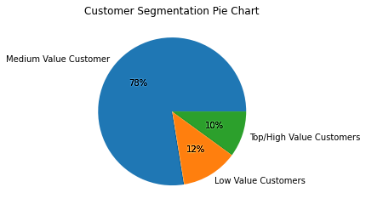
Customer Segmentation
Data ANALYSIS
Visualizing the customer segments.
Here we will use a pie plot to display all segments of customers.

Slide 23

Data ANALYSIS
Thank You

