Slide 1
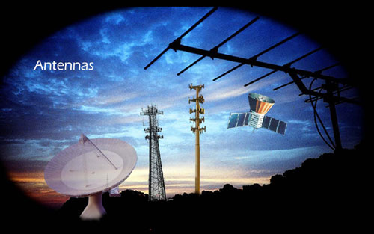
Design and Implementation of Microstrip Patch Antenna for 5G Applications
Project Update Presentation

Slide 2
Presented By
1)Sandipa Chowdhury
ID:1806168
2)Tusher Karmakar
ID:1806174
3)Alamgir Hossain
ID:1806186

Slide 3
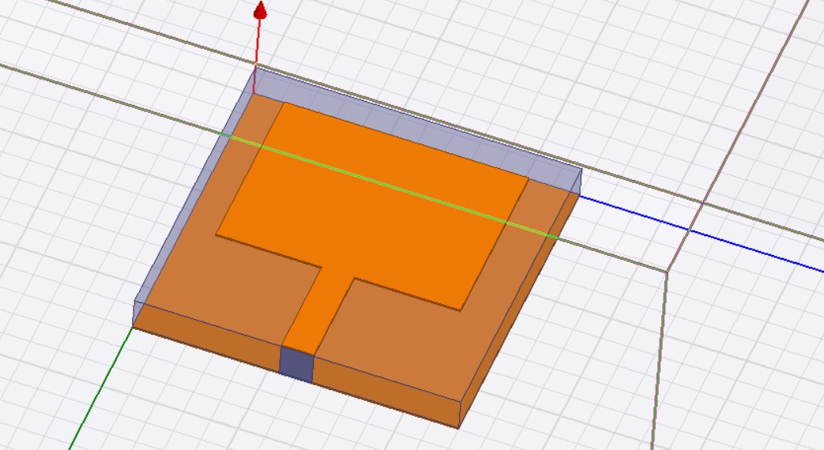
Schematic Design

Slide 4
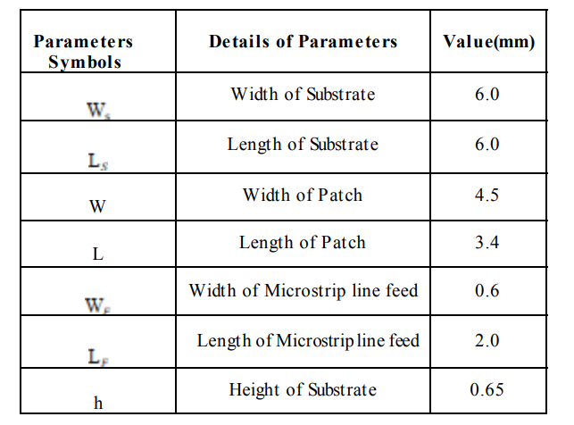
Parameters Details and values

Slide 5
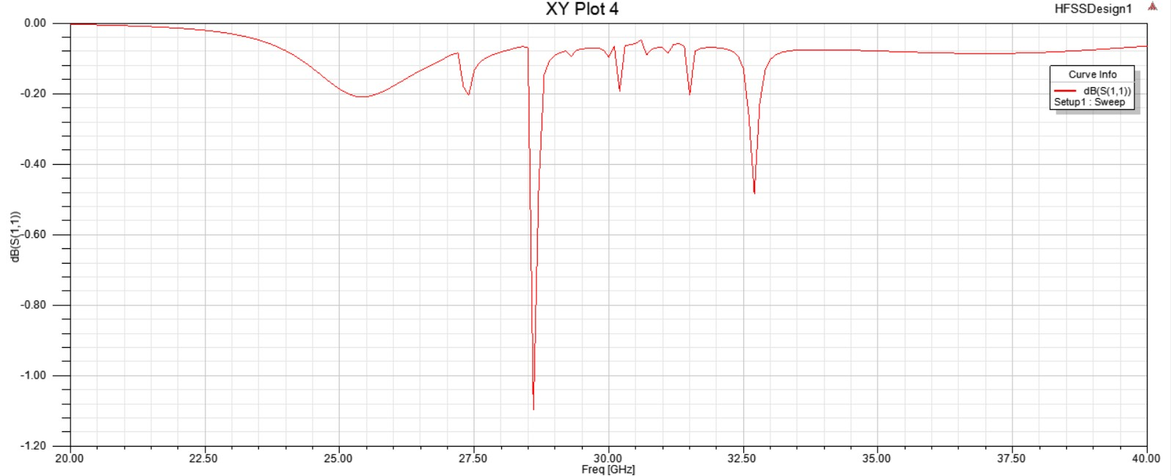
S Parameter Plot

Slide 6
Future Tasks
1)Plotting Reflection Coefficient
1
2)Plotting Radiation Pattern
2
3)Plotting for Antenna Radiation Efficiency
3
4)Plotting Current Density Distribution in Antenna
4
5) COMPARISON WITH EXISTING MICROSTRIP PATCH ANTENNAS FOR 5G
5

Slide 7
Thank You

