Slide 1
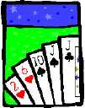
Basic Counting

Slide 2
This Lecture
Sum rule, product rule, generalized product rule
Inclusion-exclusion principle
Permutations, combinations
Binomial coefficients, combinatorial proof

Slide 3
Sum Rule
|S|: the number of elements in a set S.
A
B
If sets A and B are disjoint, then
|A ∪ B| = |A| + |B|

Slide 4
Sum Rule
A
B
If sets A and B are disjoint, then
|A ∪ B| = |A| + |B|
Class has 43 women, 54 men, so total enrollment = 43 + 54 = 97
26 lower case letters, 26 upper case letters, and 10 digits,
so total characters = 26+26+10 = 62

Slide 5
Sum Rule: Another Version
If there are n1 ways to do a task in one strategy (A) and n2 ways to do the same task in another strategy (B) where no two ways are same then irrespective of any strategy there n1 + n2 ways to do the task.

Slide 6
Sum Rule: Another Version
If there are n1 ways to do a task in one strategy (A) and n2 ways to do the same task in another strategy (B) where no two ways are same then irrespective of any strategy there n1 + n2 ways to do the task.
n1
A
B
n2
If sets A and B are disjoint, then
|A ∪ B| = |A| + |B| = n1 + n2

Slide 7

Product Rule
Given two sets A and B, the Cartisean product
If |A| = m and |B| = n, then
|A × B| = mn.
A = {a, b, c, d}, B = {1, 2, 3}
A × B = {(a,1),(a,2),(a,3),
(b,1),(b,2),(b,3),
(c,1),(c,2),(c,3),
(d,1),(d,2),(d,3) }
If there are 4 men and 3 women, there are
possible married couples.

Slide 8
Product Rule: Another Version
Suppose that a procedure can be broken down into two tasks (A and B). If there are n1 ways to do the first task (A) and n2 ways to do the second task (B), we can do the whole procedure in n1 × n2 ways!
If |A| = n1 and |B| = n2, then
|A × B| = n1 × n2.

Slide 9
EXAMPLES

Slide 10
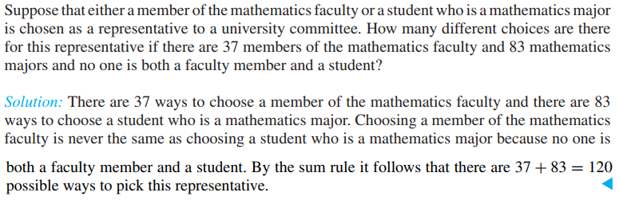

Slide 11
Math
Faculty
(37)
Math
Major
(83)
If sets A and B are disjoint, then
|A ∪ B| = |A| + |B| = 37 + 83 = 120

Slide 12
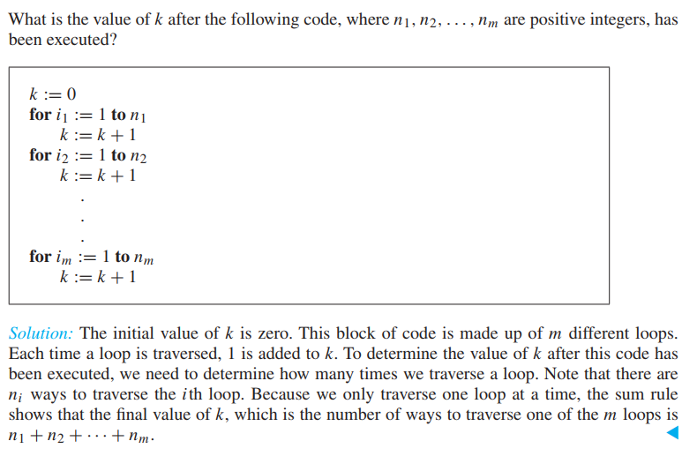

Slide 13
1 (n1)
2 (n2)
m (nm)

Slide 14



A1
A2
A3
Am

Slide 15
Palasi to Banani
Suppose you can go:
  from Palasi to Shahbag in 3 ways and
  Shahbag to Banani in 5 ways.
In how many ways, you can go from Palasi to Banani?
Yes, it is simply 3 × 5 = 15 ways.

Slide 16
CR
We want to choose CR
  One from the girls (say, 20 girls)
  One from the boys (say, 40 boys)
How many ways we can choose class representatives?
Yes, it is simply 20 × 40 = 800 ways.

Slide 17
Product Rule: Counting Strings
What is the number of length-4 strings from alphabet B ::= {0,1}?
Notice that the set of length-2 strings is just B × B
Similarly the set of length-4 strings is just B × B × B × B
And so the number of length-4 strings is
  = |B × B × B × B|
  = 2 · 2 · 2 · 2 = 2⁴
m^{n}.
The number of length-n strings from an alphabet of size m is
e.g. the number of length-n binary strings is 2^{n}
the number of length-n strings formed by capital letters is 26^{n}

Slide 18
Counting passwords
A computer system has a password consisting of 6, 7, or 8 characters.
Each of these characters must be a digit or a letter of the alphabet.
Each password must contain at least one digit.
How many such passwords are there?

Slide 19
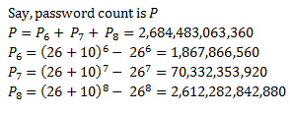
Counting passwords
Each character must be
  a digit (10 digits)
  or a letter (26 letters)
# of n characters strings
# of n letters strings
minus

Slide 20
Example: Counting Passwords
How many passwords satisfy the following requirements?
between 6 & 8 characters long
starts with a letter
case sensitive
other characters: digits or letters
L ::= {a,b,…,z,A,B,…,Z}
D ::= {0,1,…,9}

Slide 21
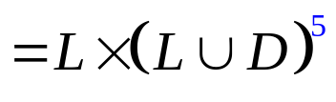

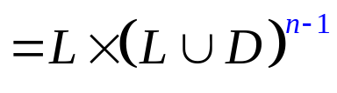
Example: Counting Passwords
L ::= {a,b,…,z,A,B,…,Z}
D ::= {0,1,…,9}
P₆ =

Slide 22
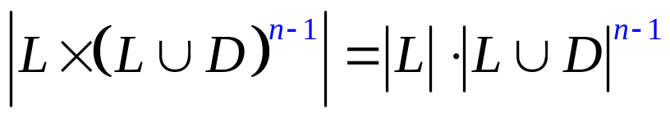
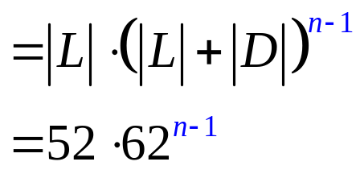
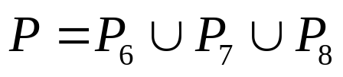
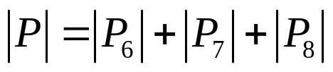

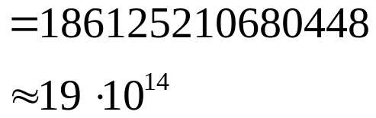
Example: Counting Passwords
The set of Passwords:
(counting by partitioning)

Slide 23
At Least One Seven
How many # 4-digit numbers with at least one 7?
count by 1st occurrence of 7:
  7xxx + o7xx + oo7x + ooo7
  where x represents any digit from 1 to 10,
  while o represent any digit from 1 to 10 except 7.
  Clearly, each number containing at least one 7 is in
  one of the above sets, and these sets are disjoint.
  Therefore, the answer to the question is:
  10³ + 9·10² + 9²·10 + 9³ = 3439
Method 1:
The set of 4-digit
numbers with 7 in
the first digit.
The set of 4-digit
numbers with 7 in
the second digit,
but the first digit
is not 7, and so on.
(counting by partitioning)

Slide 24
At Least One Seven
How many # 4-digit numbers with at least one 7?
Method 2:
|4-digit numbers with at least one 7|=
|4-digit numbers| − |those with no 7s|
= 10⁴ – 9⁴
= 3439
(counting the complement)
Counting the complement is a useful technique.

Slide 25
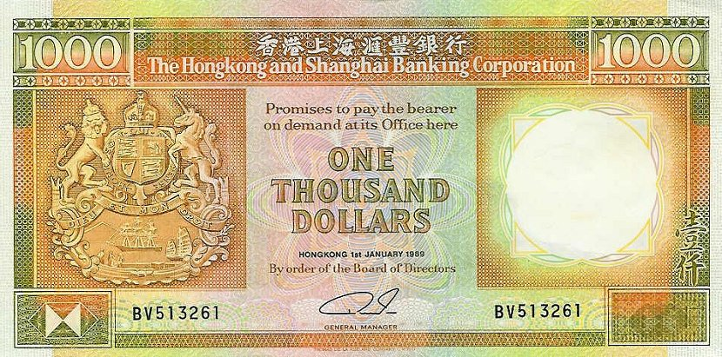
Defective Dollars
A dollar is defective if some digit appears
more than once in the 6-digit serial number.
How common are non-defective dollars?

Slide 26
Defective Dollars
How common are non-defective dollars?
10 possible choices for the first digit,
9 possible choices for the second digit, and so on…
So, there are 10x9x8x7x6x5
= 151200 serial number with all its digit different
There are totally 10⁶ = 1000000 serial numbers.
151200/1000000
= 0.1512
So, only about 15% of dollars are nondefective.

Slide 27
Generalized Product Rule
Q a set of length-k sequences. If there are:
n₁ possible 1st elements in sequences,
n₂ possible 2nd elements for each first entry,
n₃ possible 3rd elements for each 1st & 2nd,
…
then,
|Q| = n₁ · n₂ · n₃ · … · n_{k}

Slide 28
This Lecture
Sum rule, product rule, generalized product rule
Inclusion-exclusion principle
Permutations, combinations
Binomial coefficients, combinatorial proof

Slide 29
Sum Rule
If sets A and B are disjoint, then
|A ∪ B| = |A| + |B|
A
B
  What if A and B are not disjoint?

Slide 30

Inclusion-Exclusion (2 sets)
For two arbitrary sets A and B
A
B

Slide 31
Inclusion-Exclusion (2 sets)
Let S be the set of integers from 1 through 1000 that are multiples of 3 or multiples of 5.
Let A be the set of integers from 1 to 1000 that are multiples of 3.
Let B be the set of integers from 1 to 1000 that are multiples of 5.
It is clear that S is the union of A and B,
but notice that A and B are not disjoint.
A
B
|A| = 1000/3 = 333
|B| = 1000/5 = 200
A ∩ B is the set of integers that are multiples of 15, and so |A ∩ B| = 1000/15 = 66
So, by the inclusion-exclusion principle, we have |S| = |A| + |B| - |A ∩ B| = 467.

Slide 32

Inclusion-Exclusion (2 sets):
Subtraction Rule

Slide 33
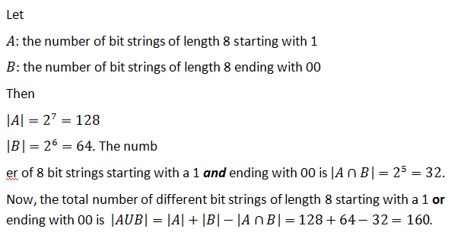
How many bit strings of length 8 start with a 1 or end with 00?

Slide 34
How many integers are there between 1 to 1000 inclusive that are not divisible by 3 or 4?

Slide 35
Inclusion-Exclusion (3 sets)
|A ∪ B ∪ C| = |A| + |B| + |C|
– |A ∩ B| – |A ∩ C| – |B ∩ C|
+ |A ∩ B ∩ C|
A
B
C

Slide 36
Inclusion-Exclusion (3 sets)
From a total of 50 students:
|A|
30 know Java
18 know C++
26 know C#
9 know both Java and C++
16 know both Java and C#
8 know both C++ and C#
47 know at least one language.
|B|
|C|
How many know none?
How many know all?
|A ∩ B|
|A ∩ C|
|B ∩ C|
|A ∩ B ∩ C|
|A ∪ B ∪ C|
|A ∪ B ∪ C| = |A| + |B| + |C| – |A ∩ B| – |A ∩ C| – |B ∩ C| + |A ∩ B ∩ C|
47 = 30 + 18 + 26 – 9 – 16 – 8 + |A ∩ B ∩ C|
|A ∩ B ∩ C| = 6

Slide 37
Inclusion-Exclusion (4 sets)
|A ∪ B ∪ C ∪ D| = |A| + |B| + |C| + |D|
– |A ∩ B| – |A ∩ C| – |A ∩ D| – |B ∩ C| – |B ∩ D| – |C ∩ D| + |A ∩ B ∩ C| + |A ∩ B ∩ D| + |A ∩ C ∩ D| + |B ∩ C ∩ D|
– |A ∩ B ∩ C ∩ D |
A
B
C
D

Slide 38
Inclusion-Exclusion (n sets)
What is the inclusion-exclusion formula for the union of n sets?

Slide 39
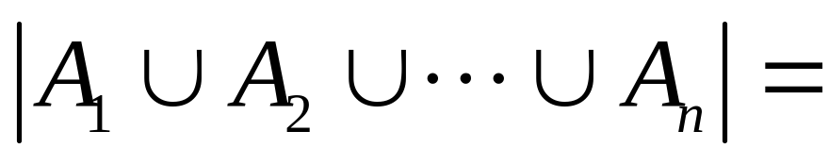
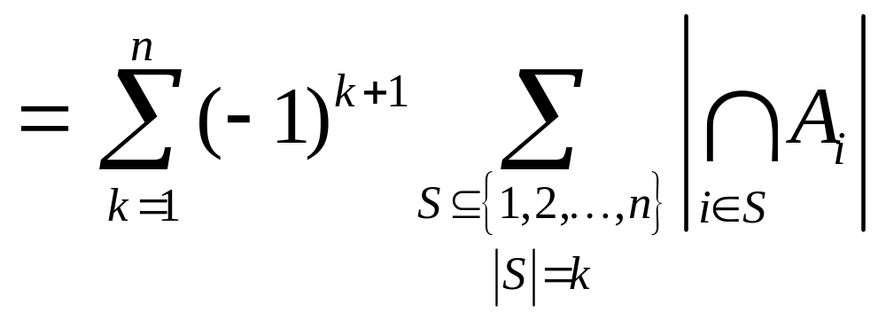
Inclusion-Exclusion (n sets)
sum of sizes of all single sets
– sum of sizes of all 2-set intersections
+ sum of sizes of all 3-set intersections
– sum of sizes of all 4-set intersections
…
+ (–1)^{n+1} × sum of sizes of intersections of all n sets

Slide 40
This Lecture
Sum rule, product rule, generalized product rule
Inclusion-exclusion principle
Permutations, combinations
Binomial coefficients, combinatorial proof

Slide 41
Permutations
A permutation of a set S is a sequence that
contains every element of S exactly once.
For example, here are all six permutations of the set {a, b, c}:
(a, b, c) (a, c, b) (b, a, c)
(b, c, a) (c, a, b) (c, b, a)
Ordering is important here.
How many permutations of an n-element set are there?

Slide 42
Permutations
How many permutations of an n-element set are there?
There are n choices for the first element.
For each of these, there are n − 1 remaining choices for
the second element.
For every combination of the first two elements, there
are n − 2 ways to choose the third element, and so forth.
Thus, there are a total of
n · (n − 1) · (n − 2) · · · 3 · 2 · 1 = n!
permutations of an n-element set.

Slide 43
Combinations
How many subsets of k elements of an n-element set?
Consider the set {1,2,3,4,5} where n=5.
If k=2, then there are 10 possible subsets of size 2,
i.e. {1,2}, {1,3}, {1,4}, {1,5}, {2,3}, {2,4}, {2,5}, {3,4}, {3,5}, {4,5}.
If k=3, then there are also 10 possible subsets of size 3,
i.e. {1,2,3}, {1,2,4}, {1,2,5}, {1,3,4}, {1,3,5}
{1,4,5}, {2,3,4}, {2,3,5}, {2,4,5}, {3,4,5}
Ordering is NOT important here.

Slide 44
Combinations
How many subsets of k elements of an n-element set?
There are n choices for the first element.
For each of these, there are n − 1 remaining choices for
the second element.
There are n – k + 1 remaining choices for the last element.
Thus, there are a total of
n · (n − 1) · (n − 2) · · · (n – k + 1) to choose k elements.
So far we counted the number of ways to choose k elements,
when the ordering is important.
e.g. {1,2,3}, {1,3,2}, {2,1,3}, {2,3,1}, {3,1,2}, {3,2,1} will be counted as 6 different ways.

Slide 45
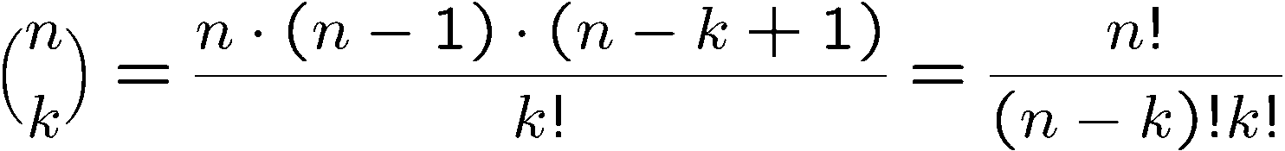
Combinations
How many subsets of k elements of an n-element set?
Thus, there are a total of
n · (n − 1) · (n − 2) · · · (n – k + 1) ways to choose k elements,
when the ordering is important.
How many different ordering of k elements are (over)-counted?
This is asking how many permutations of k elements, and so the answer is k!.
Since any ordering of the first k elements give the same subset,
we have to divide the above answer by k!, and so the final answer is

Slide 46
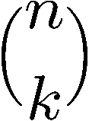
Splitting into 2 Sets
How many n-bit sequences contain k zeros and (n − k) ones?
Once the positions of k zeros are fixed,
the positions of (n-k) ones are fixed.
So the above question is asking the number of
possible positions of the k zeros, and the answer is:

Slide 47
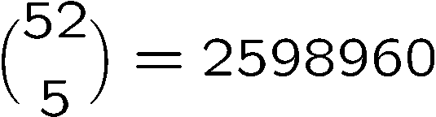
Poker Hands
There are 52 cards in a deck.
Each card has a suit and a value.
(♠ ♥ ♦ ♣)
4 suits
13 values
(2, 3, 4, 5, 6, 7, 8, 9, 10, J, Q, K, A)
Five-Card Draw is a card game in which each player
is initially dealt a hand, a subset of 5 cards.
How many different hands?

Slide 48
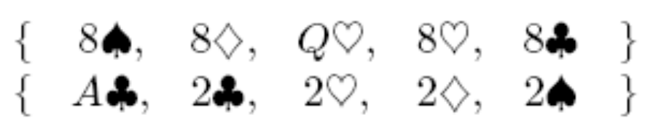
Example 1: Four of a Kind
A Four-of-a-Kind is a set of four cards with the same value.
How many different hands contain a Four-of-a-Kind?
One way to do this is to first map the problem into
a problem of counting sequences.

Slide 49

Example 1: Four of a Kind
A hand with a Four-of-a-Kind is completely described by a sequence specifying:
1. The value of the four cards.
2. The value of the extra card.
3. The suit of the extra card.
There are 13 choices for (1), 12 choices for (2), and 4 choices for (3).
By generalized product rule, there are 13x12x4 = 624 hands.
Only 1 hand in about 4165 has a Four-of-a-Kind!

Slide 50
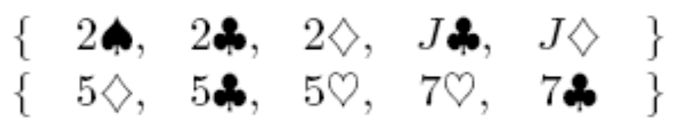
Example 2: Full House
A Full House is a hand with three cards of one value and two cards of another value.
How many different hands contain a Full House?

Slide 51
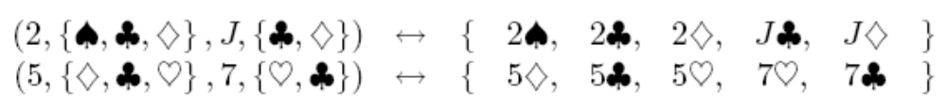
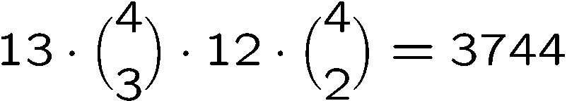
Example 2: Full House
There is a bijection between Full Houses and sequences specifying:
1. The value of the triple, which can be chosen in 13 ways.
2. The suits of the triple, which can be selected in (4 3) ways.
3. The value of the pair, which can be chosen in 12 ways.
4. The suits of the pair, which can be selected in (4 2) ways.
By generalized product rule, there are
Only 1 hand in about 634 has a Full House!

Slide 52

Example 3: Two Pairs
How many hands have Two Pairs; that is,
two cards of one value, two cards of another value, and one card of a third value?

Slide 53
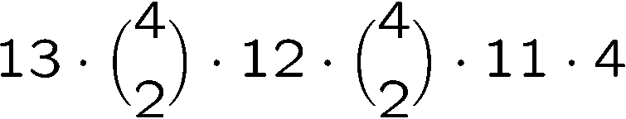
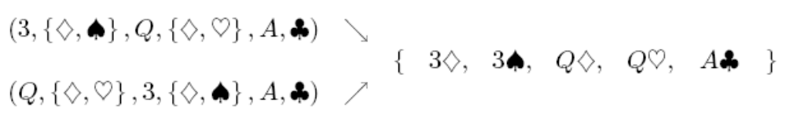
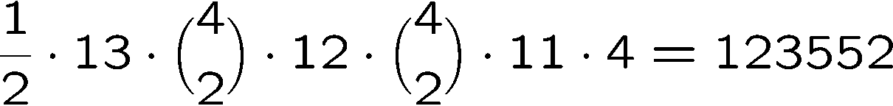
Example 3: Two Pairs
1. The value of the first pair, which can be chosen in 13 ways.
2. The suits of the first pair, which can be selected (4 2) ways.
3. The value of the second pair, which can be chosen in 12 ways.
4. The suits of the second pair, which can be selected in (4 2) ways
5. The value of the extra card, which can be chosen in 11 ways.
6. The suit of the extra card, which can be selected in 4 ways.
Number of Two pairs =
Double
Count!
So the answer is

Slide 54

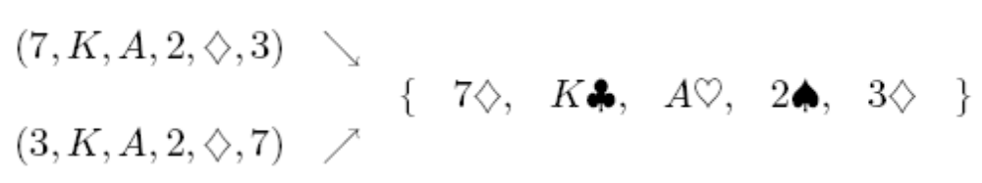
Example 4: Every Suit
How many hands contain at least one card from every suit?
1. The value of each suit, which can be selected in 13x13x13x13 ways.
2. The suit of the extra card, which can be selected in 4 ways.
3. The value of the extra card, which can be selected in 12 ways.
Double count!
So the answer is 13⁴x4x12/2 = 685464

Slide 55
This Lecture
Sum rule, product rule, generalized product rule
Inclusion-exclusion principle
Permutations, combinations
Binomial coefficients, combinatorial proof

Slide 56
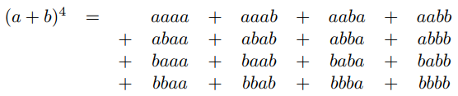


Binomial Theorem
Counting gives insight into one of the basic theorems of algebra.
A binomial is a sum of two terms, such as a + b.
Now consider its 4th power, (a + b)⁴ = a⁴ + 4a³b + 6a²b² + 4ab³ + b⁴
There is one term for every sequence of a’s and b’s.
So there are 2⁴ terms
The number of terms with k copies of b and n - k copies of a is:
So, the coefficient of a^{n-k}b^{k} is

Slide 57

General Binomial Theorem
binomial coefficient

Slide 58
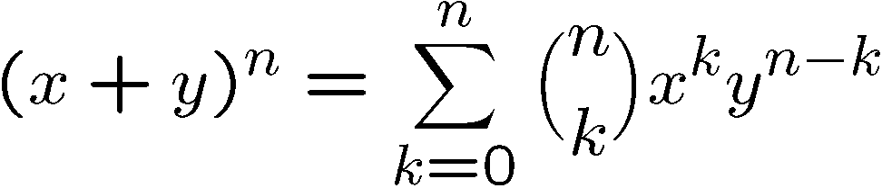
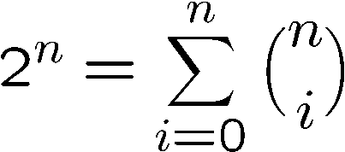
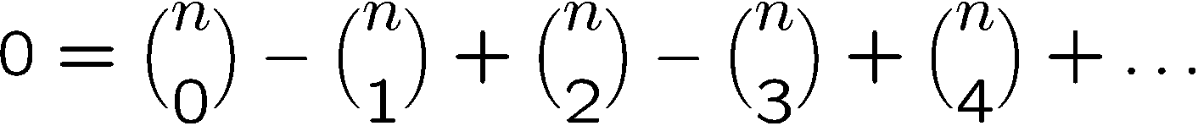
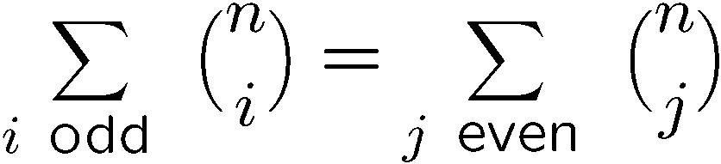
Binomial Coefficients
When x=1, y=1, it says that
When x=1, y=-1, it says that

Slide 59
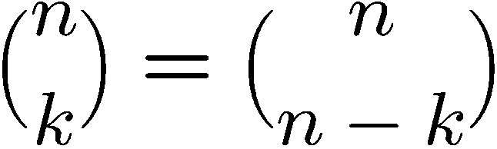
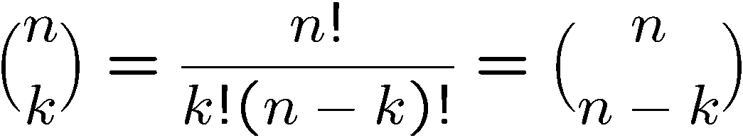
Proving Identities
Direct proof:
Combinatorial proof:
Number of ways to choose k items from n items
= number of ways to choose n-k items from n items

Slide 60
Finding a Combinatorial Proof
A combinatorial proof is an argument that establishes an algebraic fact by relying on counting principles.
Many such proofs follow the same basic outline:
1. Define a set S.
2. Show that |S| = n by counting one way.
3. Show that |S| = m by counting another way.
4. Conclude that n = m.
Double counting

Slide 61
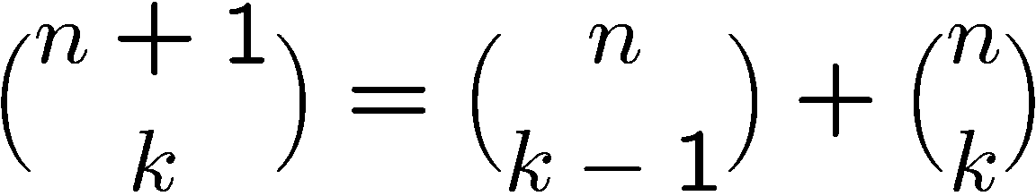
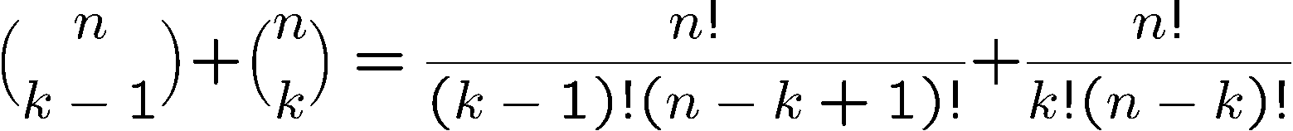
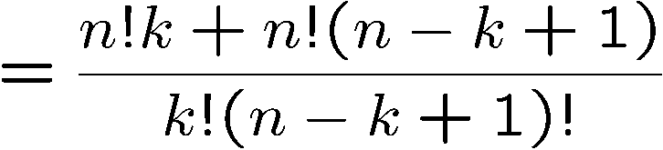
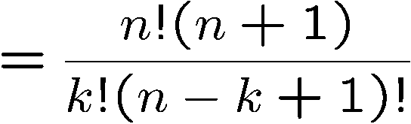
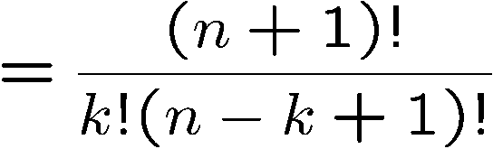
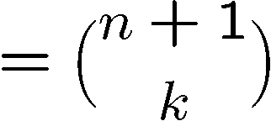
Proving Identities
Pascal’s Formula
Direct proof:
Direct proof:

Slide 62
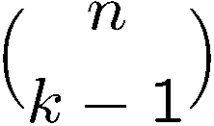

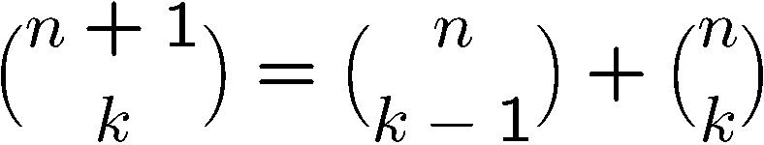
Proving Identities
Pascal’s Formula
Combinatorial proof:
The LHS is number of ways to choose k elements from n+1 elements.
Let the first element be x.
If we choose x, then we need to choose k-1 elements
from the remaining n elements, and number of ways to do so is
If we don’t choose x, then we need to choose k elements
from the remaining n elements, and number of ways to do so is
This partitions the ways to choose k elements from n+1 elements,
therefore

Slide 63
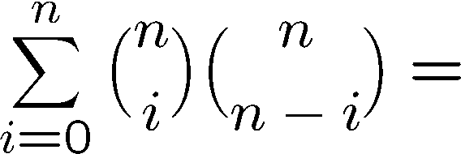
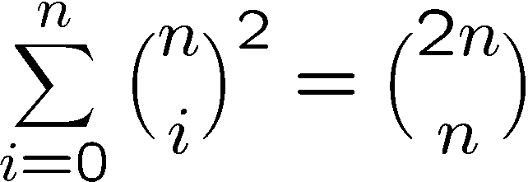
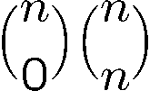
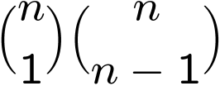
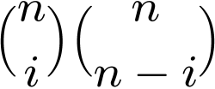
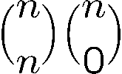
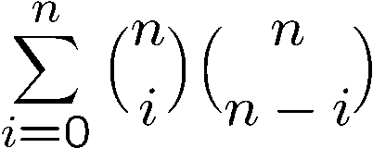
Combinatorial Proof
Consider we have 2n balls, n of them are red, and n of them are blue.
The RHS is number of ways to choose n balls from the 2n balls.
To choose n balls, we can
- choose 0 red ball and n blue balls, number of ways =
- choose 1 red ball and n-1 blue balls, number of ways =
…
choose i red balls and n-i blue balls, number of ways =
…
choose n red balls and 0 blue ball, number of ways =
Hence number of ways to choose n balls is also equal to

Slide 64
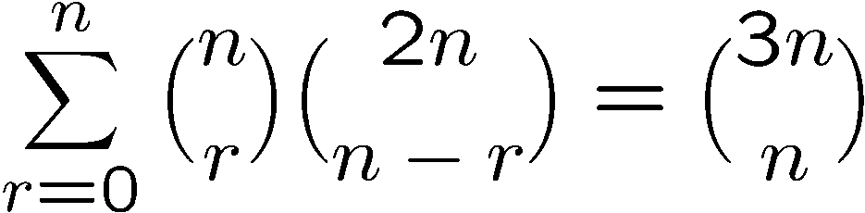
More Combinatorial Proof
Let S be all n-card hands that can be dealt from a deck containing
n red cards (numbered 1, . . . , n) and 2n black cards (numbered 1, . . . , 2n).
The right hand side = # of ways to choose n cards from these 3n cards.
The left hand side = # of ways to choose r cards from red cards x
# of ways to choose n-r cards from black cards
= # of ways to choose n cards from these 3n cards
= the right hand side.

Slide 65
Quick Summary
We have studied how to determine the size of a set directly.
The basic rules are the sum rule, product rule, and the generalized product rule.
We apply these rules in counting permutations and combinations,
which are then used to count other objects like poker hands.
Then we prove the binomial theorem and study combinatorial proofs of identities.
Finally we learn the inclusion-exclusion principle.

