Slide 1
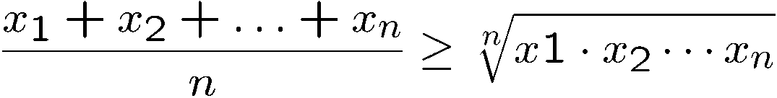

Introduction to Discrete Mathematics
A
B
C
a = qb+r gcd(a,b) = gcd(b,r)

Slide 2


Slide 3
Checker
x=0
Start with any configuration with all circles on or below the x-axis.

Slide 4
Checker
x=0
Move: jump through your adjacent neighbour,
but then your neighbour will disappear.

Slide 5
Checker
x=0
Move: jump through your adjacent neighbour,
but then your neighbour will disappear.

Slide 6
Checker
x=0
Goal: Find an initial configuration with least number of circles to jump up to level k.

Slide 7
K=1
x=0
2 circles to reach level 1.

Slide 8
K=2
x=0

Slide 9
K=2
x=0
Now we have reduced to the k=1 configuration, but one level higher.
4 circles to reach level 2.

Slide 10
K=3
x=0
This is the configuration for k=2, so jump two level higher.

Slide 11
K=3
x=0
8 circles to reach level 3.

Slide 12
K=4
x=0

Slide 13
K=4
x=0

Slide 14
K=4
x=0

Slide 15
K=4
x=0

Slide 16
K=4
x=0
Now we have reduced to the k=3 configuration, but one level higher
20 circles (not 16) to reach level 4!

Slide 17
K=5?
39 or below
40-50 circles
51-70 circles
71- 100 circles
101 – 1000 circles
1001 or above
It turns out that it is impossible to move to level 5,
and there is a very interesting mathematical proof of it.

Slide 18


Slide 19
Why Discrete Mathematics?
Understand the design of efficient computer systems.
How did Google manage to build a fast search engine?
What is the foundation of internet security?
algorithms, data structures, database,
parallel computing, distributed systems,
cryptography, computer networks…
Logic, number theory, counting, graph theory…

Slide 20
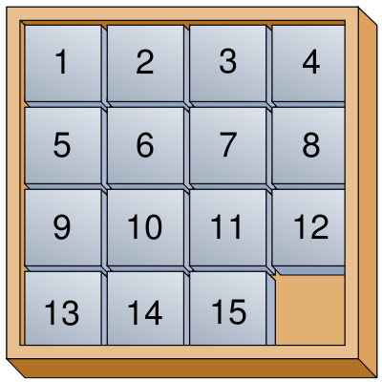

Topic: Logic and Proofs
How do computers (and humans) think?
Logic: propositional logic, first order logic
Proof: induction, contradiction
Artificial intelligence, database, circuit, algorithms

Slide 21
Topic: Number Theory
(Extended) Euclidean algorithm and prime numbers
Modular arithmetic, Chinese remainder theorem
Cryptography, coding theory, data structures

Slide 22
Topic: Counting
Sets and Functions
Combinations, Permutations, Binomial theorem
Counting by mapping, pigeonhole principle
Recursions
A
B
C
Probability, algorithms, data structures

Slide 23
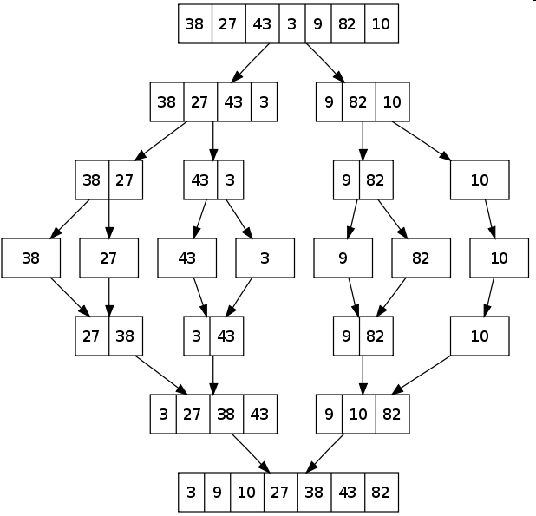
Topic: Counting
How many steps are needed to sort n numbers?
Algorithm 1 (Bubble Sort):
Every iteration moves the i-th smallest number to the i-th position
Algorithm 2 (Merge Sort):
Which algorithm runs faster?

Slide 24
Topic: Graph Theory
Graphs, Relations
Degree sequence, Eulerian graphs, isomorphism
Trees
Matching
Coloring
Computer networks, circuit design, data structures

Slide 25
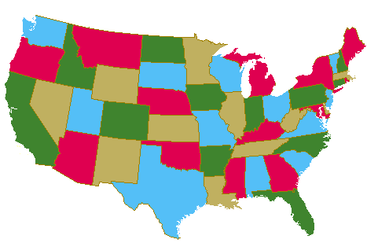



Topic: Graph Theory
How to color a map?
How to schedule exams?
How to send data efficiently?

Slide 26
Objectives of This Course
To learn basic mathematical concepts, e.g. sets, functions, graphs
To be familiar with formal mathematical reasoning, e.g. logic, proofs
To improve problem solving skills
To see the connections between discrete mathematics and computer science
Practice, Practice and Practice.

Slide 28
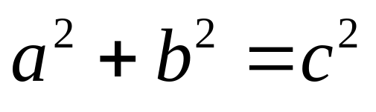
Pythagorean theorem
c
b
a
Familiar?
Obvious?

Slide 29

Good Proof
b
c
b-a
a
b-a
We will show that these five pieces can be rearranged into:
(i) a c×c square, and then
(ii) an a×a & a b×b square
And then we can conclude that

Slide 30
Good Proof
The five pieces can be rearranged into:
(i) a c×c square
c
b-a
c
c
a
b
c

Slide 31
Good Proof
How to rearrange them into an axa square and a bxb square?
b
c
b-a
a
b-a

Slide 32
Good Proof
a
b
b
a
b-a
a
b

Slide 33
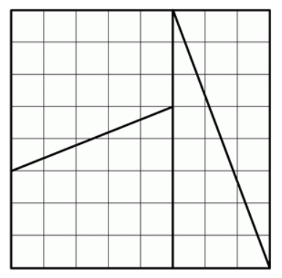
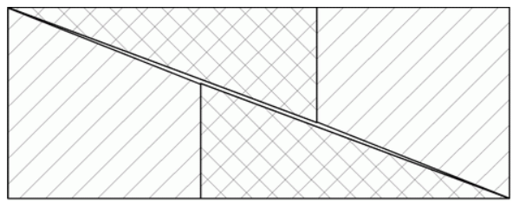
Bad Proof
A similar rearrangement technique shows that 65=64…
What’s wrong with the proof?
5 x 13
8 x 8

Slide 34
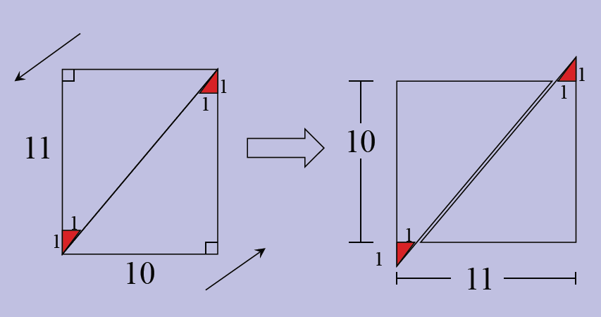
Bad Proof
Another example

Slide 35
Mathematical Proof
To prove mathematical theorems, we need a more rigorous system.
The standard procedure for proving mathematical theorems is invented by
Euclid in 300BC. First he started with five axioms (the truth of these
statements are taken for granted). Then he uses logic to deduce the truth
of other statements.
It is possible to draw a straight line from any point to any other point.
It is possible to produce a finite straight line continuously in a straight line.
It is possible to describe a circle with any center and any radius.
It is true that all right angles are equal to one another.
("Parallel postulate") It is true that, if a straight line falling on two straight lines make the interior angles on the same side less than two right angles,
the two straight lines, if produced indefinitely, intersect on that side on which are the angles less than the two right angles.

Slide 37


Slide 38
Statement (Proposition)
A Statement is a sentence that is either True or False
Examples:
2 + 2 = 4
True
Atomic statement:
if it cannot be divided into smaller statements
Molecular statement: otherwise
3 x 3 = 8
False
787009911 is a prime
Non-examples:
x+y>0
x²+y²=z²
They are true for some values of x and y
but are false for some other values of x and y.

Slide 39

More Examples
Statements
Non-Statements
The moon is made of cheese.
42 is a perfect square.
Every even number greater than 2 can be expressed as the sum of two primes.
3+7=12
Would you like some cake?
The sum of two squares.
1 + 3 + 5 + 7 + · · · + 2n + 1.
Go to your room!
3 + x = 12
3 + x = 12, where x = 9
3 + x = 12 for all values of x

Slide 40
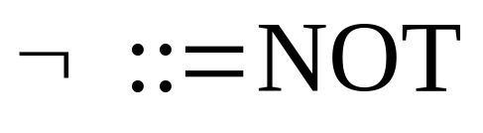




Logic Operators
~p is true if p is false
P
Q
P Q
P
Q
P Q
T
T
T
T
T
T
T
F
F
T
F
T
F
T
F
F
T
T
F
F
F
F
F
F
CONJUNCTION
DISJUNCTION

Slide 41



Compound Statement
Propositional
variable
p = “it is hot”
q = “it is sunny”
It is hot and sunny
It is not hot but sunny
It is neither hot nor sunny
Without the definition of p and q, these are called statement form or propositional form
The truth table for a given statement form displays the truth values that correspond to all possible combinations of truth values of its component statement variables.

Slide 42
Compound Statement
Propositional
variable
p = “it will be cold”
q = “it will be rainy”
It will be cold or rainy
It will either be cold or not rainy
p ∨ q
p ∨ ¬q

Slide 43


Exclusive-Or

coffee “or” tea
exclusive-or
How to construct a compound statement for exclusive-or?
Idea 1: Look at the true rows
Idea 1: Look at the true rows
Idea 1: Look at the true rows
p | q | p  q
T | T | F
T | F | T
F | T | T
F | F | F
Want the formula to be true
exactly when the input belongs
to a “true” row.
The input is the second row exactly if this sub-formula is satisfied
And the formula is true exactly when the input is the second row or the third row.

Slide 44
Exclusive-Or

coffee “or” tea
exclusive-or
How to construct a compound statement for exclusive-or?
p | q | p  q
T | T | F
T | F | T
F | T | T
F | F | F
Idea 2: Look at the false rows
Want the formula to be true
exactly when the input does
not belong to a “false” row.
The input is the first row exactly if this sub-formula is satisfied
And the formula is true exactly when the input is not in the 1st row and the 4th row.

Slide 45



Logical Equivalence
Idea 3: Guess and check
p | q
T | T | F | T | F | F
T | F | T | T | T | T
F | T | T | T | T | T
F | F | F | F | T | F
Logical equivalence: Two statements have the same truth table
As you see, there are many different ways to write the same logical formula.
One can always use a truth table to check whether two statements are equivalent.

Slide 46
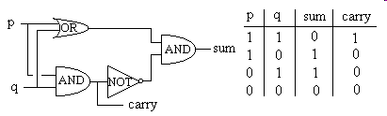
Writing Logical Formula for a Truth Table
Digital logic:
Given a digital circuit, we can construct the truth table.
Now, suppose we are given only the truth table (i.e. the specification),
how can we construct a circuit (i.e. formula) that has the same function?

Slide 47













Writing Logical Formula for a Truth Table
Use idea 1 or idea 2.
Idea 1: Look at the true rows
and take the “or”.
p | q | r | output
T | T | T | F
T | T | F | T
T | F | T | T
T | F | F | F
F | T | T | T
F | T | F | T
F | F | T | T
F | F | F | F
The formula is true exactly when the input is one of the true rows.

Slide 48



Writing Logical Formula for a Truth Table
Idea 2: Look at the false rows,
negate and take the “and”.
p | q | r | output
T | T | T | F
T | T | F | T
T | F | T | T
T | F | F | F
F | T | T | T
F | T | F | T
F | F | T | T
F | F | F | F
The formula is true exactly when the input is not one of the false row.

Slide 49
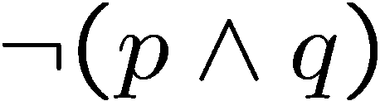

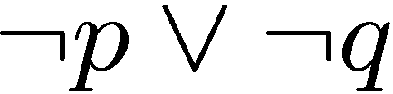

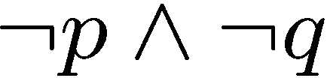
DeMorgan’s Laws
Logical equivalence: Two statements have the same truth table
Statement: Tom is in the football team and the basketball team.
Negation: Tom is not in the football team or not in the basketball team.
De Morgan’s Law
Statement: The number 783477841 is divisible by 7 or 11.
Negation: The number 783477841 is not divisible by 7 and not divisible by 11.
De Morgan’s Law

Slide 50



DeMorgan’s Laws
Logical equivalence: Two statements have the same truth table
De Morgan’s Law
T | T | F | F
T | F | T | T
F | T | T | T
F | F | T | T
De Morgan’s Law

