Slide 1
CSE 203: Data Structures
Elementary Data Structures
Binary Trees

Slide 2
Binary Trees
A binary tree is made up of a finite set of nodes. This set either is empty or consists of a node called the root together with two binary trees, called the left and right subtrees, which are disjoint from each other and from the root.
Notes:
Note that this means every node has two children, either or both of which can be empty. Technically, leaf nodes have two empty children.

Slide 3
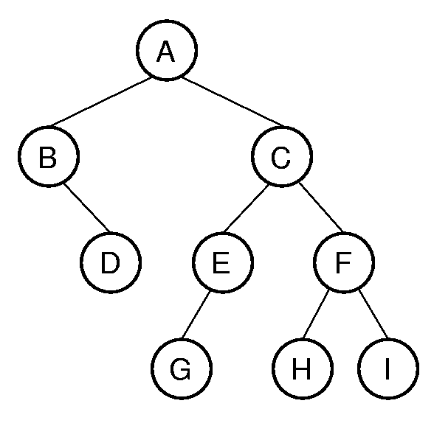
Binary Tree Example
Notation: Node, children, edge, parent, ancestor, descendant, path, depth, height, level, leaf node, internal node, subtree.
Root
Notes:
A has depth 0. B and C form level 1. The tree has height 4. Height = max depth + 1.

Slide 4
Binary Tree Example
Notation: Node, children, edge, parent, ancestor, descendant, path, depth, height, level, leaf node, internal node, subtree.
Notes:
A has depth 0. B and C form level 1. The tree has height 4. Height = max depth + 1.

Slide 5


Binary Tree Example
Notation: Node, children, edge, parent, ancestor, descendant, path, depth, height, level, leaf node, internal node, subtree.
Left Child
of A
Right Child
of A
Right
Child
of B
Does B have a child???
B has an empty child!!
Notes:
A has depth 0. B and C form level 1. The tree has height 4. Height = max depth + 1.

Slide 6
Binary Tree Example
Notation: Node, children, edge, parent, ancestor, descendant, path, depth, height, level, leaf node, internal node, subtree.
Parent of B and C
Parent of D
Notes:
A has depth 0. B and C form level 1. The tree has height 4. Height = max depth + 1.

Slide 7
Binary Tree Example
Notation: Node, children, edge, parent, ancestor, descendant, path, depth, height, level, leaf node, internal node, subtree.
A,C,E,G is a path
If n_1, n_2, ..., n_k is a sequence of nodes in the tree such that n_i is the parent of n_i + 1 for 1 ≤ i < k, then this sequence is called a path from n_1 to n_k.
Notes:
A has depth 0. B and C form level 1. The tree has height 4. Height = max depth + 1.

Slide 8
Binary Tree Example
Notation: Node, children, edge, parent, ancestor, descendant, path, depth, height, level, leaf node, internal node, subtree.
Ancestors of G
A,C,E,G is a path
Ancestor
of H
If n_1, n_2, ..., n_k is a sequence of nodes in the tree such that n_i is the parent of n_i + 1 for 1 ≤ i < k, then this sequence is called a path from n_1 to n_k.
Notes:
A has depth 0. B and C form level 1. The tree has height 4. Height = max depth + 1.

Slide 9
Binary Tree Example
Notation: Node, children, edge, parent, ancestor, descendant, path, depth, height, level, leaf node, internal node, subtree.
Descendant of A
A,C,E,G is a path
If n_1, n_2, ..., n_k is a sequence of nodes in the tree such that n_i is the parent of n_i + 1 for 1 ≤ i < k, then this sequence is called a path from n_1 to n_k.
Descendant
of C
Notes:
A has depth 0. B and C form level 1. The tree has height 4. Height = max depth + 1.

Slide 10
Binary Tree Example
Notation: Node, children, edge, parent, ancestor, descendant, path, depth, height, level, leaf node, internal node, subtree.
0
0
1
1
1
2
2
2
2
3 + 1 = 4
3
3
3
Depth of a node…
Level of a node…
3
Height of a tree
Notes:
A has depth 0. B and C form level 1. The tree has height 4. Height = max depth + 1.

Slide 11
Binary Tree Example
Notation: Node, children, edge, parent, ancestor, descendant, path, depth, height, level, leaf node, internal node, subtree.
Internal node: At least one non-empty children
Leaf node: nodes having both children empty
Notes:
A has depth 0. B and C form level 1. The tree has height 4. Height = max depth + 1.

Slide 12
Binary Tree Example
Notation: Node, children, edge, parent, ancestor, descendant, path, depth, height, level, leaf node, internal node, subtree.
Right subtree of A
Left subtree of A
Notes:
A has depth 0. B and C form level 1. The tree has height 4. Height = max depth + 1.

Slide 13
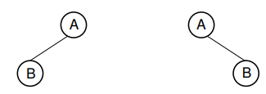

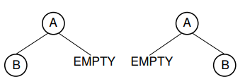
Are the following two trees same?

Slide 14
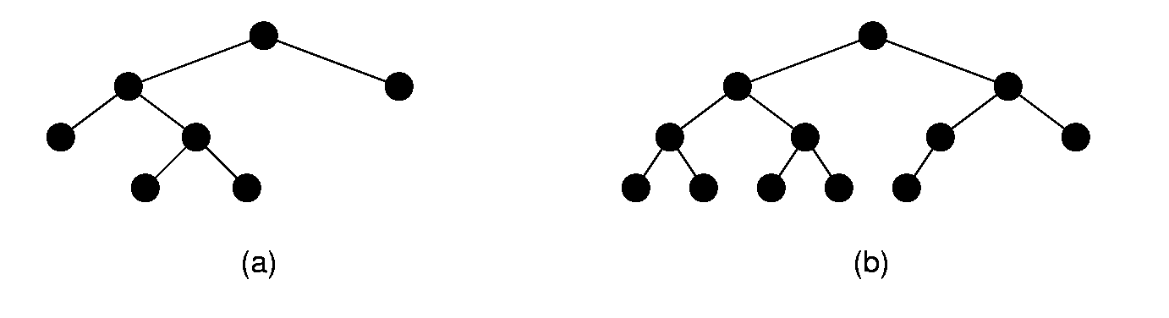
Full and Complete Binary Trees
Full binary tree: Each node is either a leaf or internal node with exactly two non-empty children.
Complete binary tree: If the height of the tree is d, then all leaves except possibly level d-1 are completely full. The bottom level has all nodes to the left side.
Full
Not anymore
Complete
Not anymore
Notes:
These terms can be hard to distinguish. Students will need to remember which is which, since this notation will be used several times during the course.

Slide 15
Full and Complete Binary Trees
Full binary tree: Each node is either a leaf or internal node with exactly two non-empty children.
Complete binary tree: If the height of the tree is d, then all leaves except possibly level d-1 are completely full. The bottom level has all nodes to the left side.
One Crucial Observation
NOT
COMPLETE
NOT FULL
Full
Complete
Notes:
These terms can be hard to distinguish. Students will need to remember which is which, since this notation will be used several times during the course.

Slide 16
Full Binary Tree Theorem (1)
Theorem: The number of leaves in a non-empty full binary tree is one more than the number of internal nodes.
Proof (by Mathematical Induction):
Base case: A full binary tree with 1 internal node must have two leaf nodes.
Induction Hypothesis: Assume any full binary tree T containing n-1 internal nodes has n leaves.
Notes:
This theorem is important, because it helps us to calculate space requirements. It tells us how many nodes are internal and how many are leaf. We need to know this if we have separate implementations for internal and leaf nodes

Slide 17
Full Binary Tree Theorem (2)
Induction Step:
We want to prove the following here:
If n-1 internal leaves means n leaves
Then n internal leaves would mean n+1 leaves
[Recall that this will establish the chain:
1 IN means 2 L
So, 2 IN means 3 L
So, 3 IN means 4
And so on…]
Notes:
Note the style of induction proof: NOT “go forward from n to n+1”. Instead, it reduces an arbitrary tree to one that meets the induction hypothesis, and then restores the original tree while maintaining the proof condition. This is generally easier to do (see explanation in Chapter 2).

Slide 18
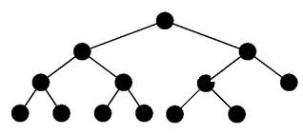
Full Binary Tree Theorem (2)
Induction Step: Given tree T with n internal nodes, pick internal node I with two leaf children. Remove I’s children, call resulting tree T’.
Clearly, T’ is a full binary tree with n-1 internal nodes
By induction hypothesis, it has n leaves.
Now:
Restore I’s two children. The number of internal nodes has now gone up by 1 to reach n. The number of leaves has also gone up by 1.
n INs
X is now an LN
now, n-1 INs
n LN (IH)
X
make X
a LN
X is now an IN
now, n INs
How many LNs?
X: IN=> LN
2 LNs added
=> LN increases by 1
=> n+1 (from IH)
X
IN = Internal Node
LN = Leaf Node
IH = Induction Hypothesis
Restore the two
children of X
Notes:
Note the style of induction proof: NOT “go forward from n to n+1”. Instead, it reduces an arbitrary tree to one that meets the induction hypothesis, and then restores the original tree while maintaining the proof condition. This is generally easier to do.

Slide 19
Why Full Binary Tree Theorem is useful?
Some binary tree implementations store data only at the leaf nodes, using the internal nodes to provide structure to the tree.
More generally, binary tree implementations might require some amount of space for internal nodes, and a different amount for leaf nodes.

Slide 20
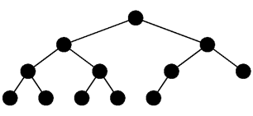
Full Binary Tree Corollary
Theorem: The number of empty subtrees in a non-empty binary tree is one more than the number of nodes in the tree.
Proof :
Take an arbitrary binary tree T and replace every empty subtree with a leaf node. Call the new tree T0.
All nodes originally in T will be internal nodes in T0 (Why?)
T0 is a full binary tree, because every internal node of T now must have two children in T0, and each leaf node in T must have two children in T0 (the leaves just added).
The Full Binary Tree Theorem tells us that the number of leaves in a full binary tree is one more than the number of internal nodes.
Thus, the number of new leaves that were added to create T0 is one more than the number of nodes in T.
Each leaf node in T0 corresponds to an empty subtree in T. Thus, the number of empty subtrees in T is one more than the number of nodes in T.

Slide 21
Full Binary Tree Corollary
Theorem: The number of empty subtrees in a non-empty binary tree is one more than the number of nodes in the tree.
Another Proof :
We prove that a binary tree with n nodes has n+1 empty subtrees
By definition, every node in binary tree T has two children (some may be empty)
A total of 2n children in a tree of n nodes.
Every node except the root node has one parent.
A total of n - 1 nodes with parents.
In other words, there are n - 1 non-empty children.
Because the total number of children is 2n, the remaining n + 1 children must be empty.

Slide 22
Binary Tree Node Class

Slide 23
Traversal of Trees
Any process for visiting the nodes in some order is called a traversal.
A traversal of a tree T is a systematic way of visiting all the nodes of T
Traversing a tree involves visiting the root and traversing its subtrees
Mainly, there are the following traversal methods:
Preorder Traversal (applicable for any tree)
Postorder Traversal (applicable for any tree)
Inorder Traversal (of a binary tree)
Any traversal that lists every node in the tree exactly once is called an enumeration of the tree’s nodes.
23

Slide 24
Preorder Traversal
In a preorder traversal, a node is visited before its descendants
If a tree is ordered, then the subtrees are traversed according to the order of the children
We assume a left to right order
Algorithm preOrder(v)
visit(v)
for each child w of v
preOrder (w)
1
A
2
9
5
B
C
D
3
4
6
7
8
E
F
I
G
H
Preorder: ABEFCIGHD
Note: this is not a binary tree

Slide 25
Postorder Traversal
In a postorder traversal, a node is visited after its descendants
Algorithm postOrder(v)
for each child w of v
postOrder (w)
visit(v)
A
9
3
8
B
7
C
D
1
2
6
4
5
E
F
I
G
H
Postorder: EFBIGHCDA
Note: this is not a binary tree

Slide 26
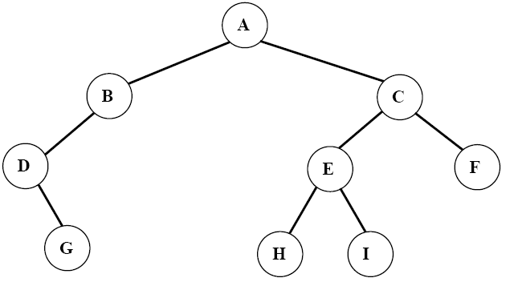
Inorder Traversal
In an inorder traversal a node is visited after its left subtree and before its right subtree:
Traverse the left subtree in inorder.
Visit the root.
Traverse the right subtree in inorder.
Algorithm inOrder(v)
if isInternal (v)
inOrder (leftChild (v))
visit(v)
if isInternal (v)
inOrder (rightChild (v))
3
4
8
6
1
9
6
2
8
2
7
5
1
4
7
9
Inorder: DGBAHEICF
3
5
26
Note: Only applicable to a binary tree

Slide 27
Level Order Traversal
In a level order traversal, every node on a level is visited before going to a lower level
1
A
2
4
3
B
C
D
5
6
7
8
9
E
F
I
G
H
Level order: ABCDEFIGH
27

Slide 28
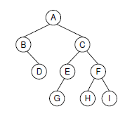
Pre-Order Traversal
A
B
D
C
E
G
F
H
I

Slide 29
Pre-Order Traversal
A
B
D
C
E
G
F
H
I

Slide 30
Pre-Order Traversal
A
B
D
C
E
G
F
H
I

Slide 31
Pre-Order Traversal
A
B
D
C
E
G
F
H
I

Slide 32
Pre-Order Traversal
A
B
D
C
E
G
F
H
I

Slide 33
Pre-Order Traversal
A
B
D
C
E
G
F
H
I

Slide 34
Pre-Order Traversal
A
B
D
C
E
G
F
H
I

Slide 35
Pre-Order Traversal
A
B
D
C
E
G
F
H
I

Slide 36
Pre-Order Traversal
A
B
D
C
E
G
F
H
I

Slide 37
Pre-Order Traversal
A
B
D
C
E
G
F
H
I

Slide 38
Post-Order Traversal
D
B
G
E
H
I
F
C
A

Slide 39
Post-Order Traversal
D
B
G
E
H
I
F
C
A

Slide 40
Post-Order Traversal
D
B
G
E
H
I
F
C
A

Slide 41
Post-Order Traversal
D
B
G
E
H
I
F
C
A

Slide 42
Post-Order Traversal
D
B
G
E
H
I
F
C
A

Slide 43
Post-Order Traversal
D
B
G
E
H
I
F
C
A

Slide 44
Post-Order Traversal
D
B
G
E
H
I
F
C
A

Slide 45
Post-Order Traversal
D
B
G
E
H
I
F
C
A

Slide 46
Post-Order Traversal
D
B
G
E
H
I
F
C
A

Slide 47
Post-Order Traversal
D
B
G
E
H
I
F
C
A

Slide 48
In-Order Traversal
B
D
A
G
E
C
H
F
I

Slide 49
In-Order Traversal
B
D
A
G
E
C
H
F
I

Slide 50
In-Order Traversal
B
D
A
G
E
C
H
F
I

Slide 51
In-Order Traversal
B
D
A
G
E
C
H
F
I

Slide 52
In-Order Traversal
B
D
A
G
E
C
H
F
I

Slide 53
In-Order Traversal
B
D
A
G
E
C
H
F
I

Slide 54
In-Order Traversal
B
D
A
G
E
C
H
F
I

Slide 55
In-Order Traversal
B
D
A
G
E
C
H
F
I

Slide 56
In-Order Traversal
B
D
A
G
E
C
H
F
I

Slide 57
In-Order Traversal
B
D
A
G
E
C
H
F
I

Slide 58
Pre-Order Traversal Code V1
/** @param rt The root of the subtree */
void preorder(BinNode rt)
{
if (rt == null) return; // Empty subtree
visit(rt);
preorder(rt.left());
preorder(rt.right());
}
Notes:
The first implementation is preferred.
The second implementation illustrates a common programming style by many students. It attempts to “look ahead” at the node to be called to determine if it is null or not. This is highly error prone, because the calling function must make sure not to pass in a null pointer for the tree root. It might appear to be more efficient (since it does not make recursive calls on the empty pointers), but it is not in reality since it is checking the pointers twice (to see if not null, then to process them).

Slide 59
Pre-Order Traversal Code V2
/** @param rt The root of the subtree */
void preorder2(BinNode rt) // Not so good
{
visit(rt);
if (rt.left() != null) preorder(rt.left());
if (rt.right() != null) preorder(rt.right());
}
Notes:
The first implementation is preferred.
The second implementation illustrates a common programming style by many students. It attempts to “look ahead” at the node to be called to determine if it is null or not. This is highly error prone, because the calling function must make sure not to pass in a null pointer for the tree root. It might appear to be more efficient (since it does not make recursive calls on the empty pointers), but it is not in reality since it is checking the pointers twice (to see if not null, then to process them).

Slide 60
Preorder vs preorder2
preorder2 makes only half as many recursive calls. (Why?)
On the other hand, preorder2 must access the left and right child pointers twice as often.
The net result is little or no performance improvement.
void preorder(BinNode rt)
{
if (rt == null) return; // Empty subtree
visit(rt);
preorder(rt.left());
preorder(rt.right());
}
void preorder2(BinNode rt) // Not so good
{
visit(rt);
if (rt.left() != null) preorder(rt.left());
if (rt.right() != null) preorder(rt.right());
}

Slide 61
Preorder2 is inferior
First, for more complex traversals it can become awkward to place the check for the NULL pointer in the calling code.
Even here we had to write two tests for NULL, rather than the one needed by preorder.
The more important concern with preorder2 is that it tends to be error prone.
While preorder2 insures that no recursive calls will be made on empty subtrees, it will fail if the initial call passes in a NULL pointer.

Slide 62
Recursion Example: Counting the nodes
We wish to count the number of nodes in a binary tree.
How?
The key insight is that the total count for any (non-empty) subtree is one for the root plus the counts for the left and right subtrees.
int count(BinNode rt) {
if (rt == null) return 0;
return 1 + count(rt.left()) +
count(rt.right());
}

Slide 63
Binary Tree Implementation: ‘Key’ Value
We do not want to describe what we are looking for by detailing and matching the entire contents of the record.
If we knew everything about the record already, we probably would not need to look for it.
Instead, we typically define what record we want in terms of a key value.
For example, if searching for payroll records, we might wish to search for the record that matches a particular ID number.
The ID number is then the search ‘key’.

Slide 64
Binary Tree Implementation

Slide 65
Binary Tree Implementation
Notes:
Standard implementation. Leaf implementation is identical to internal node implementation, resulting in much wasted space due to null pointers.

Slide 66
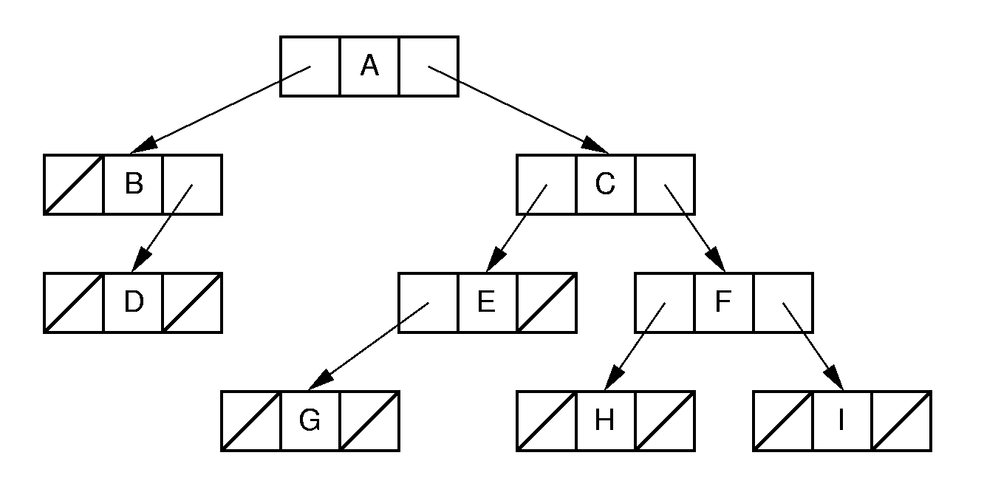
Binary Tree Implementation
Notes:
Standard implementation. Leaf implementation is identical to internal node implementation, resulting in much wasted space due to null pointers.

Slide 67
Some important issues
whether the same class definition will be used for leaves and internal nodes.
Using the same class for both will simplify the implementation,
but might be an inefficient use of space.
Some applications require data values only for the leaves.
Other applications require one type of value for the leaves and another for the internal nodes.
Also, it seems wasteful to store child pointers in the leaf nodes.

Slide 68
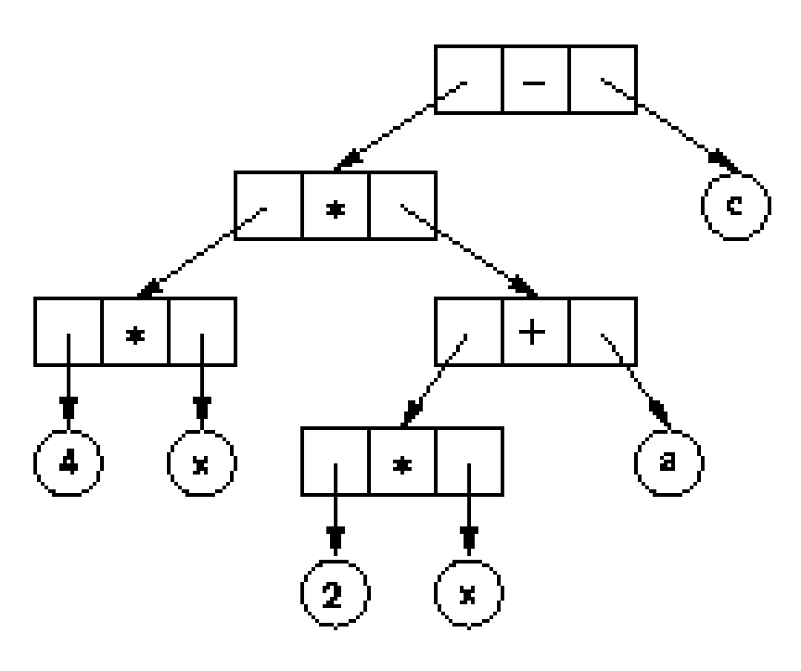
Binary Tree Implementation
4x (2x + a) + c
4 * x * (2 * x + a) + c
Notes:
Example of a tree with distinct internal and leaf node implementations.

Slide 69
Binary Tree Implementation
Internal nodes store operators
could store a small code identifying the operator (a single byte for the operator’s symbol)
the leaves store operands
i.e., variable names or numbers, (considerably larger in order to handle the wider range of possible values)
No child pointers though
4x (2x + a) + c
4 * x * (2 * x + a) + c
Notes:
Example of a tree with distinct internal and leaf node implementations.

Slide 70
Different nodes implementation with inheritance (1)

Slide 71
Different nodes implementation with inheritance (2)

Slide 72
Why two Implementations? [Design Patterns]
Design patterns capture reusable pieces of design wisdom.
Goals:
Quickly communicate design wisdom to new designers
Give a shared vocabulary to designers
WE WILL NOT FOCUS ON THIS

Slide 73
Space Requirements
Every node has two pointers to its children
total space = n(2P + D) for a tree of n nodes
P: space required by a pointer
D: amount of space required by a data value
So, total overhead: 2Pn
Overhead fraction: 2P/(2P+D)
P = D => 2/3rd of its total space is overhead
From the Full Binary Tree Theorem: Half of the pointers are null.
half of the pointers are “wasted” NULL values that serve only to indicate tree structure, but which do not provide access to new data.

Slide 74
Space Overhead
A common implementation is not to store any actual data in a node
but rather a pointer to the data record.
In this case, each node will typically store three pointers all of which are overhead:
overhead fraction of 3P/(3P + D)
P = D => 3/4th of its total space is overhead

Slide 75
Space Overhead
If only leaves store data values, then the fraction of total space devoted to overhead depends on whether the tree is full.
If the tree is not full, then conceivably there might only be one leaf node at the end of a series of internal nodes.
Thus, the overhead can be an arbitrarily high percentage
The overhead fraction drops as the tree becomes closer to full, being lowest when the tree is truly full.
In this case, about one half of the nodes are internal.

Slide 76
Space Overhead
Eliminate pointers from the leaf nodes:
n/2(2P) P
n/2(2P) + Dn P + D
This is 1/2 if P = D.
=
Full Binary Tree
n/2 IN has 2P
0 P in L
n/2 IN has D
~n/2 L has D
Notes:
This example is for full binary trees.
Half of the nodes have 2 pointers, which is overhead.
The mechanism for distinguishing leaves from internal nodes adds additional overhead not accounted for here.

Slide 77
Space Overhead
If data only at leaves with pointers eliminated
(2P)/(2P + D) ⇒ 2/3 overhead (Assuming P=D).
Note that some method is needed to distinguish leaves from internal nodes. So some space is needed here which we ignore in our analysis
Full Binary Tree
n/2 IN has 2P
~n/2 L has D

Slide 78
Space Overhead
a better implementation would have the internal nodes store two pointers and no data field while the leaf nodes store only a pointer to the data field.
(3P)/(3P + D) => ¾ when D = P.
Full Binary Tree
n/2 IN has 2P
~n/2 L has 1P
~n/2 L has 1D

Slide 79
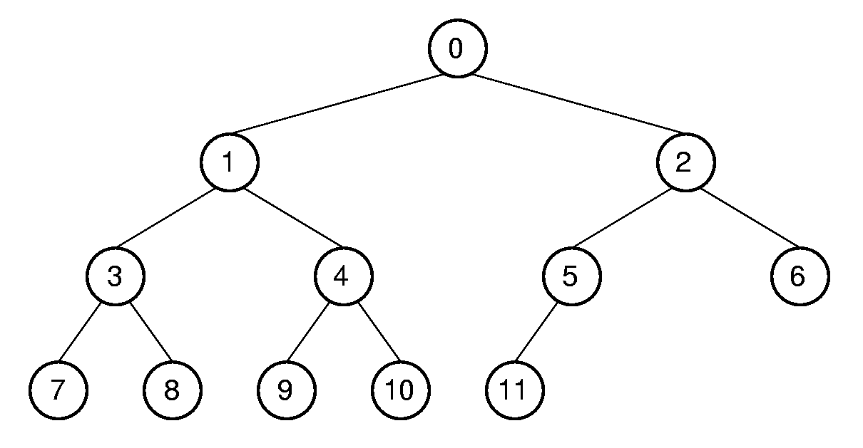
Array Implementation Complete Binary Tree
Position | 0 | 1 | 2 | 3 | 4 | 5 | 6 | 7 | 8 | 9 | 10 | 11
Parent | -- | 0 | 0 | 1 | 1 | 2 | 2 | 3 | 3 | 4 | 4 | 5
Left Child | 1 | 3 | 5 | 7 | 9 | 11 | -- | -- | -- | -- | -- | --
Right Child | 2 | 4 | 6 | 8 | 10 | -- | -- | -- | -- | -- | -- | --
Left Sibling | -- | -- | 1 | -- | 3 | -- | 5 | -- | 7 | -- | 9 | --
Right Sibling | -- | 2 | -- | 4 | -- | 6 | -- | 8 | -- | 10 | -- | --
Notes:
This is a good example of logical representation vs. physical implementation.
Since the complete binary tree is so limited in its shape (there is only one possible shape for n nodes), it is reasonable to expect that space efficiency can be achieved.

Slide 80
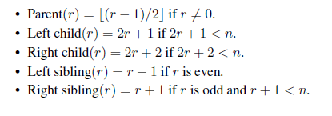
Array Implementation
Position | 0 | 1 | 2 | 3 | 4 | 5 | 6 | 7 | 8 | 9 | 10 | 11
Parent | -- | 0 | 0 | 1 | 1 | 2 | 2 | 3 | 3 | 4 | 4 | 5
Left Child | 1 | 3 | 5 | 7 | 9 | 11 | -- | -- | -- | -- | -- | --
Right Child | 2 | 4 | 6 | 8 | 10 | -- | -- | -- | -- | -- | -- | --
Left Sibling | -- | -- | 1 | -- | 3 | -- | 5 | -- | 7 | -- | 9 | --
Right Sibling | -- | 2 | -- | 4 | -- | 6 | -- | 8 | -- | 10 | -- | --
Notes:
This is a good example of logical representation vs. physical implementation.
Since the complete binary tree is so limited in its shape (there is only one possible shape for n nodes), it is reasonable to expect that space efficiency can be achieved.

Slide 81
Array Implementation
Position | 0 | 1 | 2 | 3 | 4 | 5 | 6 | 7 | 8 | 9 | 10 | 11
Parent | -- | 0 | 0 | 1 | 1 | 2 | 2 | 3 | 3 | 4 | 4 | 5
Left Child | 1 | 3 | 5 | 7 | 9 | 11 | -- | -- | -- | -- | -- | --
Right Child | 2 | 4 | 6 | 8 | 10 | -- | -- | -- | -- | -- | -- | --
Left Sibling | -- | -- | 1 | -- | 3 | -- | 5 | -- | 7 | -- | 9 | --
Right Sibling | -- | 2 | -- | 4 | -- | 6 | -- | 8 | -- | 10 | -- | --
Notes:
This is a good example of logical representation vs. physical implementation.
Since the complete binary tree is so limited in its shape (there is only one possible shape for n nodes), it is reasonable to expect that space efficiency can be achieved.

Slide 82
Array Implementation
Position | 0 | 1 | 2 | 3 | 4 | 5 | 6 | 7 | 8 | 9 | 10 | 11
Parent | -- | 0 | 0 | 1 | 1 | 2 | 2 | 3 | 3 | 4 | 4 | 5
Left Child | 1 | 3 | 5 | 7 | 9 | 11 | -- | -- | -- | -- | -- | --
Right Child | 2 | 4 | 6 | 8 | 10 | -- | -- | -- | -- | -- | -- | --
Left Sibling | -- | -- | 1 | -- | 3 | -- | 5 | -- | 7 | -- | 9 | --
Right Sibling | -- | 2 | -- | 4 | -- | 6 | -- | 8 | -- | 10 | -- | --
Notes:
This is a good example of logical representation vs. physical implementation.
Since the complete binary tree is so limited in its shape (there is only one possible shape for n nodes), it is reasonable to expect that space efficiency can be achieved.

Slide 83
Array Implementation
Position | 0 | 1 | 2 | 3 | 4 | 5 | 6 | 7 | 8 | 9 | 10 | 11
Parent | -- | 0 | 0 | 1 | 1 | 2 | 2 | 3 | 3 | 4 | 4 | 5
Left Child | 1 | 3 | 5 | 7 | 9 | 11 | -- | -- | -- | -- | -- | --
Right Child | 2 | 4 | 6 | 8 | 10 | -- | -- | -- | -- | -- | -- | --
Left Sibling | -- | -- | 1 | -- | 3 | -- | 5 | -- | 7 | -- | 9 | --
Right Sibling | -- | 2 | -- | 4 | -- | 6 | -- | 8 | -- | 10 | -- | --
Notes:
This is a good example of logical representation vs. physical implementation.
Since the complete binary tree is so limited in its shape (there is only one possible shape for n nodes), it is reasonable to expect that space efficiency can be achieved.

Slide 84
Array Implementation
Position | 0 | 1 | 2 | 3 | 4 | 5 | 6 | 7 | 8 | 9 | 10 | 11
Parent | -- | 0 | 0 | 1 | 1 | 2 | 2 | 3 | 3 | 4 | 4 | 5
Left Child | 1 | 3 | 5 | 7 | 9 | 11 | -- | -- | -- | -- | -- | --
Right Child | 2 | 4 | 6 | 8 | 10 | -- | -- | -- | -- | -- | -- | --
Left Sibling | -- | -- | 1 | -- | 3 | -- | 5 | -- | 7 | -- | 9 | --
Right Sibling | -- | 2 | -- | 4 | -- | 6 | -- | 8 | -- | 10 | -- | --
Notes:
This is a good example of logical representation vs. physical implementation.
Since the complete binary tree is so limited in its shape (there is only one possible shape for n nodes), it is reasonable to expect that space efficiency can be achieved.

