Slide 1
Graphs

Slide 2
What is a Graph?
A graph is a pair (V, E), where
V is a set of nodes, called vertices
E is a collection of pairs of vertices, called edges
V(G) and E(G) represent the sets of vertices and edges of G, respectively
Example:
a
b
V= {a, b, c, d, e}
E= {(a,b), (a,c), (a,d),
(b,e), (c,d), (c,e), (d,e)}
c
d
e
A tree is a special type of graph!
A tree is a graph that is connected and acyclic.

Slide 3
Applications
Electronic circuits
Printed circuit board
Integrated circuit
Transportation networks
Highway network
Flight network
Computer networks
Local area network
Internet
Web
Databases
Entity-relationship diagram
3

Slide 4
What can we do with graphs?
Find a path from one place to another
Find the shortest path from one place to another
Determine connectivity
Find the “weakest link” (min cut)
• check amount of redundancy in case of failures
Find the amount of flow that will go through them
4

Slide 5
Edge and Graph Types
Directed edge
ordered pair of vertices (u, v)
first vertex u is the origin
second vertex v is the destination
Undirected edge
unordered pair of vertices (u, v)
Directed graph (Digraph)
all the edges are directed
Undirected graph
all the edges are undirected
Mixed graph
some edges are undirected and some edges are directed
a
b
Directed edge
a
b
a
b
Undirected edge
a
b
a
b
c
d
e
Mixed graph

Slide 6
Terminology
End vertices (or endpoints) of an edge
u and v are the endpoints of a
Edges incident to a vertex
a, d, and b are incident to v
Adjacent vertices
u and v are adjacent
Degree of a vertex
x has degree 5
Parallel edges
h and i are parallel edges
Self-loop
j is a self-loop
v
a
b
h
j
u
d
x
z
c
e
i
w
g
f
y

Slide 7
Terminology (cont.)
Outgoing edges of a vertex
(a, b) and (a, c) are outgoing edges of vertex a
Incoming edges of a vertex
(b, c), (d, c) and (a, c) are incoming edges of vertex c
In-degree of a vertex
c has in-degree 3
b has in-degree 1
Out-degree of a vertex
a has out-degree 2
b has out-degree 1
a
b
d
c
7

Slide 8
Terminology (cont.)
Path
sequence of alternating vertices and edges
begins with a vertex
ends with a vertex
each edge is preceded and followed by its endpoints
Simple path
path such that all its vertices and edges are distinct
Examples
P₁=(V, b, X, h, Z) is a simple path
P₂=(U, c, W, e, X, g, Y, f, W, d, V) is a path that is not simple
V
a
b
P₁
d
U
X
Z
P₂
h
c
e
W
g
f
Y
Note the change in definition of path from what we learned earlier.
This could be more appropriate in some cases. But we may use both.

Slide 9
Terminology (cont.)
Dense graph: |E| ≈ |V|²; Sparse graph: |E| ≈ |V| or |E| << |V|
A weighted graph associates weights with either the edges or the vertices
A complete graph is a graph that has the maximum number of edges
for undirected graph with n vertices, the maximum number of edges is n(n-1)/2
for directed graph with n vertices, the maximum number of edges is n(n-1)
9

Slide 10
Terminology (cont.)
Cycle
A cycle is a path whose start and end vertices are the same
each edge is preceded and followed by its endpoints
Simple cycle
A cycle is simple if each edge is distinct and each vertex is distinct, except for the first and the last one
Examples
C₁=(V, b, X, g, Y, f, W, c, U, a, V) is a simple cycle
C₂=(U,c,W,e,X,g,Y,f,W,d,V,a,U) is a cycle that is not simple
V
a
b
d
U
X
Z
C₂
h
e
C₁
c
W
g
f
Y

Slide 11
Terminology (cont.)
0
1
2
A subgraph of G is a graph G’ such that
V(G’) is a subset of V(G) [V(G’) ⊆ V(G)] and
E(G’) is a subset of E(G) [E(G’) ⊆ E(G)]
A spanning subgraph G’ of G is a subgraph of G that contains all the vertices of G, that is
V(G’) is equal to V(G) [V(G’) = V(G)] and
E(G’) is a subset of E(G) [E(G’) ⊆ E(G)]
A forest is a graph without cycles.
A (free) tree is a connected forest, that is, a connected graph without cycles.
A spanning tree of a graph G is a spanning subgraph that is a (free) tree.
3
0
1
2
A subgraph
0
1
2
3
A spanning subgraph (tree)
11

Slide 12
Properties
Property 1
For an undirected graph
Σ_{v} deg(v) = 2m
Proof: each edge is counted twice
Property 2
For a directed graph
Σ_{v} indeg(v) = Σ_{v} outdeg(v) = m
Proof: each edge is counted once for in-degree and once for out-degree
Property 3
If G is a simple undirected graph, then m ≤ n (n − 1)/2,and
if G is a simple directed graph, then m ≤ n (n − 1).
Proof: each vertex has degree at most (n − 1). Then use Property 1 and Property 2.
Notation
n number of vertices
m number of edges
deg(v) degree of vertex v

Slide 13
Graph Representation
For graphs to be computationally useful, they have to be conveniently represented in programs
There are two computer representations of graphs:
Adjacency matrix representation
Adjacency lists representation

Slide 14
Adjacency Matrix Representation
Assume V = {1, 2, …, n}
An adjacency matrix represents the graph as a n x n matrix A:
A[i, j] = 1 if edge (i, j) ∈ E (or weight of edge) = 0 if edge (i, j) ∉ E
1
A | 1 | 2 | 3 | 4
1 | 0 | 1 | 1 | 0
2 | 0 | 0 | 1 | 0
3 | 0 | 0 | 0 | 0
4 | 0 | 0 | 1 | 0
a
2
d
4
b
c
3
14

Slide 15
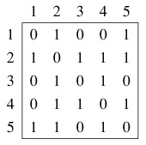
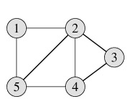
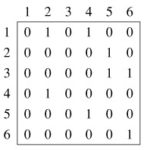
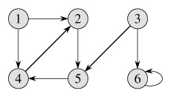
Adjacency Matrix Representation
Undirected Graph
Directed Graph
The adjacency matrix for an undirected graph is symmetric; the adjacency matrix for a digraph need not be symmetric
15

Slide 16
Adjacency Matrix Representation
|V| = n
Pros:
Simple to implement
Easy and fast to tell if a pair (i, j) is an edge: simply check if A[i, j] is 1 or 0
Can be very efficient for small graphs
Good for dense graphs (why?)
Cons:
No matter how few edges the graph has, the matrix takes O(n²), i.e., O(|V|²) in memory
|V| = n
n × n
matrix
1
2
3
4
5
6
7
8
9
16

Slide 17
Adjacency Lists Representation
A graph is represented by a one-dimensional array L of linked lists, where
L[i] is the linked list containing all the nodes adjacent to node i.
The nodes in the list L[i] are in no particular order
1
2
4
3
17

Slide 18
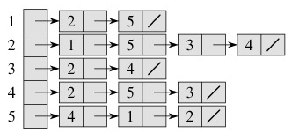
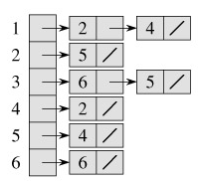
Adjacency Lists Representation
Undirected Graph
Directed Graph
18

Slide 19
Adjacency Lists Representation
Pros:
Saves on space (memory): the representation takes O(|V|+|E|) memory.
Good for large, sparse graphs (e.g., planar maps)
Cons:
It can take up to O(n) time to determine if a pair of nodes (i, j) is an edge: one would have to search the linked list L[i], which takes time proportional to the length of L[i].
How to find whether there is an edge (4,1)?
19

