Slide 1
Graphs-II

Slide 2
Graph Searching
Given: a graph G = (V, E), directed or undirected
Goal: methodically explore every vertex and every edge
Ultimately: build a tree on the graph
Pick a vertex as the root
Choose certain edges to produce a tree
Note: might also build a forest if graph is not connected
There are two standard graph traversal techniques:
Breadth-First Search (BFS)
Depth-First Search (DFS)

Slide 3
Breadth-First Search
“Explore” a graph, turning it into a tree
One vertex at a time
Expand frontier of explored vertices across the breadth of the frontier
Builds a tree over the graph
Pick a source vertex to be the root
Find (“discover”) its children, then their children, etc.

Slide 4
Breadth-First Search
It associates vertex “colors” to guide the algorithm
White vertices have not been discovered
All vertices start out white
Grey vertices are discovered but not fully explored
They may be adjacent to white vertices
Black vertices are discovered and fully explored
They are adjacent only to black and grey vertices
Explore vertices by scanning adjacency list of grey vertices

Slide 5
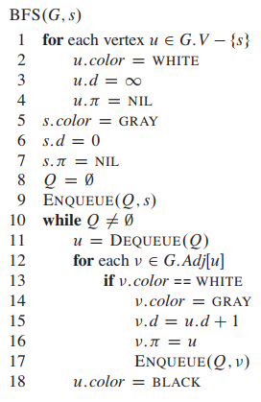
Breadth-First Search

Slide 6
Breadth-First Search: Example
r
s
t
u
∞
∞
∞
∞
∞
∞
∞
∞
v
w
x
y

Slide 7
Breadth-First Search: Example
r
s
t
u
white
∞
0
∞
∞
grey
∞
∞
∞
∞
black
v
w
x
y
Q:
s

Slide 8
Breadth-First Search: Example
r
s
t
u
white
1
0
∞
∞
grey
∞
1
∞
∞
black
v
w
x
y
Q:
w
r

Slide 9
Breadth-First Search: Example
r
s
t
u
white
1
0
2
∞
grey
∞
1
2
∞
black
v
w
x
y
Q:
r
t
x

Slide 10
Breadth-First Search: Example
r
s
t
u
white
1
0
2
∞
grey
2
1
2
∞
black
v
w
x
y
Q:
t
x
v

Slide 11
Breadth-First Search: Example
r
s
t
u
white
1
0
2
3
grey
2
1
2
∞
black
v
w
x
y
Q:
x
v
u

Slide 12
Breadth-First Search: Example
r
s
t
u
white
1
0
2
3
grey
2
1
2
3
black
v
w
x
y
Q:
v
u
y

Slide 13
Breadth-First Search: Example
r
s
t
u
white
1
0
2
3
grey
2
1
2
3
black
v
w
x
y
Q:
u
y

Slide 14
Breadth-First Search: Example
r
s
t
u
white
1
0
2
3
grey
2
1
2
3
black
v
w
x
y
Q:
y

Slide 15
Breadth-First Search: Example
r
s
t
u
white
1
0
2
3
grey
2
1
2
3
black
v
w
x
y
Q:
Ø

Slide 16
BFS: Analysis
O(V)
O(1)
O(V+E)
Each vertex is enqueued/dequeued once:
O(V) in total
Once dequeued, the adjacency list of a vertex is explored:
O(E) in total

Slide 17
Breadth-First Search: Properties
BFS calculates the shortest-path distance to the source node
Shortest-path distance δ(s,v) = minimum number of edges from s to v, or ∞ if v not reachable from s
BFS builds breadth-first tree, in which paths to root represent shortest paths in G
Thus can use BFS to calculate shortest path from one vertex to another in O(V+E) time in an unweighted graph

Slide 18
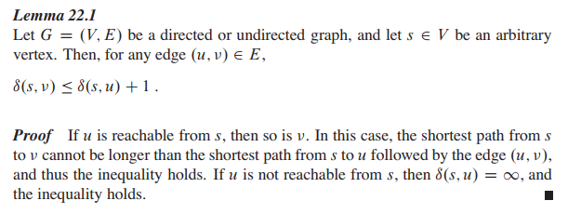

Slide 19
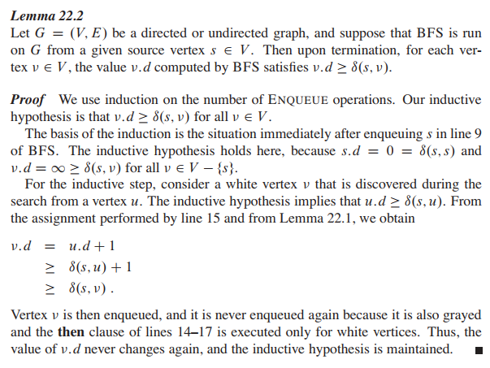

P
First
EnQ
Next
EnQs
Assume, before an EnQ, P holds
Then show, after the next EnQ,
P still holds

Slide 20
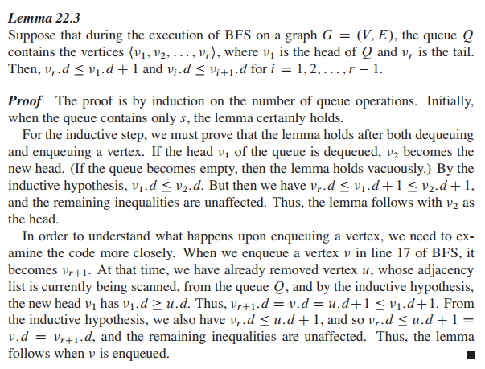
First Q
Ops.
dQ
Next Q Ops.
enQ
Before dQ, IH holds:
v1.d <= v2.d <= v3.d…<= v_r.d
v_r.d<= v1.d+1
After dQ (of v1):
v2.d <= v3.d…<= v_r.d (Okay)
v_r.d<= v1.d+1 <=v2.d+1 (Okay)

Slide 21
First Q
Ops.
dQ
Next Q Ops.
Before enQ, IH holds:
u is just out. u.d <= v1.d.
v_r.d <= u.d +1
After enQ: v_{r+1} = v is in.
v_{r+1}.d = v.d = u.d + 1
<= v1.d + 1 (Okay)
Also, v_r.d <= u.d +1 = v.d =
v_{r+1}.d.
enQ

Slide 22
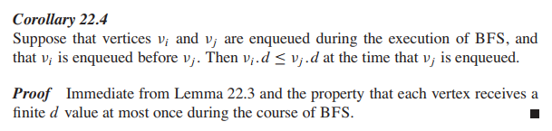

Slide 23
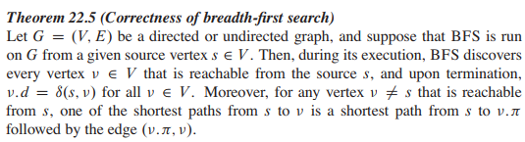
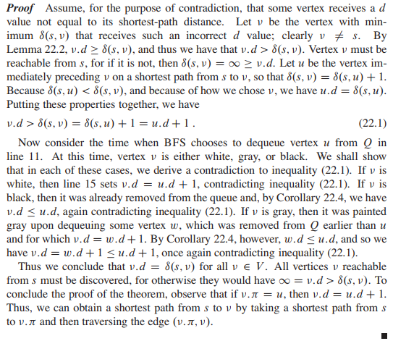

Slide 25



When u is dequeued from Q:
Case 1: v is white
v.d = u.d + 1 [Contradicts 22.1]
Case 2: v is black
v has been handled before u.
Cor. 22.4=> v.d <= u.d [Contradicts 22.1]
Case 3: v is gray
someone else (not u) ‘painted’ it gray (say w)
v.d = w.d +1 (A)
w has been handled before u.
Cor. 22.4=> w.d <= u.d (B)
(A) and (B) => v.d <= u.d [Contradicts 22.1]

Slide 26
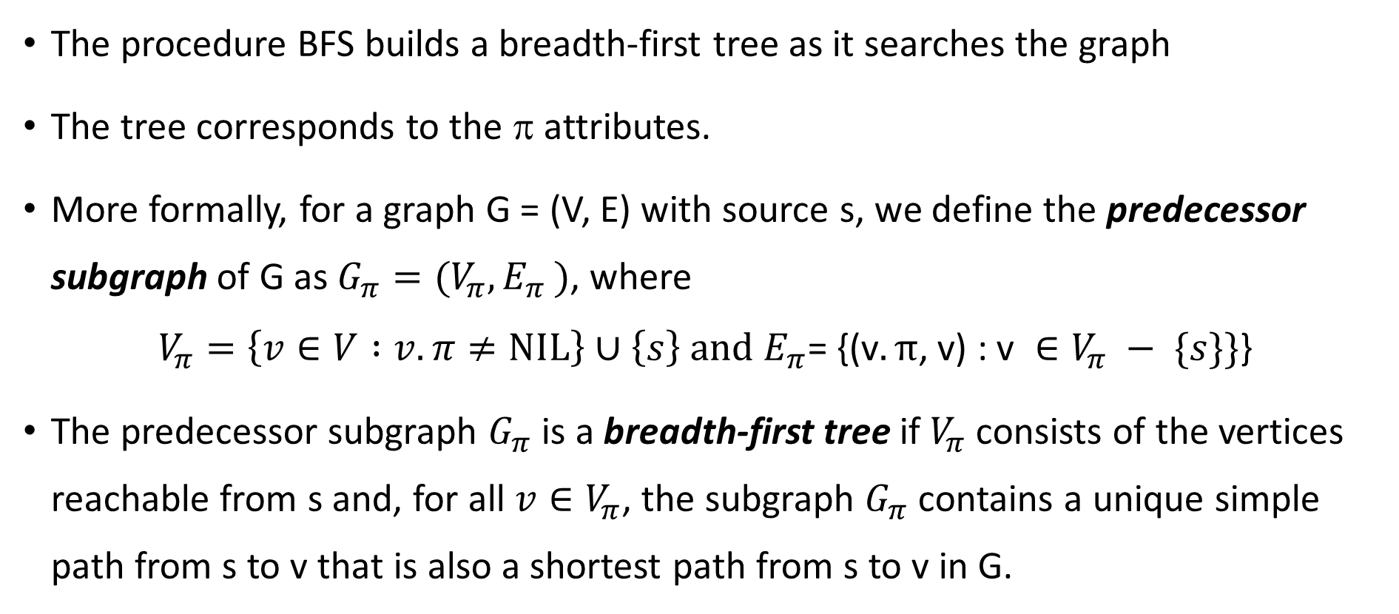
Breadth-first Trees
The procedure BFS builds a breadth-first tree as it searches the graph
The tree corresponds to the π attributes.
More formally, for a graph G = (V, E) with source s, we define the predecessor subgraph of G as $G_{π}={(V}_{π}{, E}_{π})$, where
$$V_{π}=\left\{v∈V :v.π≠NIL\right\}∪\left\{s\right\} and E_{π}\text{= \{(}\text{v}.π\text{, }\text{v}\text{)}\text{ : }\text{v} ∈V_{π} − \{s\}\}\text{\}}$$
The predecessor subgraph $G_{π}$ is a breadth-first tree if $V_{π}$ consists of the vertices reachable from s and, for all ${v∈V}_{π}$, the subgraph $G_{π}$ contains a unique simple path from s to v that is also a shortest path from s to v in G.

Slide 27
