Slide 1
Graphs-III

Slide 2
Graph Searching
Given: a graph G = (V, E), directed or undirected
Goal: methodically explore every vertex and every edge
Ultimately: build a tree on the graph
Pick a vertex as the root
Choose certain edges to produce a tree
Note: might also build a forest if graph is not connected
There are two standard graph traversal techniques:
Breadth-First Search (BFS)
Depth-First Search (DFS)

Slide 3
Depth-First Search
Depth-first search is another strategy for exploring a graph
Explore “deeper” in the graph whenever possible
Edges are explored out of the most recently discovered vertex v that still has unexplored edges
When all of v’s edges have been explored, backtrack to the vertex from which v was discovered
Vertices initially colored white
Then colored grey when discovered
Then black when finished

Slide 4
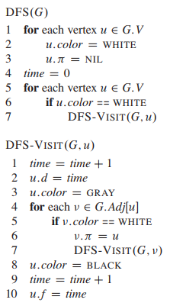


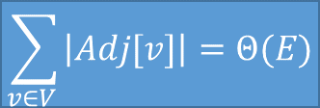
Θ(V)
How many times DFS-Visit() is called?
Θ(V)
EXCLUDING the time required for DFS-VISIT().
The procedure DFS-VISIT is called exactly once for each vertex since:
the vertex u on which DFS-VISIT() is invoked must be white
the first thing DFS-VISIT does is paint vertex u gray
Θ(V + E)
$$\sum_{v∈V }{\left|Adj[v]\right|=Θ(E)}$$

Slide 5
DFS Example
Initially…
white
source vertex
Discovered…
grey
Finished
black

Slide 6
DFS Example
white
source vertex
grey
d f
1|
|
|
black
|
|
|
|
|

Slide 7
DFS Example
white
source vertex
grey
d f
1|
|
|
black
2|
|
|
|
|

Slide 8
DFS Example
white
source vertex
grey
d f
1|
|
|
black
2|
|
3|
|
|

Slide 9
DFS Example
white
source vertex
grey
d f
1|
|
|
black
2|
|
3|4
|
|

Slide 10
DFS Example
white
source vertex
grey
d f
1|
|
|
black
2|
|
3|4
5|
|

Slide 11
DFS Example
white
source vertex
grey
d f
1|
|
|
black
2|
|
3|4
5|6
|

Slide 12
DFS Example
white
source vertex
grey
d f
1|
|
|
black
2|7
|
3|4
5|6
|

Slide 13
DFS Example
white
source vertex
grey
d f
1|
8|
|
black
2|7
|
3|4
5|6
|

Slide 14
DFS Example
white
source vertex
grey
d f
1|
8|
|
black
2|7
9|
3|4
5|6
|

Slide 15
DFS Example
white
source vertex
grey
d f
1|
8|
|
black
2|7
9|10
3|4
5|6
|

Slide 16
DFS Example
white
source vertex
grey
d f
1|
8|11
|
black
2|7
9|10
3|4
5|6
|

Slide 17
DFS Example
white
source vertex
grey
d f
1|12
8|11
|
black
2|7
9|10
3|4
5|6
|
Notes:
It may seem arbitrary that breadth-first search (the way we taught) is limited to only one source whereas depth-first search may search from multiple sources. Although conceptually, breadth-first search could proceed from multiple sources and depth-first search could be limited to one source, our approach reflects how the results of these searches are typically used. Breadth-first search usually serves to find shortestpath distances (and the associated predecessor subgraph) from a given source. Depth-first search is often a subroutine in another algorithm, as we shall see later in this chapter.

Slide 18
DFS Example
white
source vertex
grey
d f
1|12
8|11
13|
black
2|7
9|10
3|4
5|6
|

Slide 19
DFS Example
white
source vertex
grey
d f
1|12
8|11
13|
black
2|7
9|10
3|4
5|6
14|

Slide 20
DFS Example
white
source vertex
grey
d f
1 |12
8|11
13|
black
2|7
9|10
3|4
5|6
14|15

Slide 21
DFS Example
white
source vertex
grey
d f
1 |12
8|11
13|16
black
2|7
9|10
3|4
5|6
14|15

Slide 22

DFS Example
source vertex
Interesting Facts
d f
u.d records when vertex u is discovered
u:f records when the processing of vertex u is finished.
These timestamps are integers between 1 and 2 ×|V|.
Since there is one discovery event and one finishing event for each of the |V| vertices
For every vertex u, we have: u.d < u.f ---(22.2)
1 |12
8|11
13|16
2|7
9|10
3|4
5|6
14|15

Slide 23
DFS: Parenthesis Structure
DFS discovery and finishing times have parenthesis structure
Represent discovery of vertex u with “(u”
represent finishing of vertex u with “u)”
Then the history of discoveries and finishings makes a well-formed expression in the sense that the parentheses are properly nested.
We thus have an interesting parenthesis theorem!

Slide 24
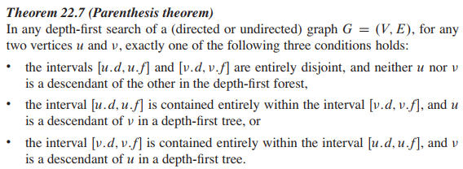

Slide 25
Case 1: u.d < v.d
Case 1A: v.d < u.f => u.d < v.d < u.f => v is discovered B4 u is finished, i.e., u is gray.
v is a descendent of u.
v is discovered more recently than u => v is finished before search returns to u.
So, [v.d, v.f] is entirely contained in [u.d, u.f]
Case 1B: u.f < v.d => u.d < u.f < v.d => v is discovered AFTER u is finished, i.e., u is Black.
(22.2) => u.d < u.f < v.d < v.f => [u.d, u.f] and [v.d, v.f] are disjoint.
So, neither vertex was discovered when the other was gray => neither is a descendent of the other.
Case 2: v.d < u.d: Exactly similar argument, with the roles of u and v reversed
u.d < u.f

Slide 26
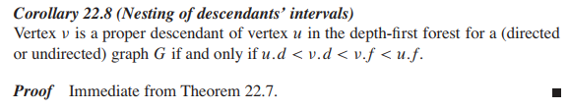

Slide 27

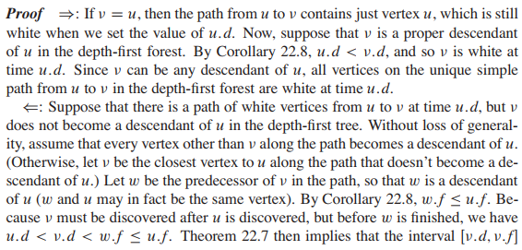
P
If, and only if
Q

Slide 28
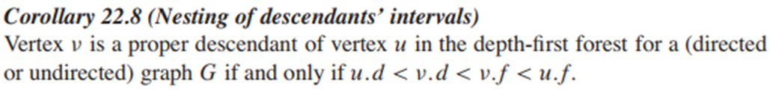
P
If, and only if
Q
A. If P then Q
u is still white when u.d is set.
Suppose v is a descendent of u.
If v = u, we are done (as u = v is white).
Suppose v is a proper descendent of u.
Then, u.d < v.d [Cor. 22.8]
So, v is white at time u.d
As per assumption, v could be any of the (proper) decedents.
So, the result follows.

Slide 29
P
If, and only if
Q
B. If Q then P
FTSOC, assume there is a path (Z) of white vertices from u to v at time u.d, but v is not a descendant of u in DFT.
If there are more like v, v is the closest one to u (in Z).
Let w is a predecessor of of v (n Z).
w must be a descendent of u (may not be proper)
So, w.f <= u.f
v is discovered after u is discovered but before w is finished: u.d < v.d < w.f
So, u.d < v.d < w.f <= u.f
Th. 22.7 => [v.d, v.f] must be contained within [u.d, u.f]
So we reach a Contradiction by Cor. 22.8.

Slide 30
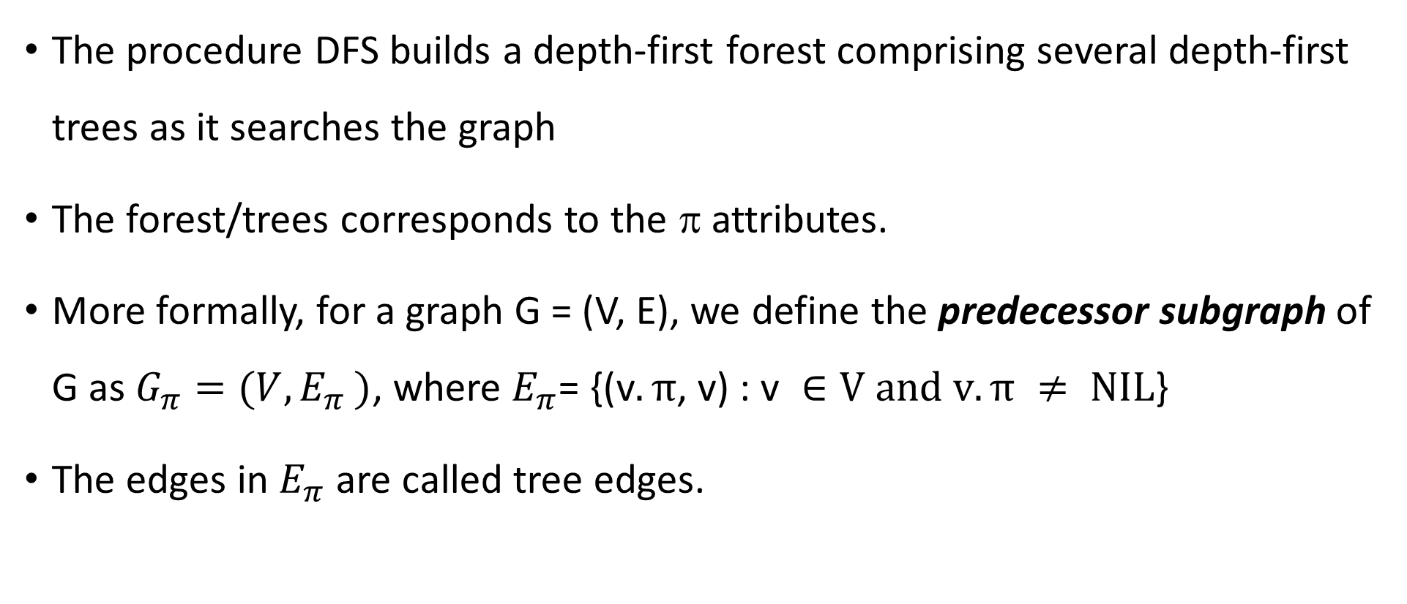
Depth-first forest
The procedure DFS builds a depth-first forest comprising several depth-first trees as it searches the graph
The forest/trees corresponds to the π attributes.
More formally, for a graph G = (V, E), we define the predecessor subgraph of G as $G_{π}=(V{, E}_{π})$, where $E_{π}\text{= \{(}\text{v}.π\text{, }\text{v}\text{)}\text{ : }\text{v} ∈\text{V} \text{and} \text{v}.π ≠ \text{NIL}\text{\}}$
The edges in $E_{π}$ are called tree edges.

Slide 31
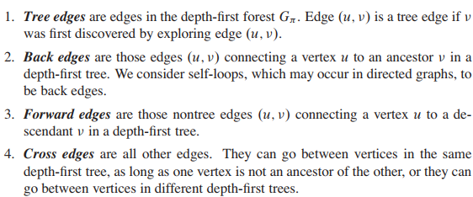
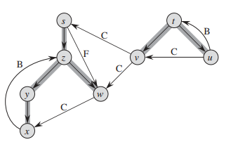
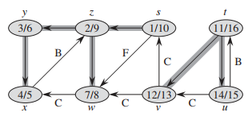
DFS: Kinds of edges
When we first explore (u, v), u is gray. The color of v determines the edged type.
encounters a white vertex
from descendent to ancestor; Encounters a gray vertex
but Not a tree edge; encounters a black vertex
encounters a black vertex

Slide 32
In a DFS of an undirected graph G, every edge of G is either a tree edge or a back edge.
Let (u, v) be an arbitrary edge of G, and suppose without loss of generality that u.d < v.d.
Then the search must discover and finish v before it finishes u (while u is gray), since v is on u’s adjacency list.
Case A: The search explores edge (u, v) first in the direction from u to v:
then v is undiscovered (white) until that time, for otherwise the search would have explored this edge already in the direction from v to u. Thus, (u, v) becomes a tree edge.
Case B: The search explores (u, v) first in the direction from v to u:
then (u, v) is a back edge since u is still gray at the time the edge is first explored.

