Slide 1
Heaps

Slide 2
A Conceptual View

Slide 3
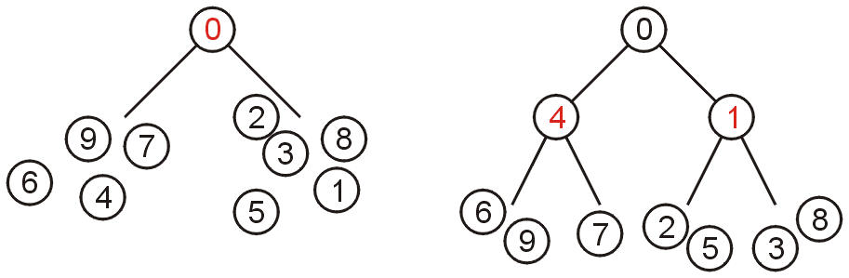
Definition
A non-empty binary tree is a min-heap if
The key associated with the root is less than or equal to the keys associated with either of the sub-trees (if any)
Both of the sub-trees (if any) are also binary min-heaps
From this definition:
A single node is a min-heap
All keys in either sub-tree are greater than the root key

Slide 4
Definition
Important:
THERE IS NO OTHER RELATIONSHIP BETWEEN
THE ELEMENTS IN THE TWO SUBTREES
[unlike the BST]
Failing to understand this is the greatest mistake a student makes

Slide 5
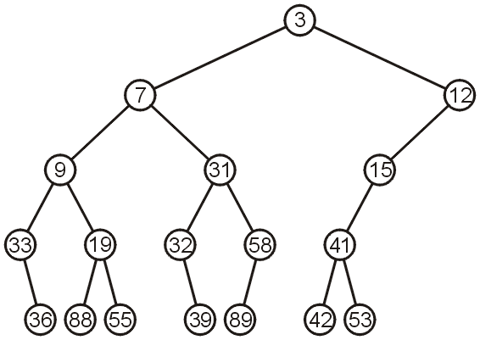
Example
This is a binary min-heap:
Note: Later, we will implement heap only with complete binary tree…

Slide 6
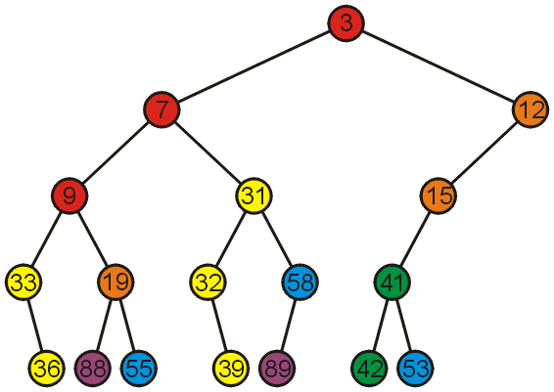
Example
Adding colour, we observe
The left subtree has the smallest (7) and the largest (89) objects
No relationship between items with similar priority
(just assume for now that the keys are priority values)

Slide 7
Operations
We will consider three operations:
Top [actually, getMinimum in this case]
Pop [remove]
Push [insert]
Notes:
7

Slide 8
Example
We can find the top object in Θ(1) time: 3

Slide 9
Pop
To remove the minimum object:
Promote the node of the sub-tree which has the least value
Recurs down the sub-tree from which we promoted the least value

Slide 10
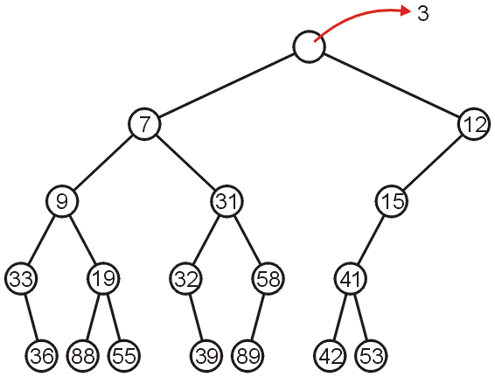
Pop
Using our example, we remove 3:

Slide 11
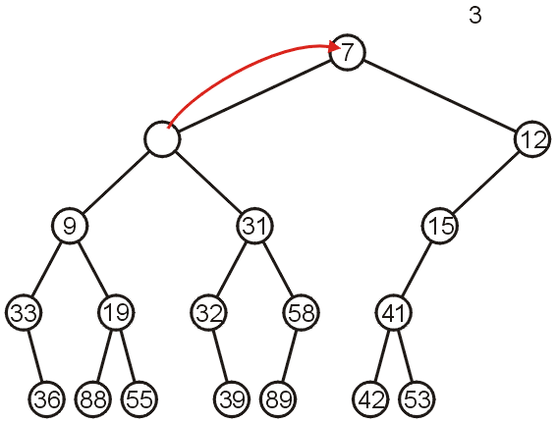
Pop
We promote 7 (the minimum of 7 and 12) to the root:

Slide 12
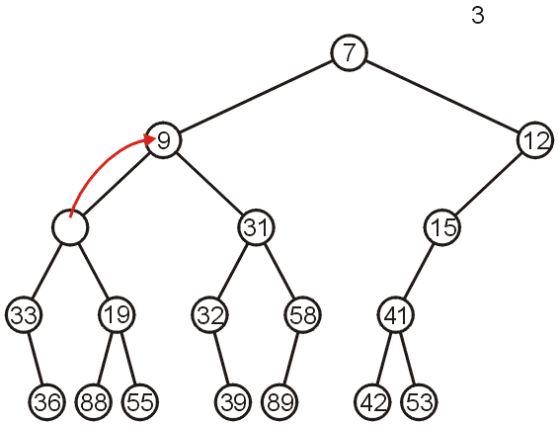
Pop
In the left sub-tree, we promote 9:

Slide 13
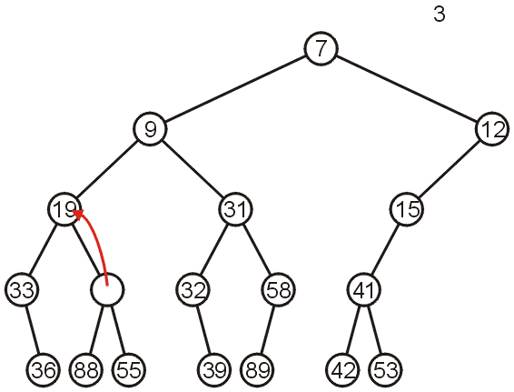
Pop
Recursively, we promote 19:

Slide 14
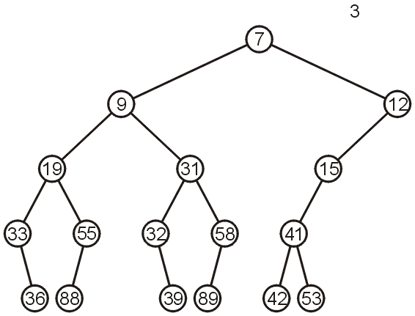
Pop
Finally, 55 is a leaf node, so we promote it and delete the leaf

Slide 15
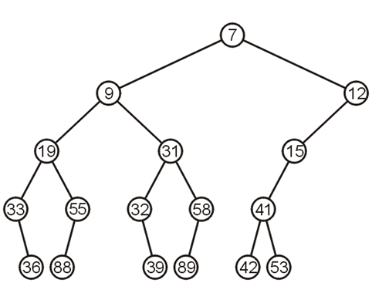
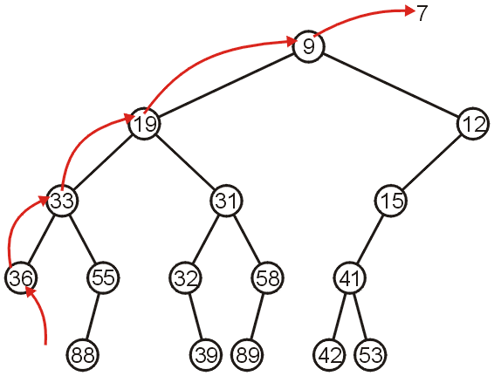
Pop
Repeating this operation again, we can remove 7:

Slide 16
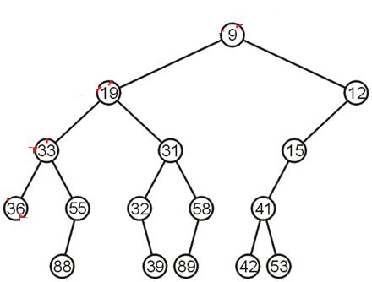
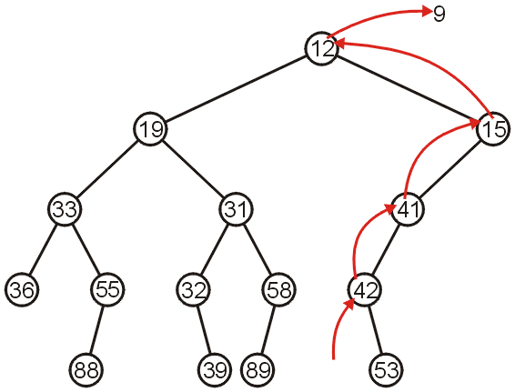
Pop
If we remove 9, we must now promote from the right sub-tree:

Slide 17
Push
Inserting into a heap may be done either:
At a leaf (move it up if it is smaller than the parent)
At the root (insert the larger object into one of the subtrees)
We will use the first approach with binary heaps
Other heaps use the second

Slide 18
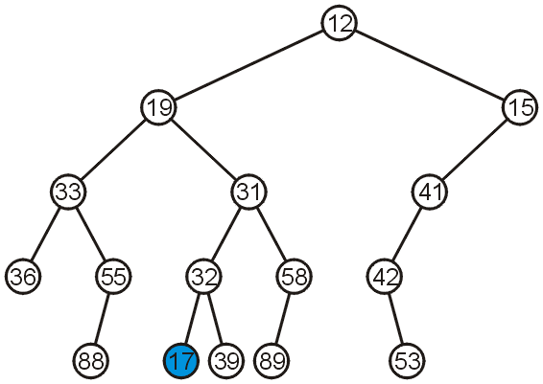
Push
Inserting 17 into the last heap
Select an arbitrary node to insert a new leaf node:

Slide 19
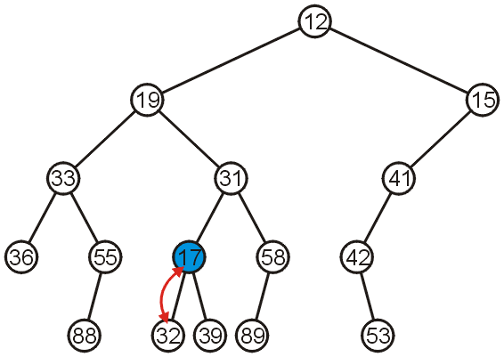
Push
The node 17 is less than the node 32, so we swap them

Slide 20
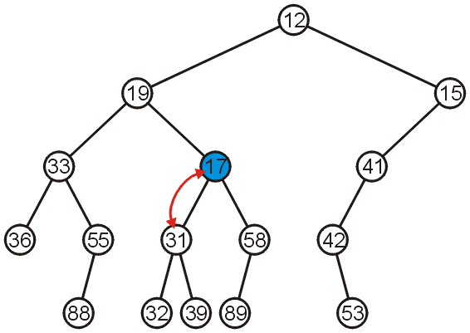
Push
The node 17 is less than the node 31; swap them

Slide 21
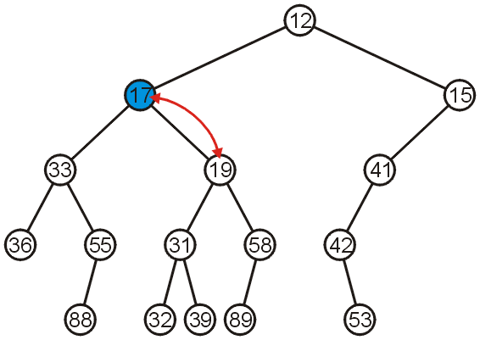
Push
The node 17 is less than the node 19; swap them

Slide 22
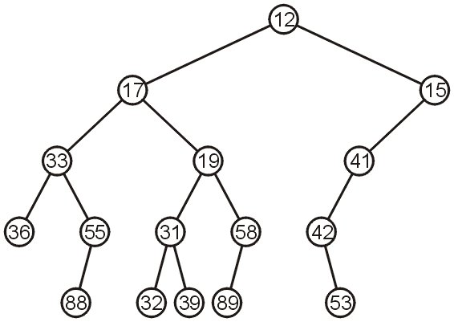
Push
The node 17 is greater than 12 so we are finished

Slide 23
Push
Observation: both the left and right subtrees of 19 were greater than 19, thus we are guaranteed that we don’t have to send the new node down
This process is called percolation, that is, the lighter (smaller) objects move up from the bottom of the min-heap

Slide 24
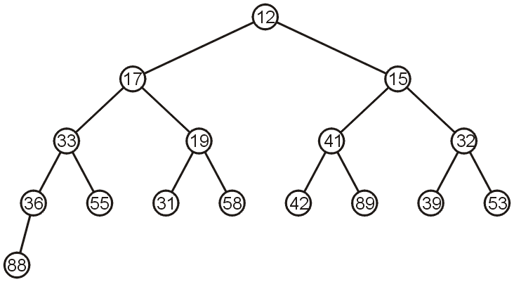
Implementing Heap as a Complete Binary Tree
For example, the previous heap may be represented as the following (non-unique!) complete binary tree:

Slide 25
Complete Binary Trees: Push
If we insert into a complete Binary tree, we need only place the new node as a leaf node in the appropriate location and percolate up

Slide 26
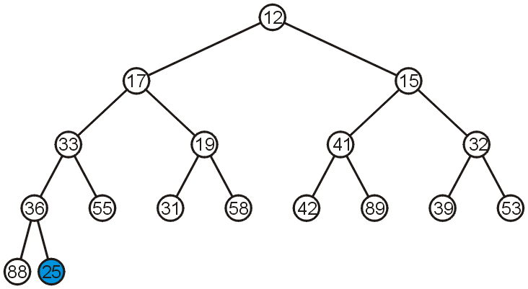
Complete Binary Trees: Push
For example, push 25:

Slide 27
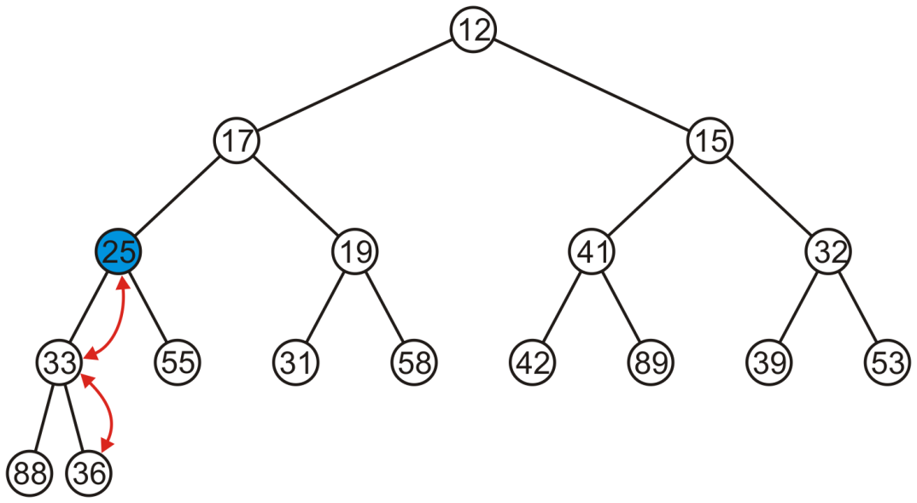
Complete Trees: Push
We have to percolate 25 up into its appropriate location
The resulting heap is still a complete tree

Slide 28
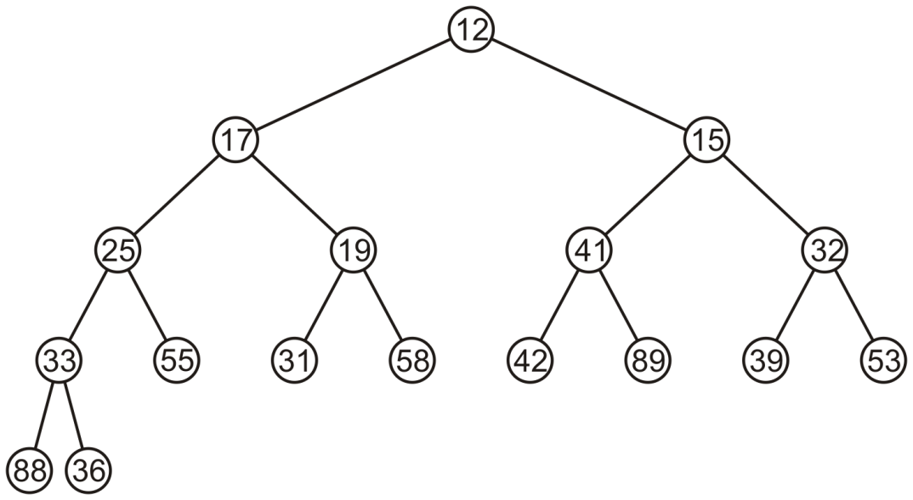
Complete Trees: Pop
Suppose we want to pop the top entry: 12

Slide 29

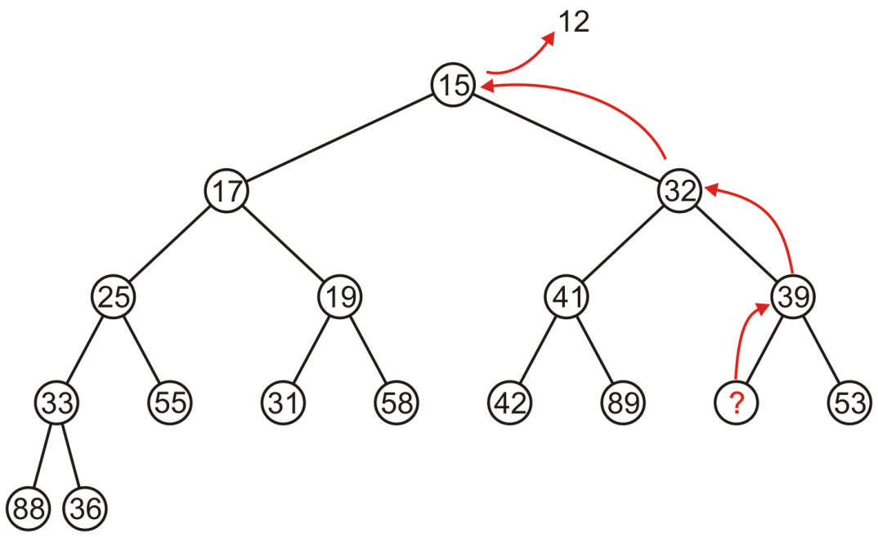
Complete Trees: Pop
Percolating up creates a hole leading to a non-complete tree

Slide 30
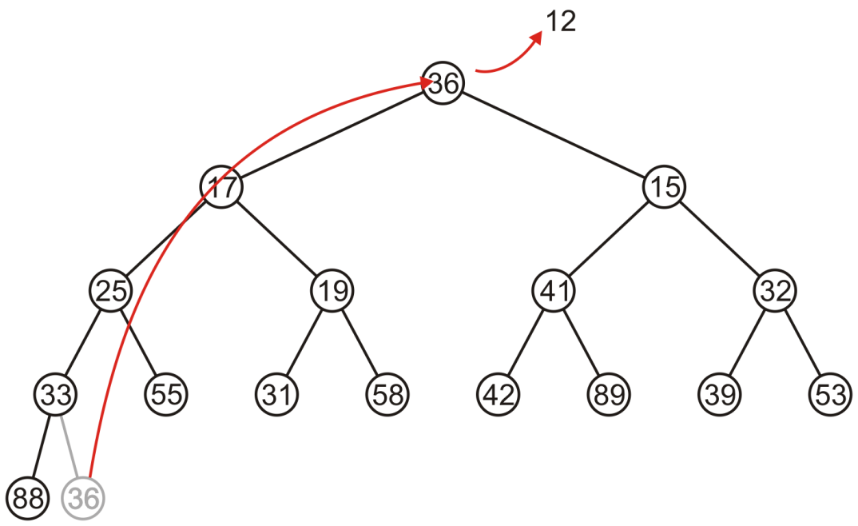
Complete Trees: Pop
Alternatively, copy the last entry in the heap to the root

Slide 31
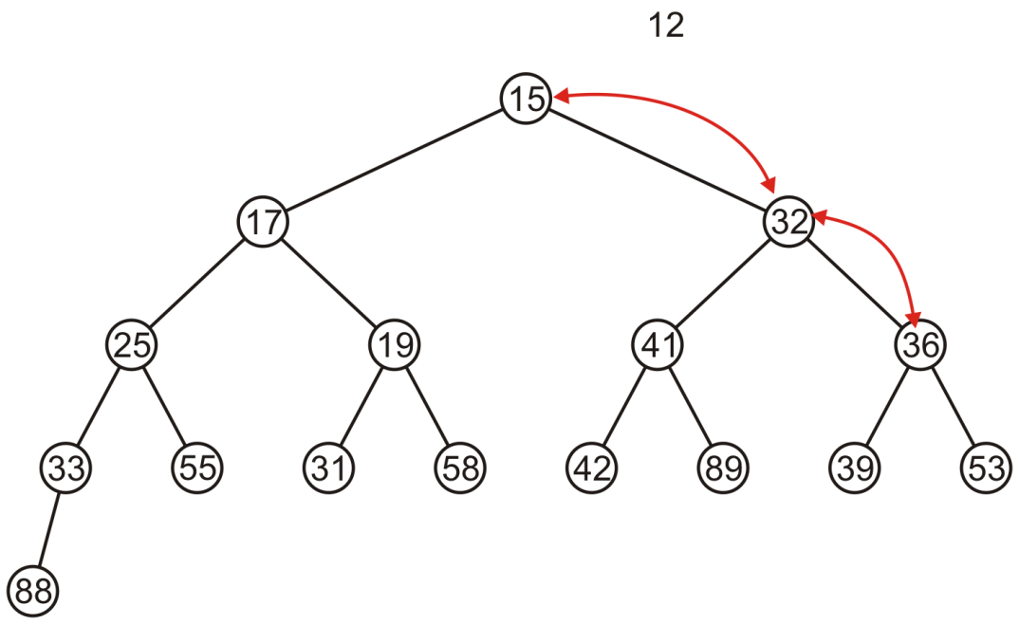
Complete Trees: Pop
Now, percolate 36 down swapping it with the smallest of its children
We halt when both children are larger

Slide 32
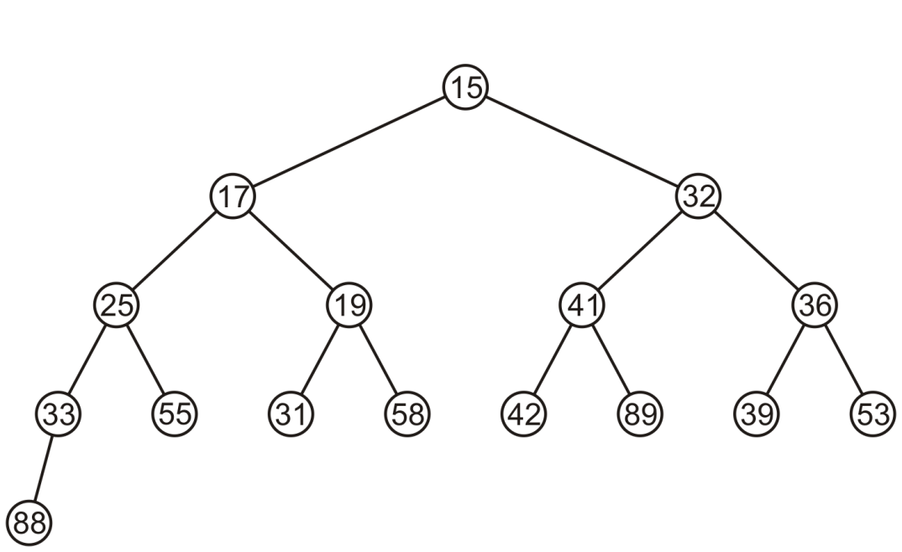
Complete Trees: Pop
The resulting tree is now still a complete tree:

Slide 33
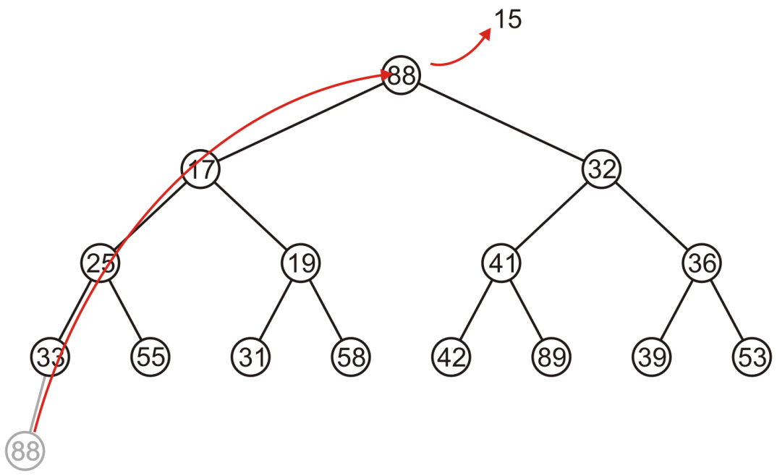
Complete Trees: Pop
Again, popping 15, copy up the last entry: 88

Slide 34
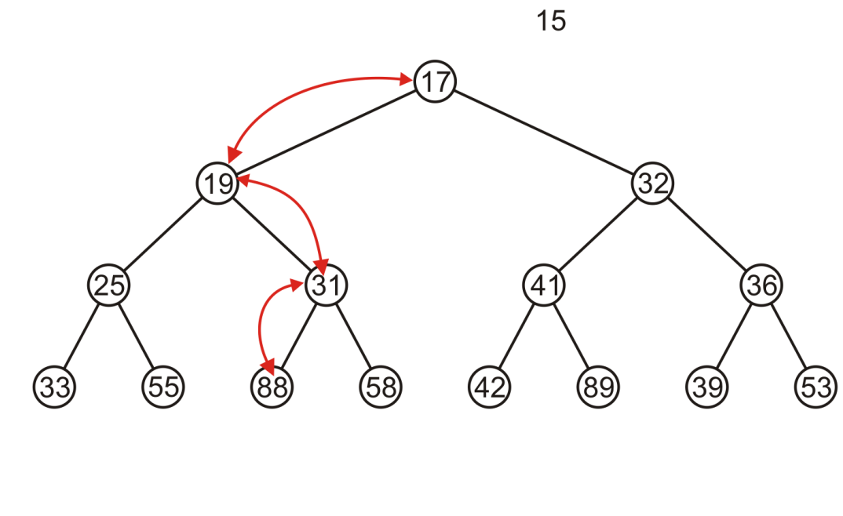
Complete Trees: Pop
This time, it gets percolated down to the point where it has no children

Slide 35
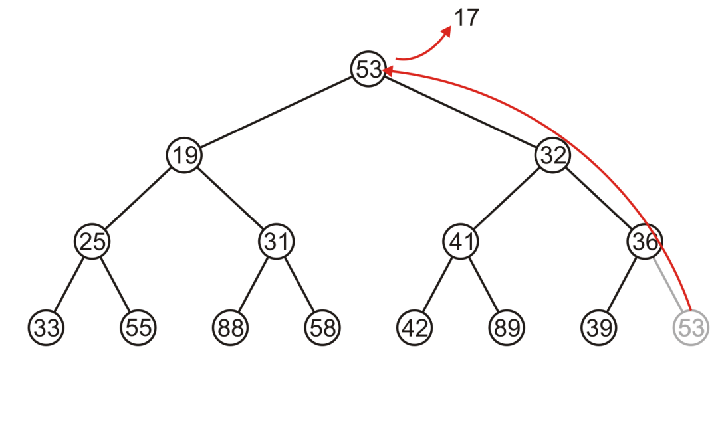
Complete Trees: Pop
In popping 17, 53 is moved to the top

Slide 36
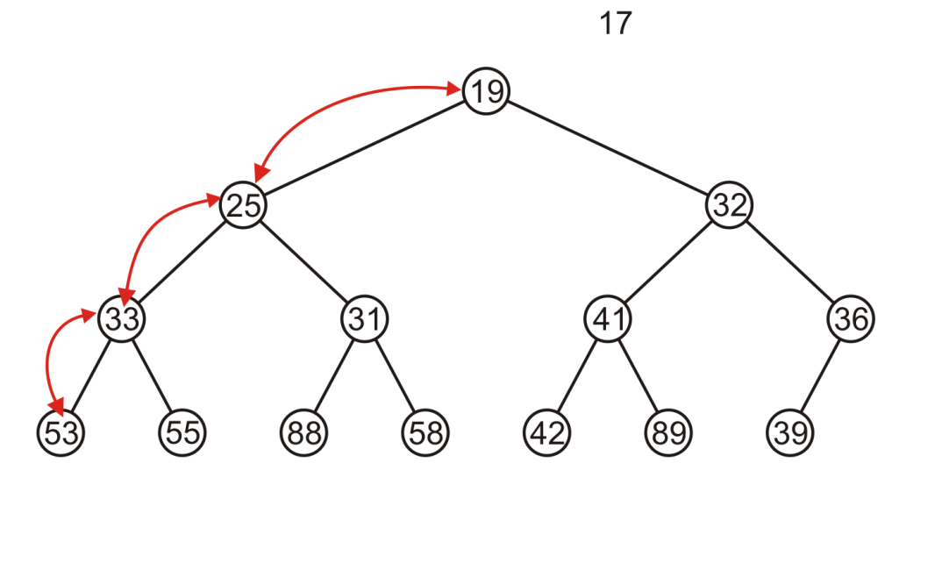
Complete Trees: Pop
And percolated down, again to the deepest level

Slide 37
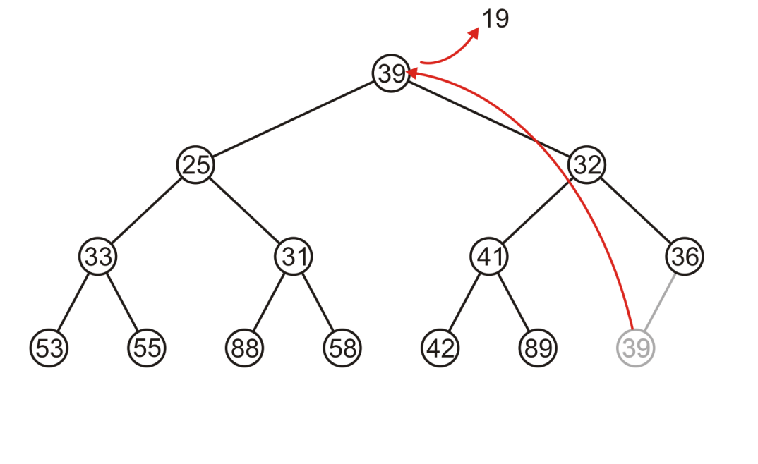
Complete Trees: Pop
Popping 19 copies up 39

Slide 38
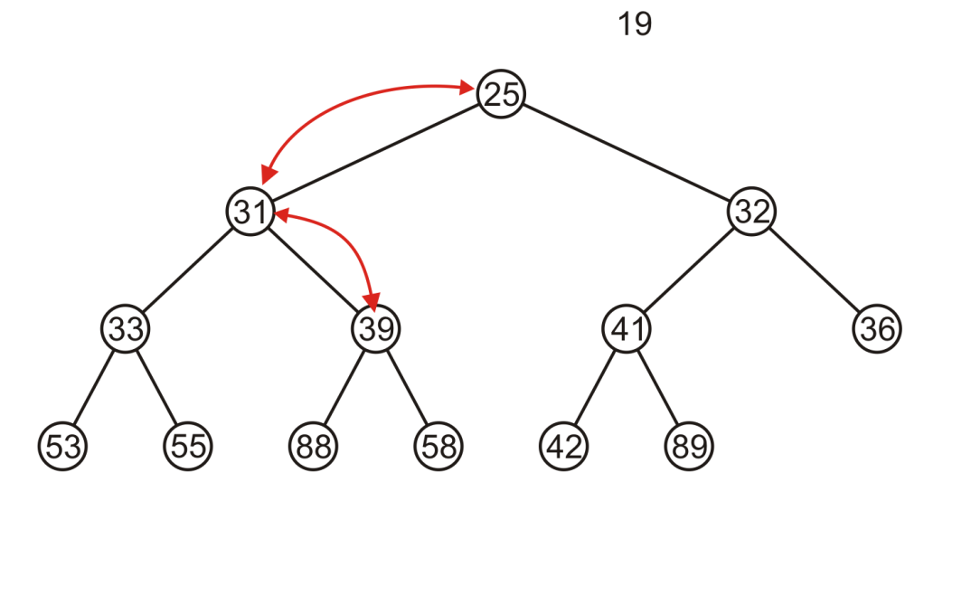
Complete Trees: Pop
Which is then percolated down to the second deepest level

Slide 39

Array Implementation
For the heap
a level order traversal yields:

Slide 40
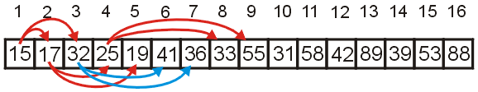
Array Implementation
.
Recall that If we associate an index–starting at 1–with each entry in the breadth-first traversal, we get:
Given the entry at index k, it follows that:
The parent of node is a k/2 parent = k >> 1;
the children are at 2k and 2k + 1 left_child = k << 1; right_child = left_child | 1;
Cost (trivial): start array at position 1 instead of position 0

Slide 41
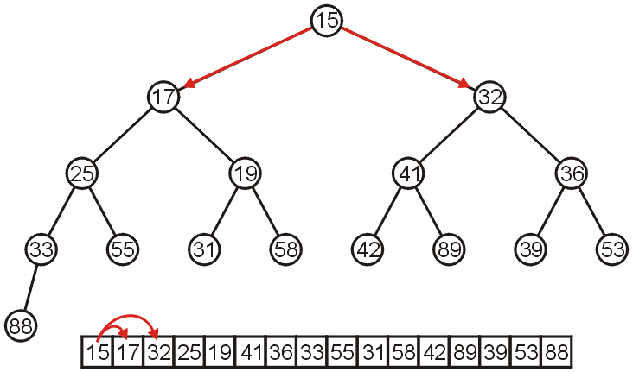
Array Implementation
.
The children of 15 are 17 and 32:

Slide 42
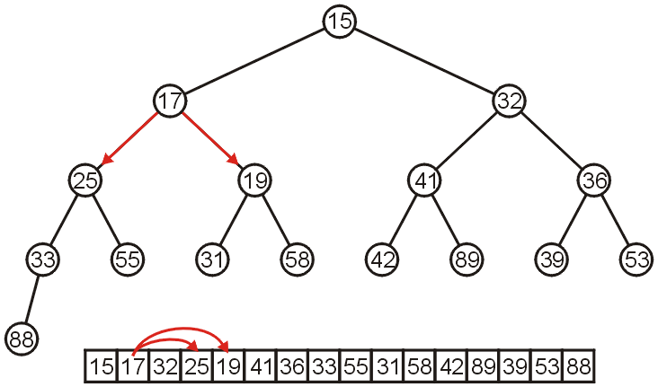
Array Implementation
.
The children of 17 are 25 and 19:

Slide 43
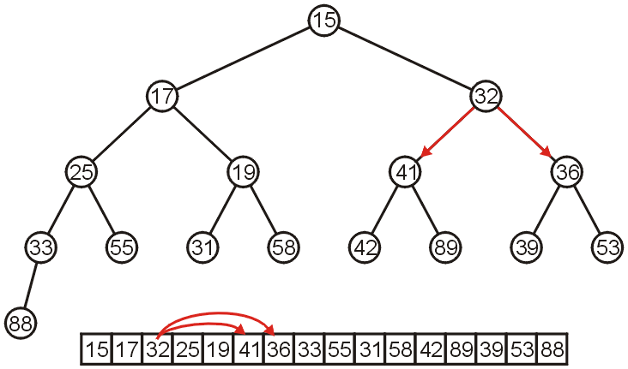
Array Implementation
.
The children of 32 are 41 and 36:

Slide 44
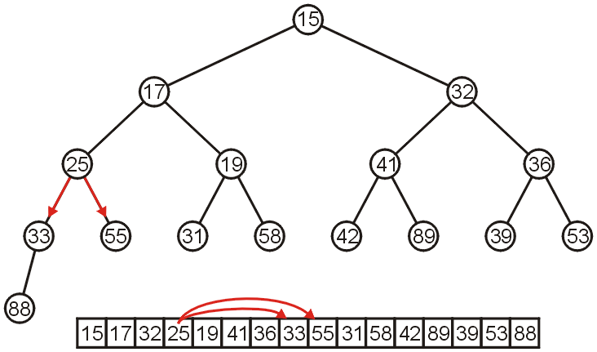
Array Implementation
The children of 25 are 33 and 55:

Slide 45
Array Implementation
.
If the heap-as-array has count entries, then the next empty node in the corresponding complete tree is at location posn = count + 1
We compare the item at location posn with the item at posn/2
If they are out of order
Swap them, set posn /= 2 and repeat

Slide 46
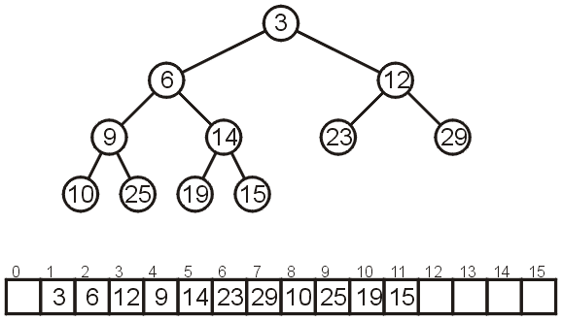
Array Implementation
.
Consider the following heap, both as a tree and in its array representation

Slide 47
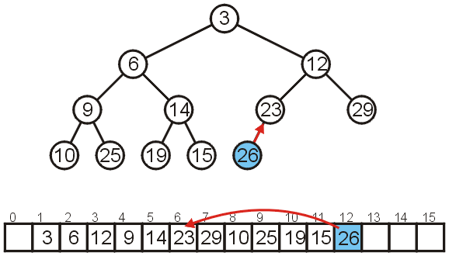
Array Implementation: Push
Inserting 26 requires no changes

Slide 48
Array Implementation: Push
Inserting 8 requires a few percolations:
Swap 8 and 23
8
8

Slide 49
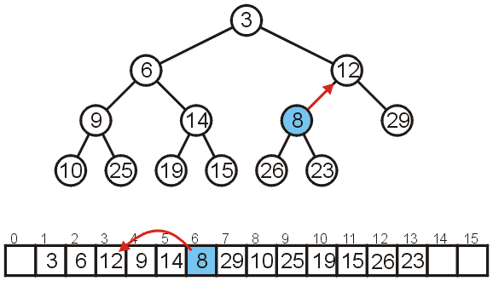
Array Implementation: Push
Swap 8 and 12

Slide 50
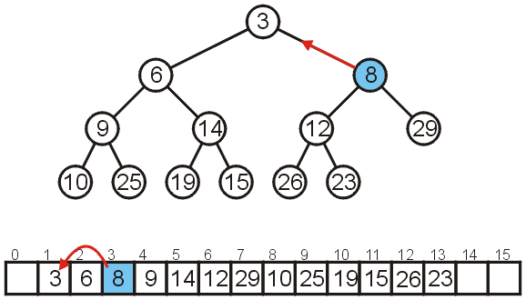
Array Implementation: Push
At this point, it is greater than its parent, so we are finished

Slide 51
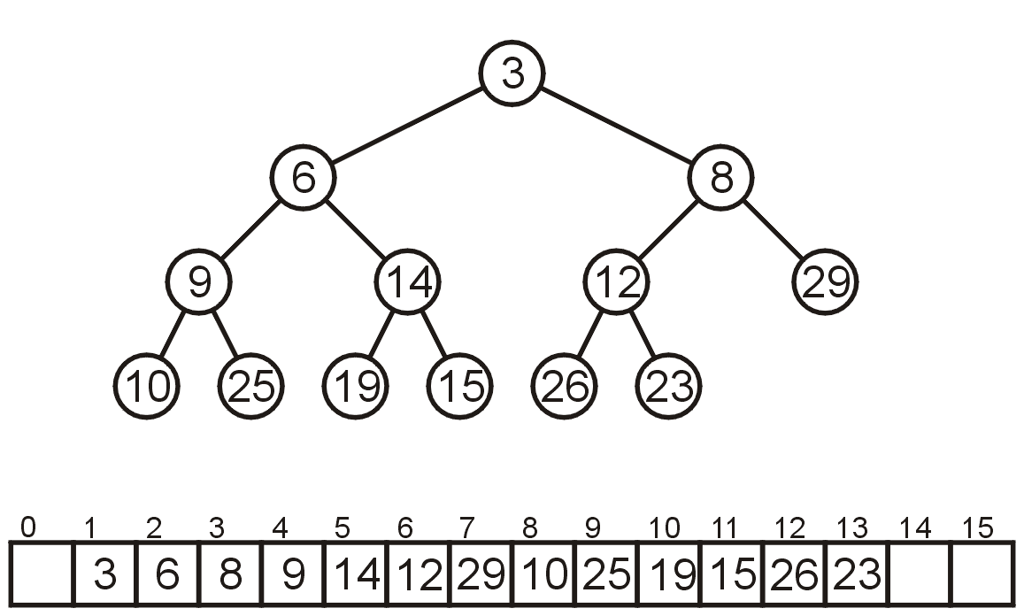
Array Implementation: Pop
As before, popping the top has us copy the last entry to the top

Slide 52
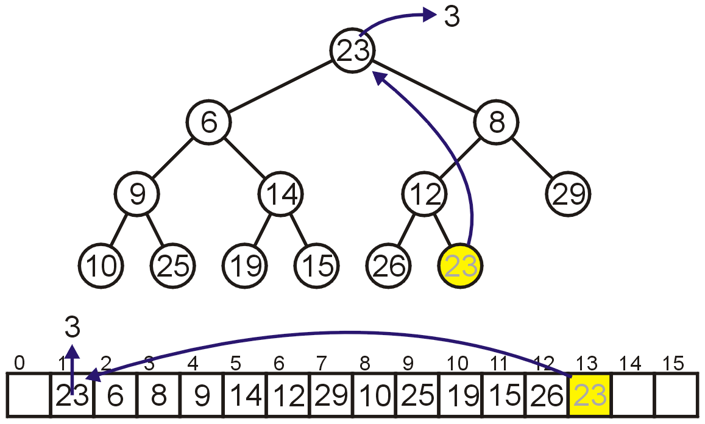
Array Implementation: Pop
Instead, consider this strategy:
Copy the last object, 23, to the root

Slide 53
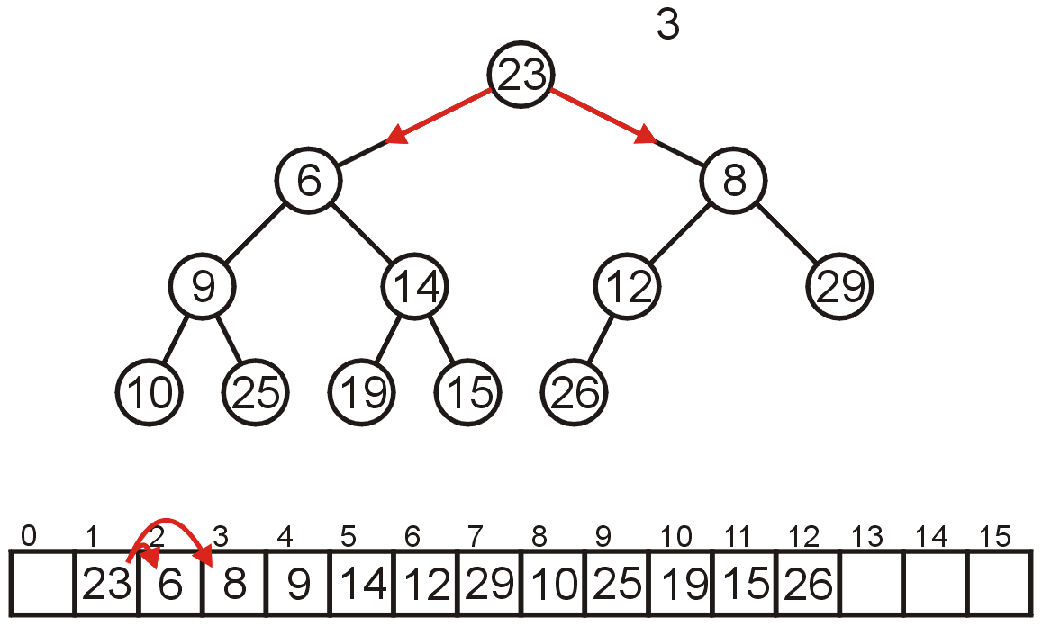
Array Implementation: Pop
Now percolate down
Compare Node 1 with its children: Nodes 2 and 3
Swap 23 and 6

Slide 54
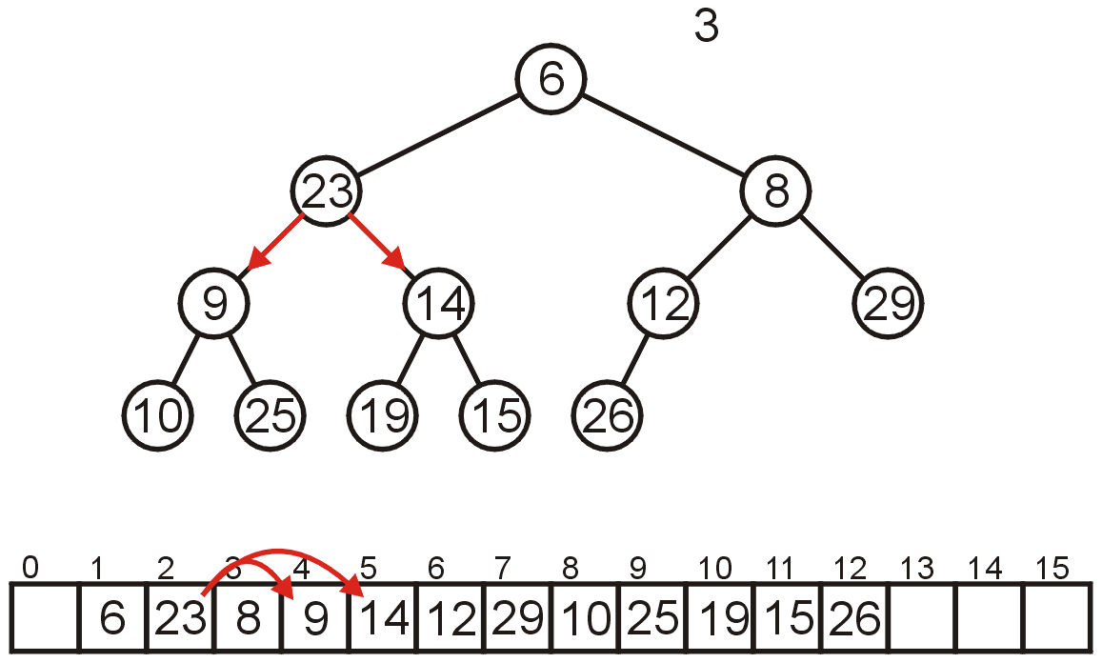
Array Implementation: Pop
Compare Node 2 with its children: Nodes 4 and 5
Swap 23 and 9

Slide 55
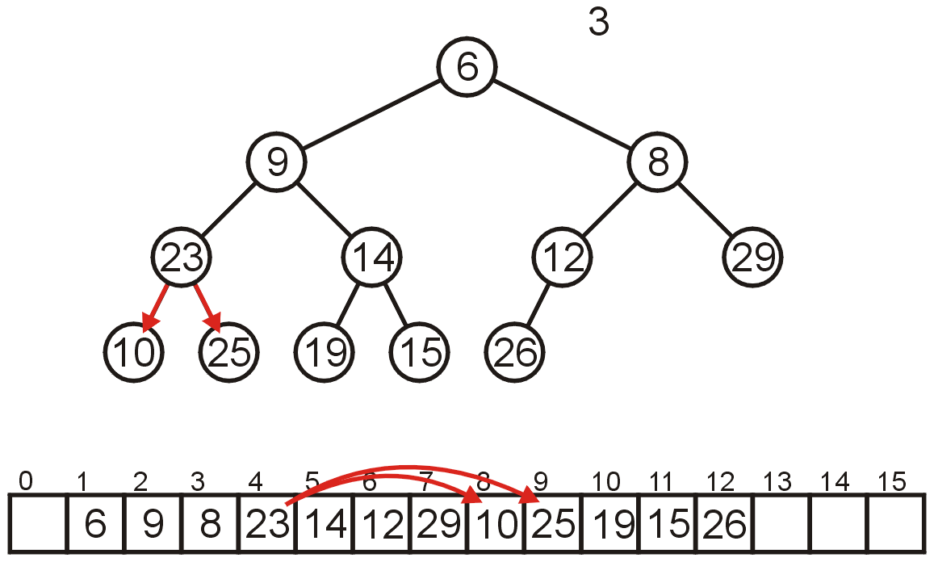
Array Implementation: Pop
Compare Node 4 with its children: Nodes 8 and 9
Swap 23 and 10

Slide 56
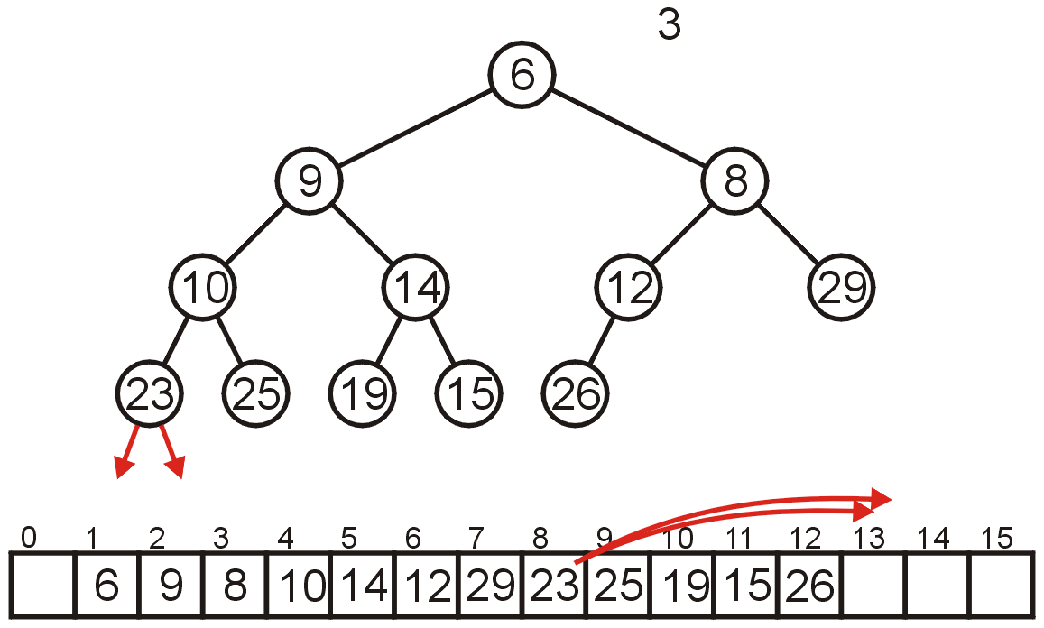
Array Implementation: Pop
The children of Node 8 are beyond the end of the array:
Stop

Slide 57
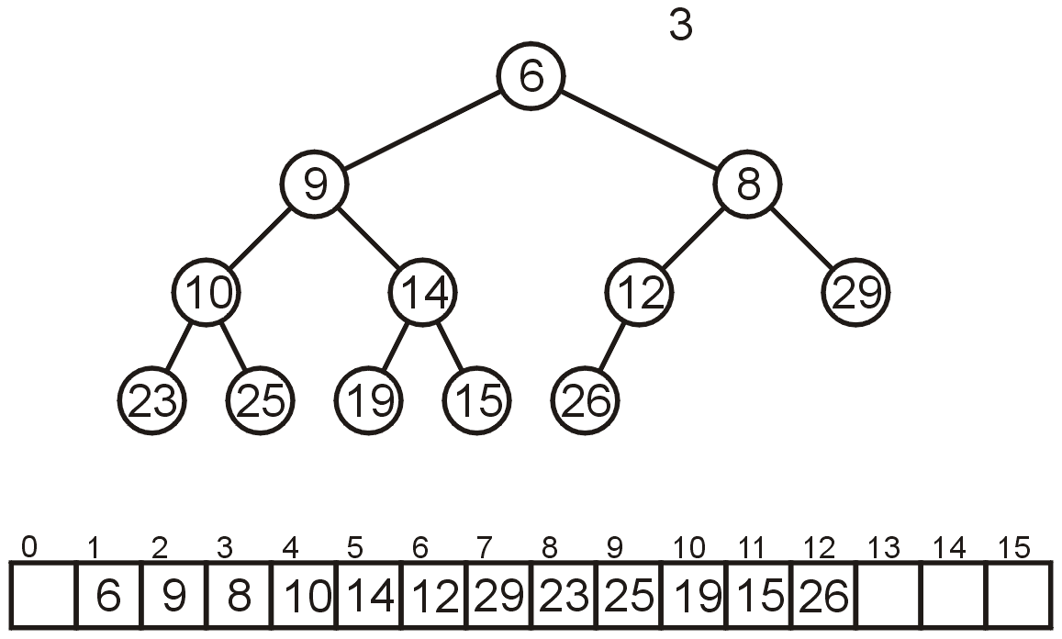
Array Implementation: Pop
The result is a binary min-heap

Slide 58
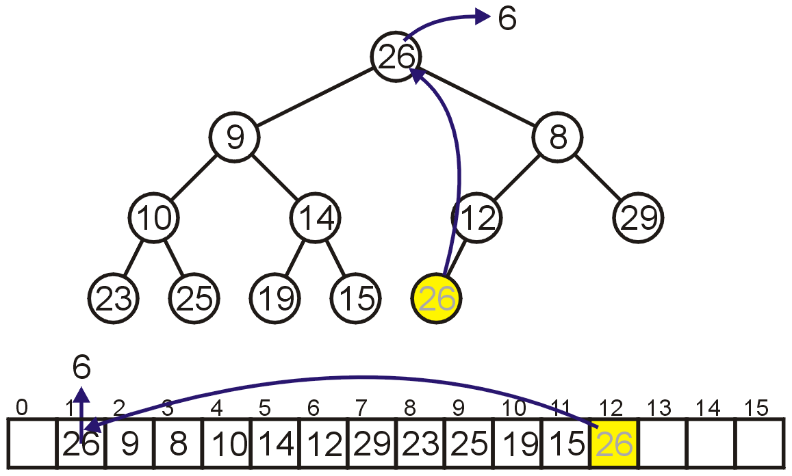
Array Implementation: Pop
Dequeuing the minimum again:
Copy 26 to the root

Slide 59
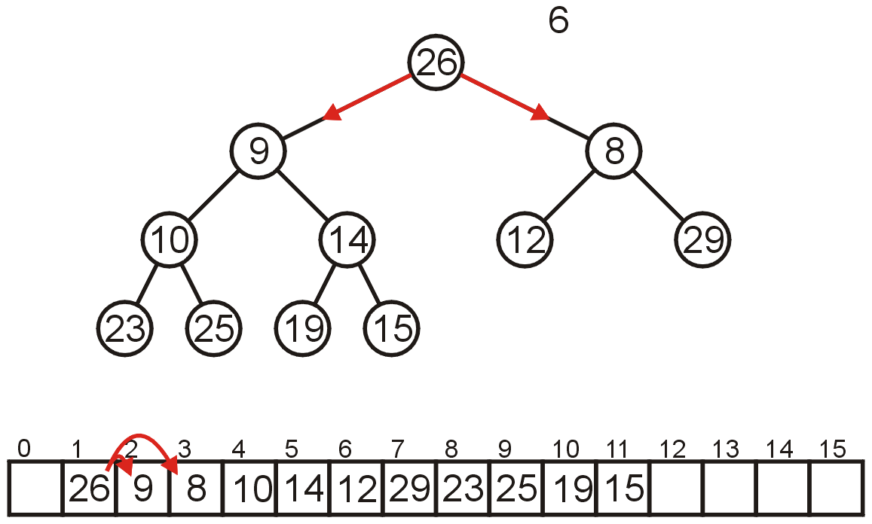
Array Implementation: Pop
Compare Node 1 with its children: Nodes 2 and 3
Swap 26 and 8

Slide 60
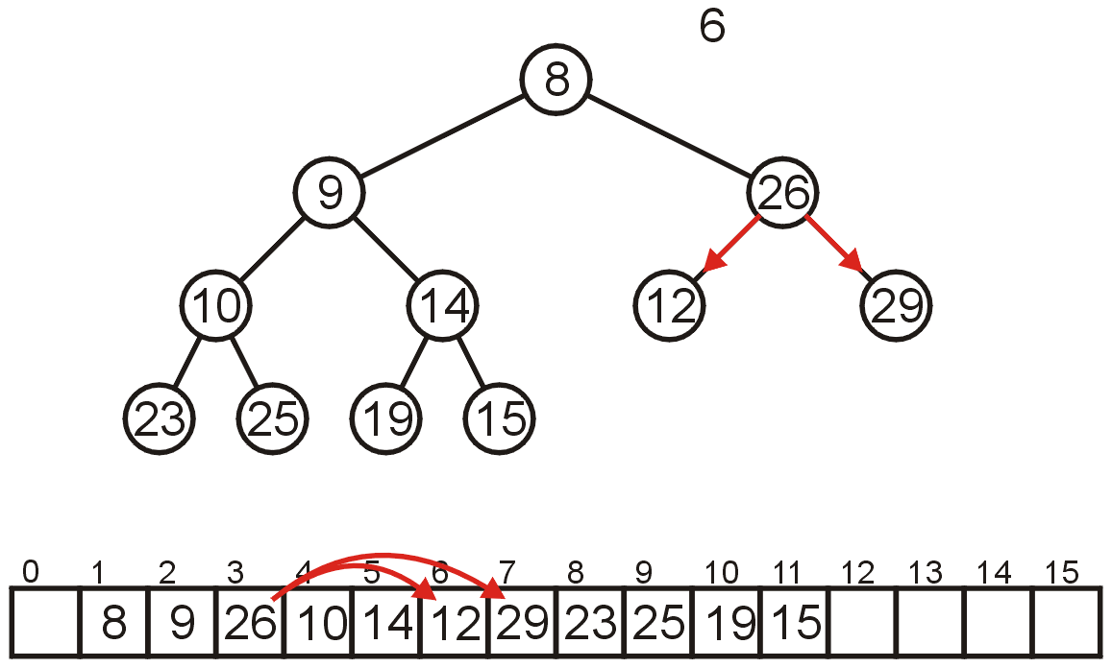
Array Implementation: Pop
Compare Node 3 with its children: Nodes 6 and 7
Swap 26 and 12

Slide 61

Array Implementation: Pop
The children of Node 6, Nodes 12 and 13 are unoccupied
Currently, count == 11

Slide 62

Array Implementation: Pop
The result is a min-heap

Slide 63

Array Implementation: Pop
Dequeuing the minimum a third time:
Copy 15 to the root

Slide 64

Array Implementation: Pop
Compare Node 1 with its children: Nodes 2 and 3
Swap 15 and 9

Slide 65

Array Implementation: Pop
Compare Node 2 with its children: Nodes 4 and 5
Swap 15 and 10

Slide 66

Array Implementation: Pop
Compare Node 4 with its children: Nodes 8 and 9
15 < 23 and 15 < 25 so stop

Slide 67

Array Implementation: Pop
The result is a properly formed binary min-heap

Slide 68

Array Implementation: Pop
After all our modifications, the final heap is

