Slide 1
Heaps

Slide 2
Algorithms and Analysis

Slide 3
Height of a Heap
Theorem: A heap storing n keys has height O(log n)
Proof: (we apply the complete binary tree property)
Let h be the height of a heap storing n keys
depth
keys
0
1
1
2
h−1
2^{h−1}
Max: 2^h
Min: 1
h
1

Slide 4
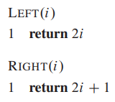
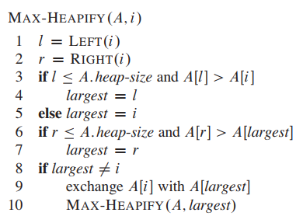
(MAX/MIN)-HEAPIFY
Its inputs are an array A and an index i into the array.
When it is called, MAX-HEAPIFY assumes
the binary trees rooted at LEFT(i) and RIGHT(i) are maxheaps,
but that A[i] might be smaller than its children
thus violating the max-heap property.
MAX-HEAPIFY lets the value at A[i] “float down” in the max-heap so that the subtree rooted at index i obeys the max-heap property.

Slide 5
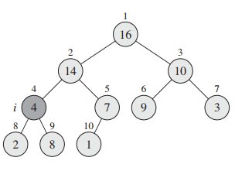
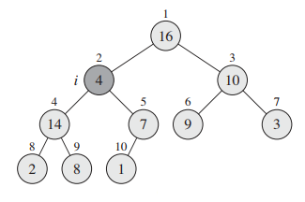
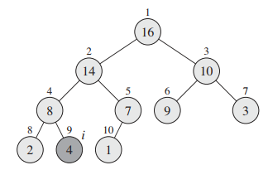
MAX-HEAPIFY(A,2)

Slide 6

(MAX/MIN)-HEAPIFY: Running time
Θ(1)
What is the worst case scenario?
If MAX-HEAPIFY is called on an array/tree of n nodes how many nodes are there in the sub- tree/array on which the recursive call is made?

Slide 7
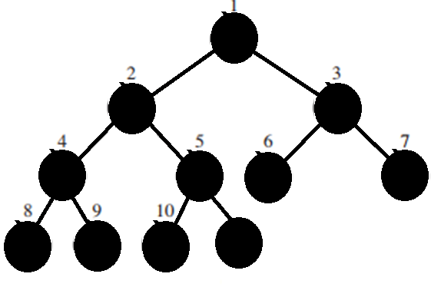
The children’s subtrees each have size at most 2n/3
A + B = n
B ≈ 2A
A ≈ n/3
B ≈ 2n/3
The worst case occurs when the bottom level of the tree is exactly half full
A
B

Slide 8
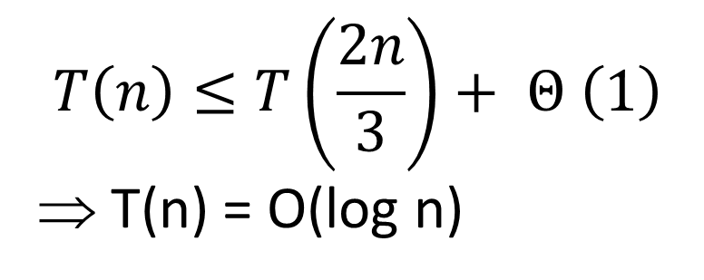
(MAX/MIN)-HEAPIFY: Running time
Θ(1)
$$T\left(n\right)≤T\left(\frac{2n}{3}\right)+ Θ \left(1\right)$$
⇒ T(n) = O(log n)
Master Theorem

Slide 9
BUILD-(MAX/MIN)-HEAP
We can use the procedure MAX-HEAPIFY in a bottom-up manner to convert an array into a max-heap.
The elements in the subarray A[⎣n/2⎦ + 1..n] are all leaves.
Each is a 1-element heap.
BUILD-MAX-HEAP goes through the remaining nodes and call MAX-HEAPIFY on each one.
BUILD-MAX-HEAP(A) 1 A.heap-size = A.length 2 for i = ⎣A.length/2⎦ downto 1 3 MAX-HEAPIFY(A, i)
n = 11
n/2 + 1 = 6
∴ 6 onward all are leaves

Slide 10
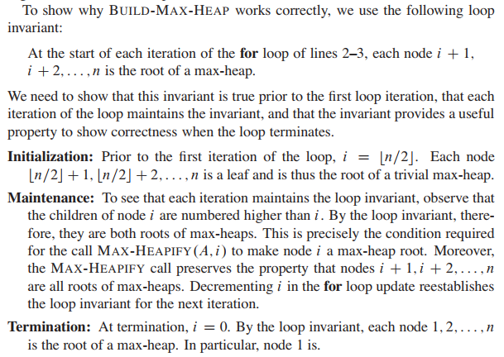
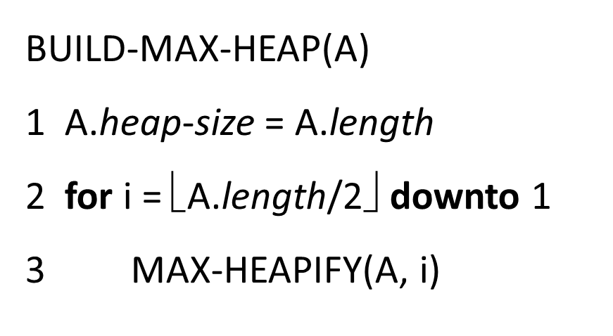
BUILD-(MAX/MIN)-HEAP: Correctness

Slide 11
BUILD-(MAX/MIN)-HEAP: Running Time (Simple)
O(1)
O(n)
O(n log n)
O(log n)

Slide 12
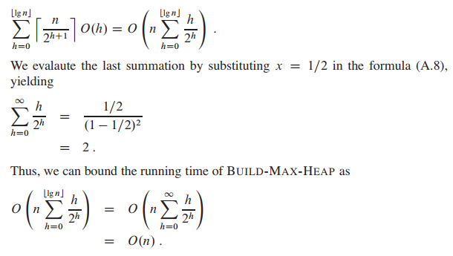
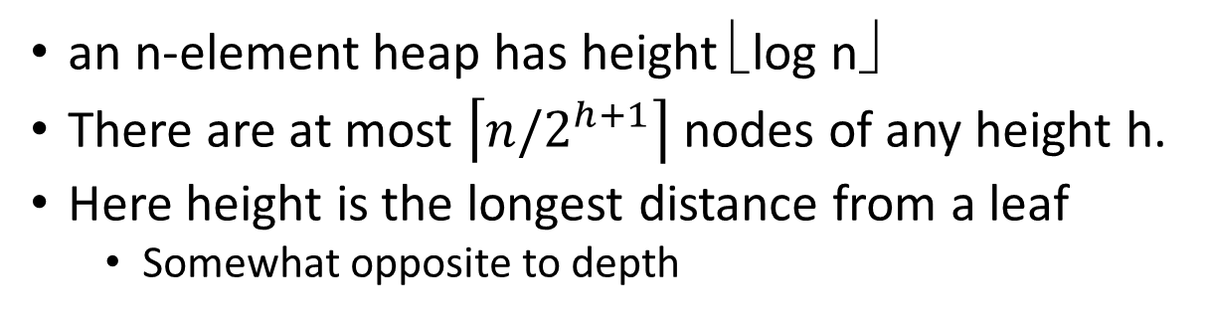
BUILD-(MAX/MIN)-HEAP: Running Time (Tighter)
an n-element heap has height ⎣log n⎦
There are at most $\left\lceil n/2^{h+1}\right\rceil$ nodes of any height h.
Here height is the longest distance from a leaf
Somewhat opposite to depth
h=3
h=1
h=2
h=1
h=0
h=0

Slide 13
Heapsort

Slide 14
Heapsort
Given BuildHeap(), a sorting algorithm can easily be constructed:
Maximum element is at A[1]
Discard by swapping with element at A[n]
Decrement heap_size[A]
A[n] now contains correct value
Restore heap property at A[1] by calling Heapify()
Repeat, always swapping A[1] for A[heap_size(A)]

Slide 15
Heapsort
Heapsort(A) {
BuildHeap(A);
for (i = length(A) downto 2) {
Swap(A[1], A[i]);
heap_size(A) = heap_size(A) − 1;
Heapify(A, 1);
}
}

Slide 16
Heapsort Example

Slide 17
Analyzing Heapsort
Heapsort(A) {
1. BuildHeap(A);
2. for (i = length(A) downto 2) {
3. Swap(A[1], A[i]);
4. heap_size(A) = heap_size(A) − 1;
5. Heapify(A, 1);
}
}
Line #2 loops for n – 1 time
So, Heapify() at Line #5 is called (from this procedure) n – 1 times.
The call to BuildHeap() takes O(n) time (Line #1)
Each of the n - 1 calls to Heapify() takes O(lg n) time
Thus the total time taken by HeapSort() = O(n) + (n - 1) O(lg n) = O(n) + O(n lg n) = O(n lg n)
Heapsort is a nice algorithm, but in practice Quicksort (coming up) usually wins

