Slide 1
CSE 203: Data Structures
Elementary Data Structures- List
Part - II

Slide 2
Freelists
System operators new and delete are slow.
So, we add freelist support to the Link class.
A freelist holds those list nodes that are not currently being used.
When a node is deleted from a linked list, it is placed at the head of the freelist.
When a new element is to be added to a linked list, the freelist is checked to see if a list node is available. If so, the node is taken from the freelist.
If the freelist is empty, the standard new operator must then be called.

Slide 3
Implementing freelist: Approach 1
create two new operators to use instead of the standard routines new and delete.
This requires that the user’s code, such as the LList class implementation be modified to call these freelist operators.
Not a good design

Slide 4
Implementing freelist: Approach 2
use C++ operator overloading to replace the meaning of new and delete when operating on Link class objects.
In this way, programs that use the LList class need not be modified at all to take advantage of a freelist.
Whether the Link class is implemented with freelists, or relies on the regular free-store mechanism, is entirely hidden from the LList class user.

Slide 5
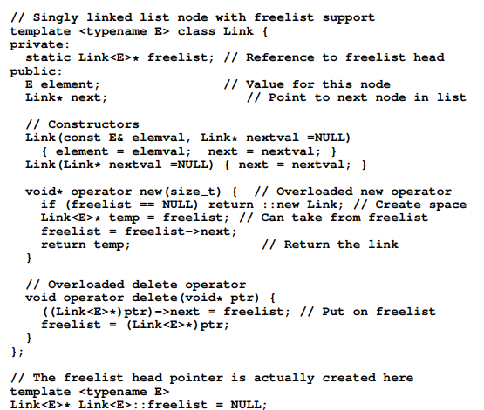

Slide 6
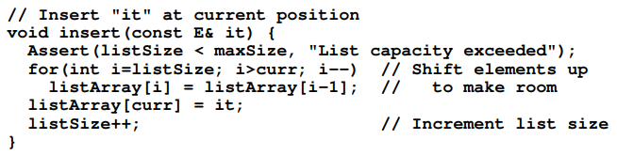
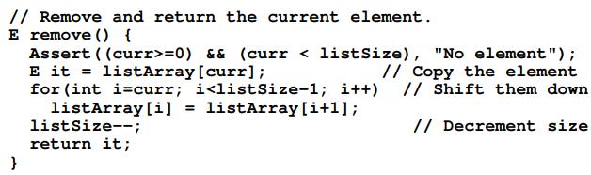
Comparison of Implementations
Array-Based Lists:
Insertion and deletion are Θ(n).
Notes:
Applies to both average and worst cases.

Slide 7
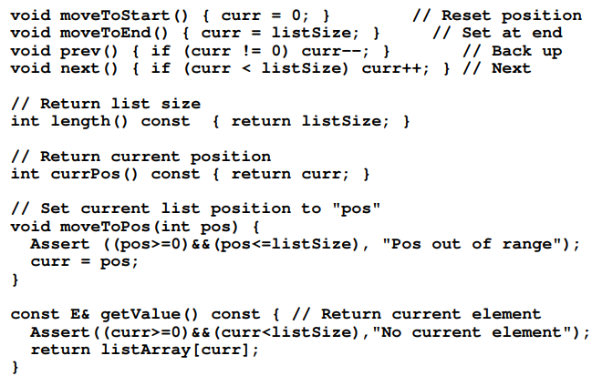
Comparison of Implementations
Array-Based Lists:
Insertion and deletion are Θ(n).
Prev and accessing a specific position are Θ(1).
accessing a specific position:
moveToPos()
getValue()
Notes:
Applies to both average and worst cases.

Slide 8
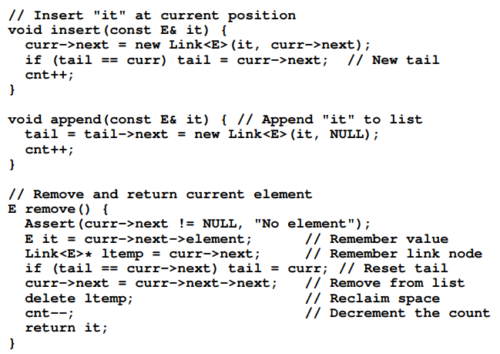
Comparison of Implementations
Linked Lists:
Insertion and deletion are Θ(1)
Notes:
Applies to both average and worst cases.

Slide 9
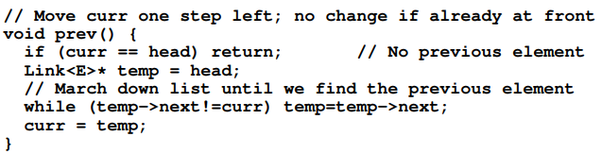
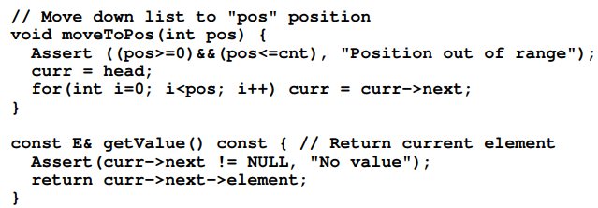
Comparison of Implementations
Linked Lists:
Insertion and deletion are Θ(1).
Prev and accessing a specific position are Θ(n).
accessing a specific position:
moveToPos()
getValue()
Notes:
Applies to both average and worst cases.

Slide 10
Comparison of Implementations
Array-Based Lists:
Insertion and deletion are Θ(n).
Prev and direct access are Θ(1).
Array must be allocated in advance.
No overhead if all array positions are full.
Linked Lists:
Insertion and deletion are Θ(1).
Prev and direct access are Θ(n).
Space grows with number of elements.
Every element requires overhead.
Notes:
Applies to both average and worst cases.

Slide 11
Space Comparison
When the array based implementation is better in space?
n(P + E) > DE => n > DE/(P+E)
If P=E, the point is at D/2.
That is, the array-based implementation would be more efficient (if the link field and the element field are the same size) whenever the array is more than half full.
n: The number of current elements
E: Space for data value.
P: Space for pointer.
D: Maximum number of elements for array.
Array Based space: DE
LL based space: (E+P)*n

Slide 12
Rule of Thumb
linked lists are more space efficient when implementing lists whose number of elements varies widely or is unknown.
Array-based lists are generally more space efficient when the user knows in advance approximately how large the list will become.

Slide 13
Doubly Linked List Concept

Slide 14


Doubly Linked List
In the single linked list, we can only traverse in one direction.
Sometimes, it is very desirable to traverse a linked list in either a forward or reverse manner.

Slide 15
Basic Operations of Doubly Linked Lists
Insert: Add a new node in the first, last or interior of the list.
Delete: Delete a node from the first, last or interior of the list.
Search: Search a node containing particular value in the linked list.

Slide 16
Insert First or Insert Last into a Doubly Linked List
To add a new node to the head and tail of a double linked list is similar to the linear linked list.
First, we need to construct a new node that is pointed by pointer newItem.
Then the newItem is linked to the left-most node (or right-most node) in the list. Finally, the Left (or Right) is set to point to the new node.

Slide 17
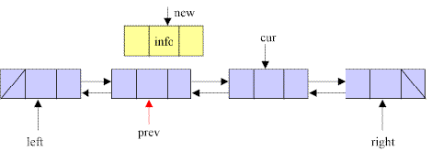
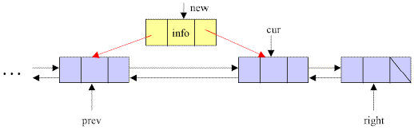
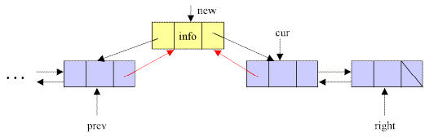
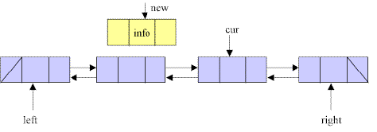
Insert Interior of Doubly Linked List
Step1. Create a new node that is pointed by new
Step2. Set the pointer prev to point to the left node of the node pointed by cur.
Step3. Set the left link of the new node to point to the node pointed by prev, and the right link of the new node to point to the node pointed by cur.
Step4. Set the right link of the node pointed by prev and the left link of the node pointed by cur to point to the new node.
Step1
Step2
Step3
Step4

Slide 18
Deletion of Doubly Linked List
To delete a node from a double linked list is easier than to delete a node from a linear linked list.
For deletion of a node in a single linked list, we have to search and find the predecessor of the discarded node. But in the double linked list, no such search is required.
Given the address of the node that is to be deleted, the predecessor and successor nodes are immediately known.

Slide 19
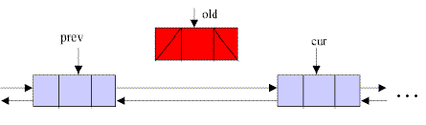
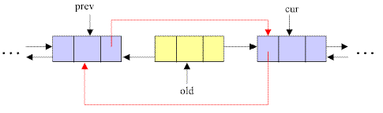
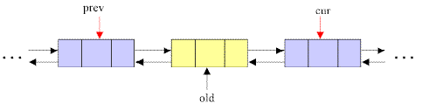
Deletion of Doubly Linked List
Step1. Set pointer prev to point to the left node of old and pointer cur to point to the node on the right of old.
Step2. Set the right link of prev to cur, and the left link of cur to prev.
Step3. Discard the node pointed by old.
step1
step2
step3

Slide 20

Doubly Linked Lists Implementations

Slide 21
Updated Link Class for Doubly Linked List

Slide 22
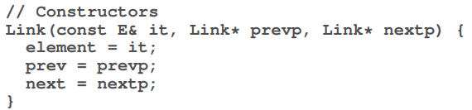
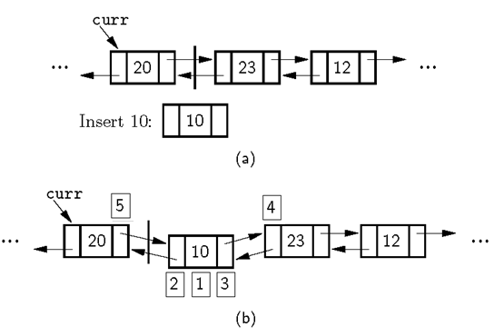
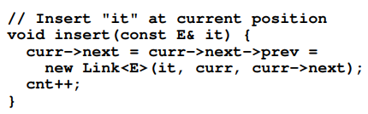
Doubly Linked Insert
1
2
3
4
5
Recall that in our implementation:
Curr points to the preceding element of the current element
To keep consistency, we insert after the node pointed by the pointer curr (unlike the conceptual discussion)
Notes:
The order, 1-5 in the book figure was wrong.

Slide 23
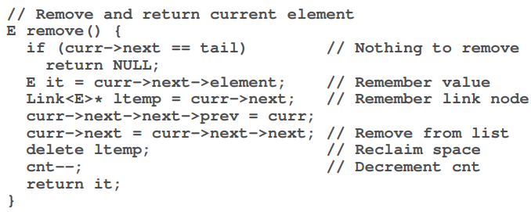
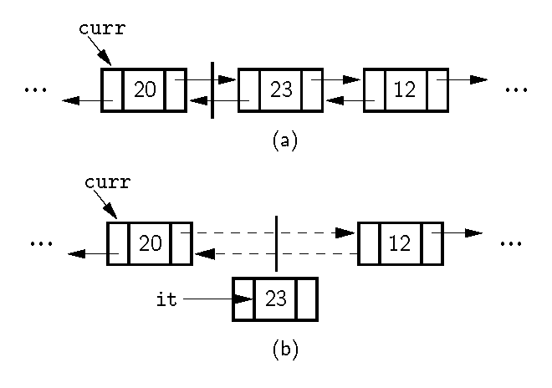
Doubly Linked Remove
Recall:
Curr points to the previous node

