Slide 1
CSE 203: Data Structures
Elementary Data Structures- List
Part - I

Slide 2
Lists
A list is a finite, ordered sequence of data items known as elements.
Important concept: List elements have a position.
Notation: <a₀, a₁, …, a_{n-1}>
What operations should we implement?
Empty list: no elements (<>)
Length of the list: number of elements
head: beginning of the list
tail: end of the list
Element position: k >=0 is the position of element a_k.
Notes:
Students should already be familiar with lists.
Chapter objective: Use algorithm analysis in a familiar context to compare implementations.

Slide 3
List Implementation Concepts
Our list implementation will support the concept of a current position.
Operations will act relative to the current position.
<20, 23 | 12, 15>
Potentially n+1 current positions
(as we may want to insert at the beginning and end)
Notes:
Here, 12 is the “current” node. We use a bar to its left to indicate this in the notation.

Slide 4

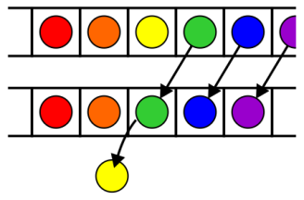
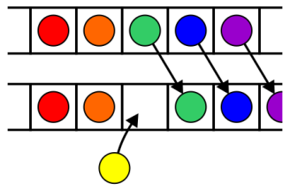
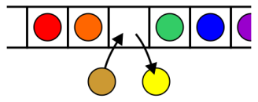
List ADT: Possible Operations
Operations at the k^{th} entry of the list include:
Access to the object Erasing an object
Insertion of a new object Replacement of the object

Slide 5
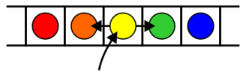
List ADT: Possible Operations
Given access to the k^{th} object, gain access to either the previous or next object
Given two abstract lists, we may want to
Concatenate the two lists
Determine if one is a sub-list of the other

Slide 6
List ADT
clear();
insert(item);
append(item);
remove();
moveToStart();
moveToEnd();
prev();
next();
length();
currPos();
moveToPos(int pos);
getValue();

Slide 7
List ADT

Slide 8
Template is a powerful and convenient C++ feature. Hopefully, you will learn it and then use it to implement list as it is shown here.

Slide 9
List ADT Examples
List: <12 | 32, 15>
L.insert(99);
Result: <12 | 99, 32, 15>
Iterate through the whole list:
for (L.moveToStart(); L.currPos()<L.length();
L.next()) {
it = L.getValue();
doSomething(it);
}

Slide 10
List Find Function
/** @return True if k is in list L,
false otherwise */
public static boolean
find(List<int> L, int k) {
for (L.moveToStart(); L.currPos()<L.length(); L.next())
if (k == L.getValue()) return true;
return false; // k not found
}

Slide 11
Array Based Implementation

Slide 12
Array Based Implementation
What will be running time of
Append?
Insert?

Slide 13
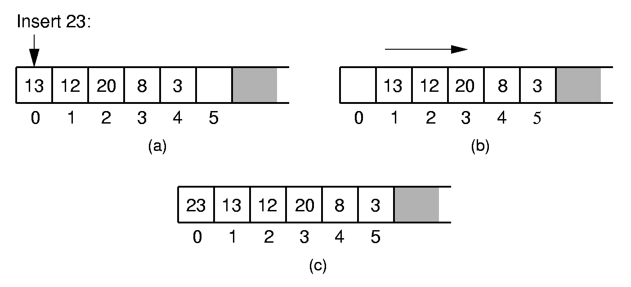
Array-Based List: Insert
Notes:
Push items up/down. Cost: Θ(n).

Slide 14
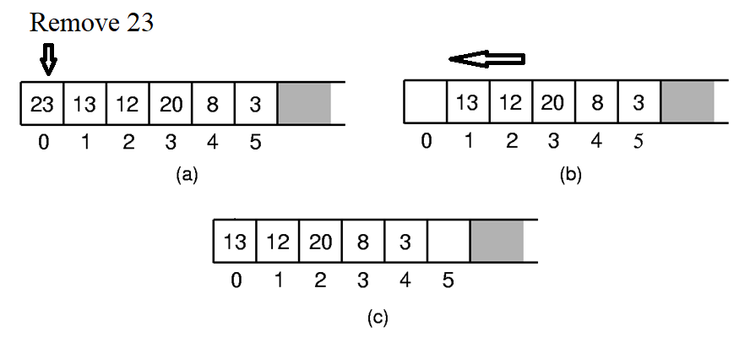
Array-Based List: Remove
Notes:
Push items up/down. Cost: Θ(n).

Slide 15
Array Based Implementation of List in C++

Slide 16
Insert
/** Insert "it" at current position */
public void insert(E it) {
assert listSize < maxSize :
"List capacity exceeded";
for (int i=listSize; i>curr; i--)
listArray[i] = listArray[i-1];
listArray[curr] = it;
listSize++;
}
Runtime?

Slide 17
Append
public void append(E it) { // Append "it"
assert listSize < maxSize :
"List capacity exceeded";
listArray[listSize++] = it;
}
Runtime?

Slide 18
Remove
/** Remove and return the current element */
public E remove() {
if ((curr < 0) || (curr >= listSize))
return null;
E it = listArray[curr];
for(int i=curr; i<listSize-1; i++)
listArray[i] = listArray[i+1];
listSize--;
return it;
}
Runtime?

Slide 19
Linked List Based Implementation

Slide 20
Linked List Concept…

Slide 21
Linked List
A linked list is a linear collection of data elements (called nodes), where the linear order is given by means of pointers.
Each node is divided into 2 parts:
1st part contains the information of the element.
2nd part is called the link field or next pointer field which contains the address of the next node in the list.
struct node {
int value;
struct node *next;
}
5
7
3
1

Slide 22
Basic Operations
Insert: Add a new node in the first, last or interior of the list.
Delete: Delete a node from the first, last or interior of the list.
Search: Search a node containing particular value in the linked list.

Slide 23
Insertion to a Linear Linked list
Add a new node at the first, last or interior of a linked list.

Slide 24
Insert First
Step 1. Create a new node that is pointed by pointer newItem.
Step 2. Link the new node to the first node of the linked list.
Step 3. Set the pointer head to the new node.
newItem
HEAD
…
newItem
HEAD
…
newItem
…
HEAD

Slide 25
Insert Last
To add a new node to the tail of the linear linked list, we need to construct a new node and set it's link field to "null".
Assume the list is not empty, locate the last node and change it's link field to point to the new node.

Slide 26
Insert Last (Cont.)
Step1. Create the new node.
Step2. Set a temporary pointer prev to point to the last node.
Step3. Set prev to point to the new node and new node as last node.
HEAD
newItem
…
NULL
HEAD
prev
newItem
…
NULL
HEAD
newItem
prev
…
NULL

Slide 27
Insert Middle (after a desired node)
newItem
HEAD
…
HEAD
prev
…
HEAD
prev
newItem
…

Slide 28
Deletion from a Linear Linked list
Deletion can be done
At the first node of linked list.
At the end of a linked list.
Within the linked list.

Slide 29
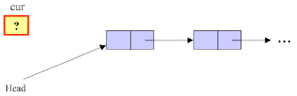
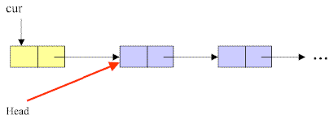
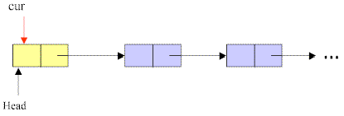
Delete First
Step1. Initialize the pointer cur point to the first node of the list.
Step2. Move the pointer head to the second node of the list.
Step3. Release the memory of the node that is pointed by the pointer cur.
Step 1
Step 2
Step 3

Slide 30
Delete Last
To delete the last node in a linked list, we use a local variable, cur, to point to the last node. We also use another variable, prev, to point to the second last node in the linked list.

Slide 31

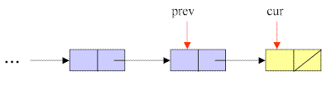
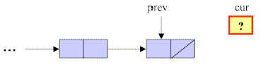
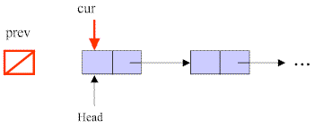
Delete Last
Step1. Initialize pointer cur to point to the first node of the list, while the pointer prev has a value of null.
Step2. Traverse the entire list until the pointer cur points to the last node of the list: assign cur to prev and then advance cur
Step3. Set NULL to next field of the node pointed by the pointer prev.
Step4. Release the memory of the node that is pointed by the pointer cur.
Step1
Step2
Step3
Step4

Slide 32
Delete Any
To delete a node that contains a particular value x in a linked list, we use a local variable, cur, to point to this node, and another variable, prev, to hold the previous node.

Slide 33
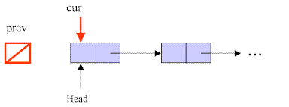

Delete Any
Step1. Initialize pointer cur to point to the first node of the list, while the pointer prev has a value of null.
Step2. Traverse the entire list until the pointer cur points to the node that contains value of x, and prev points to the previous node: assign cur to prev and then advance cur
……..
Step 1
Step 2

Slide 34
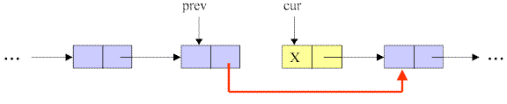

Delete Any
…….
Step3. Link the node pointed by pointer prev to the node after the cur’s node.
Step4. Release the memory of the node pointed by cur.
Step 3
Step 4

Slide 35
Linked List Based Implementation

Slide 36
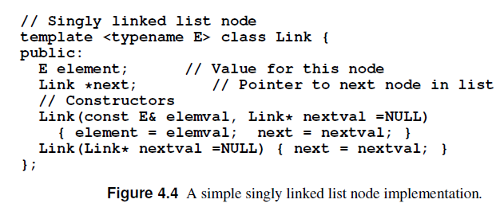
Link Class

Slide 37
Link List Based Implementation in C++

Slide 38
LList class
We have three pointers: head, tail and curr
Issues:
Where should curr point to?

Slide 39
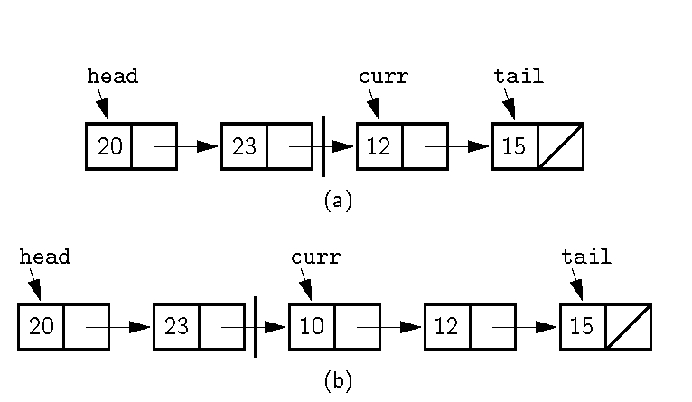
Position of curr (1)
Notes:
Naïve approach: Curr points to first node in right partition. We want to insert 10 at the beginning of the right partition. No access if available to the node with value 23. How can we do the insert?

Slide 40
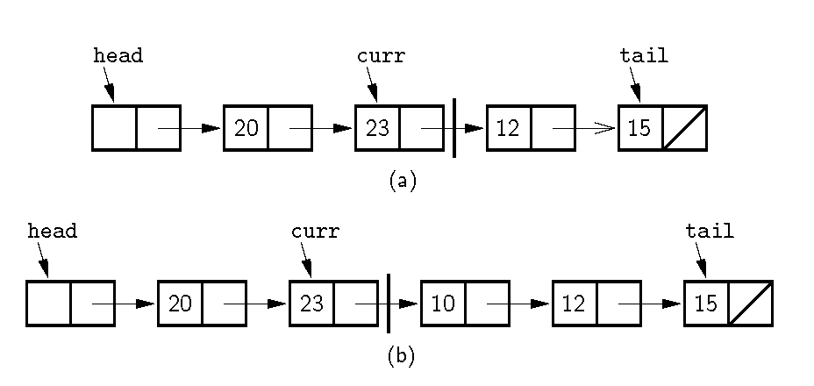
Position of curr (2)
Notes:
Alternative Implementation: Curr points to the node preceding the actual first node in the right partition. Now we can do the insert. Also note use of the header node. The header node eliminates special cases in the code.

Slide 41
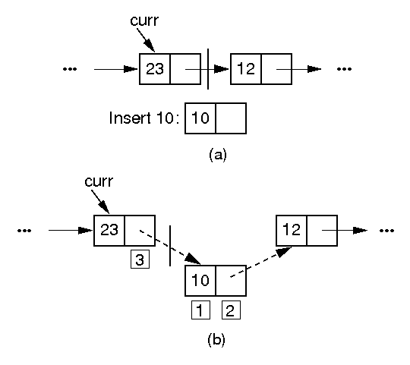
Insertion

Slide 42
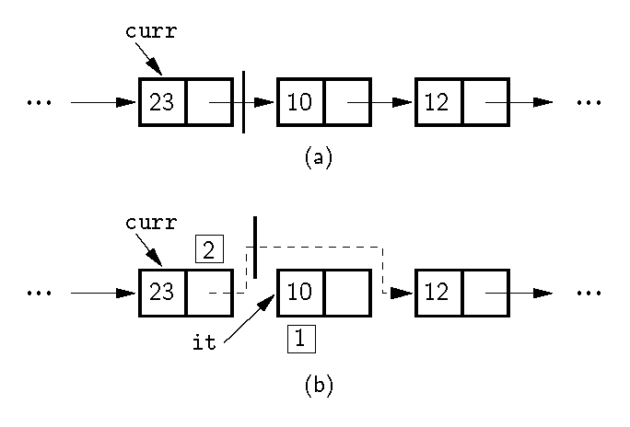
Removal

Slide 43

LList class
We have three pointers: head, tail and curr
Issues:
Where should curr point to?
Before the ‘current’ node
What about when the list is empty?
Where should head and tail point to in special cases (e.g., when the list is empty)
Rather than implementing it as a special case we can introduce a header node which does not contain any element of the list.

