Slide 1
Recurrence Analysis

Slide 2

What is a recurrence?
A recurrence is an equation or inequality that describes a function in terms of its value on smaller inputs.
Recurrence can take many forms.
Equal split
unequal split: 2/3 to 1/3 split.
Not a constant fraction…

Slide 3
Substitution Methods for Solving Recurrence

Slide 4
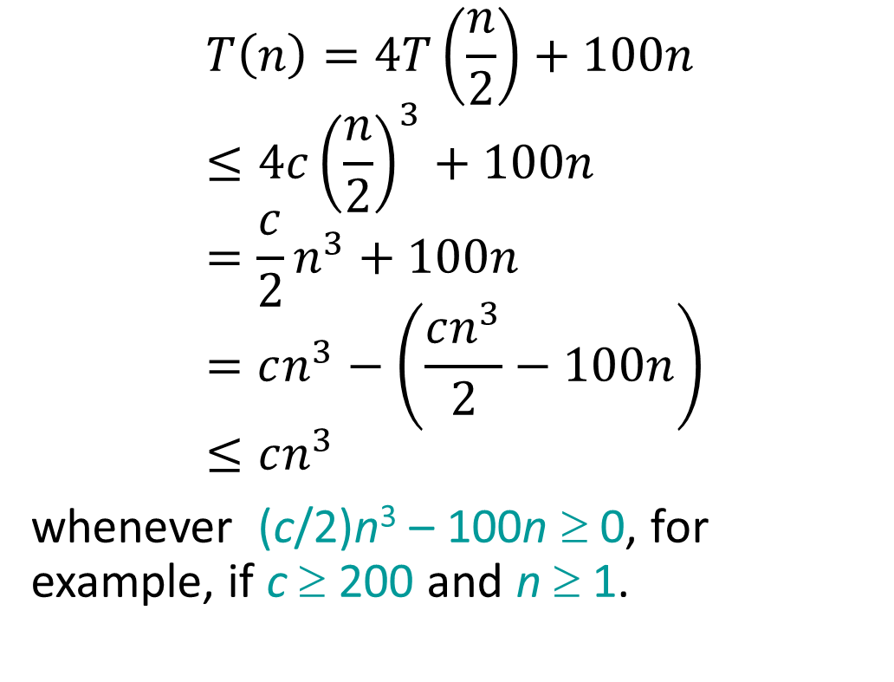
Substitution method
Example:
The most general method:
Guess the form of the solution.
Verify by induction.
Solve for constants.
$$T\left(n\right)=4T\left(\frac{n}{2}\right)+100n \\ ≤4c{\left(\frac{n}{2}\right)}^{3}+100n \\ =\frac{c}{2}n^{3}+100n \\ =cn^{3}−\left(\frac{cn^{3}}{2}−100n\right) \\ ≤cn^{3}$$
whenever (c/2)n³ – 100n ≥ 0, for example, if c ≥ 200 and n ≥ 1.
T(n) = 4T(n/2) + 100n
[Assume that T(1) = Θ(1).]
Guess O(n³) .
Assume that T(k) ≤ ck³ for k < n .
Prove T(n) ≤ cn³ by induction.
desired
residual

Slide 5
Example (continued)
We must also handle the initial conditions, that is, ground the induction with base cases.
Base: T(n) = Θ(1) for all n < n₀, where n₀ is a suitable constant.
For 1 ≤ n < n₀, we have “Θ(1)” ≤ cn³, if we pick c big enough.
This bound, T(n) ≤ cn³, is not tight!

Slide 6
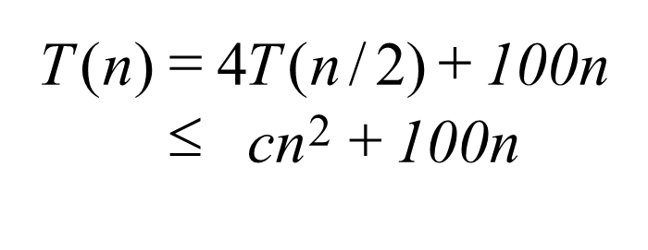


A tighter upper bound?
We shall prove that T(n) = O(n²).
Assume that T(k) ≤ ck² for k < n:
for no choice of c > 0, we can say:
$cn^{2}+100n ≤ cn^{2}$!!

Slide 7
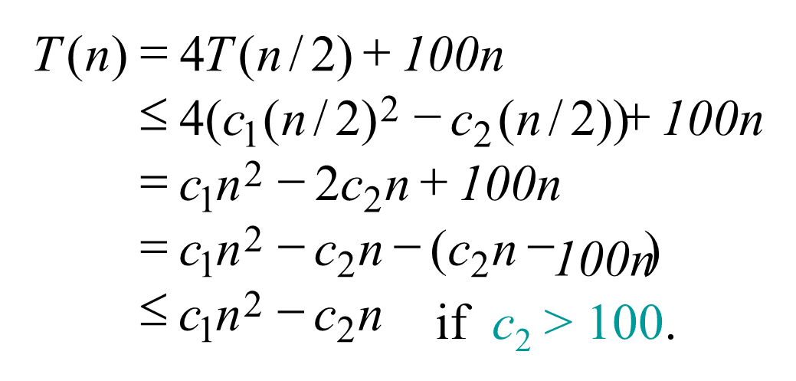
A tighter upper bound!
IDEA: Strengthen the inductive hypothesis.
Subtract a low-order term.
Inductive hypothesis: T(k) ≤ c₁k² – c₂k for k < n.
Pick c₁ big enough to handle the initial conditions.

Slide 8
Recursion-tree method
A recursion tree models the costs (time) of a recursive execution of an algorithm.
The recursion tree method is good for generating guesses for the substitution method.

Slide 9
Example of recursion tree
Solve T(n) = T(n/4) + T(n/2) + n²:

Slide 10
Example of recursion tree
Solve T(n) = T(n/4) + T(n/2) + n²:
T(n)

Slide 11
Example of recursion tree
Solve T(n) = T(n/4) + T(n/2) + n²:
n²
T(n/4)
T(n/2)

Slide 12
Example of recursion tree
Solve T(n) = T(n/4) + T(n/2) + n²:
n²
(n/4)²
(n/2)²
T(n/16)
T(n/8)
T(n/8)
T(n/4)

Slide 13
Example of recursion tree
Solve T(n) = T(n/4) + T(n/2) + n²:
n²
(n/4)²
(n/2)²
(n/16)²
(n/8)²
(n/8)²
(n/4)²
…
Θ(1)

Slide 14
Example of recursion tree
Solve T(n) = T(n/4) + T(n/2) + n²:
n²
(n/4)²
(n/2)²
(n/16)²
(n/8)²
(n/8)²
(n/4)²
…
Θ(1)

Slide 15
Example of recursion tree
Solve T(n) = T(n/4) + T(n/2) + n²:
n²
(n/4)²
(n/2)²
(n/16)²
(n/8)²
(n/8)²
(n/4)²
…
Θ(1)

Slide 16
Example of recursion tree
Solve T(n) = T(n/4) + T(n/2) + n²:
n²
(n/4)²
(n/2)²
(n/16)²
(n/8)²
(n/8)²
(n/4)²
…
…
Θ(1)

Slide 17
Example of recursion tree
for x ≠ 1
for |x| < 1
Solve T(n) = T(n/4) + T(n/2) + n²:
n²
(n/4)²
(n/2)²
(n/16)²
(n/8)²
(n/8)²
(n/4)²
…
…
Θ(1)
Total =
= Ο(n²)
geometric series

Slide 18
The master method
The master method applies to recurrences of the form
T(n) = a T(n/b) + f (n) ,
where a ≥ 1, b > 1, and f is asymptotically positive.

Slide 19
Three common cases
Compare f (n) with n^{logba}:
f (n) = O(n^{logba – ε}) for some constant ε > 0.
f (n) grows polynomially slower than n^{logba} (by an n^{ε} factor).
Solution: T(n) = Θ(n^{logba}) .

Slide 20
Three common cases
Compare f (n) with n^{logba}:
f (n) = Θ(n^{logba} lg^{k}n) for some constant k ≥ 0.
f (n) and n^{logba} grow at similar rates.
Solution: T(n) = Θ(n^{logba} lg^{k+1}n) .

Slide 21
Three common cases (cont.)
Compare f (n) with n^{logba}:
f (n) = Ω(n^{logba + ε}) for some constant ε > 0.
f (n) grows polynomially faster than n^{logba} (by an n^{ε} factor),
and f (n) satisfies the regularity condition that a f (n/b) ≤ c f (n) for some constant c < 1.
Solution: T(n) = Θ( f (n) ) .

Slide 22
Examples
Ex. T(n) = 4T(n/2) + n
a = 4, b = 2 ⇒ n^{logba} = n²; f (n) = n.
CASE 1: f (n) = O(n^{2 – ε}) for ε = 1.
∴ T(n) = Θ(n²).
Ex. T(n) = 4T(n/2) + n² a = 4, b = 2 ⇒ n^{logba} = n²; f (n) = n².
CASE 2: f (n) = Θ(n²lg⁰n), that is, k = 0.
∴ T(n) = Θ(n²lg n).

Slide 23
Examples
Ex. T(n) = 4T(n/2) + n³
a = 4, b = 2 ⇒ n^{logba} = n²; f (n) = n³.
CASE 3: f (n) = Ω(n^{2 + ε}) for ε = 1
and 4(n/2)³ ≤ cn³ (reg. cond.) for c = 1/2.
∴ T(n) = Θ(n³).

Slide 24
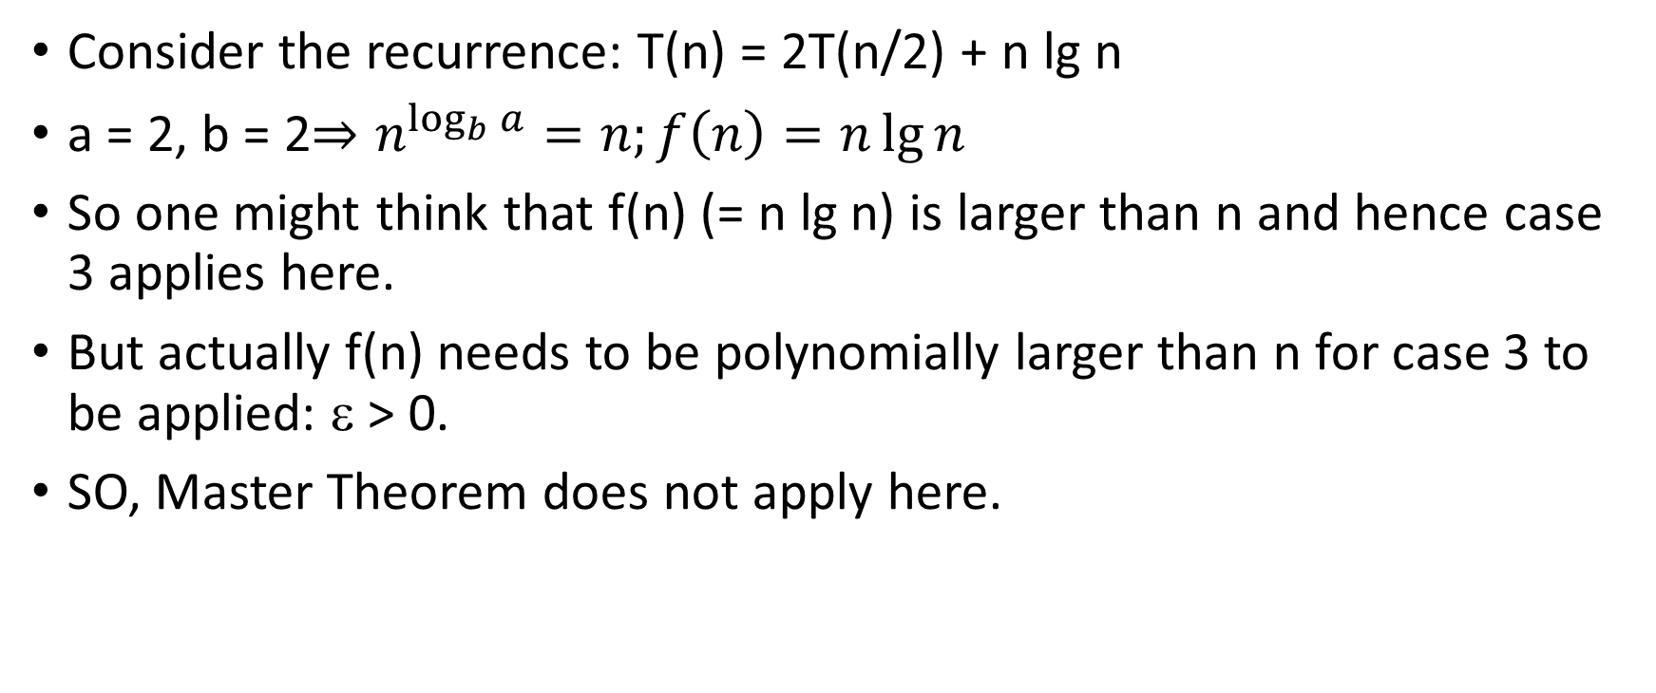
Non-Example
Consider the recurrence: T(n) = 2T(n/2) + n lg n
a = 2, b = 2$⇒n^{\log_{b}{a}}=n;f\left(n\right)=n\lg{n}$
So one might think that f(n) (= n lg n) is larger than n and hence case 3 applies here.
But actually f(n) needs to be polynomially larger than n for case 3 to be applied: ε > 0.
SO, Master Theorem does not apply here.

