Slide 1
CSE 203: Data Structures
Elementary Data Structures- Stacks
Part-I

Slide 2
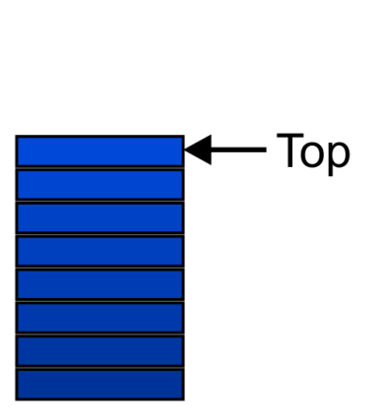
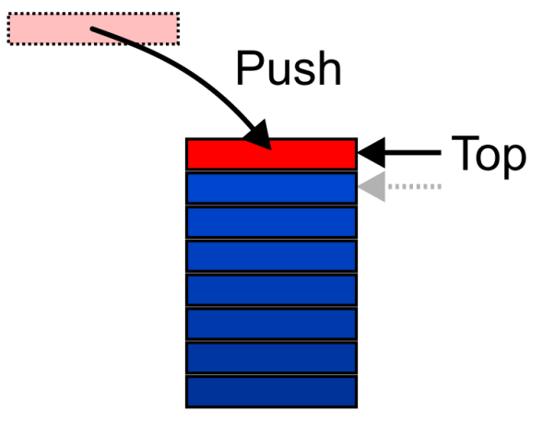
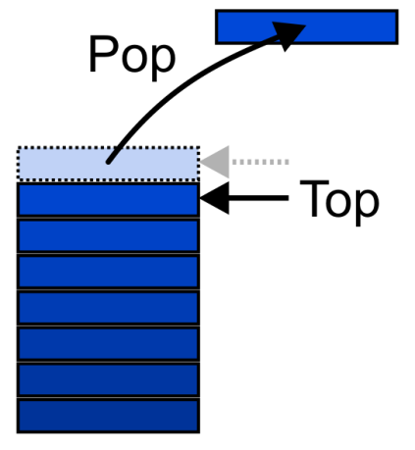
Stacks
Also called a last-in–first-out (LIFO) behaviour
Graphically, we may view these operations as follows:
There are two exceptions associated with abstract stacks:
It is an undefined operation to call either pop or top on an empty stack

Slide 3
Stacks
LIFO: Last In, First Out.
Restricted form of list: Insert and remove only at front of list.
Notation:
Insert: PUSH
Remove: POP
The accessible element is called TOP.

Slide 4
Stack ADT

Slide 5
Array-Based Stack
// Array-based stack implementation
private int maxSize; // Max size of stack
private int top; // Index for top
private E [] listArray;
Issues:
Which end is the top?
Where does “top” point to?
What are the costs of the operations?

Slide 6
Array-Based Stack
TOP
TOP
Issues:
Which end is the top?
Option 1: At the beginning.
Option 2: At the tail.
What are the costs of the operations?
Option 1 is inefficient (why?)
Option 2 is efficient (Why?)
Where does “top” point to?
The first available position in the stack
Push
Push
TOP
TOP

Slide 7
Array-Based Stack
Issues:
Which end is the top?
Option 1: At the beginning.
Option 2: At the tail.
Where does “top” point to?
The first available position in the stack
What are the costs of the operations?
Option 1 is inefficient (why?)
The last element must be at the beginning. So, every time you push, you would need to shift the items back.
Option 2 is efficient (Why?).

Slide 8
Array-Based Stack
Issues:
Which end is the top?
Option 1: At the beginning.
Option 2: At the tail.
Where does “top” point to?
The first available position in the stack
What are the costs of the operations?
Option 1 is inefficient (why?)
Option 2 is efficient (Why?).
Here, as the elements are pushed in, they are appended at the tail.
Method pop removes the tail element

Slide 9
Array Based Stack Implementation in C++

Slide 10
Linked List Based Stack
Elements are inserted and removed only from the head of the list.
A header node is not used because no special-case code is required for lists of zero or one elements.
The only data member is top, a pointer to the first (top) link node of the stack. Top is Null for empty stack.

Slide 11
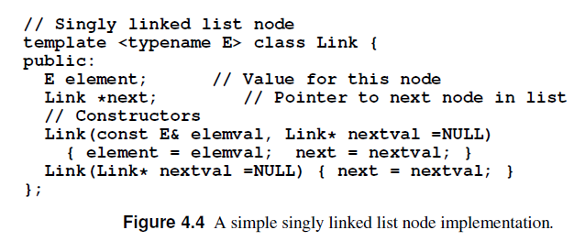
Link Based Stack Implementation in C++

Slide 12
Stack: Array-Based vs Linked Based
All operations in both implementations take constant time
The space analysis is similar to that done for list implementations.
The array-based stack must declare a fixed-size array initially, and some of that space is wasted whenever the stack is not full.
The linked stack can shrink and grow but requires the overhead of a link field for every element.

Slide 13
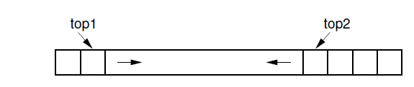
One Array Two Stacks…
Array based stack has a one-way growth. So, we can implement two stacks in one
Each grows inward from each end
This may lead to less wasted space.
However, this only works well
when the space requirements of the two stacks are inversely correlated: ideally when one stack grows, the other will shrink.
This is particularly effective when elements are taken from one stack and given to the other.
If instead both stacks grow at the same time, then the free space in the middle of the array will be exhausted quickly.

Slide 14
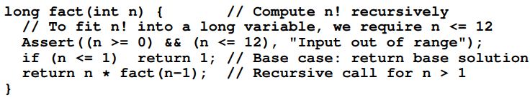
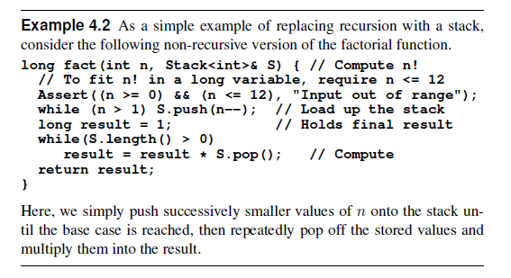
Replacing recursion with a stack
Notes:
I believe Figure 4.21 is wrong and hence I am not discussing that.

Slide 15
Replacing recursion with a stack
We could have simply written an iterative version of fact()!!!
But stack based implementation like this is useful as it is not always possible to replace recursion with iteration.
Fortunately, it is always possible to imitate recursion with a stack.
Notes:
I believe Figure 4.21 is wrong and hence I am not discussing that.

Slide 16
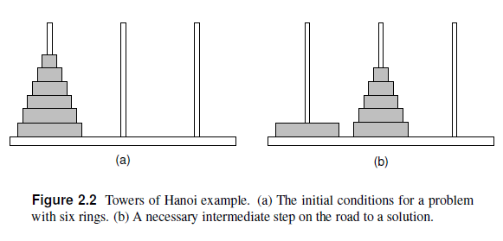
Towers of Hanoi
The problem is to move the rings from the leftmost pole to the rightmost pole (labeled Pole 3) in a series of steps.
At each step the top ring on some pole is moved to another pole.
There is one limitation on where rings may be moved: A ring can never be moved on top of a smaller ring.

Slide 17
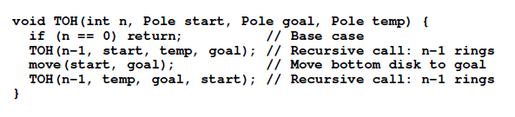
Towers of Hanoi

Slide 18
Stack Based ToH

