Slide 1
CSE 203: Data Structures
Elementary Data Structures- Stacks
Part II

Slide 2
Question…
What happens if our guess of maxSize (in the array based stack) is wrong?
Throw an exception (What is this?)
Ignore the object being pushed onto the stack (Being an Ostrich?)
Put the process pushing the object onto the stack to sleep until another process removes the top of the stack (Some advanced topic)
We could increase the size of the array

Slide 3
Array Capacity
count = 8
array_capacity = 8
array
First, let us visualize what must occur to allocate new memory

Slide 4
Array Capacity
First, this requires a call to new Type[N] where N is the new capacity
We must have access to this so we must store the address returned by new in a local variable, say tmp
temp
count = 8
array_capacity = 8
array

Slide 5
Array Capacity
count = 8
array_capacity = 8
array
temp
Next, the values must be copied over

Slide 6
Array Capacity
count = 8
array_capacity = 8
array
temp
The memory for the original array must be deallocated

Slide 7
Array Capacity
count = 8
array_capacity = 8
array
temp
Finally, the appropriate member variables must be reassigned

Slide 8
Array Capacity
Back to the original question:
How much do we change the capacity?
Add a constant?
Multiply by a constant?
First, we recognize that any time that we push onto a full stack, this requires n copies and the run time is Θ(n)
Therefore, push is usually Θ(1) except when new memory is required

Slide 9
Array Capacity
We will introduce the concept of amortized time:
If n operations requires Θ(f(n)), we will say that an individual operation has an amortized run time of Θ(f(n)/n)
Therefore, if inserting n objects requires:
Θ(n²) copies, the amortized time is Θ(n)
Θ(n) copies, the amortized time is Θ(1)

Slide 10
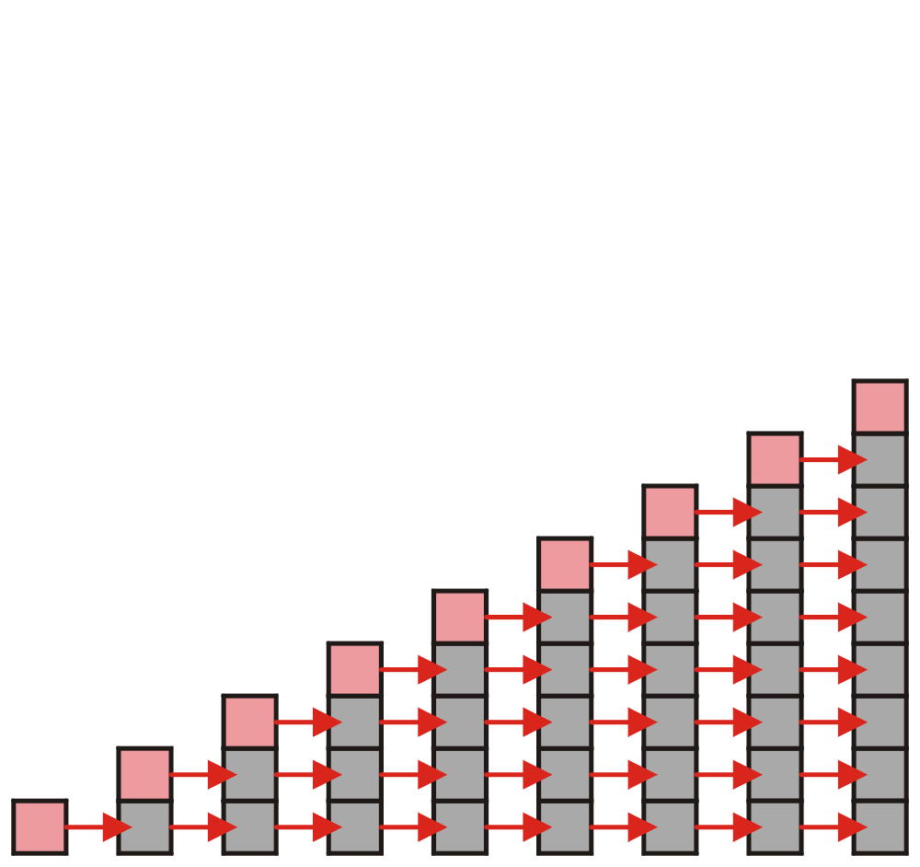
Array Capacity
Let us consider the case of increasing the capacity by 1 each time the array is full
With each insertion when the array is full, this requires all entries to be copied
Notes:
Red indicates the last inserted position. Ash indicates occupied.

Slide 11
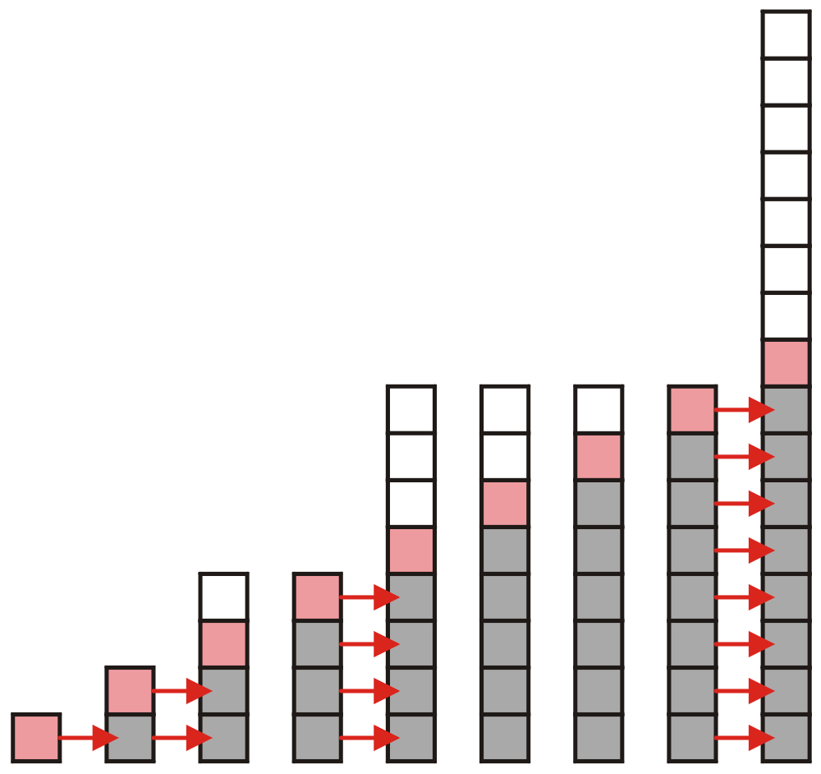
Array Capacity
Suppose we double the number of entries each time the array is full
Now the number of copies appears to be significantly fewer
Notes:
Red indicates the last inserted position. Ash indicates occupied. While indicates unoccupied.

Slide 12
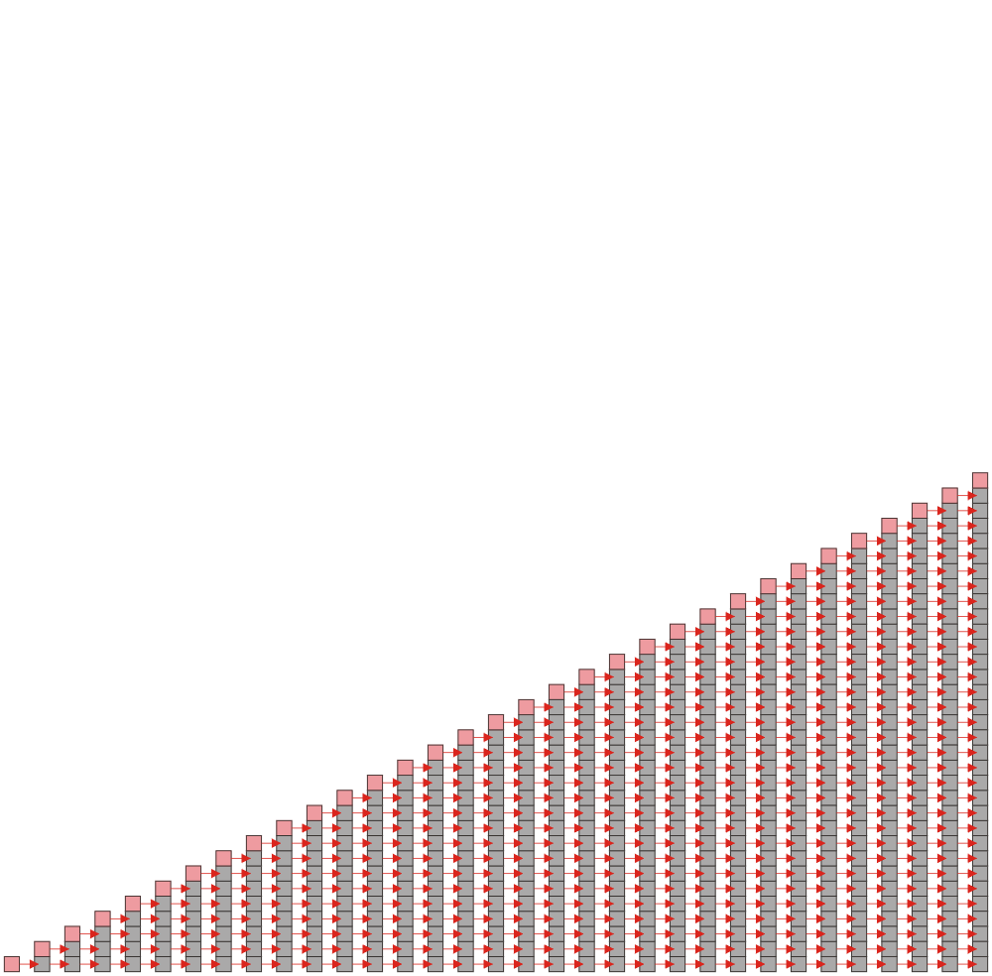
Array Capacity
Suppose we increase the array size by 1 each time it is full:
Suppose we insert k objects
The pushing of the k^{th} object on the stack requires k-1 copies
The total number of copies is now given by:
Therefore, the amortized number of copies is given by
Therefore each push must run in Θ(n) time
No wasted space.

Slide 13
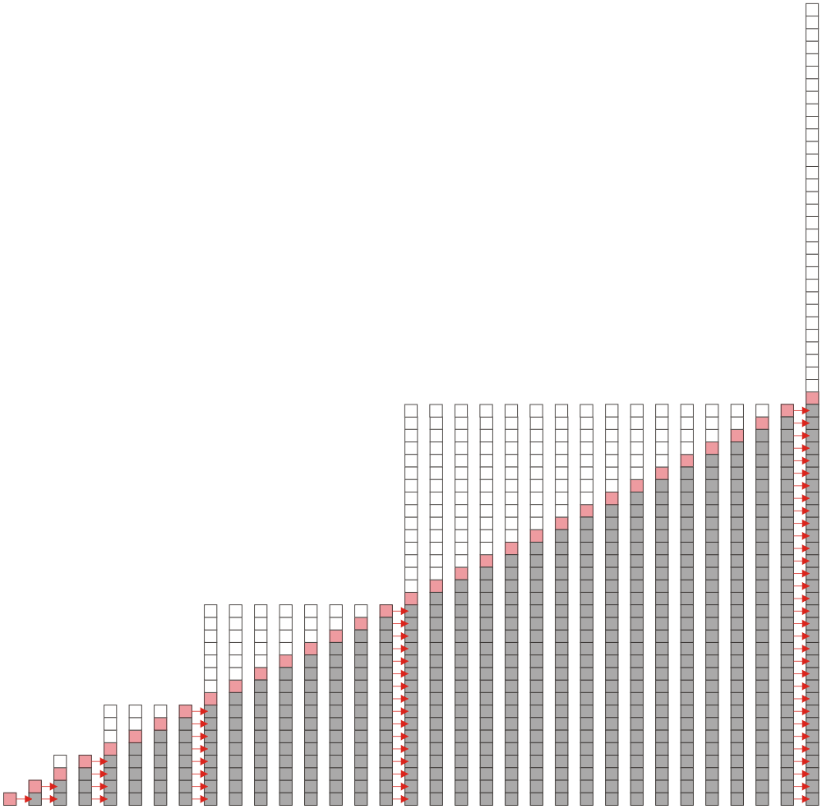
Array Capacity
Suppose we double the array size each time it is full:
We must make 1, 2, 4, 8, 16, 32, 64,... Copies at the 2nd, 3rd, 5th, 9th, 17th, 33rd, 65th, … insertions
Inserting n objects would therefore require 1, 2, 4, 8, ..., all the way up to the largest 2^{k} < n copies or
Therefore the amortized number of copies per insertion is Θ(1)
The wasted space, however is O(n)

Slide 14
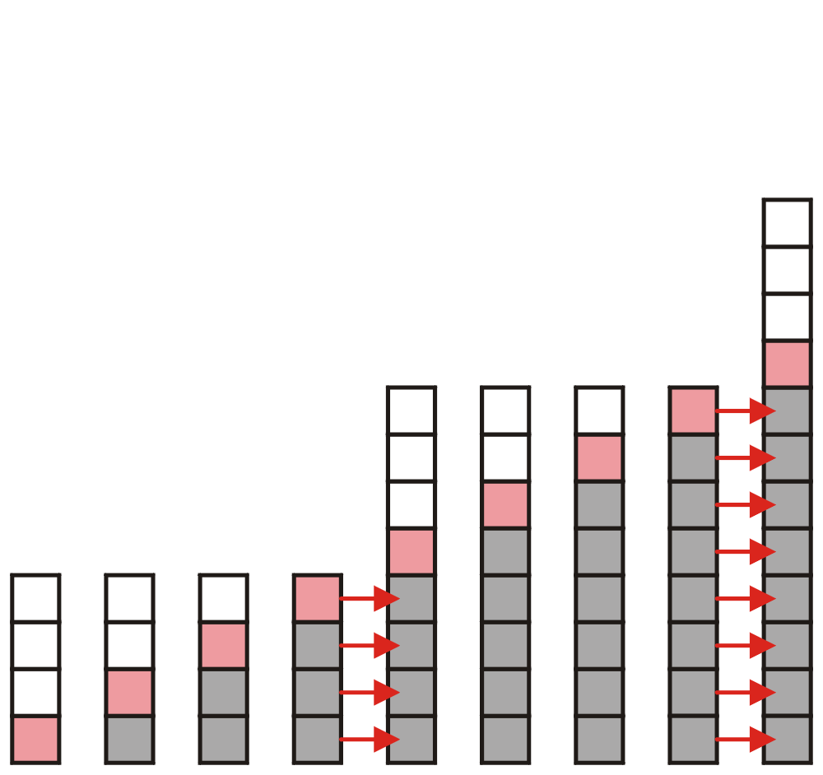
Array Capacity
What if we increase the array size by a larger constant?
For example, increase the array size by 4, 8, 100?

Slide 15
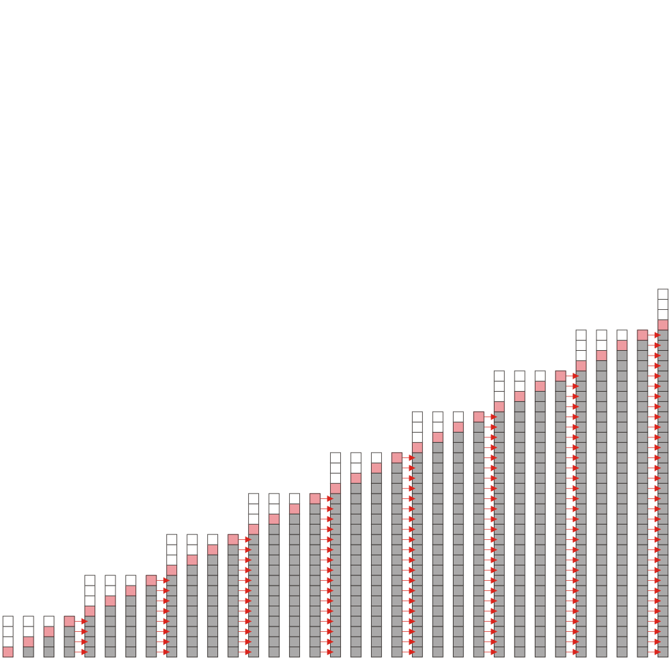
Array Capacity
Here we view the number of copies required when increasing the array size by 4; however, in general, suppose we increase it by a constant value m
At first instance, number of copies = 4 (i.e., m)
At second instance, number of copies = 4 x 2 = 8 (2m)
At third instance, number of copies = 4 x 3 = 12 (3m)
…
Therefore, the amortized
run time per insertion is Θ(n)

Slide 16
Array Capacity
 | Copies per Insertion (amortized) | Unused Memory
Increase by 1 | n – 1 | 0
Increase by m | n/m | m – 1
Increase by a factor of 2 | 1 | n
Increase by a factor of r > 1 | 1/(r – 1) | (r – 1)n
Note the difference in worst-case amortized scenarios:

Slide 17
Stack Application: Reverse-Polish Notation
Normally, mathematics is written using what we call in-fix notation:
(3 + 4) × 5 – 6
The operator is placed between to operands
One weakness: parentheses are required
(3 + 4) × 5 – 6 = 29
3 + 4 × 5 – 6 = 17
3 + 4 × (5 – 6) = –1
(3 + 4) × (5 – 6) = –7

Slide 18
Reverse-Polish Notation
Alternatively, we can place the operands first, followed by the operator:
(3 + 4) × 5 – 6
3 4 + 5 × 6 –
Parsing reads left-to-right and performs any operation on the last two operands:
3 4 + 5 × 6 –
7 5 × 6 –
35 6 –
29
(3 + 4) × 5 – 6 = 29

Slide 19
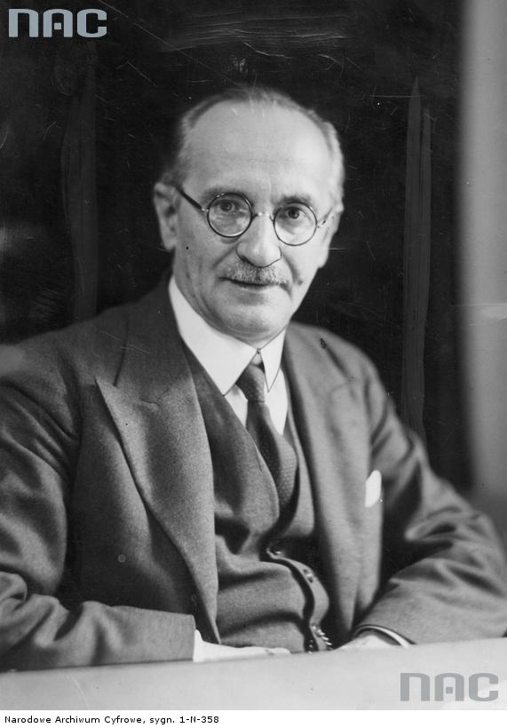
Reverse-Polish Notation
This is called reverse-Polish notation after the mathematician Jan Łukasiewicz
http://www.audiovis.nac.gov.pl/

Slide 20
Reverse-Polish Notation
Other examples:
3 4 5 × + 6 –
3 20 + 6 –
23 6 –
17
3 4 5 6 – × +
3 4 –1 × +
3 –4 +
–1
3 + 4 × 5 – 6 = 17
3 + 4 × (5 – 6) = –1

Slide 21
Reverse-Polish Notation
Benefits:
No ambiguity and no brackets are required
It is the same process used by a computer to perform computations:
operands must be loaded into registers before operations can be performed on them
Reverse-Polish can be processed using stacks

Slide 22
Reverse-Polish Notation
The easiest way to parse reverse-Polish notation is to use an operand stack:
operands are processed by pushing them onto the stack
when processing an operator:
pop the last two items off the operand stack,
perform the operation, and
push the result back onto the stack

Slide 23
Reverse-Polish Notation
Evaluate the following reverse-Polish expression using a stack:
1 2 3 + 4 5 6 × – 7 × + – 8 9 × +

Slide 24
Reverse-Polish Notation
Push 1 onto the stack
1 2 3 + 4 5 6 × – 7 × + – 8 9 × +
1

Slide 25
Reverse-Polish Notation
Push 1 onto the stack
1 2 3 + 4 5 6 × – 7 × + – 8 9 × +
2
1

Slide 26
Reverse-Polish Notation
Push 3 onto the stack
1 2 3 + 4 5 6 × – 7 × + – 8 9 × +
3
2
1

Slide 27
Reverse-Polish Notation
Pop 3 and 2 and push 2 + 3 = 5
1 2 3 + 4 5 6 × – 7 × + – 8 9 × +
5
1

Slide 28
Reverse-Polish Notation
Push 4 onto the stack
1 2 3 + 4 5 6 × – 7 × + – 8 9 × +
4
5
1

Slide 29
Reverse-Polish Notation
Push 5 onto the stack
1 2 3 + 4 5 6 × – 7 × + – 8 9 × +
5
4
5
1

Slide 30
Reverse-Polish Notation
Push 6 onto the stack
1 2 3 + 4 5 6 × – 7 × + – 8 9 × +
6
5
4
5
1

Slide 31
Reverse-Polish Notation
Pop 6 and 5 and push 5 × 6 = 30
1 2 3 + 4 5 6 × – 7 × + – 8 9 × +
30
4
5
1

Slide 32
Reverse-Polish Notation
Pop 30 and 4 and push 4 – 30 = –26
1 2 3 + 4 5 6 × – 7 × + – 8 9 × +
–26
5
1

Slide 33
Reverse-Polish Notation
Push 7 onto the stack
1 2 3 + 4 5 6 × – 7 × + – 8 9 × +
7
–26
5
1

Slide 34
Reverse-Polish Notation
Pop 7 and –26 and push –26 × 7 = –182
1 2 3 + 4 5 6 × – 7 × + – 8 9 × +
–182
5
1

Slide 35
Reverse-Polish Notation
Pop –182 and 5 and push –182 + 5 = –177
1 2 3 + 4 5 6 × – 7 × + – 8 9 × +
–177
1

Slide 36
Reverse-Polish Notation
Pop –177 and 1 and push 1 – (–177) = 178
1 2 3 + 4 5 6 × – 7 × + – 8 9 × +
178

Slide 37
Reverse-Polish Notation
Push 8 onto the stack
1 2 3 + 4 5 6 × – 7 × + – 8 9 × +
8
178

Slide 38
Reverse-Polish Notation
Push 1 onto the stack
1 2 3 + 4 5 6 × – 7 × + – 8 9 × +
9
8
178

Slide 39
Reverse-Polish Notation
Pop 9 and 8 and push 8 × 9 = 72
1 2 3 + 4 5 6 × – 7 × + – 8 9 × +
72
178

Slide 40
Reverse-Polish Notation
Pop 72 and 178 and push 178 + 72 = 250
1 2 3 + 4 5 6 × – 7 × + – 8 9 × +
250

Slide 41
Reverse-Polish Notation
Thus
1 2 3 + 4 5 6 × – 7 × + – 8 9 × +
evaluates to the value on the top: 250
The equivalent in-fix notation is
((1 – ((2 + 3) + ((4 – (5 × 6)) × 7))) + (8 × 9))
We reduce the parentheses using order-of-operations:
1 – (2 + 3 + (4 – 5 × 6) × 7) + 8 × 9

Slide 42
Reverse-Polish Notation
Incidentally,
1 – 2 + 3 + 4 – 5 × 6 × 7 + 8 × 9 = – 132
which has the reverse-Polish notation of
1 2 – 3 + 4 + 5 6 7 × × – 8 9 × +
For comparison, the calculated expression was
1 2 3 + 4 5 6 × – 7 × + – 8 9 × +

Slide 43
Application: Parsing
Most parsing uses stacks
Examples includes:
Matching tags in XHTML
In C++, matching
parentheses ( ... )
brackets, and [ ... ]
braces { ... }

Slide 44
Parsing XHTML
We will show how stacks may be used to parse an XHTML document
You will use XHTML (and more generally XML and other markup languages) in different context.

Slide 45
Parsing XHTML
A markup language is a means of annotating a document to give context to the text
The annotations give information about the structure or presentation of the text
The best known example is HTML, or HyperText Markup Language
We will look at XHTML

Slide 46
Parsing XHTML
XHTML is made of nested
opening tags, e.g., <some_identifier>, and
matching closing tags, e.g., </some_identifier>
<html>
<head><title>Hello</title></head>
<body><p>This appears in the <i>browser</i>.</p></body>
</html>

Slide 47
Parsing XHTML
Nesting indicates that any closing tag must match the most recent opening tag
Strategy for parsing XHTML:
read though the XHTML linearly
place the opening tags in a stack
when a closing tag is encountered, check that it matches what is on top of the stack
If it matches, the top of the stack is popped.
If it does not, the XHTML is invalid.

Slide 48
Parsing XHTML
Consider the code for How are you?
<i>How <u>are</i> you</u>? **INVALID**
The proper way to code this would be
<i>How <u>are</u></i><u> you</u>?
The justification for this is that now a stack may be used to parse XML

Slide 49
Parsing XHTML
<html>
<head><title>Hello</title></head>
<body><p>This appears in the <i>browser</i>.</p></body>
</html>
<html>

Slide 50
Parsing XHTML
<html>
<head><title>Hello</title></head>
<body><p>This appears in the <i>browser</i>.</p></body>
</html>
<html> | <head>

Slide 51
Parsing XHTML
<html>
<head><title>Hello</title></head>
<body><p>This appears in the <i>browser</i>.</p></body>
</html>
<html> | <head> | <title>

Slide 52
Parsing XHTML
<html>
<head><title>Hello</title></head>
<body><p>This appears in the <i>browser</i>.</p></body>
</html>
<html> | <head> | <title>

Slide 53
Parsing XHTML
<html>
<head><title>Hello</title></head>
<body><p>This appears in the <i>browser</i>.</p></body>
</html>
<html> | <head>

Slide 54
Parsing XHTML
<html>
<head><title>Hello</title></head>
<body><p>This appears in the <i>browser</i>.</p></body>
</html>
<html> | <body>

Slide 55
Parsing XHTML
<html>
<head><title>Hello</title></head>
<body><p>This appears in the <i>browser</i>.</p></body>
</html>
<html> | <body> | <p>

Slide 56
Parsing XHTML
<html>
<head><title>Hello</title></head>
<body><p>This appears in the <i>browser</i>.</p></body>
</html>
<html> | <body> | <p> | <i>

Slide 57
Parsing XHTML
<html>
<head><title>Hello</title></head>
<body><p>This appears in the <i>browser</i>.</p></body>
</html>
<html> | <body> | <p> | <i>

Slide 58
Parsing XHTML
<html>
<head><title>Hello</title></head>
<body><p>This appears in the <i>browser</i>.</p></body>
</html>
<html> | <body> | <p>

Slide 59
Parsing XHTML
<html>
<head><title>Hello</title></head>
<body><p>This appears in the <i>browser</i>.</p></body>
</html>
<html> | <body>

Slide 60
Parsing XHTML
<html>
<head><title>Hello</title></head>
<body><p>This appears in the <i>browser</i>.</p></body>
</html>
<html>

Slide 61
Parsing XHTML
We are finished parsing, and the stack is empty
Possible errors:
a closing tag which does not match the opening tag on top of the stack
a closing tag when the stack is empty
the stack is not empty at the end of the document

Slide 62
HTML
Old HTML required neither closing tags nor nesting
<html>
<head><title>Hello</title></head>
<body><p>This is a list of topics:
<ol> <!-- para ends with start of list -->
<li><i>veni <!-- implied </li> -->
<li>vidi <!-- italics continues -->
<li>vici</i>
</ol> <!-- end-of-file implies </body></html> -->
Parsers were therefore specific to HTML
Results: ambiguities and inconsistencies

Slide 63
XML
XHTML is an implementation of XML
XML defines a class of general-purpose eXtensible Markup Languages designed for sharing information between systems
The same rules apply for any flavour of XML:
opening and closing tags must match and be nested

Slide 64
Computing Spans
We show how to use a stack as an auxiliary data structure in an algorithm
Given an an array X, the span S[i] of X[i] is the maximum number of consecutive elements X[j] immediately preceding X[i] and such that X[j] ≤ X[i]
Spans have applications to financial analysis
E.g., stock at 52-week high
X
6 | 3 | 4 | 5 | 2
1 | 1 | 2 | 3 | 1
S
Notes:
S counts itself; so minimum value of S is 1.

Slide 65
Algorithm I
Algorithm spans1(X, n)
Input array X of n integers
Output array S of spans of X
S ← new array of n integers
for i ← 0 to n − 1 do
s ← 1
while s ≤ i ∧ X[i − s] ≤ X[i]
s ← s + 1
S[i] ← s
return S

Slide 66
Algorithm I: Analysis
Algorithm spans1(X, n)
Input array X of n integers
Output array S of spans of X #
S ← new array of n integers n
for i ← 0 to n − 1 do loops n times
s ← 1 n
while s ≤ i ∧ X[i − s] ≤ X[i] 1 + 2 + …+ (n − 1) (in total)
s ← s + 1 1 + 2 + …+ (n − 1) (in total)
S[i] ← s n
return S 1
Algorithm spans1 runs in O(n²) time

Slide 67
Computing Spans with a Stack
We keep in a stack the indices of the elements visible when “looking back”
We scan the array from left to right
Let i be the current index
We pop indices from the stack until we find index j such that X[i] < X[j]
We set S[i] ← i − j
We push i onto the stack

Slide 68
Algorithm II
Algorithm spans2(X, n)
S ← new array of n integers
A ← new empty stack
for i ← 0 to n − 1 do
while (¬A.isEmpty() ∧
X[top()] ≤ X[i] ) do
j ← A.pop()
if A.isEmpty() then
S[i] ← i + 1
else
S[i] ← i − j
A.push(i)
return S

Slide 69
Algorithm II: Analysis
Each index of the array
Is pushed into the stack exactly one
Is popped from the stack at most once
The statements in the while-loop are executed at most n times
Algorithm spans2 runs in O(n) time
Algorithm spans2(X, n)
S ← new array of n integers
A ← new empty stack
for i ← 0 to n − 1 do
while (¬A.isEmpty() ∧
X[top()] ≤ X[i] ) do
j ← A.pop()
if A.isEmpty() then
S[i] ← i + 1
else
S[i] ← i − j
A.push(i)
return S

Slide 70
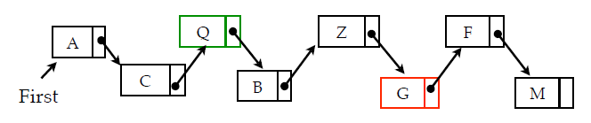
A Problem
Suppose you have a linked list L
Problem: Find the 3rd node before the one containing G.
Can you propose a solution?

Slide 71
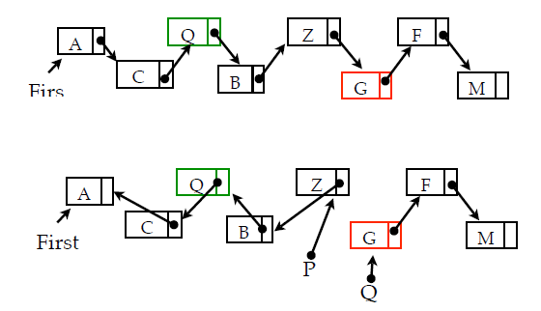
Solution 1: Link Inversion
As we walk down the list with two pointers P, Q, we reverse the NEXT pointers to point to the previous node:

Slide 72
Solution 2: Use Stack
Walk down the list, pushing node addresses onto a stack.
When you find “G”, pop 3 addresses off the stack.

