Slide 1
Solving Nonlinear Equations
Author: Autar Kaw et. al.
Textbook: TEXTBOOK: NUMERICAL METHODS WITH APPLICATIONS

Slide 2
Bisection Method

Slide 3
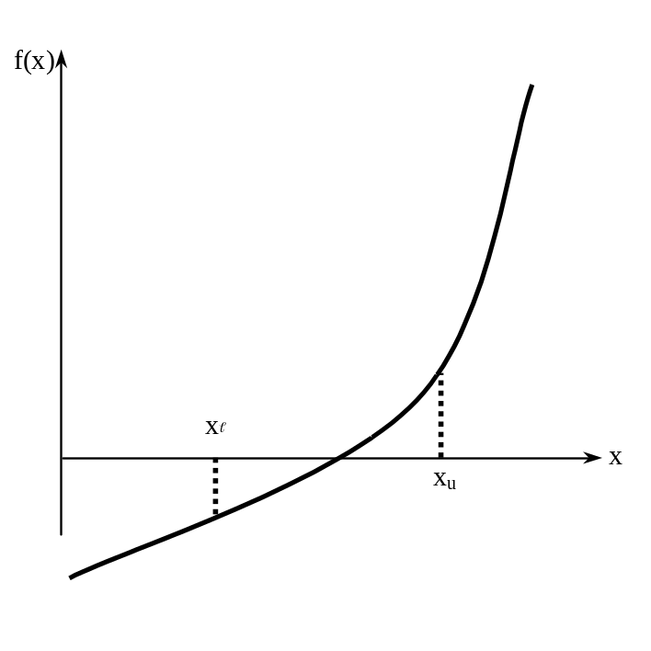
Basis of Bisection Method
Theorem
An equation f(x)=0, where f(x) is a real continuous function, has at least one root between x_{l} and x_{u} if f(x_{l}) f(x_{u}) < 0.
Figure 1 At least one root exists between the two points if the function is real, continuous, and changes sign.

Slide 4
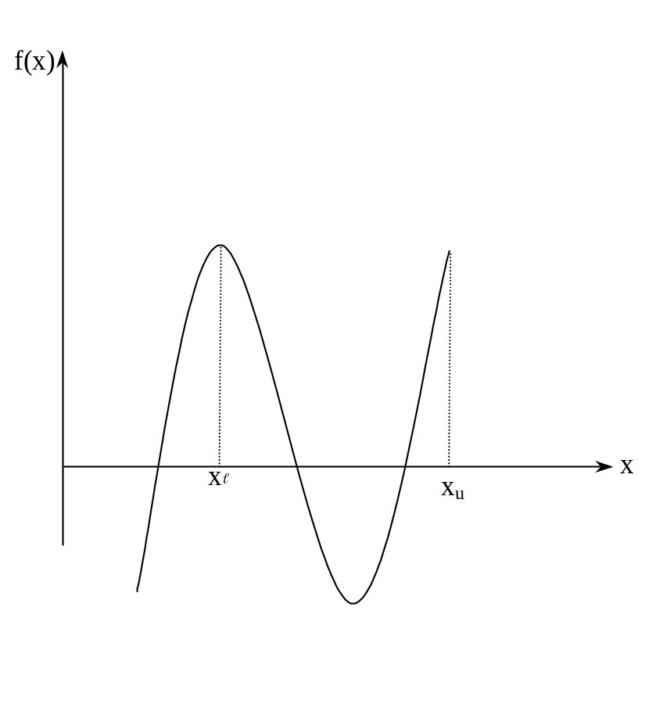


Basis of Bisection Method
Figure 2 If function does not change sign between two points, roots of the equation may still exist between the two points.

Slide 5
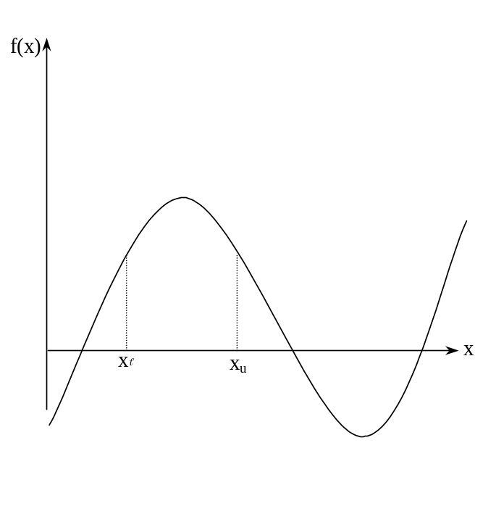
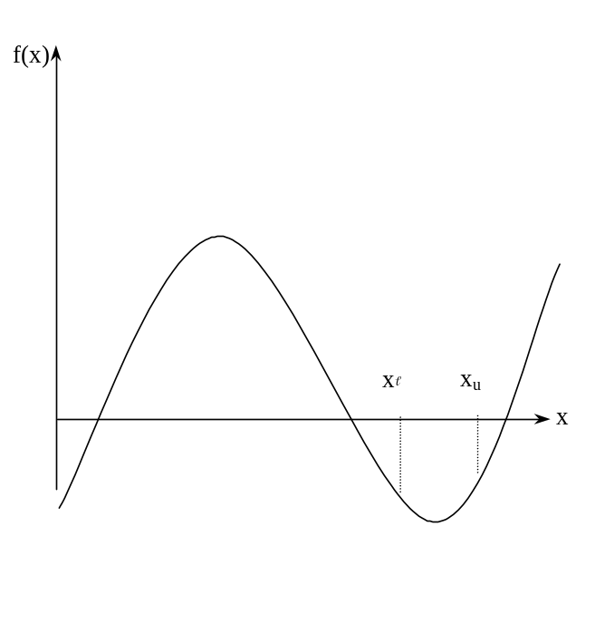
Basis of Bisection Method
Figure 3 If the function does not change sign between two points, there may not be any roots for the equation between the two points.

Slide 6
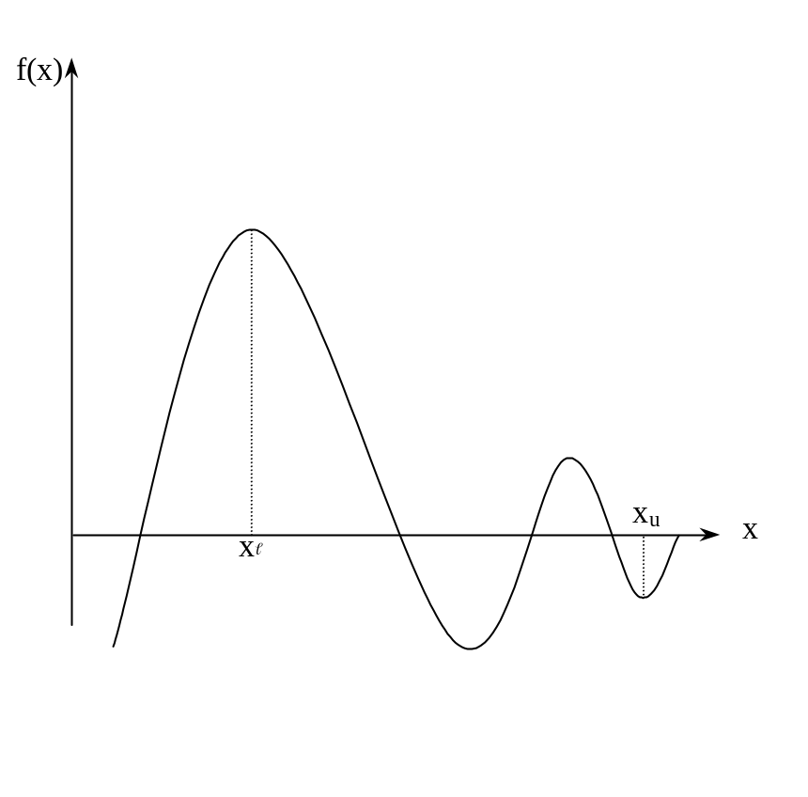
Basis of Bisection Method
Figure 4 If the function changes sign between two points, more than one root for the equation may exist between the two points.

Slide 7
Algorithm for Bisection Method

Slide 8
Step 1
Choose x and x_{u} as two guesses for the root such that f(x) f(x_{u}) < 0, or in other words, f(x) changes sign between x and x_{u}. This was demonstrated in Figure 1.
Figure 1

Slide 9
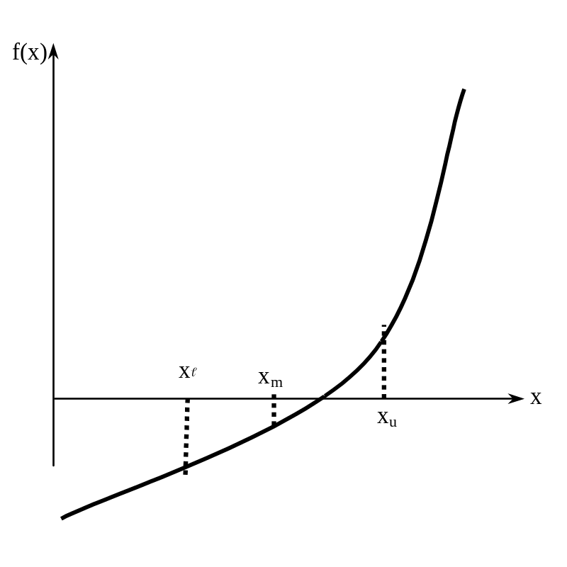
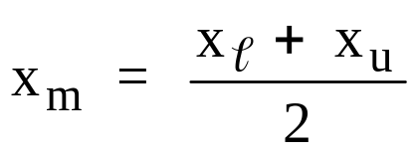
Step 2
Estimate the root, x_{m} of the equation f (x) = 0 as the mid point between x and x_{u} as
Figure 5 Estimate of x_{m}

Slide 10



Step 3
Now check the following
If , then the root lies between x and x_{m}; then x = x ; x_{u} = x_{m}.
If , then the root lies between x_{m} and x_{u}; then x = x_{m}; x_{u} = x_{u}.
If ; then the root is x_{m.} Stop the algorithm if this is true.

Slide 11
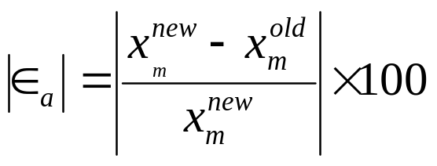


Step 4
Find the new estimate of the root
Find the absolute relative approximate error
where

Slide 12
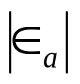


Step 5
Compare the absolute relative approximate error with the pre-specified error tolerance .
Go to Step 2 using new upper and lower guesses.
Yes
Is ?
No
Stop the algorithm
Note one should also check whether the number of iterations is more than the maximum number of iterations allowed. If so, one needs to terminate the algorithm and notify the user about it.

Slide 13

Example 1
You are working for ‘DOWN THE TOILET COMPANY’ that makes floats for ABC commodes. The floating ball has a specific gravity of 0.6 and has a radius of 5.5 cm. You are asked to find the depth to which the ball is submerged when floating in water.
Figure 6 Diagram of the floating ball

Slide 14

Example 1 Cont.
The equation that gives the depth x to which the ball is submerged under water is given by
a) Use the bisection method of finding roots of equations to find the depth x to which the ball is submerged under water. Conduct three iterations to estimate the root of the above equation.
b) Find the absolute relative approximate error at the end of each iteration, and the number of significant digits at least correct at the end of each iteration.

Slide 15
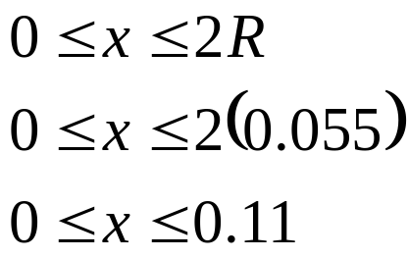
Example 1 Cont.
From the physics of the problem, the ball would be submerged between x = 0 and x = 2R,
where R = radius of the ball,
that is
Figure 6 Diagram of the floating ball

Slide 16
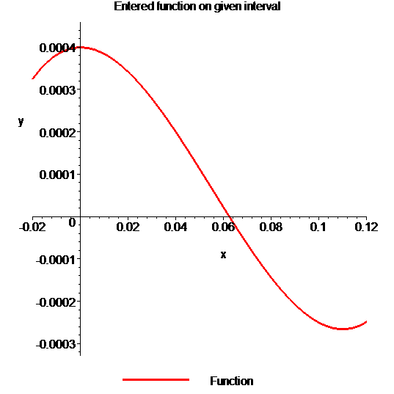
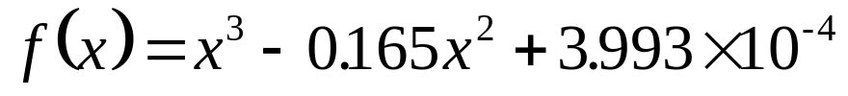
Example 1 Cont.
Solution
To aid in the understanding of how this method works to find the root of an equation, the graph of f(x) is shown to the right,
where
Figure 7 Graph of the function f(x)

Slide 17
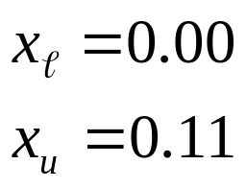
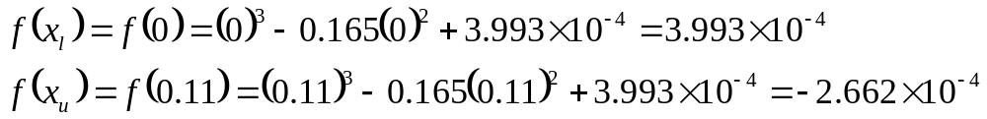
Example 1 Cont.
Let us assume
Check if the function changes sign between x and x_{u .}
Hence
So there is at least on root between x and x_{u,} that is between 0 and 0.11

Slide 18
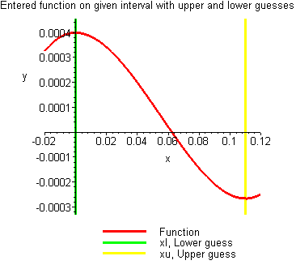
Example 1 Cont.
Figure 8 Graph demonstrating sign change between initial limits

Slide 19
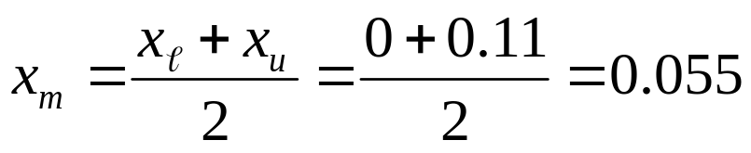
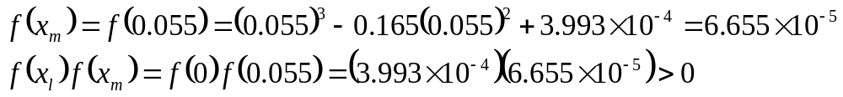


Example 1 Cont.
Iteration 1
The estimate of the root is
Hence the root is bracketed between x_{m} and x_{u}, that is, between 0.055 and 0.11. So, the lower and upper limits of the new bracket are
At this point, the absolute relative approximate error cannot be calculated as we do not have a previous approximation.

Slide 20
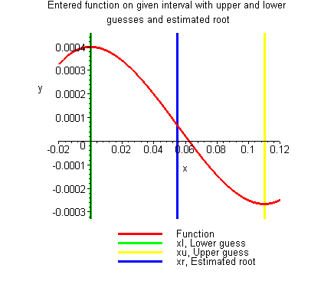
Example 1 Cont.
Figure 9 Estimate of the root for Iteration 1

Slide 21
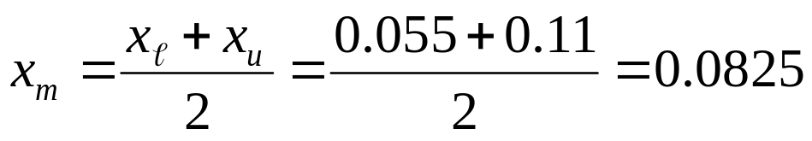
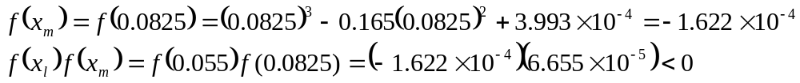

Example 1 Cont.
Iteration 2
The estimate of the root is
Hence the root is bracketed between x and x_{m}, that is, between 0.055 and 0.0825. So, the lower and upper limits of the new bracket are

Slide 22
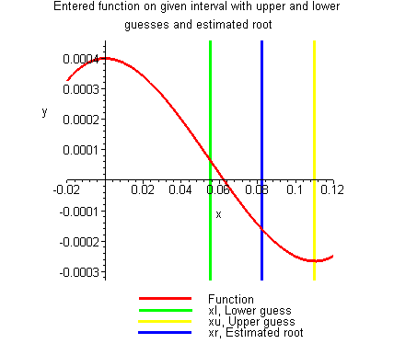
Example 1 Cont.
Figure 10 Estimate of the root for Iteration 2

Slide 23

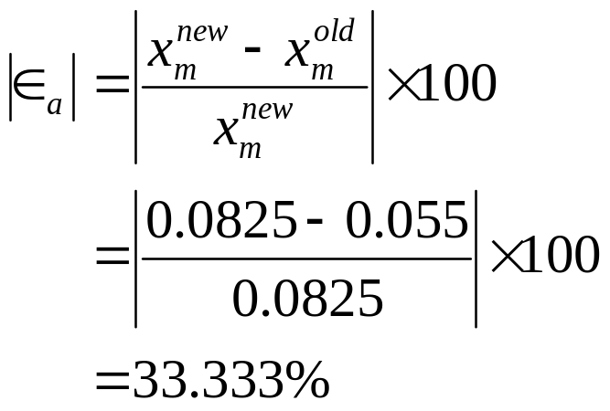
Example 1 Cont.
The absolute relative approximate error at the end of Iteration 2 is
None of the significant digits are at least correct in the estimate root of x_{m} = 0.0825 because the absolute relative approximate error is greater than 5%.

Slide 24
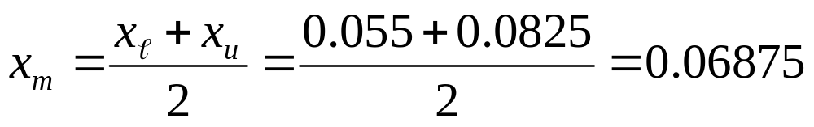
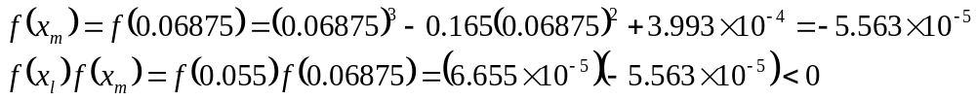

Example 1 Cont.
Iteration 3
The estimate of the root is
Hence the root is bracketed between x and x_{m}, that is, between 0.055 and 0.06875. So, the lower and upper limits of the new bracket are

Slide 25
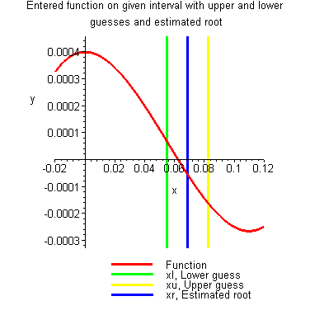
Example 1 Cont.
Figure 11 Estimate of the root for Iteration 3

Slide 26
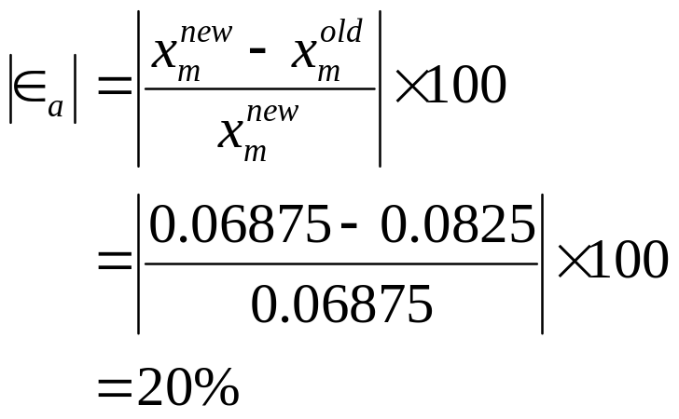
Example 1 Cont.
The absolute relative approximate error at the end of Iteration 3 is
Still none of the significant digits are at least correct in the estimated root of the equation as the absolute relative approximate error is greater than 5%.
Seven more iterations were conducted and these iterations are shown in Table 1.

Slide 27
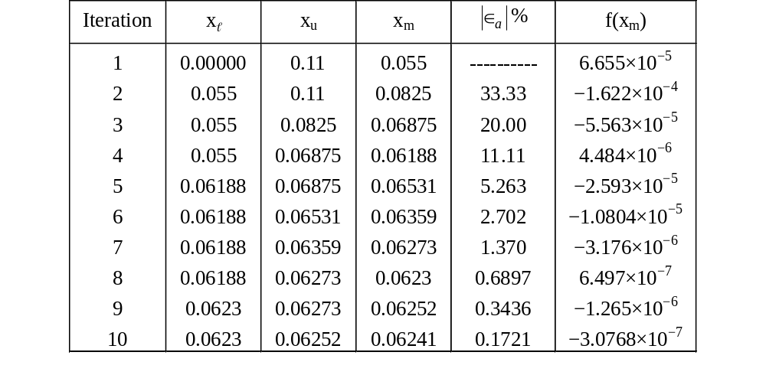
Table 1 Cont.
Table 1 Root of f(x)=0 as function of number of iterations for bisection method.

Slide 28
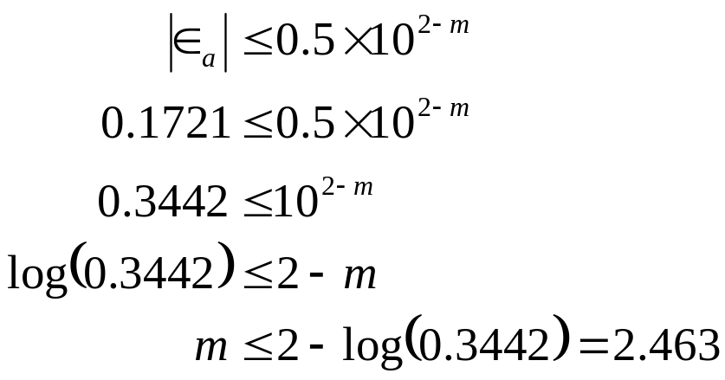

Table 1 Cont.
Hence the number of significant digits at least correct is given by the largest value of m for which
So
The number of significant digits at least correct in the estimated root of 0.06241 at the end of the 10th iteration is 2.

Slide 29
Advantages
Always convergent
The root bracket gets halved with each iteration - guaranteed.

Slide 30
Drawbacks
Slow convergence
If one of the initial guesses is close to the root, the convergence is slower

Slide 31
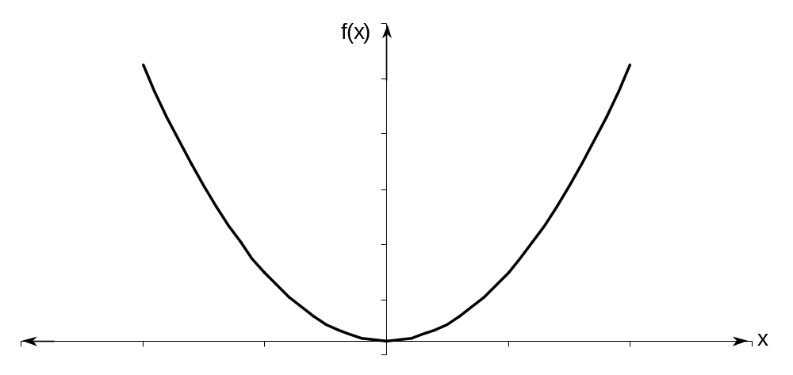
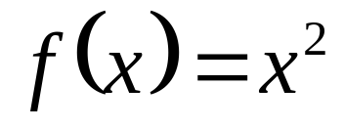
Drawbacks (continued)
If a function f(x) is such that it just touches the x-axis it will be unable to find the lower and upper guesses.

Slide 32
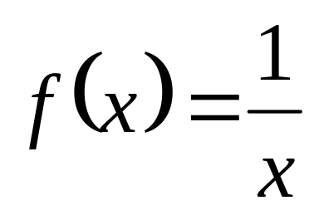
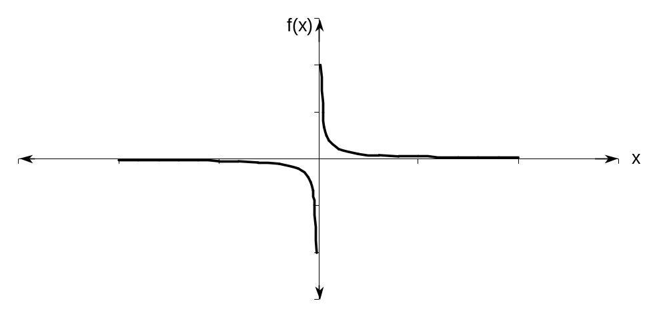
Drawbacks (continued)
Function changes sign but root does not exist

Slide 33
THE END

