Slide 1
Naïve Gauss Elimination
Partial Pivoting
Author: Autar Kaw et. al.
Textbook: TEXTBOOK: NUMERICAL METHODS WITH APPLICATIONS

Slide 2
Naïve Gauss Elimination
Pitfalls

Slide 3
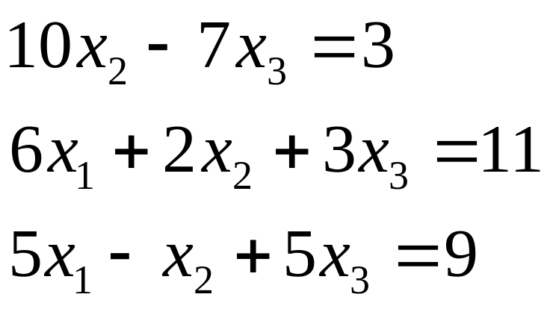
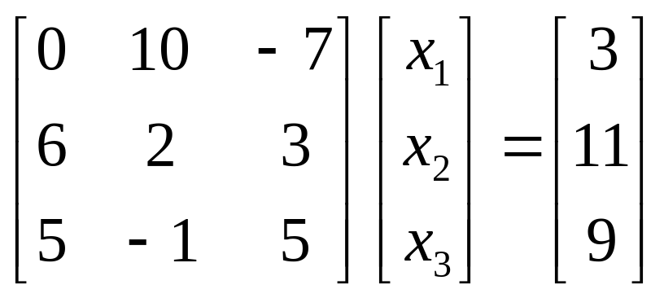
Pitfall#1. Division by zero

Slide 4
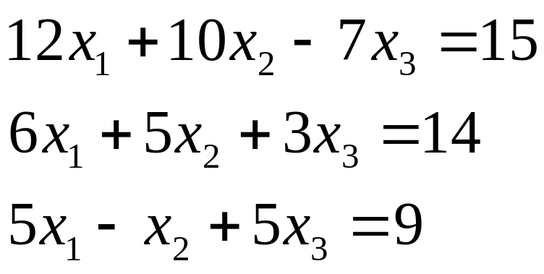
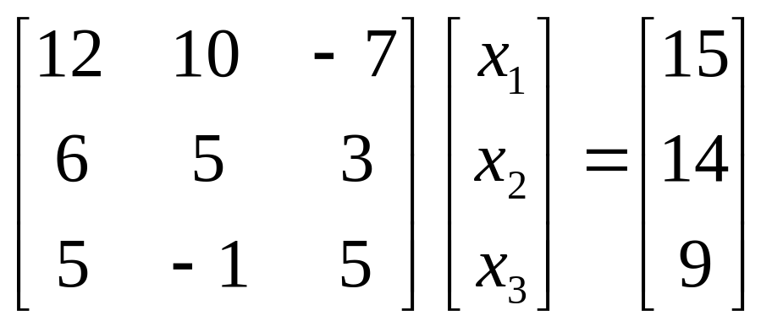
Is division by zero an issue here?

Slide 5
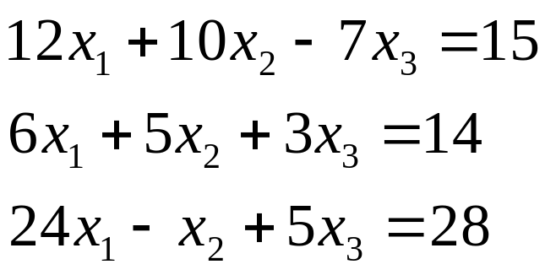
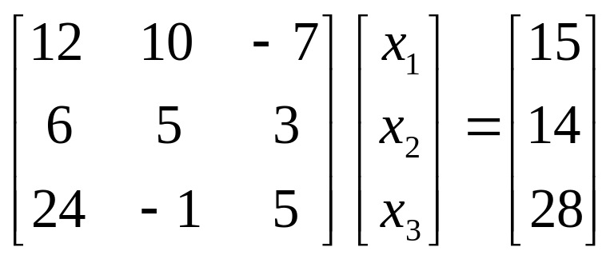
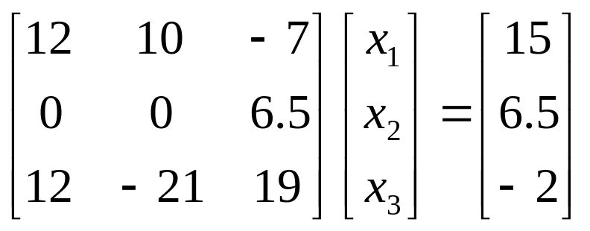
Is division by zero an issue here? YES
Division by zero is a possibility at any step of forward elimination

Slide 6
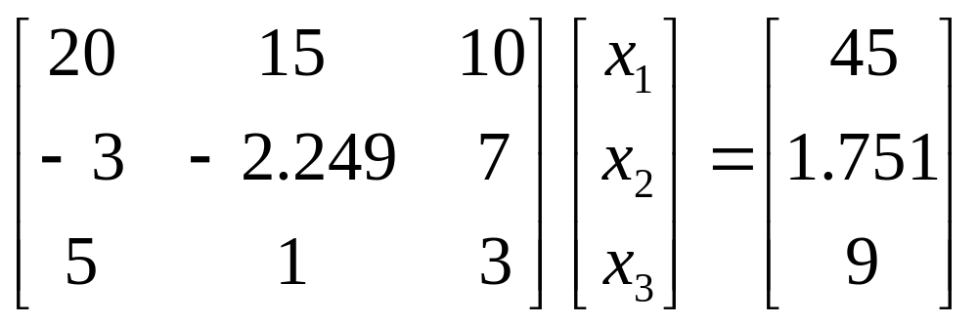
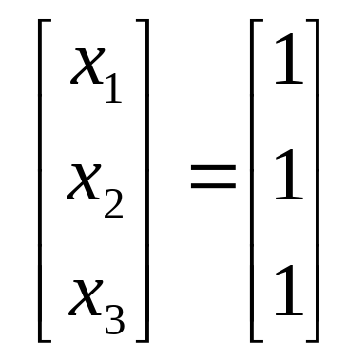
Pitfall#2. Large Round-off Errors
Exact Solution

Slide 7
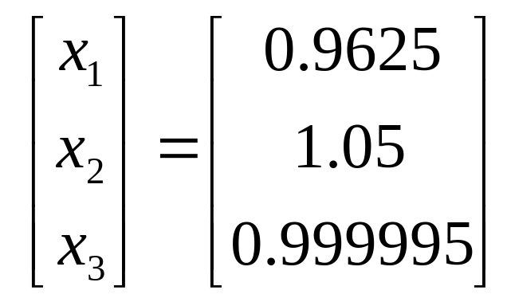
Pitfall#2. Large Round-off Errors
Solve it on a computer using 6 significant digits with chopping

Slide 8
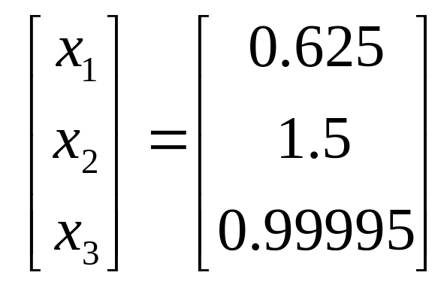
Pitfall#2. Large Round-off Errors
Solve it on a computer using 5 significant digits with chopping
Is there a way to reduce the round off error?

Slide 9
Avoiding Pitfalls
Increase the number of significant digits
Decreases round-off error
Does not avoid division by zero

Slide 10
Avoiding Pitfalls
Gaussian Elimination with Partial Pivoting
Avoids division by zero
Reduces round off error

Slide 11
Gauss Elimination with Partial Pivoting

Slide 12
Pitfalls of Naïve Gauss Elimination
Possible division by zero
Large round-off errors

Slide 13
Avoiding Pitfalls
Increase the number of significant digits
Decreases round-off error
Does not avoid division by zero

Slide 14
Avoiding Pitfalls
Gaussian Elimination with Partial Pivoting
Avoids division by zero
Reduces round off error

Slide 15
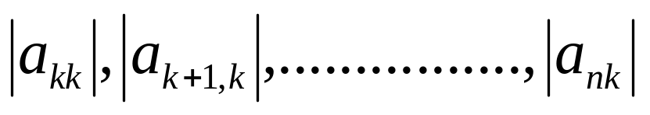
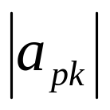

What is Different About Partial Pivoting?
At the beginning of the k^{th} step of forward elimination, find the maximum of
If the maximum of the values is
in the p ^{th} row,
then switch rows p and k.

Slide 16
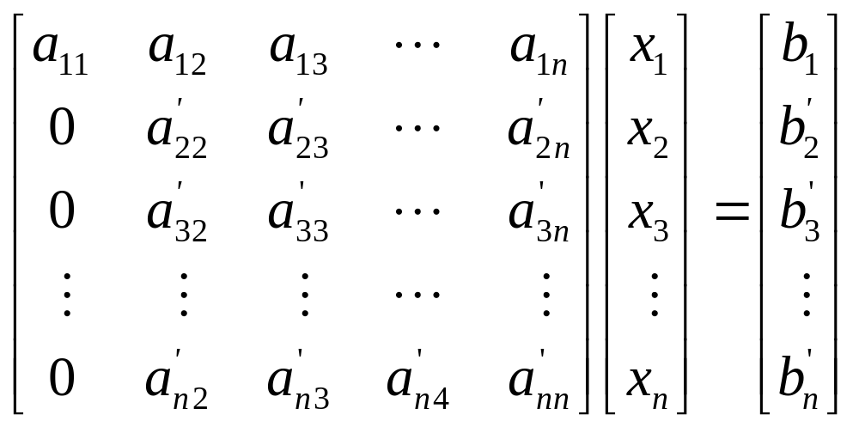
Matrix Form at Beginning of 2nd Step of Forward Elimination

Slide 17
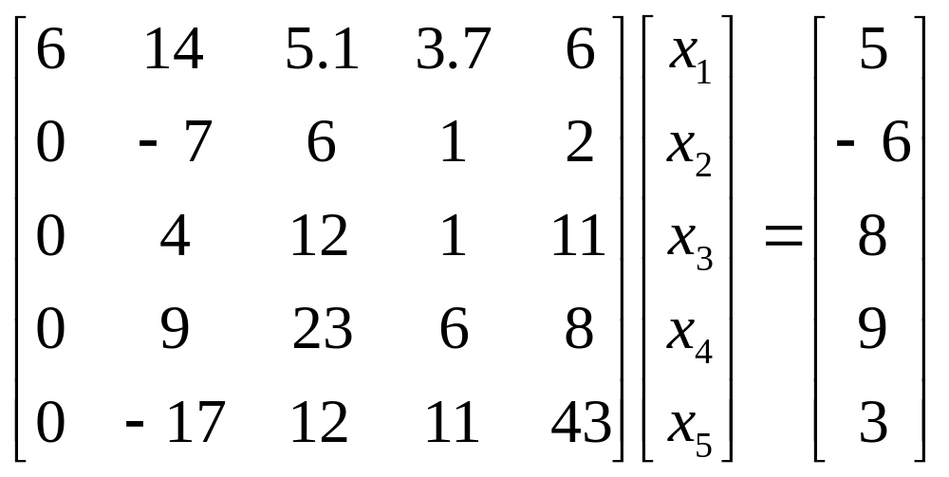
Example (2nd step of FE)
Which two rows would you switch?

Slide 18
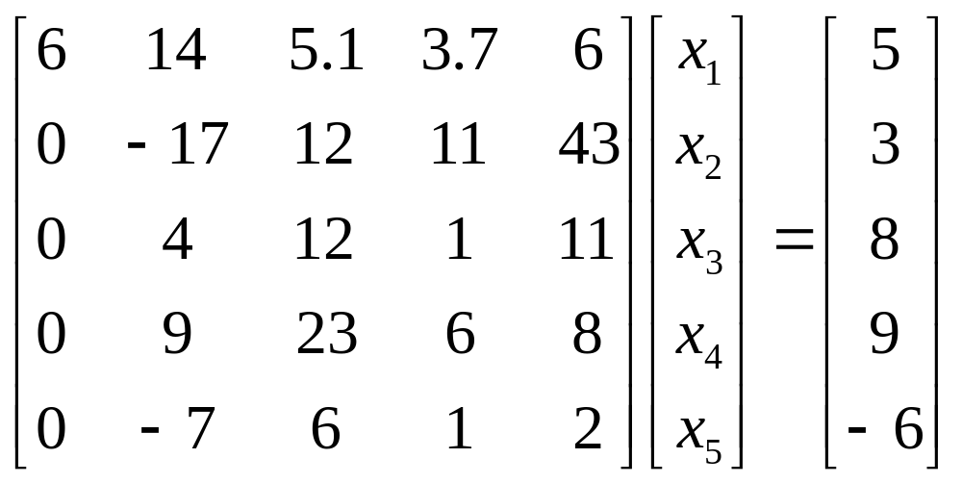
Example (2nd step of FE)
Switched Rows

Slide 19
Gaussian Elimination with Partial Pivoting
A method to solve simultaneous linear equations of the form [A][X]=[C]
Two steps
1. Forward Elimination
2. Back Substitution

Slide 20
Forward Elimination
Same as naïve Gauss elimination method except that we switch rows before each of the (n-1) steps of forward elimination.

Slide 21
Example: Matrix Form at Beginning of 2nd Step of Forward Elimination

Slide 22
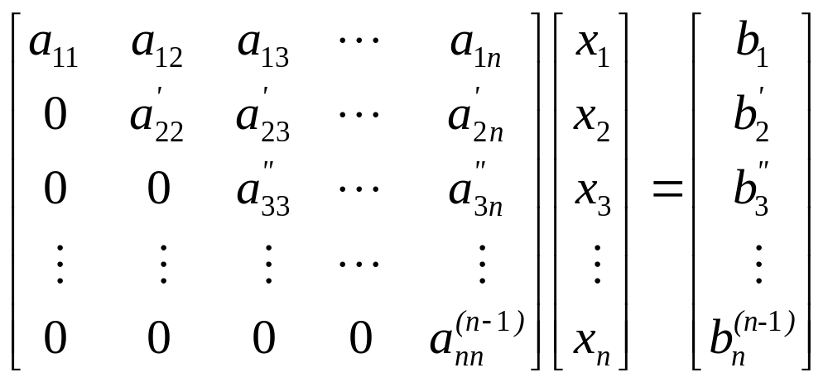
Matrix Form at End of Forward Elimination

Slide 23
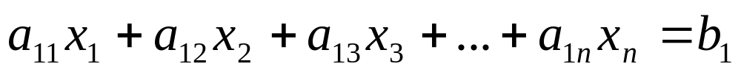
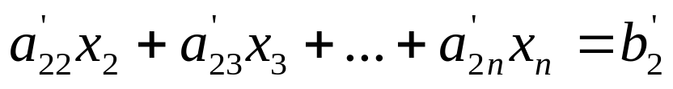
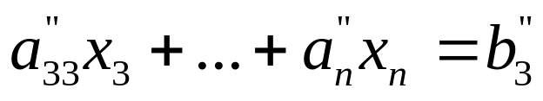
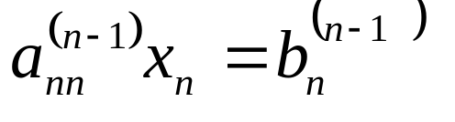
Back Substitution Starting Eqns
. .
. .
. .

Slide 24
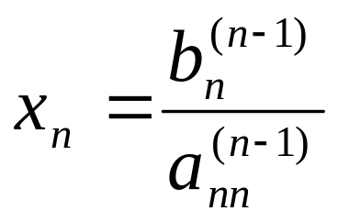
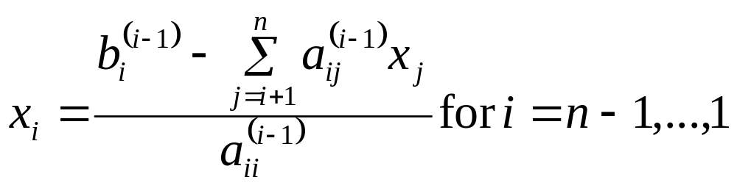
Back Substitution

Slide 25
THE END
http://numericalmethods.eng.usf.edu

Slide 26
Gauss Elimination with Partial Pivoting
Example

Slide 27
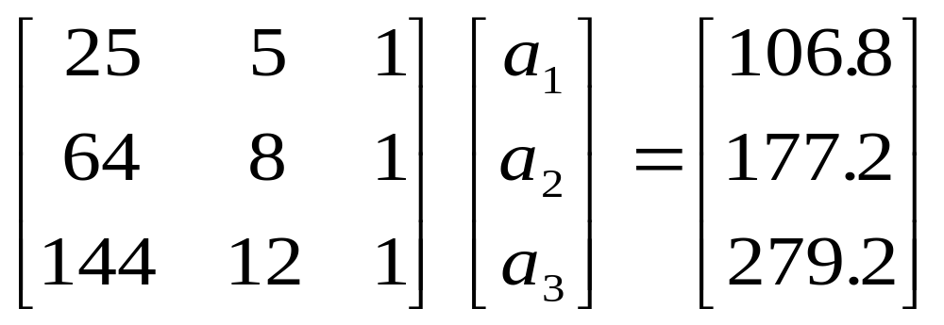
Example 2
Solve the following set of equations by Gaussian elimination with partial pivoting

Slide 28
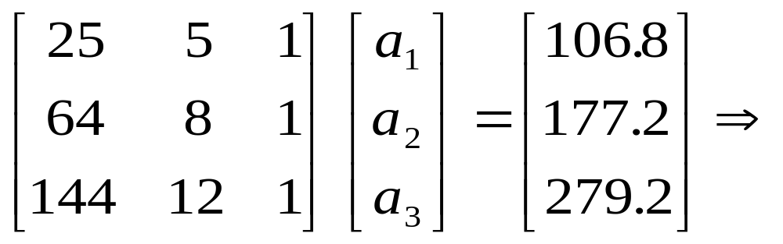
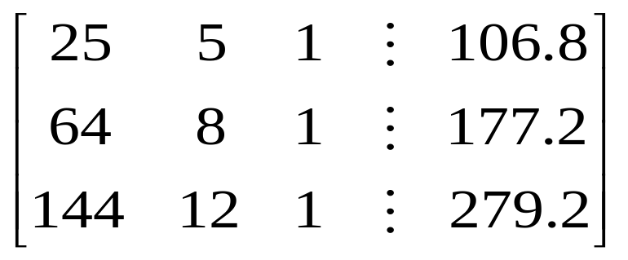
Example 2 Cont.
Forward Elimination
Back Substitution

Slide 29
Forward Elimination

Slide 30
Number of Steps of Forward Elimination
Number of steps of forward elimination is (n−1)=(3−1)=2

Slide 31
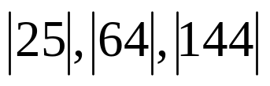
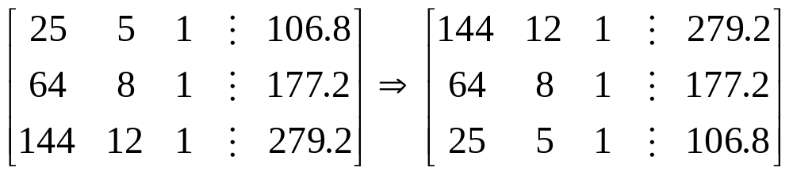
Forward Elimination: Step 1
Examine absolute values of first column, first row
and below.
Largest absolute value is 144 and exists in row 3.
Switch row 1 and row 3.

Slide 32
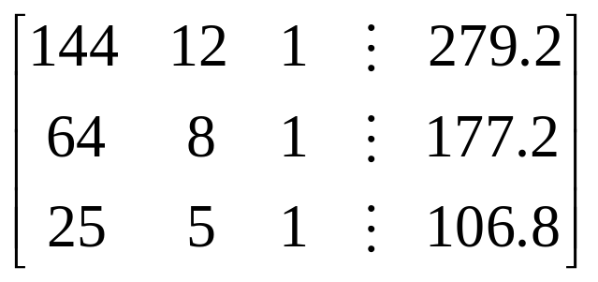
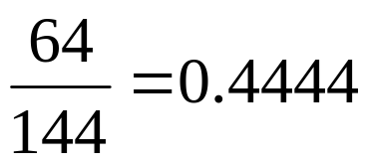
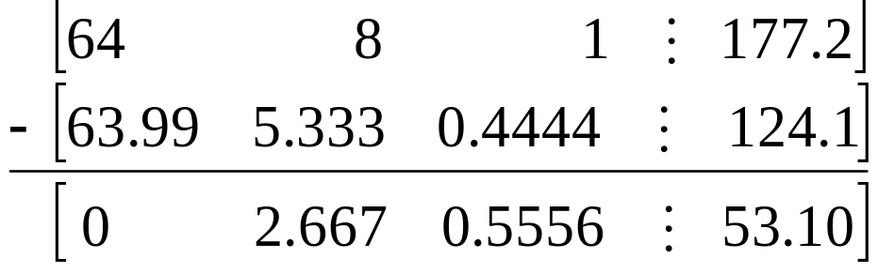
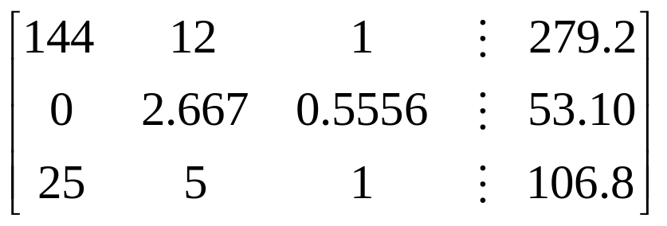
Forward Elimination: Step 1 (cont.)
Divide Equation 1 by 144 and
multiply it by 64, .
.
Subtract the result from Equation 2
Substitute new equation for Equation 2

Slide 33
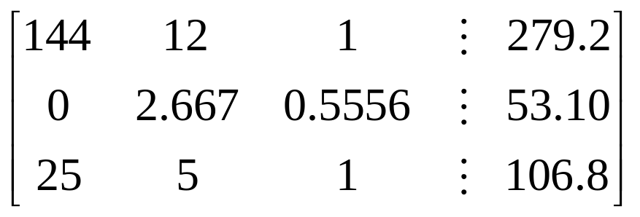
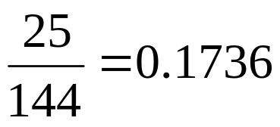
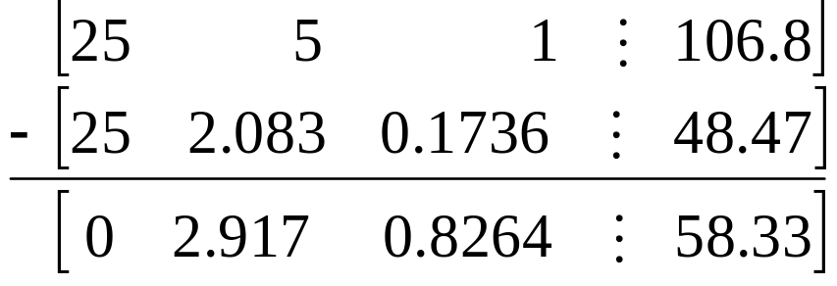
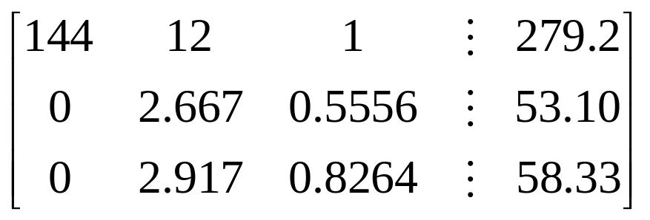
Forward Elimination: Step 1 (cont.)
Divide Equation 1 by 144 and
multiply it by 25, .
.
Subtract the result from Equation 3
Substitute new equation for Equation 3

Slide 34
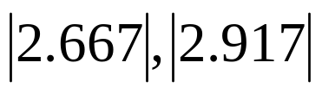
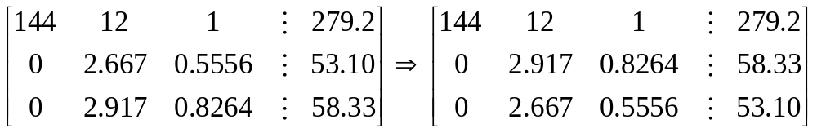
Forward Elimination: Step 2
Examine absolute values of second column, second row
and below.
Largest absolute value is 2.917 and exists in row 3.
Switch row 2 and row 3.

Slide 35
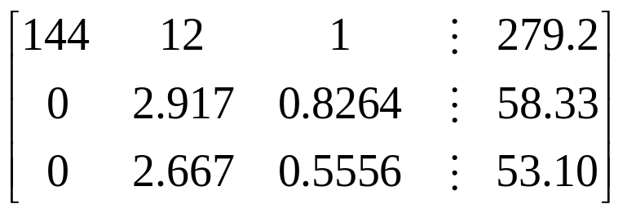
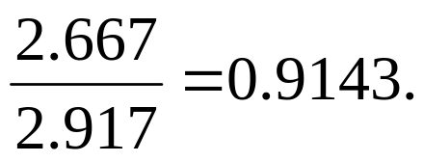
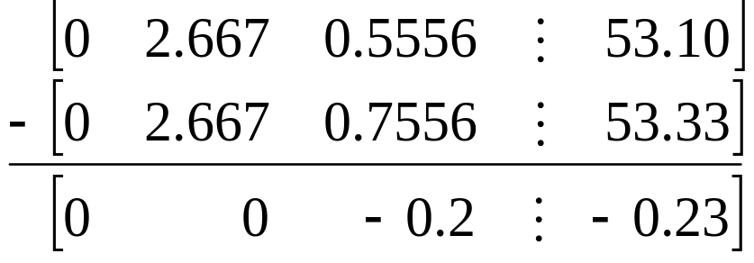
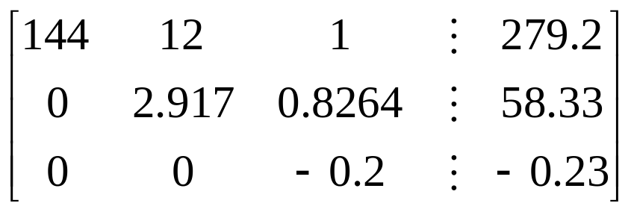
Forward Elimination: Step 2 (cont.)
Divide Equation 2 by 2.917 and
multiply it by 2.667,
.
Subtract the result from Equation 3
Substitute new equation for Equation 3

Slide 36
Back Substitution

Slide 37
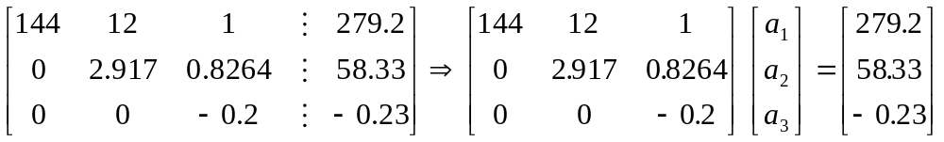
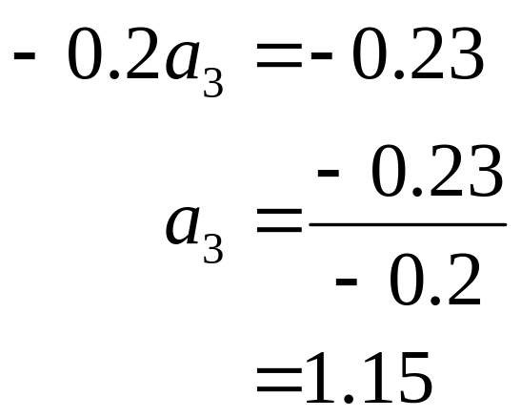
Back Substitution
Solving for a₃

Slide 38
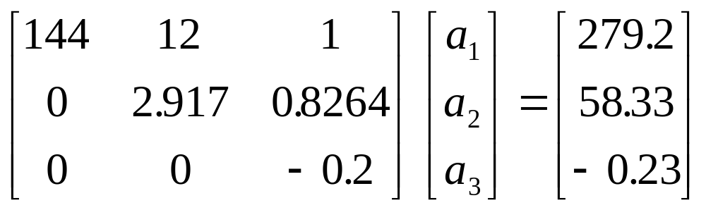
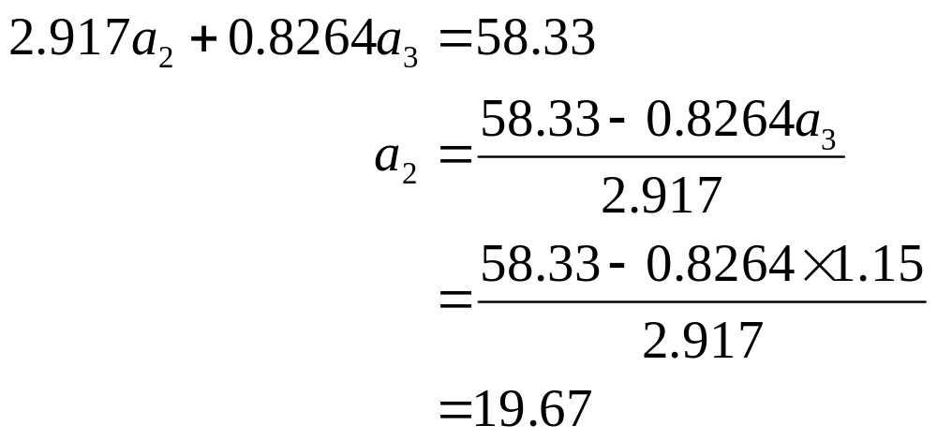
Back Substitution (cont.)
Solving for a₂

Slide 39
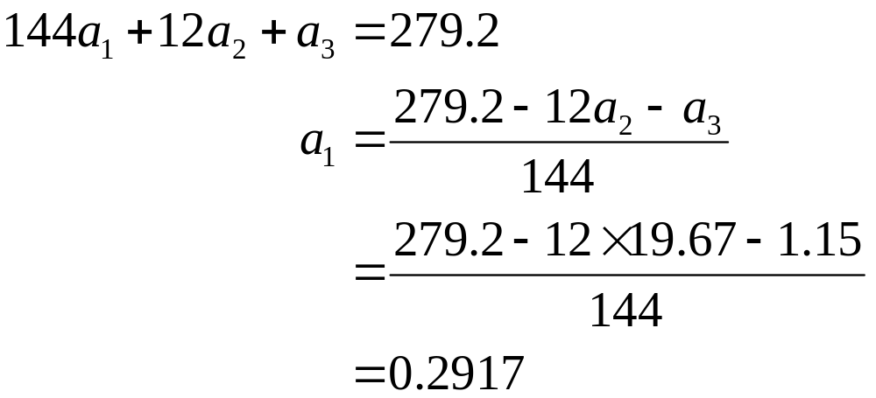
Back Substitution (cont.)
Solving for a₁

Slide 40

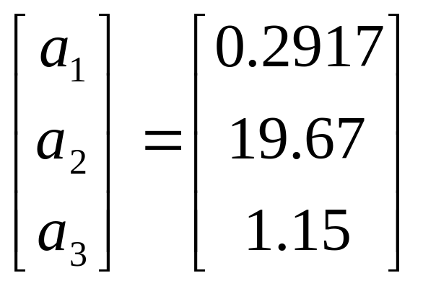
Gaussian Elimination with Partial Pivoting Solution

Slide 41
Gauss Elimination with Partial Pivoting
Another Example

Slide 42
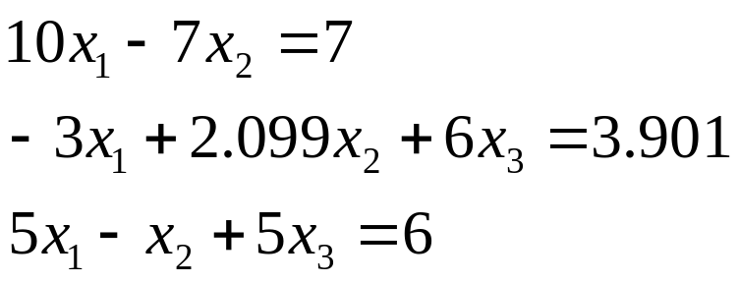
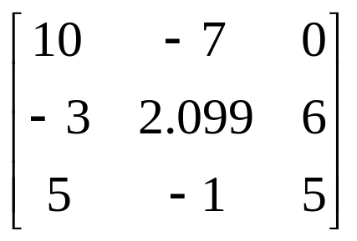


Partial Pivoting: Example
Consider the system of equations
In matrix form
=
Solve using Gaussian Elimination with Partial Pivoting using five significant digits with chopping

Slide 43



Partial Pivoting: Example
Forward Elimination: Step 1
Examining the values of the first column
|10|, |-3|, and |5| or 10, 3, and 5
The largest absolute value is 10, which means, to follow the rules of Partial Pivoting, we switch row1 with row1.
Performing Forward Elimination

Slide 44

Partial Pivoting: Example
Forward Elimination: Step 2
Examining the values of the first column
|-0.001| and |2.5| or 0.0001 and 2.5
The largest absolute value is 2.5, so row 2 is switched with row 3
Performing the row swap

Slide 45

Partial Pivoting: Example
Forward Elimination: Step 2
Performing the Forward Elimination results in:

Slide 46



Partial Pivoting: Example
Back Substitution
Solving the equations through back substitution

Slide 47


Partial Pivoting: Example
Compare the calculated and exact solution
The fact that they are equal is coincidence, but it does illustrate the advantage of Partial Pivoting

Slide 48
THE END

