Slide 1
Linear Regression
Author: Autar Kaw et. al.
Textbook: TEXTBOOK: NUMERICAL METHODS WITH APPLICATIONS

Slide 2
Linear Regression

Slide 3








What is Regression?
What is regression? Given n data points
best fit
to the data.
Residual at each point is
y
x
Figure. Basic model for regression

Slide 4

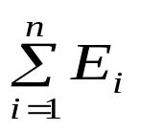







Linear Regression-Criterion#1
Given n data points
best fit
to the data.
Does minimizing
work as a criterion?
y
x
Figure. Linear regression of y vs x data showing residuals at a typical point, x_{i} .

Slide 5
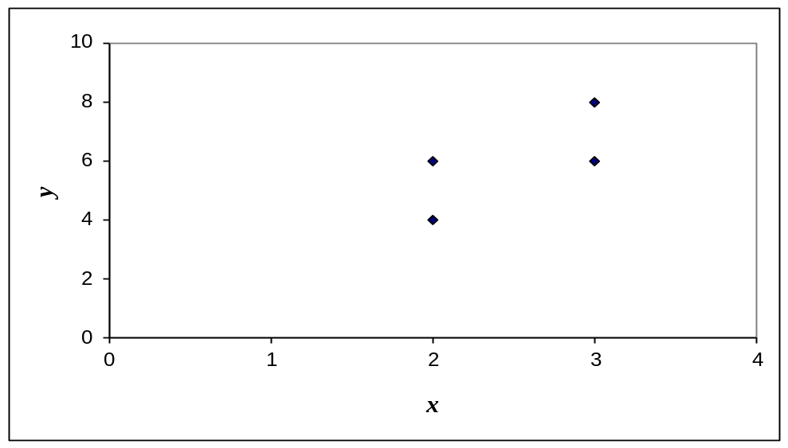
Example for Criterion#1
Example: Given the data points (2,4), (3,6), (2,6) and (3,8), best fit the data to a straight line using Criterion#1
Minimize
Table. Data Points
x | y
2.0 | 4.0
3.0 | 6.0
2.0 | 6.0
3.0 | 8.0
Figure. Data points for y vs x data.

Slide 6
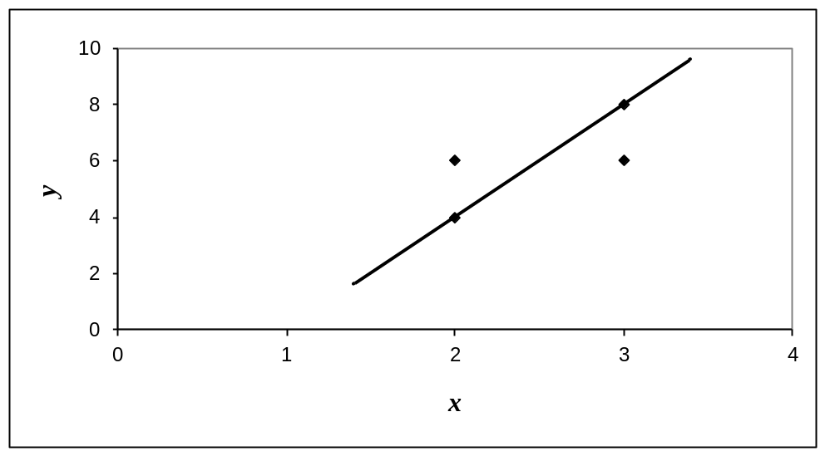
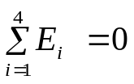
Linear Regression-Criteria#1
Using y=4x − 4 as the regression curve
Table. Residuals at each point for regression model y=4x − 4
x | y | y_{predicted} | E = y - y_{predicted}
2.0 | 4.0 | 4.0 | 0.0
3.0 | 6.0 | 8.0 | -2.0
2.0 | 6.0 | 4.0 | 2.0
3.0 | 8.0 | 8.0 | 0.0
Figure. Regression curve y=4x − 4 and y vs x data

Slide 7
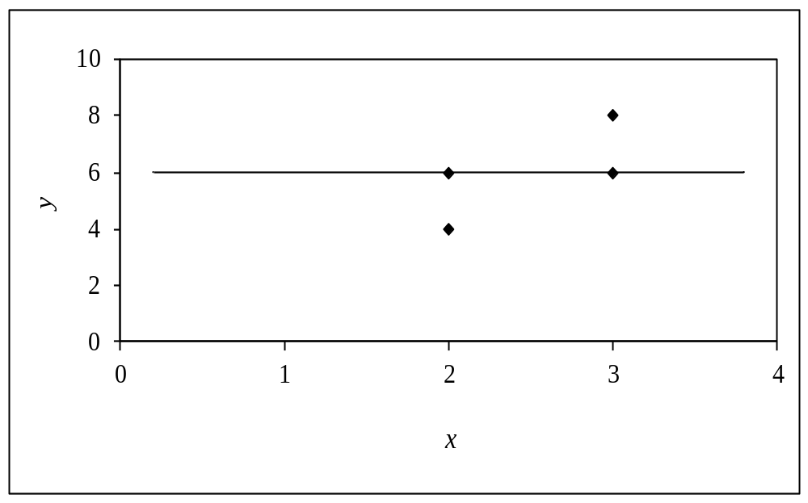
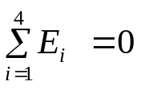
Linear Regression-Criterion#1
Using y=6 as a regression curve
Table. Residuals at each point for regression model y=6
x | y | y_{predicted} | E = y - y_{predicted}
2.0 | 4.0 | 6.0 | -2.0
3.0 | 6.0 | 6.0 | 0.0
2.0 | 6.0 | 6.0 | 0.0
3.0 | 8.0 | 6.0 | 2.0
Figure. Regression curve y=6 and y vs x data

Slide 8
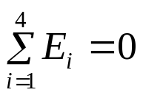
Linear Regression – Criterion #1
for both regression models of y=4x-4 and y=6
The sum of the residuals is minimized, in this case it is zero, but the regression model is not unique.
Hence the criterion of minimizing the sum of the residuals is a bad criterion.

Slide 9
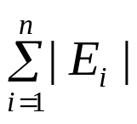






Linear Regression-Criterion#2
Will minimizing
work any better?
y
x
Figure. Linear regression of y vs. x data showing residuals at a typical point, x_{i} .

Slide 10
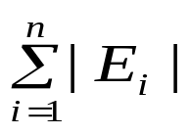
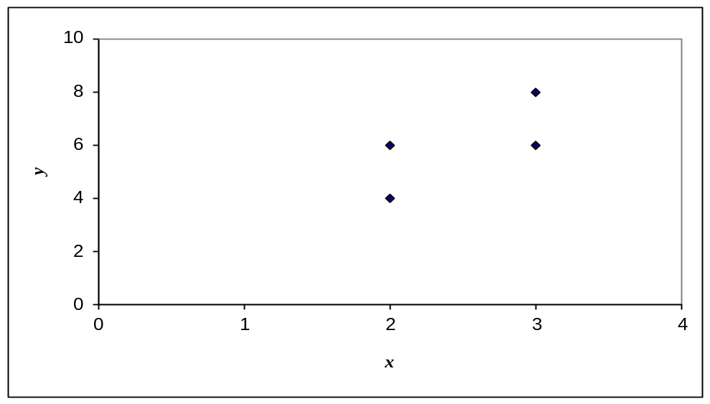
Example for Criterion#2
Example: Given the data points (2,4), (3,6), (2,6) and (3,8), best fit the data to a straight line using Criterion#2
Minimize
Table. Data Points
x | y
2.0 | 4.0
3.0 | 6.0
2.0 | 6.0
3.0 | 8.0
Figure. Data points for y vs. x data.

Slide 11
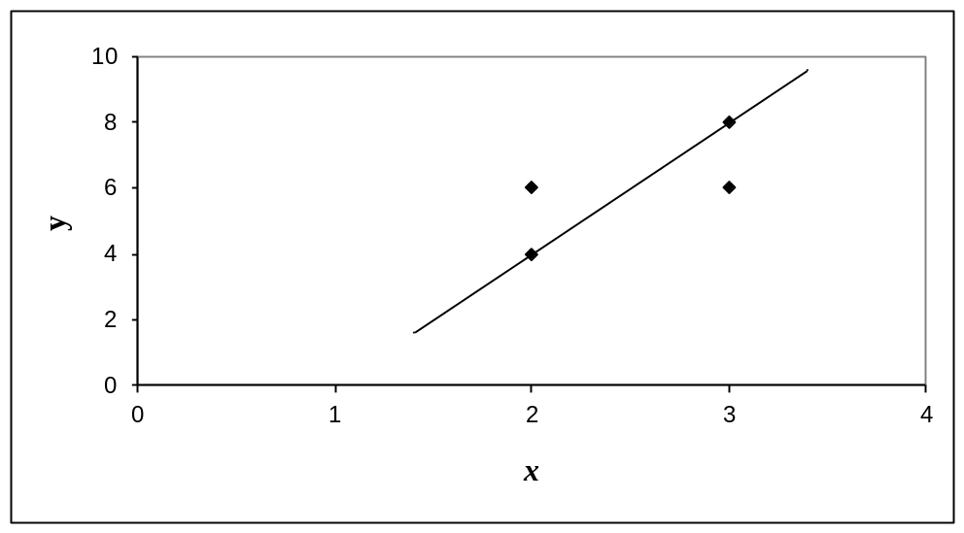
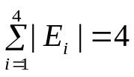
Linear Regression-Criterion#2
Using y=4x − 4 as the regression curve
Table. Residuals at each point for regression model y=4x − 4
x | y | y_{predicted} | E = y - y_{predicted}
2.0 | 4.0 | 4.0 | 0.0
3.0 | 6.0 | 8.0 | -2.0
2.0 | 6.0 | 4.0 | 2.0
3.0 | 8.0 | 8.0 | 0.0
Figure. Regression curve y= y=4x − 4 and y vs. x data

Slide 12


Linear Regression-Criterion#2
Using y=6 as a regression curve
Table. Residuals at each point for regression model y=6
x | y | y_{predicted} | E = y - y_{predicted}
2.0 | 4.0 | 6.0 | -2.0
3.0 | 6.0 | 6.0 | 0.0
2.0 | 6.0 | 6.0 | 0.0
3.0 | 8.0 | 6.0 | 2.0
Figure. Regression curve y=6 and y vs x data

Slide 13
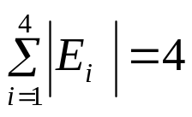
Linear Regression-Criterion#2
for both regression models of y=4x − 4 and y=6.
The sum of the absolute residuals has been made as small as possible, that is 4, but the regression model is not unique.
Hence the criterion of minimizing the sum of the absolute value of the residuals is also a bad criterion.

Slide 14
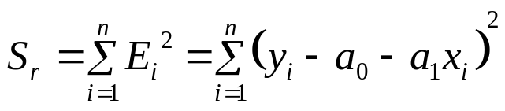





Least Squares Criterion
The least squares criterion minimizes the sum of the square of the residuals in the model, and also produces a unique line.
y
x
Figure. Linear regression of y vs x data showing residuals at a typical point, x_{i} .

Slide 15






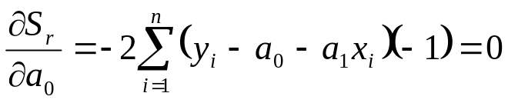
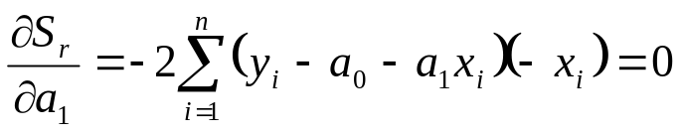
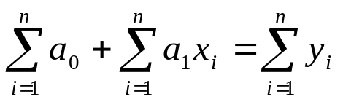
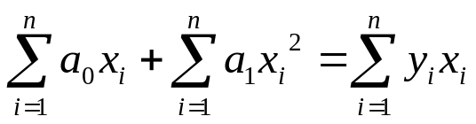
Finding Constants of Linear Model
Minimize the sum of the square of the residuals:
To find
and
we minimize
with respect to
and
.
giving

Slide 16
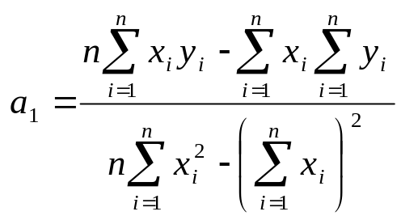
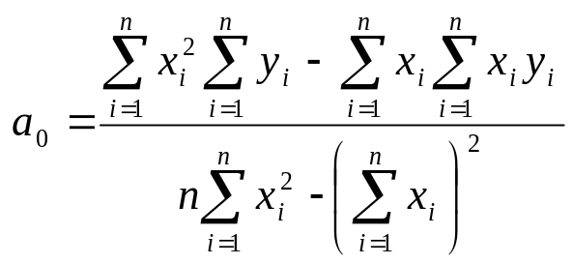

Finding Constants of Linear Model
Solving for
and
directly yields,
and

Slide 17

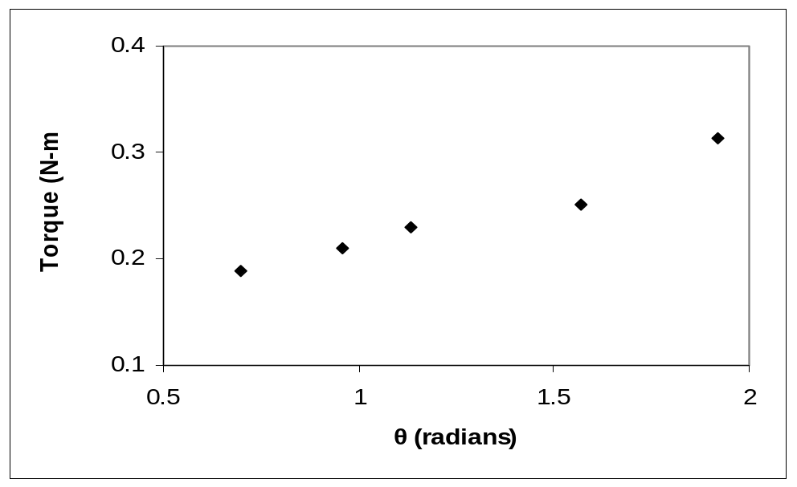
Example 1
The torque, T needed to turn the torsion spring of a mousetrap through an angle, is given below.
Find the constants for the model given by
Table: Torque vs Angle for a torsional spring
Angle, θ | Torque, T
Radians | N-m
0.698132 | 0.188224
0.959931 | 0.209138
1.134464 | 0.230052
1.570796 | 0.250965
1.919862 | 0.313707
Figure. Data points for Torque vs Angle data

Slide 18





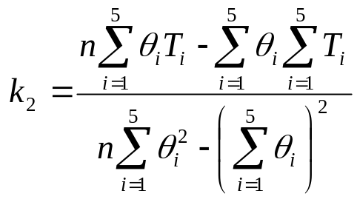
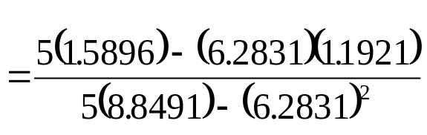
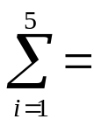

Example 1 cont.
The following table shows the summations needed for the calculations of the constants in the regression model.
Table. Tabulation of data for calculation of important
summations
Radians | N-m | Radians² | N-m-Radians
0.698132 | 0.188224 | 0.487388 | 0.131405
0.959931 | 0.209138 | 0.921468 | 0.200758
1.134464 | 0.230052 | 1.2870 | 0.260986
1.570796 | 0.250965 | 2.4674 | 0.394215
1.919862 | 0.313707 | 3.6859 | 0.602274
6.2831 | 1.1921 | 8.8491 | 1.5896
Using equations described for
and
with
N-m/rad

Slide 19

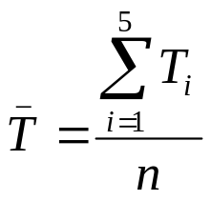
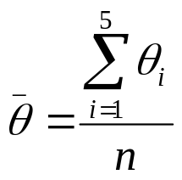
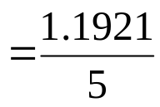
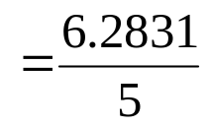


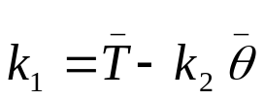

Example 1 cont.
Use the average torque and average angle to calculate
Using,
N-m

Slide 20
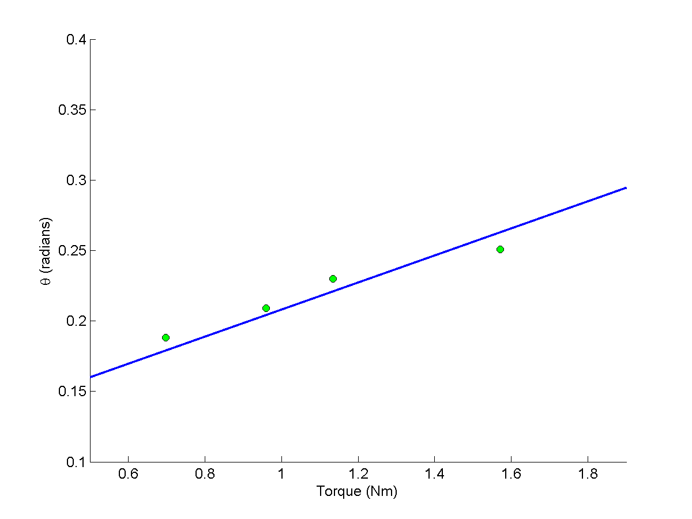
Example 1 Results
Using linear regression, a trend line is found from the data
Figure. Linear regression of Torque versus Angle data
Can you find the energy in the spring if it is twisted from 0 to 180 degrees?

Slide 21
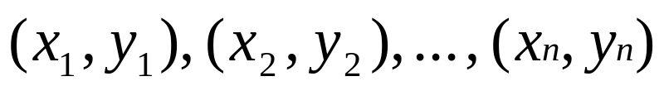

Linear Regression (special case)
Given
best fit
to the data.

Slide 22


Linear Regression (special case cont.)
y
x

Slide 23
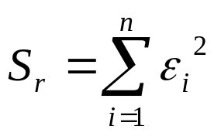
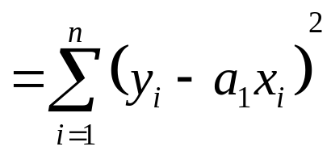
Linear Regression (special case cont.)
Residual at each data point
Sum of square of residuals

Slide 24

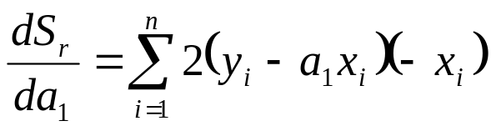
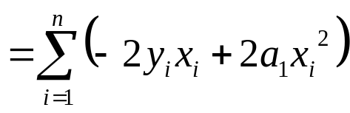
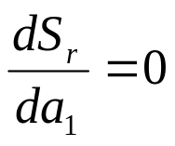
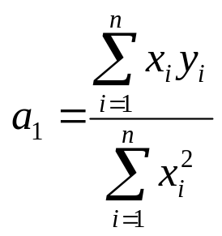
Linear Regression (special case cont.)
Differentiate with respect to
gives

Slide 25

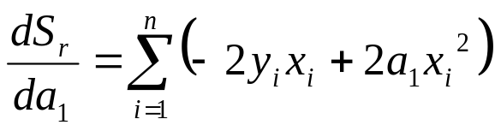
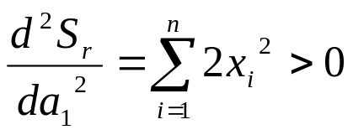
Linear Regression (special case cont.)
Does this value of a₁ correspond to a local minima or local maxima?
Yes, it corresponds to a local minima.

Slide 26

Linear Regression (special case cont.)

Slide 27


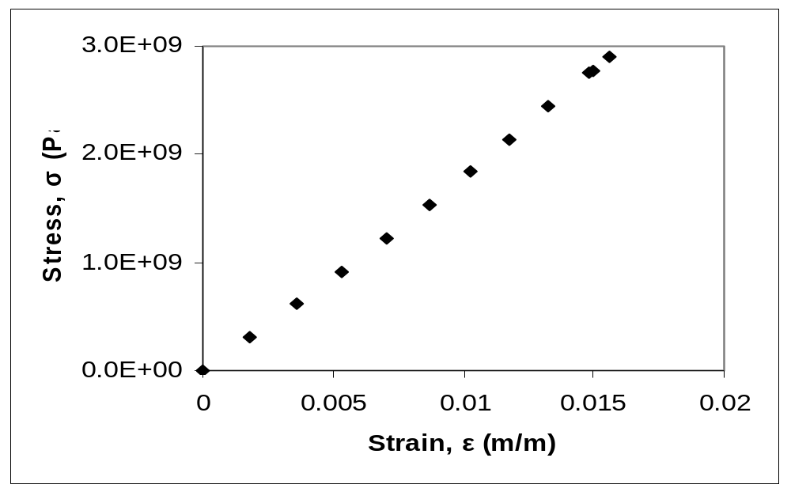
Example 2
To find the longitudinal modulus of composite, the following data is collected. Find the longitudinal modulus,
using the regression model
Table. Stress vs. Strain data
and the sum of the square of the
Strain | Stress
(%) | (MPa)
0 | 0
0.183 | 306
0.36 | 612
0.5324 | 917
0.702 | 1223
0.867 | 1529
1.0244 | 1835
1.1774 | 2140
1.329 | 2446
1.479 | 2752
1.5 | 2767
1.56 | 2896
residuals.
Figure. Data points for Stress vs. Strain data

Slide 28
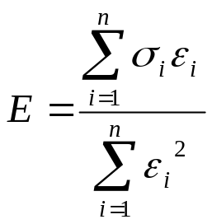
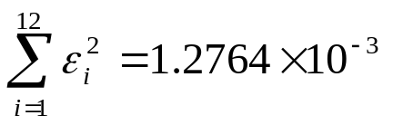
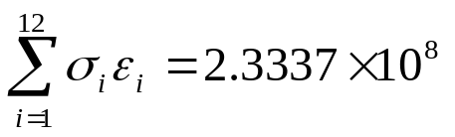
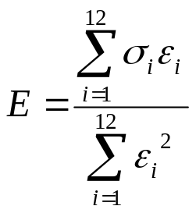
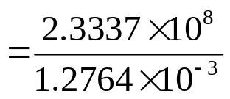


Example 2 cont.
Table. Summation data for regression model
i | ε | σ | ε ² | εσ
1 | 0.0000 | 0.0000 | 0.0000 | 0.0000
2 | 1.8300×10⁻³ | 3.0600×10⁸ | 3.3489×10⁻⁶ | 5.5998×10⁵
3 | 3.6000×10⁻³ | 6.1200×10⁸ | 1.2960×10⁻⁵ | 2.2032×10⁶
4 | 5.3240×10⁻³ | 9.1700×10⁸ | 2.8345×10⁻⁵ | 4.8821×10⁶
5 | 7.0200×10⁻³ | 1.2230×10⁹ | 4.9280×10⁻⁵ | 8.5855×10⁶
6 | 8.6700×10⁻³ | 1.5290×10⁹ | 7.5169×10⁻⁵ | 1.3256×10⁷
7 | 1.0244×10⁻² | 1.8350×10⁹ | 1.0494×10⁻⁴ | 1.8798×10⁷
8 | 1.1774×10⁻² | 2.1400×10⁹ | 1.3863×10⁻⁴ | 2.5196×10⁷
9 | 1.3290×10⁻² | 2.4460×10⁹ | 1.7662×10⁻⁴ | 3.2507×10⁷
10 | 1.4790×10⁻² | 2.7520×10⁹ | 2.1874×10⁻⁴ | 4.0702×10⁷
11 | 1.5000×10⁻² | 2.7670×10⁹ | 2.2500×10⁻⁴ | 4.1505×10⁷
12 | 1.5600×10⁻² | 2.8960×10⁹ | 2.4336×10⁻⁴ | 4.5178×10⁷
 |  |  | 1.2764×10⁻³ | 2.3337×10⁸

Slide 29

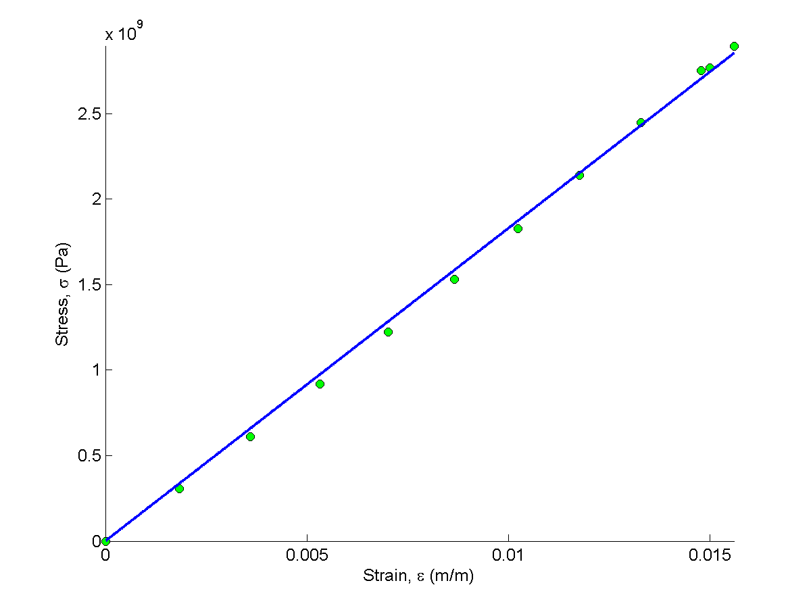
Example 2 Results
The equation
describes the data.
Figure. Linear regression for stress vs. strain data

Slide 30
THE END

