Slide 1
Operating Systems

Slide 2
39. File and Directories

Slide 3
Concepts
File
File is simply a linear array of bytes.
Each file has low-level name as ’inode number’
Directory
A file
A list of <user-readable filename, low-level filename> pairs
/
root directory
vaild files :
/foo/bar.txt
/bar/foo/bar.txt
vaild directory :
/
/foo
/bar
/bar/bar
/bar/foo/
foo
bar
bar.txt
bar
foo
bar.txt
An Example Directory Tree
Youjip Won

Slide 4
Interface: Creating a file
Use open system call with O_CREAT flag.
int fd = open("foo", O_CREAT|O_WRONLY|O_TRUNC, S_IRUSR|S_IWUSR);
O_CREAT : create file.
O_WRONLY : only write to that file while opened.
O_TRUNC : make the file size zero (remove any existing content).
open system call returns file descriptor.
file descriptor is an integer, is used to access files.
Ex) read (file descriptor)
File descriptor table
struct proc {
...
struct file *ofile[NOFILE]; // Open files
...
};

Slide 5
Interface: Reading and Writing Files
An Example of reading and writing ‘foo’ file.
The result of strace to figure out cat is doing.
open(): open file for reading with O_RDOLY and O_LARGEFILE flags.
returns file descriptor 3 ( 0,1,2, is for standard input/output/error)
read(): read bytes from the file.
write(): write buffer to standard output.
prompt> echo hello > foo //save the output to the file foo
prompt> cat foo //dump the contents to the screen
hello
prompt>
prompt> stace cat foo //strace to figure out what cat is doing
…
open(“foo”, O_RDONLY|O_LARGEFILE) = 3
read(3, “hello\n”, 4096) = 6 /*the number of bytes to read*/
write(1, “hello\n”, 6) = 6
hello
read(3, “hello\n”, 4096) = 0
write(1, “hello\n”, 6) = 0
..
prompt>

Slide 6
Reading and Writing Files (Cont.)
OFFSET
The position of the file where we start read and write.
When a file is open, “an offset” is allocated.
Updated after read/write
How to read or write to a specific offset within a file ?
Third argument is how the seek is performed.
SEEK_SET : to offset bytes.
SEEK_CUR: to its current location plus offset bytes.
SEEK_END: to the size of the file plus offset bytes.
offset
off_t lseek(int fd, off_t offset /*location */, int whence);

Slide 7
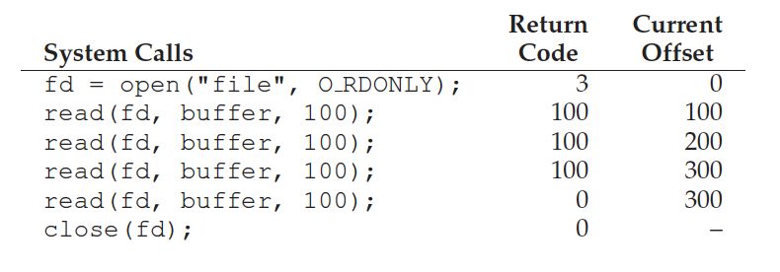
abstractions
struct file {
int ref;
char readable;
char writable;
struct inode *ip;
uint off;
};
struct {
struct spinlock lock;
struct file file[NFILE];
} ftable;

Slide 8
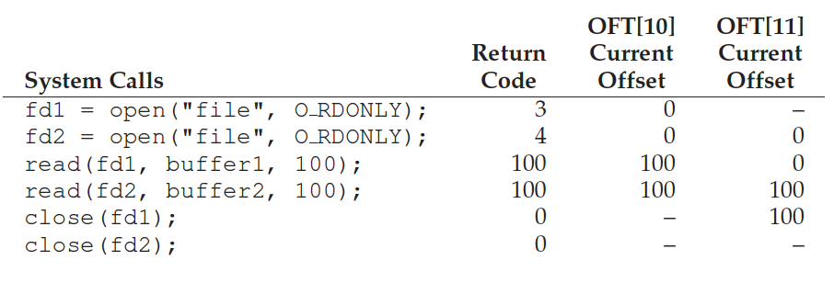
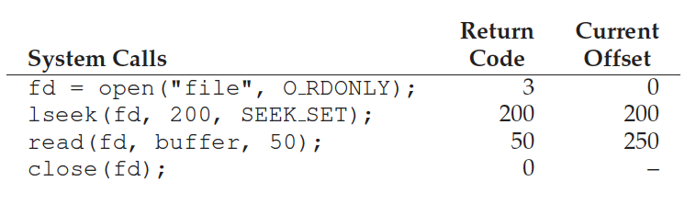
Sample traces

Slide 9
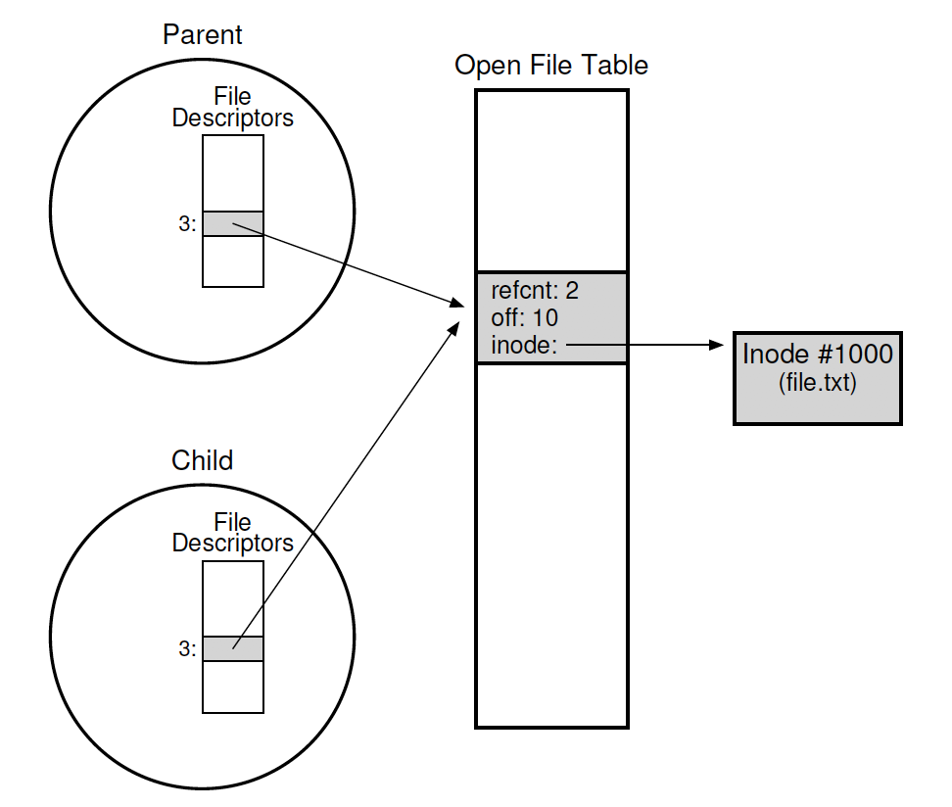
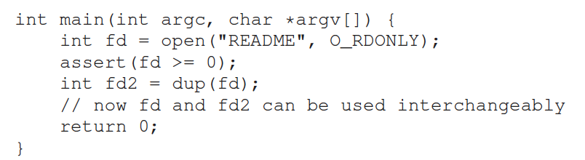
fork() and dup()
Child process inherits the file descriptor table of the parent.
Duplicating a file descriptor

Slide 10
fsync()
Persistency
write():write data to the buffer. Later, save it to the storage.
some applications require more than eventual guarantee. Ex) DBMS
fsync():the writes are forced immediately to disk.
An Example of fsync().
If a file is created, it needs to be durably a part of the directory.
Above code requires fsync() to directory also.
off_t fsync(int fd /*for the file referred to by the specified file*/)
int fd = open("foo", O_CREAT | O_WRONLY | O_TRUNC);
int rc = write(fd, buffer, size);
rc = fsync(fd);

Slide 11
Renaming Files
rename():rename a file to different name.
It implemented as an atomic call.
Ex) change from foo to bar
Saving a file in an editor
promt > mv foo bar
int fd = open("foo.txt.tmp", O_WRONLY|O_CREAT|O_TRUNC);
write(fd, buffer, size); // write out new version of file
fsync(fd);
close(fd);
rename("foo.txt.tmp", "foo.txt");

Slide 12
Getting Information About Files
stat(): Show the File metadata
metadata is information about each file, ex: size, permission, ..
stat structure is below:
struct stat {
dev_t st_dev; /* ID of device containing file */
ino_t st_ino; /* inode number */
mode_t st_mode; /* protection */
nlink_t st_nlink; /* number of hard links */
uid_t st_uid; /* user ID of owner */
gid_t st_gid; /* group ID of owner */
dev_t st_rdev; /* device ID (if special file) */
off_t st_size; /* total size, in bytes */
blksize_t st_blksize; /* blocksize for filesystem I/O */
blkcnt_t st_blocks; /* number of blocks allocated */
time_t st_atime; /* time of last access */
time_t st_mtime; /* time of last modification */
time_t st_ctime; /* time of last status change */
};

Slide 13
Getting Information About Files (Cont.)
An example of stat()
All information is in a inode
prompt> echo hello > file
prompt> stat file
File: ‘file’
Size: 6 Blocks: 8 IO Block: 4096 regular file
Device: 811h/2065d Inode: 67158084 Links: 1
Access: (0640/-rw-r-----) Uid: (30686/ root) Gid: (30686/ remzi)
Access: 2011-05-03 15:50:20.157594748 -0500
Modify: 2011-05-03 15:50:20.157594748 -0500
Change: 2011-05-03 15:50:20.157594748 -0500

Slide 14
Removing Files
The result of strace to figure out what rm is doing.
rm is Linux command to remove a file
rm calls unlink() to remove a file.
prompt> strace rm foo
...
unlink(“foo”)
...
prompt>

Slide 15
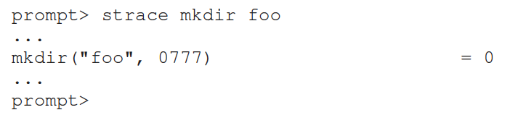
Making Directories
mkdir(): Make a directory
When a directory is created, it is empty.
Empty directory have two entries: . (itself), ..(parent)
prompt> ls -al
total 8
drwxr-x--- 2 roo root 6 Apr 30 16:17 ./
drwxr-x--- 26 root root 4096 Apr 30 16:17 ../

Slide 16
Reading Directories
readdir()
Directory is a file, but with a specific structure.
When reading a directory, we use specific system call other than read().
A sample code to read directory entries.
int main(int argc, char *argv[]) {
DIR *dp = opendir("."); /* open current directory */
assert(dp != NULL);
struct dirent *d;
while ((d = readdir(dp)) != NULL) { /* read one directory entry */
printf("%d %s\n", (int) d->d_ino, d->d_name);
}
closedir(dp); /*close current directory */
return 0;
}

Slide 17
Reading Directories
Structure of the directory entry
struct dirent {
char d_name[256]; /* filename */
ino_t d_ino; /* inode number */
off_t d_off; /* offset to the next dirent */
unsigned short d_reclen; /* length of this record */
unsigned char d_type; /* type of file */
};

Slide 18
Deleting Directories
rmdir(): Delete a directory.
rmdir()requires directory be empty before it deleted.
If you call rmdir()to a non-empty directory, it will fail.

Slide 19
Hard Links
link(): Link old file and a new file.
Create hard link named file2.
The result of link()
Two files have same inode number, but two human name(file, file2)
prompt> echo hello > file
prompt> cat file
hello
prompt> ln file file2 /* create a hard link, link file to file2 */
prompt> cat file2
hello
prompt> ls -i file file2
67158084 file /* inode value is 67158084 */
67158084 file2 /* inode value is 67158084 */
prompt>

Slide 20
Hard Links (Cont.)
How to create hard link file?
Step1. Make an inode, track all information about the file.
Step2. Link a human-readable name to file.
Step3. Put link file into a current directory.
After creating a hard link to file, old and new files have no difference.
Thus, to remove a file, we call unlink().

Slide 21
unlink Hard Links
What unlink() is doing ?
Check reference count within the inode number.
Remove link between human-readable name and inode number.
Decrease reference count.
When only it reaches zero, It delete a file (free the inode and related blocks)

Slide 22
unlink Hard Links (Cont.)
The result of unlink()
prompt> echo hello > file /* create file*/
prompt> stat file
... Inode: 67158084 Links: 1 ... /* Link count is 1 */
prompt> ln file file2 /* hard link file2 */
prompt> stat file
... Inode: 67158084 Links: 2 ... /* Link count is 2 */
prompt> stat file2
... Inode: 67158084 Links: 2 ... /* Link count is 2 */
prompt> ln file2 file3 /* hard link file3 */
prompt> stat file
... Inode: 67158084 Links: 3 ... /* Link count is 3 */
prompt> rm file /* remove file */
prompt> stat file2
... Inode: 67158084 Links: 2 ... /* Link count is 2 */
prompt> rm file2 /* remove file2 */
prompt> stat file3
... Inode: 67158084 Links: 1 ... /* Link count is 1 */
prompt> rm file3

Slide 23
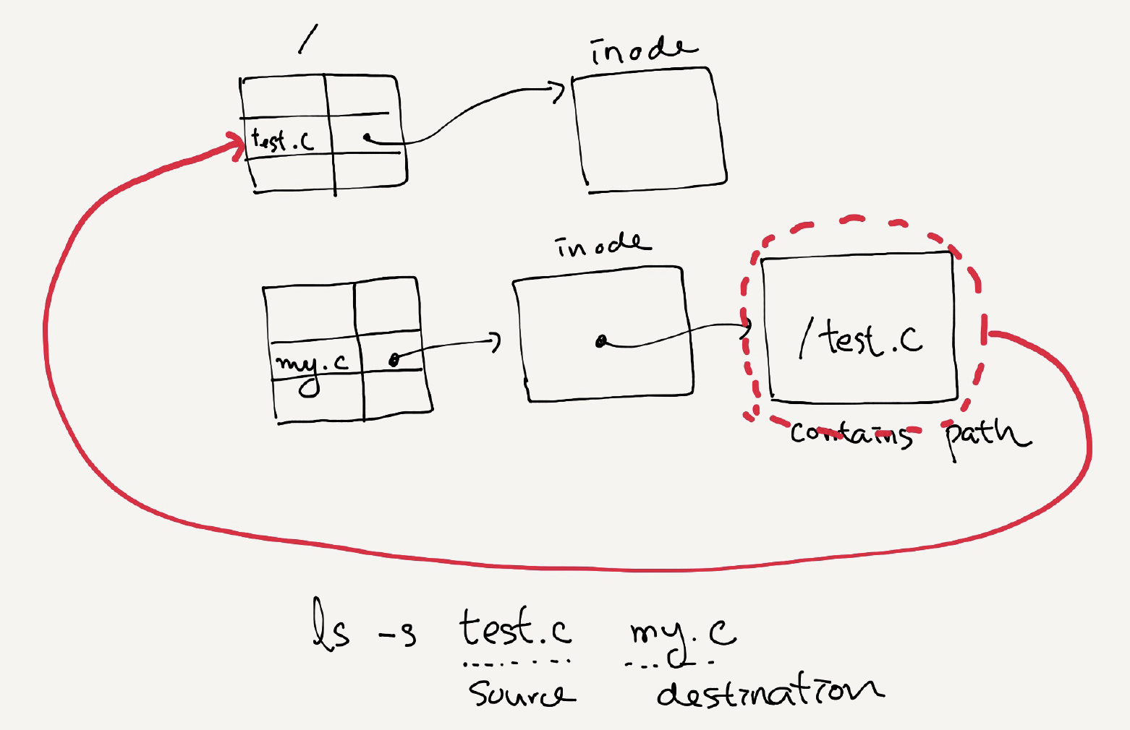
Symbolic Links
Symbolic link
Special file that contains path to the source directory.
Hard Link cannot create to a directory.
Hard Link cannot create to a file to other partition.
An example of symbolic link
prompt> echo hello > file
prompt> ln –s file file2 /* option –s : create a symbolic link, */
prompt> cat file2
hello

Slide 24
Symbolic Links (Cont.)
Symbolic link is different file type.
Symbolic link is subject to the dangling reference.
prompt> ls -al
drwxr-x--- 2 remzi remzi 29 May 3 19:10 ./
drwxr-x--- 27 remzi remzi 4096 May 3 15:14 ../ /* directory */
-rw-r----- 1 remzi remzi 6 May 3 19:10 file /* regular file */
lrwxrwxrwx 1 remzi remzi 4 May 3 19:10 file2 -> file /* symbolic link */
prompt> echo hello > file
prompt> ln -s file file2
prompt> cat file2
hello
prompt> rm file
prompt> cat file2
cat: file2: No such file or directory

Slide 25
Summary
Create file
read/write/lseek
mkdir/readdir
fsync
hardlink/softlink

