Slide 1

Project title:-CrimeLink
(Online Crime Reporting Platform)
BCA 6th Semester Group Project(Group 8)
Nihira Sinha (2212427)
Sanya Bhardwaj(2212451)
Shruti Kumari(2212464)
Tushti Savarn(2212478)

Slide 2
Introduction
Problem Statement: Manual crime reporting is slow, inefficient, and lacks transparency.
Solution: CrimeLink provides an online platform to report crimes, upload evidence, and track case progress.
Crime reporting today faces significant challenges. Manual processes often lead to delays, inefficiencies, and a lack of transparency, making it difficult for victims and witnesses to report incidents effectively.
CrimeLink addresses these issues by offering a secure and user-friendly online platform. It allows individuals to report crimes, upload evidence, and track case progress in real-time. By streamlining the reporting process, CrimeLink enhances accessibility, improves response times, and ensures greater transparency in the justice system.

Slide 3
Project Scope
Who will use it?
Citizens: Report crimes, submit evidence, and access emergency SOS.
Police Officers: Monitor reports, verify evidence, and track cases in real time.
What does it do?
Online Crime Reporting- Users can file complaints digitally.
Evidence Submission – Upload images, videos, or documents securely.
Real-Time Tracking – Follow case progress instantly.

Slide 4
System Features
Citizen Dashboard :-
Report Crimes – Submit crime reports with details and evidence.
Track Case Status – Monitor the progress of submitted reports.
Interact with the Chatbot – Get assistance for their queries and doubts.
Police Dashboard:
View Assigned Cases – Access and review crime reports allocated to them.
Update Case Statuses – Modify report progress (e.g., Under Review, In Progress, Closed).
Manage Users and Cases – Oversee citizen and police accounts.
Access Analytics and System Logs – Monitor system activity, generate reports, and track performance.

Slide 5
System Architecture
Client-Side Requirements
Supported Devices: Desktop Computers, Laptops, Smartphones, Tablets.
Processor: Dual-core (Intel i3 or equivalent) or higher
RAM: Minimum 2GB
Storage: At least 500MB of free space
Display Resolution: 1024x768 pixels or higher
Internet Speed: Minimum 2 Mbps
Browser Compatibility: Chrome, Firefox, Edge, Safari (latest versions)
Server-Side Requirements
Processor: Quad-core (Intel Xeon or AMD Ryzen) or higher
RAM: Minimum 8GB
Storage: At least 100GB SSD
Bandwidth: Minimum 100 Mbps
Database Support: MySQL
Scanners or Cameras:Upload scanned documents & photographic evidence
Frontend:HTML, CSS, JavaScript for UI & interactivity
Backend: PHP for server-side scripting

Slide 6
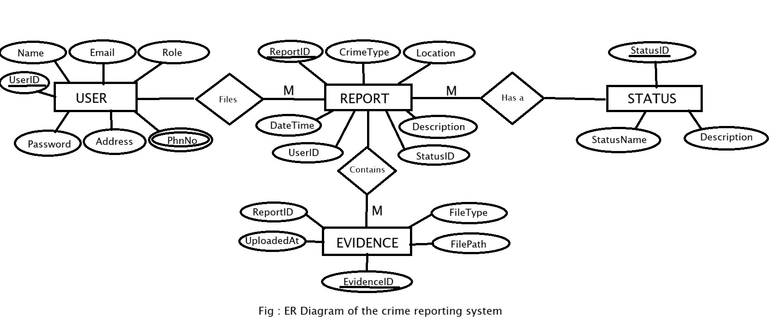
ER Diagram

Slide 7
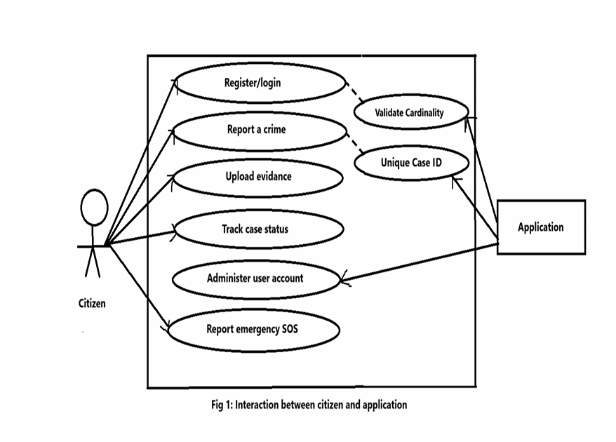
Use Case Diagrams (Citizen and Application)

Slide 8
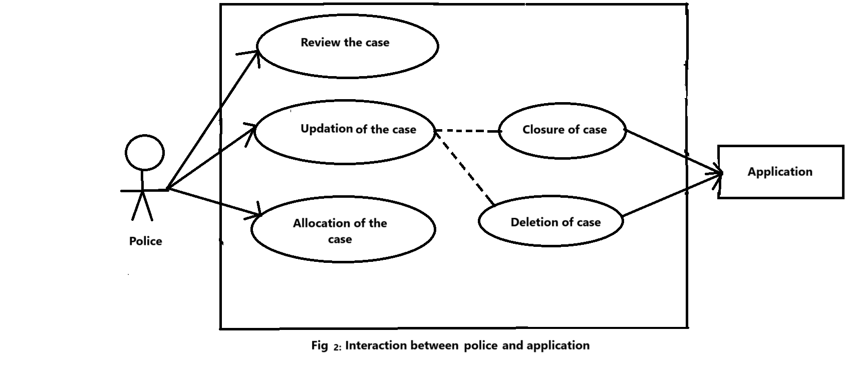
Use Case Diagram (Police and Application)

Slide 9
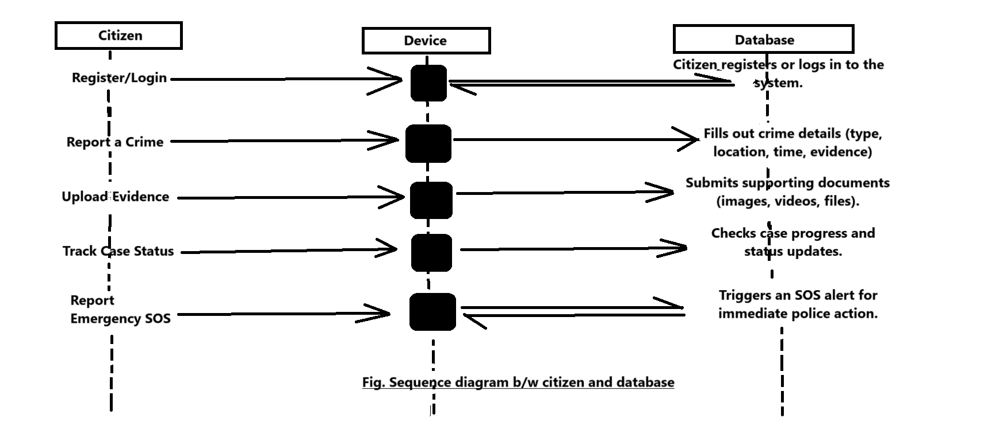
Sequence Diagrams
Sequence diagram (Citizen)

Slide 10
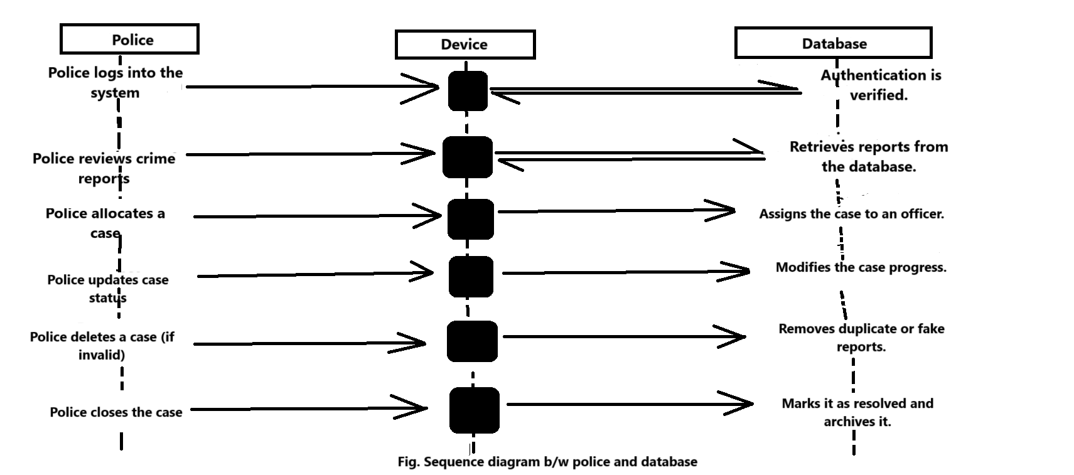
Sequence diagram (Police)

