Slide 1

PushtiShangar: Streamlining Spiritual Commerce
Presented by: Preyash Thakkar (20BCP143)
Under the Supervision of Dr. Rutvij Jhaveri

Slide 2
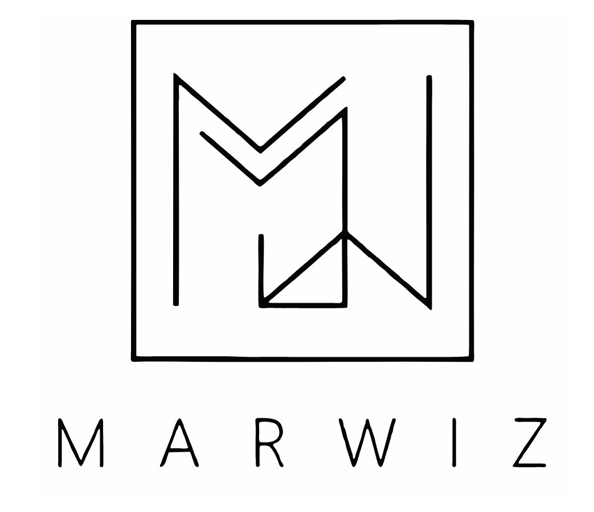
About Company
Marwiz Tech, under unified leadership, pioneers cutting-edge virtual ad management alongside integrated IT solutions. Specializing in streamlined ad campaigns and marketplace innovations, Marwiz Tech delivers comprehensive services, including market research, creative development, and precise analytics. As a singular force, Marwiz embodies tech-driven solutions, empowering businesses with unparalleled insights and seamless ad experiences..

Slide 3

Abstract
1
Vision Statement
Marwiz envisions a tech-driven future where businesses thrive through innovative advertising and streamlined technology solutions.
2
Mission Statement
To simplify and elevate the advertising industry, Marwiz is dedicated to delivering cutting-edge virtual ad management and marketplace solutions that drive client success.
3
Core Values
Innovation, Integrity, Collaboration – Marwiz values drive excellence, ensuring client success through cutting-edge solutions and ethical practices.

Slide 4
Project Introduction
1
Scope
2
Features
3
Benefits
Revamping Pushtishangar's ecommerce experience, our project introduces an interactive admin panel designed to streamline product, category, and blog management processes. With user-friendly functionalities, administrators can efficiently handle tasks and enhance overall site management.
The platform offers real-time analytics for sales and user activity, simplifying product management and content creation for admins. Customers receive instant payment updates via WebSocket technology using PhonePe sandbox, while social media content from Facebook, Instagram, and YouTube is seamlessly integrated.
Enhance productivity, accelerate project timelines, and empower decision-making by creating an intuitive and user-friendly space tailored to Pushtishangar's spiritual offerings. This initiative aims to streamline processes, facilitate efficient navigation, and ensure seamless access to the diverse array of products and services available.

Slide 5
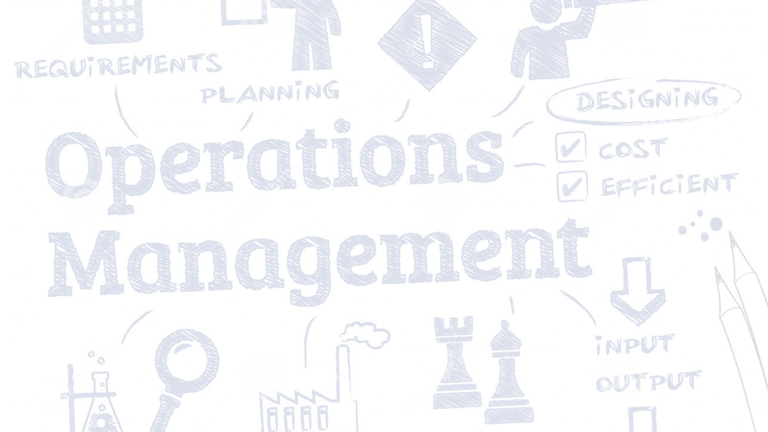
Problem Definition
Inefficient Workflows
Data Overload
Risk Blind Spots
Current systems within Pushtishangar lack the automation needed for the agile demands of our ecommerce project, impacting operational efficiency.
Extracting actionable insights from the substantial volume of project data on the Pushtishangar platform proves challenging, resulting in information overload for our teams.
Identification and mitigation of potential risks are inadequately addressed in the existing Pushtishangar system, creating gaps in risk management.
Technology Solution:
Leveraging the MERN stack, our solution addresses the challenges faced by static websites. By introducing load balancing capabilities, we aim to enhance performance and mitigate the inefficiencies outlined above.

Slide 6




Underlying technology
MongoDB: Leveraging MongoDB for seamless data storage and retrieval, ensuring efficient handling of complex project datasets.
Express: Utilizing Express to build a robust backend, facilitating streamlined processes through smart task allocation and workflow automation.
React: Harnessing the power of React for an interactive user interface, enhancing user experience and decision support.
Node.js: Implementing Node.js to enable advanced server-side operations, providing a foundation for predictive analytics within our project.

Slide 7
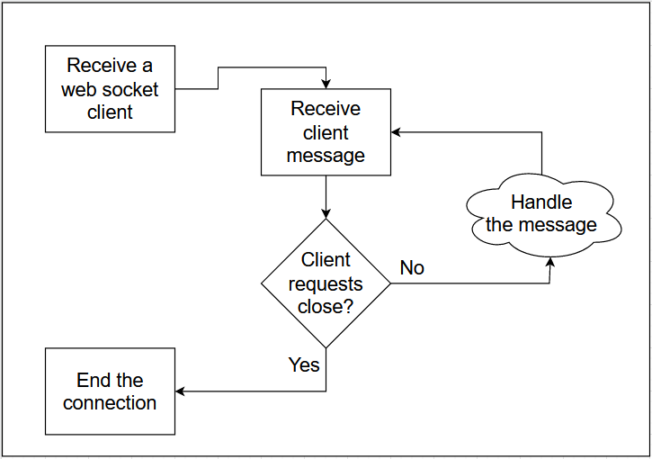
Real time Communication Using Web Socket
In the Pushti Shangar e-commerce platform, WebSocket enables real-time, bidirectional communication between the client and server. It's used for instant updates on order status and inventory changes, providing users with timely notifications without needing to refresh the page. This ensures that product availability is always current, enhancing the user experience with immediate and relevant information.

Slide 8
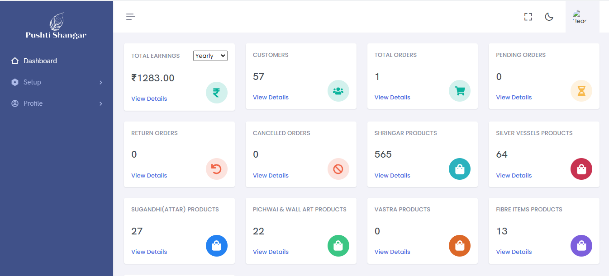
Admin Panel Dashboard For Better Data Representation

Slide 9
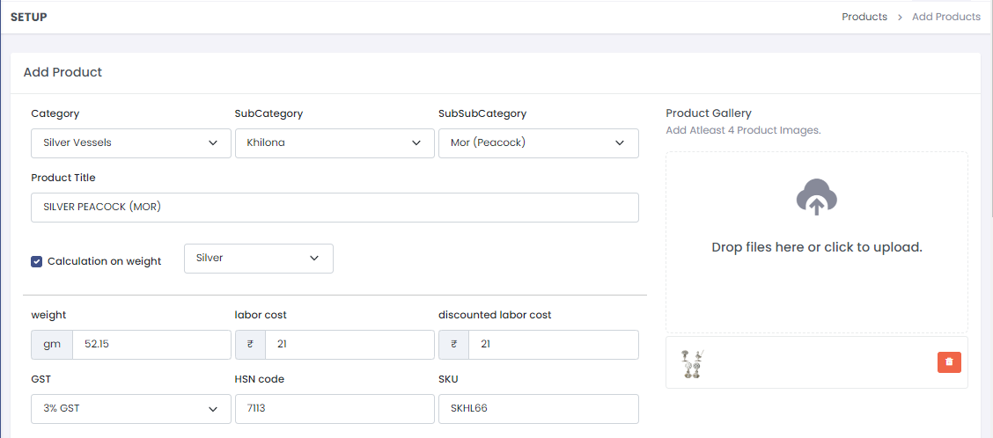
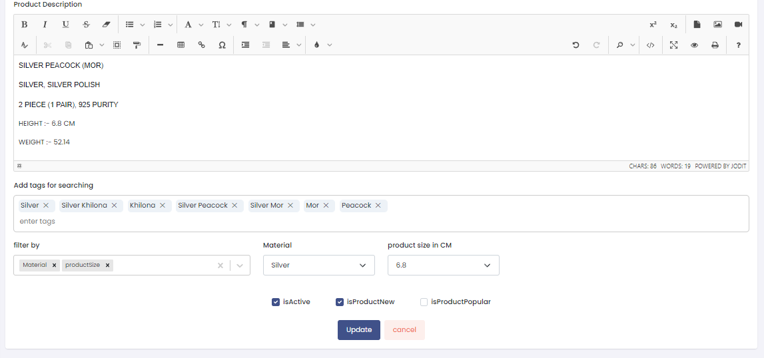
Product Master to Add and Edit the products
Our user-friendly admin panel facilitates seamless product management, allowing you to effortlessly add and edit product details and variants. With integrated photo searching tags, finding and selecting images is a breeze, enhancing the visual appeal of your listings. Additionally, our auto price calculator, based on weight and labor prices, simplifies pricing decisions, ensuring accuracy and consistency across your inventory.

Slide 10
Conclusion: As we conclude the Pushtishangar project, we anticipate widespread adoption and potential partnerships for our advanced project management platform.
Future Prospects
Impact
Next Steps
Looking ahead, our focus is on establishing solid foundations for the Pushtishangar project, fostering collaborations and envisioning expanded horizons.
We envision a significant transformation in project management efficiency, ushering in an era of informed decision-making and operational excellence.
Moving forward, our journey involves further development, thorough testing, and strategic preparations for a successful market entry for Pushtishangar.

Slide 11
Thank You 🙂

