Slide 1


DSC-530 Term Project Exploration and Analysis
Janine Par

Slide 2

Yelp Dataset
is a website with business directory and customer rate, comment, provide tip and contact these establishment where enterprises can get listed and found online. Customers can find them, contact them and rate them. Yelp is used like Yellow Pages but online and interactive where customers can collaborate and provide meaningful feedback.
Yelp Dataset can be downloaded in a compressed format (tar) and when decompressed will have subset of business, reviews, tip and user data in JSON files which intended to be used in personal, educational and academic purposes.
Scope: Businesses that are categories.str.contains("Restaurants") or categories.str.contains("Food")’. I used the unique ID: business_id to join these datasets:
yelp_academic_dataset_business.json : Contains business data including location data, attributes, and categories.
2. yelp_academic_dataset_tip.json: Tips written by a user on a business. Tips are shorter than reviews and tend to convey quick suggestions.
3. yelp_academic_dataset_checkin.json: Checkins on a business.
Links:
https://www.yelp.com/dataset
https://www.yelp.com/dataset/documentation/main

Slide 3
Yelp Dataset
Analysis Questions:
What are the factors that impacts the rating of the business establishment
How can features and attribute impacts the establishment outcome
How does the attributes or features affect rating or reviews
Is there any association between number of check-ins and number of reviews
Can we predict a closure of a business establishment?

Slide 4
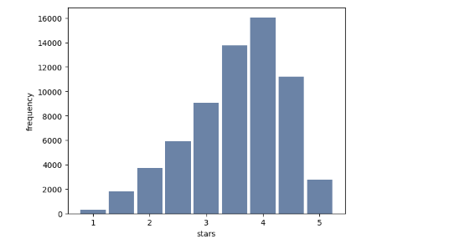
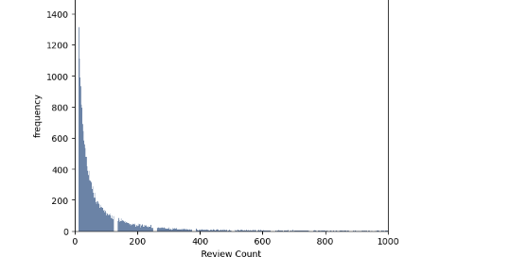
Variables
Business Dataset

Slide 5









Histogram of Variables
The use of Data assets....
In current process:
In Data Science
Reports representation of historical data to show current
metrices and information in different user-friendly format
Improve current processes with:
Use of Data Engineering to extract and process huge amount of structured and Unstructured data.
Capable of complex Algorithm models and Data processing to identify hidden patterns and insights
Exploration of the unknown
Computer Engineering and Machine Learning
Delivers Predictive models to forecast future
Analytics exploration of information to identify insights to
Improve business
Research/Development focusing on innovation and
Introduction of new product and services to improve
existing offering
Business Intelligence analyzing current data to deliver
actionable information to make informed
business decision.

Slide 6



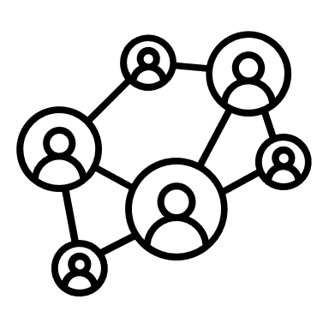

CDF of a Variable
Problems are easier to solve, Work are easily done, People are being connected, Diseases are detected earlier…..
Medical and Healthcare
Faster Diagnosis using known medical information and captured patient data
Recommendation on treatments where effectiveness are backed by data
Improve hospitals and healthcare facilities services
Travel and Logistics
Improve Travel by recommending routes base on real-time situations (weather, events, roadside accidents)
Optimize Delivery routes that guarantee customer satisfaction and lower delivery cost
Social Media
Connecting people with the same likes, background, and acquaintances (Facebook, Instagram, Linkedin)
Builds community, group and organization with shared ideas and common goals
Users Experience
Personalize customer experiences
Suggest Product and Services and compare pricing
Ease in searches by providing recommendation that fit’s customer need (Amazon recommends, Auto-fill on Search engines)
Risk and Fraud Management decision (Examples)
Reporting, Alerting and Notification System
Monitoring Application
Automated Case Management
Reduction of False Positive when identifying fraud
Influence Security Applications

Slide 7
Analytical Distribution
The use of Data assets....
In current process:
In Data Science
Reports representation of historical data to show current
metrices and information in different user-friendly format
Improve current processes with:
Use of Data Engineering to extract and process huge amount of structured and Unstructured data.
Capable of complex Algorithm models and Data processing to identify hidden patterns and insights
Exploration of the unknown
Computer Engineering and Machine Learning
Delivers Predictive models to forecast future
Analytics exploration of information to identify insights to
Improve business
Research/Development focusing on innovation and
Introduction of new product and services to improve
existing offering
Business Intelligence analyzing current data to deliver
actionable information to make informed
business decision.

Slide 8
Analytical Distribution
The use of Data assets....
In current process:
In Data Science
Reports representation of historical data to show current
metrices and information in different user-friendly format
Improve current processes with:
Use of Data Engineering to extract and process huge amount of structured and Unstructured data.
Capable of complex Algorithm models and Data processing to identify hidden patterns and insights
Exploration of the unknown
Computer Engineering and Machine Learning
Delivers Predictive models to forecast future
Analytics exploration of information to identify insights to
Improve business
Research/Development focusing on innovation and
Introduction of new product and services to improve
existing offering
Business Intelligence analyzing current data to deliver
actionable information to make informed
business decision.

Slide 9
Scatterplot, Correlation and Causation
Problems are easier to solve, Work are easily done, People are being connected, Diseases are detected earlier…..
Medical and Healthcare
Faster Diagnosis using known medical information and captured patient data
Recommendation on treatments where effectiveness are backed by data
Improve hospitals and healthcare facilities services
Travel and Logistics
Improve Travel by recommending routes base on real-time situations (weather, events, roadside accidents)
Optimize Delivery routes that guarantee customer satisfaction and lower delivery cost
Social Media
Connecting people with the same likes, background, and acquaintances (Facebook, Instagram, Linkedin)
Builds community, group and organization with shared ideas and common goals
Users Experience
Personalize customer experiences
Suggest Product and Services and compare pricing
Ease in searches by providing recommendation that fit’s customer need (Amazon recommends, Auto-fill on Search engines)
Risk and Fraud Management decision (Examples)
Reporting, Alerting and Notification System
Monitoring Application
Automated Case Management
Reduction of False Positive when identifying fraud
Influence Security Applications

Slide 10
Hypothesis Test
Problems are easier to solve, Work are easily done, People are being connected, Diseases are detected earlier…..
Medical and Healthcare
Faster Diagnosis using known medical information and captured patient data
Recommendation on treatments where effectiveness are backed by data
Improve hospitals and healthcare facilities services
Travel and Logistics
Improve Travel by recommending routes base on real-time situations (weather, events, roadside accidents)
Optimize Delivery routes that guarantee customer satisfaction and lower delivery cost
Social Media
Connecting people with the same likes, background, and acquaintances (Facebook, Instagram, Linkedin)
Builds community, group and organization with shared ideas and common goals
Users Experience
Personalize customer experiences
Suggest Product and Services and compare pricing
Ease in searches by providing recommendation that fit’s customer need (Amazon recommends, Auto-fill on Search engines)
Risk and Fraud Management decision (Examples)
Reporting, Alerting and Notification System
Monitoring Application
Automated Case Management
Reduction of False Positive when identifying fraud
Influence Security Applications

Slide 11
Hypothesis Test
Problems are easier to solve, Work are easily done, People are being connected, Diseases are detected earlier…..
Medical and Healthcare
Faster Diagnosis using known medical information and captured patient data
Recommendation on treatments where effectiveness are backed by data
Improve hospitals and healthcare facilities services
Travel and Logistics
Improve Travel by recommending routes base on real-time situations (weather, events, roadside accidents)
Optimize Delivery routes that guarantee customer satisfaction and lower delivery cost
Social Media
Connecting people with the same likes, background, and acquaintances (Facebook, Instagram, Linkedin)
Builds community, group and organization with shared ideas and common goals
Users Experience
Personalize customer experiences
Suggest Product and Services and compare pricing
Ease in searches by providing recommendation that fit’s customer need (Amazon recommends, Auto-fill on Search engines)
Risk and Fraud Management decision (Examples)
Reporting, Alerting and Notification System
Monitoring Application
Automated Case Management
Reduction of False Positive when identifying fraud
Influence Security Applications

Slide 12
Regression Analysis
Prediction and Forecast Future based on the company’s data assets in a combination of other relevant business data domain =“New Data”
Delivers models that can be used to predict real-time scenarios that can improve user experience.
Capabilities in looking at a wide range of business operations and discover unknown unknown allowing focus on areas with potential risk and failures before it happens.
Scale up the data analytics and reporting by looking at a larger volume and variety of datasets (Big Data) with the use of technology.
Develop new capabilities by innovating products and services backed by customer data.
Learn and Improve with wide range of new solutions with predicted best-case outcomes.

Slide 13
References
Lau, D. C. H. (2019, January 10). 5 steps of a data science project lifecycle. Towards Data Science. https://towardsdatascience.com/5-steps-of-a-data-science-project-lifecycle-26c50372b492
Upasana. (2021, July 15). Data science Applications: Top 10 use cases of data science. Edureka. https://www.edureka.co/blog/data-science-applications/.
https://observablehq.com/@louismlym/assignment-2-exploratory-data-analysis

