Slide 1


DSC-530 Term Project Exploration and Analysis
Janine Par

Slide 2

Yelp Dataset
is a platform used by customers to find details about the business, contact and rate them. Yelp is used like Yellow Pages but more interactive where customers can collaborate and provide meaningful feedback of the businesses.
Yelp Dataset can be downloaded in a compressed format (tar) and when decompressed will have subset of business, reviews, tip and user data in JSON files which intended to be used in personal, educational and academic purposes.
Scope: Businesses that are categories.str.contains("Restaurants") or categories.str.contains("Food")’. I used the unique ID: business_id to join these datasets:
yelp_academic_dataset_business.json : Contains business data including location data, attributes, and categories.
2. yelp_academic_dataset_tip.json: Tips written by a user on a business. Tips are shorter than reviews and tend to convey quick suggestions.
3. yelp_academic_dataset_checkin.json: Checkins on a business.
Links:
https://www.yelp.com/dataset
https://www.yelp.com/dataset/documentation/main

Slide 3
Yelp Dataset
Analysis Questions:
What are the factors that impacts the rating of the business establishment
How can rating impacts the establishment outcome (Is Open or Close)?
Is there any association between number of check-ins and number of reviews

Slide 4
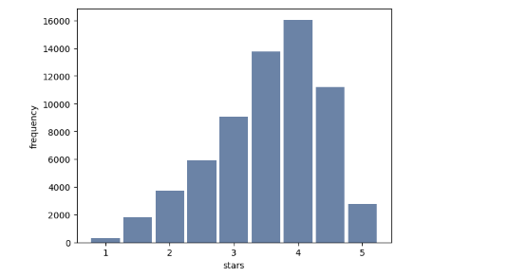
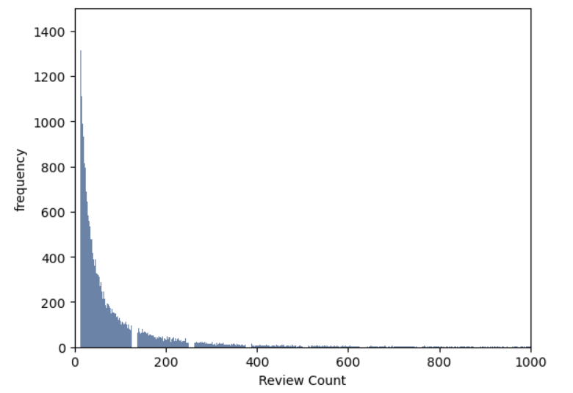
Variables
Business Dataset
1. Star (Rating)
In float format and rounded to half-stars for a business ID
The distribution is approximately bell shape which is the shape of the Normal Distribution
Tail extends farther to the left compared to the right.
2. Review Count
Integer type of total number of reviews for a business ID
The distribution is right skewed. This can be due to the quality of review data and to understand more about the data, the review datasets can be analyzed to identify and clean-up for bias and outliers. Review dataset which is not currently in scope for my analysis.

Slide 5
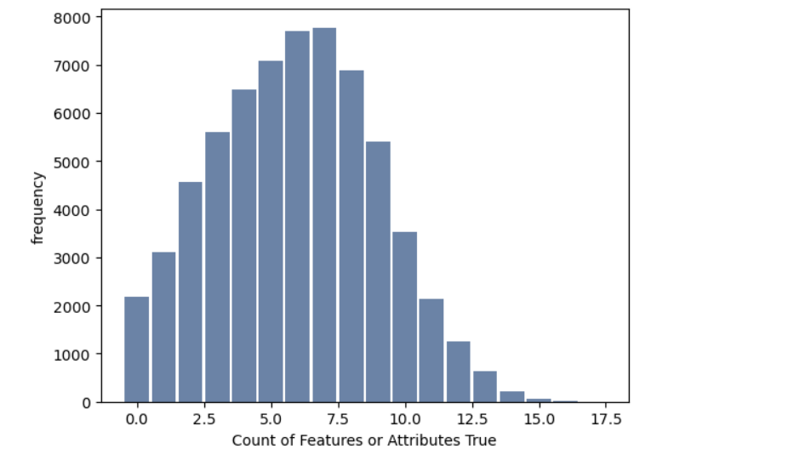
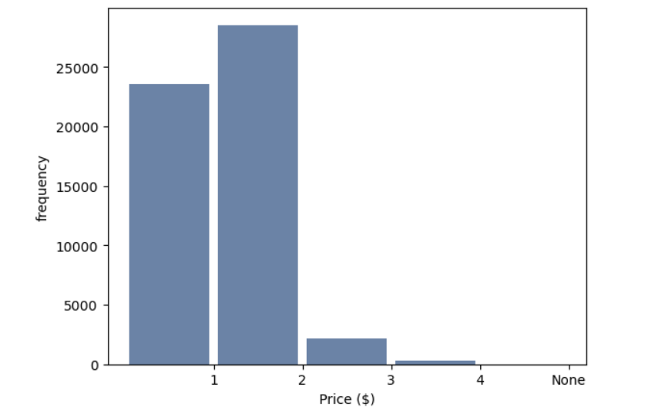
Variables
Business Dataset
3. Attributes and Features that are True (derived new variable)
Integer that represent the count of attributes with key/vaue = ‘True’. (i.e., Dine-in, Deliveries)
The distribution is approximately bell shape which is the shape of the Normal Distribution
4. Price
Integer which represent the Price
1 ($); 2 ($$); 3($$$)…
The distribution is right skewed showing that it is less common for Restaurant and Food businesses in yelp to have food prices averaging to hundreds.

Slide 6
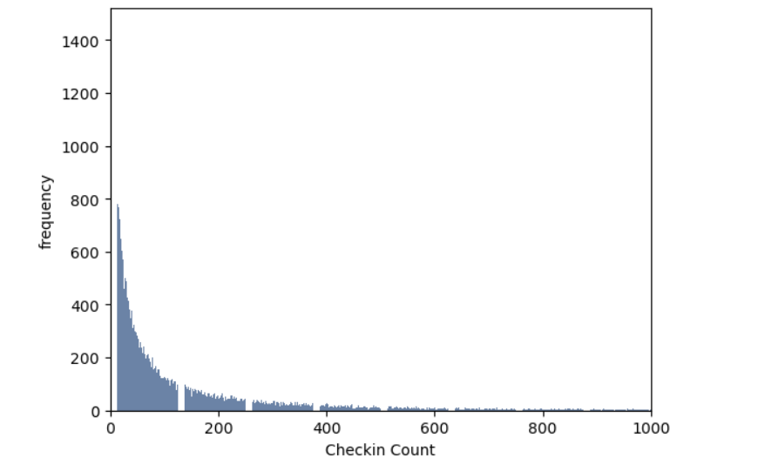
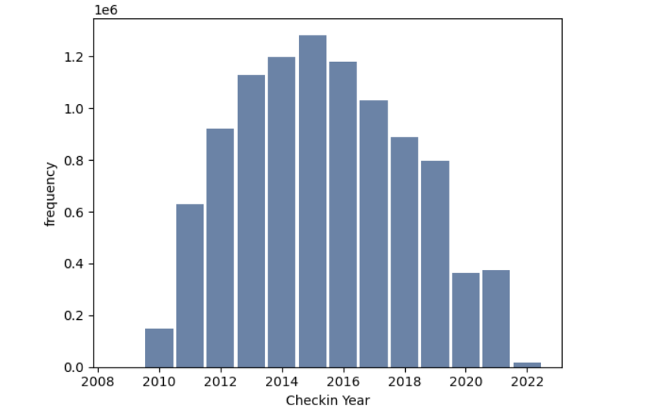
float, star rating, rounded to half-stars
Variables
Checkin Dataset
5. Check-in Count (Derived New Variable)
Integer type which is aggregated count of check-in dates per business id.
The distribution is right skewed. Showing that there are less restaurant and food business that have check-ins that are greater than 100.
6. Check-in Count Per Year (Derived New Variable)
Integer total number of check-in for a business ID for each year
The distribution is approximately bell shape which is the shape of the Normal Distribution but shows a drop of check-in during pandemic years from 2019 - 2021

Slide 7
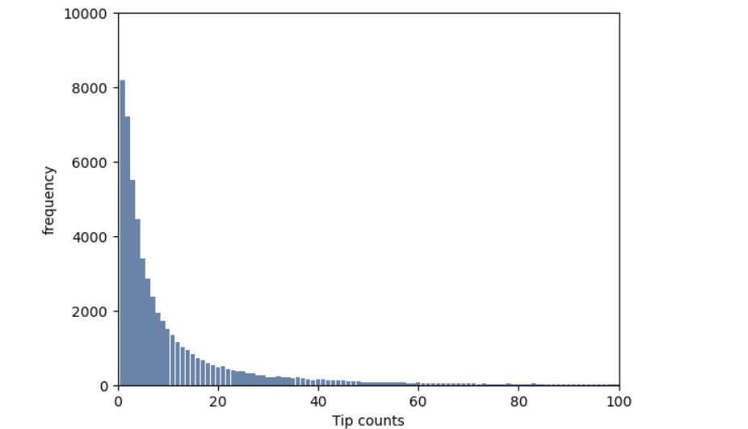
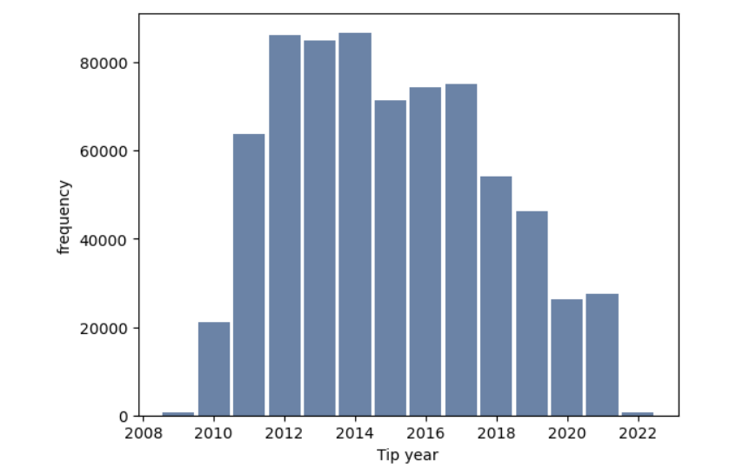
float, star rating, rounded to half-stars
Variables
Tips Dataset
7. Tip Count (Derived New Variable)
Integer count which is aggregated Tips per business id.
The distribution is right skewed. Showing that there are less restaurant and food business that have Tips that are greater than 10.
8. Tip Count Per Year (Derived New Variable)
Integer total number of Tips for a business ID for each year
The distribution is approximately bell shape which is the shape of the Normal Distribution but shows a drop of tip count during pandemic years from 2019 - 2021

Slide 8
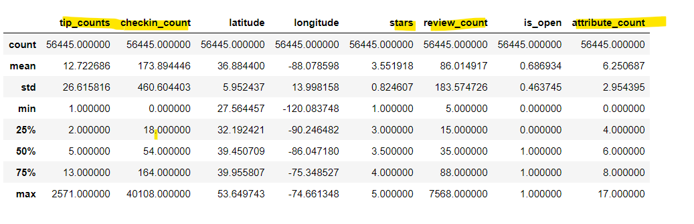
Variables
Summary

Slide 9
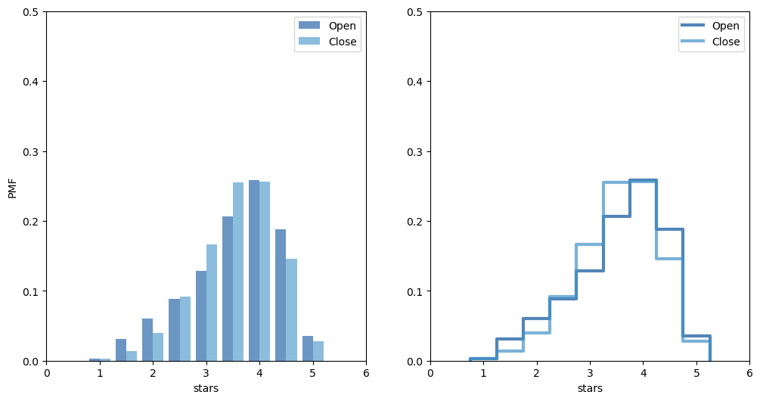
PMF Two Scenarios
Star Rating for Open and Closed Restaurant and Food businesses in Yelp
PMF shows that open establishment gain more higher ratings than closed businesses.

Slide 10
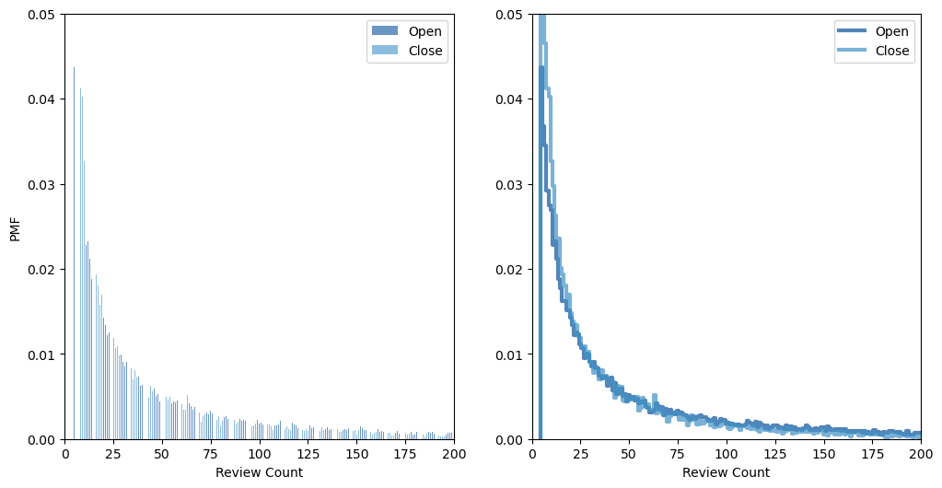
PMF Two Scenarios
Review Count for Open and Closed Restaurant and Food businesses in Yelp
PMF shows that Close restaurants have more less frequent reviews compare to Open businesses.

Slide 11
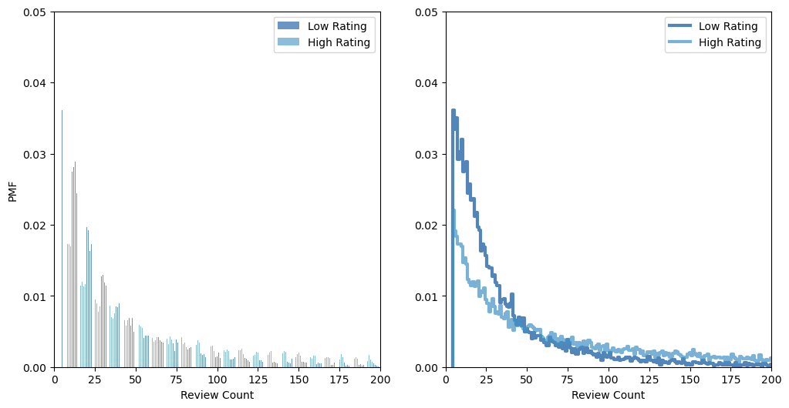
PMF Two Scenarios
Review Count for Low Rating (<3 stars) and High Rating (>3 stars) Restaurant and Food Businesses in Yelp
PMF shows that more low rating stars have less frequent reviews compare to High rating businesses.

Slide 12
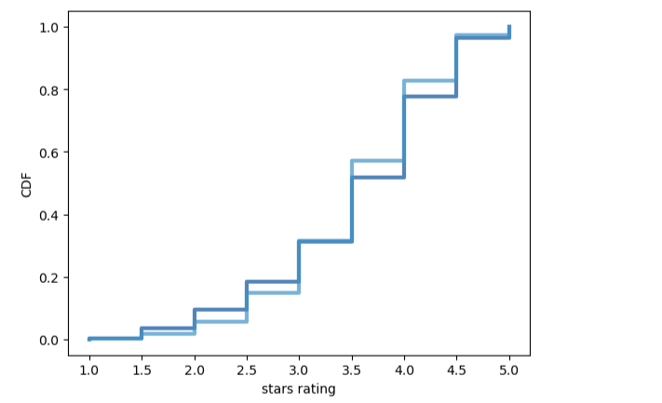

CDF
CDF of open restaurant/food businesses has more average star rating (2.5-3.0) compared to those that were closed. Closed businesses has an increased percentage on medium high (4-4.5) ratings. Both Open and Close businesses have close to same CDF on high star rating (5).
This shows that there are other variables that can influence the outcome of a restaurant besides the star rating.

Slide 13
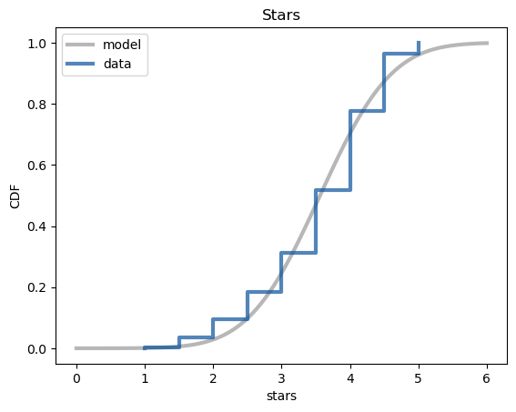
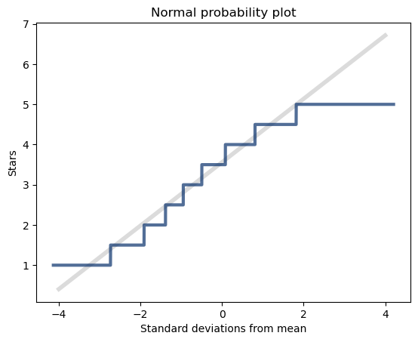
Analytical Distribution
The plot shows that there are few standard deviation from the mean but the tails deviates.

Slide 14
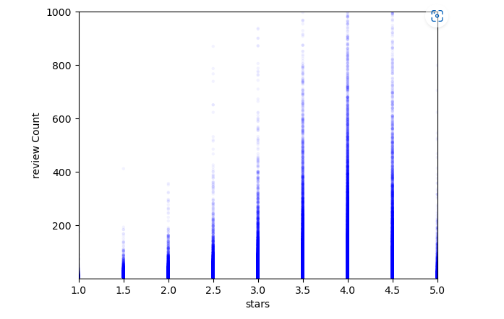


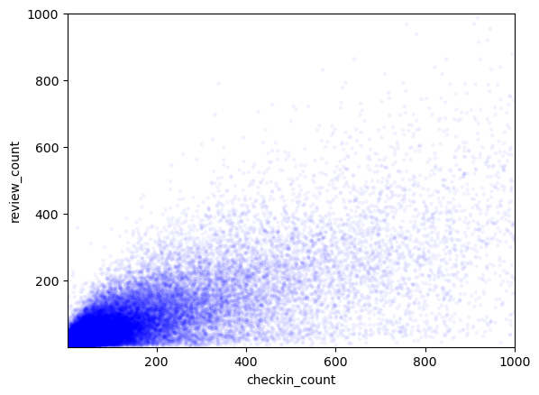
Scatter Plots, Correlation and Causation
Review count and Star Ratings
Review count and Check-in Count
The scatterplot on Review Count and Stars shows data are packed into columns because the star ratings is in values rounded to half-stars.
Both shows positive coefficient relationship between these two variables that the value of one variable increases, the value of the other variable also tends to increase.

Slide 15
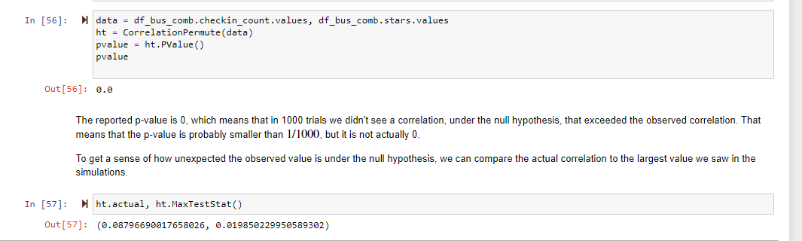
Hypothesis Testing
Null hypothesis (H0): There is no correlation between business star rating and number of check-ins
Alternative hypothesis(HA): Correlation exists between the business star rating and the number of check-ins
Results:
The actual correlation is 0.09. The computed p-value is 0; after 1000 iterations the largest simulated correlation is .02 . Observed correlation is small but statistically significant.

Slide 16
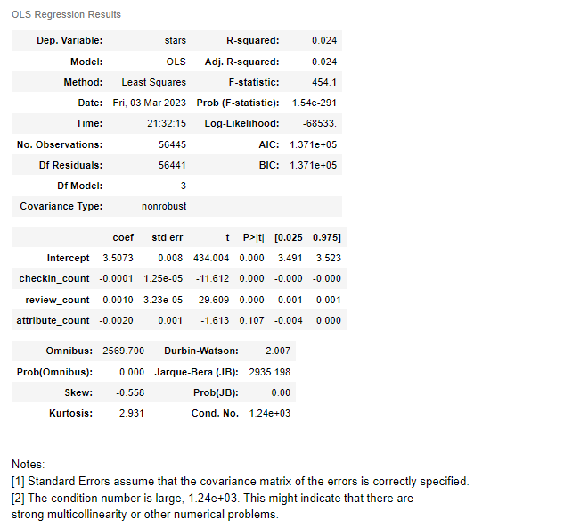

Regression Analysis
Multiple Linear Regression:
stars ~ checkin_count + review_count + attribute_count
Dependent Variable - Star Ratings
Explanatory Variables:
Checkin Count
Review Count
Attribute count
- Shows that the review and checkin count have statistically significant effect on Star Rating with having p-value less than 0.05 which could mean that these two variable together could account for the variation of business star rating.

Slide 17
References
https://www.yelp.com/dataset
Yelp, I. (2022) Yelp dataset, Kaggle. Available at: https://www.kaggle.com/datasets/yelp-dataset/yelp-dataset (Accessed: March 4, 2023).
Alifierakis, M. (2018) Using yelp data to predict restaurant closure, Medium. Towards Data Science. Available at: https://towardsdatascience.com/using-yelp-data-to-predict-restaurant-closure-8aafa4f72ad6 (Accessed: March 4, 2023).

