Slide 1
Project Codename Olympia
JALGROUP

Slide 2
Work Required
Research on Skating events of Winter Olympics
Research c#
Learn SQLite library and database in general
Learn different diagram platforms such as Dia and StarUML
Proper amount of meeting times per week

Slide 3
Difficulties
Incremental and Iterative process
Many variants of class and use-case diagrams
Deliberation of what is and what isn’t a class
How classes are coupled/cohesive
Learning a new language
Implementing database/gui
Tweaking Doxyen via Linux

Slide 4
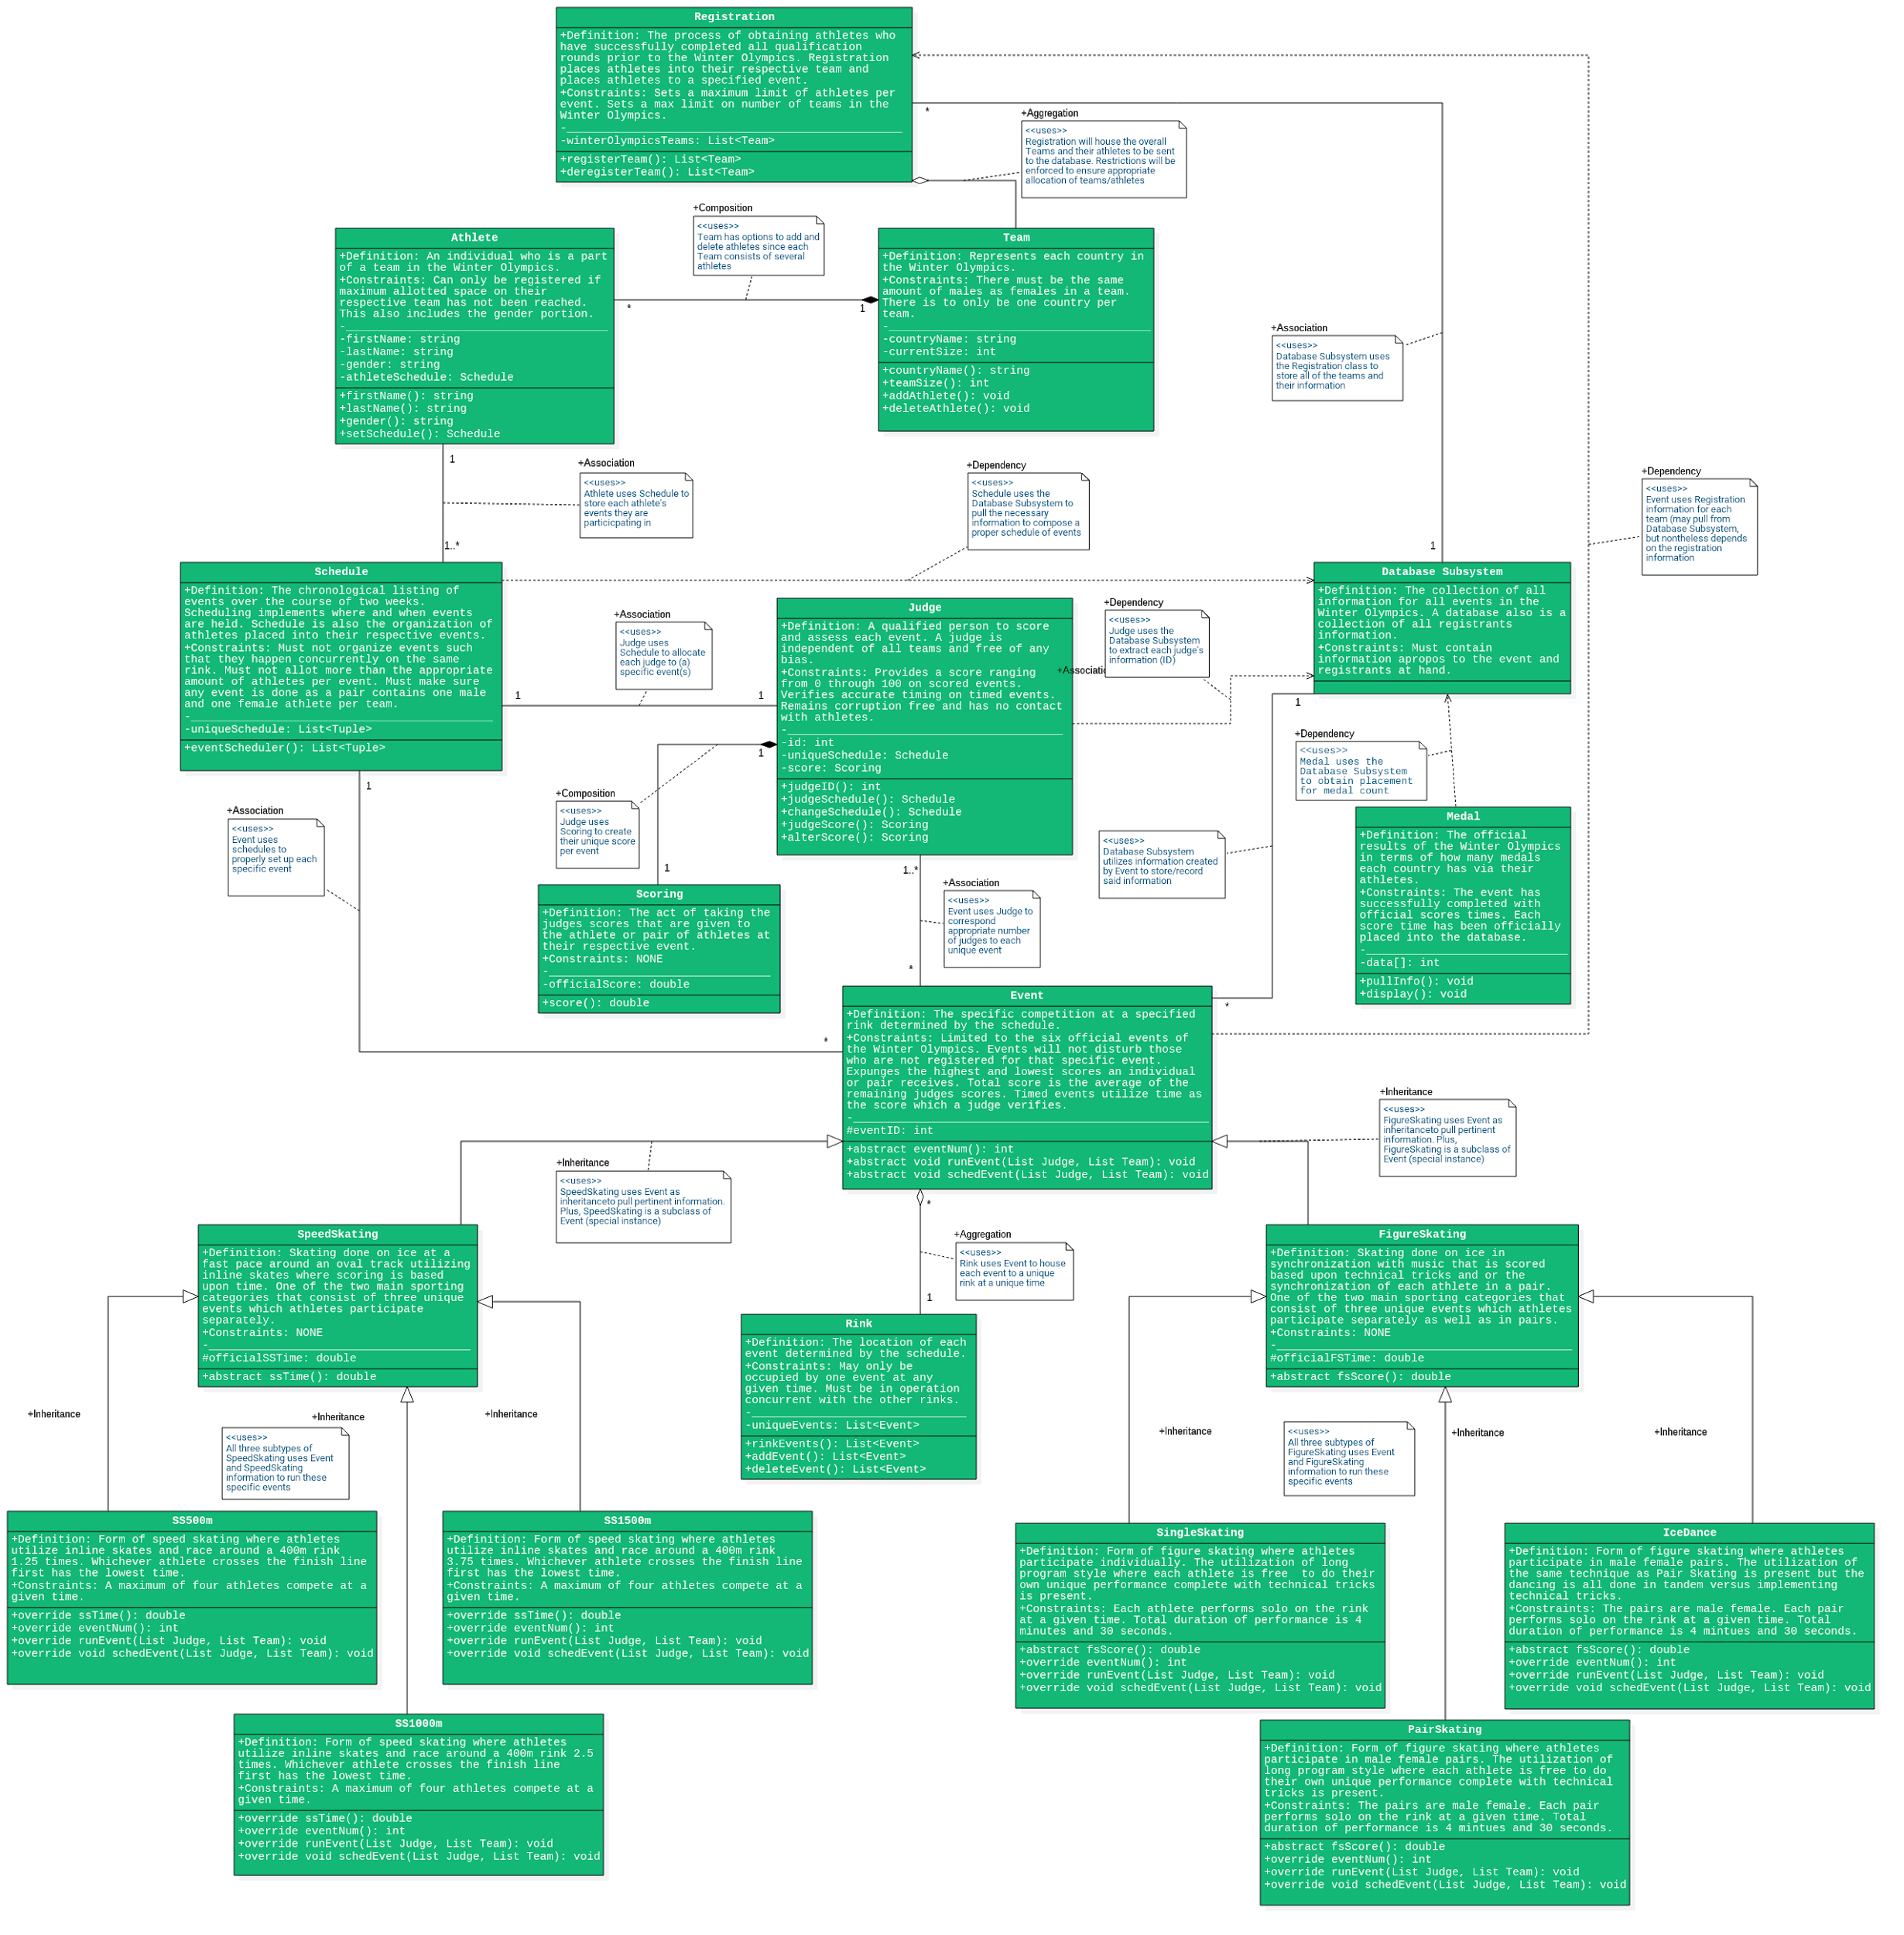

Slide 5
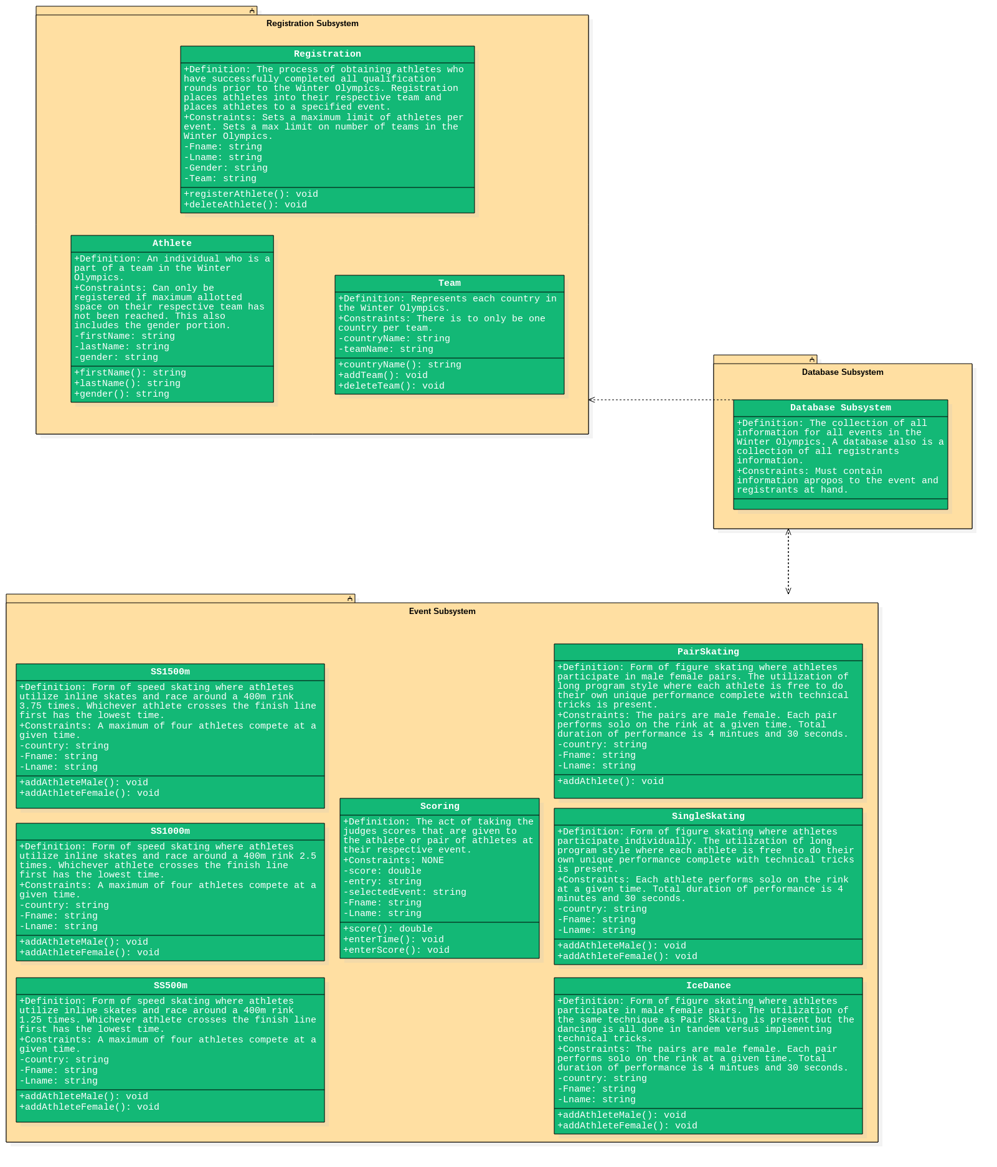

Slide 6
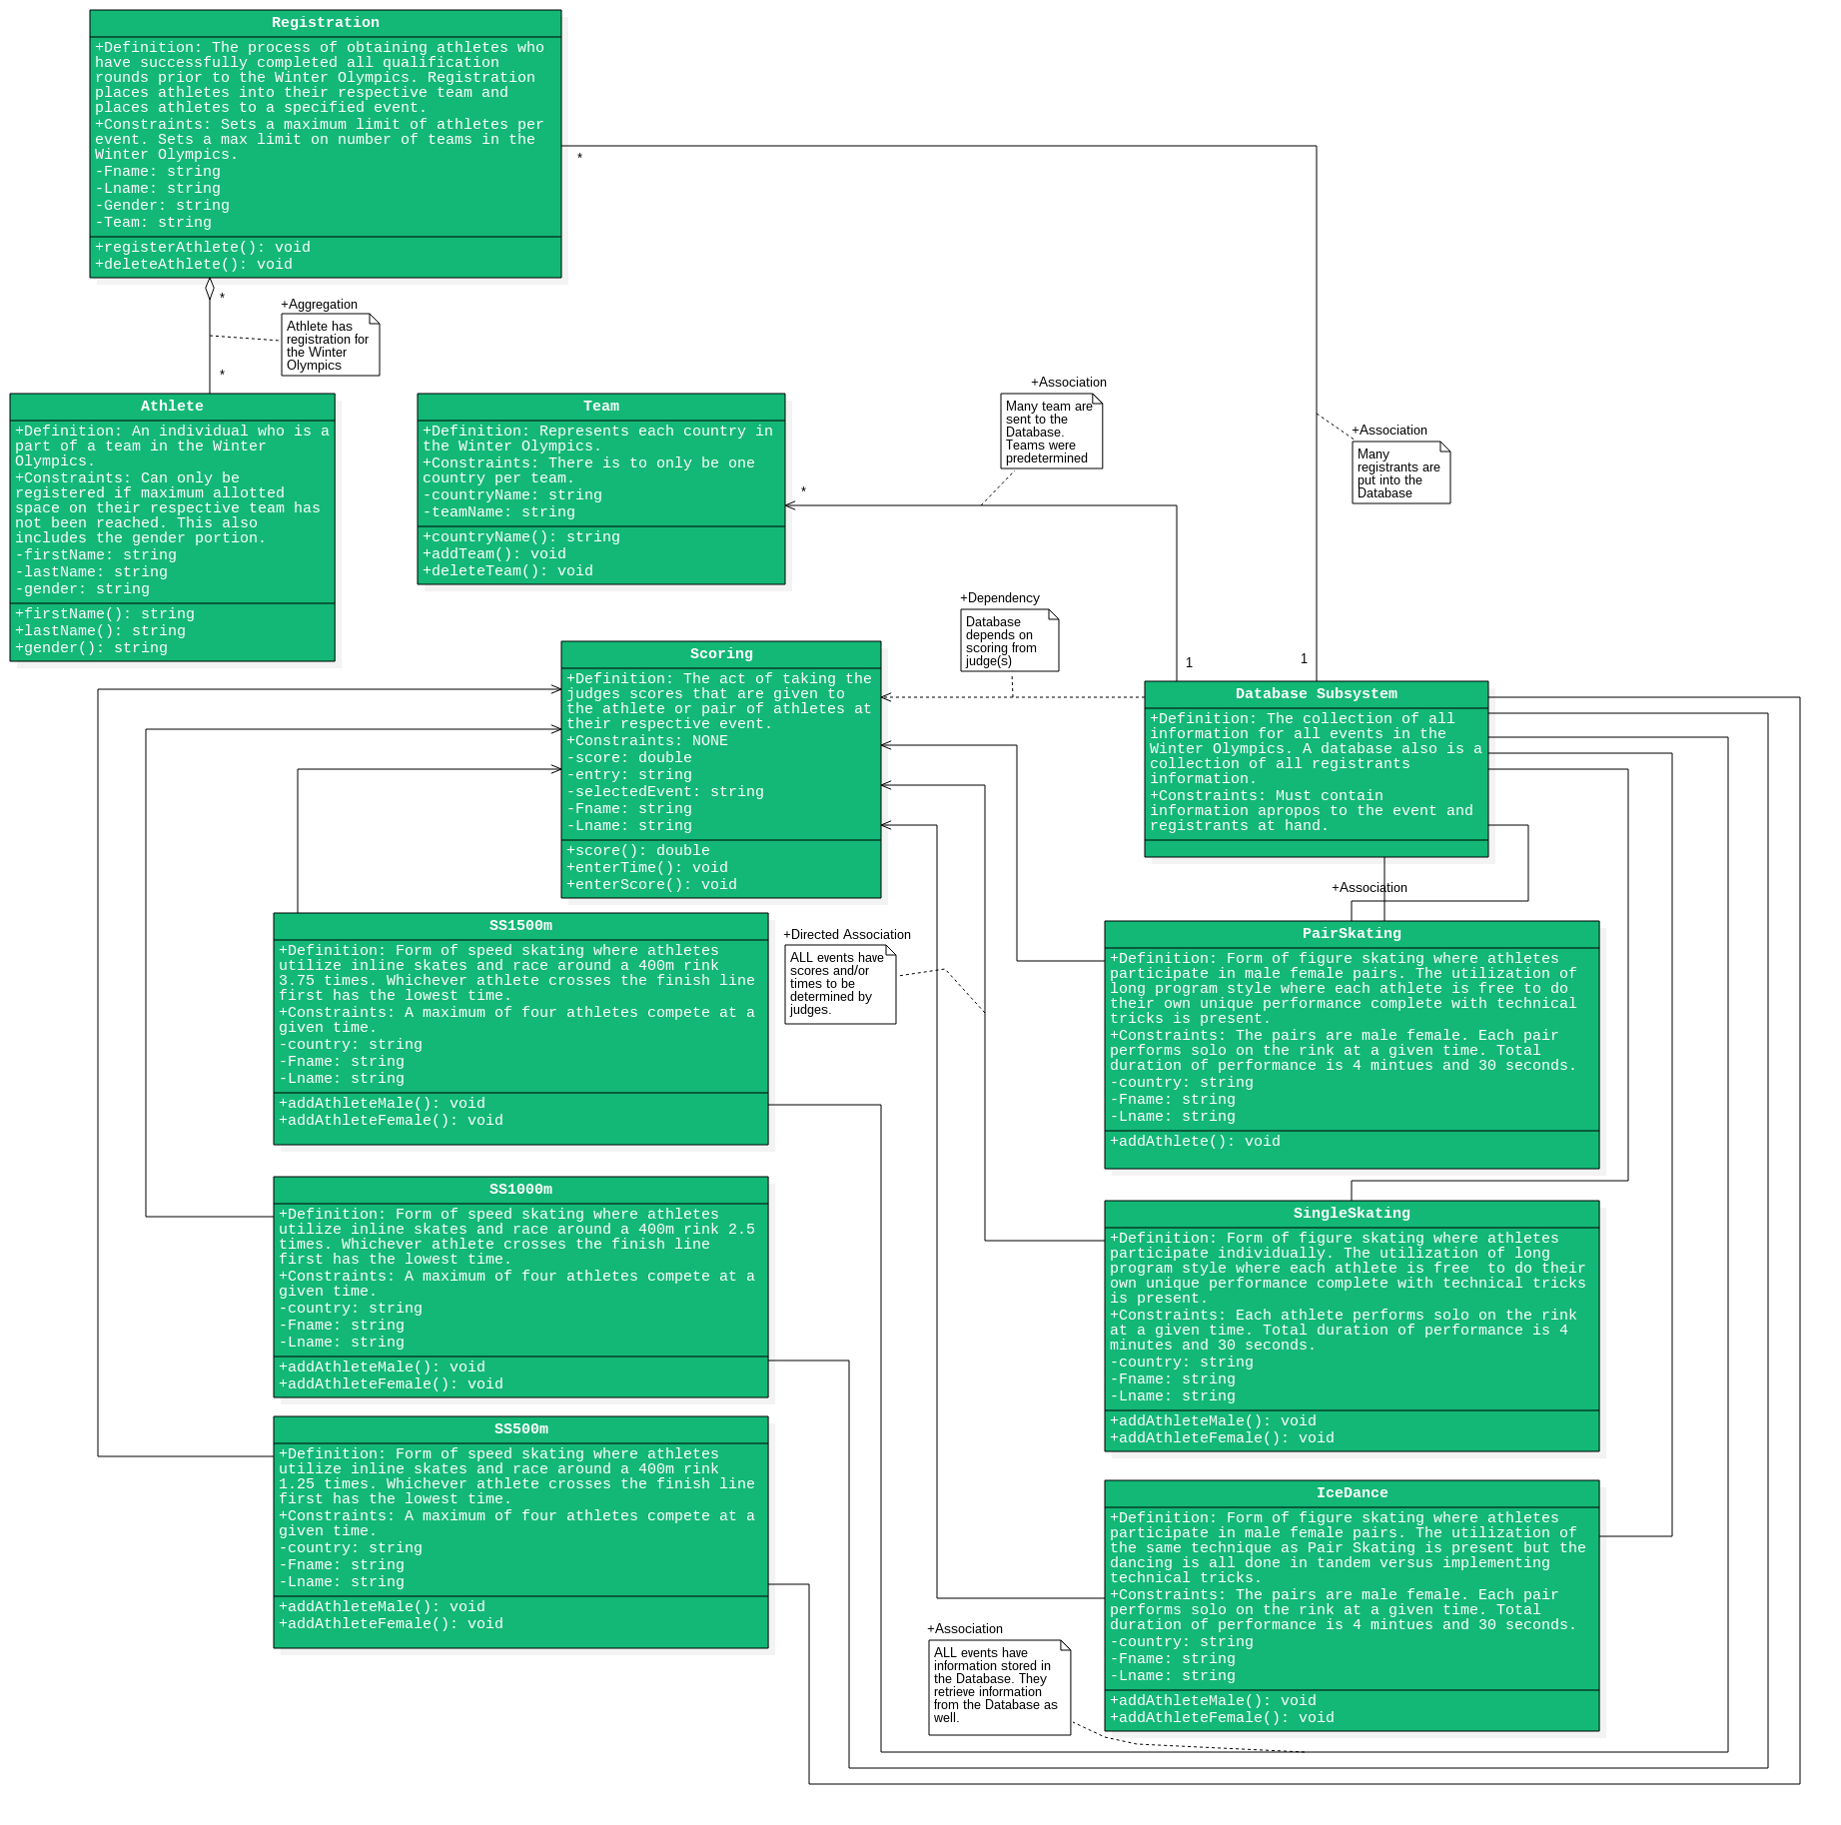

Slide 7
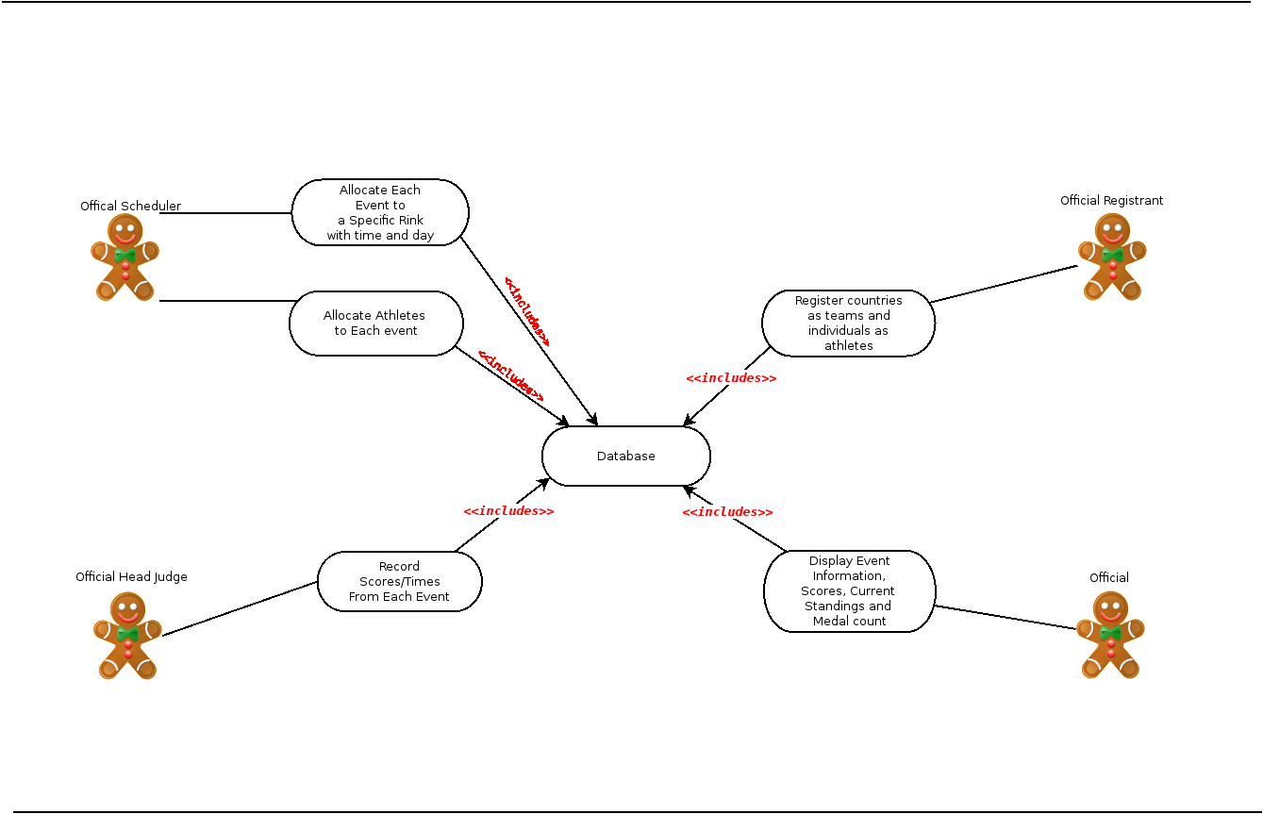

Slide 8
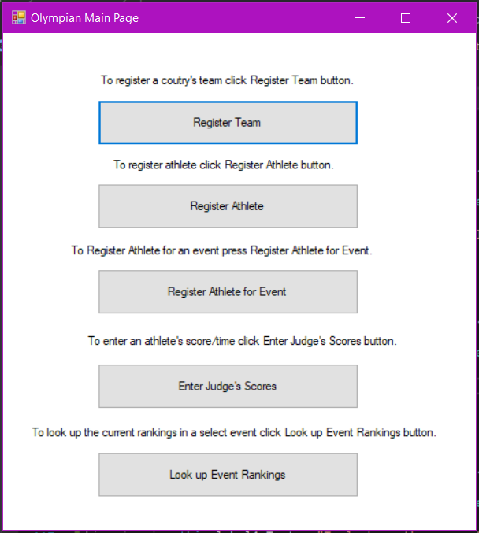

Slide 9
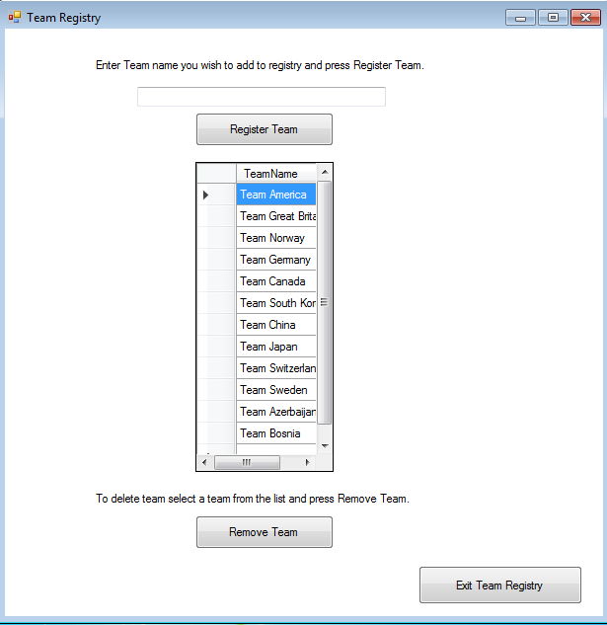

Slide 10
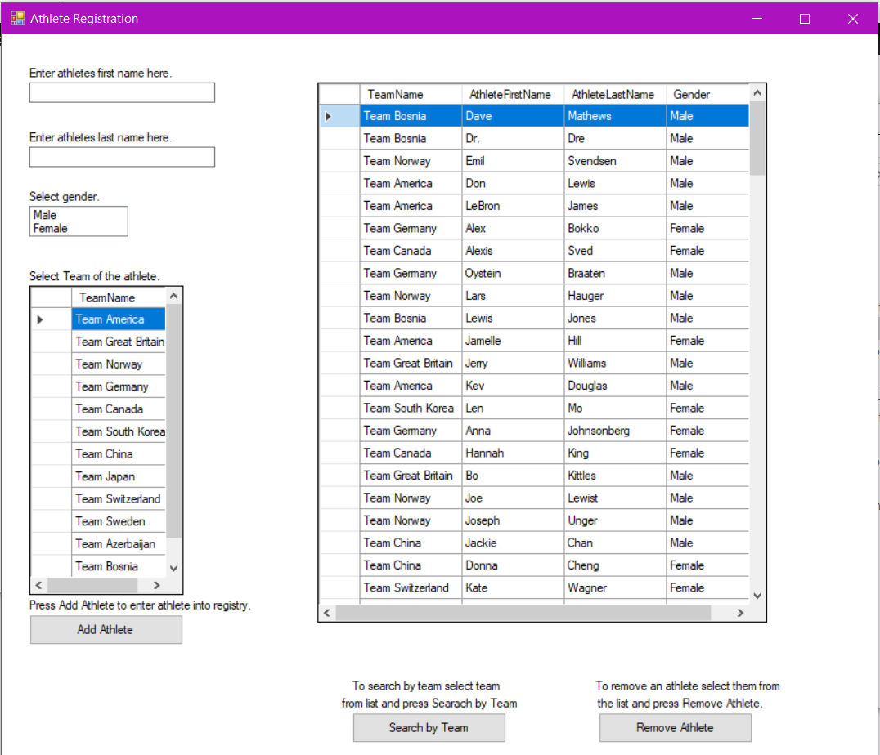

Slide 11
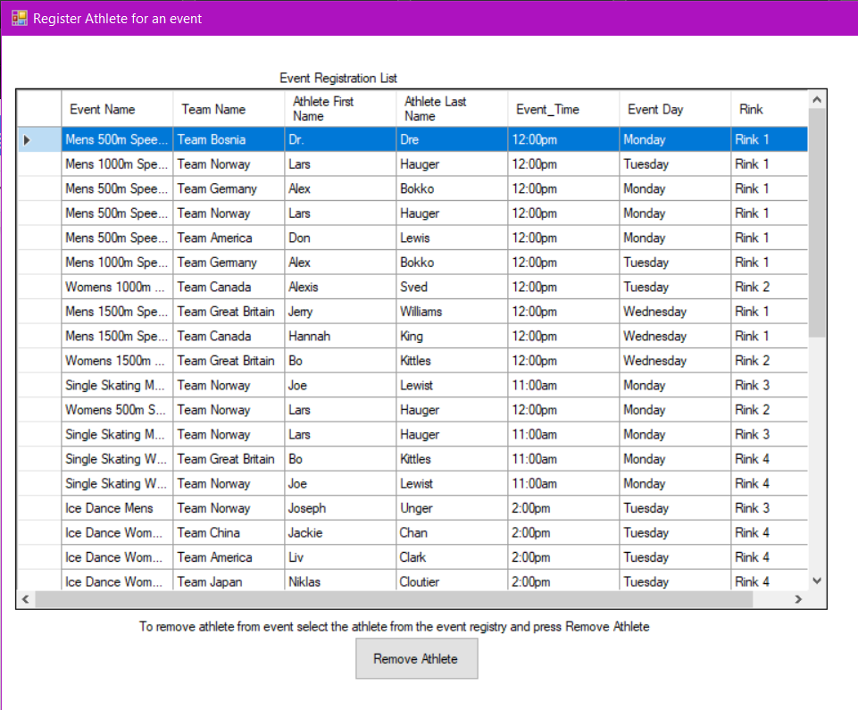

Slide 12
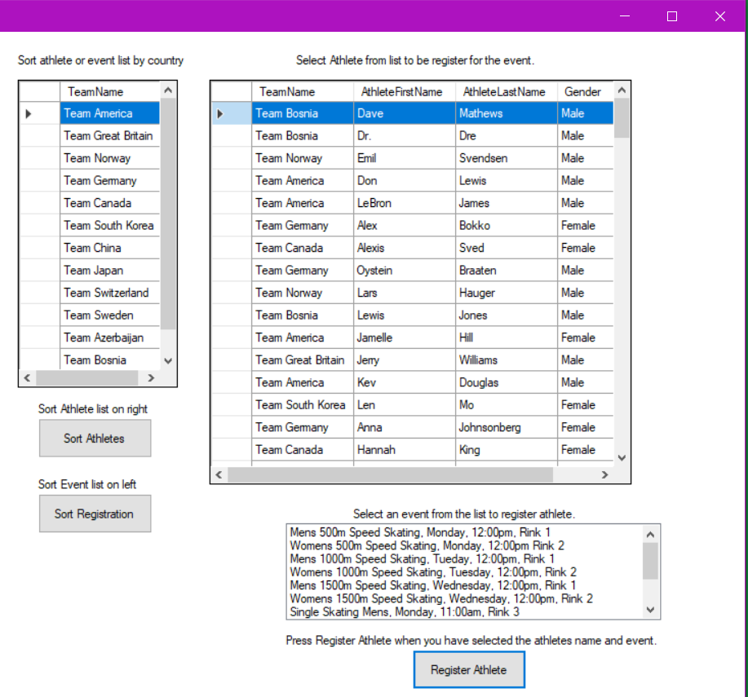

Slide 13
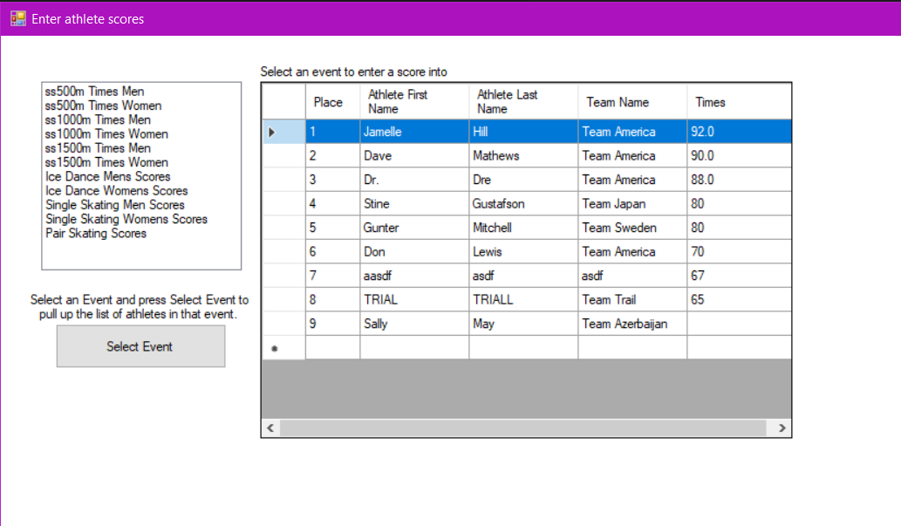

Slide 14
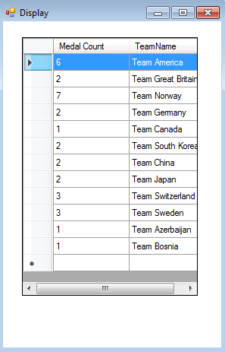

Slide 15
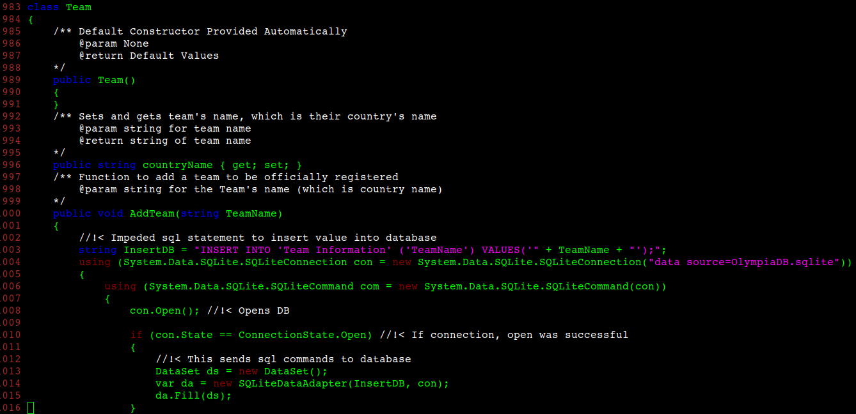

Slide 16
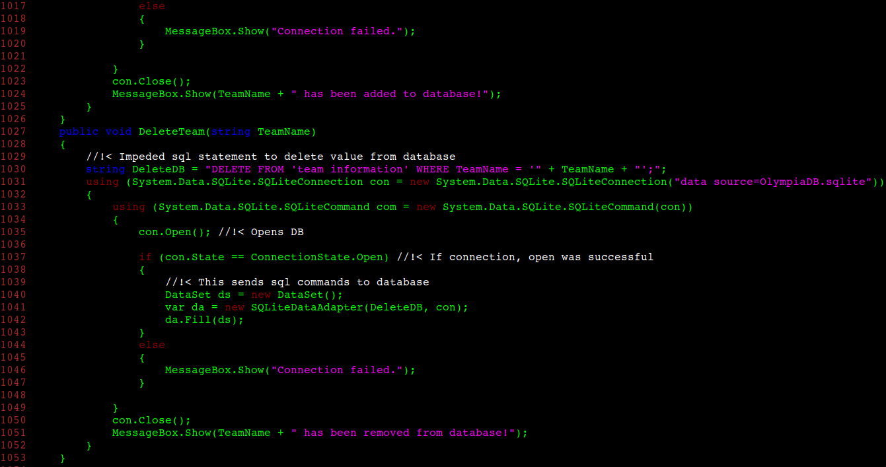

Slide 17
Additional Improvements
Separate login section for officials separate from the main Winter Olympic system
Adjust medal count to display in an appropriate order
Enhance a more secure way to alter scheduling

